Slide 1
<트리맵 – 한글버전>

Slide 2
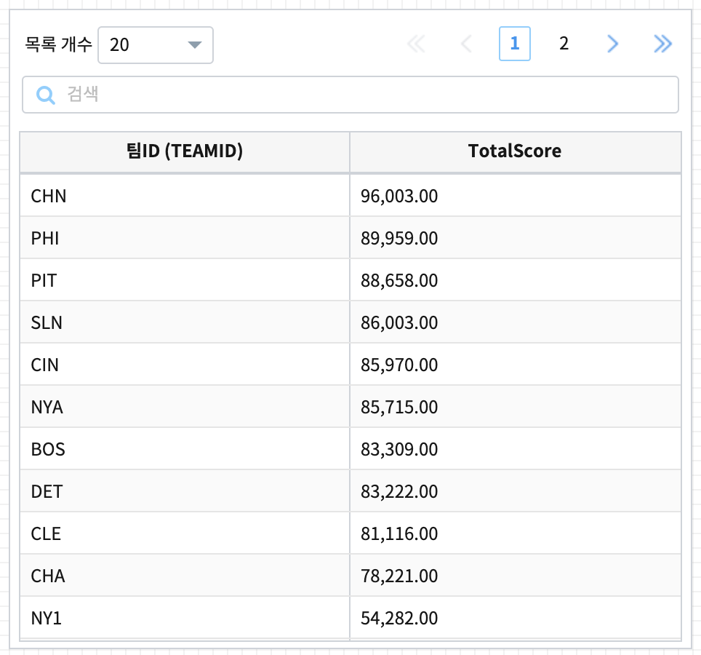
treemap_00.png

Slide 3
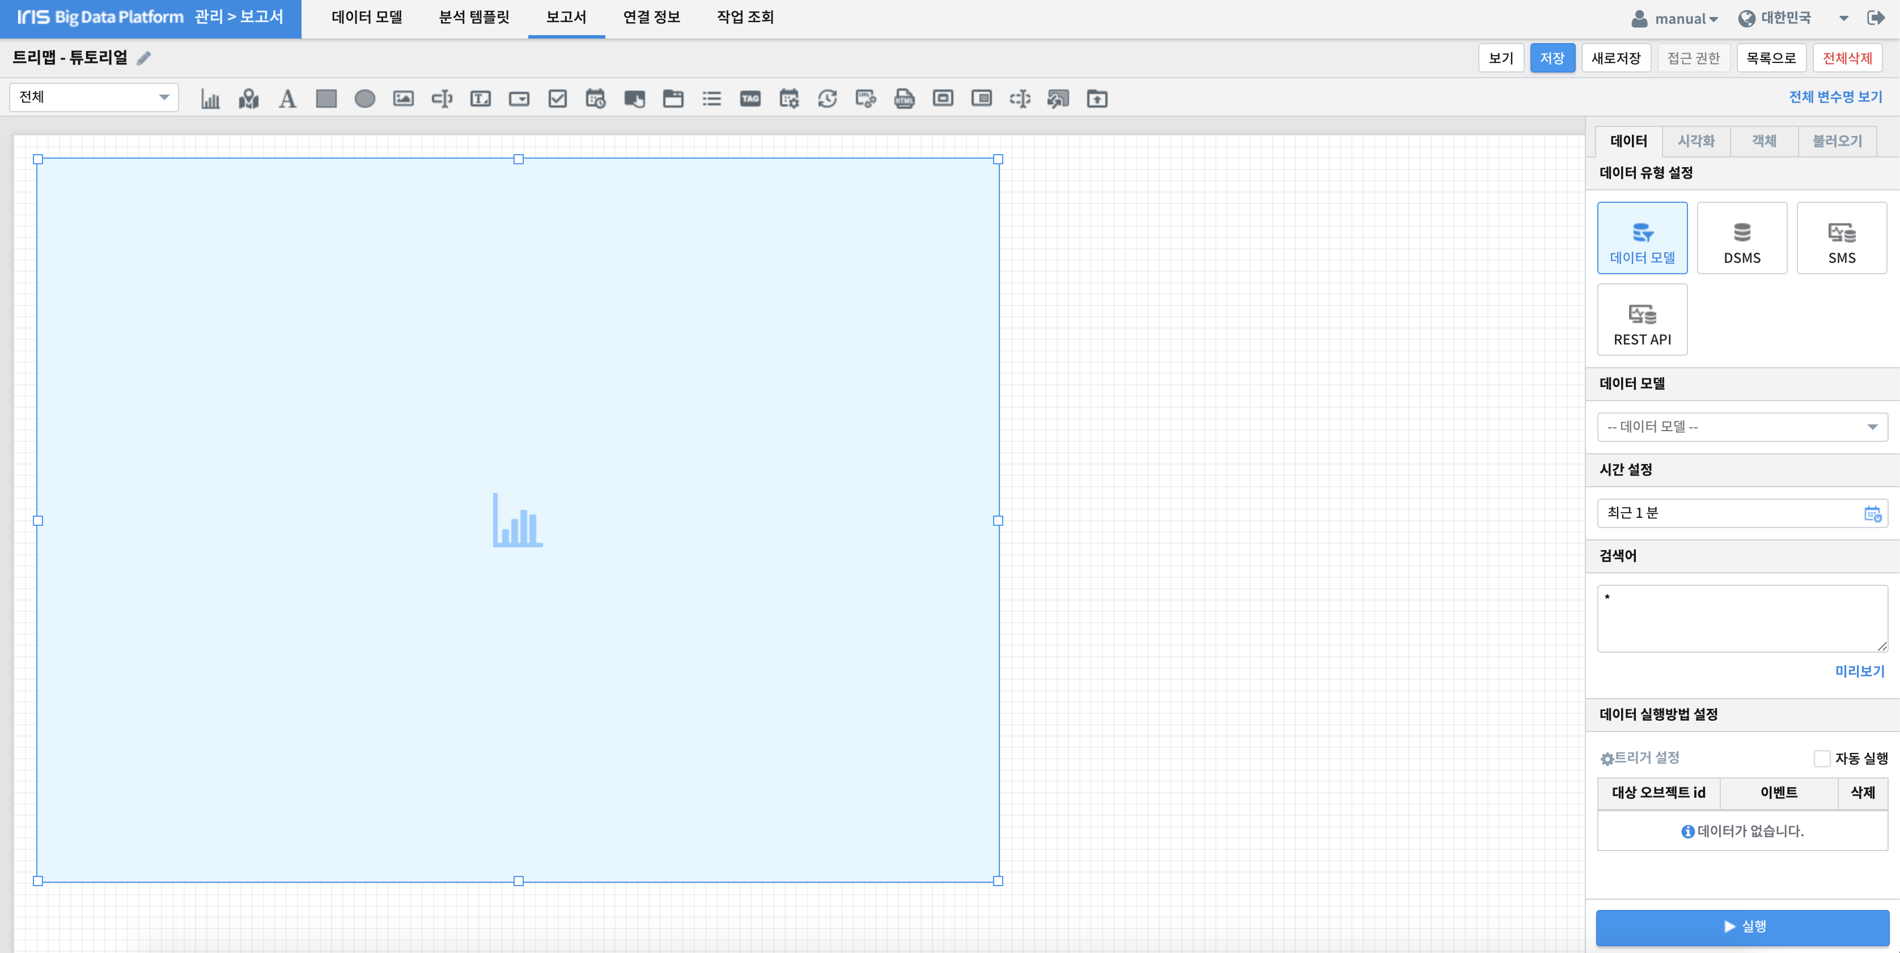
treemap_01.png

Slide 4
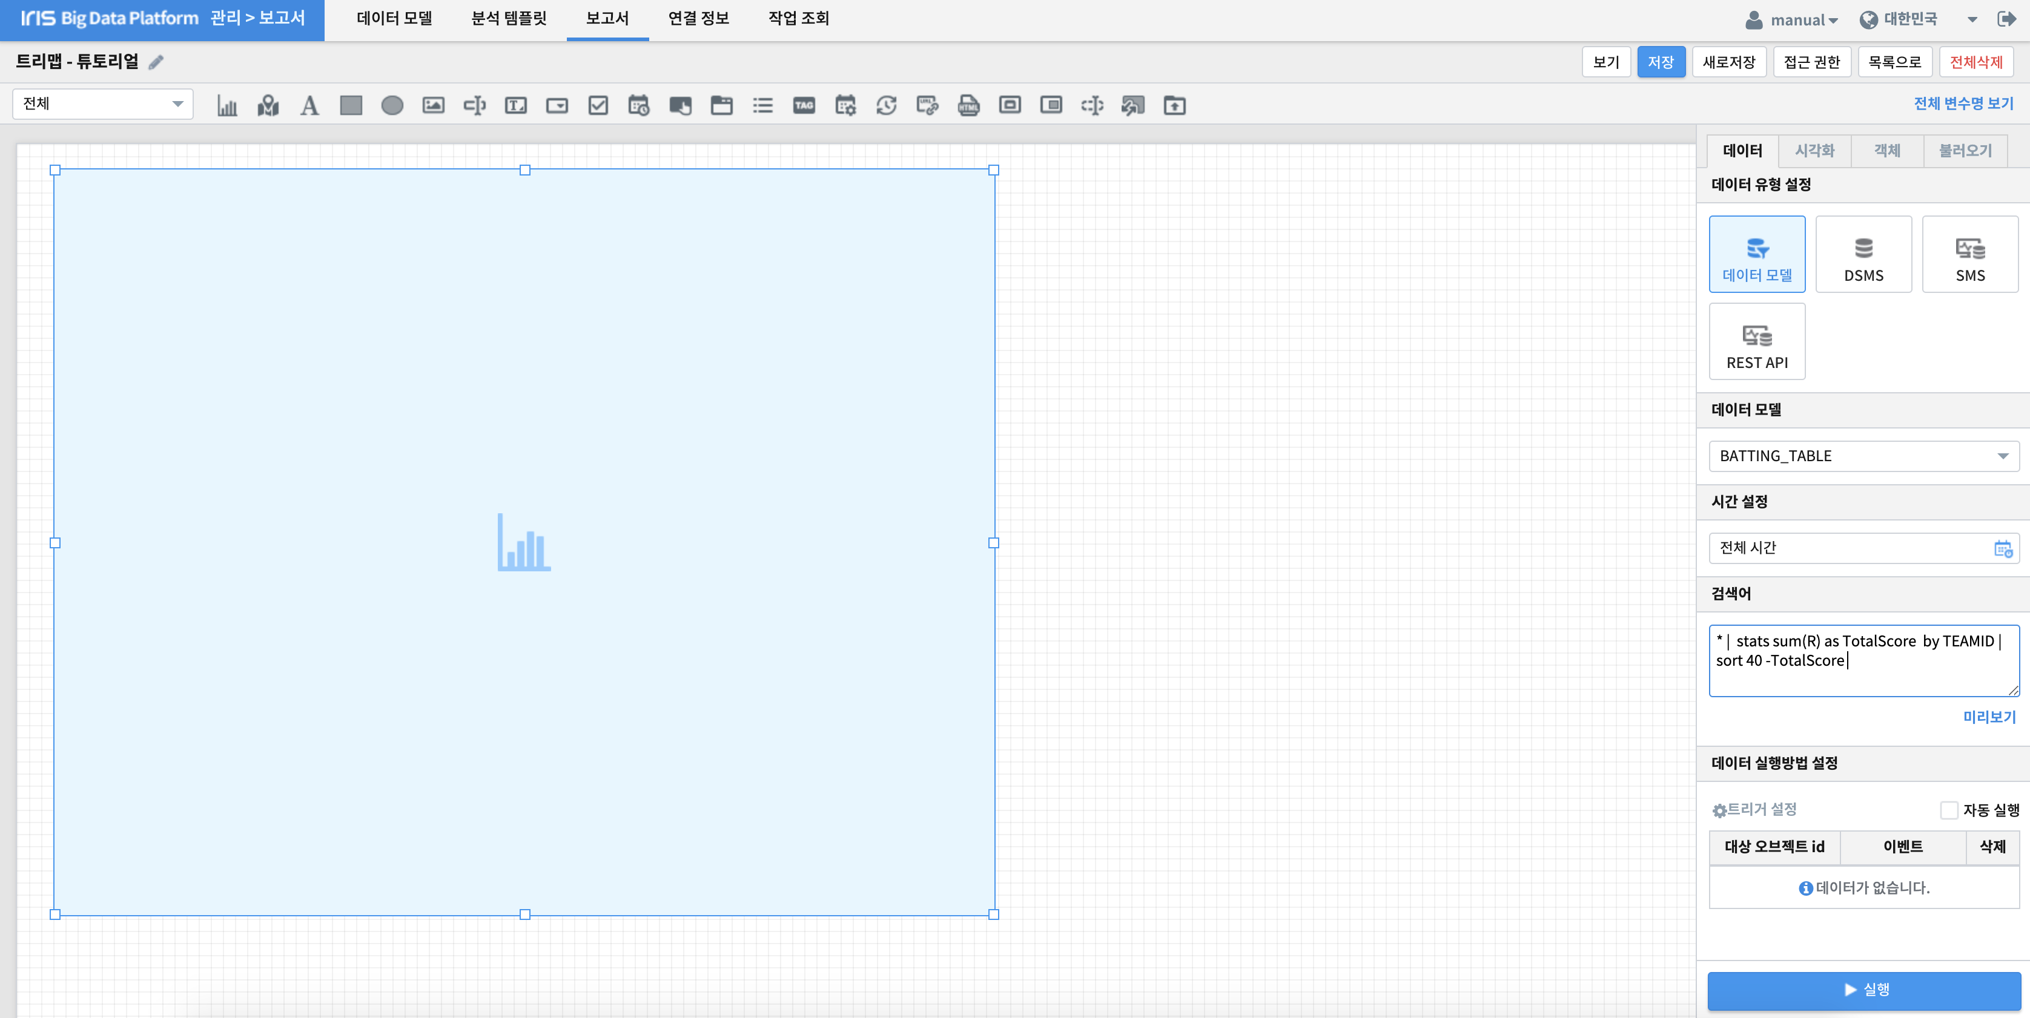
treemap_02.png

Slide 5
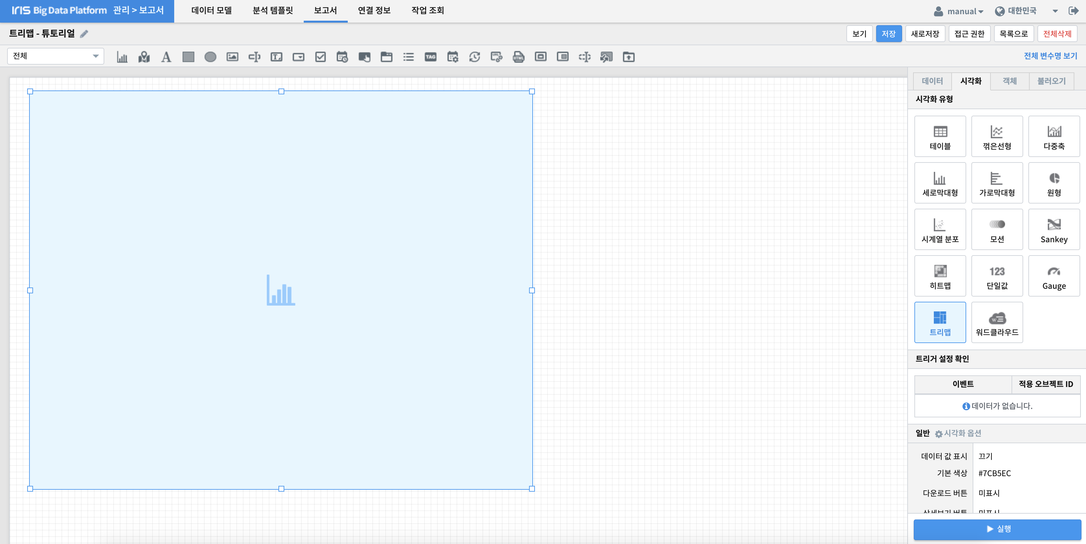


treemap_03.png

Slide 6
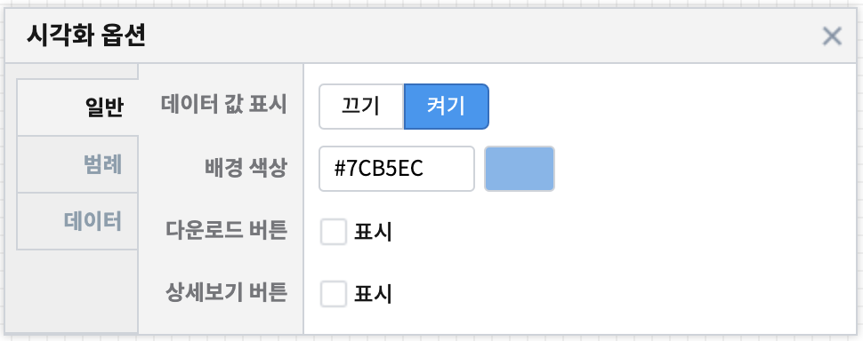


treemap_04.png
treemap_05.png
treemap_06.png

Slide 7
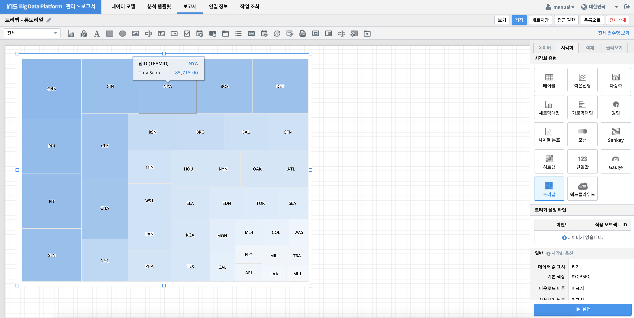
treemap_07.png

Slide 8
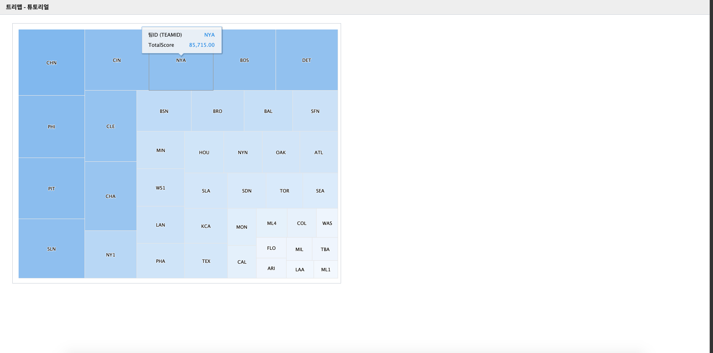
treemap_08.png

Slide 9
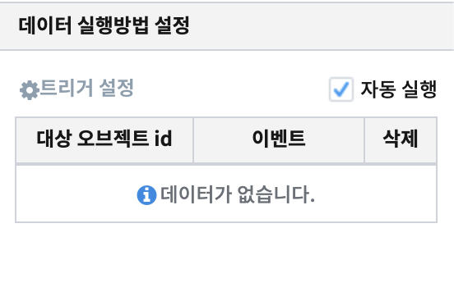
autoplay.png

Slide 10
< 트리맵 – 영어버전>

Slide 11
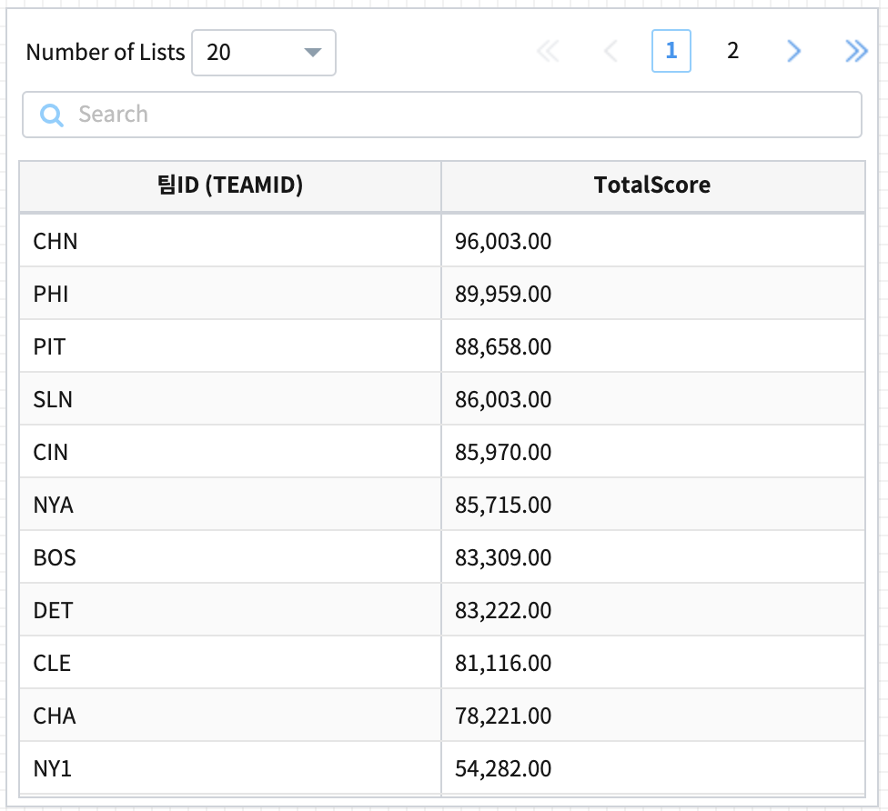
treemap_00.png

Slide 12
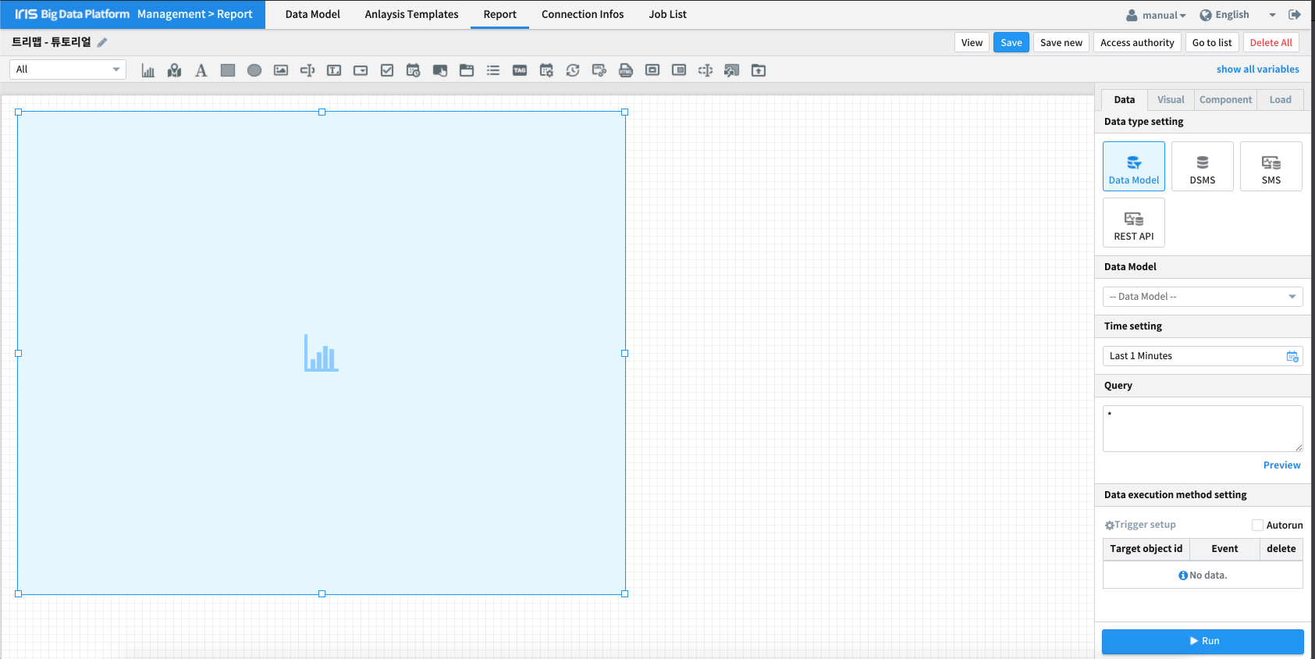
treemap_01.png

Slide 13
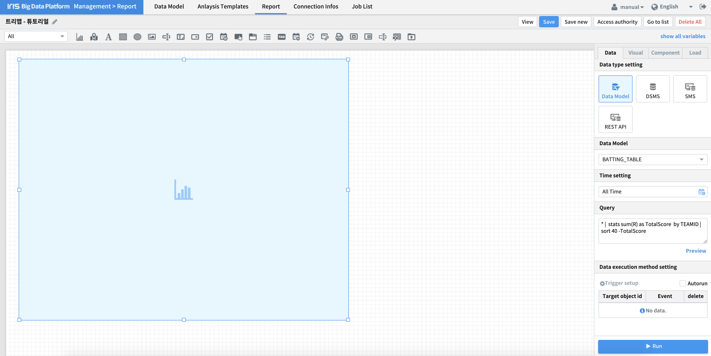
treemap_02.png

Slide 14
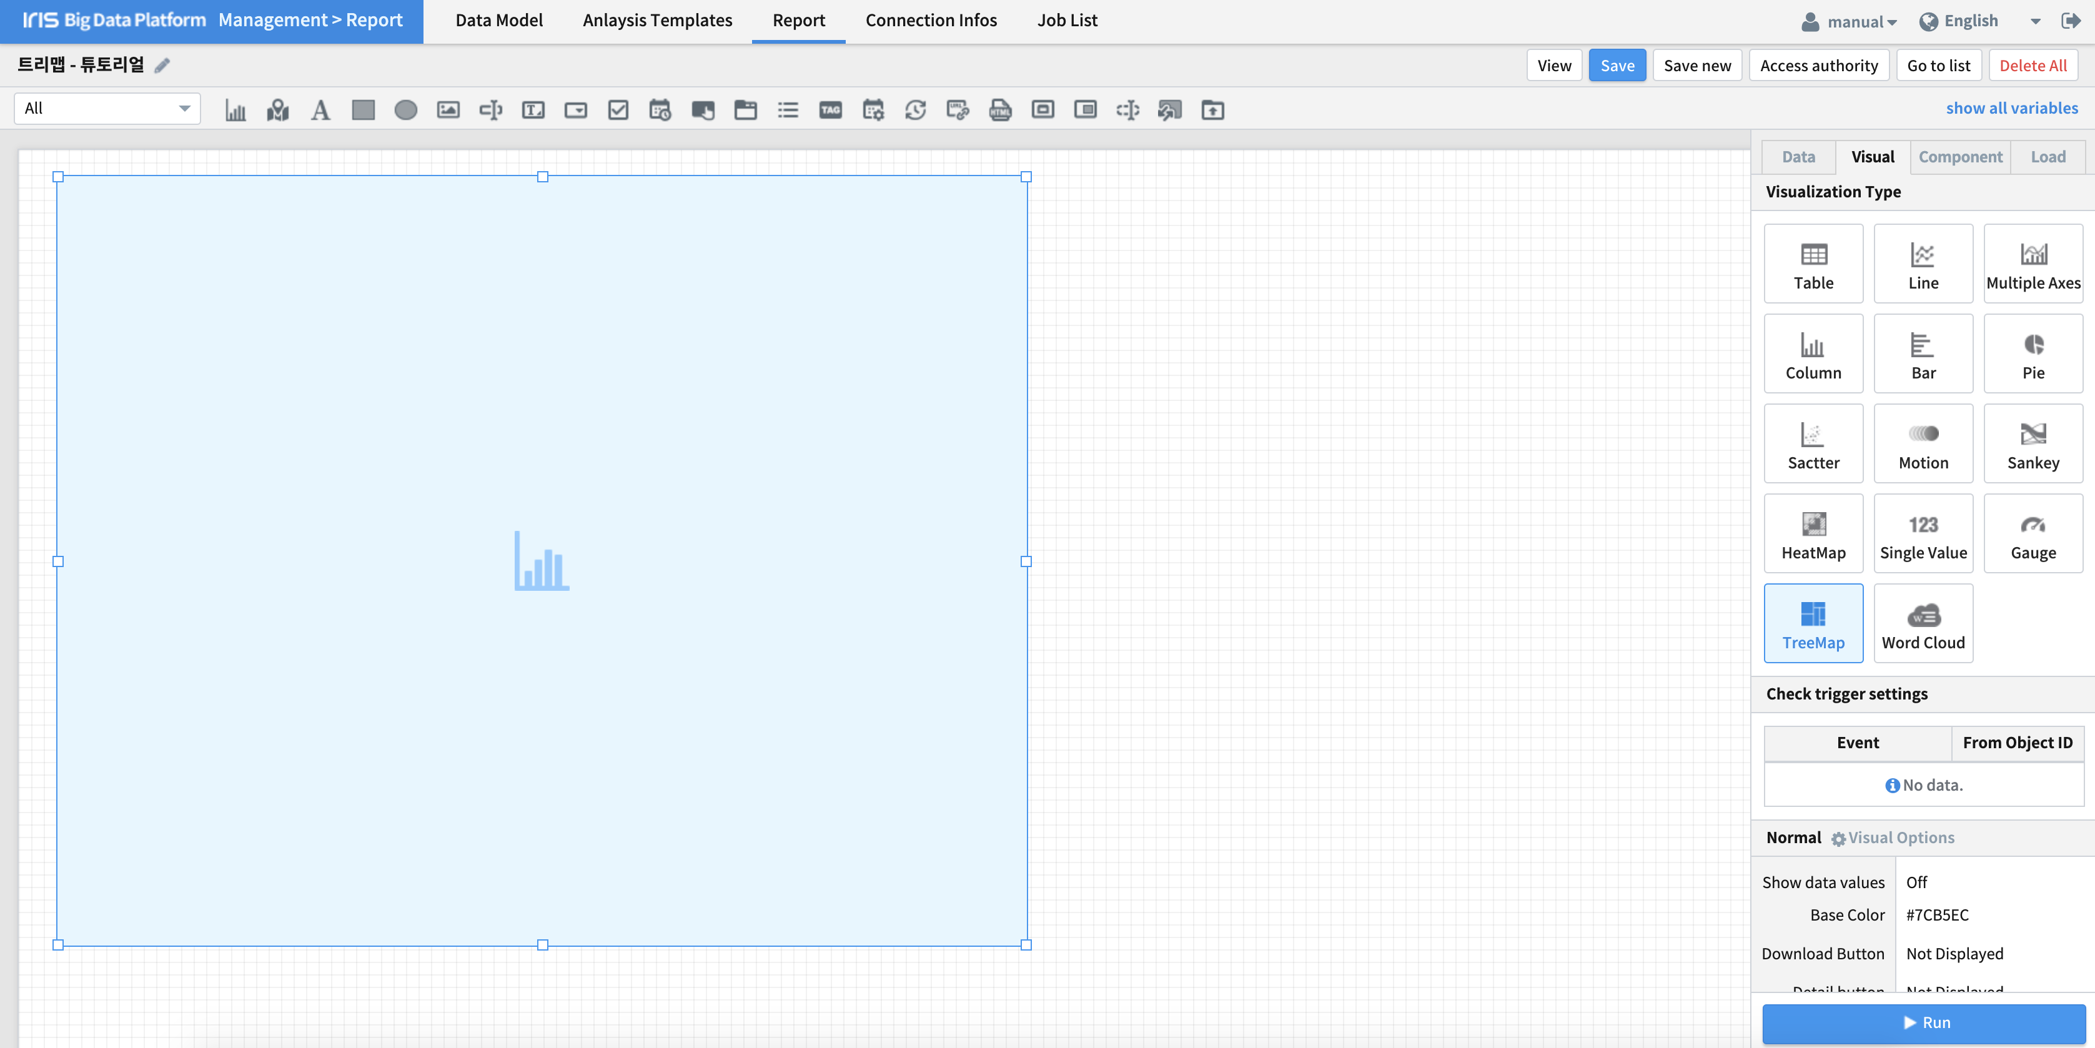
treemap_03.png

Slide 15
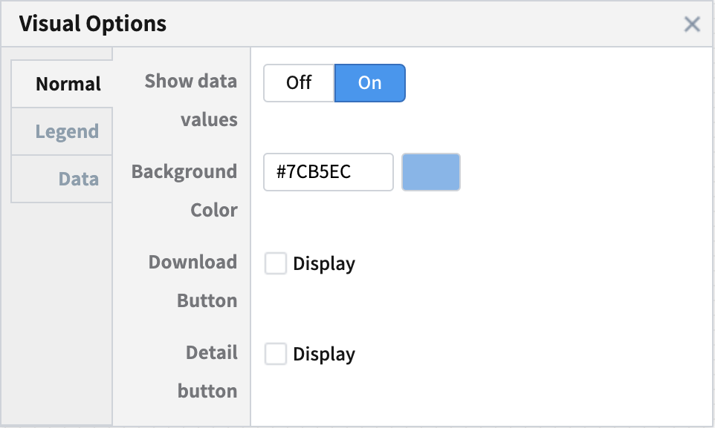
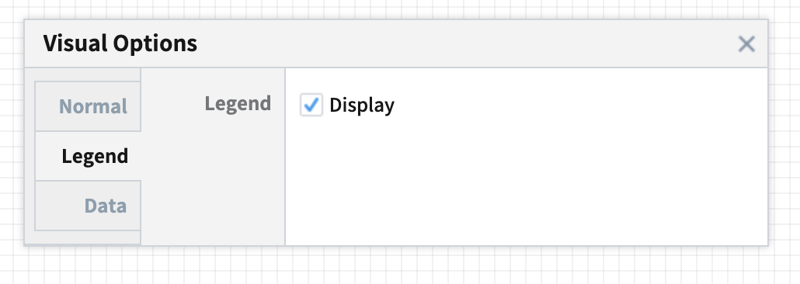
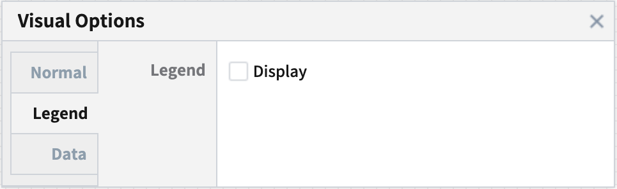

treemap_04.png
treemap_05.png
treemap_06.png

Slide 16
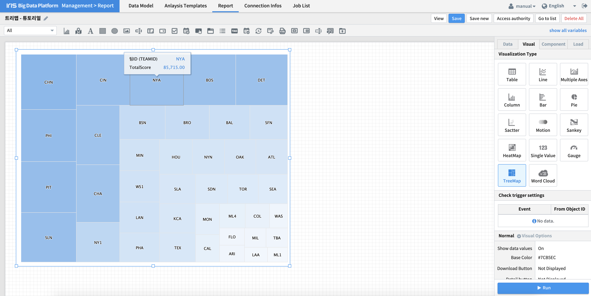
treemap_07.png

Slide 17
treemap_08.png

Slide 18
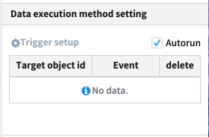
autoplay.png

