Slide 1

OpenLayers
Schuyler Erle <sderle@metacarta.com>
Christopher Schmidt <crschmidt@metacarta.com>
Notes:
Theme created by
Sakari Koivunen and Henrik Omma
Released under the LGPL license.

Slide 2
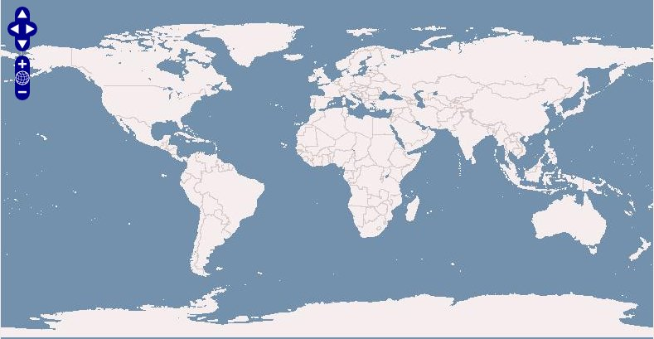
What is OpenLayers?

Slide 3
What is OpenLayers?
An API for building web map applications

Slide 4
What is OpenLayers?
An API for building web map applications
Pure client-side JavaScript

Slide 5
What is OpenLayers?
An API for building web map applications
Pure client-side JavaScript
“AJAX”

Slide 6
What is OpenLayers?
An API for building web map applications
Pure client-side JavaScript
“AJAX”
“Web 2.0”

Slide 7
What is OpenLayers?
An API for building web map applications
Pure client-side JavaScript
“AJAX”
“Web 2.0”

Slide 8
What is OpenLayers?
An API for building web map applications
Pure client-side JavaScript
“AJAX”
Supports open standards

Slide 9
What is OpenLayers?
An API for building web map applications
Pure client-side JavaScript
“AJAX”
Supports open standards
Supports closed standards, too

Slide 10
What is OpenLayers?
An API for building web map applications
Pure client-side JavaScript
“AJAX”
Supports open standards
Supports closed standards, too
BSD licensed

Slide 11
Quick Demonstration
Tiling
Zoom in/out
Panning
Zoom Box!

Slide 12
History of the Project
Started after Where 2.0 in 2005

Slide 13
History of the Project
Started after Where 2.0 in 2005
Motivated by MetaCarta's business needs

Slide 14
History of the Project
Started after Where 2.0 in 2005
Motivated by MetaCarta's business needs
Went through several internal revisions

Slide 15
History of the Project
Started after Where 2.0 in 2005
Motivated by MetaCarta's business needs
Went through several internal revisions
Final rewrite took only a month

Slide 16
History of the Project
Started after Where 2.0 in 2005
Motivated by MetaCarta's business needs
Went through several internal revisions
Final rewrite took only a month
Released before Where 2.0 in 2006

Slide 17
History of the Project
Started after Where 2.0 in 2005
Motivated by MetaCarta's business needs
Went through several internal revisions
Final rewrite took only a month
Released before Where 2.0 in 2006
Already used by > 10,000 people

Slide 18
OpenLayers Features: Layers
OGC WMS
OGC WFS
GeoRSS
CSV
ka-Map
WorldWind (*)
Canvas
Google Maps
MSN Virtual Earth
Yahoo! Maps
Multimap

Slide 19
OpenLayers Features: Controls
Zoom / Pan
Zoom Bar
Mouse controls
Layer Switcher (aka “legend”)
Scale Ratio
Scale Bar
Permalink

Slide 20
OpenLayers Features: et cetera...
Markers
Popups
Feature objects
Event handling
... and, of course ...

Slide 21
OpenLayers Features: et cetera...
Markers
Popups
Feature objects
Event handling
“AJAX”

Slide 22
OpenLayers: WMS
  <html>
  <head>
  <script src="http://openlayers.org/api/2/OpenLayers.js"></script>
  </head>
  <body>
  <div style="width:100%; height:100%" id="map"></div>
  <script defer="defer" type="text/javascript">
  var map = new OpenLayers.Map('map');
  var wms = new OpenLayers.Layer.WMS("OpenLayers WMS",
  "http://labs.metacarta.com/wms/vmap0", {layers: 'basic'});
  map.addLayer(wms);
  map.zoomToMaxExtent();
  </script>
  </body>
  </html>

Slide 23
OpenLayers: WMS
  <html>
  <head>
  <script src="http://openlayers.org/api/2/OpenLayers.js"></script>
  </head>
  <body>
  <div style="width:100%; height:100%" id="map"></div>
  <script defer="defer" type="text/javascript">
  var map = new OpenLayers.Map('map');
  var wms = new OpenLayers.Layer.WMS("OpenLayers WMS",
  "http://labs.metacarta.com/wms/vmap0", {layers: 'basic'});
  map.addLayer(wms);
  map.zoomToMaxExtent();
  </script>
  </body>
  </html>

Slide 24
OpenLayers: WMS
  <html>
  <head>
  <script src="http://openlayers.org/api/2/OpenLayers.js"></script>
  </head>
  <body>
  <div style="width:100%; height:100%" id="map"></div>
  <script defer="defer" type="text/javascript">
  var map = new OpenLayers.Map('map');
  var wms = new OpenLayers.Layer.WMS("OpenLayers WMS",
  "http://labs.metacarta.com/wms/vmap0", {layers: 'basic'});
  map.addLayer(wms);
  map.zoomToMaxExtent();
  </script>
  </body>
  </html>

Slide 25
OpenLayers: WMS
  <html>
  <head>
  <script src="http://openlayers.org/api/2/OpenLayers.js"></script>
  </head>
  <body>
  <div style="width:100%; height:100%" id="map"></div>
  <script defer="defer" type="text/javascript">
  var map = new OpenLayers.Map('map');
  var wms = new OpenLayers.Layer.WMS("OpenLayers WMS",
  "http://labs.metacarta.com/wms/vmap0", {layers: 'basic'});
  map.addLayer(wms);
  map.zoomToMaxExtent();
  </script>
  </body>
  </html>

Slide 26
OpenLayers: WMS
  <html>
  <head>
  <script src="http://openlayers.org/api/2/OpenLayers.js"></script>
  </head>
  <body>
  <div style="width:100%; height:100%" id="map"></div>
  <script defer="defer" type="text/javascript">
  var map = new OpenLayers.Map('map');
  var wms = new OpenLayers.Layer.WMS("OpenLayers WMS",
  "http://labs.metacarta.com/wms/vmap0", {layers: 'basic'});
  map.addLayer(wms);
  map.zoomToMaxExtent();
  </script>
  </body>
  </html>

Slide 27
OpenLayers: WMS
  <html>
  <head>
  <script src="http://openlayers.org/api/2/OpenLayers.js"></script>
  </head>
  <body>
  <div style="width:100%; height:100%" id="map"></div>
  <script defer="defer" type="text/javascript">
  var map = new OpenLayers.Map('map');
  var wms = new OpenLayers.Layer.WMS("OpenLayers WMS",
  "http://labs.metacarta.com/wms/vmap0", {layers: 'basic'});
  map.addLayer(wms);
  map.zoomToMaxExtent();
  </script>
  </body>
  </html>

Slide 28
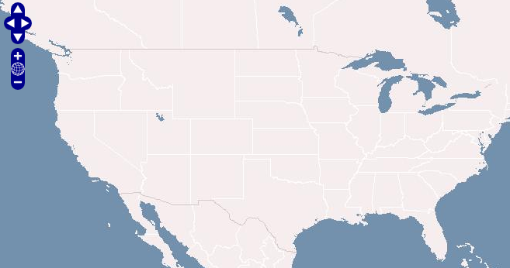
OpenLayers: WMS

Slide 29
OpenLayers + ka-Map
  <html>
  <head>
  <script src="http://openlayers.org/api/2/OpenLayers.js"></script>
  </head>
  <body>
  <div style="width:100%; height:100%" id="map"></div>
  <script defer="defer" type="text/javascript">
  var map = new OpenLayers.Map('map');
  var wms = new OpenLayers.Layer.WMS("OpenLayers WMS",
  "http://labs.metacarta.com/wms/vmap0", {layers: 'basic'});
  map.addLayer(wms);
  map.zoomToMaxExtent();
  </script>
  </body>
  </html>

Slide 30
OpenLayers + ka-Map
  <html>
  <head>
  <script src="http://openlayers.org/api/2/OpenLayers.js"></script>
  </head>
  <body>
  <div style="width:100%; height:100%" id="map"></div>
  <script defer="defer" type="text/javascript">
  var map = new OpenLayers.Map('map');
  var wms = new OpenLayers.Layer.WMS("OpenLayers WMS",
  "http://labs.metacarta.com/wms/vmap0", {layers: 'basic'});
  var kamap = new OpenLayers.Layer.KaMap( "KaMap",
  "http://openlayers.org/world/index.php",
  {g: "satellite", map: "world"});
  map.addLayer(wms);
  map.zoomToMaxExtent();
  </script>
  </body>
  </html>

Slide 31
OpenLayers + ka-Map
  <html>
  <head>
  <script src="http://openlayers.org/api/2/OpenLayers.js"></script>
  </head>
  <body>
  <div style="width:100%; height:100%" id="map"></div>
  <script defer="defer" type="text/javascript">
  var map = new OpenLayers.Map('map');
  var wms = new OpenLayers.Layer.WMS("OpenLayers WMS",
  "http://labs.metacarta.com/wms/vmap0", {layers: 'basic'});
  var kamap = new OpenLayers.Layer.KaMap( "KaMap",
  "http://openlayers.org/world/index.php",
  {g: "satellite", map: "world"});
  map.addLayers([wms, kamap]);
  map.zoomToMaxExtent();
  </script>
  </body>
  </html>

Slide 32
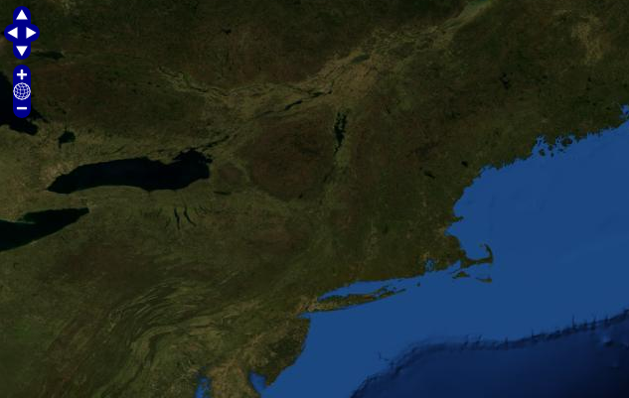
OpenLayers + ka-Map

Slide 33
Google Maps in OpenLayers
  <html>
  <head>
  <script src="http://openlayers.org/api/2/OpenLayers.js"></script>
  </head>
  <body>
  <div style="width:100%; height:100%" id="map"></div>
  <script defer="defer" type="text/javascript">
  var map = new OpenLayers.Map('map');
  var layer = new OpenLayers.Layer.Google("Google");
  map.addLayer(layer);
  map.zoomToMaxExtent();
  </script>
  </body>
  </html>

Slide 34
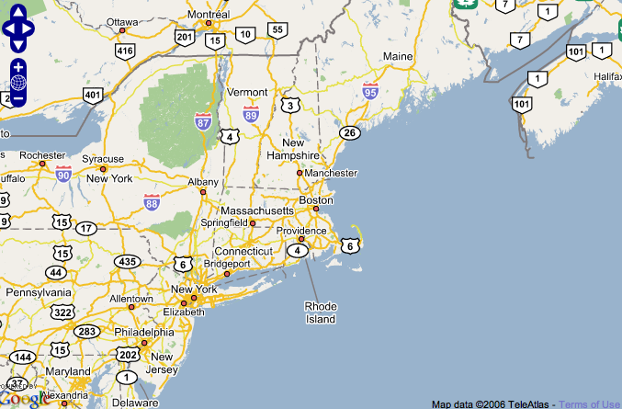
Google Maps in OpenLayers

Slide 35
MSN Virtual Earth in OpenLayers
  <html>
  <head>
  <script src="http://openlayers.org/api/2/OpenLayers.js"></script>
  </head>
  <body>
  <div style="width:100%; height:100%" id="map"></div>
  <script defer="defer" type="text/javascript">
  var map = new OpenLayers.Map('map');
  var layer = new OpenLayers.Layer.VirtualEarth("MSN VE");
  map.addLayer(layer);
  map.zoomToMaxExtent();
  </script>
  </body>
  </html>

Slide 36
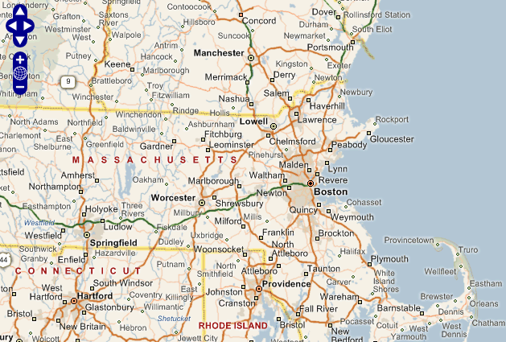
MSN Virtual Earth in OpenLayers

Slide 37
Commercial Layers in OpenLayers
Additionally, OpenLayers supports...

Slide 38
Commercial Layers in OpenLayers
Additionally, OpenLayers supports...
Y! Maps

Slide 39
Commercial Layers in OpenLayers
Additionally, OpenLayers supports...
Y! Maps
MultiMap

Slide 40
Commercial Layers in OpenLayers
Additionally, OpenLayers supports...
Y! Maps
MultiMap
(insert your own here)

Slide 41
OpenLayers: Transparent WMS
var map = new OpenLayers.Map('map');
  var wms = new OpenLayers.Layer.WMS( "OpenLayers WMS",
  "http://labs.metacarta.com/wms/vmap0", {layers: 'basic'} );
  var twms = new OpenLayers.Layer.WMS( "World Map",
  "http://world.freemap.in/cgi-bin/mapserv?",
  {map: '/www/freemap.in/world/map/factbooktrans.map',
  transparent:'true', layers: 'factbook', 'format':'png'} );
  map.addLayers([wms,twms]);
  map.zoomToMaxExtent();

Slide 42
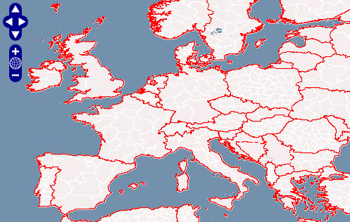
OpenLayers: Transparent WMS

Slide 43
OpenLayers: WFS
OpenLayers.ProxyHost="/cgi-bin/proxy.cgi?url=";
var map = new OpenLayers.Map('map');
  var wms = new OpenLayers.Layer.WMS( "OpenLayers WMS",
  "http://labs.metacarta.com/wms/vmap0", {layers: 'basic'} );
  var layer = new OpenLayers.Layer.WFS( "Owl Survey",
  "http://www.bsc-eoc.org/cgi-bin/bsc_ows.asp?",
  {typename: "OWLS", maxfeatures: 30});
  map.addLayers([wms,georss]);
  map.zoomToMaxExtent();

Slide 44
OpenLayers: WFS
OpenLayers.ProxyHost="/cgi-bin/proxy.cgi?url=";
var map = new OpenLayers.Map('map');
  var wms = new OpenLayers.Layer.WMS( "OpenLayers WMS",
  "http://labs.metacarta.com/wms/vmap0", {layers: 'basic'} );
  var layer = new OpenLayers.Layer.WFS( "Owl Survey",
  "http://www.bsc-eoc.org/cgi-bin/bsc_ows.asp?",
  {typename: "OWLS", maxfeatures: 30});
  map.addLayers([wms,georss]);
  map.zoomToMaxExtent();

Slide 45
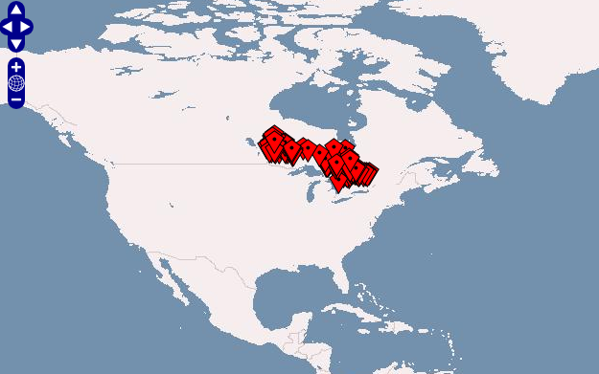
OpenLayers: WFS

Slide 46
OpenLayers: GeoRSS
OpenLayers.ProxyHost="/cgi-bin/proxy.cgi?url=";
var map = new OpenLayers.Map('map');
  var wms = new OpenLayers.Layer.WMS( "OpenLayers WMS",
  "http://labs.metacarta.com/wms/vmap0", {layers: 'basic'} );
  var georss = new OpenLayers.Layer.GeoRSS( "GeoRSS",
  "http://earthquake.usgs.gov/recenteqsww/eqs7day-M2.5.xml" );
  map.addLayers([wms,georss]);
  map.zoomToMaxExtent();

Slide 47
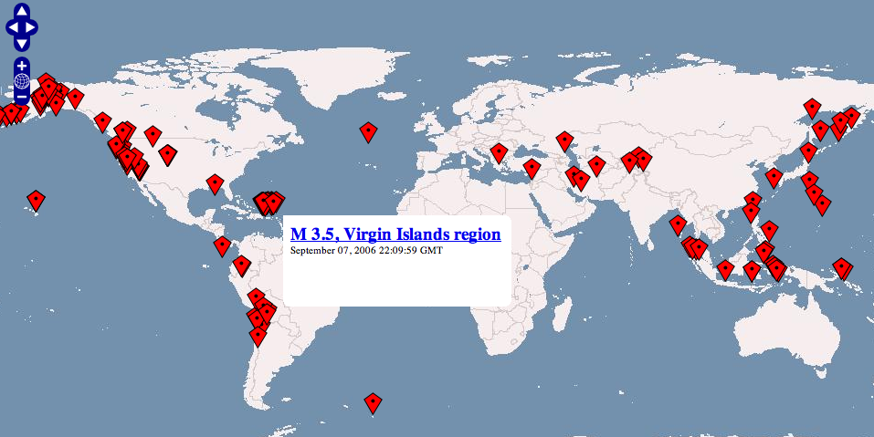
OpenLayers: GeoRSS

Slide 48
OpenLayers: Markers
var map = new OpenLayers.Map('map');
var markers = new OpenLayers.Layer.Markers("Markers");
map.addLayer(markers);
var point = new OpenLayers.LonLat(5, 40)
var marker = new OpenLayers.Marker(point);
markers.addMarker(marker);
  map.zoomToMaxExtent();

Slide 49
OpenLayers: Markers
var map = new OpenLayers.Map('map');
var markers = new OpenLayers.Layer.Markers("Markers");
map.addLayer(markers);
var point = new OpenLayers.LonLat(5, 40)
var marker = new OpenLayers.Marker(point);
markers.addMarker(marker);
  map.zoomToMaxExtent();

Slide 50
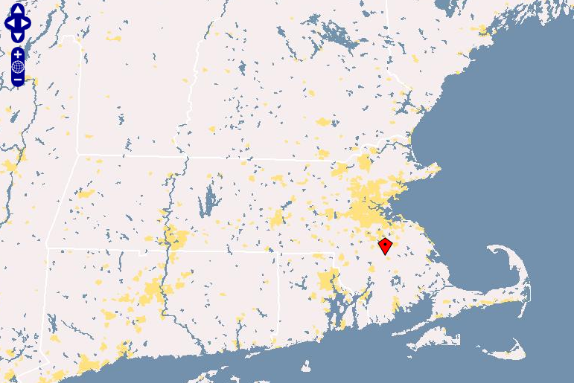
OpenLayers: Markers

Slide 51
OpenLayers: Popups
var markers = new OpenLayers.Layer.Markers("Markers");
map.addLayer(markers);
popup = new OpenLayers.Popup.Anchored("Example",
new OpenLayers.LonLat(5,40),
new OpenLayers.Size(200,75),
"Welcome to Barcelona");
popup.setBackgroundColor(“yellow”);
popup.setOpacity(0.8);
popup.hide();
map.addPopup(popup);
var point = new OpenLayers.LonLat(5, 40)
var marker = new OpenLayers.Marker(point);
markers.addMarker(marker);
marker.events.register( "click", marker,
function (e) { popup.toggle() } );

Slide 52
OpenLayers: Popups
var markers = new OpenLayers.Layer.Markers("Markers");
map.addLayer(markers);
popup = new OpenLayers.Popup.Anchored("Example",
new OpenLayers.LonLat(5,40),
new OpenLayers.Size(200,200),
"Welcome to Barcelona");
popup.hide();
popup.setBackgroundColor(“yellow”);
popup.setOpacity(0.8);
map.addPopup(popup);
var point = new OpenLayers.LonLat(5, 40)
var marker = new OpenLayers.Marker(point);
markers.addMarker(marker);
marker.events.register( "click", marker,
function (e) { popup.toggle() } );

Slide 53
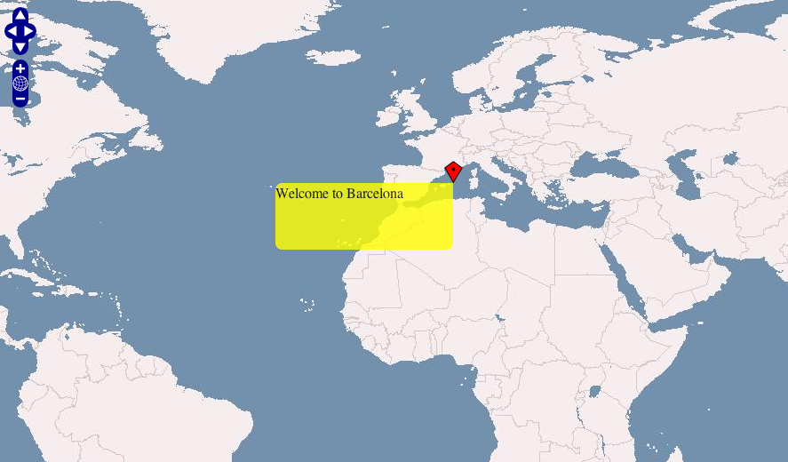
OpenLayers: Popups

Slide 54
OpenLayers: Custom Controls
var controls = [
new OpenLayers.Control.PanZoomBar(),
new OpenLayers.Control.MouseDefaults(),
new OpenLayers.Control.Scale(),
new OpenLayers.Control.Permalink()
];
var map = new OpenLayers.Map('map', { controls: controls });

Slide 55
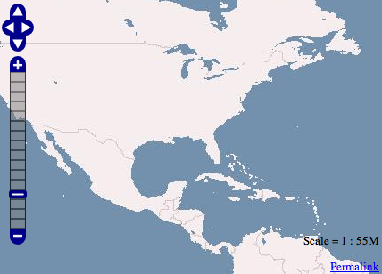
OpenLayers: Custom Controls

Slide 56
Contributing to OpenLayers
Visit the website: http://openlayers.org/

Slide 57
Contributing to OpenLayers
Visit the website: http://openlayers.org/
Join the mailing lists

Slide 58
Contributing to OpenLayers
Visit the website: http://openlayers.org/
Join the mailing lists
Meet on irc.freenode.net #openlayers

Slide 59
Contributing to OpenLayers
Visit the website: http://openlayers.org/
Join the mailing lists
Meet on irc.freenode.net #openlayers
Submit a contributor agreement

Slide 60
Contributing to OpenLayers
Visit the website: http://openlayers.org/
Join the mailing lists
Meet on irc.freenode.net #openlayers
Submit a contributor agreement
Start sending patches!

Slide 61
Appreciation
John Frank at MetaCarta for believing in the idea
MetaCarta generally for employing us and sending us here

Slide 62
Appreciation
John Frank at MetaCarta for believing in the idea
MetaCarta generally for employing us and sending us here
Erik Uzureau and Phil Lindsay for making it happen
The growing OpenLayers community

Slide 63
Appreciation
John Frank at MetaCarta for believing in the idea
MetaCarta generally for employing us and sending us here
Erik Uzureau and Phil Lindsay for making it happen
The growing OpenLayers community
You, for your time and interest

Slide 64
http://openlayers.org/
Schuyler Erle <sderle@metacarta.com>
Christopher Schmidt <crschmidt@metacarta.com>
Notes:
Theme created by
Sakari Koivunen and Henrik Omma
Released under the LGPL license.

