Slide 1
Zowe Project Review
Notes:
Closing Slide

Slide 2
Mission
Zowe is an integrated and extensible open source framework for z/OS. Zowe, like Mac OS or Windows, comes with a set of APIs and OS capabilities that applications build on and also includes some applications out of the box.
The contributors of Zowe strive to:
Modernize the user experience of z/OS through open source
Have the Zowe codebase serve as a hub of z/OS knowledge
Listen to z/OS community desires/feedback to make software we all enjoy
Reduce fragmented experiences and reinvention of wheel via making developing Zowe-based products beneficial and easy
In doing so we believe:
Zowe will help to attract and minimize training time of next generation developers
The OMP will continue to be the home for open source mainframe development
The z/OS community will become comfortable with open source use

Slide 3
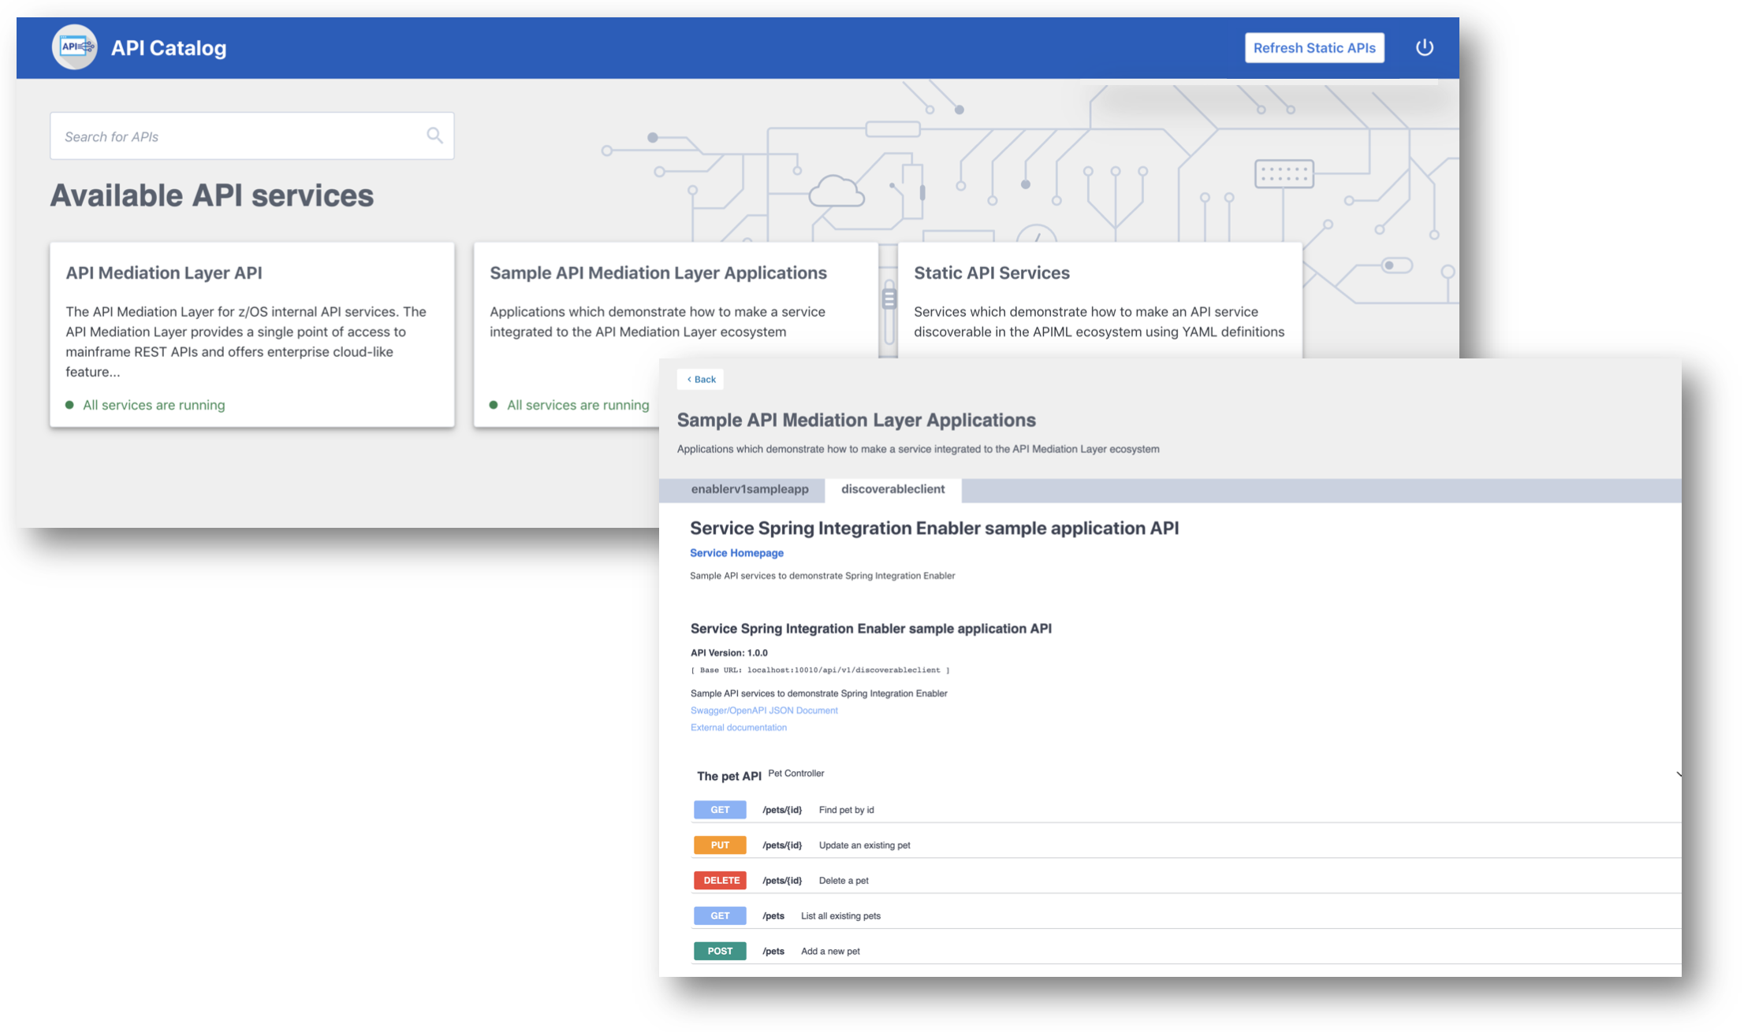
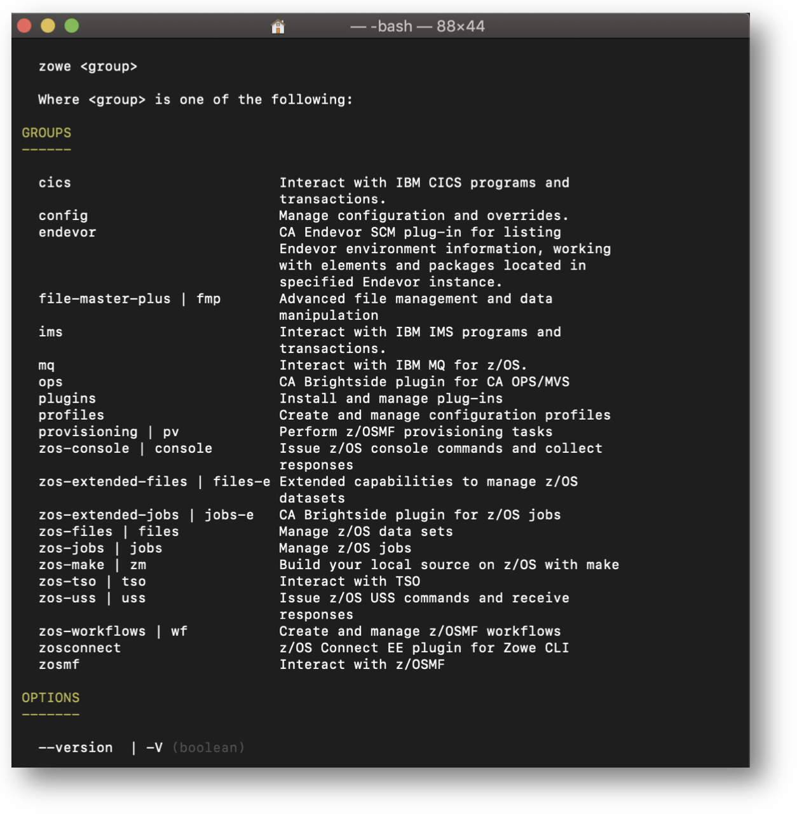
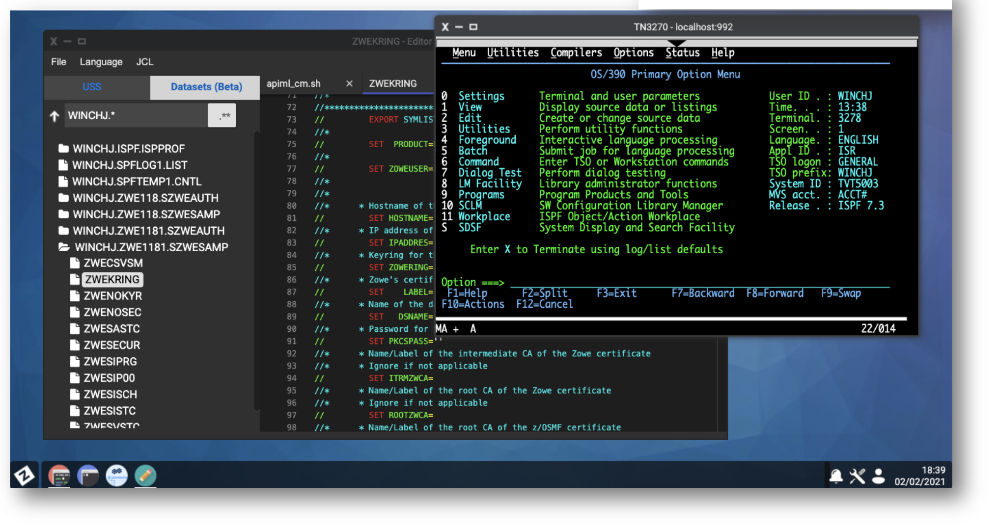
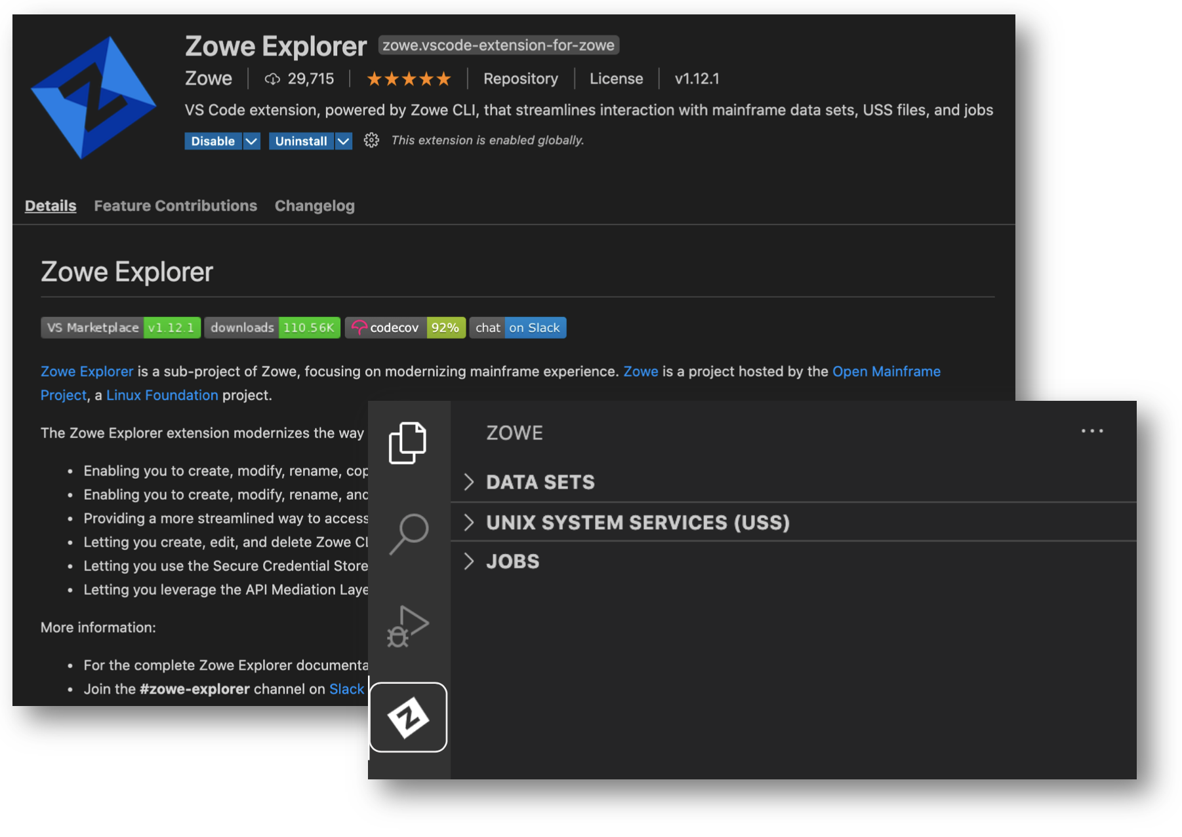
Technology
Zowe offers modern interfaces to interact with z/OS which lets you work with z/OS with a similar experience to cloud platforms. You can use Zowe as-is, or install 1st and 3rd party plugins and extensions into Zowe to make the most of Zowe and z/OS.
Includes:
CLI: CICD, Automation, and z/OS enablement of popular non-Z software
Virtual Desktop: Desktop-in-a-browser that allows interaction with z/OS in a modern & intuitive way
IDE Explorers: Develop for z/OS in VSCode (+more) by bringing z/OS concepts to IDEs through Explorer plugins
API Mediation Layer: Unify z/OS webservers for improved management, security, high availability and more

Slide 4
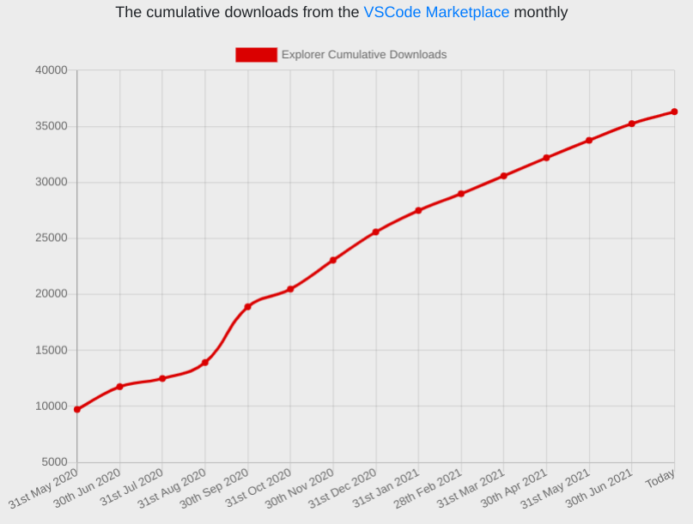
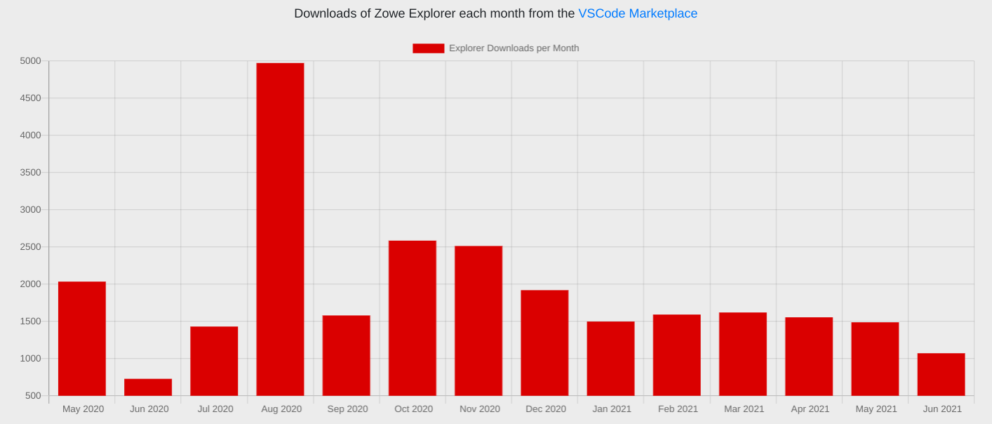
Metrics
SHARE March 2021: Zowe a positive disruptor in the Open Source track, has enough session submissions that SHARE must be selective. ~150 attendees per session, ~10 sessions
Quarterly webinars being done, views to date: Oct (165), Jan (117), Apr (136)
Zowe used in training:
Cobol Training Course
Master the mainframe competition: 11k students in 2020, big spike in downloads!
Zowe badge is Interskill's most popular, thousands issued!

Slide 5
2021 Releases
7 Releases just this year (12 YTD)
Too many changes to list: https://docs.zowe.org/stable/getting-started/summaryofchanges
Revamped website and documentation site
Release structure details https://github.com/zowe/community/blob/master/Technical-Steering-Committee/release.md
Currently, 6-week schedule between releases

Slide 6
2022 Plans
Zowe v2.0.0
Est Feb 2022, many proposals for improvements https://github.com/zowe/community/issues/924
V1.x which are already Long term support releases (LTS) will continue post-v2.0.0 in maintenance mode for some months
Zowe Incubators
Zebra: re-usable and industry compliant JSON formatted RMF/SMF data records for analyzing in modern tooling
Zowe mobile: Mobile UI for interacting with Zowe server stack on the go
Workflow Wizard: Create and modify z/OSMF workflows through intelligent editor powered through Zowe UIs

Slide 7
Organization
Squads: Zowe's technology is diverse, so each component has a squad. Cross-technology needs also have squads to lead efforts: Documentation, outreach, infrastructure, installation and configuration tooling, and security.
Zowe Leadership Committee (ZLC): An elected group which focuses on business relations to understand and instruct how Zowe committers can improve Zowe to make it relevant for more z/OS users
Technical Steering Committee (TSC): A group composed of each squad's representative and a few individuals elected by ZLC. The TSC guides cross-squad standards, initiatives, communication, and more
More here: https://github.com/zowe/community/blob/master/README.md
Membership info here:

Slide 8
Communication
Slack: https://slack.openmainframeproject.org
LFX Chat: https://chat.lfx.linuxfoundation.org
Mailing list: Zowe-dev@lists.openmainframeproject.org
Forums: https://community.openmainframeproject.org/c/zowe
Squad meetings: Technology or specialty-focused planning and discussion meetings
Community meetings: ZLC and TSC meetings to help engage in different ways
Links and more here: https://github.com/zowe/community/blob/master/README.md#communication-channels

Slide 9
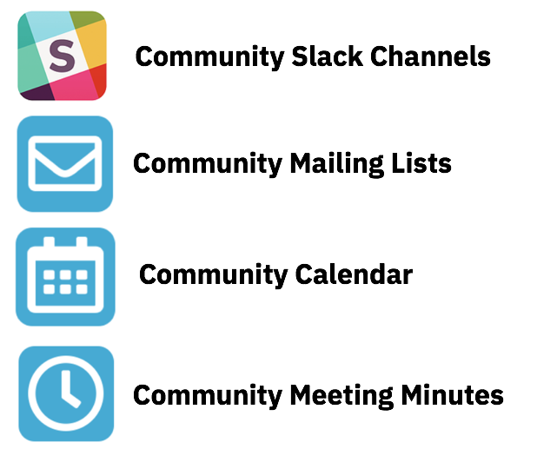
Getting Started with …
Project Community site
https://zowe.org
Access to Beta Download
https://zowe.org/download
Review Zowe squads, missions and activities
https://zowe.org/contribute/
Code Guidelines
https://zowe.org/code-guidelines/
Project Governance
https://zowe.org/about-us/
GitHub
https://github.com/zowe
Project Documentation (includes user and install guides)
https://zowe.github.io/docs-site/
Developer Tutorials
https://zowe.github.io/docs-site/guides/intro.html
https://developer.ibm.com/tutorials/zowe-step-by-step-tutorial/

Slide 10
Get involved in the Zowe community
Join Open Source Community @ https://www.openmainframeproject.org/projects/zowe
PROJECTS
Participate in and contribute to the Zowe developer community at zowe.org
Learn how your organization can become a steward and supporter of this project with Open Mainframe Project membership at openmainframeproject.org/about/join
DEVELOPER
COMMUNITY
PLATFORM
PARTICIPATION
Ecosystem
PROFITS
PRODUCTS
PROMOTION
SOFTWARE
Notes:
Closing slide

