Slide 1

Introducing ZNETBOOT
“Easy Linux on z/VM”
Rick Troth
rogue programmer
http://www.casita.net/nord

Slide 2
Agenda
Linux on Z, Linux on z/VM (history)
z/Linux for non-z people: ZNETBOOT tool
ZNETBOOT config file
ZNETBOOT Project: z/Linux for non-z people
ZNETBOOT Package

Slide 3

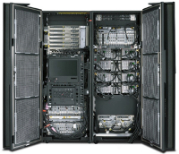
Mainframe Motivation
S/370 Bigfoot
S/390 IBM skunkworks
BMC Software, 1999 December, GCC and Doom
Obvious use case for VM/ESA, 41000 virtual penguins
After that, it was easy …
… NOT!!!!!

Slide 4
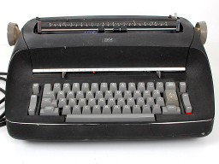
System Z remains Foreign
What’s a 3270? (it’s actually a 3215!)
Was that binary or text?
I don’t know Rexx.
I definitely don’t know XEDIT.
So many steps! I lost track.

Slide 5

Simplify: enter ZNETBOOT
Familiar configuration format
One command launches Linux
Can be re-run any number of times (idempotent)

Slide 6




ZNETBOOT Configuration
kernel, initrd, parameters
ZNETBOOT_KERNEL=http://znetboot.casita.net/nord/image
ZNETBOOT_INITRD=http://znetboot.casita.net/nord/ramdisk.gz
… other parameters, not prefixed with “ZNETBOOT_” …
Examples: ClefOS, Alpine, Debian, NORD, …

Slide 7

ZNETBOOT Configuration
Automatic CMSCONFFILE handling
ZNETBOOT_KERNEL=http://dl.blah.com/some/place/kernel.img
ZNETBOOT_INITRD=http://dl.blah.com/some/place/initrd.img
ZNETBOOT_TOFILE=NETTYPE=qeth
ZNETBOOT_TOFILE=IPADDR=192.168.10.10
… other parameters …

Slide 8

ZNETBOOT Project
On GitHub
  anyone can download and use it
  anyone can join and contribute
Community support
Actually used by real people

Slide 9

ZNETBOOT Package
CMS-specific components collected from the project
Standard VMARC delivery
Not magic, “it’s just Rexx and Pipelines”

Slide 10
ZNETBOOT Links
http://www.github.com/trothr/znetboot/
http://www.casita.net/pub/znetboot/znetboot.vmarc
http://www.casita.net/pub/znetboot/znetboot.tar.gz
http://www.casita.net/pub/znetboot/znetboot.odp
http://www.casita.net/pub/znetboot/znetboot.ppt

Slide 11
ZNETBOOT Links
ClefOS on z/VM markdown:
https://github.com/trothr/znetboot/blob/master/clefonvm.md
Sir Rob’s GitHub repository:
https://github.com/rvdheij/

