Slide 1
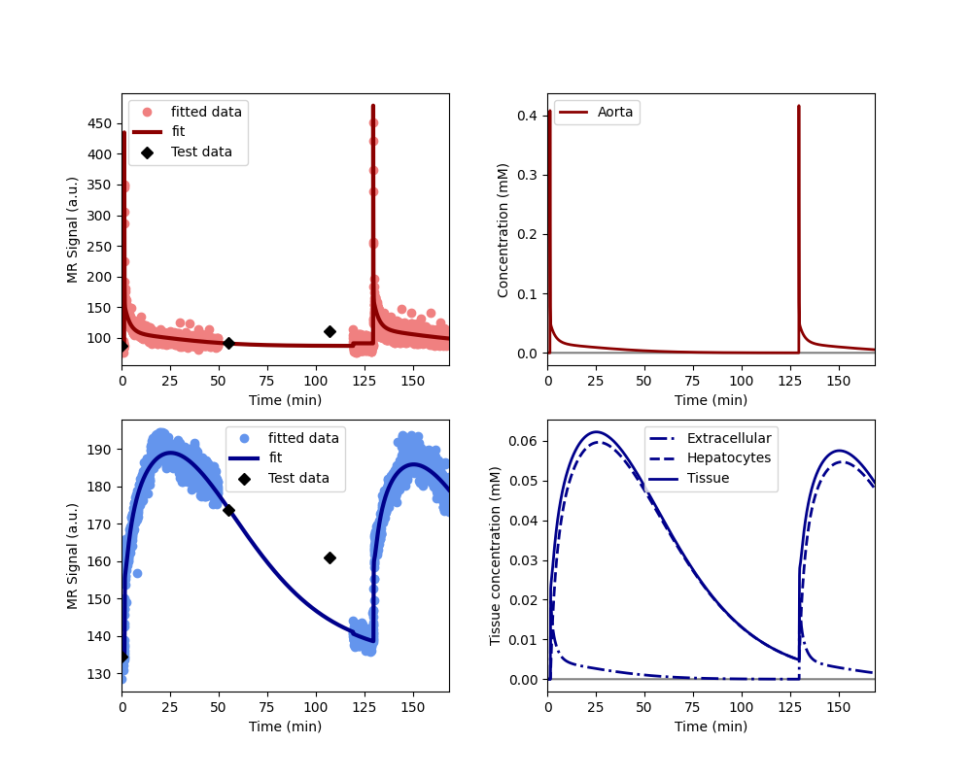
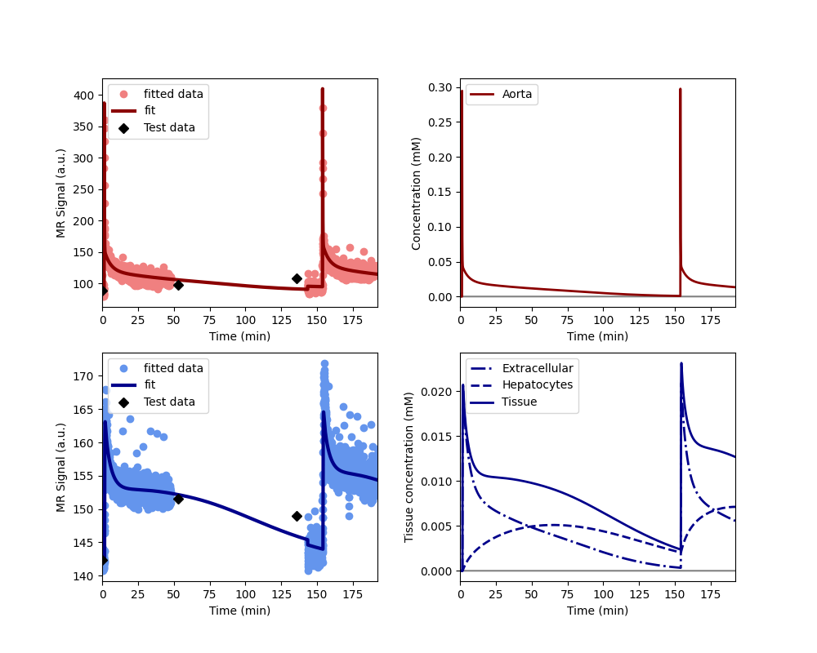
S1 before
S1 1min
S1 20min
S1 end
S2 before
S2 20min
Baseline
Treatment

Slide 2
First scan
(20mins)
Second scan
(20mins)
Aorta signal
(both scans)
Liver signal
(both scans)
a
b
c
d
Baseline visit
e
f
g
h
Treatment visit

