Slide 1


Hands on Termianl
[Get your hands dirty @ the linux terminal ~]$

Slide 2
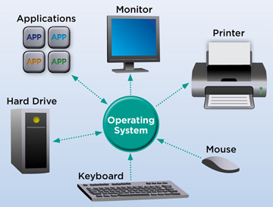
First things first , what’s an OS ?
An operating system is the software layer that sits between the programs you run and the hardware to help them communicate in an efficient way that is both fast and reliable , some operating systems that you may have encountered are { android , Linux , mac OS , IOS , windows , orbis OS , BSD , symbian , wear os }

Slide 3
What is lunix
Lunix, Debian and Mandrake are all versions of an illegal hacker operation system, invented by a Soviet computer hacker named Linyos torovoltos, before the Russians lost the Cold War. It is based on a program called "xenix", which was written by Microsoft for the US government. These programs are used by hackers to break into other people's computer systems to steal credit card numbers. They may also be used to break into people's stereos to steal their music, using the"mp3" program. Torovoltos is a notorious hacker, responsible for writing a lot of illegal hacking and spyware software for the rusian intelligence agencies

Slide 4
What is Linux ?
Linux is an open-source free “as in freedom” computer operating system ,
Linux a UNIX like operating system which makes it very flexible, modular and developer friendly
Linux “the kernel” is initially made by the Swedish programmer Linus Torvalds “just for fun” but after releasing it under the GPL license in 1993 it started being taken seriously and became the biggest collaborative work in the human history
Linux is now the most popular operating system ever , running on 100% of world’s super computers , 97% of the servers , 75% of the phones and tablets , and it powers all the chrome-books and most of if not all embedded devices of the world

Slide 5
Who is Linux for ?
People who value privacy “Edward Snowden recommends it ;)”
Programmers , Linux supports all IDEs and programming languages
Enterprises , Linux is more secure and reliable than it’s competitors making it the best for mission critical applications
Computer enthusiasts who like to customize and have full control over their systems
Digital music producers , radio am broadcasters , hackers and tinkerers , retro gamers , governments , minimalists , crypto miners , space helicopters , people with old/low-end hardware , printer fanboys
Linux is for everyone ;-)

Slide 6
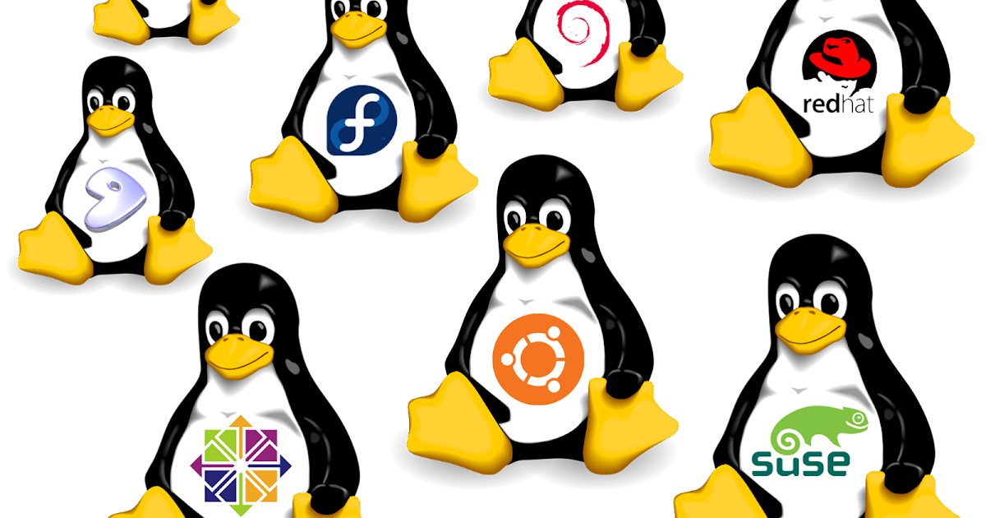
Distros ? What ?

Slide 7
A list of some popular distros
Fedora “ the best :-D ”
Ubuntu “ the devil ”
Arch “ by the way ”
Debian “ grandpa ”
Manjaro “ because you can’t install arch ”
Alpine “ runs on a calculator ”
Gentoo “ flex ”
Chrome OS “ say it if you wanna die ”
Mint “ green ubuntu ”

Slide 8
How to get Linux
Choose a distro
Download from the official website
Flash the .iso file to a thumb drive
Boot from the disk
Install!

Slide 9
Flashing a drive

Slide 10
Partitions , booting
What is a partition ?
A partition is a part of a storage device like a hard drive or a
Flash drive , partitions allocate a physical space from the drive so the bios knows exactly where to look for an OS to boot
So , what is booting ?
Booting is basically turning PC on , but it have more than that to it , when you press the power button the PC loads the bios to the ram than the bios will look for an OS and load it to the ram , when the OS is in the ram you will get to your lock screen , that process takes time that’s why computers take a while to turn on

Slide 11
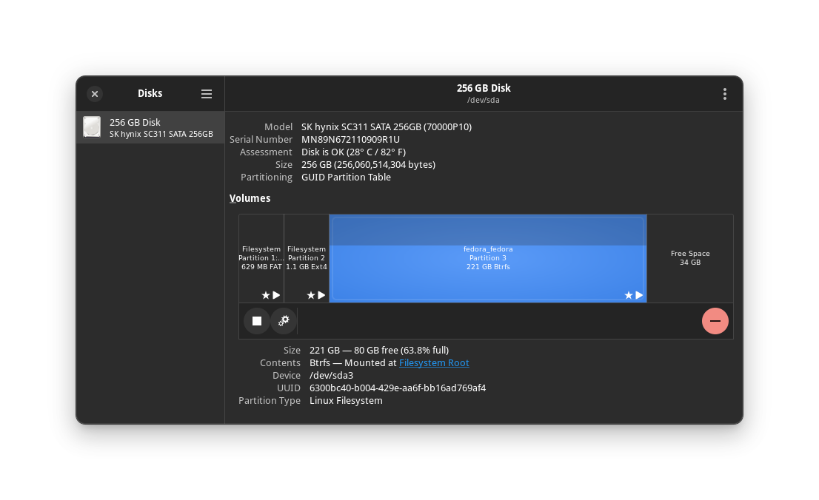
partitions
in the case of this computer , we have 1 disk divided into 4 partitions one of which is free space , we will talk more about that in a sec

Slide 12
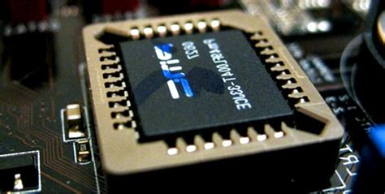
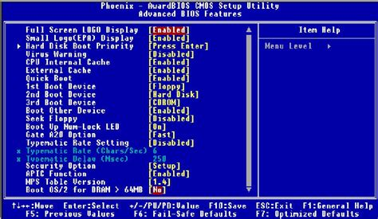
So what is that BIOS thing ?
BIOS or “basic input output system” is a software that comes with every computer , it offers the bare minimum for a PC to turn on , but in some modern computers it can have more advanced features , the bios is the first thing that loads to ram because it comes in it’s own chip so the computer always knows where to find it , if any damage happens to the bios , the computer won’t be able to turn on

Slide 13
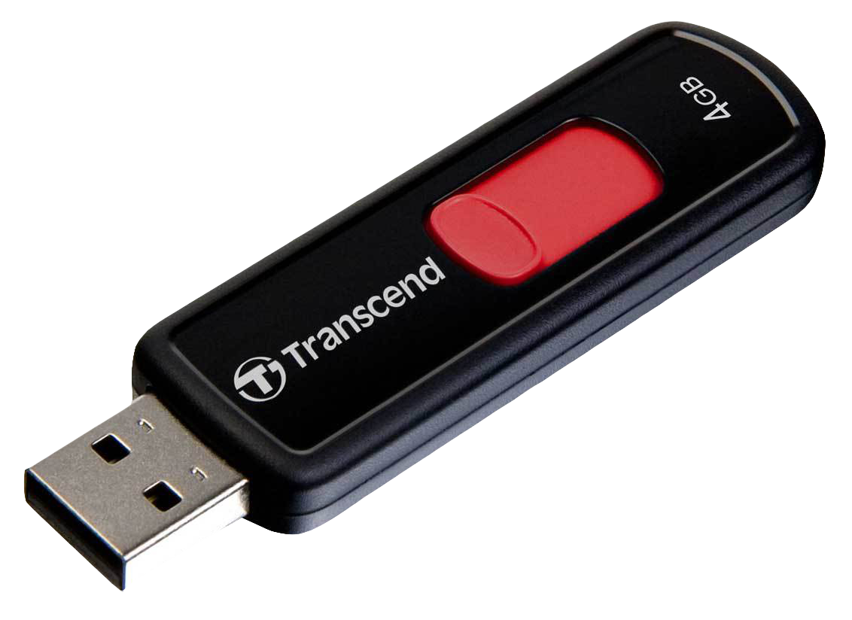
Why flash a USB stick ? Why i can’t double click and install like anything else ????
Installing operating systems is different from installing programs , when you install a program you are not leaving the operating system that you are running but to install a new operating system you need to boot into that system , and to boot into anything it needs to be in it’s own separate partition in order to your PC’s bios to find it and boot into it , so we flash an ISO into a thumb drive to make it possible to boot into it

Slide 14
How do i flash an ISO into a USB stick ?
download balena etcher app on your PC
Open the app
Insert the USB disk
Make sure the disk contains no important data
Select the image from the app
Select the disk
Flash!!

Slide 15
booting into the flashed drive

Slide 16
More about the boot process and partitions
To boot from a usb drive you have to access the boot menu first
There are 2 types of boot , legacy and EFI
EFI is much better than legacy boot but it’s not available on older computers like the ones that shipped with windows 7
EFI uses a partition table named GPT “guided partition table” and legacy uses a partition table called MBR “master boot record”
GPT is better than MBR and can handle more storage sizes, more partitions

Slide 17
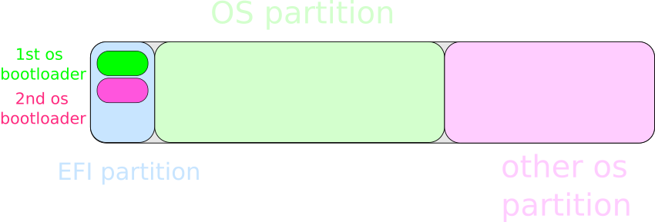
How EFI works
GPT partition table

Slide 18
How EFI works
BIOS
EFI always points to the EFI partition

Slide 19
How EFI works
BIOS

Slide 20
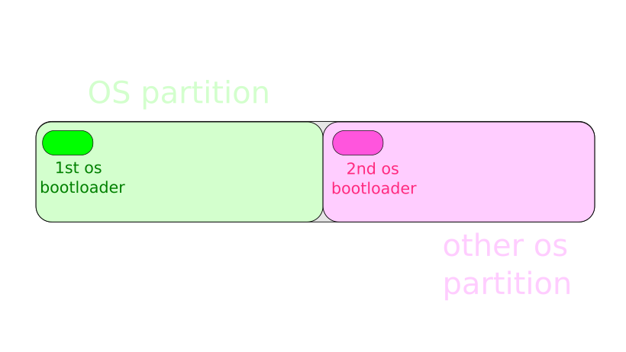
How legacy boot works
MBR partition table

Slide 21
How legacy boot works
BIOS
the master partition

Slide 22
Legacy boot drawbacks
can’t have more than 4 partitions
Harder to troubleshoot
Legacy boot’s partition table “MBR” can’t handle more than 2 TB per disk

Slide 23
Before you shut down
if you already have a spare partition you are good to go
If you don’t have a spare partition you need to create one
How to create a spare partition ?
Open the disk manager
Shrink a volume to free up some space on your disk
Note :
The spare partition need to be at least 20 GB but it’s recommended to be larger than 64 GB to have space for your files and programs

Slide 24
How to boot into the flash drive
Shut down your computer
Insert the flash drive
Enter the boot menu
Select the flash drive and hit the return key

Slide 25
Now you are in the life session
What is a life session ?
A life session is when you boot into Linux from a flash drive
It exists to let you try the system and test and make sure that all your hardware works on Linux before you install it on your PC’s disk
How is it different from having the system installed ?
In a life session all changes you apply to your system are temporary so if you unplug the flash drive or shut down your computer everything will be back at it’s initial state , so if you install any program you won’t find it on the next boot

Slide 26
Time to actually Install fedora Linux
Open the install to hard drive app
Choose the right timezone and keyboard layout
Partition the drive
Double check your configuration
Install !!

Slide 27
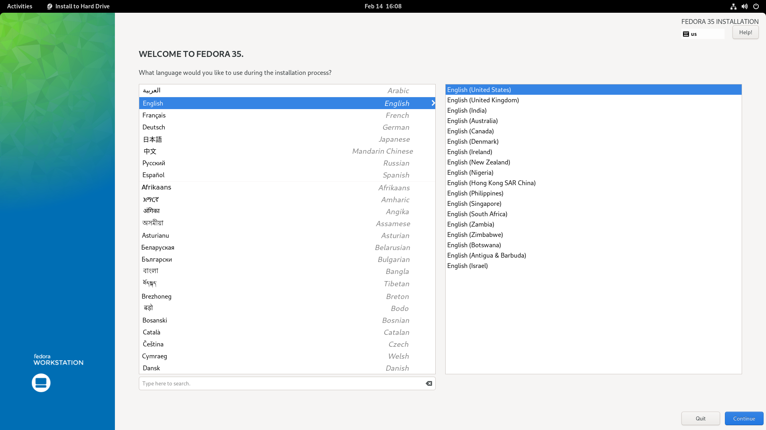
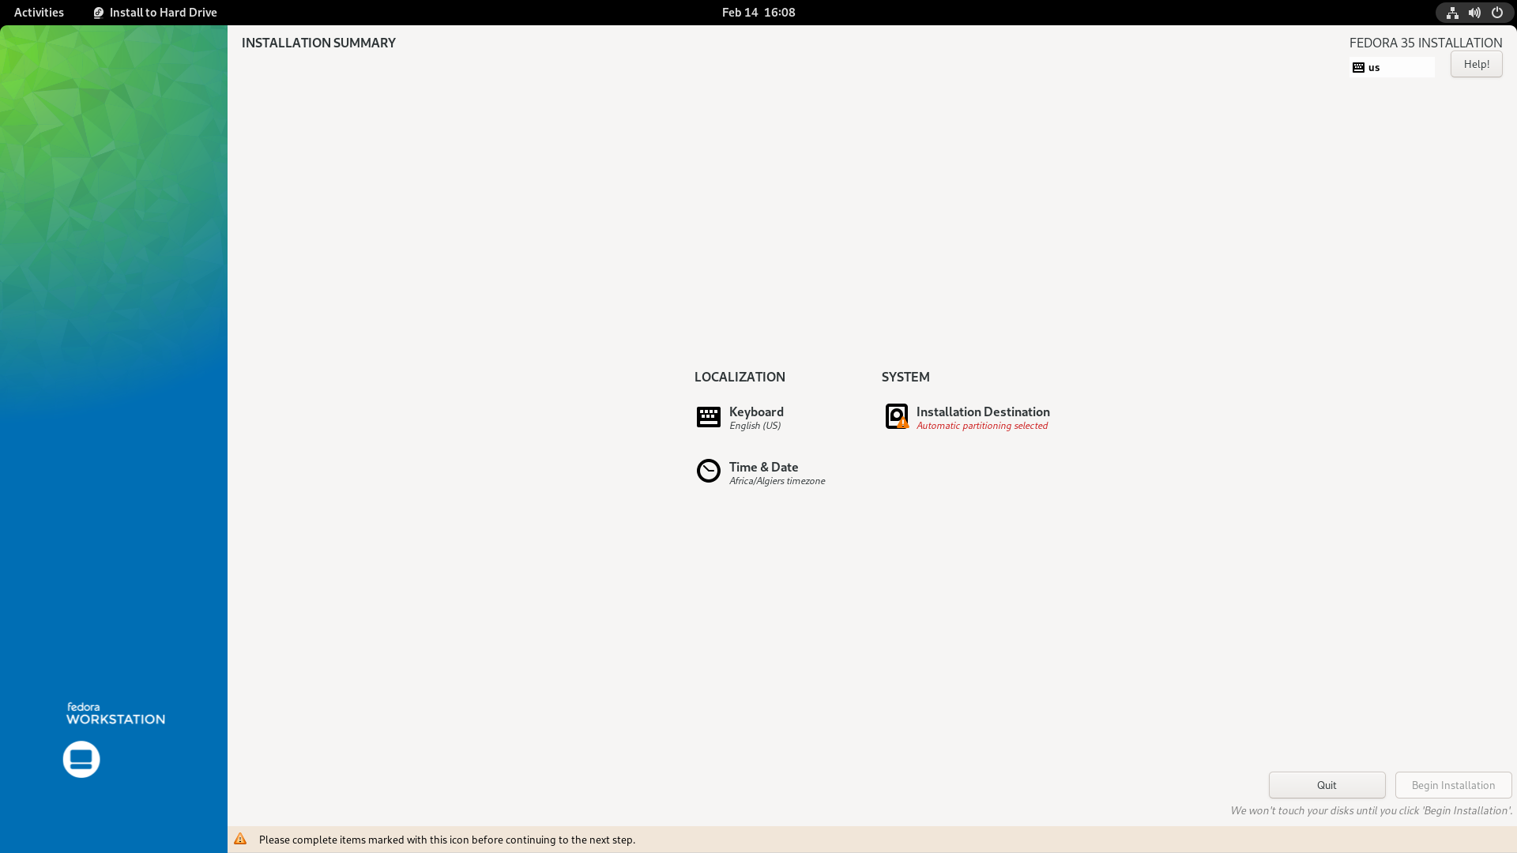
Starting the installer

Slide 28
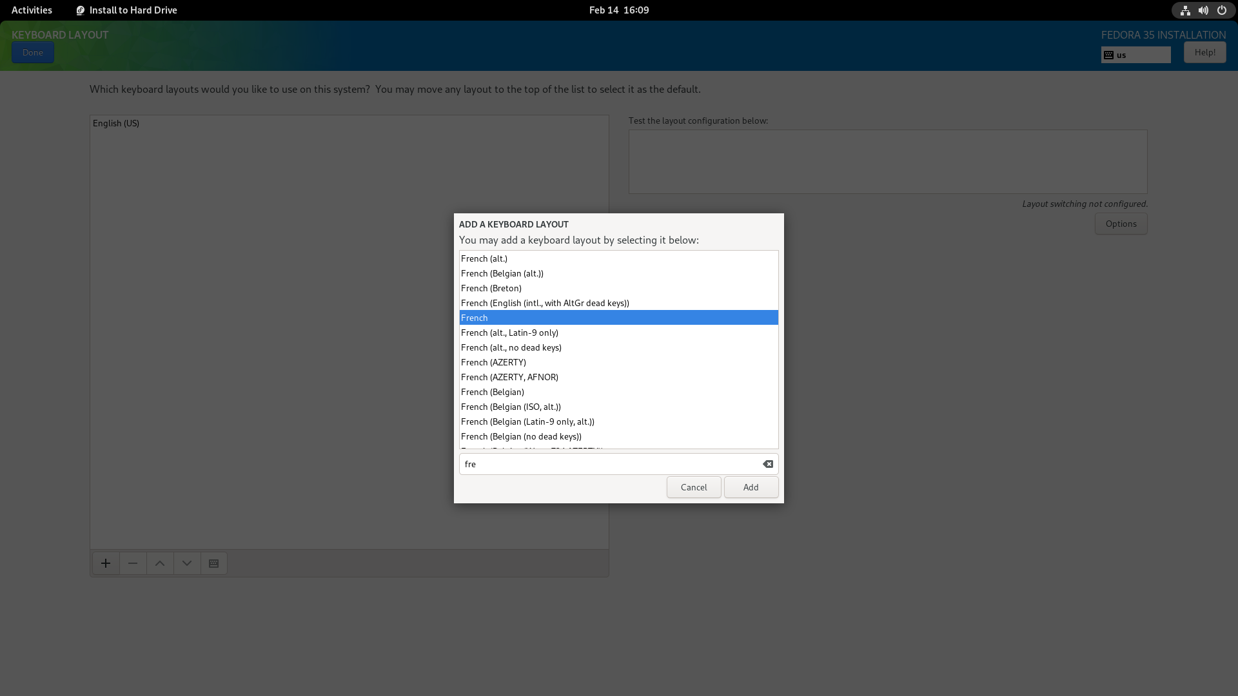
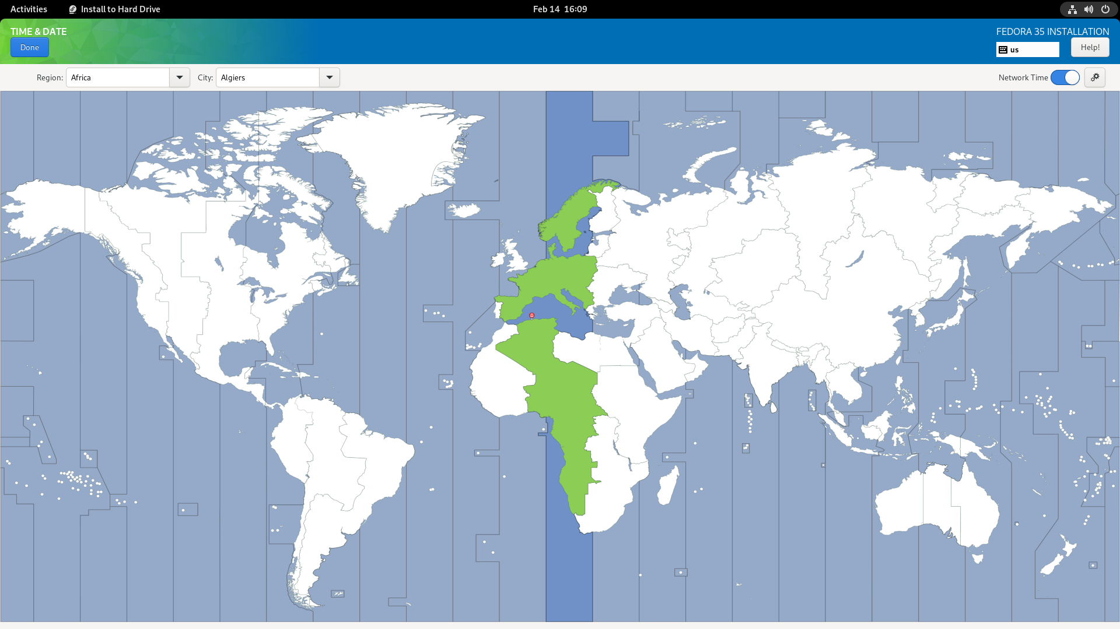
Choosing the timezone and keyboard layout

Slide 29
let’s talk about partitioning
Why you can’t install all your OSes on the same partition ?
How your partition layout should look like ?
What is a file system ?
Why BTRFS over ext4 ?
Why not put BTRFS everywhere ?
What is swap ?
Why we won’t set up traditional swap on fedora ?

Slide 30
Checking configuration
make sure the keyboard layout and time zone are correct
Make sure you are not reformatting your EFI partition
Make sure you are not overwriting your existing OS partitions
Make sure the partitions you are formatting does not contain any important data , because it will not be recoverable
Make sure you are not leaving empty unusable space
Make sure the root partition is BTRFS
If everything is ok than ask one of the staff to check the config again before you hit the install button

