Slide 1


Hands on Terminal
Session 2
[Getyourhandsdirty@thelinuxterminal ~]$

Slide 2
Summary
Linux on the Desktop
Understand the UI
Linux Directory structure
Permissions
Notes:
On

Slide 3
Linux on the Desktop
What is a desktop environment?

Slide 4
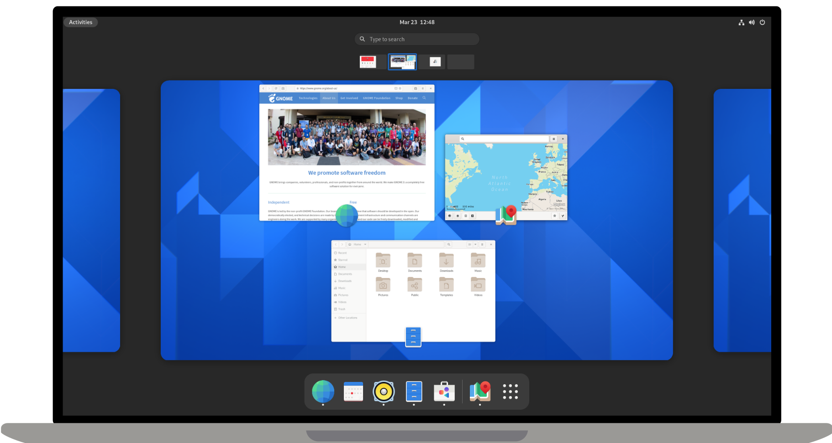
Linux on the Desktop
What is a desktop environment?

Slide 5
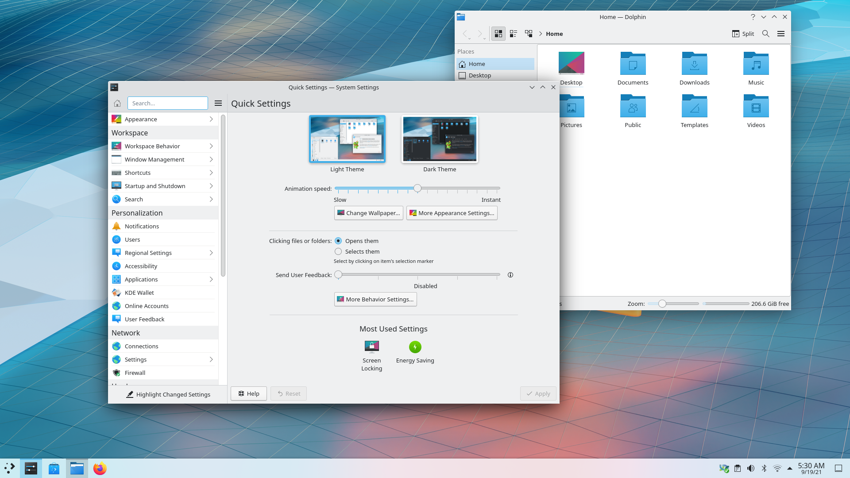
Linux on the Desktop
What is a desktop environment?

Slide 6
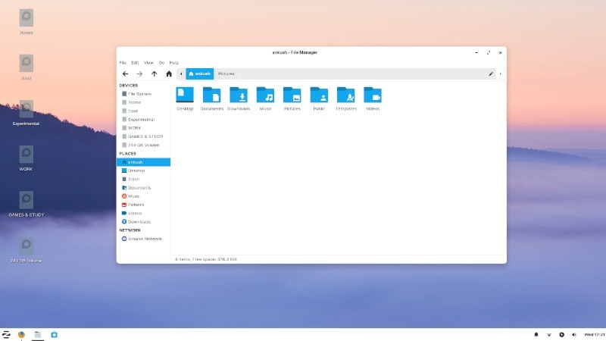
Linux on the Desktop
What is a desktop environment?

Slide 7
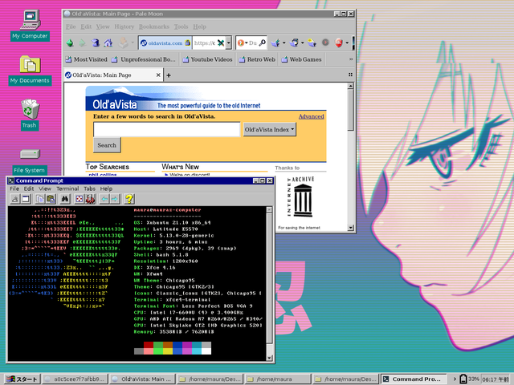
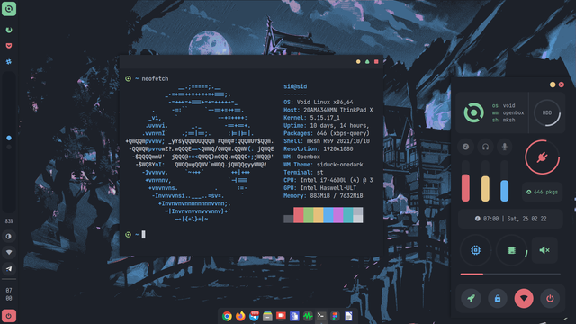
Linux on the Desktop
YOU CAN DO EVERYTHING

Slide 8

Linux on the Desktop
LETS GOOO

Slide 9
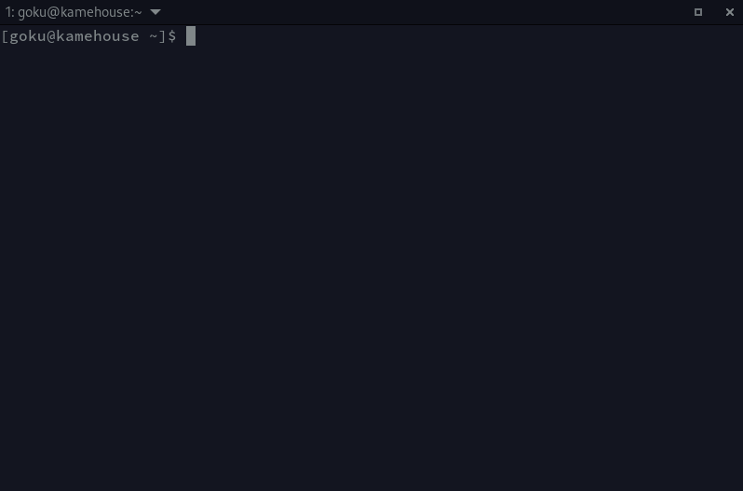
Linux FileSystem Strucutre
Let’s open a terminal!

Slide 10
Linux File System Structure
Your first command!
ls
pwd
cd

Slide 11
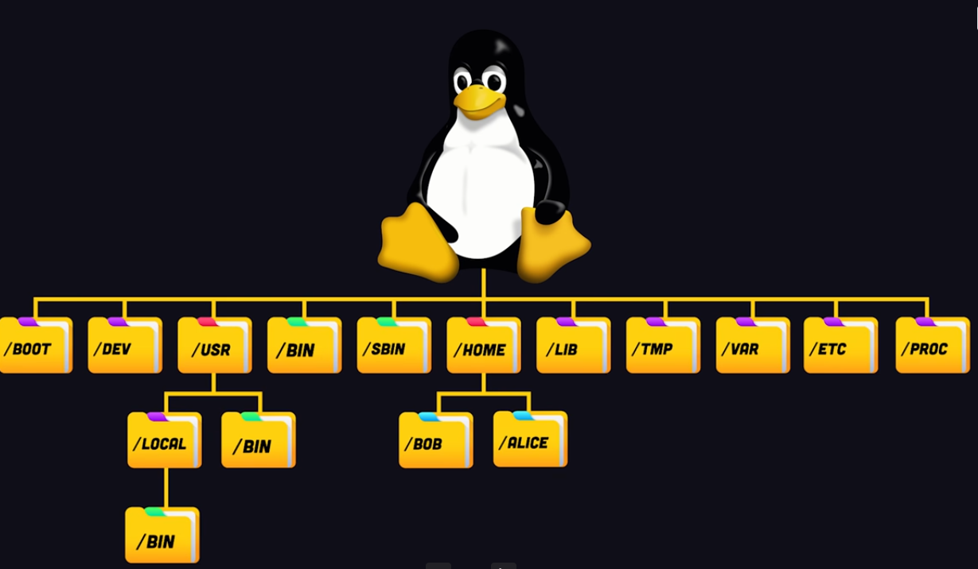
Linux File System Structure
firship’s picture!
https://fireship.io

Slide 12
Linux File System Structure
/
Here it all begins!!
the root directory(not to be confused with the /root)
the top level directory on Linux
`sudo rm -rf /` what can happen? dont do that pls

Slide 13
Linux File System Structure
/bin
Executable files that are essential for the system
You know your ls command it's here! (do `ls |grep ls`)
$ cd /bin
$ ls | grep ls
Notes:
Explain that this basic commands are here!

Slide 14
Linux File System Structure
/sbin
Same as /bin but it can be run only by sudo user

Slide 15
Linux File System Structure
/lib and lib64/
Libraries are basically codes that can be used by the executable binaries.
The /lib directory holds the libraries needed by the binaries in /bin and /sbin directories.
Libraries needed by the binaries in the /usr/bin and /usr/sbin are located in the directory /usr/lib.

Slide 16
Linux File System Structure
/boot
DO NOT TOUCH IT
Things that are needed to boot the system (like the Linux kernel itself for example)

Slide 17
Linux File System Structure
/usr
User system
he /usr directory contains applications and files used by users, as opposed to applications and files used by the system. For example, non-essential applications are located inside the /usr/bin directory instead of the /bin directory and non-essential system administration binaries are located in the /usr/sbin directory instead of the /sbin director
You will also find bin, sbin and lib directories in /usr. What is the difference with their root-hanging cousins? Not much nowadays. Originally, the /bin directory (hanging off of root) would contain very basic commands, like ls, mv and rm; the kind of commands that would come pre-installed in all UNIX/Linux installations, the bare minimum to run and maintain a system. /usr/bin on the other hand would contain stuff the users would install and run to use the system as a work station, things like word processors, web browsers, and other apps.

Slide 18
Linux File System Structure
/etc
everything configured here!
used for systemwide configuration files:
if you have a webserver, then your configuratoin will be stored here.
you need to backup your /etc directory in case something happens to

Slide 19
Linux File System Structure
/home
Sweet home
  Contains personal directories for the users.
  The home directory contains the user data and user-specific configuration files. As a user, you’ll put your personal files, notes, programs etc in your home directory.
  /home/user

Slide 20
Linux File System Structure
/media and /mnt
Mount them all!
  Used for mounting external hard drive or other things!
    You can also mount a netwok share thing here too.
    /mnt:
        for "permenant" storage attachment (you kindof want to keep them mounted )
        /media
        More for temporary storage
        Your usb stick for example

Slide 21
Linux File System Structure
/opt
I LOOOOVE options
  optional and third party software
  Things that are not available in the distribution's repositories!
  For example intellij idea :( (i hate java btw)

Slide 22
Linux File System Structure
/tmp
Everythins is temporary
Temporary files and directories that will be deleted when system restarts

Slide 23
Linux File System Structure
/dev
I don’t get it too
Devices files
Contains special files, including those relating to the devices.
These are virtual files, not physically on the disk.

Slide 24
Linux File System Structure
let’s practice more

Slide 25
Permissions!
  Linux is multi-user OS. which means multiple users in a firm acess the same system!
  giving the fact that some things should remain secret, we need to have special permissions for files and directories so we need to have a way to do all of that.
  In Linux (and any UNIX like OS) 2 factors are used to decide which file would be accessed and by which user.
  1. File Ownership
  2. File Permission
  Let's talk about them

Slide 26
Permissions!
File ownership

Slide 27
Permissions!
File ownership
    Every file or directory has an owner
    3 kinds of owners
    User
  2. Group
  3. Other

Slide 28
Permissions!
1 User
$ touch my_file.txt
$ mkdir my_directory
let’s check who is the user owner!
$ ls -l my_file.txt
Notes:
Show them how to spot the user that owns the file and directory.

Slide 29
Permissions!
2 Group
$ touch my_file.txt
$ mkdir my_directory
let’s check who is the group owner!
$ ls -l my_file.txt
Notes:
Show them how to spot the user that owns the file and directory

Slide 30
Permissions!
2 Group
Why having groups?
it let’s you manage multiple users at the same time!
Notes:
Show them how to spot the user that owns the file and directory

Slide 31
Permissions!
3 Others
it’s just everyone else
Notes:
Show them how to spot the user that owns the file and directory

Slide 32
Permissions!
2. File permissions

Slide 33
Permissions!
What are the types of permissions?
Read
Write
Execute

Slide 34
Permissions!
2.1 Read
View or copy file contents
$ ls -l my_file.txt

Slide 35
Permissions!
2.3 Execute
Run the file if it’s executable
$ .\my_script.sh

Slide 36
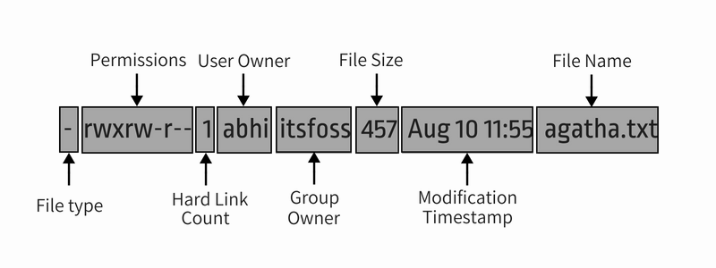
Permissions!
Let’s get into the details!
$ ls -l
Notes:
Got what everything means?
let’s play a little bit.

Slide 37
Permissions!
$ touch file1
$ mkdir dir
Notes:
Show them how to create a new file and a new directory using the command line

Slide 38
Permissions!
CHANGE THE WORLD!
Hay! How can i change the permission?
$ chmod is a command that allows you to change permissions to files and directories.

Slide 39
Permissions!
chmod how it works?
2 ways to use it
1. Absolute mode
2. Symbolic mode
  the only difference is how permissions are represented.

Slide 40
Permissions!
Absolute mode
Permissions are represented in numerical form:
  read : 4
  write : 2
  execute : 1
  no permission : 0
$ chmod 666 my_file.txt
Notes:
Try other “combinaisions”

Slide 41
Permissions!
Symbolic mode
Permissions are represented like this:
  read : r
  write : w
  execute : x
  user : u
  group : g
  other : o
  all : a
  Use mathematical operators to add or delete permissions
  + : add permission
  - : delete permission
$ chmod +x my_file.rpm
Notes:
Try other “combinaisions”

Slide 42
Permissions!
test test test
$ chmod 666 my_file.txt
$ chmod +x file
$ chmod +w file
$ chmod +r file
$ chmod u-x file
$ chmod u+x file
$ chmod g-w file
$ chmod g-rw file
Notes:
Try other “combinaisions”

Slide 43
Permissions!
What if i want to change the owner?
$ chown command let’s you change ownership of a file/directory
$ chown +x zrodiyaman file
hmmmmmmmmmmmmmmmmm

Slide 44
Permissions!
You need sudo power!
$ sudo chown +x zrodiyaman file
seee who owns the file now
$ ls -l

Slide 45
Permissions!
What if i want to change the group owner?
$ chown <new_user_name>:<new_user_group> <filename>
$ chown :<new_user_group> <filename>

Slide 46
Permissions!
YOU HAVE THE PERMISSION TO ASK QUESTIONS
Notes:
Add some beautiful question thingy

Slide 47
Links
  Permission
  https://linuxhandbook.com/linux-file-permissions/
    https://linuxhandbook.com/suid-sgid-sticky-bit/
    https://www.youtube.com/watch?v=4e669hSjaX8
    https://www.youtube.com/watch?v=AvdVbh3j-50
    File System
    official standard by linux foundation https://refspecs.linuxfoundation.org/fhs.shtml (last one was released in june 3 2015)
    https://refspecs.linuxfoundation.org/FHS_3.0/fhs-3.0.pdf pdf version
  https://linuxhandbook.com/linux-directory-structure/
    https://www.linux.com/training-tutorials/linux-filesystem-explained/
    https://cybersophia.net/training/linux-directory-structure-explained/
    https://www.howtogeek.com/117435/htg-explains-the-linux-directory-structure-explained/
    Desktop Environment
    https://xfce.org/
    https://www.gnome.org/
    https://kde.org/

