Slide 1
Graph Representation Learning
Xinjian Zhao

Slide 2
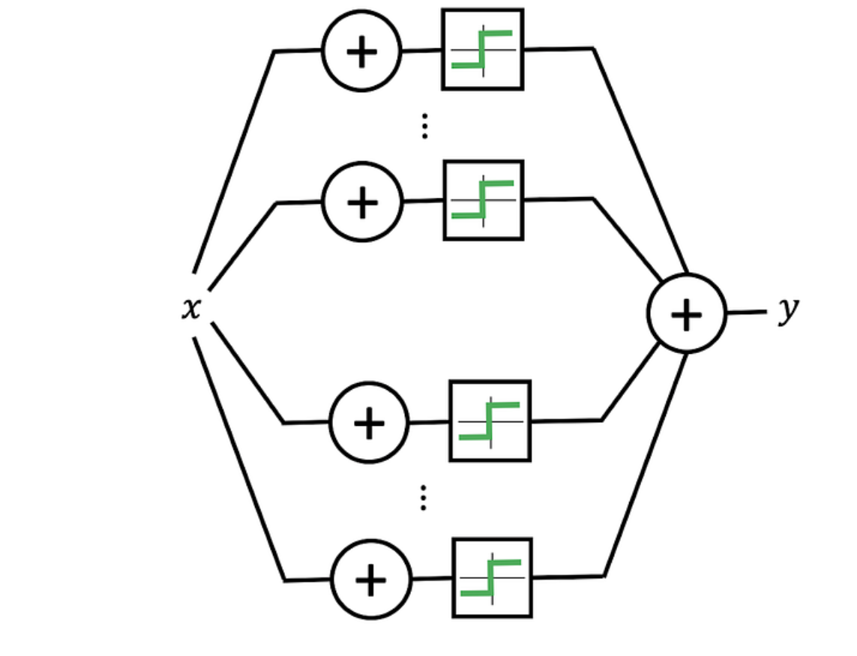
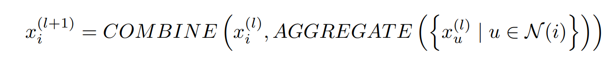
Representation Learning and GRL
MIP Reading Group
MPNN:

Slide 3
A key component of a GNN is the message-passing mechanism, which allows information to flow between the nodes in a graph.

Slide 4
Downstream Task
Node classification
Graph classification
Link prediction
……

Slide 5
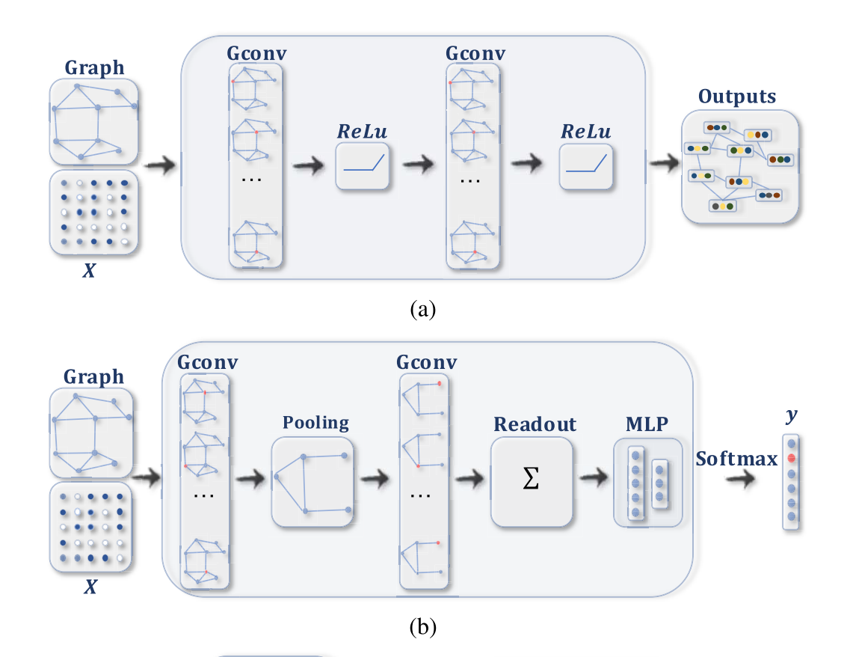
Node classification/
Link prediction
Graph classification

Slide 6
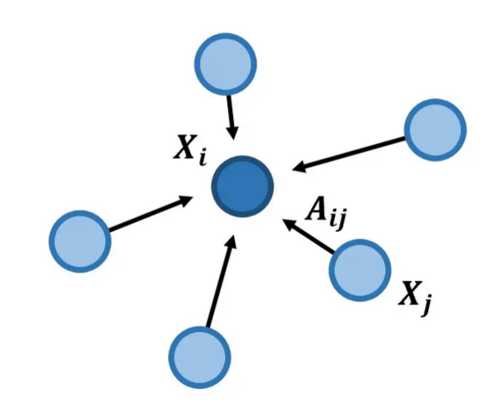
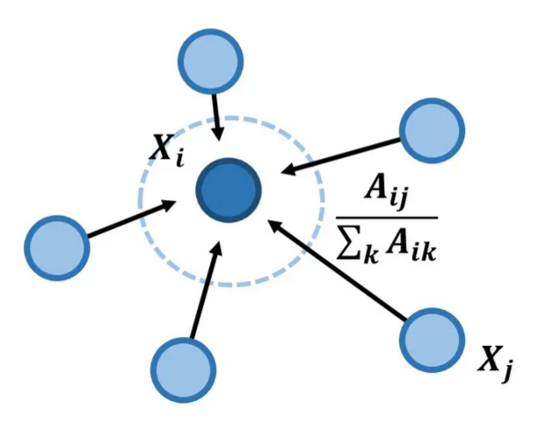
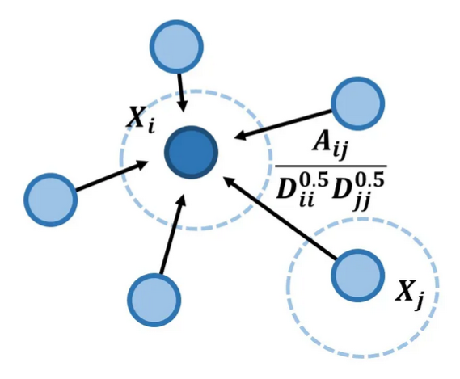





Graph Convolutional Network（GCN）

Slide 7
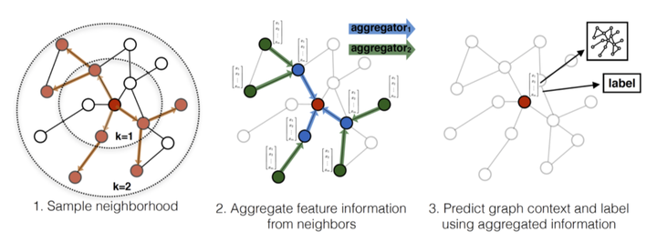
GraphSAGE

Slide 8
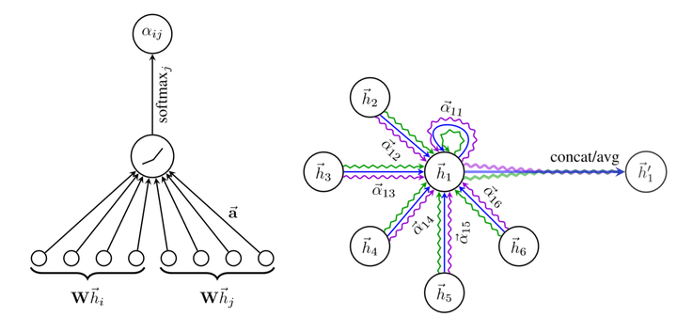
Graph Attention Networks (GAT)
Instead of aggregating information from all neighboring nodes equally, GATs assign a weight to each neighboring node based on its importance for the downstream task.

Slide 9
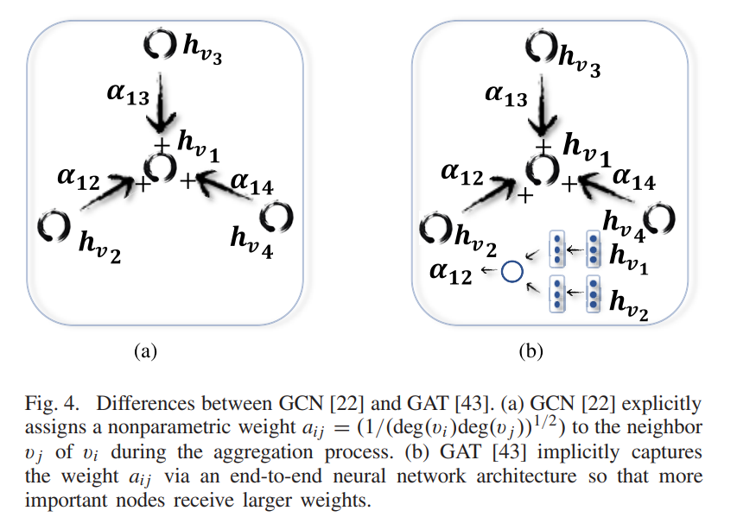

Slide 10
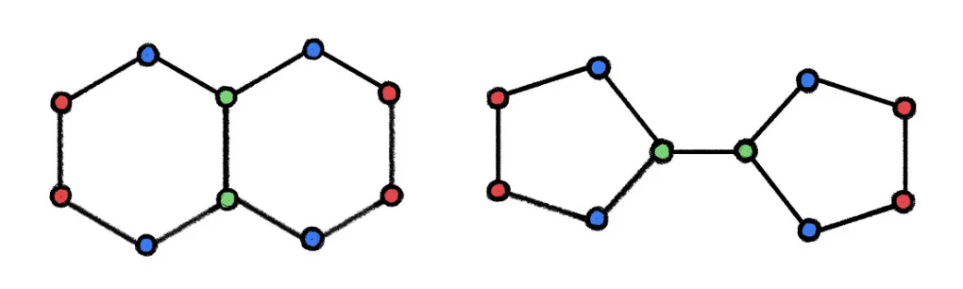
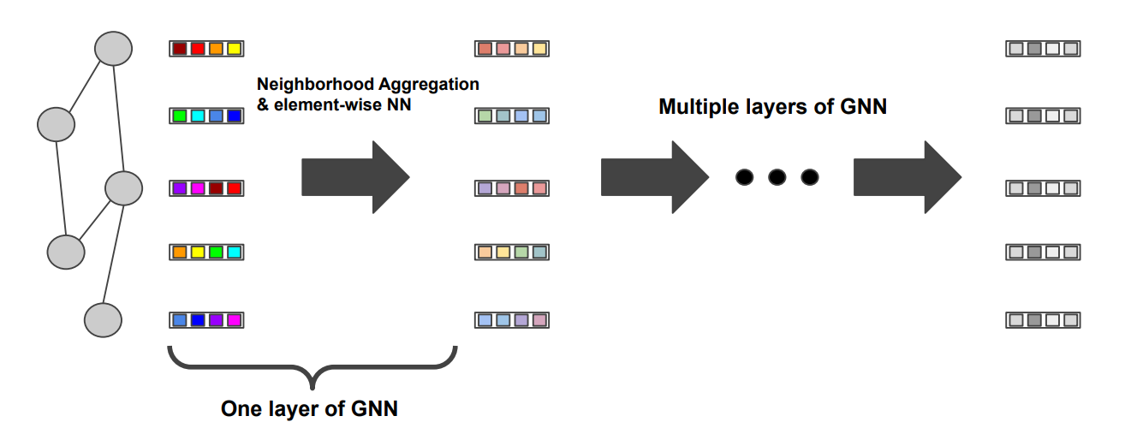
Limitations of GNNs
Expressive power
Over smoothing

Slide 11
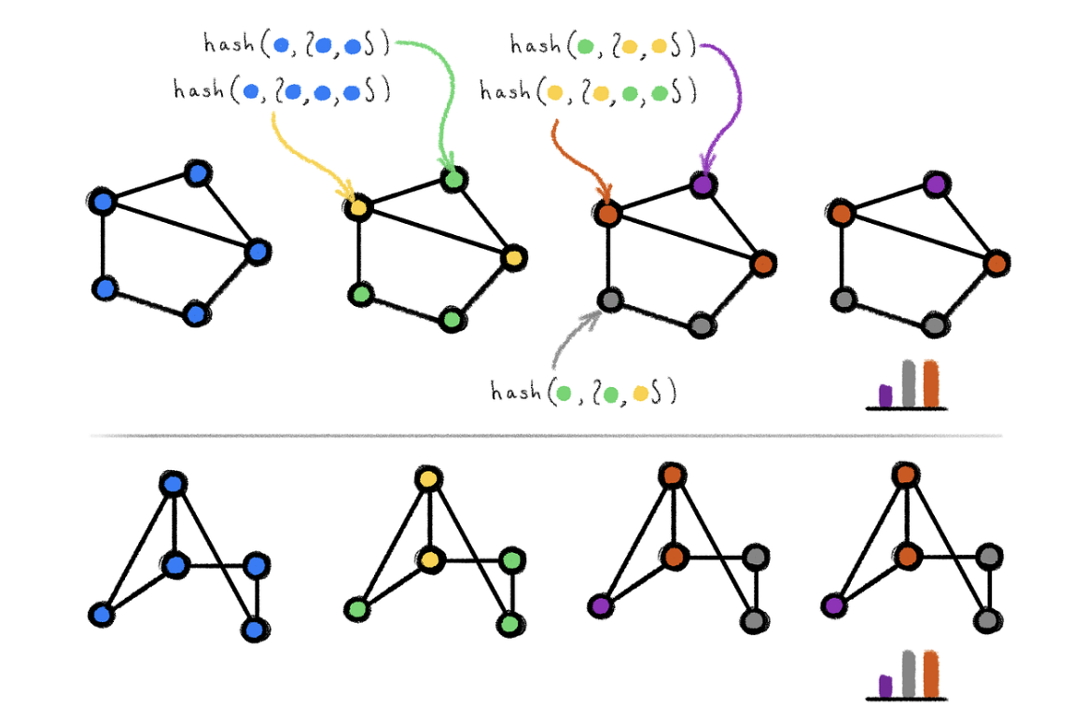
WL-test & GNN
The node features provided by the dataset contain rich topological information, which leads us to ignore the expressive power upper bound of most GNNs.

Slide 12
A successful GNN algorithm will map two nodes to the same representation only if they have the same subtree structure.

Slide 13
WL-test & GNN
1. FROM STARS TO SUBGRAPHS: UPLIFTING ANY GNN WITH LOCAL STRUCTURE AWARENESS - Thinker的文章 - 知乎
https://zhuanlan.zhihu.com/p/521550980
2. 构建 GNN 的「统一场」：从与 WL 算法、组合优化算法的联系看 GNN 的表达能力 - 知乎
https://zhuanlan.zhihu.com/p/129102309
3. GIN：How Powerful are Graph Neural Networks- 知乎 https://zhuanlan.zhihu.com/p/575156815

Slide 14
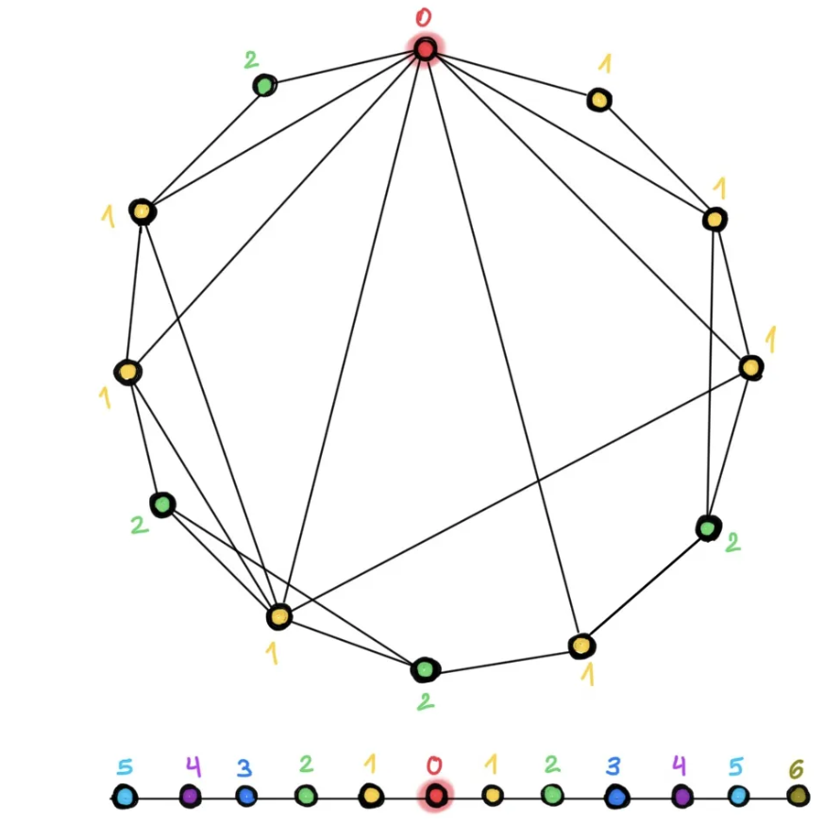
Over-smoothing
In small-world graphs, only a few hops are needed to reach any node from another one.

Slide 15
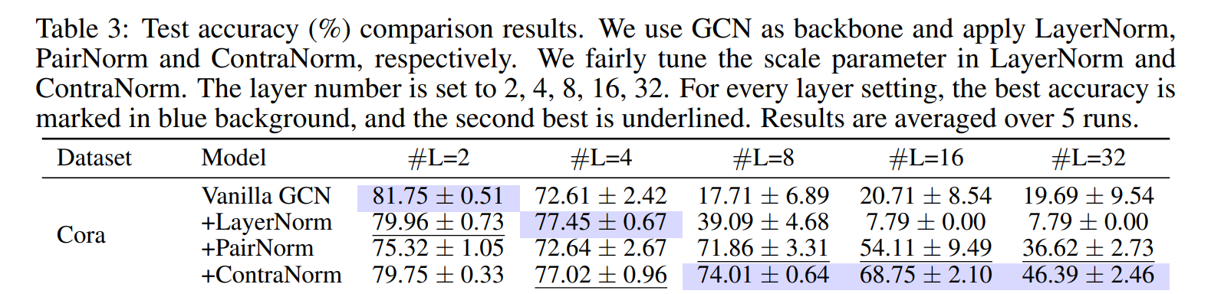
Over-smoothing
如何解决图神经网络（GNN）训练中过度平滑的问题？ - 我爱学习的回答 - 知乎 https://www.zhihu.com/question/346942899/answer/1912229287

Slide 16
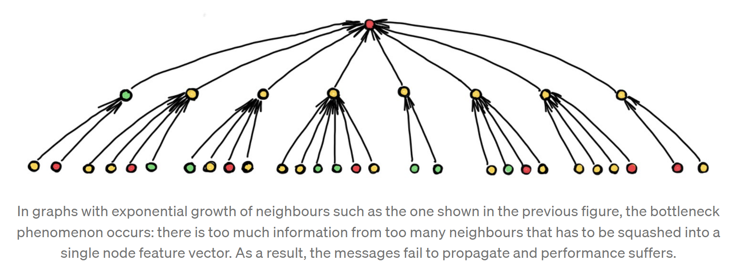
Long-range Interactions

Slide 17
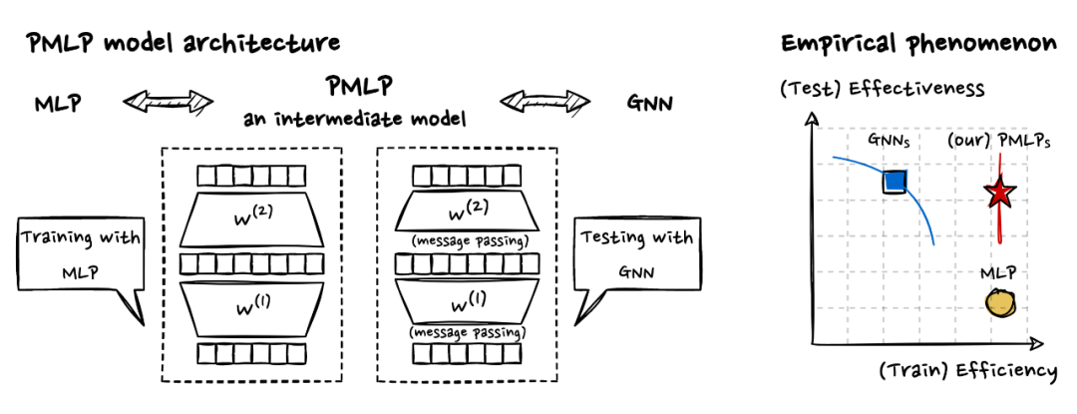
Insights by Bridging GNNs and MLPs
The model architecture is equivalent to MLP at training time, but equivalent to GNN at testing time (i.e., additional message passing is inserted in the middle layer of the model).

Slide 18
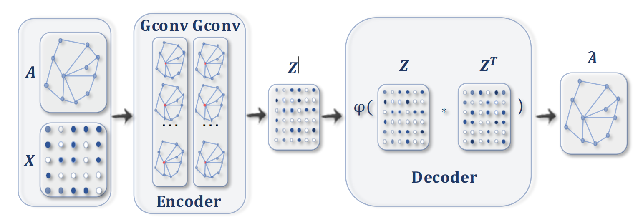
Graph Autoencoder (GAE)

Slide 19
Reference
[1] Graph Neural Networks are Inherently Good Generalizers: Insights by Bridging GNNs and MLPs
[2] https://disco.ethz.ch/courses/fs21/seminar/talks/GNN_Oversmoothing.pdf
[3] https://towardsdatascience.com/do-we-need-deep-graph-neural-networks-be62d3ec5c59
[4] https://towardsdatascience.com/geometric-foundations-of-deep-learning-94cdd45b451d
[5] CONTRANORM: A CONTRASTIVE LEARNING PERSPECTIVE ON OVERSMOOTHING AND BEYOND, ICLR 2023
[6] https://www.zhihu.com/question/54504471

Slide 20
Thanks !

