Slide 1
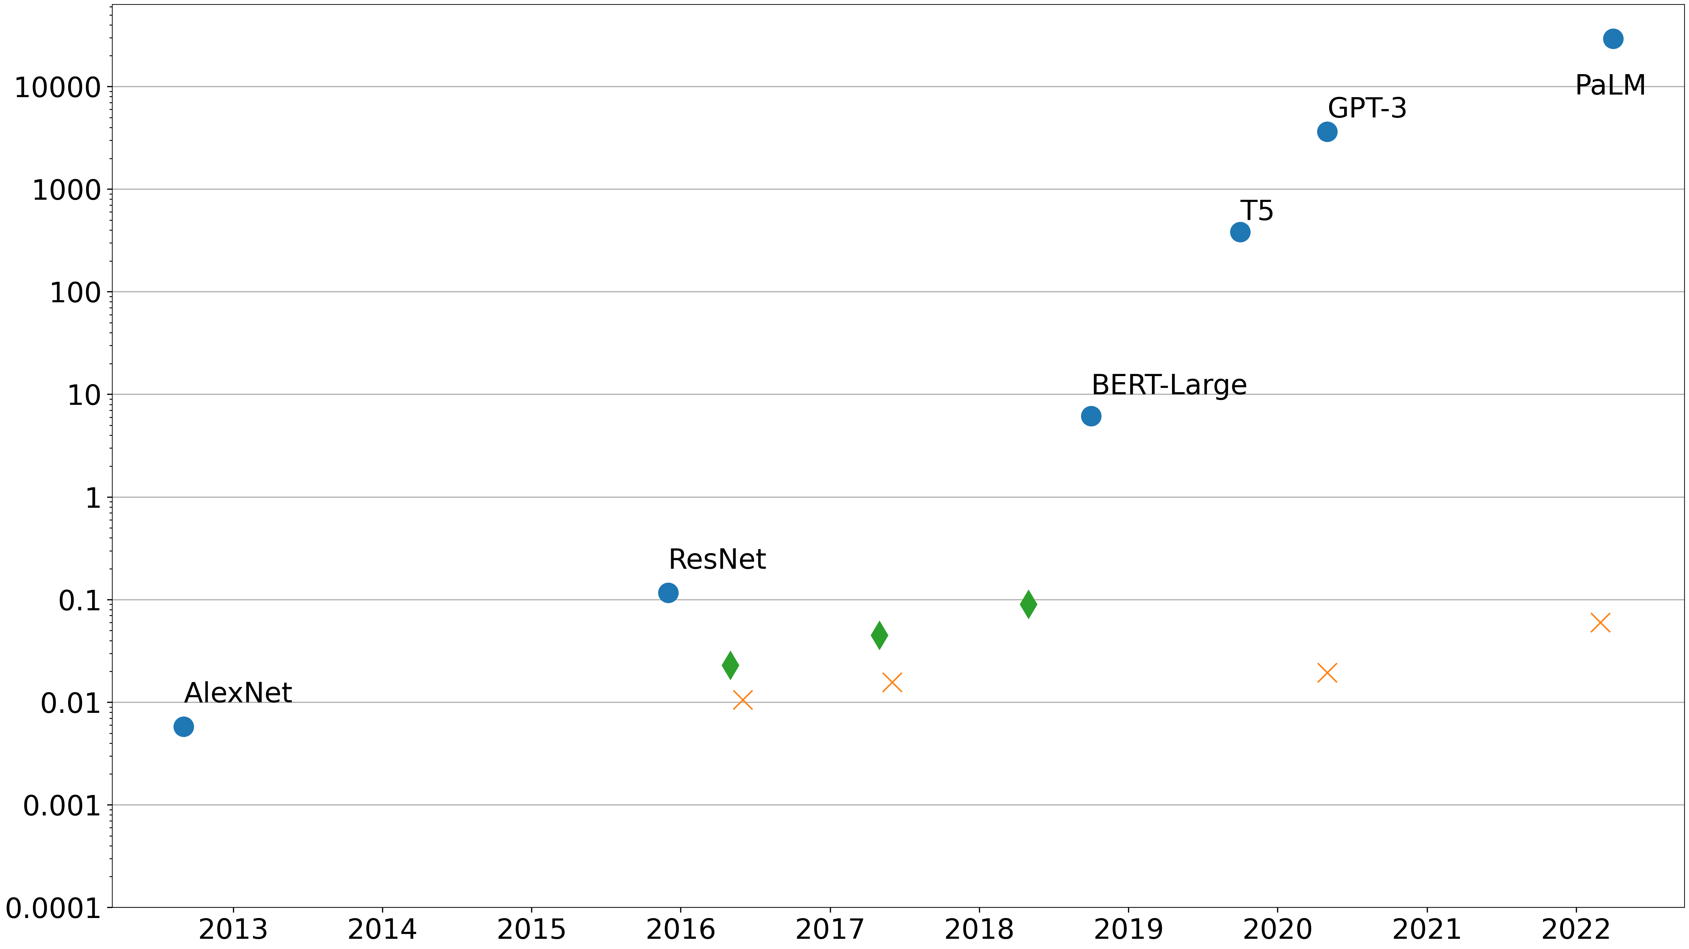
56x every 18 months
PetaFLOP/s-day (training)
TPU
GPU
2x every 18 months according to Moore's Law
CPU
Year

Slide 2
Input
Partitioned input
Compute node
Compute node 1
Compute node 2
Compute node 3
Parallel computing
Output
Merged output
(a) Single-node execution
(b) Distributed execution on multiple nodes

Slide 3
Program
Data
Forward
Operator 1 (parameters)
Operator 2
(parameters)
Operator 3 (parameters)
Training device
Backward
Gradient 1
Gradient 2
Gradient 3

Slide 4
Program replica
Data partition 1
Operator 1
Operator 2
Operator 3
Device 1
Gradient 1
Gradient 2
Gradient 3
AllReduce
(calculates an average)
Gradient 1
Gradient 2
Gradient 3
Device 2
Operator 1
Operator 2
Operator 3
Data partition 2
Program replica

Slide 5
Program partition 1
Operator 1
Data
Partition 1
Operator 2
Device 1
Broadcast
Gather
Operator 1
Partition 2
Device 2
Program partition 2

Slide 6
Program partition 1
Data
Operator 1
Device 1
Send data
Receive data
Operator 2
Device 2
Program partition 2

Slide 7
Replica of program partition 1
Replica of program partition 2
Data partition 1
Operator 1
Send
Operator 2
Device 1
Device 2
Gradient 1
Gradient 2
AllReduce
Gradient 1
Gradient 2
Device 3
Operator 1
Operator 2
Device 4
Data partition 2
Replica of program partition 1
Replica of program partition 2

Slide 8
Model partitioning
Time
Device 4
Forward computation
 |  |  | F_{3,0} | F_{3,1} | B_{3,0} | B_{3,1}
 |  | F_{2,0} | F_{2,1} |  |  | B_{2,0} | B_{2,1}
 | F_{1,0} | F_{1,1} |  |  |  |  | B_{1,0} | B_{1,1}
F_{0,0} | F_{0,1} |  |  |  |  |  |  | B_{0,0} | B_{0,1}
Backward computation
Device 3
To reduce memory overhead, activation values are recomputed during backward computation.
Device 2
Device 1
Each mini-batch is divided into two micro-batches to build a pipeline.

Slide 9
Spine switch
ToR switch
ToR switch
Server
Server
Server
Server
Device
Device
Device
Device
Device
Device
Device
Device
Device
Device
Device
Device
Device
Device
Device
Device

Slide 10
Device 1
Device 1
Device 2
Device 3
Device 1
Device 2
Device 3
2 | 4 | 6
2 | 4 | 6
1 | 2 | 3
4 | 8 | 12
2 | 4 | 6
1 | 2 | 3
4 | 8 | 12
Broadcast
Reduce
AllReduce
Device 1
Device 2
Device 3
Device 1
Device 1
Device 2
Device 3
2 | 4 | 6
2 | 4 | 6
2 | 4 | 6
7 | 14 | 21
7 | 14 | 21
7 | 14 | 21
7 | 14 | 21
Device 1
Device 2
Device 3
Device 1
Device 2
Device 3
Device 1
2
7
3
2
7
3
2 | 7 | 3
Gather
AllGather
Scatter
Device 1
Device 1
Device 2
Device 3
Device 1
Device 2
Device 3
2 | 7 | 3
2 | 7 | 3
2 | 7 | 3
2 | 7 | 3
2
7
3

Slide 11
Step 1
(Reduce)
Device 1
Step 2
(Reduce)
Device 1
2+ 1 | 4 | 6
3 | 4+ 10 | 6
Device 2
Device 3
Device 2
Device 3
1 | 2+ 8 | 3
4 | 8 | 12+ 6
1 | 10 | 3+ 18
4+ 3 | 8 | 18
Step 4
(Broadcast)
Device 1
Step 3
(Broadcast)
Device 1
7 | 14 | 21
3 | 14 | 21
Device 2
Device 3
Device 2
Device 3
7 | 14 | 21
7 | 14 | 21
7 | 10 | 21
7 | 14 | 18

Slide 12
Parameter server 1
Parameter server 2
Parameter partition 1
Parameter partition 2
Pull parameters
Push gradients
Training server 1
Training server 2
Parameter partition 1
Parameter partition 2
Parameter partition 1
Parameter partition 2

