Slide 1
Hello OpenMM
A practical introduction to the OpenMM API by example
Christopher Bruns
Michael Sherman (Sherm)
June 2009

Slide 2
Examples
Argon: compile, link, run, find documentation (now)
NaCl: how to use OpenMM from an existing MD code (after lunch)
Ethane: bonds (homework)
Water box: explicit solvation (homework)

Slide 3
Language issues
OpenMM native API is C++
In-class examples are in easy-to-follow C++
Yes, OpenMM works from C or Fortran main programs also
Multi-lingual help available this afternoon

Slide 4
OpenMM MD Units
Length
  nanometers (10⁻⁹ meters)
Time
  picoseconds (10⁻¹² seconds)
Mass
  Dalton (Da), atomic mass units, grams per mole
Energy
  kilojoules per mole
(Nice feature: f=ma in these units)
OpenMM has kcal/Angstrom conversions

Slide 5
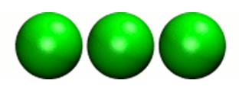
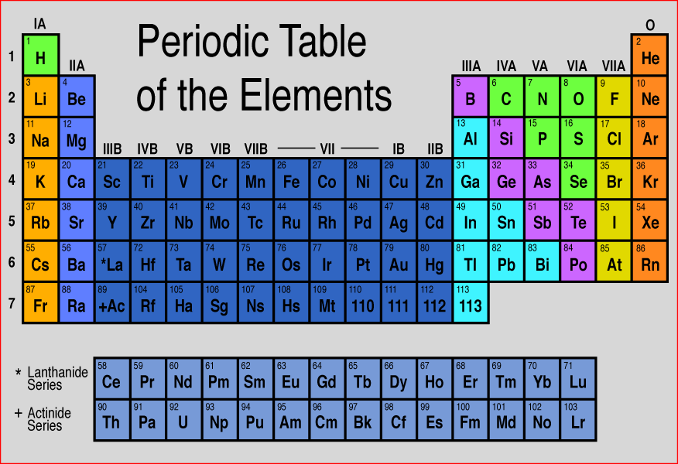
Example 1: Argon
HelloArgon.cpp
Simplest example
Only van der Waals forces
  “inert” noble gas
→ Goal: compile, link, run with OpenMM, visualize results
  on your laptop
  in your language (later; C++ first)

Slide 6
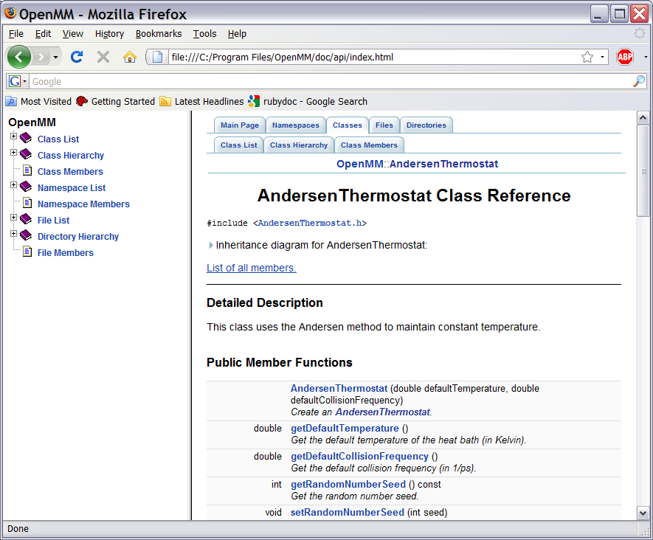
API Documentation
OpenMM/doc/api/index.html

Slide 7
HelloArgon.cpp: top
#include "OpenMM.h"
#include <cstdio>
// Forward declaration of routine for printing one frame of the
// trajectory, defined later in this source file.
void writePdbFrame(int frameNum, const OpenMM::State&);
void simulateArgon()
{
// Load any shared libraries containing GPU implementations.
OpenMM::Platform::loadPluginsFromDirectory(
OpenMM::Platform::getDefaultPluginsDirectory());

Slide 8
HelloArgon.cpp: structure and forces
// Create a System with nonbonded forces.
OpenMM::System system;
OpenMM::NonbondedForce* nonbond =
new OpenMM::NonbondedForce();
system.addForce(nonbond);
// Create three atoms.
std::vector<OpenMM::Vec3> initPosInNm(3);
for (int a = 0; a < 3; ++a)
{
// Space atoms out evenly (in nm)
initPosInNm[a] = OpenMM::Vec3(0.5*a,0,0);
system.addParticle(39.95); // mass(Ar), g/mole
// charge, L-J sigma (nm), epsilon (well depth)s (kJ)
nonbond->addParticle(0.0, 0.3350, 0.996); // vdWRad(Ar)=.188 nm
}

Slide 9
HelloArgon.cpp: simulation set up
// Set step size in ps.
OpenMM::VerletIntegrator integrator(0.004);
// Let OpenMM Context choose best platform.
OpenMM::OpenMMContext context(system, integrator);
printf( "REMARK Using OpenMM platform %s\n",
context.getPlatform().getName().c_str() );
// Set starting positions of the atoms.
// Leave time and velocity zero.
context.setPositions(initPosInNm);

Slide 10
HelloArgon.cpp: simulation loop
// Simulate.
for (int frameNum=1; ;++frameNum) {
// Output current state information.
OpenMM::State state =
context.getState(OpenMM::State::Positions);
const double timeInPs = state.getTime();
writePdbFrame(frameNum, state); // output coordinates
if (timeInPs >= 10.) // done?
break;
// Advance state many steps at a time,
// for efficient use of OpenMM.
integrator.step(10); // (use a lot more than this normally)
}
(Don’t look at coordinates every step)

Slide 11
Argon exercise 1:
1a. Compile, link, and run HelloArgon.cpp
1b. Collect the output into a file “argon.pdb”
1c. View argon.pdb animation in VMD. Show me.
1d. Increase number of atoms from 3 to 6. Run again.
1e. Answer this: what OpenMM platform did you actually use?

Slide 12

Argon exercise 1
You should see something like this in VMD:
(depending on VMD version, you might have to fiddle with the van der Waals radius)

Slide 13
HelloArgon.cpp: main() subroutine
int main()
{
try {
simulateArgon();
return 0; // success!
}
// Catch and report usage and runtime errors
// detected by OpenMM and fail.
catch(const std::exception& e) {
printf("EXCEPTION: %s\n", e.what());
return 1; // failure!
}
}

Slide 14
HelloArgon.cpp: output
// Handy PDB writer for quick-and-dirty trajectory output.
void writePdbFrame(int frameNum, const OpenMM::State& state) {
// Reference atomic positions in the OpenMM State.
const std::vector<OpenMM::Vec3>& posInNm =
state.getPositions();
// Use PDB MODEL "cards" to number trajectory frames
printf("MODEL %d\n", frameNum); // start of frame
for (int a = 0; a < (int)posInNm.size(); ++a)
{
printf("ATOM %5d AR AR 1 ", a+1); // atom #
printf("%8.3f%8.3f%8.3f 1.00 0.00\n", // coordinates
posInNm[a][0]*10, posInNm[a][1]*10, posInNm[a][2]*10);
// "*10" converts nanometers to Angstroms
}
printf("ENDMDL\n"); // end of frame
}

Slide 15
Argon exercise 2:
Report the total energy in a “REMARK…” with each frame of argon coordinates.
  research methods State::getPotentialEnergy() and State::getKineticEnergy()
  you will need to modify the argument to OpenMMContext::getState(…);
Be aware that computing energy will dramatically slow your simulation!
  (just in this preview release)

Slide 16
Lunch break

Slide 17
Hello OpenMM
A practical introduction to the OpenMM API by example
(part 2)
Christopher Bruns
Michael Sherman (Sherm)
June 2009

Slide 18
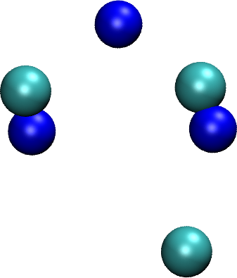
Example 2: Sodium Chloride
HelloSodiumChloride.cpp (.c, .f90)
Only nonbonded forces
  Coulomb & van der Waals
Implicit solvent
  Langevin integrator instead of Verlet
  Generalize Born (GBSA) OBC
→ Goal: learn how to hook an existing
MD code to OpenMM

Slide 19
Strategy for using OpenMM from an existing MD code
Write a few, high-level routines containing all your OpenMM calls
  Make them understand your data structures & OpenMM
  Should reside in a separate compilation unit
  Write in any language callable from MD code (we suggest C++ but C or Fortran work too)
Call only the high-level routines from your MD code
  No direct interface to OpenMM at that level
  Use an opaque “handle” for communication
We’ll illustrate with simplified example, then Peter will show how he did Gromacs

Slide 20

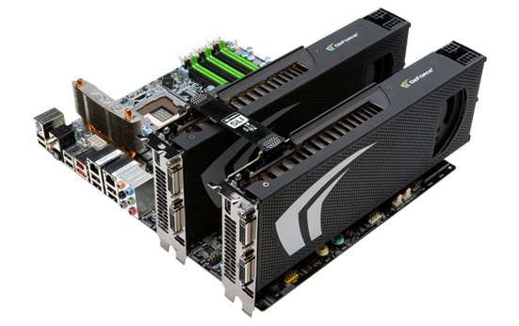
OpenMM interface strategy
Initialize
Advance State
Retrieve State
Wrapers
Terminate
State
You write these
OpenMM
MD Code (e.g., Amber)
in C++ if possible
else C or F95 via (prototype) wrappers

Slide 21
HelloSodiumChloride.cpp
(toy MD code)
Modeling and simulation parameters
const double Temperature = 300; // Kelvins
const double FrictionInPerPs = 91.; // collisions per picosecond
const double SolventDielectric = 80.; // typical for water
const double SoluteDielectric = 2.; // typical for protein
const double StepSizeInFs = 2; // integration step size (fs)
const double ReportIntervalInFs = 50; // when to issue PDB frame (fs)
const double SimulationTimeInPs = 100; // total simulation time (ps)
const bool WantEnergy = true; // slow!

Slide 22
HelloSodiumChloride.cpp
(toy MD code, cont.)
Atom and force field data
struct MyAtomInfo {
const char* pdb;
double mass, charge, vdwRadiusInAng, vdwEnergyInKcal,
gbsaRadiusInAng, gbsaScaleFactor;
double initPosInAng[3];
double posInAng[3]; // leave room for runtime state info
} atoms[] = {
// pdb mass charge vdwRad vdwEnergy gbsaRad gbsaScale initPos
{" NA ", 22.99, 1, 1.8680, 0.00277, 1.992, 0.8, 8, 0, 0},
{" CL ", 35.45, -1, 2.4700, 0.1000, 1.735, 0.8, -8, 0, 0},
{" NA ", 22.99, 1, 1.8680, 0.00277, 1.992, 0.8, 0, 9, 0},
{" CL ", 35.45, -1, 2.4700, 0.1000, 1.735, 0.8, 0,-9, 0},
{" NA ", 22.99, 1, 1.8680, 0.00277, 1.992, 0.8, 0, 0,-10},
{" CL ", 35.45, -1, 2.4700, 0.1000, 1.735, 0.8, 0, 0, 10},
{""} // end of list
};

Slide 23
HelloSodiumChloride.cpp
(declare interface routines)
Forward declarations of user-written interface
struct MyOpenMMData;
static MyOpenMMData* myInitializeOpenMM(const MyAtomInfo atoms[],
double temperature,
double frictionInPs,
double solventDielectric,
double soluteDielectric,
double stepSizeInFs,
std::string& platformName);
static void myStepWithOpenMM(MyOpenMMData*, int numSteps);
static void myGetOpenMMState(MyOpenMMData*, bool wantEnergy,
double& time, double& energy,
MyAtomInfo atoms[]);
static void myTerminateOpenMM(MyOpenMMData*);

Slide 24
HelloSodiumChloride.cpp
(toy MD code, cont.)
Main program
const int NumReports = (int)(SimulationTimeInPs*1000 / ReportIntervalInFs + 0.5);
const int NumSilentSteps = (int)(ReportIntervalInFs / StepSizeInFs + 0.5);
double time, energy;
std::string platformName;
MyOpenMMData* omm = myInitializeOpenMM(atoms, Temperature, FrictionInPerPs,
SolventDielectric, SoluteDielectric,
StepSizeInFs, platformName);
printf("REMARK Using OpenMM platform %s\n", platformName.c_str());
myGetOpenMMState(omm, WantEnergy, time, energy, atoms);
myWritePDBFrame(0, time, energy, atoms);
for (int frame=1; frame <= NumReports; ++frame) {
myStepWithOpenMM(omm, NumSilentSteps);
myGetOpenMMState(omm, WantEnergy, time, energy, atoms);
myWritePDBFrame(frame, time, energy, atoms);
}
myTerminateOpenMM(omm);

Slide 25
HelloSodiumChloride.cpp
(handle data structure)
The “handle” is a pointer to one of these:
struct MyOpenMMData {
MyOpenMMData()
: system(0), context(0), integrator(0) {}
~MyOpenMMData()
{ delete system; delete context; delete integrator;}
OpenMM::System* system;
OpenMM::OpenMMContext* context;
OpenMM::Integrator* integrator;
};

Slide 26
HelloSodiumChloride.cpp
(initialization function)
MyOpenMMData*
myInitializeOpenMM(const MyAtomInfo atoms[],
double temperature,
double frictionInPs,
double solventDielectric,
double soluteDielectric,
double stepSizeInFs,
std::string& platformName)
{
// Load all available OpenMM plugins from their default location.
OpenMM::Platform::loadPluginsFromDirectory
(OpenMM::Platform::getDefaultPluginsDirectory());
// Allocate the handle object.
MyOpenMMData* omm = new MyOpenMMData();

Slide 27
HelloSodiumChloride.cpp
(initialization function)
Allocate System and Force objects; add Forces to the System.
omm->system = new OpenMM::System();
OpenMM::NonbondedForce* nonbond = new OpenMM::NonbondedForce();
OpenMM::GBSAOBCForce* gbsa = new OpenMM::GBSAOBCForce();
omm->system->addForce(nonbond);
omm->system->addForce(gbsa);
Specify dielectrics for GBSA implicit solvation.
gbsa->setSolventDielectric(solventDielectric);
gbsa->setSoluteDielectric(soluteDielectric);

Slide 28
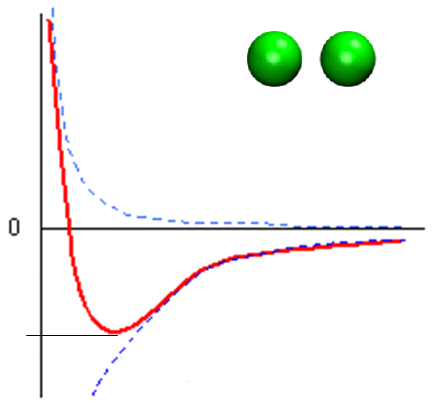
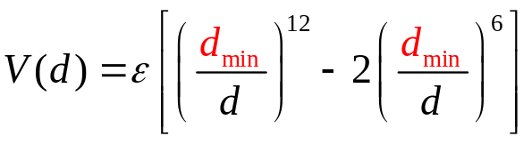
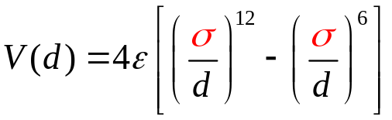

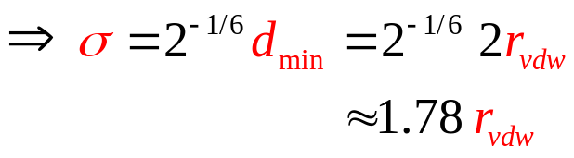
Lennard-Jones potential
d
Issues:
radius vs. diameter
r_{vdw}=d_{min}/2
d_{min} vs. σ
V(d)
r_{vdw}
Repulsive: +Ad¹²
Attractive: -Bd⁶
σ
d_{min}

Slide 29
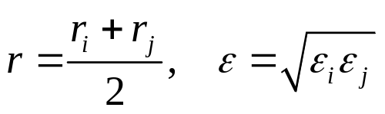

Lennard-Jones potential
Another issue:
combining rules
Lorentz-Berthelot:
(AMBER, CHARMM)
Jorgensen:
(OPLS)
Halgren (MMFF, AMOEBA), Waldman-Hagler, etc.
OpenMM preview release 3 NonbondedForce supports only Lorentz-Berthelot; more later

Slide 30
HelloSodiumChloride.cpp
(initialization function)
Read per-atom info from MD code data structures; watch the units!
std::vector<Vec3> initialPosInNm;
for (int n=0; *atoms[n].pdb; ++n) {
const MyAtomInfo& atom = atoms[n];
omm->system->addParticle(atom.mass);
nonbond->addParticle(atom.charge,
atom.vdwRadiusInAng * OpenMM::NmPerAngstrom
* OpenMM::SigmaPerVdwRadius,
atom.vdwEnergyInKcal * OpenMM::KJPerKcal);
gbsa->addParticle(atom.charge,
atom.gbsaRadiusInAng * OpenMM::NmPerAngstrom,
atom.gbsaScaleFactor);
// Convert the initial position to nm and append to the array.
const Vec3 posInNm(atom.initPosInAng[0] * OpenMM::NmPerAngstrom,
atom.initPosInAng[1] * OpenMM::NmPerAngstrom,
atom.initPosInAng[2] * OpenMM::NmPerAngstrom);
initialPosInNm.push_back(posInNm);
}

Slide 31
HelloSodiumChloride.cpp
(end of initialization function)
Create Integrator and Context; return platform name and handle
omm->integrator = new OpenMM::LangevinIntegrator
(temperature,
frictionInPs,
stepSizeInFs * OpenMM::PsPerFs);
omm->context = new OpenMM::OpenMMContext
(*omm->system, *omm->integrator);
omm->context->setPositions(initialPosInNm);
platformName = omm->context->getPlatform().getName();
return omm;
}

Slide 32
HelloSodiumChloride.cpp
(stepping and termination functions)
Take lots of steps at once on the GPU
void
myStepWithOpenMM(MyOpenMMData* omm, int numSteps) {
omm->integrator->step(numSteps);
}
Clean up OpenMM objects
void
myTerminateOpenMM(MyOpenMMData* omm) {
delete omm;
}

Slide 33
HelloSodiumChloride.cpp
(state retrieval function)
First, decide what values you want to see
void
myGetOpenMMState(MyOpenMMData* omm, bool wantEnergy,
double& timeInPs, double& energyInKcal,
MyAtomInfo atoms[])
{
int infoMask = 0;
infoMask = OpenMM::State::Positions;
if (wantEnergy) {
infoMask += OpenMM::State::Velocities; // for K.E.(cheap)
infoMask += OpenMM::State::Energy; // for P.E.(expensive)
}
// Forces are also available (and cheap).

Slide 34
HelloSodiumChloride.cpp
(end of state retrieval function)
Then get the State and convert units as needed
const OpenMM::State state = omm->context->getState(infoMask);
timeInPs = state.getTime(); // OpenMM time is in ps already
// Copy OpenMM positions into atoms array; change from nm to Angstroms.
const std::vector<Vec3>& positionsInNm = state.getPositions();
for (int i=0; i < (int)positionsInNm.size(); ++i)
for (int j=0; j < 3; ++j)
atoms[i].posInAng[j] = positionsInNm[i][j]
* OpenMM::AngstromsPerNm;
// Get energy if needed and convert from kJ to kcal.
energyInKcal = 0;
if (wantEnergy)
energyInKcal = (state.getPotentialEnergy() + state.getKineticEnergy())
* OpenMM::KcalPerKJ;

Slide 35
Sodium Chloride Exercises
Run the example as-is. Capture the output in “nacl.pdb”. Visualize in VMD.
Science question: at what temperature does our salt crystal model melt?

Slide 36
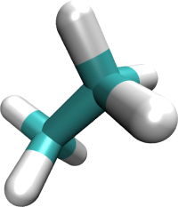
3. Ethane Example (on your own)
HelloEthane.cpp
  H₃C-CH₃
Nonbonded forces
  Coulomb & van der Waals
Bonded forces
  Bond stretch
  Bond angle bend
  Dihedral torsion
→ Goal: learn how to tell OpenMM about bonded forces
Stretch
Torsion
Bend

Slide 37
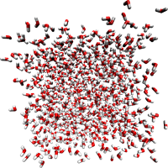
4. Water Box Example (on your own)
HelloWaterBox.cpp
Periodic boundary
condition
Bond length constraints
Andersen thermostat
→ Goal: learn to use OpenMM to model explicit solvation

Slide 38
Notes on the other examples
Units!
Nonbond revisited: “exception” lists
  1-2, 1-3 are 0, 1-4 scaled
Bend, stretch, torsion
  To 2 or not to 2
  Amplitude conversion

Slide 39
C and Fortran users
Run the Argon and NaCl exercises in C or Fortran
While you are still here!
Prototype C header and Fortran module are available
  They are experimental and not yet complete
  Please help us make them nicer!

Slide 40
Summary of the Four Examples
Example | solvent | Thermostat | Boundary | Forces & Constraints | API
Argon | vacuum | none | none | nonbonded (van der Waals + Coulomb) | C++, C, Fortran
NaCl | implicit water | Langevin | none | nonbonded | C++, C, Fortran
Ethane | vacuum | none | none | nonbonded, stretch, bend, torsion | C++
Water | explicit water | Andersen | Periodic | nonbonded, stretch, bend, constraints | C++

Slide 41
Discussion
Examples
API
Interface strategy
Etc.

