Slide 1



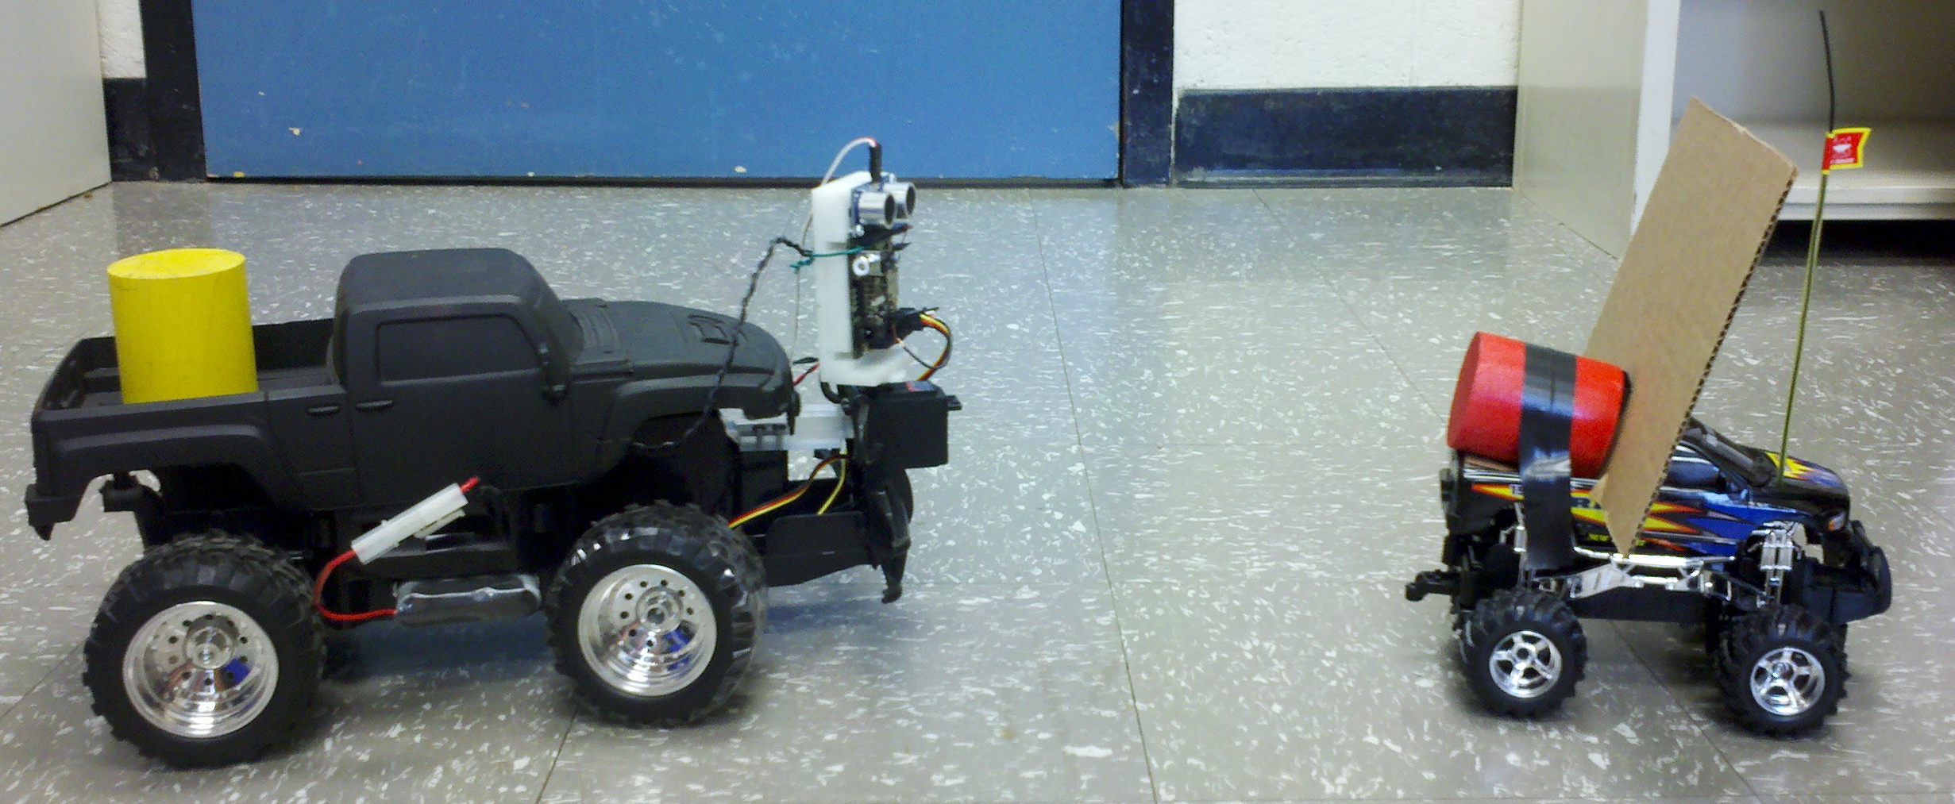
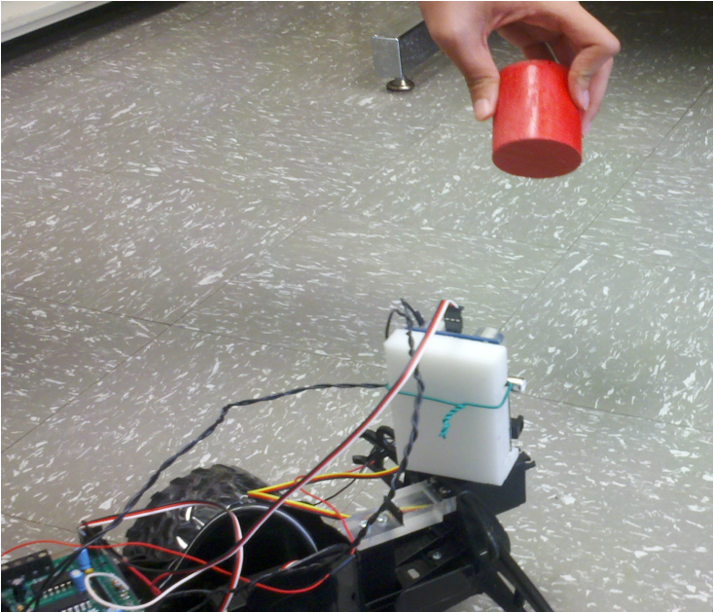
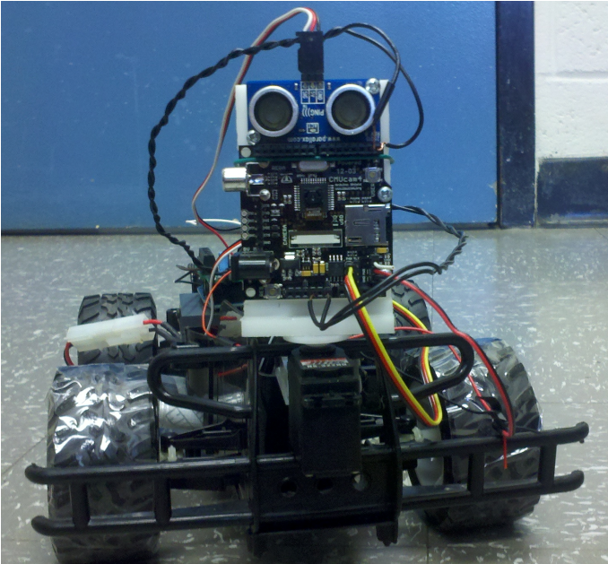

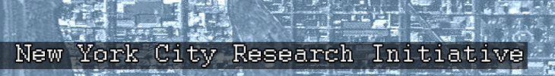


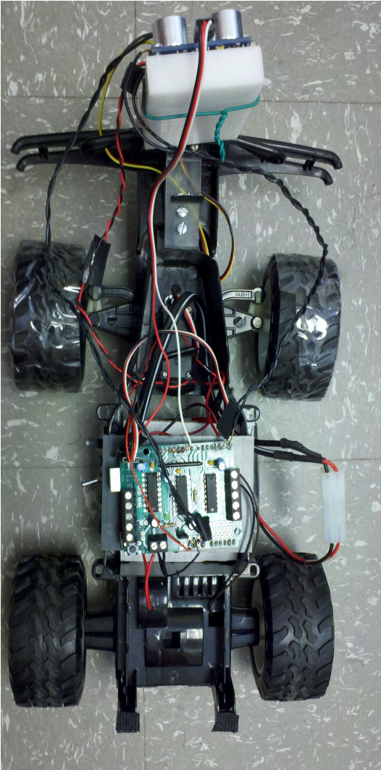
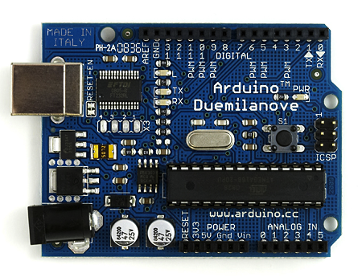
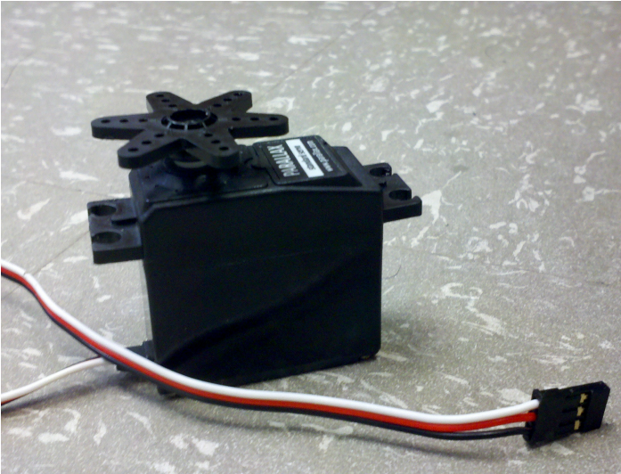
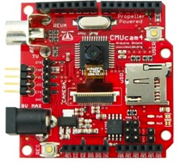

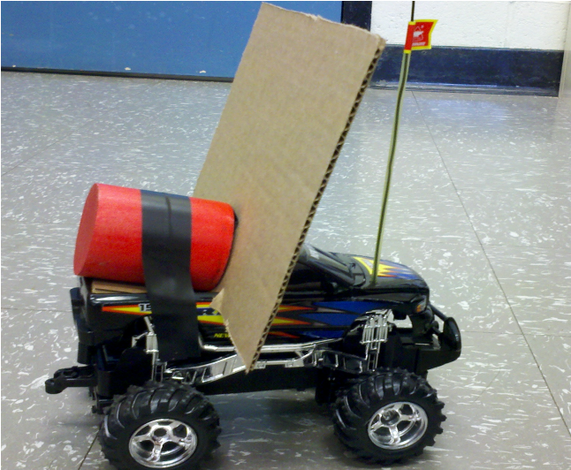
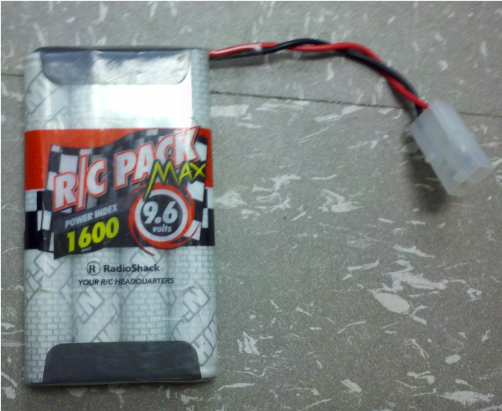
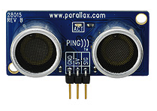
Abstract
Theory
Tracking
An autonomous vehicle is one that is able to operate independently of human control through feedback returned by various sensors. These vehicles are often used to reduce problems, risks and costs that arise from human involvement. The goal of this project is to design and program a convoy in which autonomous vehicles follows a human controlled lead car. In order to develop this system of vehicles, multiple sensors have to be used to keep the convoy together. Standard radio controlled cars are used as the vehicles in the system and were equipped with Arduino microcontrollers, the CMUcam4 camera for color tracking as well as the Parallax Ping))) ultrasonic sensor. Servos are also mounted on the vehicles in order to allow the camera and ping to turn according to the lead car. Using these sensors, the distance between the vehicles is used to determine the motor speed, while the input from the CMUcam4 allows the vehicles to follow the ones ahead when they turn. These sensors continuously return data, allowing for the following cars to adjust to any changes in the system.
The autonomous car should be able to identify a target of a given color, and use its sensors and motors to follow it. Our target, a lead car, is a small remote-controlled car with a colored cylinder mounted on it. The autonomous car will follow this lead car. The car will track the colored cylinder and steer itself to maintain vision of the lead car. The autonomous car will also use ultrasonic sensing to maintain a certain distance from the lead car. Additional autonomous cars can be added to this system to create a convoy, each tracking a colored cylinder mounted on the car it is following.
The CMUcam4 used a unique method of color tracking that enabled us to implement the autonomous vehicle. First, using the RGB color naming system, we chose a range of colors that the camera would track. At 30 frames per second, the camera searches in its field of vision for anything in this range and tags it as a pixel to track. It creates a “blob” of tagged pixels and marks the geometric centroid. Data from the movement centroid is then sent to the servo motor that the camera and the Ping))) sensor are attached to. Using this data, the servo turns so that the sensors are always pointed at the tracked object. This data is also sent to the servo attached to the front wheels which are used to steer the car.
Troubleshooting
Under dark or bright conditions, the camera perceives color differently. Increasing the RGB range for the color tracking fixed this.
When the lead car made sharp or fast turns, the Ping))) sensor lost track of the board on the lead car that it was bouncing sound waves off of. This would give wrong distance data to the system.
By using CMUcam4 as opposed to the CMUcam2, the system's code had to be revamped because the old code was incompatible with the new camera.
The autonomous car motor is controlled by a numeric system that does not correspond to a realistic velocity system. To find the optimal speeds for the car, we actively experiment through trial and error.
The car also has a very small steering degree range. Friction from the wheel's material further impeded this movement limitation. Taping the wheels decreased the friction slightly.
Goals
Parts
Design and program an autonomous vehicle. System should be replicable and modular, allowing for the possibility of an autonomous vehicle convoy.
Refurbish system's hardware components, with a focus on upgrading the previous system's camera to the more reliable CMUcam4.
Revamp system code to work with the new CMUcam4 while maintaining all functionality of the old system.
Improve vehicle following algorithm to account for steering friction and speed changes.
Clockwise from top-left.
Car with Motor: An RC car modified to carry the autonomous system. Comes with a power switch.
Arduino with Motor Shield: Microcontroller used to process code and send commands. The shield distributes signals from the Arduino and power from the battery to the rest of the parts.
Servos: Motors that can rotate and stop anywhere in a180 degree range. One Servo steers the front wheels while the other rotates the camera and allows it a greater field of vision.
CMUcam4: 30 FPS camera that also doubles as a microprocessor with embedded color tracking. Using this data, the Arduino can control the steering servo to follow the lead car.
Ping))): Sensor which sends and receives ultrasonic waves to calculate distance from a target. Using this data, the Arduino can maintain a set distance between the autonomous car and the lead car.
Rechargeable Battery: Supplying 9.6 volts and up to 1.5 amps for the entire autonomous system.
Lead Car: A smaller, remote-controlled RC car. Mounted on the back is a colored cylinder for the CMUcam4 to track and a board to bounce waves for the Ping))) sensor.
Approach & Conclusion
The implementation of the new CMUcam4 clearly enhanced the performance of the autonomous vehicle system. The new camera's higher FPS rate allowed for faster color tracking, so the system rarely lost track of the lead car. Also, the camera's built-in servo motor control allowed the Arduino microcontroller to free up some of its processing power, speeding up the following algorithm. The revamping of the system's code to work with the CMUcam4 not only successfully maintained all previous functionality of the system, but also allowed our group to improve the modularity and efficiency of the algorithm. The code is now split into specific functions of the system, and variables are easily changed.
Future Goals
Improve following algorithm to make it more reliable and respond faster to changes in speed.
Make usable in more natural environment with obstacles.
Switch to a sensor more reliable than color tracking or fix the issue with shadows and lighting.
Implement more autonomous follower vehicles to create a convoy.
Sponsors:
National Aeronautics and Space Administration (NASA)
NASA Goddard Space Flight Center (GSFC)
NASA Goddard Institute for Space Studies (GISS)
NASA New York City Research Initiative (NYCRI)
New Jersey Space Grant Consortium (NJSGC)
References
Contributors:
Agyeman, Kwabena and Anthony Rowe. CMUcam4 Command List. 2012. Print.
Chukrallah, Bashir, David Laslo, Michael Ma, Sean Murphy, and Stefan Novak. Autonomous Vehicle Control Systems. Rutgers University, 1 May 2006. Web.
Dalvano, Michael, Syed Faiz, Louis Riera, and Christopher Lee. Navigation of Autonomous Vehicles. Rutgers University, 27 April 2012. Web
Gartzman, Steve, Marifae Tibay, Thien Win, Steve Agudelo, Christian Cuentas, and Adekola Adesina. A Convoy of Autonomous Vehicles. Rutgers University, 24 Apr. 2009. Web.
Haim Baruh, Ph. D., Principal Investigator
Joshua Metersky, Undergraduate Student
Richard Quan, Undergraduate Student
David Wu, High School Student
Special thanks to Kwabena Agyeman and Han Sun

