Slide 1

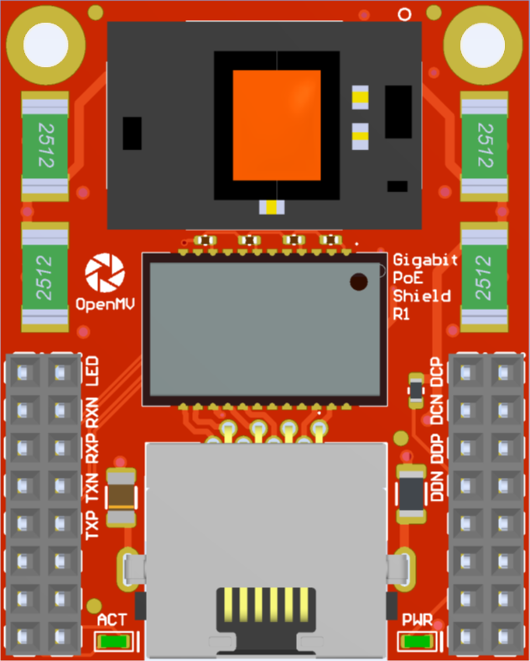
Gigabit PoE Shield
Pinout
Not Connected
MDI LED
DC P
Not Connected
Not Connected
MDI RX N / DB N
DC N
Not Connected
Not Connected
MDI RX P / DB P
DD P
Not Connected
Not Connected
MDI TX N / DA N
DD N
Not Connected
Not Connected
MDI TX P / DA P
Not Connected
Not Connected
Not Connected
Not Connected
VIN Out (5.4V @ 1.2A)
3.3V Rail
GND Rail
3.3V Rail
GND Rail

