Slide 1

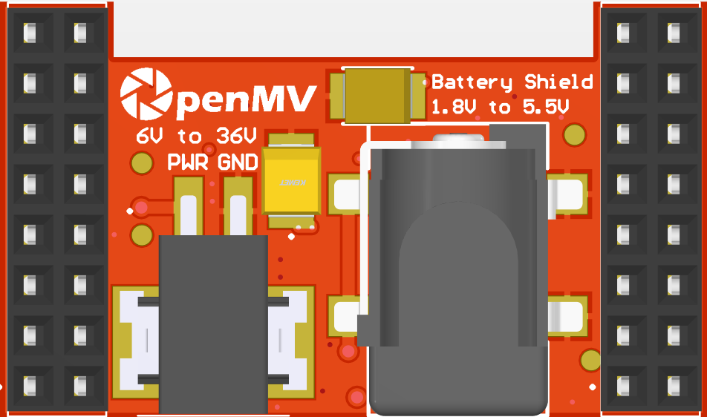
Battery Shield
Pinout
Not Connected
Not Connected
Not Connected
Not Connected
Not Connected
Not Connected
Not Connected
Not Connected
Not Connected
Not Connected
Not Connected
Not Connected
BAT 0-6V -> P6 0-2.8V
RAW Out (3.5V @ 800mA)
VIN Out (5.6V @ 600mA)
3.3V Rail
GND Rail
3.3V Rail
GND Rail

