Slide 1

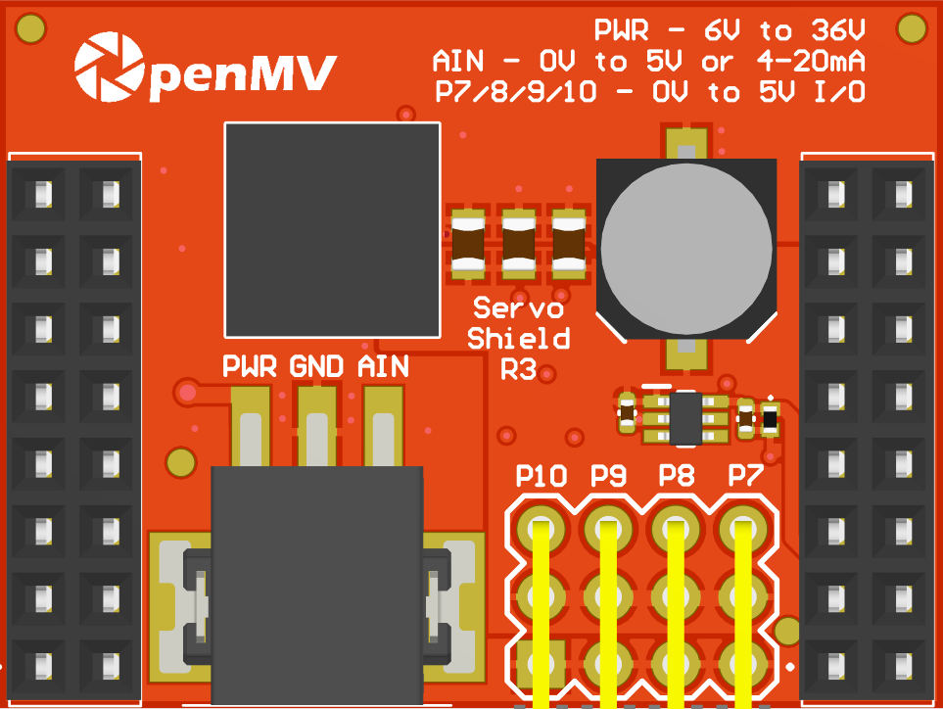
Servo Shield
Pinout
Not Connected
Not Connected
Not Connected
Not Connected
Not Connected
P10 – 3.3V -> 5V GPIO
Not Connected
P9 – 3.3V -> 5V GPIO
Not Connected
P8 – 3.3V -> 5V GPIO
Not Connected
P7 – 3.3V -> 5V GPIO
AIN 0-5V -> P6 0-3.3V
VIN Out (5.6V @ 5A)
3.3V Rail
GND Rail
3.3V Rail
GND Rail

