Slide 1

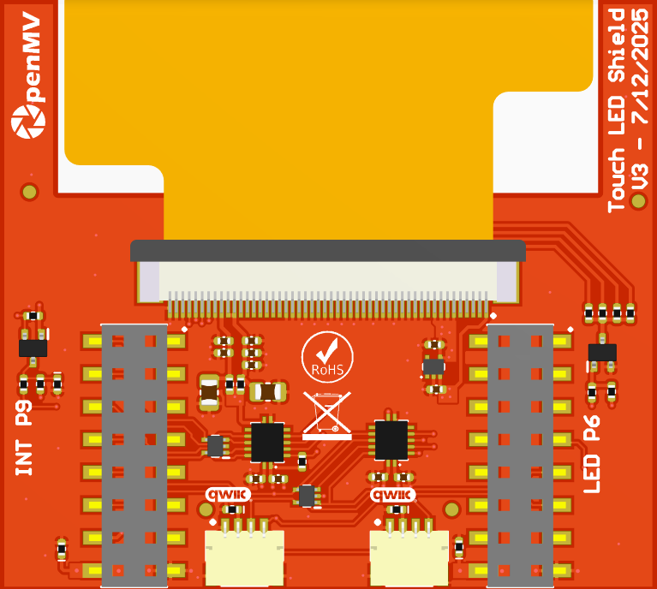
Touch LCD
Shield Pinout
P0 – LCD MOSI
Not Connected
P1 – LCD TE
Not Connected
P2 – LCD SCLK
Not Connected
P3 – LCD SSEL
P9 – Touch INT_N
P4 – Touch/QWIIC SCL
P8 – LCD RS
P5 – Touch/QWIIC SDA
P7 – Touch/LCD RESET_N
P6 – LCD Backlight
Not Connected
3.3V Rail
GND Rail
3.3V Rail
GND Rail

