Slide 1

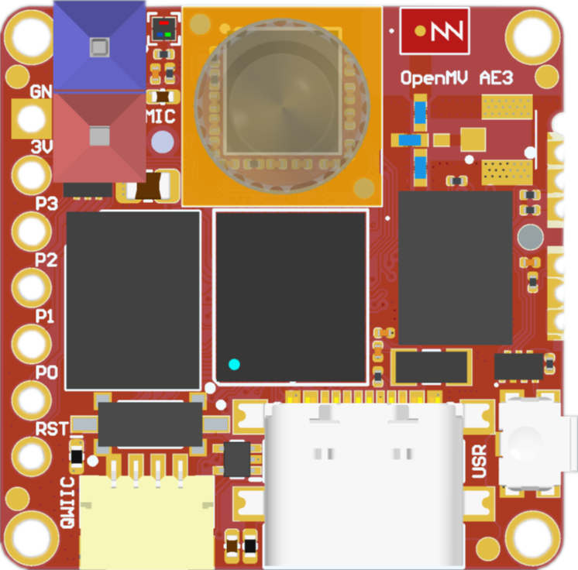
B2B Header Pinout (on the board backside)
B2B | Name | Alternative Function |  |  |  |  |  | V Ref | Pin
Pin 2 | P0 | SPI 0 MOSI | I2C 2 SCL | UART 4 TX | TIM 0 T1 | PDM D3 |  | 3.3V Ref | P5.1
Pin 4 | P1 | SPI 0 MISO | I2C 2 SDA | UART 4 RX | TIM 0 T0 |  |  | 3.3V Ref | P5.0
Pin 6 | P2 | SPI 0 SCLK | LPI2C SCA | UART 5 TX | TIM 1 T1 |  |  | 3.3V Ref | P5.3
Pin 8 | P3 | SPI 0 SS | LPI2C SCL | UART 5 RX | TIM 1 T0 | PDM C3 |  | 3.3V Ref | P5.2
Pin 10 | P4 |  | I2C1 SCL | UART 1 TX | TIM 2 T1 | PDM C0 | CAN TXD | 3.3V Ref | P0.5
Pin 12 | P5 |  | I2C1 SDA | UART 1 RX | TIM 2 T0 | PDM D0 | CAN RXD | 3.3V Ref | P0.4
Pin 14 | P6 |  | I2C1 SDA | UART 3 CTS | TIM 9 T0 |  |  | 1.8V Ref | P7.2
Pin 16 | P7 |  | I2C1 SCL | UART 3 RTS | TIM 9 T1 |  |  | 1.8V Ref | P7.3
Pin 18 | P8 |  | I3C SDA | UART 3 RX | TIM 5 T0 | ANA S10 |  | 1.8V Ref | P1.2
Pin 20 | P9 |  | I3C SCL | UART 3 TX | TIM 5 T1 | ANA S11 |  | 1.8V Ref | P1.3
Pin 1 | 1.8V Supply
Pin 3 | JTAG_TCK |  |  |  |  |  | 1.8V Ref |  | P4.4
Pin 5 | JTAG_TMS |  |  |  |  |  | 1.8V Ref |  | P4.5
Pin 7 | JTAG TDI |  |  |  |  |  | 1.8V Ref |  | P4.6
Pin 9 | JTAG TDO |  |  |  |  |  | 1.8V Ref |  | P4.7
Pin 11 | JTAG RSTN |  |  |  |  |  | 1.8V Ref
Pin 13 | RECOVERY |  |  |  |  |  | 1.8V Ref
Pin 15 | 3.3V Supply
Pin 17 | RSTN |  |  |  |  |  | 3.3V Ref
Pin 19 | GND
OpenMV AE3
All pins are 3.3V tolerant with a 3.3V output
All pins can sink or source up to 25 mA
By: Ibrahim Abdelkader & Kwabena W. Agyeman
https://openmv.io
Machine Module Peripherals / Timers
Pin
Name
GND Rail
1.8V SWD
3.3V Rail (1A supply Max)
1.8V
TMS
PDM C3
TIM1 T0
UART 5 RX
LPI2C SCL
SPI 0 SS
P3
RSTN
TIM1 T1
UART 5 TX
LPI2C SDA
SPI 0 SCLK
P2
TCK
GND
TIM0
T0
UART 4 RX
I2C 2 SDA
SPI 0 MISO
P1
TDO
PDM D3
TIM0 T1
UART 4 TX
I2C 2 SCL
SPI 0 MOSI
P0
Reset (Connect to GND to reset)
SW
Machine Module Peripherals / Timers
Pin
Name
GND Rail
3.3V Rail (1A supply Max)
PDM D0
TIM2 T0
UART 1 RX
I2C 1 SDA
CAN RXD
P5
PDM C0
TIM2 T1
QWIIC Connector
UART 1 TX
I2C 1 SCL
CAN TXD
P4

