Slide 1

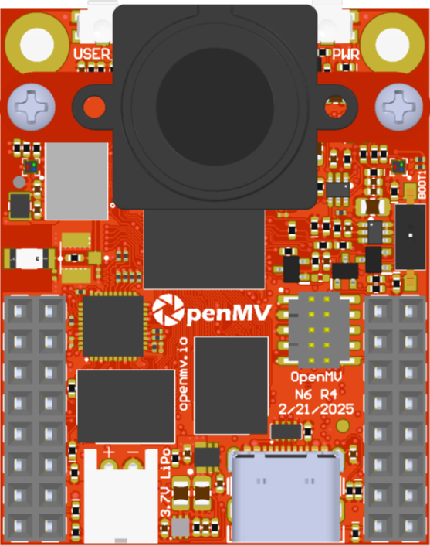
SW
SW2
All pins are 3.3V tolerant with a 3.3V output
All pins can sink or source up to 20 mA
OpenMV N6
By: Ibrahim Abdelkader & Kwabena W. Agyeman
https://openmv.io
RAW provides always-on unregulated (3.6V-5V) power in on/off or deepsleep modes.
Micro SD Slot
SD < 2GB Max
SDHC < 32GB Max
SDXC < 2TB Max
Connect BOOT0 to 3.3V to put the board into recovery mode to reflash the bootloader.
Pin
Name
BOOT 1 SW
Pin
Name
Machine Module Peripherals / Timers
Machine Module Peripherals / Timers
SPI 2
MOSI
I2S 2 SDO
P0
ETH LED
DC P
Reset (Connect to GND to reset)
SPI 2
MISO
I2S 2 SDI
P1
ETH RXN / DB N
DC N
P11
WKUP3
UART4 TX
CAN 1 TX
SPI 2
SCLK
I2S 2 CK
P2
ETH RXP / DB P
DD P
P10
Frame Sync Input/Output
TIM15 CH2
UART4 RX
CAN 1 RX
SPI 2
SS
I2S 2 WS
P3
ETH TXN / DA N
DD N
P9
TIM17 CH1
TIM2 CH3
I2C 2
SCL
UART 3
TX
I3C 2 SCL
P4
ETH TXP / DA P
P14 – UART7 TX
P8
TIM4 CH2
TIM2 CH4
I2C 2
SDA
UART 3
RX
I3C 2 SDA
P5
SW2 - WKUP2
P13 – UART7 RX
P7
TIM4 CH1
TIM12 CH1
ADC
P6
RAW
BOOT 0
VIN (3.6V - 5V)
3.3V Rail (1A supply Max)
GND Rail
3.3V Rail
GND Rail

