Slide 1
NARS an Artificial General Intelligence (AGI) Project
Peter Isaev & Patrick Hammer
Temple University

Slide 2
WHAT IS NOT INTELLIGENCE
Innate behavior, or instinct
Exhaustive search
Basic information retrieval
Repeated routines
Algorithm following numerical calculation, sorting, fixed mapping, …

Slide 3
“Intelligence” Interpreted
Main­stream AI treats “Intelligence” as a collection of problem-specific and domain-specific parts
AGI takes “Intelligence” as a general-purpose capability that should be treated as a whole
AGI research still includes different research objectives and strategies

Slide 4
Basic Assumption
“Intelligence” is the capability of a system to adapt to its environment and to work with insufficient knowledge and resources
Assumption of Insufficient Knowledge and Resources (AIKR):
To rely on finite processing capacity
To work in real time
To open to unexpected tasks

Slide 5
Reasoning System Framework
a language for representation
a semantics of the language
a set of inference rules
a memory structure
a control mechanism
Advantages:
domain independence
rich expressing power
justifiability of the rules
flexibility in combining the rules
Notes:
5

Slide 6
Fundamental Issues
Under AIKR, the system cannot guarantee absolute correctness or optimum anymore. Now what is the standard of validity or rationality?
Validity and rationality become relative to the available knowledge and resources.
Desired features: general, adaptive, flexible, robust, scalable
Notes:
6

Slide 7
NON-AXIOMATIC REASONING SYSTEM
NARS has a logic part and a control part, with a “logic” in the original sense
NARS is fully based on AIKR
NARS has a designed meta-level and an acquired object-level

Slide 8
Term and Statement
Term: word, as name of a concept
Statement: subject-copula-predicate
S → P
as specialization-generalization
water
liquid
Copula inheritance is reflexive and transitive
Notes:
8

Slide 9
Binary Truth-value
Experience K: a finite set of statements
Beliefs K*: the transitive closure of K
A statement is true if
either it is in K*
or it has the form of X → X
otherwise it is false
Notes:
9

Slide 10
Extension and Intension
For a given term T,
its extension T^{E} = {x | x → T}
its intension T^{I} = {x | T → x}
T^{E}
T^{I}
T
Theorem:
(S → P) ⇔ (S^{E} ⊆ P^{E}) ⇔ (P^{I} ⊆ S^{I})
Notes:
10

Slide 11
Evidence
Positive evidence of S → P :
{x | x ∈ (S^{E} ∩ P^{E}) ∪ (P^{I} ∩ S^{I})}
Negative evidence of S → P :
{x | x ∈ (S^{E} – P^{E}) ∪ (P^{I} – S^{I})}
⊗
⊕
S
P
Amount of evidence:
positive: w⁺ = |S^{E} ∩ P^{E} | + |P^{I} ∩ S^{I} |
negative: w– = |S^{E} – P^{E} | + |P^{I} – S^{I} |
total: w = w⁺ + w– = |S^{E} | + |P^{I} |
⊕
⊗
Notes:
11

Slide 12
MEANING OF TRUTH
Traditionally: the “truth-value” of a statement measures its agreement with the reality, how close it is to an objective fact
NARS: the “truth-value” of a statement measures its evidential support, indicates how close it is to the evidence

Slide 13
Truth-Value Defined
In NARS, the truth-value of a statement is a pair of real numbers in [0, 1], and measures the evidential support to the statement.
S → P <f, c>
frequency: f = w⁺/w
confidence: c = w / (w +1)
S
P
<f, c>
Notes:
13

Slide 14
Truth-Value Produced
Actual experience: a stream of statements with truth-value, where the confidence is in (0, 1)
Each inference rule has a truth-value function, and the truth-value of the conclusion is determined only by the evidence provided by the premises
Notes:
14

Slide 15
Truth-value Function Design
1. Treat all involved variables as Boolean
2. For each value combination in premises, decide the values in conclusion
3. Build Boolean functions among the variables
4. Extend the operators to real-number:
not(x) = 1 – x
and(x, y) = x * y
or(x, y) = 1 – (1 – x) * (1 – y)
Notes:
15

Slide 16
Deduction
M → P [f₁, c₁]
S → M [f₂, c₂]
⎯⎯⎯⎯⎯⎯
S → P [f, c]
bird → animal [1.00, 0.90]
robin → bird [1.00, 0.90]
⎯⎯⎯⎯⎯⎯⎯⎯⎯⎯⎯⎯
robin → animal [1.00, 0.81]
M
f = f₁ * f₂
c = c₁ * c₂ * f₁ * f₂
S
P
Notes:
16

Slide 17
Induction
M → P [f₁, c₁]
M → S [f₂, c₂]
⎯⎯⎯⎯⎯⎯
S → P [f, c]
f = f1
c = f2 * c1 * c2 / (f2 * c1 * c2 + 1)
swan → bird [1.00, 0.90]
swan → swimmer [1.00, 0.90]
⎯⎯⎯⎯⎯⎯⎯⎯⎯⎯⎯⎯
bird → swimmer [1.00, 0.45]
M
S
P
Notes:
17

Slide 18
Abduction
P → M [f₁, c₁]
S → M [f₂, c₂]
⎯⎯⎯⎯⎯⎯
S → P [f, c]
f = f2
c = f1 * c1 * c2 / (f1 * c1 * c2 + 1)
seabird → swimmer [1.00, 0.90]
gull → swimmer [1.00, 0.90]
⎯⎯⎯⎯⎯⎯⎯⎯⎯⎯⎯⎯⎯⎯
gull → seabird [1.00, 0.45]
M
S
P
Notes:
18

Slide 19
Revision
S → P [f₁, c₁]
S → P [f₂, c₂]
⎯⎯⎯⎯⎯⎯
S → P [f, c]
f1 * c1 * (1 - c2) + f2 * c2 * (1 - c1)
⎯⎯⎯⎯⎯⎯⎯⎯
c1 * (1 - c2) + c2 * (1 - c1)
c1 * (1 - c2) + c2 * (1 - c1)
⎯⎯⎯⎯⎯⎯⎯⎯⎯⎯⎯⎯
c1 * (1 - c2) + c2 * (1 - c1) + (1 - c2) * (1 - c1)
f =
c =
bird → swimmer [1.00, 0.62]
bird → swimmer [0.00, 0.45]
⎯⎯⎯⎯⎯⎯⎯⎯⎯⎯⎯⎯
bird → swimmer [0.67, 0.71]
S
P
Notes:
19

Slide 20
Types of Inference
Local Inference: revising beliefs or choosing an answer for a question
Forward inference: from existing beliefs to new beliefs (deduction, induction, abduction, …)
Backward inference: from existing questions/goals and beliefs to derived questions
Notes:
20

Slide 21
Memory Structure
A task is a question, a goal, or a piece of new knowledge (a judgement)
A belief is accepted knowledge
The tasks and beliefs are clustered into concepts, each named by a term
Concepts are prioritized in the memory; tasks and beliefs are prioritized within each concept
Notes:
21

Slide 22
Memory as a Network
gull
swimmer
[?]
robin
[1.00, 0.90]
[1.00, 0.90]
[1.00, 0.90]
[1.00, 0.45]
[0.00, 0.90]
C_{bird}
feathered_creature
[1.00, 0.90]
[1.00, 0.90]
[1.00, 0.90]
[1.00, 0.90]
crow
bird
swan
Notes:
22

Slide 23
Meaning of Concept
Every concept in NARS is fluid:
Its meaning is determined neither by reference nor definition, but by experienced relations
Each relation is a matter of degree
Meaning changes by history and context
Notes:
23

Slide 24
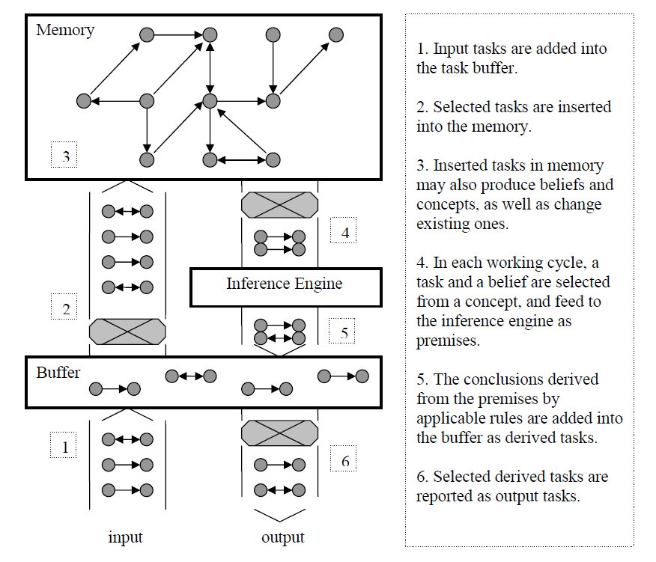
Architecture and Routine

Slide 25
Control Strategy
In each step, a task interacts with a belief according to applicable rules
The task and belief are selected probabilistically, biased by priority
Factors influence the priority of an item: its quality, its usefulness in history, and its relevance to the current context
Notes:
25

Slide 26
The Layers of the Logic
IL-9
NAL-9
event, goal, and operation as term
IL-8
NAL-8
IL-7
NAL-7
statement and variable as term
IL-6
NAL-6
IL-5
NAL-5
implementation
IL-4
NAL-4
derivative copulas & compound terms
IL-3
NAL-3
IL-2
NAL-2
atomic term
IL-1
NAL-1

Slide 27
Copulas & Compound Terms
Ideas from set theory:
Variants of the inheritance copula: similarity, instance, and property
Compound terms: sets, intersections, differences, products, and images
New inference rules for comparison, analogy, plus compound-term composition and decomposition
Notes:
27

Slide 28
Higher-Order Reasoning
Ideas from propositional/predicate logic:
Copulas: implication and equivalence
Compound statements: negation, conjunction, and disjunction
Conditional inferences as implication
Variable terms as symbols
NAL as a universal meta-logic
Notes:
28

Slide 29
Procedural Reasoning
Ideas from logic programming:
Events as statements with temporal relations (sequential and parallel)
Operations as executable events, with a sensorimotor interface
Goals as events to be realized
Mental operations are integrated into the inference process
Notes:
29

Slide 30
Unifications in NARS
Fully based on AIKR
Unified representational language
Complete inferential power
Reasoning as learning, planning, problem solving, decision making, ...
Integrating with other software & hardware via plug-and-play
Notes:
30

Slide 31
Implementation
NARS has been mostly implemented in the open-source project OpenNARS for research
Working examples exist as proof of concept (POC)
The system shows many human-like properties, though it is not deemed to be a psychological model
Notes:
31

Slide 32
Potential Applications
NARS is not designed for any specific application, it can be considered as a general purpose tool
Suitable domains:
AIKR is applicable
Tasks expressible as reasoning
Tools have compatible interface
Notes:
32

Slide 33
Publications & reports: http://www.cis.temple.edu/~pwang/
Source code, examples, and documents:
http://opennars.org/
Participations and COLLABORATIONS are welcome!

