Slide 1
OpenNARS
for Research General Overview
Peter Isaev & Patrick Hammer
Temple University

Slide 2
OpenNARS Control criteria
Operating under AIKR, NARS expects a new task to arrive at any given moment
System should always stay responsive to new inputs and derivations
Data structures are always bounded in size
Operating cycle needs to finish roughly in a constant time
Short/Long Term Importance: selection of an item is reflected by its short-term importance while forgetting relies on its long-term importance
Implementation of relative forgetting: unimportant items have to be forgotten after some time or when resources are not available anymore

Slide 3
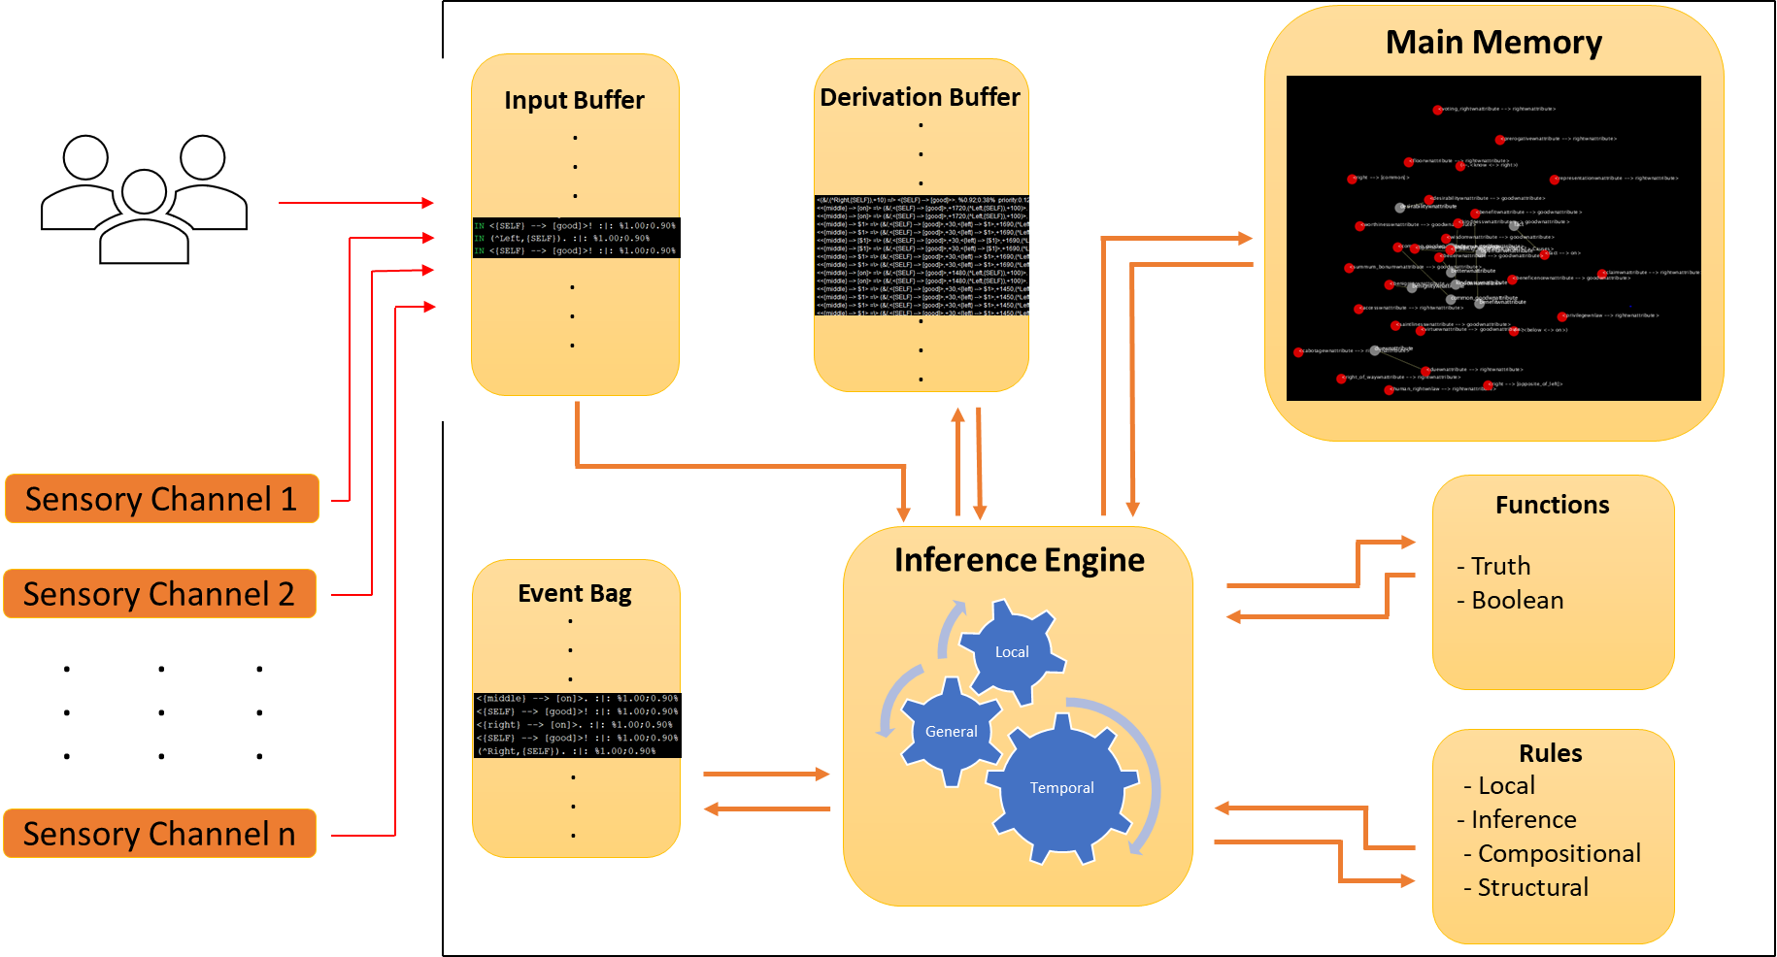
Control Flow Diagram

Slide 4
Memory Overview
System Global Memory is defined as "Memory of Concepts"
Priority queue data structure called "Bag"
Limited predefined size
Element is taken out based on probabilistic priority distribution, meaning even an element with lowest priority has a chance to be selected
Operations defined: put(), get() and get(key)
When full, element with lowest priority is removed

Slide 5
budget and truth values
Budget Value: set of three rational numbers assigned to each data item, that controls resources to be dedicated for a data item
Priority: measures short-term importance
Durability: a decay rate, describes how fast Priority of an item should decay
Quality: indicates the long-term importance of the data item
Truth Value: set of two rational numbers which indicate degree of belief based on the evidence collected from system’s experience
Frequency shows amount of positive evidence / total evidence
Confidence indicates degree of reliability of corresponding frequency
*(All values within the budget and truth values range from 0 to 1 )

Slide 6
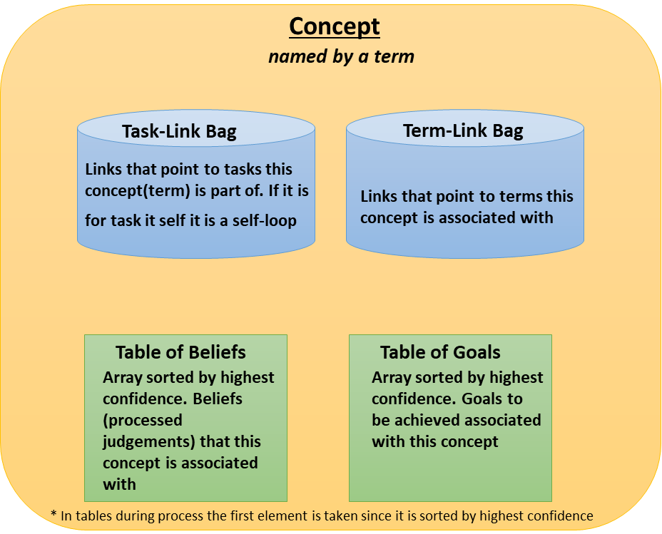
role of concept
Local memory is defined as a data structures within a Concept unit
2 - way role of concept: storage and inference entity
Efficient and compact: everything necessary is stored within a concept
Concept has inner data structures

Slide 7

Operating Cycle
Main operating cycle is data driven, guided by the priority of data items.
Add results (derivations and inputs) from global buffer into main memory, triggering potential revisions in the related concepts.
Select a concept C from main memory.
Select a tasklink from C
Select a termlink from C
Obtain the highest-confident belief from the concept the termlink points to
Apply inference rule with the tasklink’s task, and the belief as premises
Adjust budget value through use of budget functions for data items participated in the inference
Input conclusions into global buffer.

Slide 8
task and believe
Sentence is stored in memory as either a task or a belief (or both).
Judgment needs to be absorbed into beliefs.
A belief is a judgment that has been absorbed already and will be used to process the tasks
Task is what to be processed by the system
Notes:
8

Slide 9
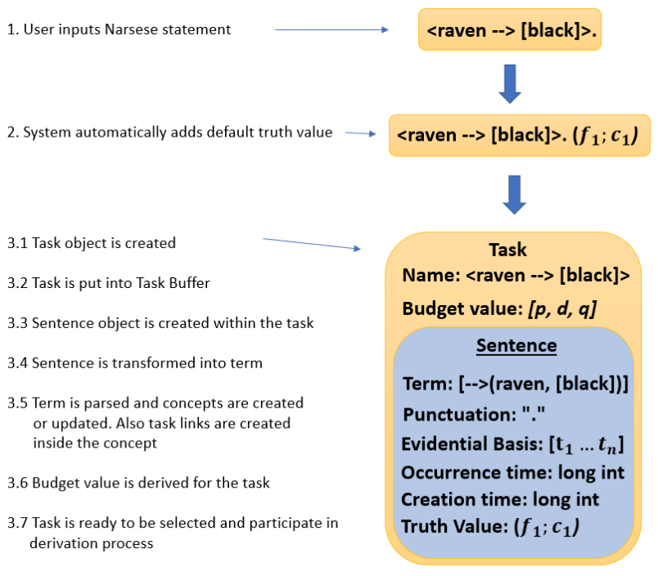
processing of a Task
Notes:
9

Slide 10
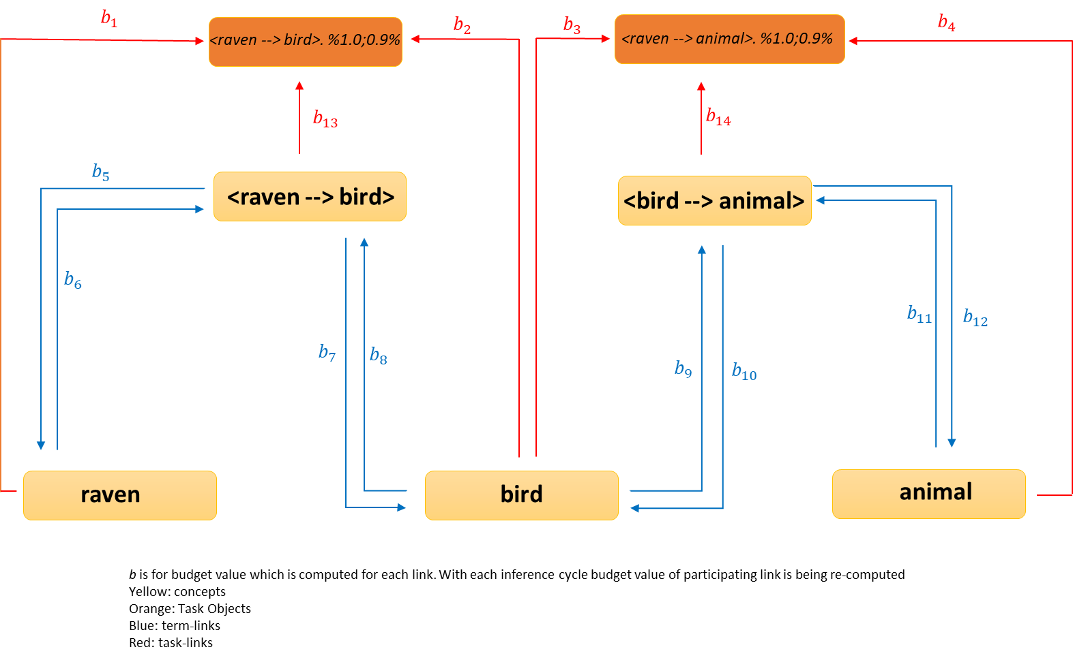

TaskLink and TermLink

Slide 11
basic Syllogistic Rules
Deduction: {M --> P, S --> M} |- S --> P
Abduction: {P --> M, S --> M} |- S --> P
Induction: {M --> P, M --> S} |- S --> P
Exemplification: {P --> M, M --> S} |- S --> P
Comparison: {M --> P, M --> S} |- S <-> P
Analogy: {M --> P, S <-> M} |- S --> P
Resemblance: {M <-> P, S <-> M} |- S <-> P
Notes:
11

Slide 12

extended Boolean and "truth expectation"
Treat all involved variables as Boolean and apply extended Boolean operations
not(x) = 1 – x
and(x, y) = x * y
or(x, y) = 1 – (1 – x) * (1 – y)
"Truth Expectation" used in local inference and budget computation defined as: $c∗\left(f−0.5\right)+0,5$
Notes:
12

Slide 13
Budget Functions
budgetInference() creates a budget for derived task and also updates budget for selected concept’s termlink
merge() revises budget when merging identical items
activate() updates currently selected concept’s budget value
revise() assigns budget to item whose truth value derived using revision rule
truth_to_quality() converts truth value to quality of an item

Slide 14
Publications & reports: http://www.cis.temple.edu/~pwang/
Source code, examples, and documents:
http://opennars.org/
Wiki Pages:
http://github.com/opennart/wiki
Participations and COLLABORATIONS are welcome!

