Slide 1

The Roadmap of NARS
Pei Wang
Temple University
August 2019

Slide 2

The Starting Point
Intelligence is the principle of adaptation with insufficient knowledge and resources
NARS is designed by incrementally extending a reasoning system
The roadmap presented in the 2006 AGI Workshop: From NARS to a thinking machine

Slide 3
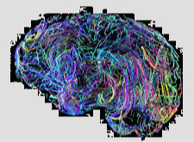
NARS per se
Formal language (Narsese) and logic (NAL): testing
Resource management: tuning and theorizing
Finalizing the mental operators
Native sensorimotor and NLP
Local axiomatic (mathematical) reasoning

Slide 4
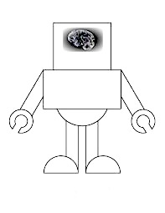
NARS+
NARS with knowledge sources
Memory/experience databases
NARS with software tools
“NARS inside” robots
Distributed/cloud implementation
Hardware/firmware implementation

Slide 5
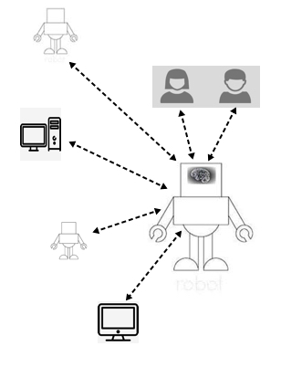
NARS and the others
Implanting vs. acquiring
Communication conventions
Education guideline
Moral, ethical, and legal regulations

Slide 6
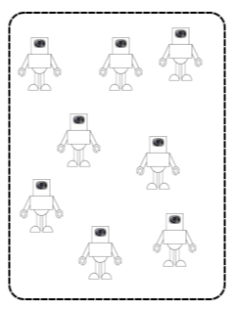
A Society of NARS
Cooperation and competition
Social structure and customs
Sociology of AGI
A community as a whole: goals, abilities, and beliefs
Relation with human society

Slide 7
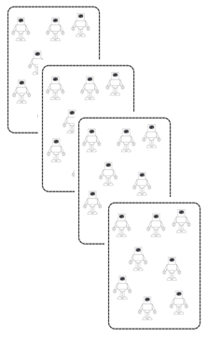
A Species of NARS
Reproduction via evolutionary computation, with personality parameters as DNA
Combining forms of adaptation: intelligence and evolution
Relation with the human species

