Slide 1
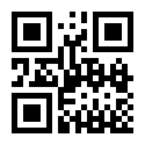
Introduction
OpenNeuro PET is developing infrastructure and tooling to increase accessibility, reproducibility, and ease of curation of PET data.
Add your information, graphs and images to this section.
Include a QR code to scan to download a digital copy of your poster.
Methodology
Results
Add your information, graphs and images to this section.
Add your information, graphs and images to this section.
OpenNeuro PET
Gitte Moos Knudsen, Robert Innis, Melanie Ganz-Benjaminsen, Adam Thomas, Cyril Pernet, Martin Nørgaard,
Douglas Greeve, Russel Poldrak, Paul Wighton, Anthony Galassi

