Slide 1
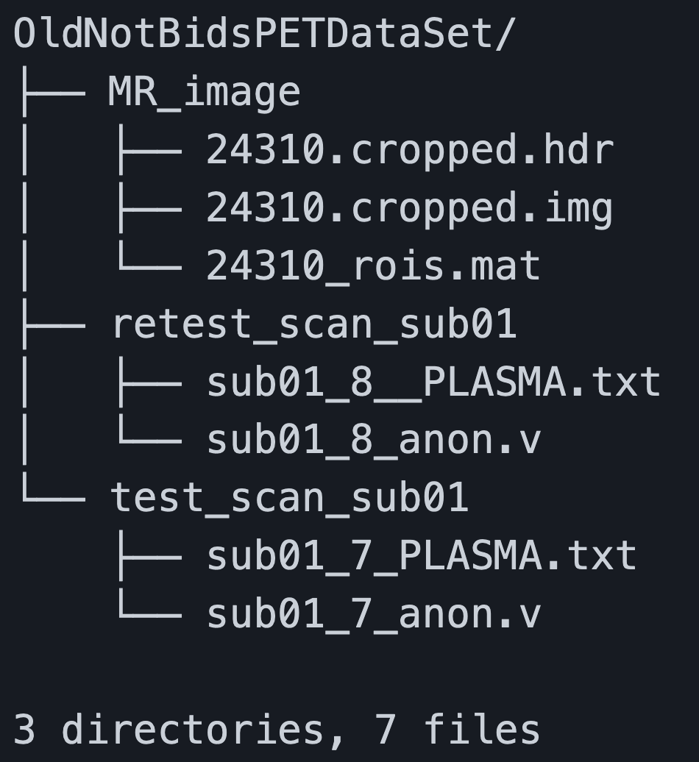
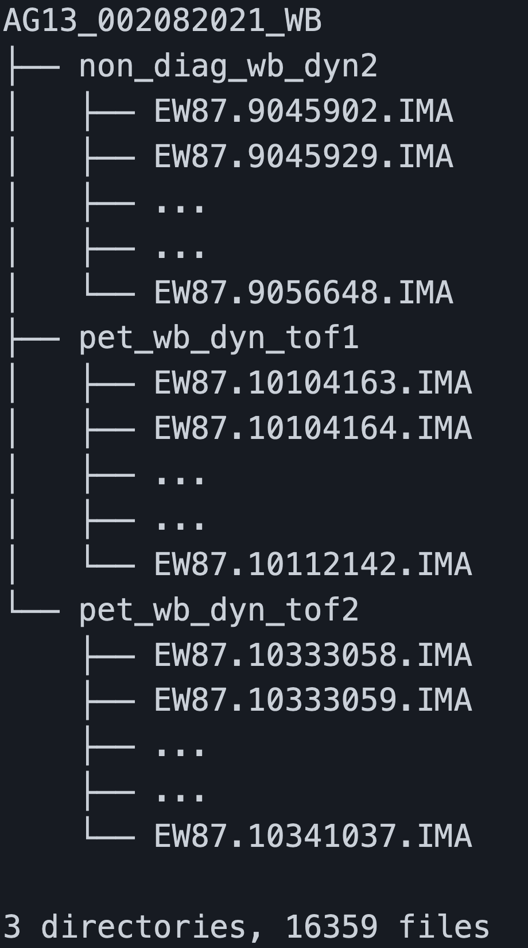
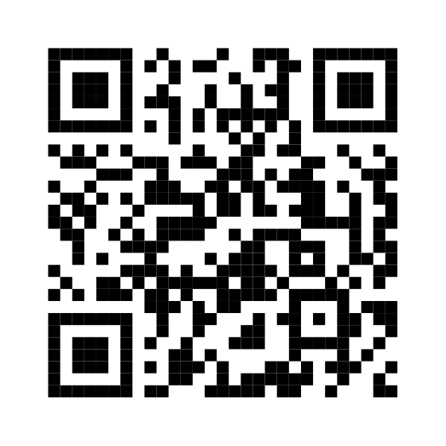
Introduction
OpenNeuro PET is developing infrastructure and tooling that increases accessibility, reproducibility, and the curation of PET data.
The OpenNeuro PET is working on:
Further Integrating PET into BIDS -> Brain imaging data structure
Providing Tools and Support to convert imaging and physio data into BIDS
Partnering w/ Existing Neuroimaging libraries/efforts
Current Work
Results
Add your information, graphs and images to this section.
OpenNeuro PET
Gitte Moos Knudsen, Robert Innis, Melanie Ganz-Benjaminsen, Adam Thomas, Cyril Pernet, Martin Nørgaard,
Douglas Greeve, Russel Poldrak, Paul Wighton, Anthony Galassi

