Slide 1
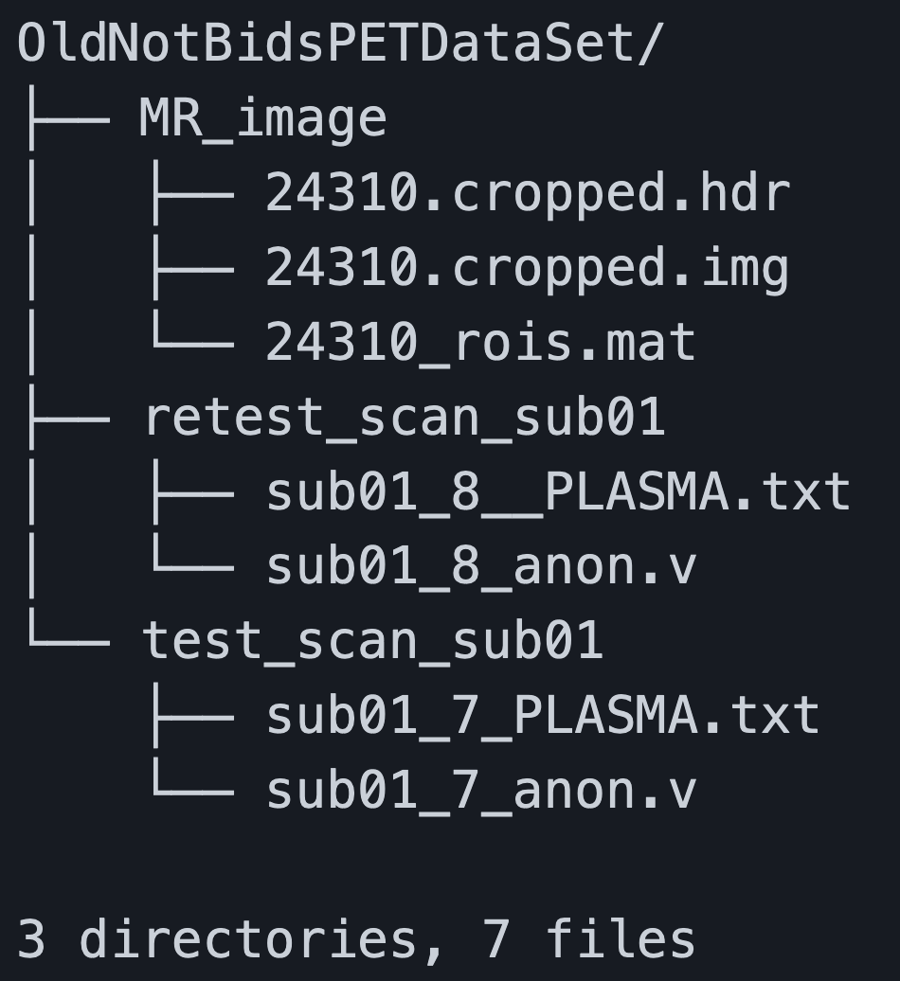
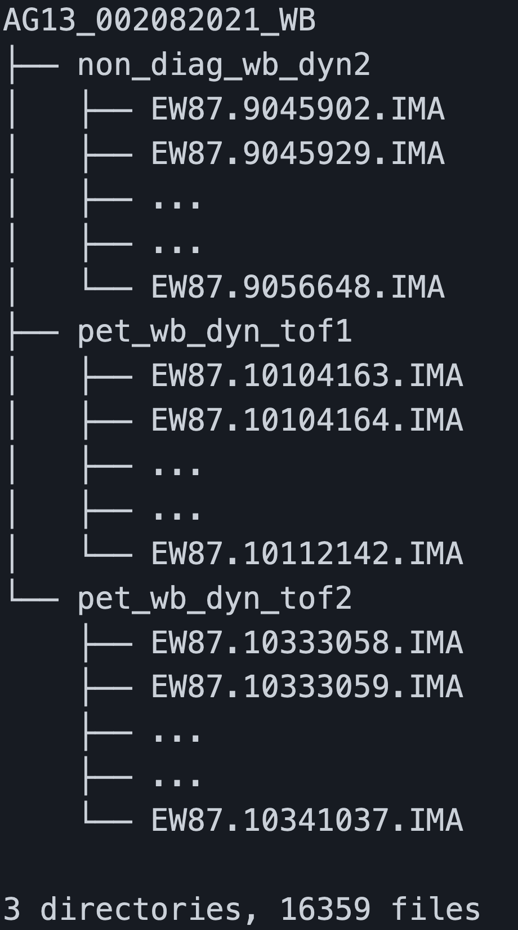
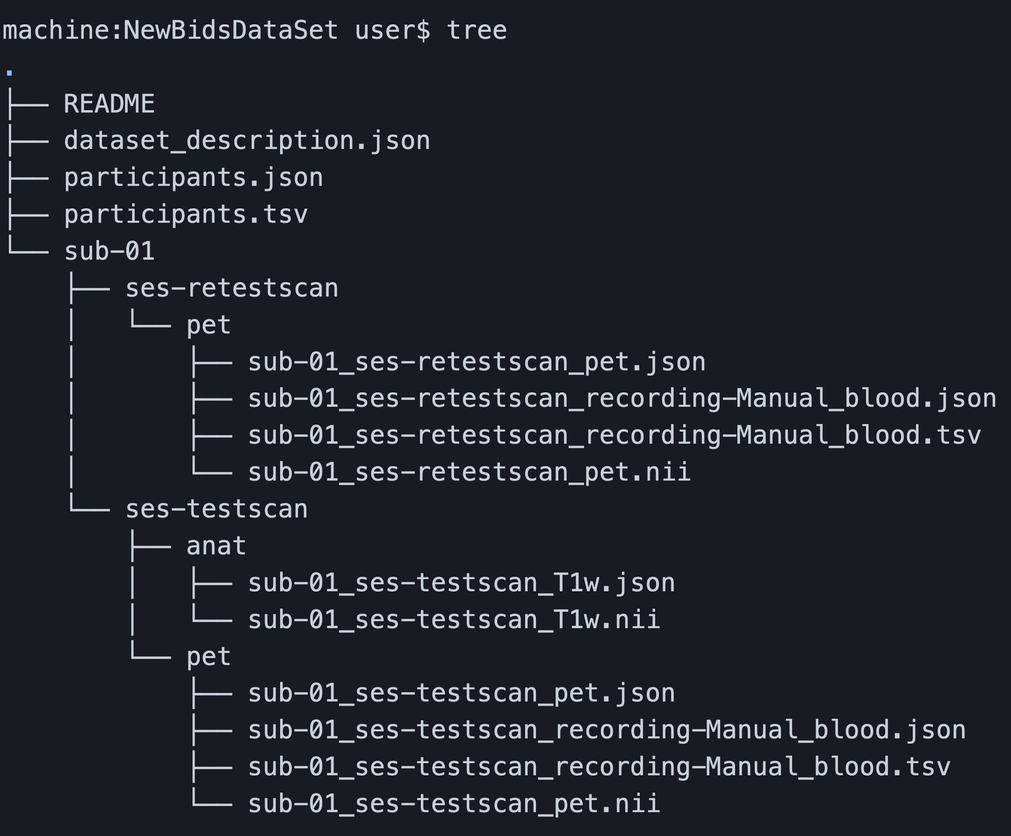
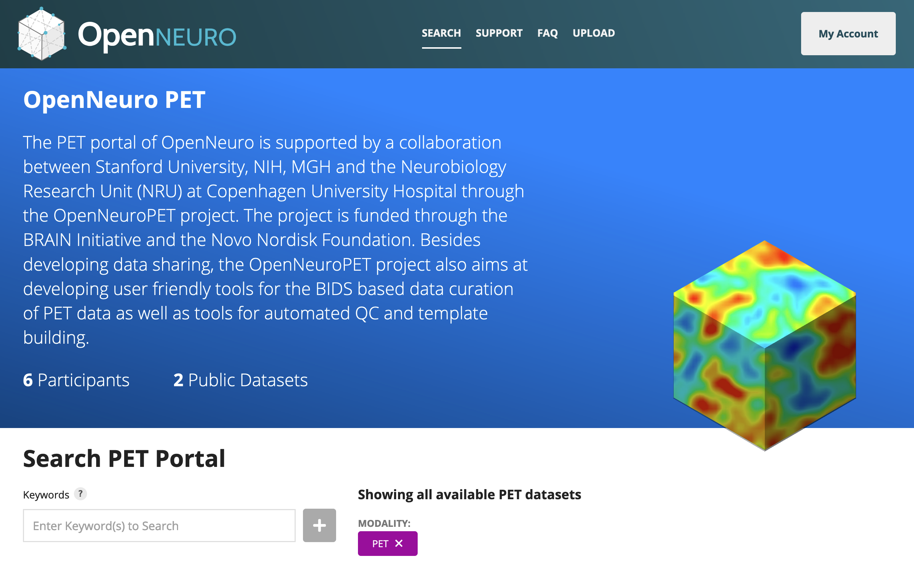
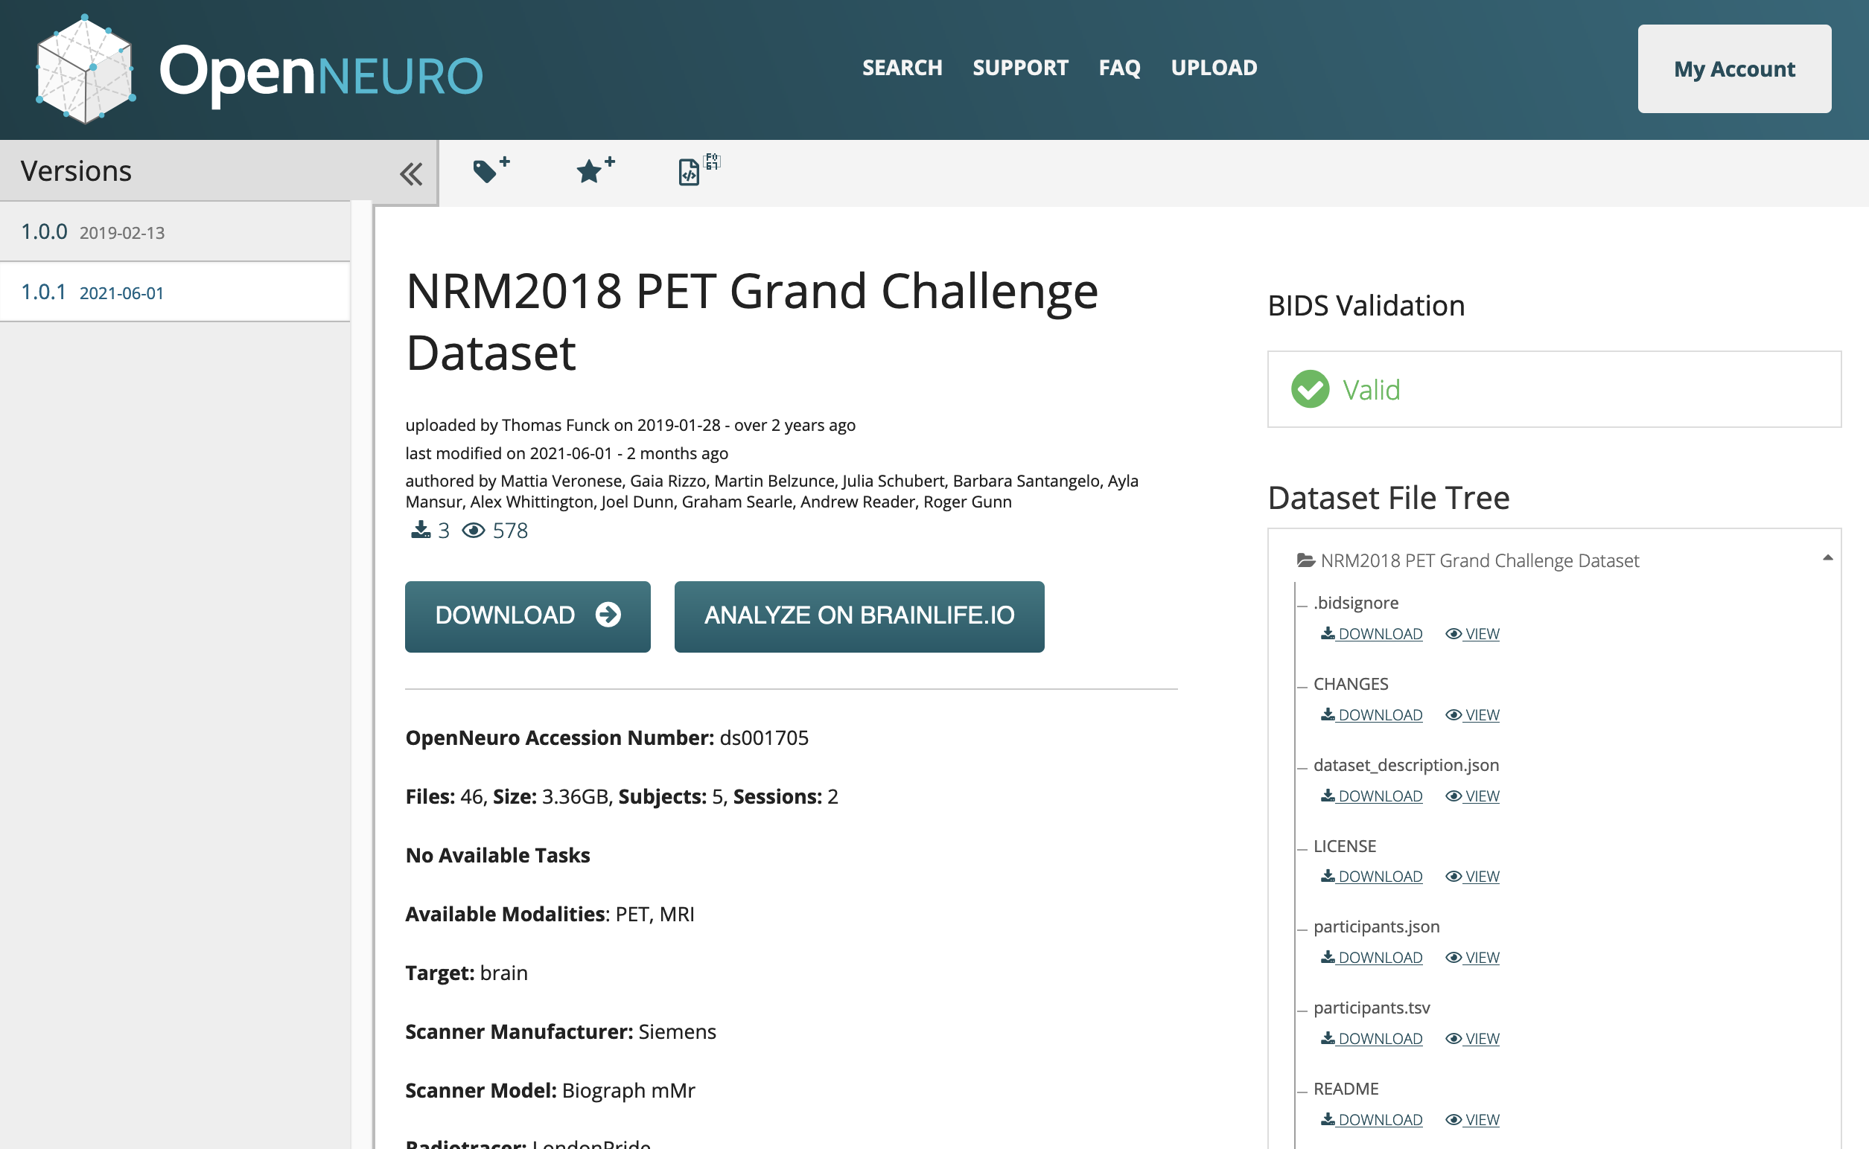
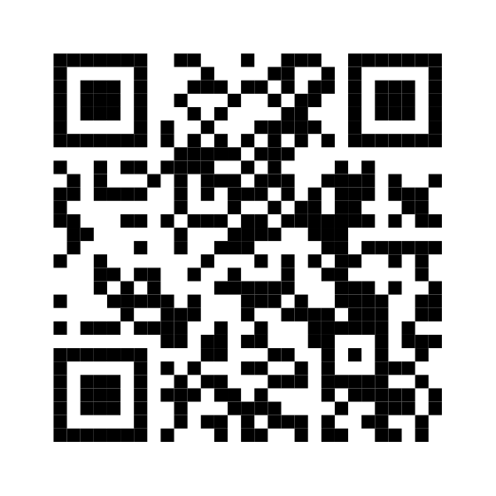
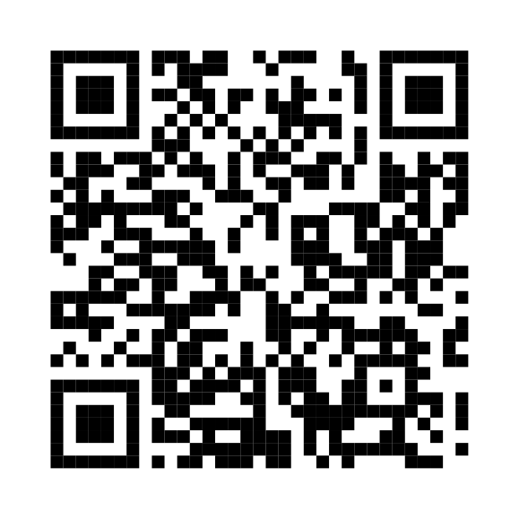
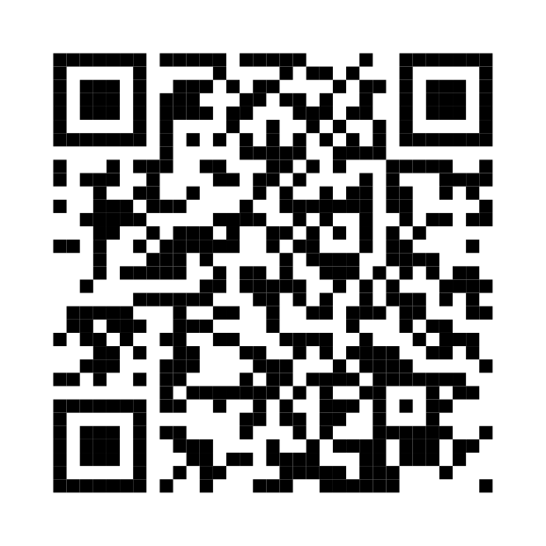
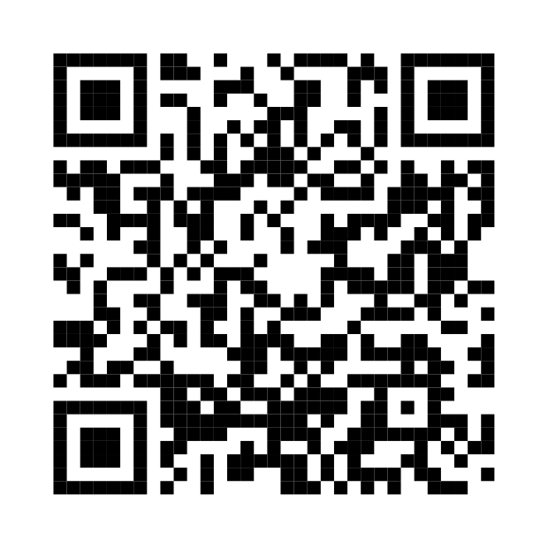
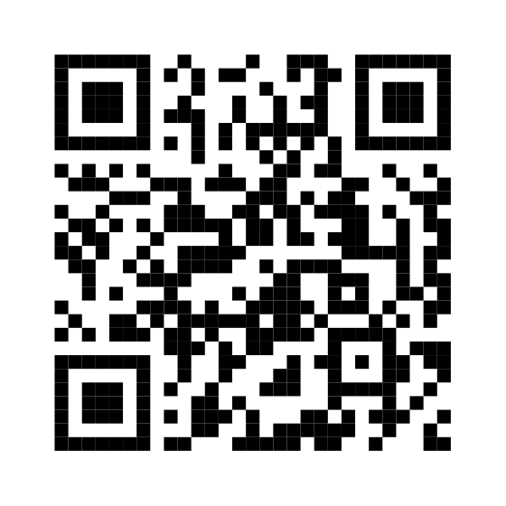
Introduction
OpenNeuroPET is developing infrastructure and tooling that increases accessibility, reproducibility, and the curation of PET data.
OpenNeuroPET is focused on creating the infrastructure to guide PET research data into BIDS, but what does that look like?
One of the first steps to increasing the shareability of PET data was the inclusion of PET into the popular brain imaging data structure BIDS [1] with the BIDS extension proposal 009 (BEP009 [2]). A standardized data format makes sharing different datasets simpler as part of the data dictionary is included in the file structure itself. Modalities follow a standard scheme and additional metadata is included in json or tab separated text files.
Organizing these datasets into the standardized BIDS set on the right leads to easier classification for humans and machines alike.
Once a PET dataset is converted into BIDS it can be uploaded, browsed, and downloaded via a browser (or the command line). The BIDS Validator will tell you if the dataset is valid and you can collect, view, or run analysis on this standardized structure.
Results
Learn more about BIDS
Read about BEP009
Current Work
Specifically, OpenNeuroPET is working on developing software to support the PET BIDS standard as well as continuing to extend BIDS to support PET pre-processing derivatives.
OpenNeuroPET is building out the infrastructure to support:
Use a PET BIDS Converter
Use the BIDS Validator
Conversion of reconstructed PET data and metadata into BIDS
Creating CC0 and GDPR-DUA upload portals for OpenNeuro.org
Converting datasets at the Neurobiology Research Unit at Copenhagen University and the NIMH
Reaching out to senior PET experts while extending BIDS further with BIDS extension proposal 023 to include pre-processing derivatives
Working with popular neuroimaging tool makers to better support PET
To contact OpenNeuroPET or to find out more about its work follow the link to the right.
https://openneuropet.github.io
OpenNeuroPET
Gitte Moos Knudsen, Robert Innis, Melanie Ganz-Benjaminsen, Adam Thomas, Cyril Pernet, Martin Nørgaard,
Douglas Greeve, Russel Poldrak, Paul Wighton, Anthony Galassi

