Slide 1
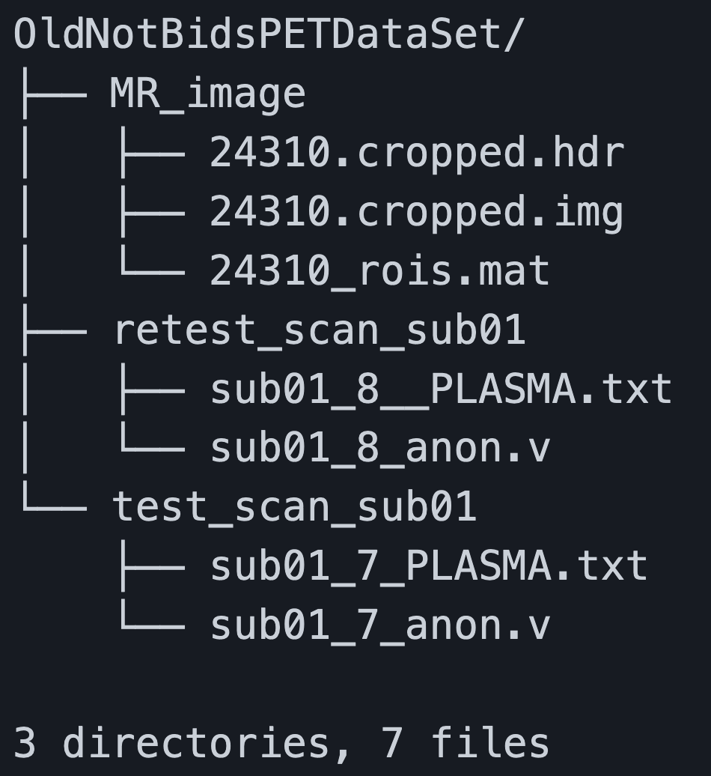
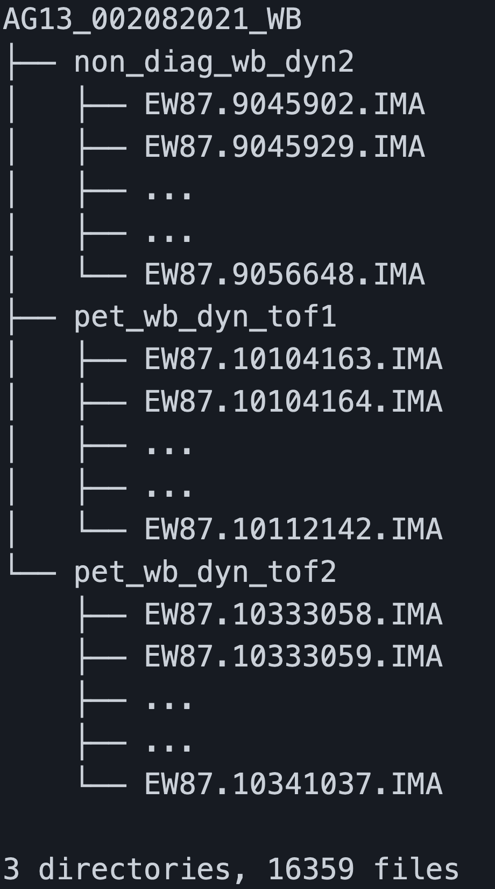
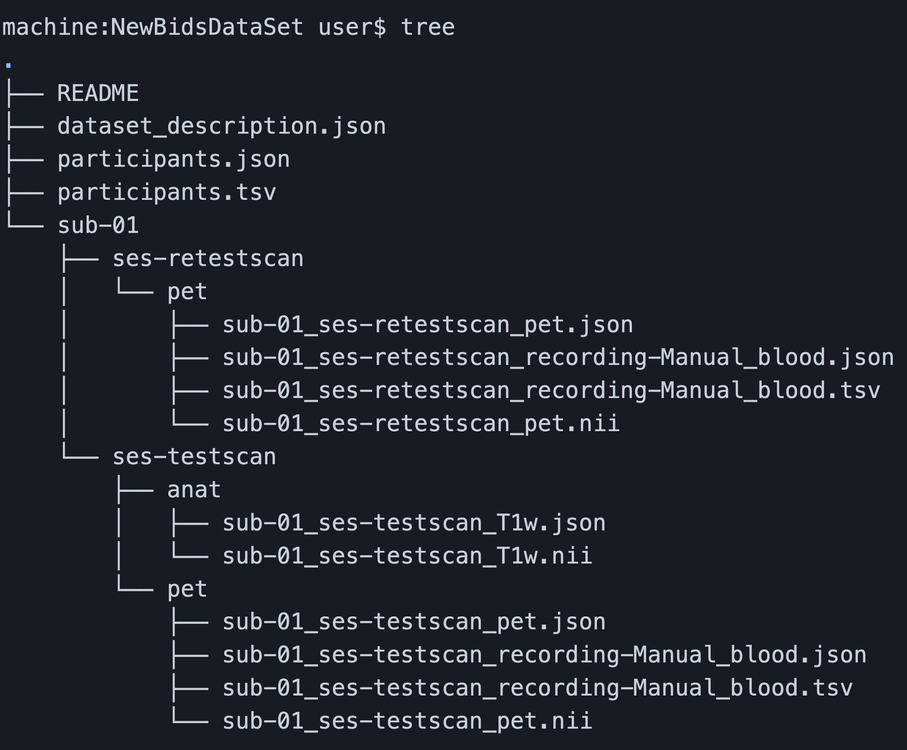
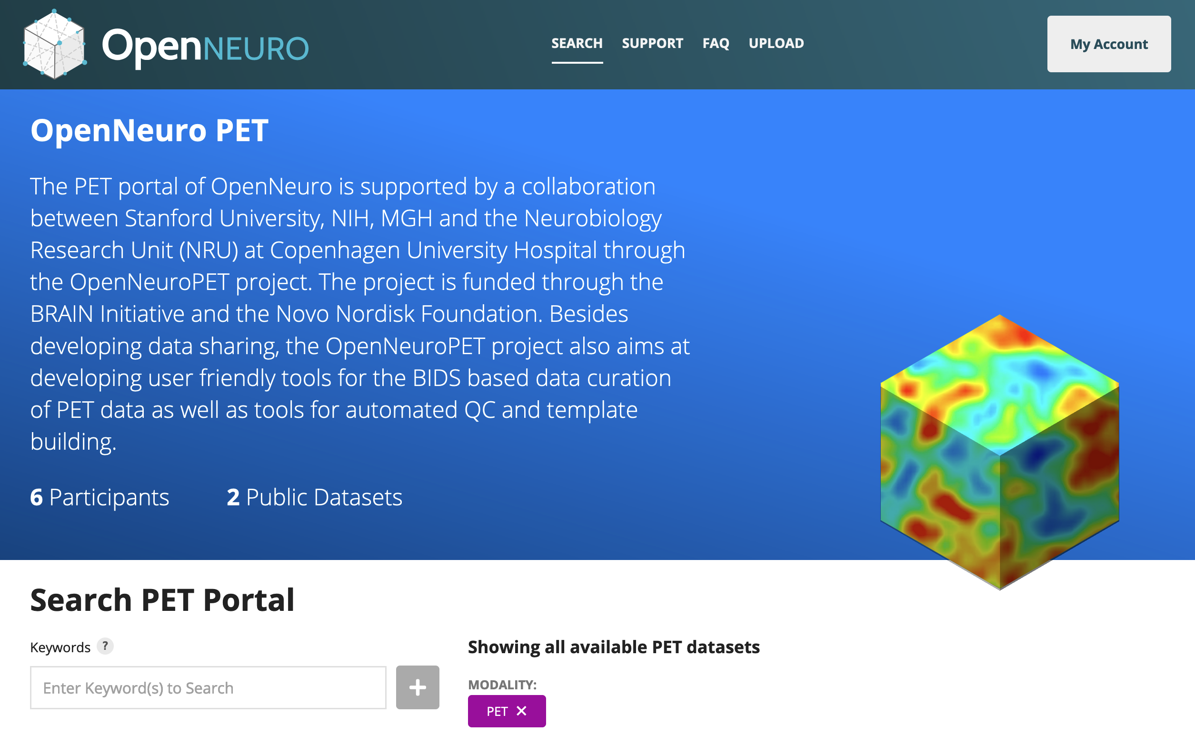
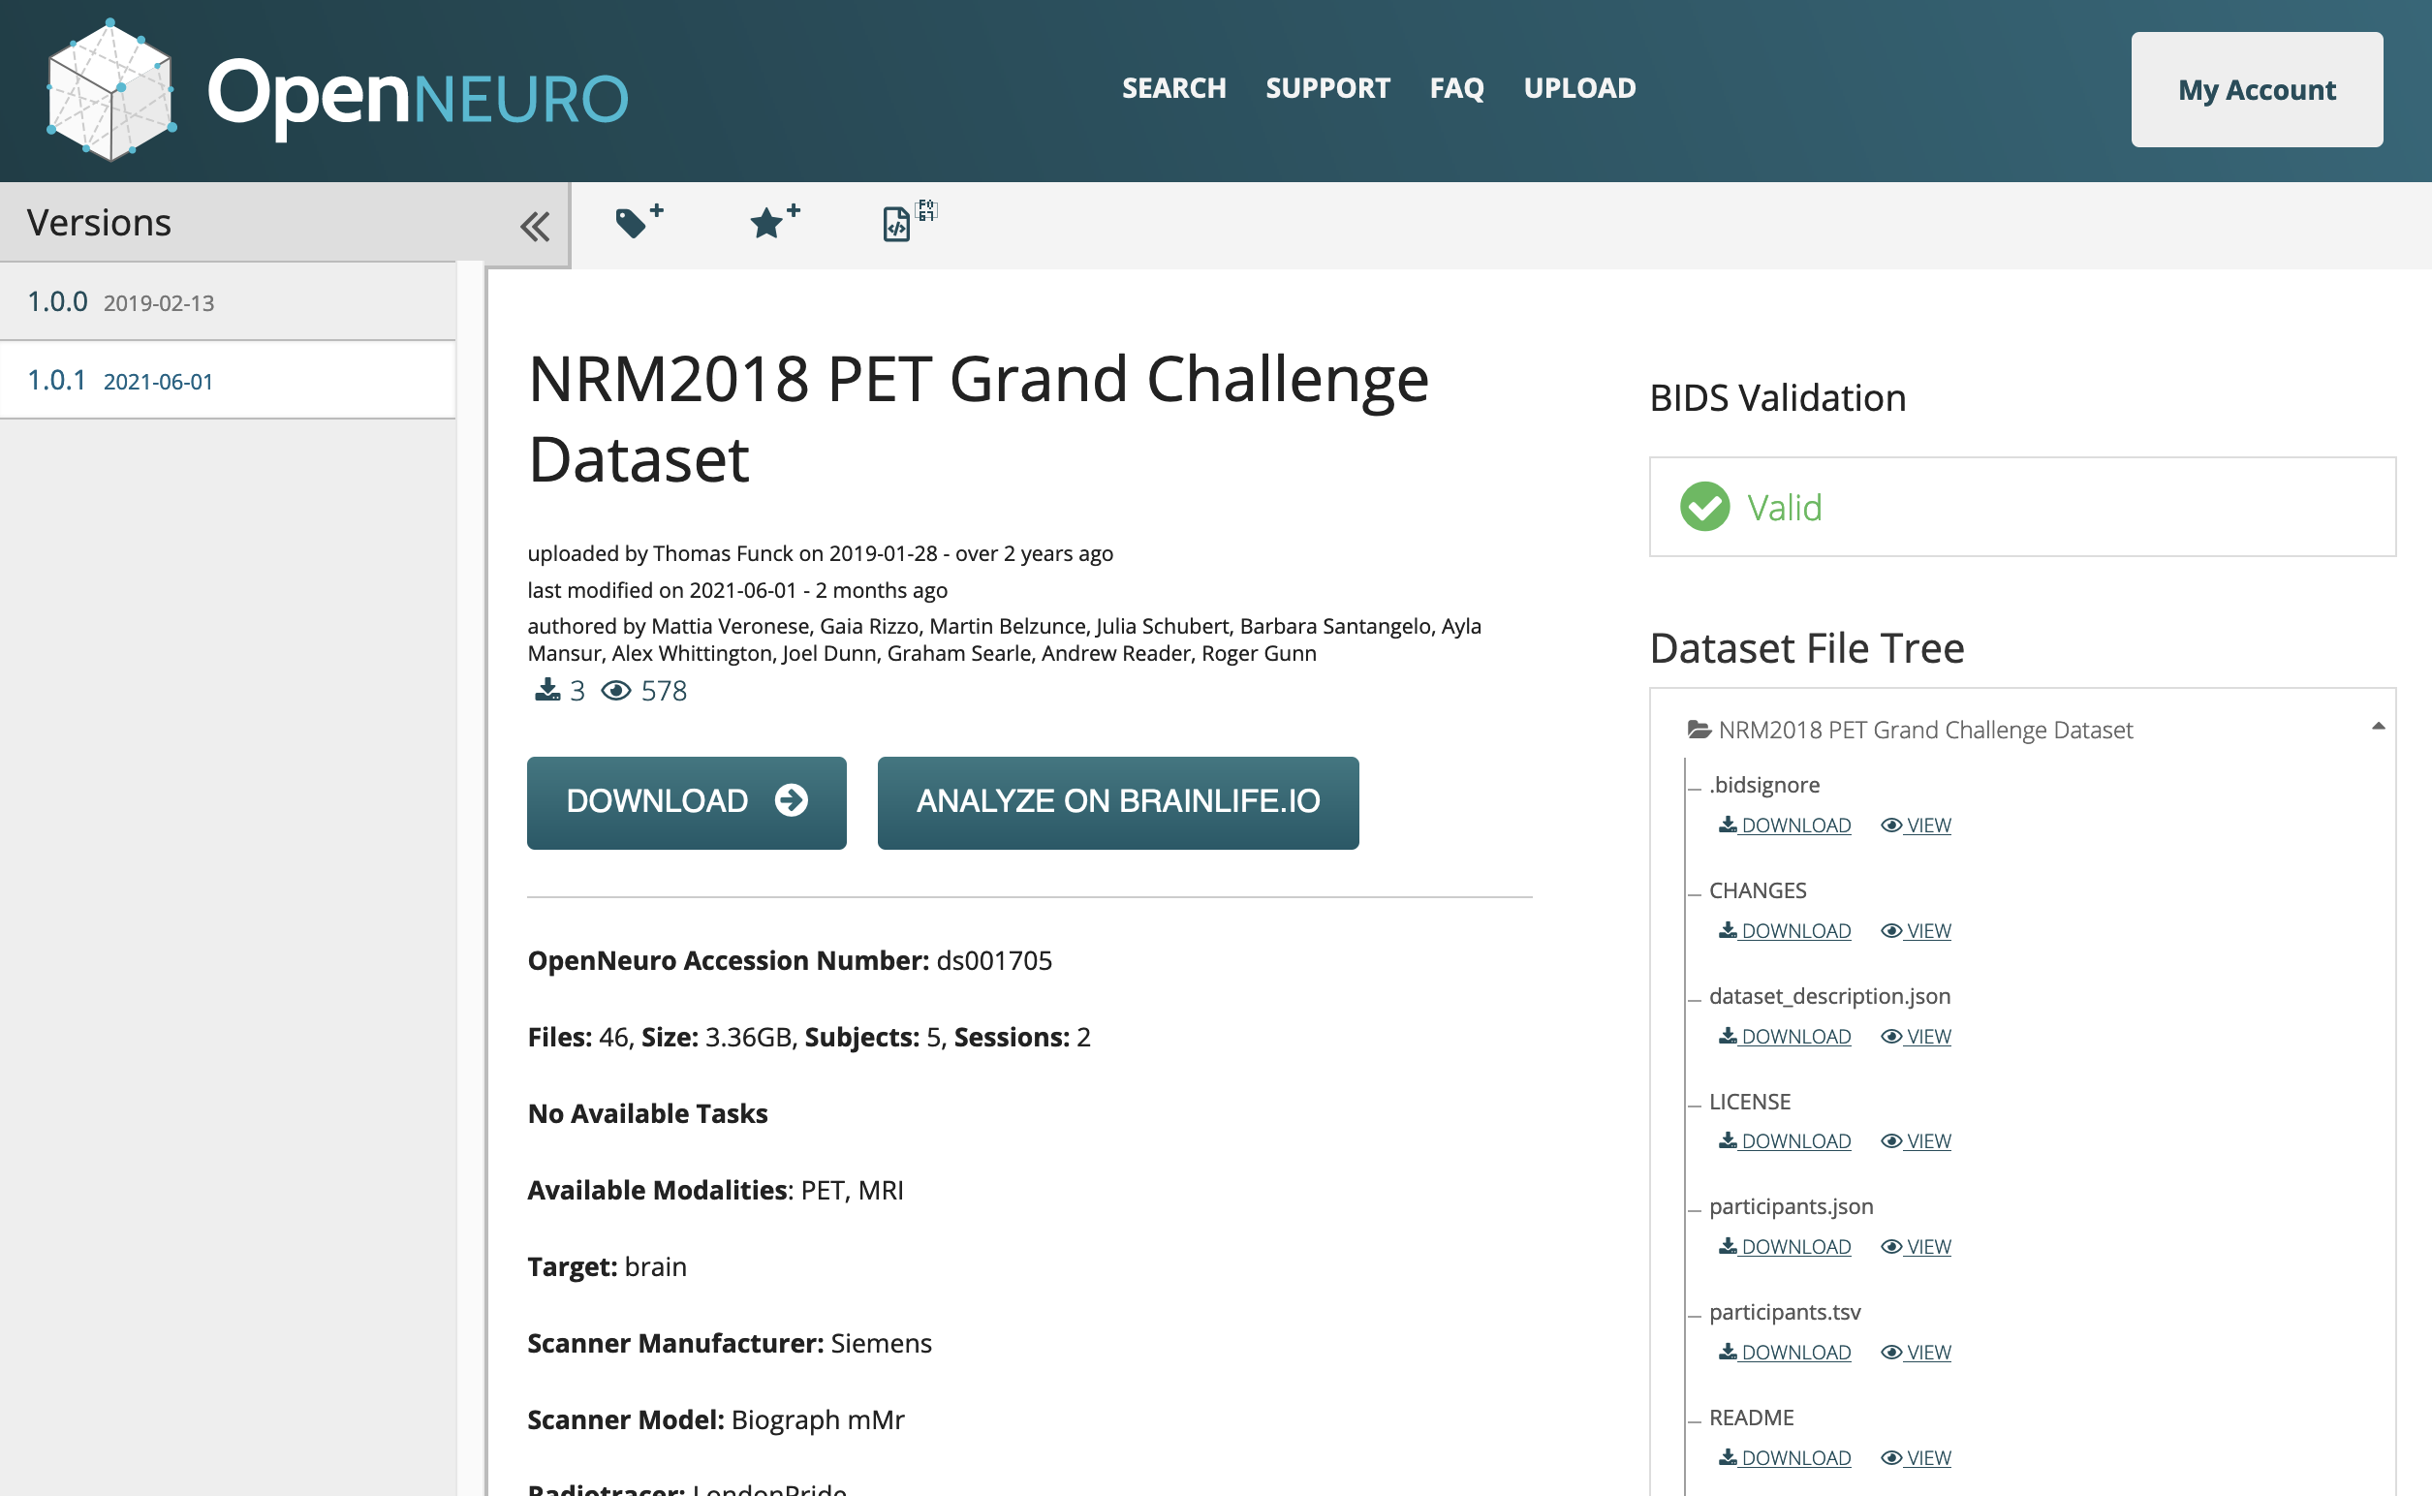

Introduction
OpenNeuroPET is developing infrastructure and tooling that increases accessibility, reproducibility, and the curation of PET data.
OpenNeuroPET is focused on creating the infrastructure to guide research data into BIDS, but what does that look like?
One of the first steps to increasing the shareability of PET data was the inclusion of PET into the popular brain imaging data structure BIDS [1] with BEP009 [2]. A standardized data format makes sharing different datasets simpler as part of the data dictionary is included in the file structure itself. Modalities follow a standard scheme and additional metadata is included in json or tab separated text files.
Organizing these datasets into the standardized BIDS set on the right leads to easier classification for humans and machines alike.
Applying BIDS to PET data reduces the imaging file count in the and standardizes both imaging and physiological data.
Once a PET dataset is converted into BIDS it can be uploaded, browsed, and downloaded via a browser (or the command line). The BIDS Validator will tell you if the dataset is valid and you can collect, view, or run analysis on this standardized structure.
Results
Add your information, graphs and images to this section.
Current Work
OpenNeuroPET
Gitte Moos Knudsen, Robert Innis, Melanie Ganz-Benjaminsen, Adam Thomas, Cyril Pernet, Martin Nørgaard,
Douglas Greeve, Russel Poldrak, Paul Wighton, Anthony Galassi

