Slide 1
Graphical multiple comparison procedures
Combining flexibility with optimality
Yao Chen (Novartis), Dong Xi (Gilead), Frank Bretz (Novartis)
ICSA Applied Statistics Symposium
Arlington, VA
June 14, 2026

Slide 2



Course instructors
Yao Chen
Novartis
Interests:
Multiple testing
Subgroup analysis
Machine learning
Dong Xi
Gilead
Interests:
Multiple testing
Adaptive designs
Causal inference
Frank Bretz
Novartis
Interests:
Multiple testing
Adaptive designs
Dose finding

Slide 3

Agenda
Part 1: Introduction and basic concepts; graphical approaches to multiple testing (Frank Bretz; 95 mins including Q&A)
Break: 15 minutes
Part 2: Optimization of graphical multiple comparison procedures (Yao Chen; 60 minutes including Q&A)
Part 3: graphicalMCP: implementation of graphical approaches (Dong Xi; 70 minutes including Q&A)

Slide 4
Disclaimer
The views expressed in this presentation are those of the presenters and do not necessarily represent the views of, and should not be attributed to, the presenters’ affiliations

Slide 5
Acknowledgement
Werner Brannath
Ethan Brockmann
Ekkehard Glimm
Florian Klinglmueller
Willi Maurer
Martin Posch
Kornelius Rohmeyer

Slide 6
Learning objectives
Become familiar with graphical approaches to multiple testing
Apply and optimize graphical approaches in clinical trial settings
Understand the basic functionality of the graphicalMCP package

Slide 7
Outline
Introduction and basic concepts
Graphical approaches to multiple testing
Optimizing graphical multiple comparison procedures
graphicalMCP: implementation of graphical approaches

Slide 8
Outline
Introduction and basic concepts
Graphical approaches to multiple testing
Optimizing graphical multiple comparison procedures
graphicalMCP: implementation of graphical approaches

Slide 9
Sources of multiplicity
Multiple test problems are very common in clinical trials
Applications include the comparison of a new treatment with
  Several other treatments (e.g., multiple doses)
  A control treatment for more than one endpoint
  A control treatment for more than one population
  A control treatment repeatedly in time
  ... (or any combination thereof)
Multiple test problems in clinical trials are very diverse and many different methods are available

Slide 10
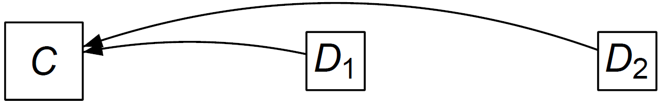
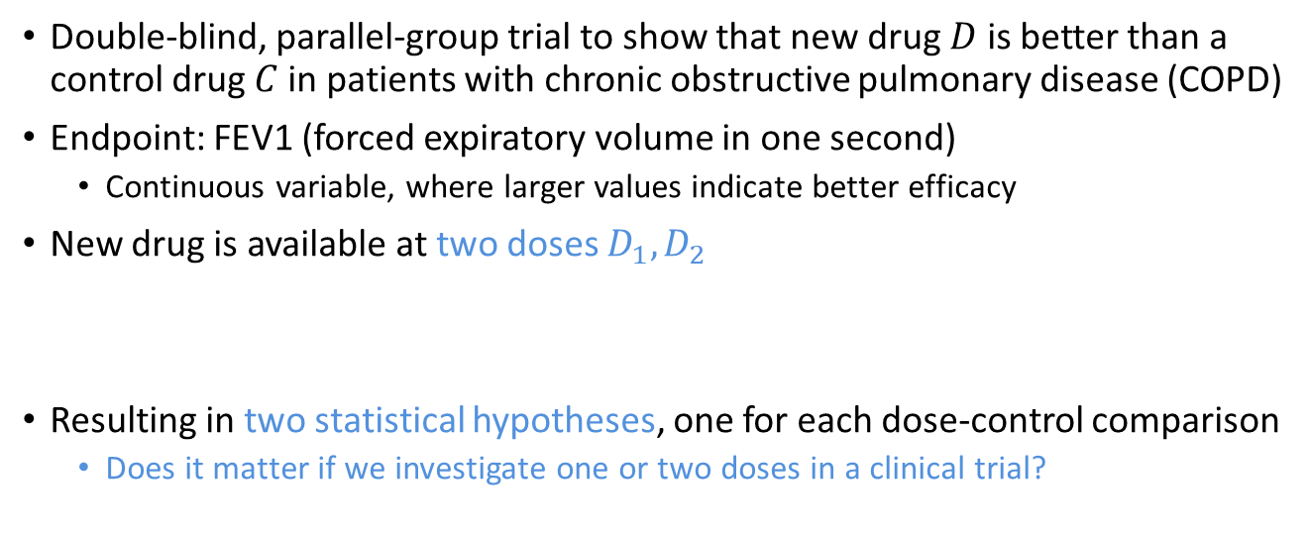
Example 1 – Multiple doses
Double-blind, parallel-group trial to show that new drug $D$ is better than a control drug $C$ in patients with chronic obstructive pulmonary disease (COPD)
Endpoint: FEV1 (forced expiratory volume in one second)
  Continuous variable, where larger values indicate better efficacy
New drug is available at two doses $D_{1},D_{2}$
Resulting in two statistical hypotheses, one for each dose-control comparison
  Does it matter if we investigate one or two doses in a clinical trial?

Slide 11
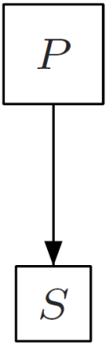
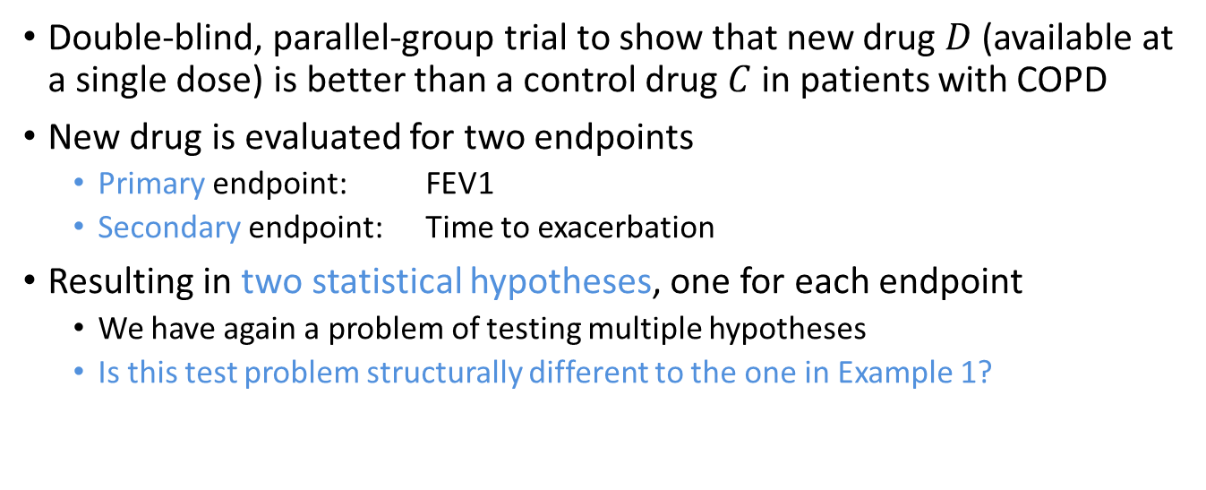
Example 2 – Multiple endpoints
Double-blind, parallel-group trial to show that new drug $D$ (available at a single dose) is better than a control drug $C$ in patients with COPD
New drug is evaluated for two endpoints
  Primary endpoint: FEV1
  Secondary endpoint: Time to exacerbation
Resulting in two statistical hypotheses, one for each endpoint
  We have again a problem of testing multiple hypotheses
  Is this test problem structurally different to the one in Example 1?

Slide 12
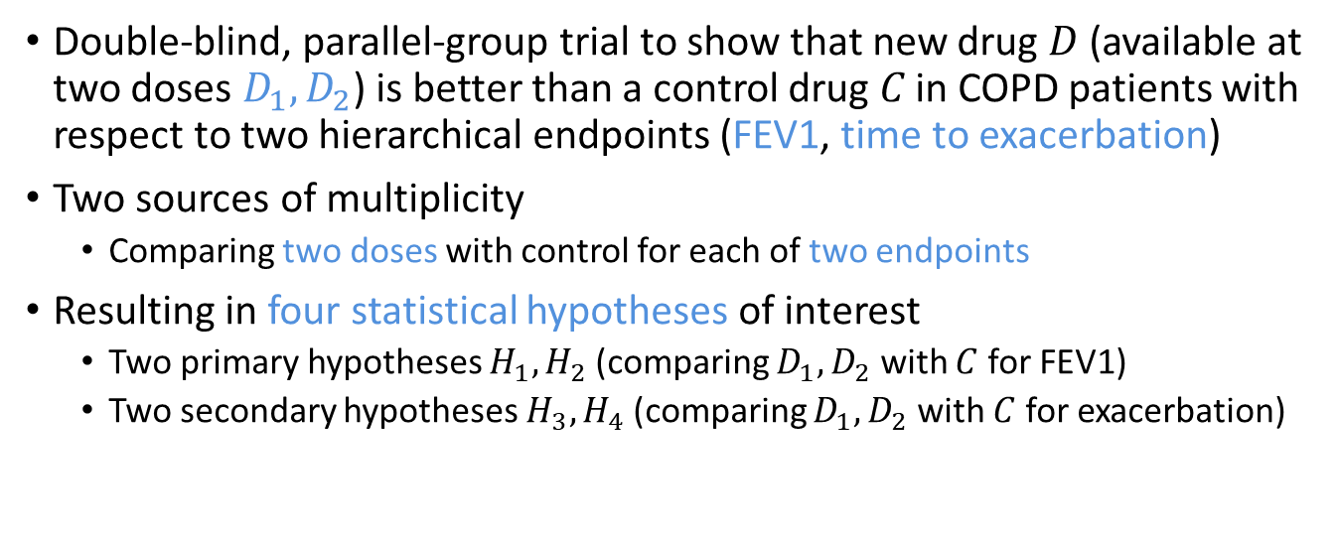
Example 3 – Multiple endpoints and multiple doses
Double-blind, parallel-group trial to show that new drug $D$ (available at two doses $D_{1},D_{2}$) is better than a control drug 𝐶 in COPD patients with respect to two hierarchical endpoints (FEV1, time to exacerbation)
Two sources of multiplicity
  Comparing two doses with control for each of two endpoints
Resulting in four statistical hypotheses of interest
  Two primary hypotheses $H_{1},H_{2}$ (comparing $D_{1},D_{2}$ with $C$ for FEV1)
  Two secondary hypotheses $H_{3},H_{4}$ (comparing $D_{1},D_{2}$ with $C$ for exacerbation)

Slide 13
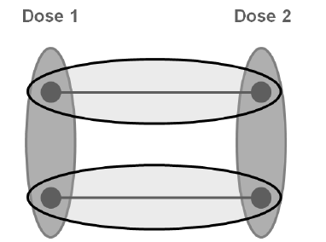
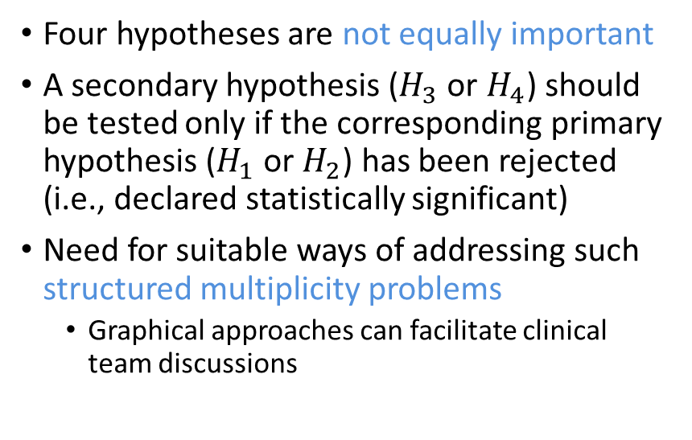
Example 3 – Multiple endpoints and multiple doses
Four hypotheses are not equally important
A secondary hypothesis ($H_{3}$ or $H_{4}$) should be tested only if the corresponding primary hypothesis ($H_{1}$ or $H_{2}$) has been rejected (i.e., declared statistically significant)
Need for suitable ways of addressing such structured multiplicity problems
  Graphical approaches can facilitate clinical team discussions
vs Placebo
vs Placebo
Primary:
Secondary:

Slide 14
Dealing with multiplicity
Reduce degree of multiplicity to the extent possible
  Address limited number of questions
  Minimize number of variables by using composite endpoints or summary scores
  Prioritize questions
If multiplicity still persists...
  Multiplicity adjustment should always be considered
  Regulatory guidelines require a description of the multiplicity adjustment in Phase III study protocols
  If not thought necessary, explain why

Slide 15

FDA guideline on multiple endpoints
Focus on...
confirmatory trials but acknowledges multiplicity issues throughout drug development
multiple endpoints, though principles extend to other multiplicity issues
efficacy endpoints, though ideas apply to safety endpoints for confirmatory purposes

Slide 16
FDA guideline on multiple endpoints
Rational clinical endpoint classification
Endpoint | Characterization | Implication on approval and product labeling | Multiplicity adjustment
Primary | Necessary and/or sufficient to establish efficacy (trial success) | Mandatory for approval | Yes
Secondary | Additional meaningful outcomes that represent alternative facets of the disease (not just minor variations on other endpoints) | Not sufficient for approval; could lead to additional labeling claims | Yes
Exploratory | Hypothesis generating and variations on primary/secondary endpoints | Descriptive extensions (not considered as new claims) | No

Slide 17



Other regulatory guidelines

Slide 18
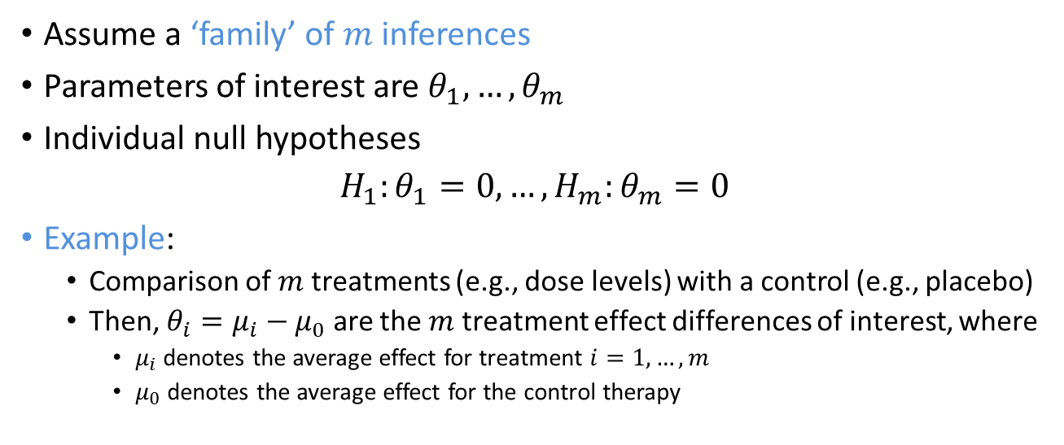
Notation
Assume a ‘family’ of $m$ inferences
Parameters of interest are $θ_{1},…,θ_{m}$
Individual null hypotheses
$$H_{1}:θ_{1}=0, …,H_{m}:θ_{m}=0$$
Example:
  Comparison of $m$ treatments (e.g., dose levels) with a control (e.g., placebo)
  Then, $θ_{i}=μ_{i}−μ_{0}$ are the $m$ treatment effect differences of interest, where
    $μ_{i}$ denotes the average effect for treatment $i=1,…,m$
    $μ_{0}$ denotes the average effect for the control therapy

Slide 19
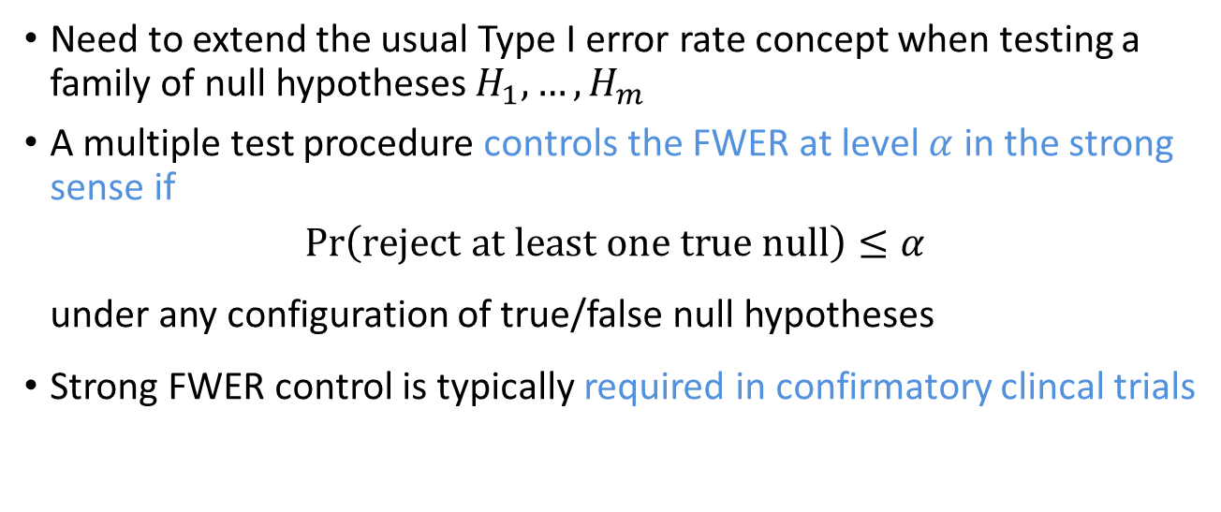
Familywise error rate (FWER)
Need to extend the usual Type I error rate concept when testing a family of null hypotheses $H_{1},…,H_{m}$
A multiple test procedure controls the FWER at level $α$ in the strong sense if
$$\operatorname{Pr}\left(\text{reject} \text{at} \text{least} \text{one} \text{true} \text{null}\right)≤α$$
under any configuration of true/false null hypotheses
Strong FWER control is typically required in confirmatory clincal trials

Slide 20
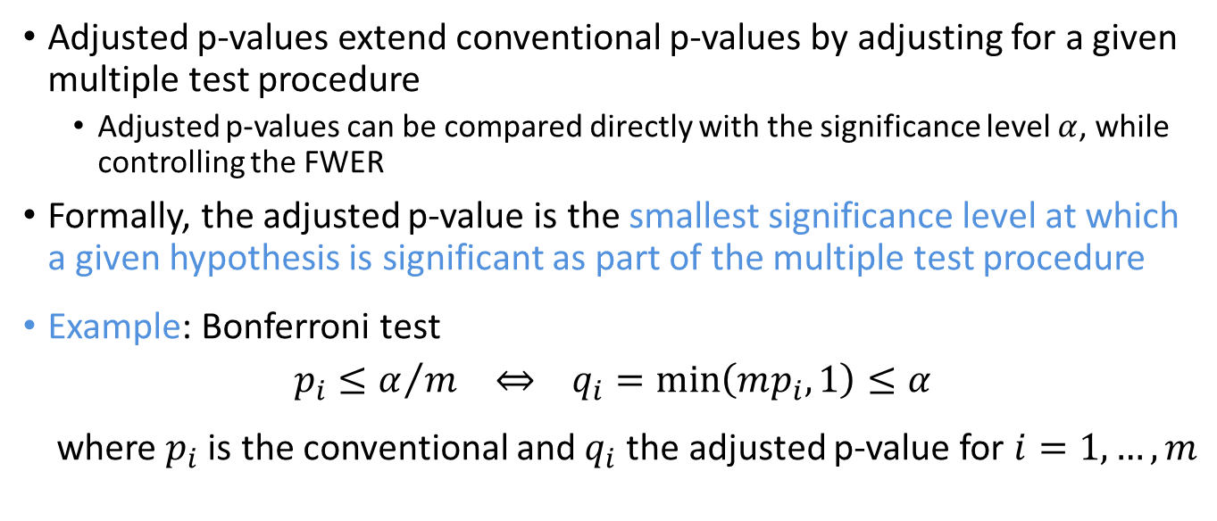
Adjusted p-values
Adjusted p-values extend conventional p-values by adjusting for a given multiple test procedure
  Adjusted p-values can be compared directly with the significance level $α$, while controlling the FWER
Formally, the adjusted p-value is the smallest significance level at which a given hypothesis is significant as part of the multiple test procedure
Example: Bonferroni test
$$p_{i}≤α/m ⇔ q_{i}=\min\left(mp_{i},1\right)≤α$$
where $p_{i}$ is the conventional and $q_{i}$ the adjusted p-value for $i=1,…,m$

Slide 21
Common multiple test procedures
Single step and stepwise methods
Single step test
  Use constant critical values for all hypotheses.
  Examples: Bonferroni, Simes, Dunnett, …
Stepwise test procedures
  Critical values may change depending on the decision of a different null hypothesis
  Rely on closed testing (general principle to construct multiple test procedures)
  Examples: Holm, Hochberg, Hommel, step-down Dunnett, …

Slide 22
Common multiple test procedures
Hochberg and Tamhane (1987); Dmitrienko, Tamhane and Bretz (2009)
 | Account for (known) correlations
 | No |  | Yes
Single step | Bonferroni | Simes | Dunnett
Stepwise | Holm | Hochberg or Hommel | Stepdown Dunnett
Stepwise procedures are more powerful than single step tests
  Single step methods are often used as ‘building blocks’ for advanced multiple test procedures (e.g., graphical approaches)
Simes-based methods are more powerful than Bonferroni-based methods, but rely on ‘positivity’ assumption
Accounting for known correlations leads to power increase
All these methods treat the null hypotheses as equally important
  Need for tailored approaches that address structured multiplicity problems

Slide 23
Outline
Introduction and basic concepts
Graphical approaches to multiple testing
  Heuristics and conventions
  Connection to common multiple test procedures
  Formal description
  Suggested workflow and Example 3 revisited
Optimizing graphical multiple comparison procedures
graphicalMCP: implementation of graphical approaches

Slide 24
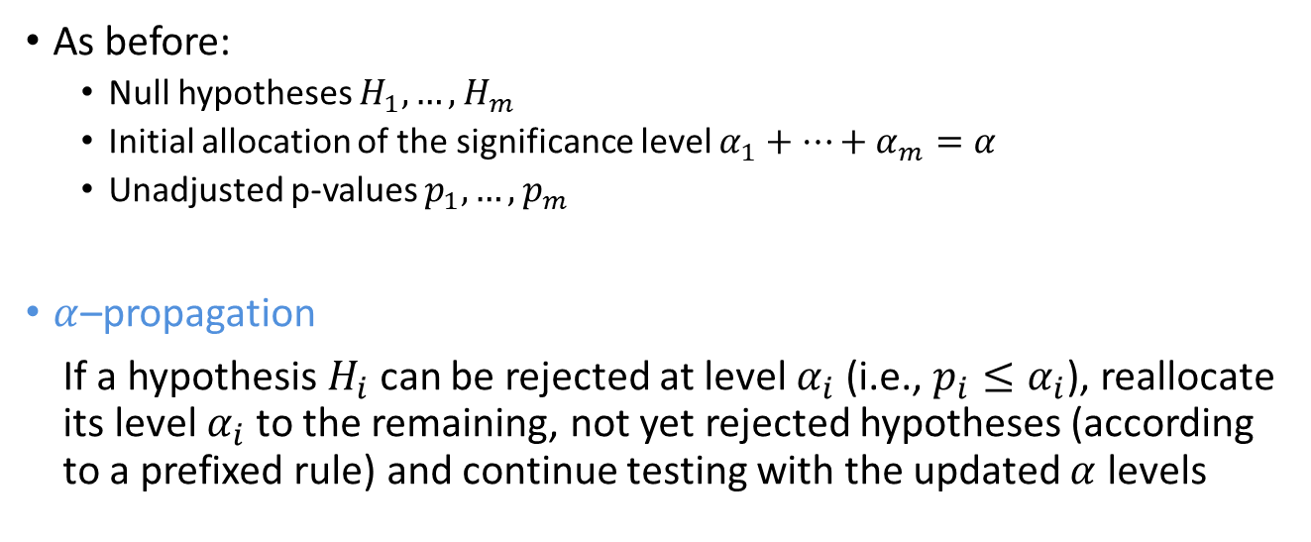
Heuristics
As before:
  Null hypotheses $H_{1},…,H_{m}$
  Initial allocation of the significance level $α_{1}+…+α_{m}=α$
  Unadjusted p-values $p_{1},…,p_{m}$
$α$–propagation
If a hypothesis $H_{i}$ can be rejected at level $α_{i}$ (i.e., ${p_{i}≤α}_{i}$), reallocate its level $α_{i}$ to the remaining, not yet rejected hypotheses (according to a prefixed rule) and continue testing with the updated $α$ levels

Slide 25
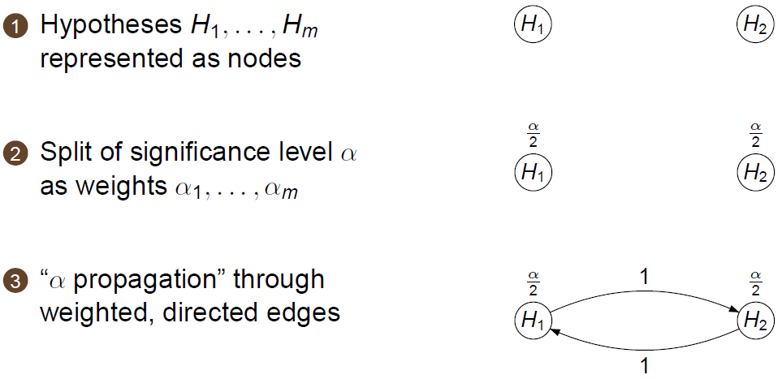
Conventions
Bonferroni
Holm

Slide 26
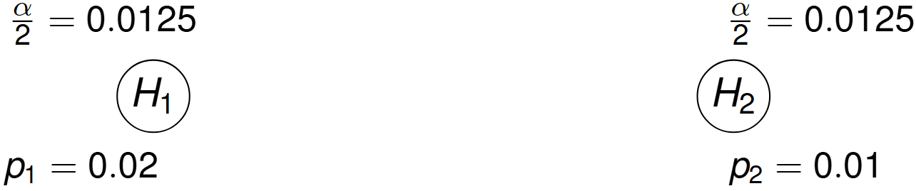
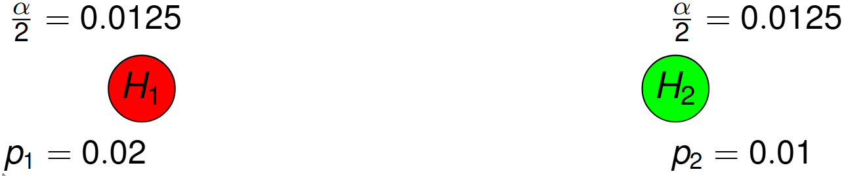

Common multiple test procedures
Bonferroni test – Example with $α=0.025$ for $m=2$ null hypotheses
No edges between nodes, therefore no 𝛼–propagation

Slide 27
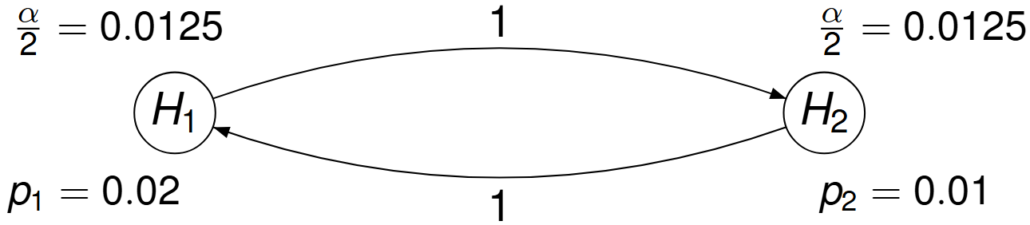



Common multiple test procedures
Holm procedure – Example with $α=0.025$ for $m=2$ hypotheses
Test $H_{1}$ at level $α/2$
Test $H_{2}$ at level $α/2$

Slide 28
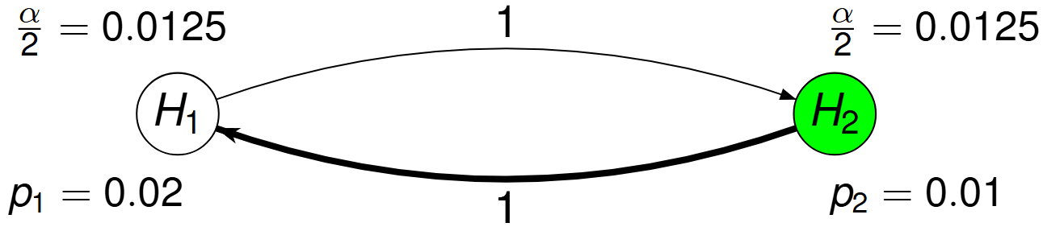
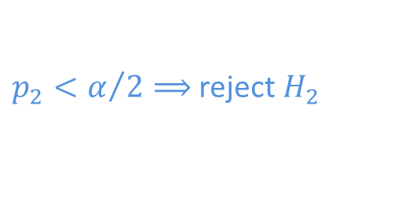
Common multiple test procedures
Holm procedure – Example with $α=0.025$ for $m=2$ hypotheses
$p_{2}<α/2⟹$ reject $H_{2}$

Slide 29
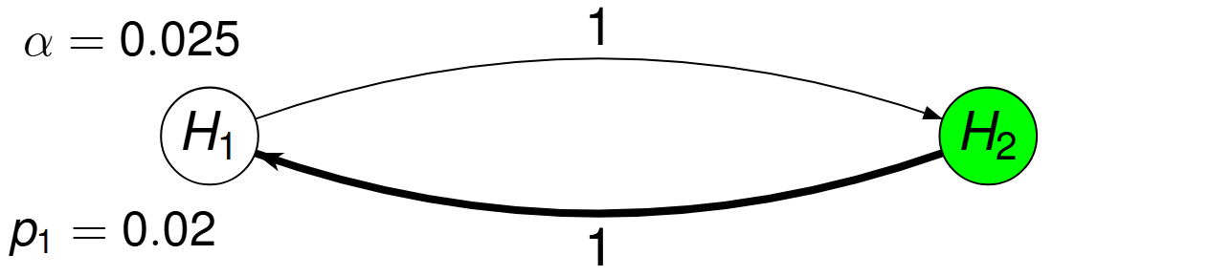

Common multiple test procedures
Holm procedure – Example with $α=0.025$ for $m=2$ hypotheses
Propagate $α/2$

Slide 30
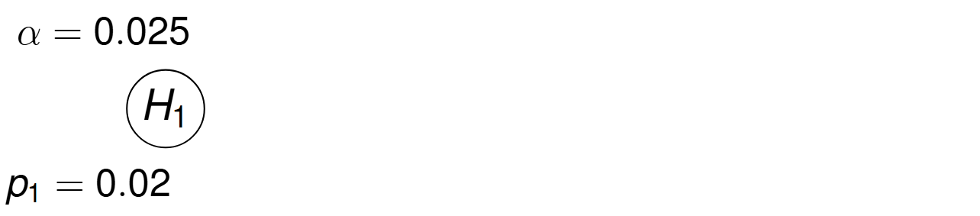

Common multiple test procedures
Holm procedure – Example with $α=0.025$ for $m=2$ hypotheses
Remove node for $H_{2}$

Slide 31
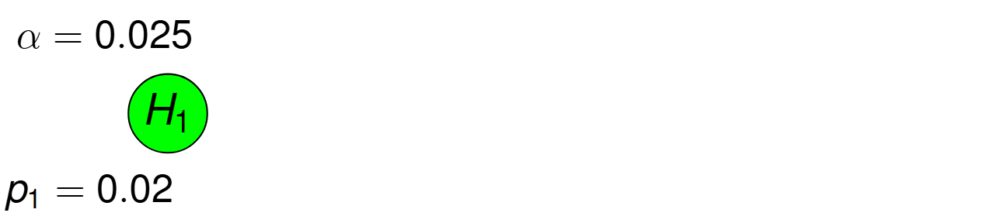
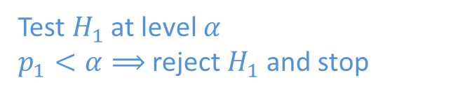
Common multiple test procedures
Holm procedure – Example with $α=0.025$ for $m=2$ hypotheses
Test $H_{1}$ at level $α$
$p_{1}<α⟹$ reject $H_{1}$ and stop

Slide 32
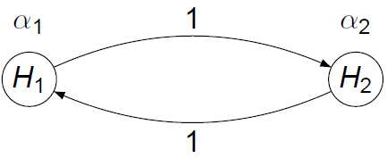
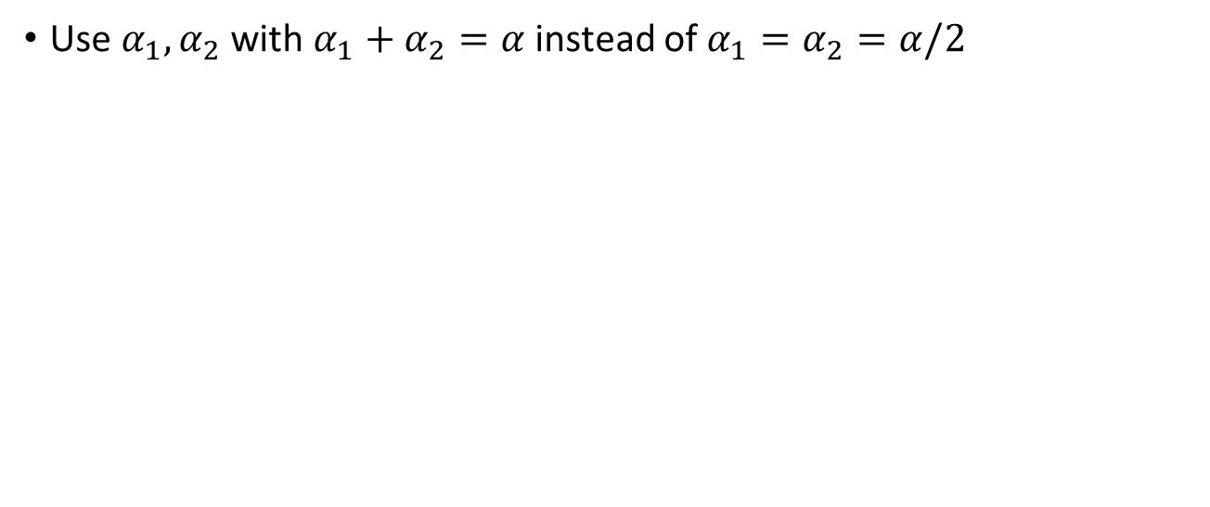
Common multiple test procedures
Weighted Holm procedure
Use $α_{1},α_{2}$ with $α_{1}+α_{2}=α$ instead of $α_{1}=α_{2}=α/2$

Slide 33
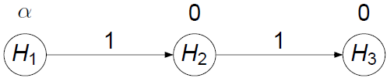
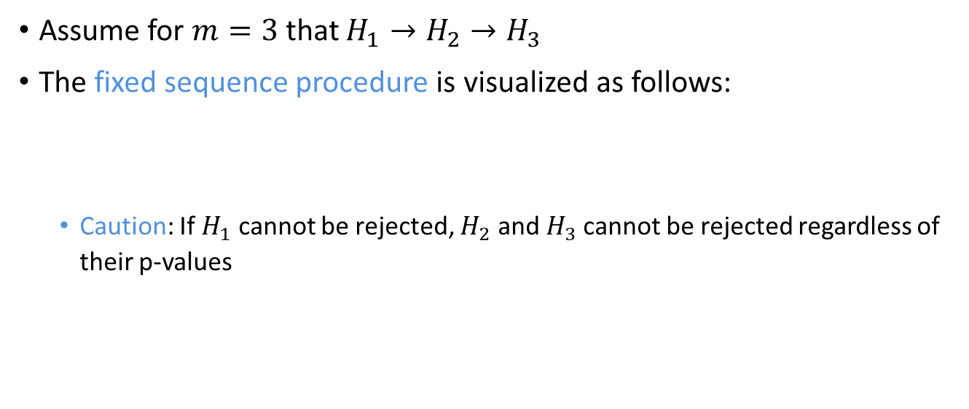
Common multiple test procedures
Fixed sequence tests (Maurer et al., 1995; Westfall and Krishen, 2001)
Assume for $m=3$ that $H_{1}→H_{2}→H_{3}$
The fixed sequence procedure is visualized as follows:
  Caution: If $H_{1}$ cannot be rejected, $H_{2}$ and $H_{3}$cannot be rejected regardless of their p-values

Slide 34
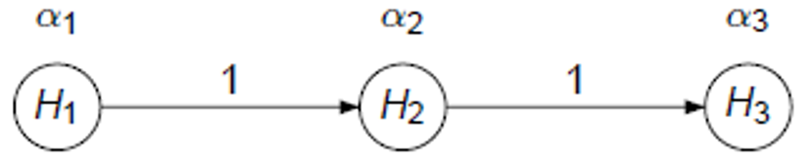
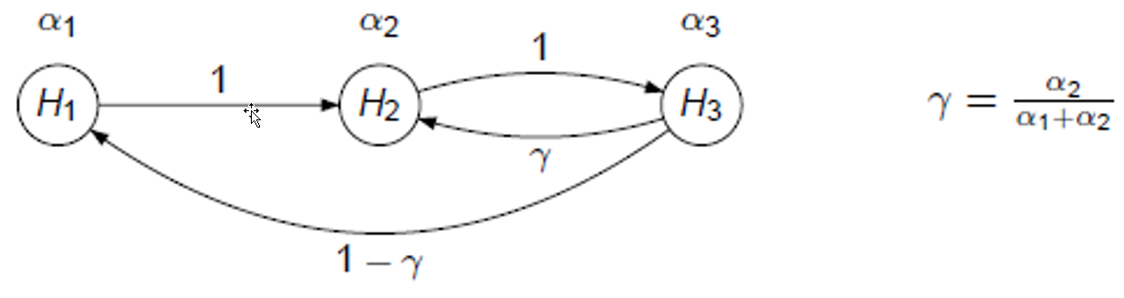
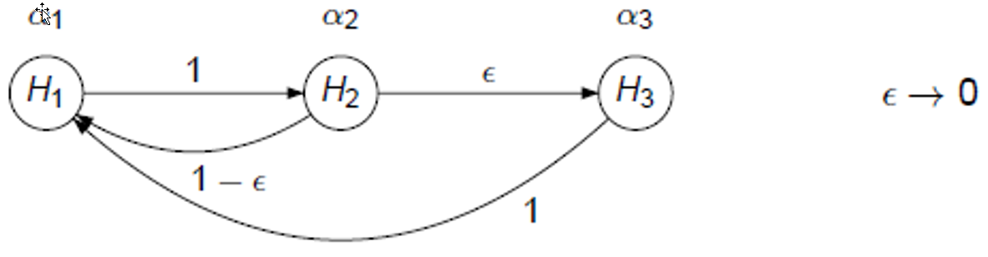
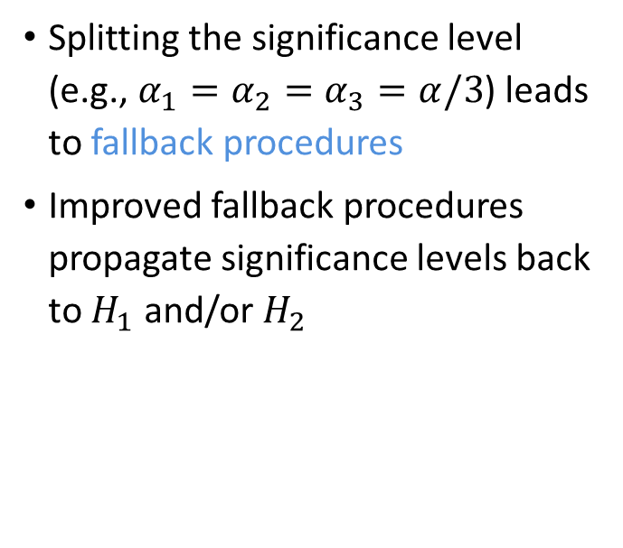
Common multiple test procedures
Fallback procedures
Splitting the significance level (e.g., $α_{1}=α_{2}=α_{3}=α/3$) leads to fallback procedures
Improved fallback procedures propagate significance levels back to $H_{1}$ and/or $H_{2}$
(Wiens, 2003)
(Wiens and Dmitrienko, 2005)
(Hommel and Bretz, 2008)

Slide 35
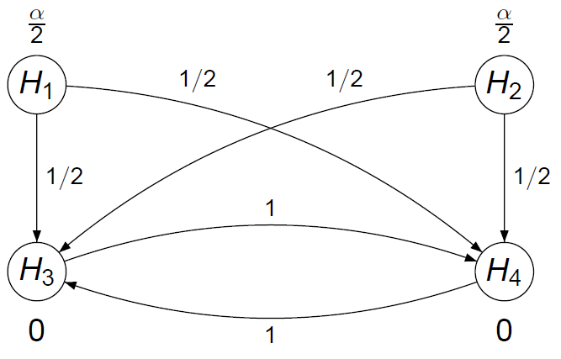
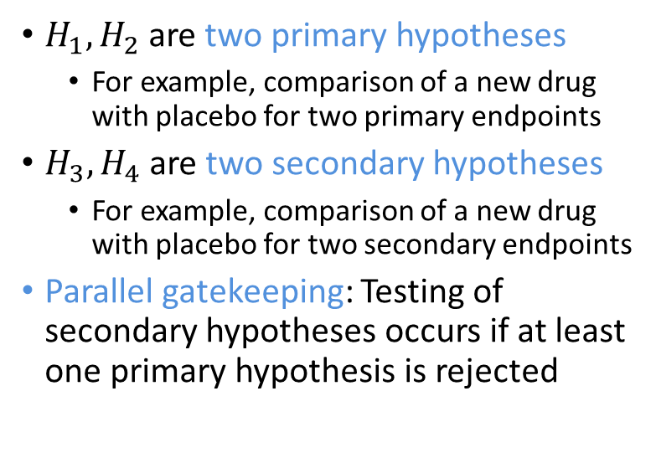
Common multiple test procedures
Parallel gatekeeping procedure (Dmitrienko et al., 2003)
$H_{1},H_{2}$ are two primary hypotheses
  For example, comparison of a new drug with placebo for two primary endpoints
$H_{3},H_{4}$ are two secondary hypotheses
  For example, comparison of a new drug with placebo for two secondary endpoints
Parallel gatekeeping: Testing of secondary hypotheses occurs if at least one primary hypothesis is rejected

Slide 36
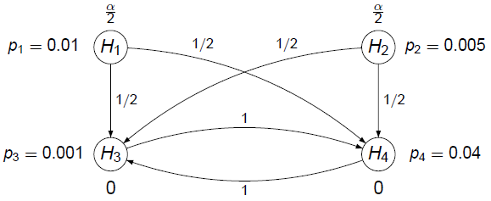

Common multiple test procedures
Parallel gatekeeping procedure – Example with $α=0.025$

Slide 37
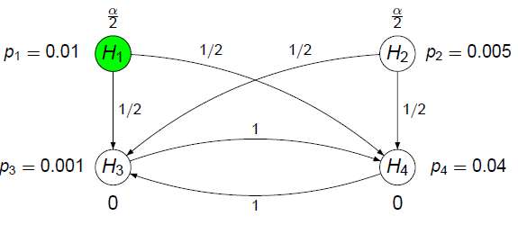
Common multiple test procedures
Parallel gatekeeping procedure – Example with $α=0.025$

Slide 38
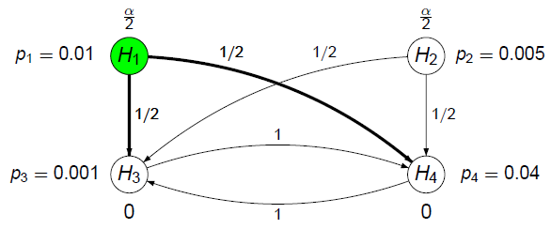
Common multiple test procedures
Parallel gatekeeping procedure – Example with $α=0.025$

Slide 39
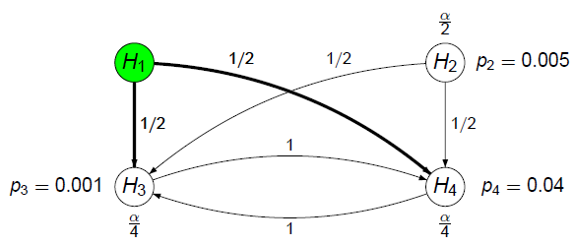
Common multiple test procedures
Parallel gatekeeping procedure – Example with $α=0.025$

Slide 40
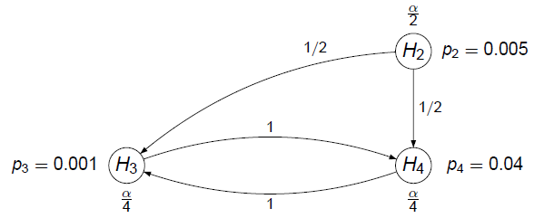
Common multiple test procedures
Parallel gatekeeping procedure – Example with $α=0.025$

Slide 41
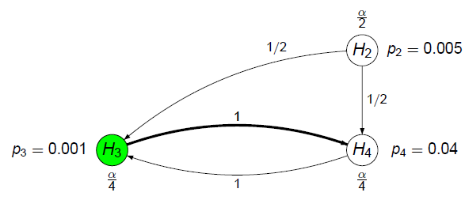
Common multiple test procedures
Parallel gatekeeping procedure – Example with $α=0.025$

Slide 42
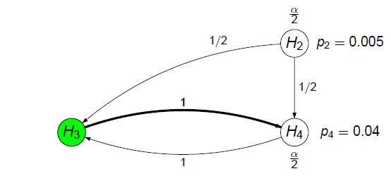
Common multiple test procedures
Parallel gatekeeping procedure – Example with $α=0.025$

Slide 43
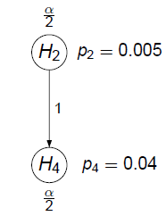
Common multiple test procedures
Parallel gatekeeping procedure – Example with $α=0.025$

Slide 44
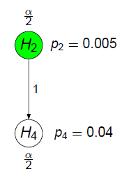
Common multiple test procedures
Parallel gatekeeping procedure – Example with $α=0.025$

Slide 45

Common multiple test procedures
Parallel gatekeeping procedure – Example with $α=0.025$

Slide 46
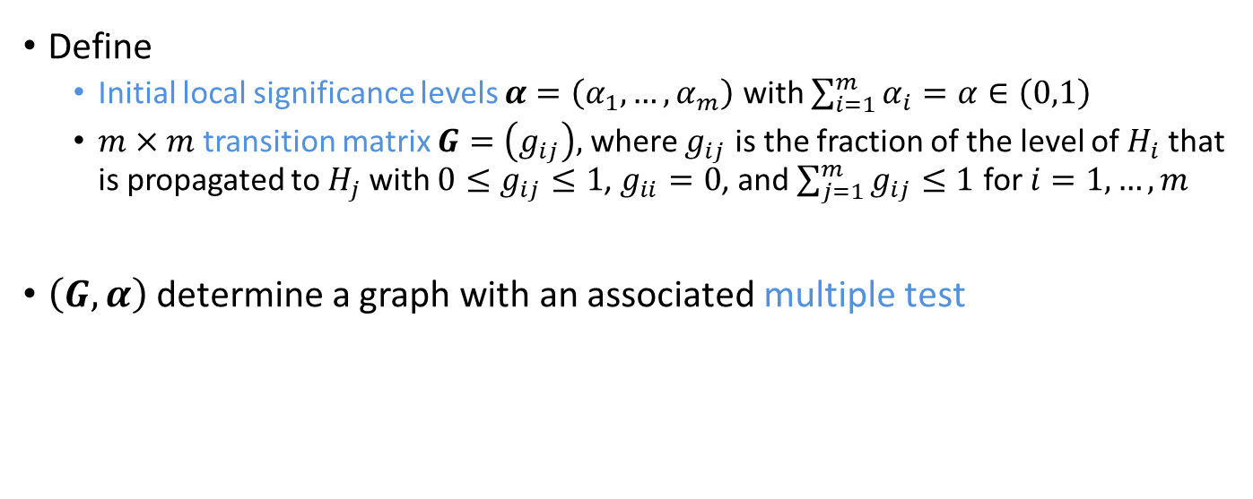
Formal description
Notation
Define
  Initial local significance levels $α=\left(α_{1},…,α_{m}\right)$ with $\sum_{i=1}^{m}{α_{i}}=α∈\left(0,1\right)$
  $m×m$ transition matrix $G=\left(g_{ij}\right),$where $g_{ij}$ is the fraction of the level of $H_{i}$ that is propagated to $H_{j}$ with $0≤g_{ij}≤1$, $g_{ii}=0$, and $\sum_{j=1}^{m}{g_{ij}}≤1$ for $i=1,…,m$
$\left(G,α\right)$ determine a graph with an associated multiple test

Slide 47
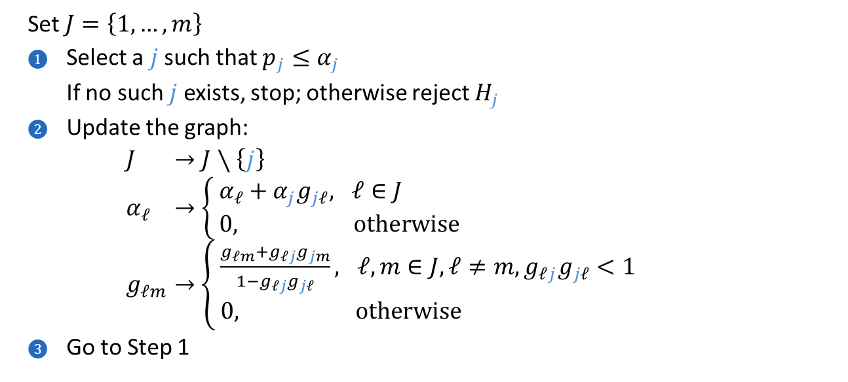
Formal description
Update algorithm
  Set $J=\left\{1,…,m\right\}$
  Select a $j$ such that $p_{j}≤α_{j}$
  If no such $j$ exists, stop; otherwise reject $H_{j}$
  Update the graph:
  $J$ $→J∖\left\{j\right\}$
  $α_{ℓ}$ $→$ $\left\{\begin{aligned}&α_{ℓ}+α_{j}g_{jℓ}, ℓ∈J \\ &0, \text{otherwise}\end{aligned}\right.$
  $g_{ℓm}→$ $\left\{\begin{aligned}&\frac{g_{ℓm}+g_{ℓj}g_{jm}}{1−g_{ℓj}g_{jℓ}}, ℓ,m∈J,ℓ≠m,g_{ℓj}g_{jℓ}<1 \\ &0, \text{otherwise}\end{aligned}\right.$
  Go to Step 1
(Maurer, Bretz and Posch, 2022)

Slide 48
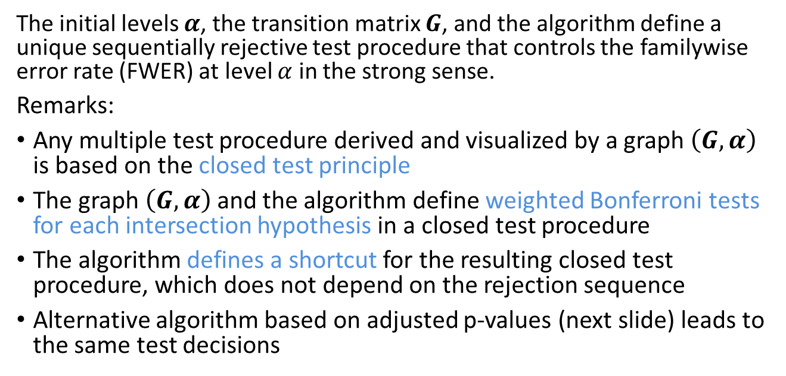
Formal description
Main result (Bretz, Maurer, Brannath, and Posch 2009)
The initial levels $α$, the transition matrix $G$, and the algorithm define a unique sequentially rejective test procedure that controls the familywise error rate (FWER) at level $α$ in the strong sense.
Remarks:
Any multiple test procedure derived and visualized by a graph $\left(G,α\right)$ is based on the closed test principle
The graph $\left(G,α\right)$and the algorithm define weighted Bonferroni tests for each intersection hypothesis in a closed test procedure
The algorithm defines a shortcut for the resulting closed test procedure, which does not depend on the rejection sequence
Alternative algorithm based on adjusted p-values (next slide) leads to the same test decisions

Slide 49
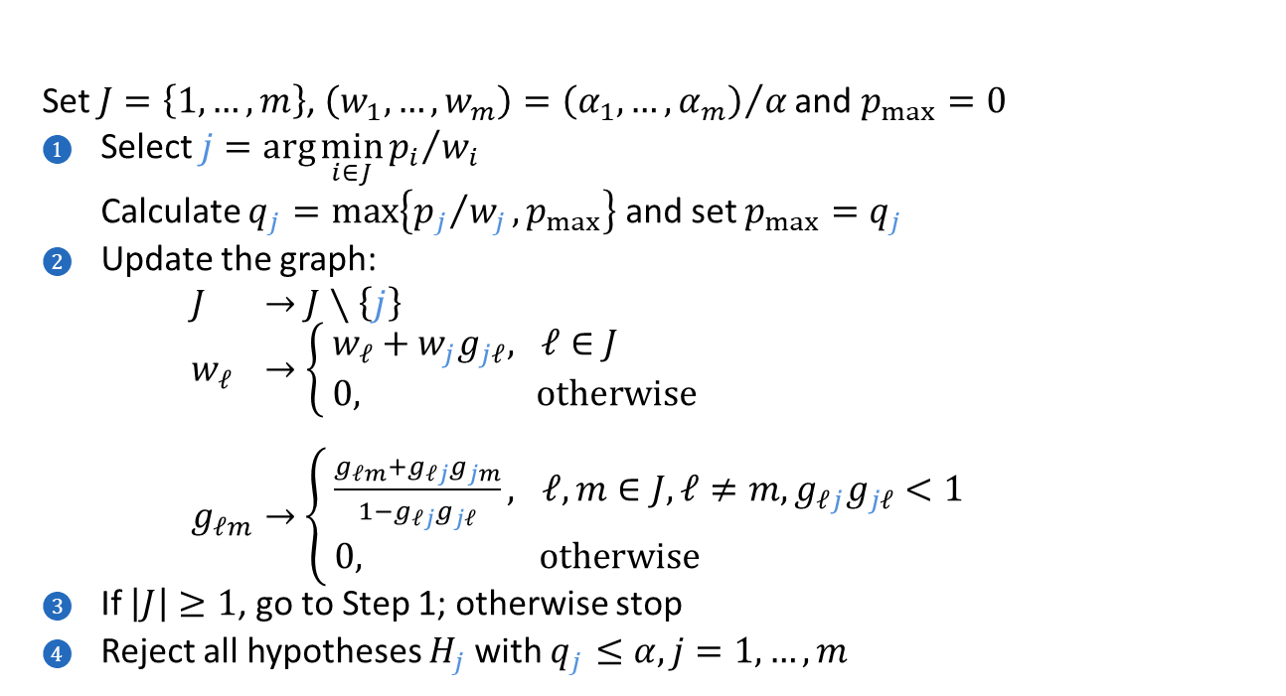
Formal description
Adjusted p-values
  Set $J=\left\{1,…,m\right\}$, $\left(w_{1},…,w_{m}\right)={\left(α_{1},…,α_{m}\right)}/α$ and $p_{max}=0$
  Select $j=\arg{\min_{i∈J}{{p_{i}}/{w_{i}}}}$
  Calculate $q_{j}=\max\left\{{p_{j}}/{w_{j}},p_{max}\right\}$ and set $p_{max}=q_{j}$
  Update the graph:
  $J$ $→J∖\left\{j\right\}$
  $w_{ℓ}$ $→$ $\left\{\begin{aligned}&w_{ℓ}+w_{j}g_{jℓ}, ℓ∈J \\ &0, \text{otherwise}\end{aligned}\right.$
  $g_{ℓm}→$ $\left\{\begin{aligned}&\frac{g_{ℓm}+g_{ℓj}g_{jm}}{1−g_{ℓj}g_{jℓ}}, ℓ,m∈J,ℓ≠m,g_{ℓj}g_{jℓ}<1 \\ &0, \text{otherwise}\end{aligned}\right.$
  If $\left|J\right|≥1$, go to Step 1; otherwise stop
  Reject all hypotheses $H_{j}$ with $q_{j}≤α,j=1,…,m$

Slide 50
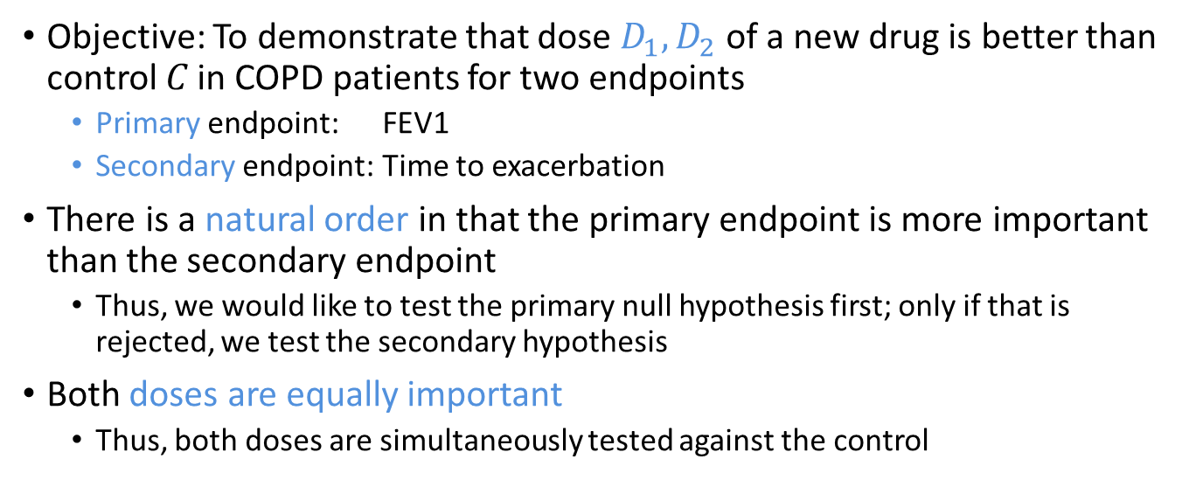
Example 3 revisited
Background
Objective: To demonstrate that dose $D_{1},D_{2}$ of a new drug is better than control 𝐶 in COPD patients for two endpoints
  Primary endpoint: FEV1
  Secondary endpoint: Time to exacerbation
There is a natural order in that the primary endpoint is more important than the secondary endpoint
  Thus, we would like to test the primary null hypothesis first; only if that is rejected, we test the secondary hypothesis
Both doses are equally important
  Thus, both doses are simultaneously tested against the control

Slide 51
Suggested workflow
In close collaboration between clinicians and statisticians (LaLonde and Nissen, 2025), select a general graphical test strategy that addresses the trial objectives
Finetune it based on
  clinical importance relationships among trial objectives
  assumptions about effect sizes, nuisance parameters, correlations, ...
Perform sample size calculations for a suitable power definition

Slide 52
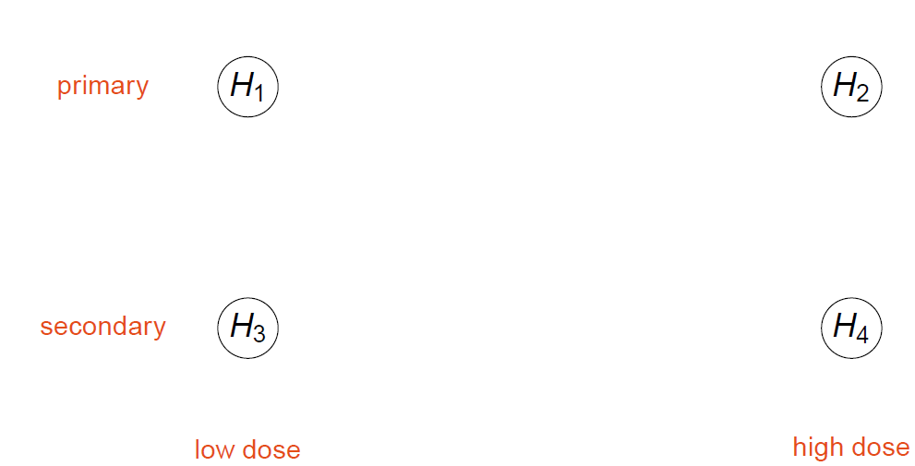
Example 3 revisited
Building a multiple test procedure – Hypotheses

Slide 53
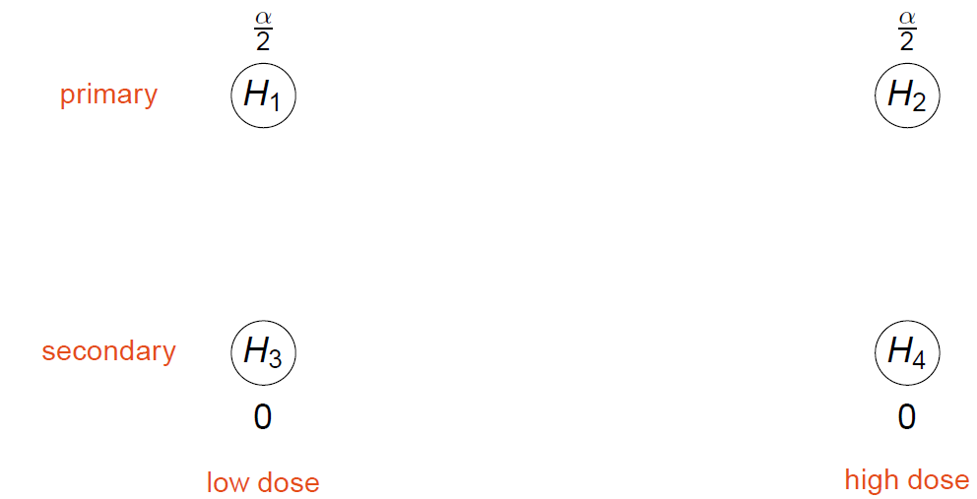
Example 3 revisited
Building a multiple test procedure – Initial significance levels

Slide 54
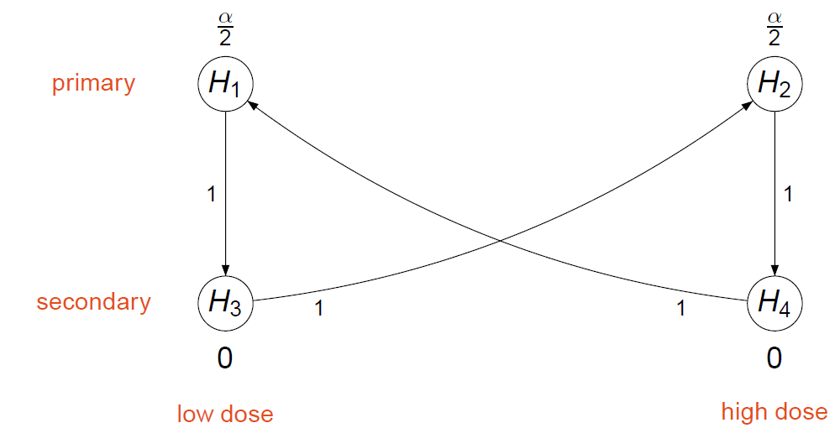
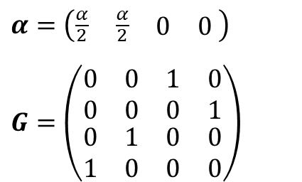
Example 3 revisited
Building a multiple test procedure – Propagation of significance levels
$$α=\left(\begin{matrix}\begin{matrix}\frac{α}{2} & \frac{α}{2}\end{matrix} & \begin{matrix}0 & 0\end{matrix}\end{matrix} \right)$$
$$G=\left(\begin{matrix}\begin{matrix}0 & 0 \\ 0 & 0\end{matrix} & \begin{matrix}1 & 0 \\ 0 & 1\end{matrix} \\ \begin{matrix}0 & 1 \\ 1 & 0\end{matrix} & \begin{matrix}0 & 0 \\ 0 & 0\end{matrix}\end{matrix}\right)$$

Slide 55
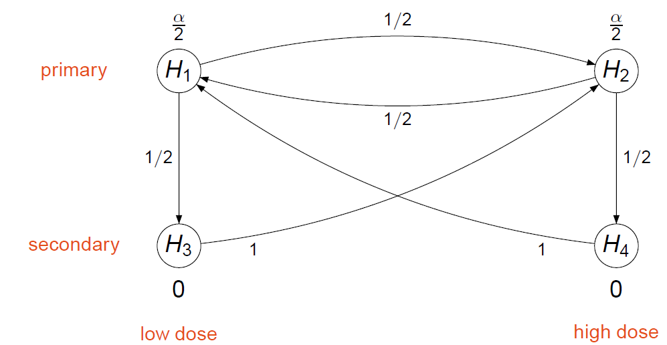

Example 3 revisited
Building a multiple test procedure – Alternative propagation
$$α=\left(\begin{matrix}\begin{matrix}\frac{α}{2} & \frac{α}{2}\end{matrix} & \begin{matrix}0 & 0\end{matrix}\end{matrix} \right)$$
$$G=\left(\begin{matrix}\begin{matrix}0 & \frac{1}{2} \\ \frac{1}{2} & 0\end{matrix} & \begin{matrix}\frac{1}{2} & 0 \\ 0 & \frac{1}{2}\end{matrix} \\ \begin{matrix}0 & 1 \\ 1 & 0\end{matrix} & \begin{matrix}0 & 0 \\ 0 & 0\end{matrix}\end{matrix}\right)$$

Slide 56



Example 3 revisited
Building a multiple test procedure – General approach
$$α=\left(\begin{matrix}\begin{matrix}α_{1} & α_{2}\end{matrix} & \begin{matrix}0 & 0\end{matrix}\end{matrix} \right)$$
$$G=\left(\begin{matrix}\begin{matrix}0 & γ_{1} \\ γ_{2} & 0\end{matrix} & \begin{matrix}1−γ_{1} & 0 \\ 0 & 1−γ_{2}\end{matrix} \\ \begin{matrix}0 & 1 \\ 1 & 0\end{matrix} & \begin{matrix}0 & 0 \\ 0 & 0\end{matrix}\end{matrix}\right)$$
Resulting graph depends on the remaining design parameters $α_{1}$, $γ_{1}$, and $γ_{2}$
These need to be fine-tuned based on further clinical considerations, or assumptions about effect sizes, nuisance parameters, correlations, ...

Slide 57
Sample size and power calculations
Scenarios
Calculating the power or sample size for a given test procedure should be done under a plausible range of assumptions ('scenarios')
  This ensures a robust assessment of the performance of the proposed graphical test procedure
Assumptions may have to be made for a variety of parameters (e.g., effect sizes, nuisance parameters, correlations)
  For some parameters there might be more information available (e.g., effect sizes) than for others (e.g., correlation between endpoints)
Parameters underlying the scenarios can take different forms
  For example, standardized effect sizes can conveniently be expressed through marginal power values or non-centrality parameters

Slide 58
Sample size and power calculations
Outcome measures
To calculate the power for a given graphical test procedure, distinguish between the probabilities of
successful trial (as driven by the primary objectives)
rejecting an individual null hypotheses
(weighted) combination of individual rejections, e.g., probability of rejecting
  at least one hypothesis ('disjunctive power')
  the primary endpoint hypothesis for at least one dose
  all primary and secondary endpoint hypotheses for at least one dose
  all hypotheses ('conjunctive power')

Slide 59


Example 3 revisited
Building a multiple test procedure – Power
Design parameters |  |  | Scenarios |  |  |  |  | Outcome measures
$$α_{1}$$ | $$γ_{1}$$ | $$γ_{2}$$ | $$ρ$$ | $$π_{1}^{marg}$$ | $$π_{2}^{marg}$$ | $$π_{3}^{marg}$$ | $$π_{4}^{marg}$$ | $$π$$ | $$π_{1}^{ind}$$ | $$π_{2}^{ind}$$ | $$π_{3}^{ind}$$ | $$π_{4}^{ind}$$
0.0125 | 0 | 0 | 0.5 | 0.9 | 0.9 | 0.8 | 0.8 | 0.9372 | 0.8694 | 0.8694 | 0.7042 | 0.7046
0.0125 | 0 | 0 | 0.8 | 0.9 | 0.9 | 0.8 | 0.8 | 0.9373 | 0.8697 | 0.8702 | 0.7385 | 0.7392
0.0125 | 0 | 0 | 0.95 | 0.9 | 0.9 | 0.8 | 0.8 | 0.9371 | 0.8703 | 0.8706 | 0.7604 | 0.7607
0.0125 | 0.5 | 0.5 | 0.5 | 0.9 | 0.9 | 0.8 | 0.8 | 0.9372 | 0.8752 | 0.8753 | 0.6988 | 0.6993
0.0125 | 0.5 | 0.5 | 0.8 | 0.9 | 0.9 | 0.8 | 0.8 | 0.9373 | 0.8751 | 0.8753 | 0.7301 | 0.7307
0.0125 | 0.5 | 0.5 | 0.95 | 0.9 | 0.9 | 0.8 | 0.8 | 0.9371 | 0.8745 | 0.8748 | 0.7483 | 0.7486
0.0125 | $$1−ε$$ | $$1−ε$$ | 0.5 | 0.9 | 0.9 | 0.8 | 0.8 | 0.9372 | 0.8813 | 0.8815 | 0.6717 | 0.6719
0.0125 | $$1−ε$$ | $$1−ε$$ | 0.8 | 0.9 | 0.9 | 0.8 | 0.8 | 0.9373 | 0.8815 | 0.8816 | 0.7035 | 0.704
0.0125 | $$1−ε$$ | $$1−ε$$ | 0.95 | 0.9 | 0.9 | 0.8 | 0.8 | 0.9371 | 0.8815 | 0.8817 | 0.7236 | 0.7239
$ε→0$; $ρ=corr\left(Z_{1},Z_{3}\right)=corr\left(Z_{2},Z_{4}\right)$ where $Z_{i}$ denotes the test statistic for $H_{i}$; $corr\left(Z_{1},Z_{2}\right)=corr\left(Z_{3},Z_{4}\right)=0.5$
$π$: probability of a for a successful trial; $π_{i}^{marg}$ and $π_{i}^{ind}$: marginal and individual power for $H_{i}$, respectively

Slide 60
Outline
Introduction and basic concepts
Graphical approaches to multiple testing
Optimizing graphical multiple comparison procedures
  Optimizing weighted Bonferroni test
  Optimizing graphical approach
graphicalMCP: implementation of graphical approaches

Slide 61
Outline
Introduction and basic concepts
Graphical approaches to multiple testing
Optimizing graphical multiple comparison procedures
  Optimizing weighted Bonferroni test
  Optimizing graphical approach
graphicalMCP: implementation of graphical approaches

Slide 62

How to design a graph
Example 3 revisited
primary
secondary
Graph design normally depends on the clinical consideration and certain metrics
  Is equal split always reasonable among primary endpoints? What if $H_{2}$ has smaller power than $H_{1}$?
  If $H_{1}$ is rejected, shall the weight be propagated to $H_{2}$?

Slide 63

Weighted Bonferroni test
Consider testing $m$ null hypotheses, $H_{1},…, H_{m}$ vs. upper alternatives
To control the FWER at an overall significance level $α$, weighted Bonferroni tests are considered
Let $p_{i}$ be the one-sided $p$-value for $H_{i}$, marginal power for $H_{i}$ is $π_{i}^{marg}=Pr⁡(p_{i}≤α)$, $ξ_{i}$ is the non-centrality parameter for $H_{i}$
Assign a weight $w_{i}≥0$ to $H_{i}$ and reject $H_{i}$ if $p_{i}≤w_{i}α$
  $\sum_{i}{w_{i}}=1$
Question of interest: how to choose $w_{i}$ for an “optimized” weighted Bonferroni test?

Slide 64


What to optimize?
Maximize "power" of weighted Bonferroni tests
$s.t. 0≤w_{i}≤1$ for $i=1,…, m \sum_{i}{w_{i}}=1$
Average power : $\frac{1}{m}\sum_{i=1}^{m}{P_{ξ_{i}}(p_{i}≤w_{i}α)}$
Disjunctive power: $P_{{\left\{ξ_{i}\right\}}_{i=1}^{m}}\left\{\bigcup_{i}{\left(p_{i}≤w_{i}α\right)}\right\}$, i.e., probability to reject at least one null hypothesis
Conjunctive power: $P_{{\left\{ξ_{i}\right\}}_{i=1}^{m}}\left\{\bigcap_{i}{\left(p_{i}≤w_{i}α\right)}\right\}$, i.e., probability to reject all null hypotheses
Disjunctive power and conjunctive power are more commonly used but the computation depends on joint distribution
We will focus on disjunctive power today

Slide 65
Existing approaches
Optimal weights for fixed sequence procedures are determined:
  By maximizing weighted power (Westfall et al. 2001)
  And the expected number of rejections (Zhang et al. 2015)
Analytical formulae are derived for weighted Bonferroni tests to achieve optimal average power (Roeder & Wasserman 2009, Rubin et al. 2006)
Optimal design for disjunctive power and total number of rejection with small number of hypotheses (Heller et al. 2023)
Grid search and simulation (Bretz et al. 2011, Wiens et al. 2013, Dmitrienko et al. 2015)
Optimization using deep learning to enhance weighted power in graphical approaches (Zhan et al. 2022)

Slide 66











Why split $α$?
Comparison with fixed sequence procedure
$α=0.025$, test statistics follow asymptotic normal distribution and are independent
Marginal powers of $H_{1}$ and $H_{2}$ (under full $α$) are 0.9, 0.8
$p_{1}$ and $p_{2}$ are $p$-values for $H_{1}$ and $H_{2}$
$$\operatorname{Pr}\left(p_{1}<\frac{0.025}{2}\right)+$$
$$\operatorname{Pr}\left(\frac{0.025}{2}<p_{1}<0.025\right)×Pr\left(p_{2}<\frac{0.025}{2}\right)⁡$$
$$α/2$$
$$α/2$$
$$H_{1}$$
$$H_{2}$$
$$H_{1}$$
$$H_{2}$$
Power of rejecting $H_{1}$ is $0.9$
Power of rejecting $H_{2}$ is $0.72$
Power of at least one rejection: 0.9
Expected # of rejections: 1.62
Power of rejecting $H_{1}$ is $0.883$
Power of rejecting $H_{2}$ is $0.786$
Power of at least one rejection: 0.953
Expected # of rejection: 1.67

Slide 67





Why split $α$?
Intuition and conclusion
More gain with increased $α$
Less gain with increased $α$
$α$-splitting could achieve
  higher disjunctive power (i.e., reject at least one hypothesis)
  larger expected number of rejections
More robust when we have uncertainty with assumptions

Slide 68



How to split $α$?
Under independence
Consider two hypotheses with independent test statistics
Hypotheses with larger marginal power get larger weights
Scenario 1: Marginal power of 80% and 80%
Scenario 2: Marginal power of 90% and 70%
Scenario 1: Optimal weights of 0.5 and 0.5
Scenario 2: Optimal weights of 0.679 and 0.321

Slide 69




How to split $α$?
Under dependence
Consider two hypotheses with correlated test statistics
  Marginal power of 80% and 80%
When correlation presents, it is not always optimal to split $α$
Optimal $α$ split may not be unique
Scenario 1: Correlation 0.9
Scenario 2: Correlation 0.797
Scenario 1: Optimal weights (1, 0) or (0, 1)
Scenario 2: Optimal weights (1, 0) or (0.5, 0.5) or (0, 1)

Slide 70

Optimization
Maximize disjunctive power of weighted Bonferroni tests
$$Pr⁡(∪_{i=1}^{m}(p_{i}≤w_{i}α))$$
$s.t. 0≤w_{i}≤1$ for $i=1,…, m, \sum_{i}{w_{i}}=1$
We choose Sequential Least SQuares Programming (SLSQP) algorithm in Nloptr library
  Explicit expression on objective function and its gradients are available
  The constraints are needed when using optimization algorithms
For correlated case, searching with multiple starting points can thoroughly investigating the space and return global optima in most cases
Additional constraints from clinical consideration can be incorporated in the upper/lower bound of the optimization

Slide 71



Solution
$α=0.025$, $π^{marg}=(90\%, 75\%, 60\%)$
Independence
$ρ=0$
Starting point: (1/3, 1/3, 1/3)
Optimal weights: (0.536, 0.299, 0.164)
Optimal disjunctive power: 95.7%
Computing time: 0.00425s
Dependence
$R=\left[\begin{matrix}1 & 0.8 & 0.4 \\ 0.8 & 1 & 0.2 \\ 0.4 & 0.2 & 1\end{matrix}\right]$
Starting points: (1, 0, 0), (0, 1, 0), (0, 0, 1), (1/2, 1/2, 0), (1/2, 0, 1/2), (0, 1/2, 1/2), (1/3, 1/3, 1/3)
Optimal weights: (0.953, 0, 0.047)
  Benchmark: (0.536, 0.299, 0.164)
Optimal disjunctive power: 90.2%
  Benchmark: 87.7%
Computing time: 0.0685s (> 7*0.00425)
No longer follows the order of marginal power due to correlation!

Slide 72
Outline
Introduction and basic concepts
Graphical approaches to multiple testing
Optimizing graphical multiple comparison procedures
  Optimizing weighted Bonferroni test
  Optimizing graphical approach
graphicalMCP: implementation of graphical approaches

Slide 73


Graphical approach
Graph is defined based on hypothesis weights and transition matrix
  Hypothesis weights
    defines the initial state of the MCP
    Maximize the disjunctive power at initial state
  Transition matrix
    defines next state, i.e., updated graph given one hypothesis is rejected from the initial state
    Maximize the disjunctive power of remaining hypotheses at the next state
    Back-calculate the transition weights that maximize the disjunctive power at next state

Slide 74

Demo
Set up constraints
Constraints on weights
  Primary endpoints are more important than secondary endpoints
    We will not test secondary hypotheses until at least one primary endpoint is significant
    Weights ${(w}_{1}, {1−w}_{1}, 0, 0)$
    $α_{1}=w_{1}⋅α, α_{2}=\left(1−w_{1}\right)⋅α$

Slide 75

Demo
Set up constraints
Constraints on transition matrix
  Secondary endpoint will not be tested unless its corresponding primary endpoint is significant
    There will be no path from $H_{1}$ to $H_{4}$ or $H_{2}$ to $H_{3}$
    There will be no path between two secondary endpoints
  Transition matrix
  $$\left(\begin{matrix}0 & γ_{1} & 1−γ_{1} & 0 \\ γ_{2} & 0 & 0 & 1−γ_{2} \\ 0 & 1 & 0 & 0 \\ 1 & 0 & 0 & 0\end{matrix}\right)$$
  with $\sum_{j=1}^{m}{g_{ij}=1}$

Slide 76


Demo
Scenario set up
Assume the marginal powers of $H_{1}$, $H_{2}$, $H_{3}$ and $H_{4}$ are 0.9, 0.7, 0.75, 0.625
There are equal number of patients in placebo arm and both dose arms. So the correlation between $H_{1}$ and $H_{2}$ and correlation between $H_{3}$ and $H_{4}$ are both 0.5
The correlations between $H_{1}$ and $H_{3}$, $H_{2}$ and $H_{4}$ are set to be 0.8
$$\left(\begin{matrix}1 & 0.5 & 0.8 & 0.4 \\ 0.5 & 1 & 0.4 & 0.8 \\ 0.8 & 0.4 & 1 & 0.5 \\ 0.4 & 0.8 & 0.5 & 1\end{matrix}\right)$$

Slide 77



Demo
Hypothesis weight optimization
Step 1: optimize the hypotheses weights
  $w_{opt}=(0.93, 0.07, 0, 0)$ with disjunctive power of 0.9007
  $w=(0.5, 0.5, 0, 0)$ yields disjunctive power of 0.886
  Due to the existence of correlation, split $α$ equally between $H_{1}$ and $H_{2}$ is not reasonable even compare with fixed sequence test.
Original design
Optimal design

Slide 78



Demo
Transition matrix optimization
Step 2: optimize the transition matrix
  $G_{opt}=\left(\begin{matrix}0 & 0.36 & 0.64 & 0 \\ 0.06 & 0 & 0 & 0.94 \\ 0 & 1 & 0 & 0 \\ 1 & 0 & 0 & 0\end{matrix}\right)$ v.s. $G_{orig}=\left(\begin{matrix}0 & 0.5 & 0.5 & 0 \\ 0.5 & 0 & 0 & 0.5 \\ 0 & 1 & 0 & 0 \\ 1 & 0 & 0 & 0\end{matrix}\right)$
  Due to the already large weight on $H_{1}$, there is no need for large or any $α$ propagation from $H_{2}$ to $H_{1}$
Original design
Optimal design

Slide 79



Power comparison
Original design
Optimal design
Method | $$H_{1}$$ | $$H_{2}$$ | $$H_{3}$$ | $$H_{4}$$ | Disjunctive power | Expected number of rejection
Original | 0.858 | 0.667 | 0.640 | 0.523 | 0.8862 | 2.688
Optimal | 0.894 | 0.635 | 0.691 | 0.510 | 0.9025 | 2.73
Gain | 3.6% | -3.2% | 5.1% | -1.3% | 1.63% | 0.042

Slide 80
Summary and conclusion
Optimal weighted Bonferroni test for disjunctive power
  Hypotheses with larger power are usually assigned with larger weights
  Correlation has an impact on optimal weights
    Higher correlation could lead to non-unique solutions
    Higher correlation could lead to more extreme weights on the boundary
Optimal graphical approach with 2-step approach
  Step 1: Maximize the disjunctive power at initial state
  Step 2: Back-calculate the transition weight for the optimal disjunctive power at next state
Suggested workflow
  Include all clinical consideration, i.e. constraints, for graph design
  Run optimization with constraints and get the optimal graph design
  Simulate power and compare with original design (if there is any)

Slide 81
Outline
Introduction and basic concepts
Graphical approaches to multiple testing
Optimizing graphical multiple comparison procedures
graphicalMCP: implementation of graphical approaches
  Bonferroni-based approaches
  Beyond Bonferroni

Slide 82
Outline
Introduction and basic concepts
Graphical approaches to multiple testing
Optimizing graphical multiple comparison procedures
graphicalMCP: implementation of graphical approaches
  Bonferroni-based approaches
  Beyond Bonferroni

Slide 83
Graphical approaches using R
gMCP
graphicalMCP
Pioneer R package for graphical MCPs
Allows efficient power simulation for Bonferroni graphs
Flexible GUI for visualization
Incomplete beyond Bonferroni
GUI depends on JAVA which is difficult to install and maintain
Similar performance for Bonferroni graphs
Flexible to extend to other types, e.g., Hochberg, Simes, parametric etc.
Low dependency and only R-based
Efficient power simulation
Actively maintained
Other useful R packages/shiny apps: gMCPLite, lrstat, etc.
Shiny app based on gMCP: https://mrc-bsu.shinyapps.io/20MRC_BSU_GraphApp/

Slide 84

Graphical approaches using R graphicalMCP package
  Open-source package on CRAN at https://cran.r-project.org/web/packages/graphicalMCP/index.html
  Github repository on OpenPharma https://openpharma.github.io/graphicalMCP/
  Following good practice for open-source package development
    >95% unit test coverage
  Validation documentation
    Internal consistency
    Comparisons with other packages
  Detailed documentation and vignettes

Slide 85
GraphicalMCP package
Structure
Graph
Graph
Test
Shortcut algorithm
Power
Weighting strategy
Test
Bonferroni
Hochberg
Parametric
Simes
Etc.
Bonferroni
Mixed types of tests
Test results
Step-wise decisions
Power results
Test results
Closed tests

Slide 86
GraphicalMCP package
Function reference
Graph operations | Testing | Power simulation
graph_create() Create an initial graph graph_update() Update an initial graphical after deleting hypotheses as_initial_graph() Convert other graph classes (e.g., gMCP) to graphicalMCP graph_generate_weights() Generate the weighting strategy based on a graph | graph_test_shortcut() Shortcut (sequentially rejective) test graph_test_closure() Closed test adjust_p_*() Calculate adjusted p-values adjust_weights_*() Calculate adjusted hypothesis weights graph_rejection_orderings() Find alternative rejection sequences for shortcut tests | graph_calculate_power()

Slide 87

Example 3 Revisited
Background
Objective: To demonstrate that dose $D_{1}$ or $D_{2}$of a new drug is better than control $C$ in COPD patients for two endpoints
  Primary endpoint: FEV1
  Secondary endpoint: Time to exacerbation
There is a natural order in that the primary endpoint is more important than the secondary endpoint
  Thus, we would like to test the primary null hypothesis first; only if that is rejected, we test the secondary hypothesis
Both doses are equally important
  Thus, both doses are simultaneously tested against the control

Slide 88

Example 3 Revisited
Create an initial graph
hypotheses <- c(0.5, 0.5, 0, 0)
transitions <- rbind(c(0, 0.5, 0.5, 0),
c(0.5, 0, 0, 0.5),
c(0, 1, 0, 0),
c(1, 0, 0, 0))
hyp_names <- c("H1", "H2", "H3", "H4")
g <- graph_create(hypotheses,
transitions,
hyp_names)
plot(g, vertex.size = 30)

Slide 89


Example 3 Revisited
Update the initial graph
Assume $H_{2}$ is rejected
Obtain an updated graph after $H_{2}$ removed
updated_g <-
graph_update(g, delete = c(F, T, F, F))
plot(updated_g, vertex.size = 30)

Slide 90

Example 3 Revisited
Perform testing
Assume p-values obtained for $H_{1}−H_{4}$
Perform the shortcut procedure at one-sided significance level 0.025
$H_{1}$, $H_{2}$, and $H_{4}$ are rejected
p_value <- c(0.018, 0.01, 0.105, 0.006)
test_results <- graph_test_shortcut(g, p = p_value, alpha = 0.025)
test_results$outputs$rejected
> H1 H2 H3 H4
> TRUE TRUE FALSE TRUE
test_results$outputs$adjusted_p
> H1 H2 H3 H4
> 0.024 0.020 0.105 0.024
Rejection decisions
Adjusted p-values

Slide 91




Example 3 Revisited
Stepwise decisions using test_values
How $H_{1}$, $H_{2}$, and $H_{4}$ are rejected?
test_results <- graph_test_shortcut(g, p = p_value, alpha = 0.025, test_values = T)
test_results$test_values$results
> Step Hypothesis p <= Weight * Alpha Inequality_holds
> 1 H2 0.010 0.50 0.025 TRUE
> 2 H1 0.018 0.75 0.025 TRUE
> 3 H4 0.006 0.50 0.025 TRUE
> 4 H3 0.105 1.00 0.025 FALSE
$H_{2}$ rejected
$H_{1}$ rejected
$H_{4}$ rejected
$H_{3}$ not rejected

Slide 92



Example 3 Revisited
Alternative rejection sequences
The default sequence of rejections is from the smallest adjusted p-value to the largest
There may be other possible rejection sequences after rejecting $H_{2}$
  $p_{1}<0.75α$ or $p_{4}<0.25α$
graph_rejection_orderings(test_results)$valid_orderings
> [[1]]
> H2 H1 H4
> 2 1 4
>
> [[2]]
> H2 H4 H1
> 2 4 1
$H_{2}→H_{1}→H_{4}$
$H_{2}→H_{4}→H_{1}$

Slide 93

Example 3 Revisited
Perform power simulation
Assume the marginal power to reject $H_{1}−H_{4}$ is 90%, 90%, 80%, and 80%
  Marginal power: power to reject a single hypothesis without multiplicity adjustment
  Often readily available from statistical software
Assume all test statistics are independent of each other (for illustration)
  Local power to reject $H_{1}−H_{4}$ is 88%, 88%, 67%, 67%
  Local power: power to reject a single hypothesis with multiplicity adjustment
set.seed(1234)
power_results <- graph_calculate_power(g, sim_n = 1e6, sim_corr = diag(4), power_marginal = c(0.9, 0.9, 0.8, 0.8))
power_results$power$power_local
> H1 H2 H3 H4
> 0.88 0.88 0.67 0.67

Slide 94
Example 3 Revisited
Customizable success objectives
Default objectives for outputs
  Local power
  Expected number of rejections
  Disjunctive and conjunctive power
User-defined success objectives
success_fns <- list(# Prob to reject both hypotheses for either dose `(H1andH3)or(H2andH4)` = function(x) (x[1] & x[3]) | (x[2] & x[4]))
power_results <- graph_calculate_power(g, sim_n = 1e6, sim_corr = diag(4), power_marginal = c(0.9, 0.9, 0.8, 0.8), sim_success = success_fns)
power_results$power$power_success
> (H1andH3)or(H2andH4) 0.83281

Slide 95
Outline
Introduction and basic concepts
Graphical approaches to multiple testing
Optimizing graphical multiple comparison procedures
graphicalMCP: implementation of graphical approaches
  Bonferroni-based approaches
  Beyond Bonferroni

Slide 96

Graphical approaches beyond Bonferroni
Background
Bonferroni-based graphs are simple using a shortcut procedure
  At most $m$ tests for $m$ hypotheses
But it may be improved for power gain using closed test procedures
  Hochberg- or Simes-based tests for non-negatively correlated test statistics
  Parametric-based tests for exact correlations
  More computationally intensive, e.g., $\sim 2^{m}$ tests for $n$ hypotheses
Mixed types of tests may be needed for interpretability and power
  E.g., parametric-based tests for primary hypotheses
  Hochberg- or Simes-based tests for groups of secondary hypotheses
  Bonferroni-based tests for the rest (and connecting all tests)

Slide 97


Closed test procedures
Two hypotheses
General principle to construct powerful multiple test procedures
Schematic diagram for 2 hypotheses $H_{1}$ and $H_{2}$:
Rejection rule: Reject $H_{1}$ (say) at overall $α$, if $H_{1}$ and $H_{12}$ are rejected, each at local level $α$
Operationally:
  Test $H_{12}$ at local level $α$; if rejected, proceed; otherwise stop
  Test $H_{1}$ and $H_{2}$ each at local level $α$. Reject $H_{1}$ ($H_{2}$) overall if $H_{12}$ and $H_{1}$ ($H_{2}$) are rejected locally
  Overall Type I error rate control in the strong sense

Slide 98








Closed test procedures
Three hypotheses and Venn-type diagram
$$H_{12}$$
$$H_{1}$$
$$H_{2}$$
$$H_{123}$$
$$H_{13}$$
$$H_{23}$$
$$H_{3}$$

Slide 99




Holm procedure: Closed test using Bonferroni
Two hypotheses
Reject $H_{12}$ using Bonferroni, if $p_{1}≤α/2$ or $p_{2}≤α/2$
Followed by unadjusted tests for $H_{1}$ and $H_{2}$
When the decision rules are combined, we obtain the Holm procedure:
  The procedure begins with the more significant p-value and rejects the corresponding hypothesis if the p-value is no greater than $α/2$
  If the first hypothesis is rejected, the other hypothesis is tested at level $α$. Otherwise, the other hypothesis is retained without testing
Graph for Holm procedure determines hypothesis weights
  $1/2$, $1/2$ $(H_{12})$
  $1$ ($H_{1}$ or $H_{2}$)

Slide 100

Hommel procedure: Closed test using Simes
Two hypotheses
(p₁ ≤ α and p₂ ≤ α) or
Reject $H_{12}$ using Simes, if ($p_{1}≤α$ and $p_{2}≤α$) or $p_{1}≤α/2$ or $p_{2}≤α/2$
Followed by unadjusted tests for $H_{1}$ and $H_{2}$
When the decision rules are combined, we obtain the Hommel procedure:
  The procedure begins with the less significant p-value and rejects both hypothesis if the p-value is no greater than $α$
  If both hypotheses are not rejected, the hypothesis with the more significant p-value is tested at an $α/2$ level
Graph for Hommel procedure determines hypothesis weights
  $1/2$, $1/2$ $(H_{12})$
  $1$ ($H_{1}$ or $H_{2}$)

Slide 101

Hochberg procedure: Conservative shortcut to Hommel
Two hypotheses
(p₁ ≤ α and p₂ ≤ α) or
Reject $H_{12}$ using a conservative Simes, if ($p_{1}≤α$ and $p_{2}≤α$) or $p_{1}≤α/2$ or $p_{2}≤α/2$ (same as Simes for two hypotheses)
Followed by unadjusted tests for $H_{1}$ and $H_{2}$
When the decision rules are combined, we obtain the Hochberg procedure:
  The procedure begins with the less significant p-value and rejects both hypothesis if the p-value is no greater than $α$
  If both hypotheses are not rejected, the hypothesis with the more significant p-value is tested at an $α/2$ level
Graph for Hochberg procedure determines hypothesis weights
  $1/2$, $1/2$ $(H_{12})$
  $1$ ($H_{1}$ or $H_{2}$)
Hochberg procedure is only applicable to equally weighted hypotheses

Slide 102

Dunnett procedure: Closed test using parametric
Two hypotheses
Reject $H_{12}$ using parametric, if $p_{1}≤cα/2$ or $p_{2}≤cα/2$
Followed by unadjusted tests for $H_{1}$ and $H_{2}$
$c$ is determined such that $\operatorname{Pr}\left(p_{1}≤\frac{cα}{2}or p_{2}≤\frac{cα}{2}\right)=α$, where the test statistics of $z_{1}$ and $z_{2}$ follow a bivariate normal distribution with mean 0 and a known correlation matrix
When the decision rules are combined, we obtain the Dunnett step-down procedure:
  The procedure begins with the more significant p-value and rejects the corresponding hypothesis if the p-value is no greater than $cα/2$
  If the first hypothesis is rejected, the other hypothesis is tested at an $α$ level. Otherwise, the other hypothesis is retained without testing
Graph for the Dunnett procedure determines hypothesis weights
  $1/2$, $1/2$ $(H_{12})$
  $1$ ($H_{1}$ or $H_{2}$)
  $c$ is further determined by the correlation between test statistics
p₁ ≤ cα/2 or p₂ ≤ cα/2

Slide 103
CANTOS trial
Background
Randomized, double-blind Phase 3 trial of canakinumab for patients with previous myocardial infarction and an elevated HS-CRP level
  Three canakinumab doses (50mg, 150mg, 300mg) versus placebo
  Lasted over 6 years with 10,061 patients enrolled
  Total number of events for the primary endpoint was 955
Primary endpoint (PE): nonfatal myocardial infarction, nonfatal stroke, or cardiovascular death
Secondary endpoint 1 (SE1): PE + hospitalization for unstable angina
Secondary endpoint 2 (SE2): new-onset type 2 diabetes

Slide 104

CANTOS trial
Graphical multiple comparison procedure
300mg
150mg
50mg
PE
SE1
SE2

Slide 105
CANTOS trial
Mixed types of tests
Closed test based on the graph
Primary hypotheses are tested using weighted Dunnett tests
  Correlation between test statistics are calculated based on the common control
Secondary hypotheses for each dose are tested using weighted Holm tests
Bonferroni tests for remaining tests, e.g., to connect mixed types
At the final analysis, the total significance level is 0.0245
  0.0001 and 0.0004 are spent at the 1st and 2nd interim analyses, respectively

Slide 106
CANTOS trial
Graphical multiple comparison procedure with mixed types of tests
Parametric
Bonferroni to connect mixed types of tests
Bonferroni
Bonferroni
Bonferroni

Slide 107

CANTOS trial
Closed test procedure
Generate the whole closure ($2^{9}−1=511$ intersection hypotheses)
  $H_{11}∩H_{21}∩H_{31}∩H_{12}∩H_{22}∩H_{32}∩H_{13}∩H_{23}∩H_{33}$ (overall intersection hypothesis)
  $H_{21}∩H_{31}∩H_{12}∩H_{22}∩H_{32}∩H_{13}∩H_{23}∩H_{33}$ (intersection hypothesis without $H_{11}$)
  …
Find hypothesis weights from the corresponding (initial and updated) graph
  Algorithm 1 in Bretz et al. (2011)
Calculate the critical values based on the types of tests
Perform testing for rejections and non-rejections

Slide 108

CANTOS trial
An illustration
Parametric
Consider the overall intersection hypothesis $H_{11}∩H_{21}∩…∩H_{33}$
Weighted parametric test for $H_{11}$, $H_{21}$ and $H_{31}$ based on hypothesis weights:
  0.2 for $H_{11}$
  0.4 for $H_{21}$ and $H_{31}$
Note weights 0 for $H_{12}, H_{13}, …,$ and $H_{33}$

Slide 109


CANTOS trial
An illustration
Consider the intersection hypothesis $H_{21}∩…∩H_{33}$ (i.e., without $H_{11}$)
Weighted parametric test for $H_{21}$ and $H_{31}$ based on weights:
  0.49 for $H_{21}$
  0.45 for $H_{31}$
Weighted Bonferroni test for $H_{12}$ and $H_{13}$ based on weights:
  0.054 for $H_{12}$
  0.006 for $H_{13}$
Note weights 0 for $H_{22}, …,H_{33}$
Parametric
Bonferroni

Slide 110
CANTOS trial
Results
Endpoint | Dose vs. Placebo | P-value | P-value threshold for statistical significance
PE | 300mg | 0.0157 | > 0.00529
 | 150mg | 0.010375 | < 0.010575
 | 50mg | 0.15 | > 0.010575
SE1 | 300mg | 0.002 | -
 | 150mg | 0.0025 | < 0.002645
 | 50mg | 0.06 | -
SE2 | 300mg | 0.003 | -
 | 150mg | 0.01 | > 0.00294
 | 50mg | 0.035 | -

Slide 111
CANTOS trial
What if Bonferroni tests had been used for primary
Endpoint | Dose vs. Placebo | P-value | P-value threshold for statistical significance
 |  |  | Dunnett (prespecified) | Bonferroni
PE | 300mg | 0.0157 | > 0.00529 | > 0.0049
 | 150mg | 0.010375 | < 0.010575 | > 0.0098
 | 50mg | 0.15 | > 0.010575 | > 0.0098
PE for 150mg vs. placebo was statistically significant using the pre-specified Dunnett tests
It would not have been significant, had a Bonferroni-based graph been used

Slide 112
Hypothetical example based on CANTOS trial
Create an initial graph
hypotheses <- c(0.2, 0.4, 0.4, 0, 0, 0, 0, 0, 0)
epsilon <- 1e-5
transitions <- rbind(H11=c(0, 0.45, 0.25, 0.27, 0, 0, 0.03, 0, 0),
H21=c(0.07, 0, 0.63, 0, 0.27, 0, 0, 0.03, 0),
H31=c(0.07, 0.13, 0, 0, 0, 0.72, 0, 0, 0.08),
H12=c(0, 0, 0, 0, 0, 0, 1, 0, 0),
H22=c(0, 0, 0, 0, 0, 0, 0, 1, 0),
H32=c(0, epsilon, 0, 0, 0, 0, 0, 0, 1 - epsilon),
H13=c(0, epsilon, 0, 1 - epsilon, 0, 0, 0, 0, 0),
H23=c(0, 0, epsilon, 0, 1 - epsilon, 0, 0, 0, 0),
H33=c(0, 0, 0, 0, 0, 1, 0, 0, 0))
g <- graph_create(hypotheses, transitions)
plot_layout <- rbind(c(0.15, 0.5), c(0.65, 0.5), c(1.15, 0.5), c(0, 0), c(0.5, 0), c(1, 0), c(0.3, 0), c(0.8, 0), c(1.3, 0))
plot(g, layout = plot_layout, eps = epsilon, edge_curves = c(pairs = 0.95), vertex.size = 15, margins = c(1,1,3,1))

Slide 113
Hypothetical example based on CANTOS trial
Perform testing
corr <- matrix(0.4, nrow = 3, ncol = 3)
diag(corr) <- 1
graph_test_closure(
g,
p = pvalues,
alpha = 0.0245,
test_groups = list(1:3, 4:9),
test_types = c("parametric", "bonferroni"),
test_corr = list(corr, NA))
Test summary ($outputs)
Hypothesis Adj. P-value Reject
H11 0.06489 FALSE
H21 0.02406 TRUE
H31 0.15000 FALSE
H12 0.06489 FALSE
H22 0.02405 TRUE
H32 0.15000 FALSE
H13 0.06489 FALSE
H23 0.06483 FALSE
H33 0.15000 FALSE

Slide 114

Hypothetical example based on CANTOS trial
Closed tests
graph_test_closure(g, p = pvalues, alpha = 0.0245, test_groups = list(1:3, 4:9), test_types = c("parametric", "bonferroni"), test_corr = list(corr, NA), test_values = TRUE)
Intersection hypothesis without $H_{11}$
Hypothesis Test p c_value Weight Alpha Inequality_holds
H21 parametric 0.010375 1.0495852959 0.490 0.0245 TRUE
H31 parametric 0.150000 1.0495852959 0.450 0.0245 FALSE
H12 bonferroni 0.002000 0.054 0.0245 FALSE
H22 bonferroni 0.002500 0.000 0.0245 FALSE
H32 bonferroni 0.060000 0.000 0.0245 FALSE
H13 bonferroni 0.003000 0.006 0.0245 FALSE
H23 bonferroni 0.010000 0.000 0.0245 FALSE
H33 bonferroni 0.035000 0.000 0.0245 FALSE

Slide 115
Hypothetical example based on CANTOS trial
Perform power simulation
graph_calculate_power(g, alpha = 0.0245, sim_corr = corr_sim, sim_n = 1e5, power_marginal = c(marginal_power), test_groups = list(1:3, 4:9), test_types = c("parametric", "bonferroni"), test_corr = list(corr, NA), sim_success = success_fns)
$power_local
H11 H21 H31 H12 H22 H32 H13 H23 H33
0.71632 0.78361 0.79903 0.44600 0.52279 0.59799 0.34676 0.40382 0.47063
$rejection_expected
[1] 5.08695
$power_at_least_1
[1] 0.91791
$power_all
[1] 0.27901
$power_success
AllPE 0.59057
Expected number of rejections
Power to reject at least 1 hypothesis
Power to reject all hypotheses
User-defined power of success to reject all PE

Slide 116
Hypothetical example based on CANTOS trial
Simes tests for secondary hypotheses
Closed test based on the graph
Primary hypotheses are tested using weighted Dunnett tests
  Correlation between test statistics are calculated based on the common control
Secondary hypotheses for each dose are tested using weighted Simes tests
  Positive correlations are expected between secondary endpoints for each dose
  Three groups of hypotheses using separate weighted Simes tests
Bonferroni tests for remaining tests

Slide 117
Hypothetical example based on CANTOS trial
Simes tests for secondary hypotheses
Parametric
Bonferroni to connect mixed types of tests
Simes
Simes
Simes

Slide 118
Hypothetical example based on CANTOS trial
Perform testing
graph_test_closure(
g,
p = pvalues,
alpha = 0.0245,
test_groups = list(1:3, c(4, 7), c(5, 8), c(6, 9)),
test_types = c("parametric", "simes", "simes", "simes"),
test_corr = list(corr, NA, NA, NA))
Hypothesis Adj. P-value Reject
H11 0.06489 FALSE
H21 0.02406 TRUE
H31 0.15000 FALSE
H12 0.06489 FALSE
H22 0.02405 TRUE
H32 0.15000 FALSE
H13 0.06489 FALSE
H23 0.06483 FALSE
H33 0.15000 FALSE

Slide 119

Hypothetical example based on CANTOS trial
Closed tests
graph_test_closure(g, p = pvalues, alpha = 0.0245, test_groups = list(1:3, c(4, 7), c(5, 8), c(6, 9)), test_types = c("parametric", "simes", "simes", "simes"), test_corr = list(corr, NA, NA, NA), test_values = TRUE)
Intersection hypothesis without $H_{11}$
Hypothesis Test p c_value Weight Alpha Inequality_holds
H21 parametric 0.010375 1.0495852959 0.490 0.0245 TRUE
H31 parametric 0.150000 1.0495852959 0.450 0.0245 FALSE
H12 simes 0.002000 0.054 0.0245 FALSE
H22 simes 0.002500 0.000 0.0245 FALSE
H32 simes 0.060000 0.000 0.0245 FALSE
H13 simes 0.003000 0.006 0.0245 FALSE
H23 simes 0.010000 0.000 0.0245 FALSE
H33 simes 0.035000 0.000 0.0245 FALSE

Slide 120
Hypothetical example based on CANTOS trial
Perform power simulation
graph_calculate_power(g, alpha = 0.0245, sim_corr = corr_sim, sim_n = 1e5, power_marginal = c(marginal_power), test_groups = list(1:3, c(4, 7), c(5, 8), c(6, 9)), test_types = c("parametric", "simes", "simes", "simes"), test_corr = list(corr, NA, NA, NA), sim_success = success_fns)
H11 H21 H31 H12 H22 H32 H13 H23 H33
0.7186 0.7851 0.8000 0.4504 0.5256 0.6016 0.3500 0.4087 0.4750
$rejection_expected
[1] 5.1151 (↑ 5.08695)
$power_at_least_1
[1] 0.91879 (↑ 0.91791)
$power_all
[1] 0.28348 (↑ 0.27901)
$power_success
AllPE 0.593 (↑ 0.59057)
Increasing power compared to Bonferroni tests for secondary

Slide 121

GraphicalMCP package
Resources
Github repository on OpenPharma https://openpharma.github.io/graphicalMCP/
Get Started
Glossary
Function reference
Articles
  Bonferroni-based graphs
  Closed tests for mixed types of tests
  Common MCPs
  Internal validation
  Comparisons with other packages
  Rationales to generate the weighting strategy
Changelog

Slide 122
Summary
The graphical approach offers the possibility to:
  tailor advanced multiple test procedures to structured families of hypotheses reflecting clinical considerations
  visualize complex decision strategies in an easily communicable way
  ensures strong FWER control
Covers many common multiple test procedures as special cases
Optimization of graphs addresses clinical consideration and statistical optimality
Convenient implementations with graphicalMCP
  Extensions to mixed types of tests, e.g., Hochberg, parametric, Simes, etc.

Slide 123
Extensions not covered in this training
Extensions reviewed by Xi and Bretz (2021)
Other extensions
Adjusted p-values and simultaneous confidence intervals
Weighted and trimmed Simes tests
Group-sequential and adaptive designs
Families of hypotheses
Entangled graphs (including truncated test procedures)
Symmetric graphs (including Hochberg procedure)
Generalized error rate control (Robertson et al., 2020)
Online testing (Fischer et al., 2024)
Reverse graphical approaches (Gou, 2024)
Combined data from multiple trials (Vandemeulebroecke et al., 2024)
Closed MCP-Mod (König et al., 2025)
E-values (Hartog and Lei, 2025)

Slide 124
Recap and Contact
Introduction and basic concepts
Graphical approaches to multiple testing
Optimizing graphical multiple comparison procedures
graphicalMCP: implementation of graphical approaches
Contact:
yao.chen@novartis.com dong.xi1@gilead.com frank.bretz@novartis.com
Code: https://github.com/openpharma/graphical-multiple-comparisons

Slide 125
Thank you

Slide 126
References
Bretz, Maurer, Brannath, Posch (2009) A graphical approach to sequentially rejective multiple test procedures. Statistics in Medicine 28: 586–604.
Bretz, Maurer, Hommel (2011) Test and power considerations for multiple endpoint analyses using sequentially rejective graphical procedures. Statistics in Medicine, 30(13), 1489-1501.
Bretz, Posch, Glimm, Klinglmueller, Maurer, Rohmeyer (2011) Graphical approaches for multiple comparison procedures using weighted Bonferroni, Simes or parametric tests. Biometrical Journal 53: 894–913.
Dmitrienko, Offen, Westfall (2003) Gatekeeping strategies for clinical trials that do not require all primary effects to be significant. Statistics in Medicine 22: 2387–2400.
Dmitrienko, Paux, Brechenmacher (2015) Power calculations in clinical trials with complex clinical objectives. Journal of the Japanese Society of Computational Statistics, 28(1), 15-50.
Dmitrienko, Tamhane, Bretz (2009) Multiple testing problems in pharmaceutical statistics. Chapman and Hall/CRC
Dunnett, Tamhane (1991). Step‐down multiple tests for comparing treatments with a control in unbalanced one‐way layouts. Statistics in Medicine, 10(6), 939-947.
European Medicines Agency (2017) Guideline on multiplicity issues in clinical trials
Fischer, Bofill Roig, Brannath (2024) The online closure principle. The Annals of Statistics, 52(2), 817-841.
Food and Drug Administration (2022) Multiple Endpoints in Clinical Trials
Gou (2024) Reverse graphical approaches for multiple test procedures. Journal of Biopharmaceutical Statistics 34(1): 90-110.
Hartog, Lei. (2025) Family-wise error rate control with e-values. arXiv preprint arXiv:2501.09015.
Heller, Krieger, Rosset (2023) Optimal multiple testing and design in clinical trials. Biometrics, 79(3), 1908-1919.

Slide 127
References
Hochberg (1988) A sharper Bonferroni procedure for multiple tests of significance. Biometrika, 75(4), 800-802
Hochberg, Tamhane (1987) Multiple comparison procedures. Wiley
Hommel (1988) A stagewise rejective multiple test procedure based on a modified Bonferroni test. Biometrika, 75(2), 383-386
Hommel, Bretz (2008) Aesthetics and power considerations in multiple testing–a contradiction? Biometrical Journal 50 (5), 657–666
International Council of Harmonization (2025) Topic M11: Clinical electronic structured harmonized protocol
Koenig, Krasnozhon, Bornkamp, Bretz, Glimm, Graf, Xi (2025) Closed MCP‐Mod for pairwise comparisons of several doses with a control. Statistics in Medicine, 44(10-12), e70124
LaLonde, Nissen (2025) Multiplicity control in clinical trials. NEJM Evidence, 4(8)
Marcus, Peritz, Gabriel (1976) On closed testing procedures with special reference to ordered analysis of variance. Biometrika, 63(3), 655-660
Maurer, Bretz, Posch (2022) Rationale for the update algorithm of the graphical approach to sequentially rejective multiple test procedures. Pharmaceutical Statistics, 21(4), 757-763
Maurer, Hothorn, Lehmacher (1995). Multiple comparisons in drug clinical trials and preclinical assays: a-priori ordered hypotheses. Biometrie in der chemischpharmazeutischen Industrie 6, 3–18
National Medical Products Administration (2021) Guideline on multiplicity issues in clinical trials
Ridker, Everett, Thuren, MacFadyen, Chang, Ballantyne, ..., Glynn (2017). Antiinflammatory therapy with canakinumab for atherosclerotic disease. New England Journal of Medicine, 377(12), 1119-1131
Robertson, Wason, Bretz (2020). Graphical approaches for the control of generalized error rates. Statistics in medicine, 39(23), 3135-3155
Roeder, Wasserman (2009) Genome-wide significance levels and weighted hypothesis testing. Statistical science: a review journal of the Institute of Mathematical Statistics, 24(4), 398

Slide 128
References
Rubin, Dudoit, van der Laan (2006) A method to increase the power of multiple testing procedures through sample splitting
Vandemeulebroecke, Haering, Hua, Wei, Xi (2024) New strategies for confirmatory testing of secondary hypotheses on combined data from multiple trials. Clinical Trials 21(2): 171-179
Westfall, Krishen (2001) Optimally weighted, fixed sequence and gatekeeper multiple testing procedures. Journal of Statistical Planning and Inference 99, 25–40
Wiens (2003) A fixed sequence Bonferroni procedure for testing multiple endpoints. Pharmaceutical Statistics 2, 211–215
Wiens, Dmitrienko (2005) The fallback procedure for evaluating a single family of hypotheses. Journal of Biopharmaceutical Statistics 15 (6), 929–942
Wiens, Dmitrienko, Marchenko (2013) Selection of hypothesis weights and ordering when testing multiple hypotheses in clinical trials. Journal of Biopharmaceutical Statistics, 23(6), 1403-1419
Xi, Bretz (2021) Graphical approaches for multiple comparison procedures. In: Handbook of Multiple Comparisons (eds: Cui, Dickhaus, Ding, Hsu). Chapman & Hall
Xi, Chen (2024) Optimal weighted Bonferroni tests and their graphical extensions. Statistics in Medicine, 43(3), 475-500
Zhan, Hartford, Kang, Offen (2022) Optimizing graphical procedures for multiplicity control in a confirmatory clinical trial via deep learning. Statistics in biopharmaceutical research, 14(1), 92-102
Zhang, Wang, Troendle (2015) Optimizing the order of hypotheses in serial testing of multiple endpoints in clinical trials. Statistics in Medicine, 34(9), 1467-1482

