Slide 1


Introduction to Multivariate Analysis in R
Neil McRoberts, UC Davis, nmcroberts@ucdavis.edu
Paul Esker, Penn State University, pde6@psu.edu

Slide 2
Outline of the workshop
Preliminaries
Getting R up and running for everyone
Making sure everyone has the work files
Some R preliminaries
Ordination methods
Principal components analysis
Principal coordinates analysis
Cluster analyses
Hierarchical clustering
Non-hierarchical clustering

Slide 3
Outline of the workshop (cont’d.)
Linking clustering methods with ordination
Discriminant analysis
Examining differences among known groups
Multivariate hypothesis tests (linking discriminant analysis with MANOVA)
Special topics (time permitting)
Partial Least Squares (multivariate prediction)
Correspondence analysis (analysis of joint dependence in contingency tables)

Slide 4
Principal components analysis
The oldest of the multivariate ordination methods – invented by Pearson (1901) and separately by Hotelling (1933).
Can think of it as a method for studying variance-covariance structure in a set of variables measured on a group of objects, OR
A method for finding low-dimensional approximation for the relative positions of a set of points in a multi-dimensional space.
Variables
X₁…
X_{m}
Y₁ =aX₁ + bX₂+ cX₃
1
X₂
At most
Y_{m-1} =aX₁ + bX₂+ cX₃
orthogonal (uncorrelated) can be extracted from m variables
X₁
Objects
X₃
n

Slide 5
Principal components analysis
The method of extraction of Y₁… Y_{m-1} guarantees var(Y₁) > var(Y₂)… > var(Y_{m-1}).
The values of the objects along the extracted Y_{m-1} are referred to as Principal component scores.
The distribution of the variance in the data among the Y_{m-1} is examined by looking at the eigenvalues (latent roots, components)
The contributions of the original data variables (X₁… X_{m}) to the Y_{m-1} principal components (principal axes) are captured by the eigenvectors (latent vectors, loadings)
Y₂
Y₁

Slide 6
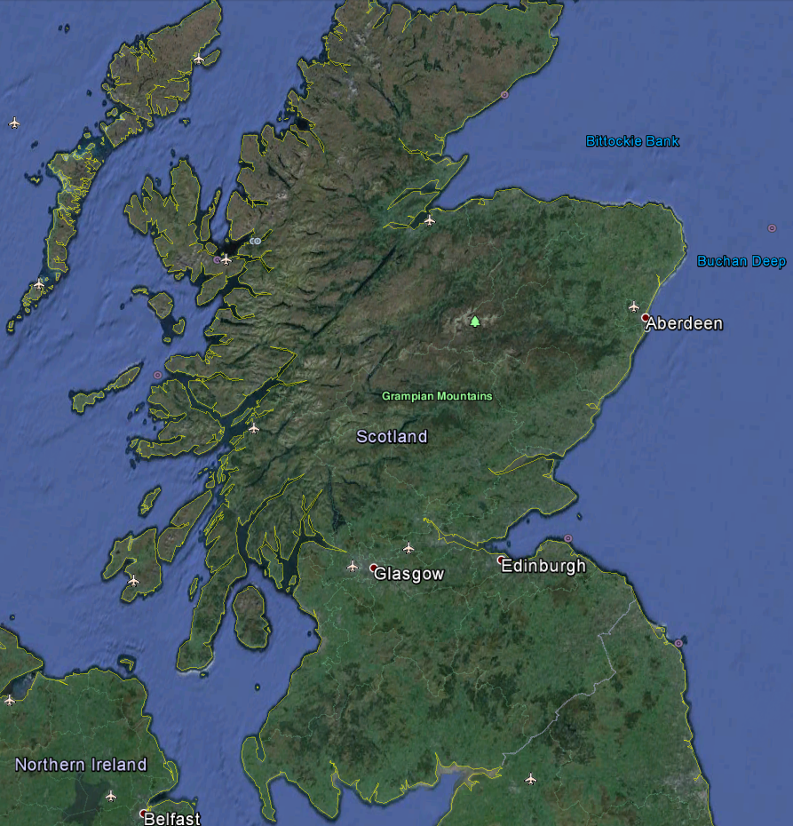
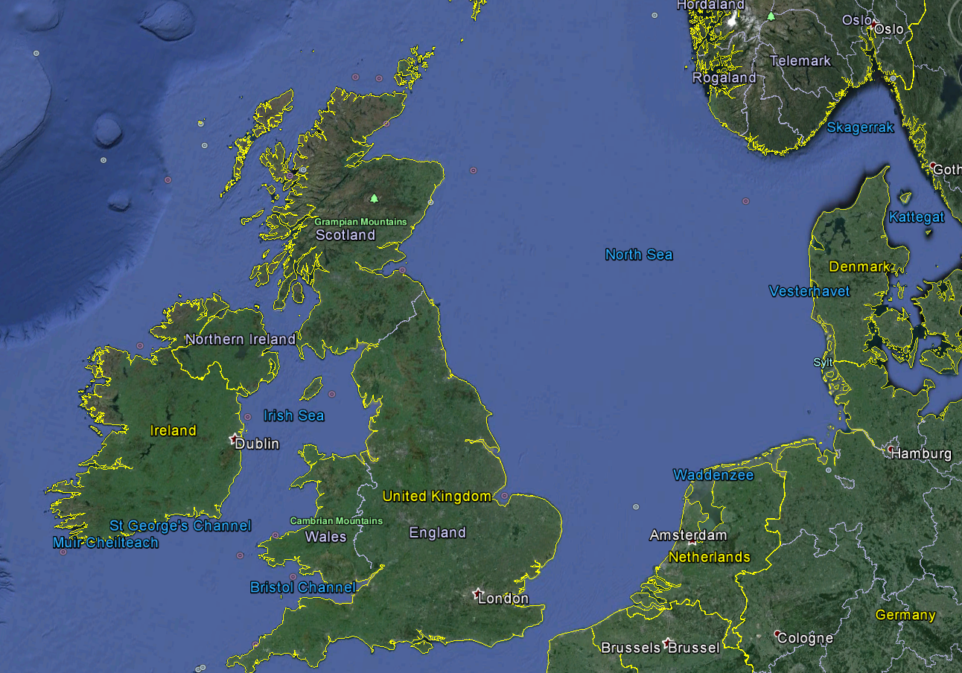
Principal components analysis Example 1
Analysis of multiple “pest” survey in winter wheat crops in Scotland
Policy-maker/sponsor question: Is there a need to maintain a regional crop health advisory system?
Are the problems faced by crops not the same everywhere?
50 crops sampled up to 6 times per season. Multiple pests, weeds & diseases recorded using standardized protocols
North
East
West

Slide 7
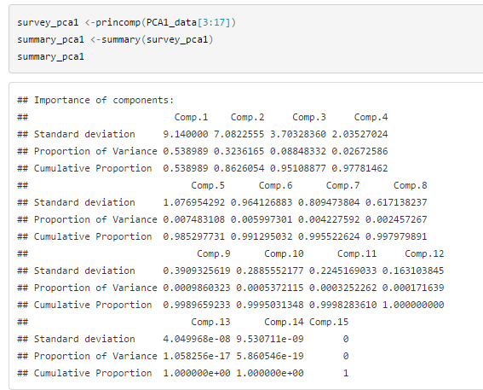
R code and output

Slide 8
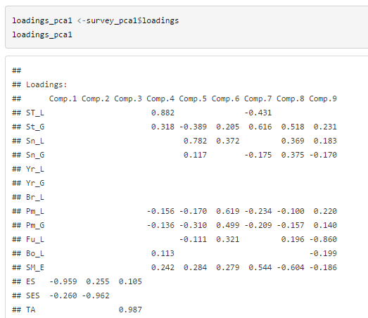
R code and output

Slide 9
R code and output

Slide 10
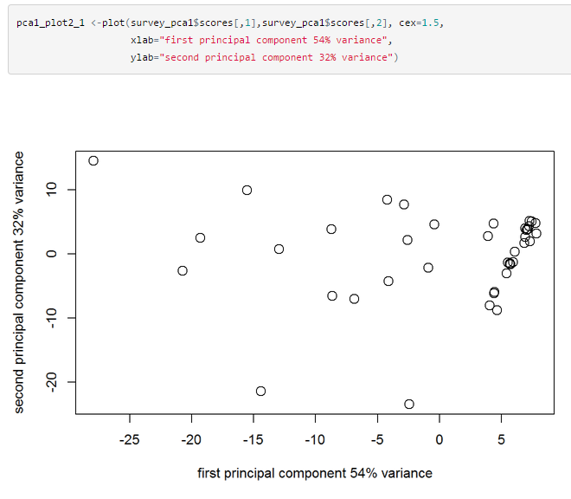
R code and output

Slide 11
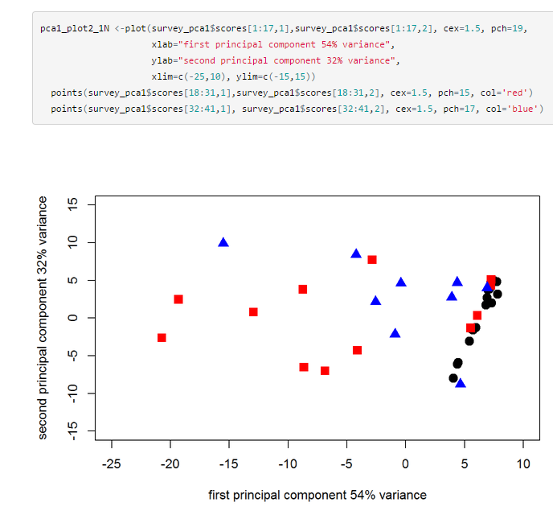
R code and output

Slide 12
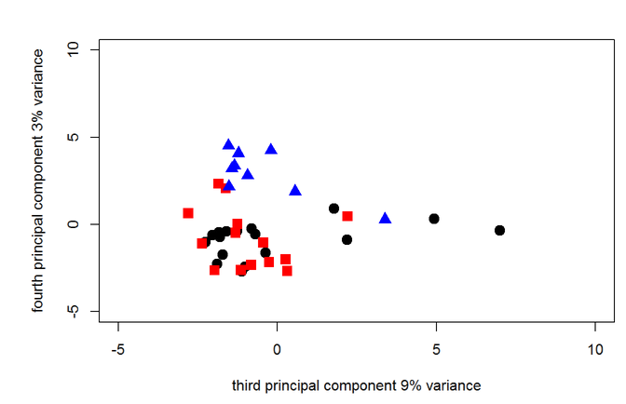
R code and output
North
East
West

Slide 13
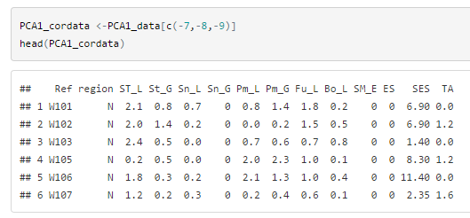
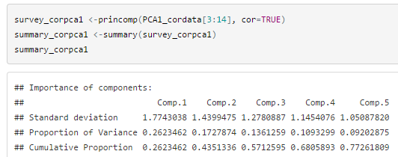
Dropping variables prior to re- analysis

Slide 14
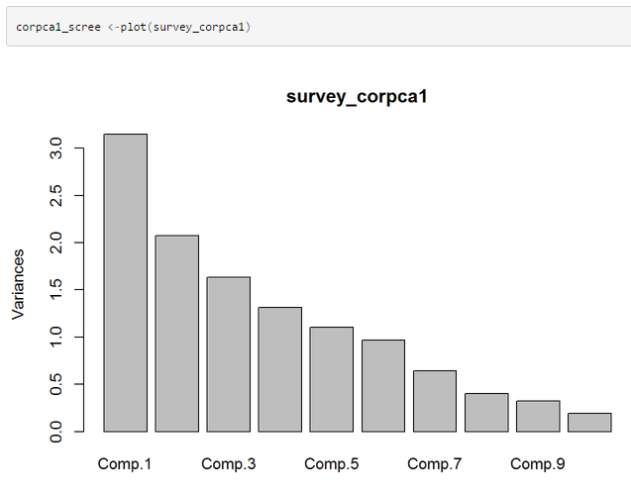
Scree plot of components from PCA of correlation matrix

Slide 15
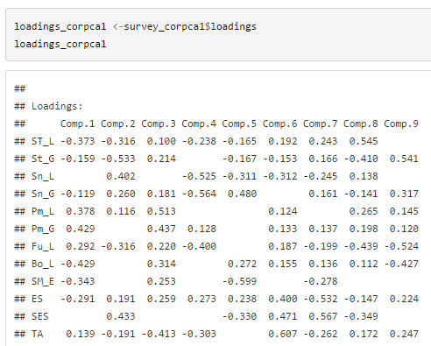
Loadings (latent vectors)from PCA of correlation matrix

Slide 16
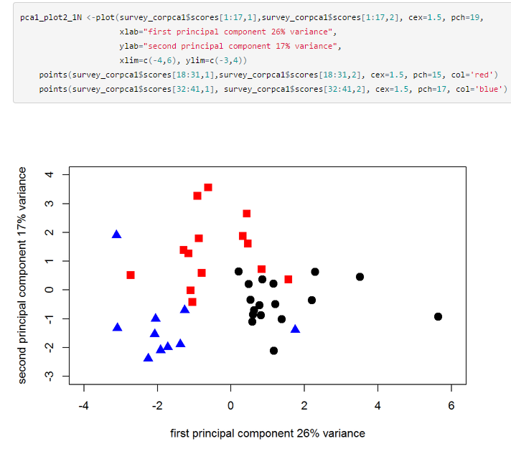

Slide 17
Loadings (latent vectors)from PCA of correlation matrix

Slide 18
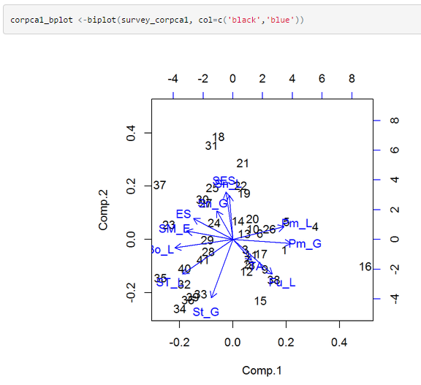
Biplot of variables and objects from PCA of correlation matrix

Slide 19
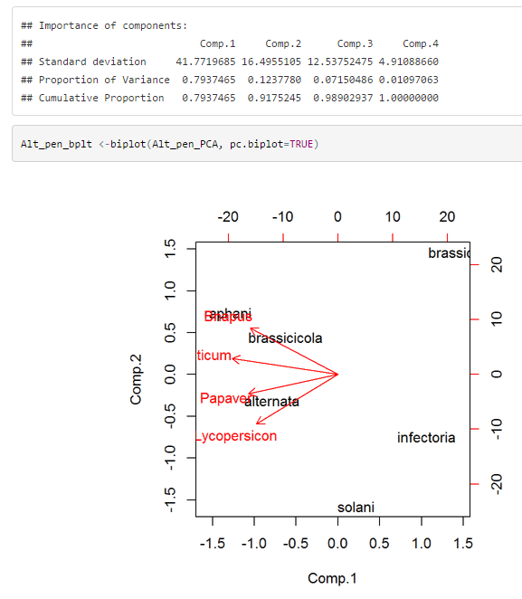
Biplots in univariate analysis: Inspecting two-factor interactions in ANOVA

Slide 20
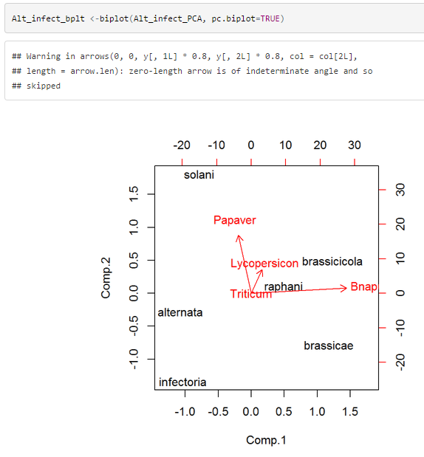
Biplots in univariate analysis: Inspecting two-factor interactions in ANOVA

Slide 21
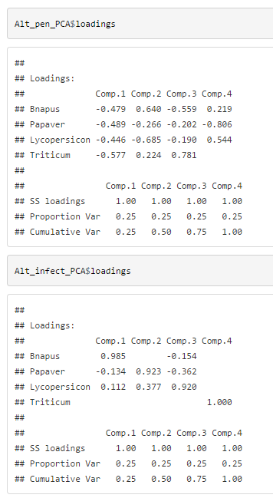
Biplots in univariate analysis: Inspecting two-factor interactions in ANOVA
Might be worth looking at PC1 against PC3 here

Slide 22
Principal Coordinates Analysis
A
B
C
D
E
0
0
Distance matrix
0
≥0
0
Can we represent the distance matrix for many objects in a small number of dimensions?
If the objects are located in a standard 2D Euclidean space, then, yes of course, But what if the space is Euclidean but has many dimensions,
And/Or the distances are not Euclidean?
0
A B C D E…

Slide 23
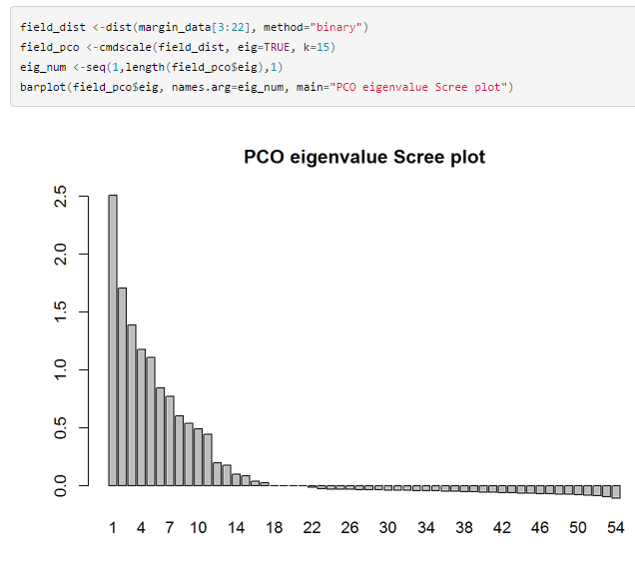
Principal Coordinates Analysis

Slide 24
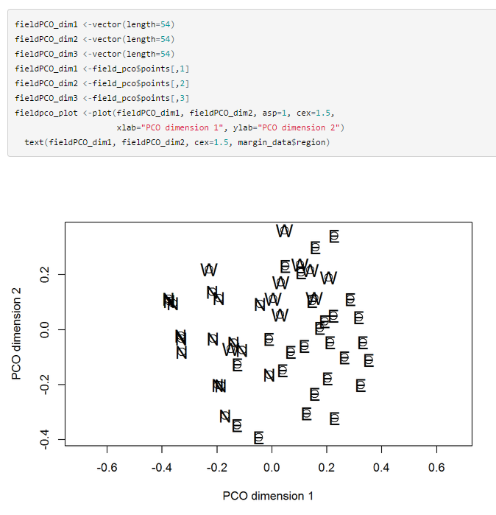
Principal Coordinates Analysis

Slide 25
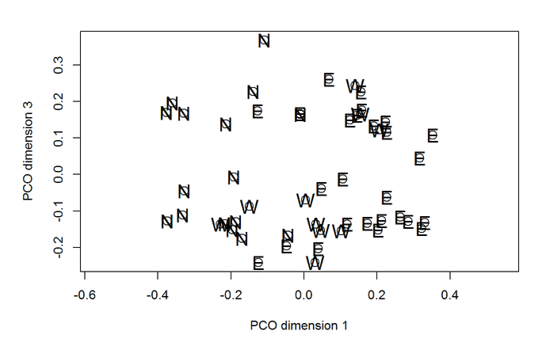
Principal Coordinates Analysis

Slide 26
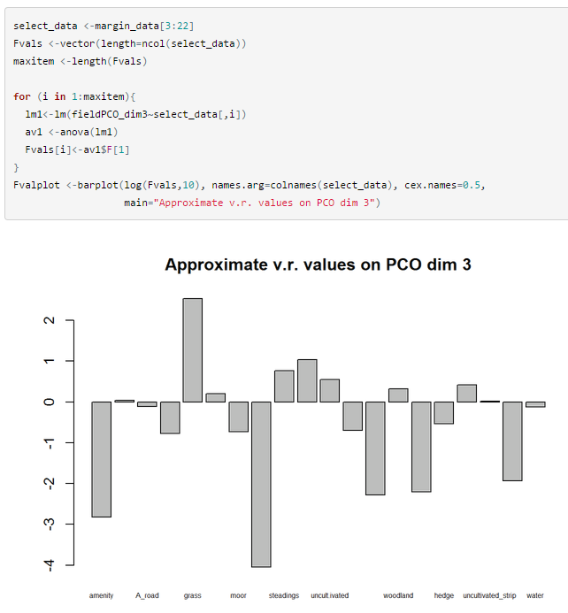
Principal Coordinates Analysis

Slide 27
BREAK

Slide 28
Cluster Analyses
A
B
C
D
E
0
Data Matrix
0
Distance matrix
0
≥0
0
0
A B C D E…
Non-hierarchical cluster analysis
Hierarchical cluster analysis
PCO
PCA

Slide 29
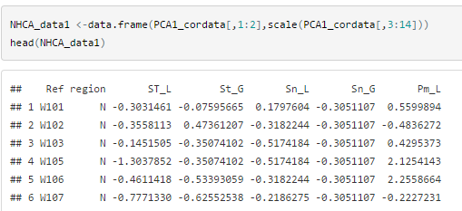
Non-hierarchical cluster analysis: Re-scaling data prior to analysis

Slide 30
Non-hierarchical cluster analysis: Re-scaling data prior to analysis

Slide 31
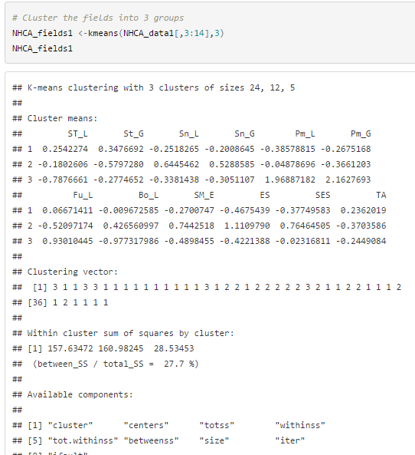
K-means Clustering output

Slide 32
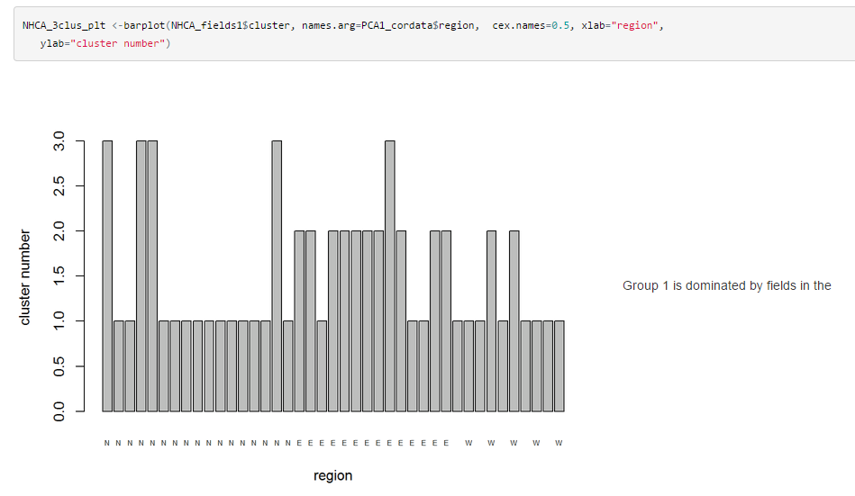
K-means Clustering output

Slide 33
K-means Clustering output

