Slide 1


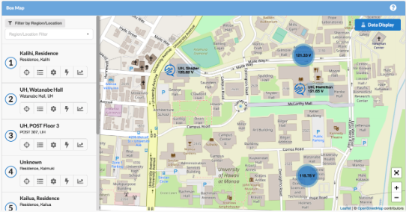
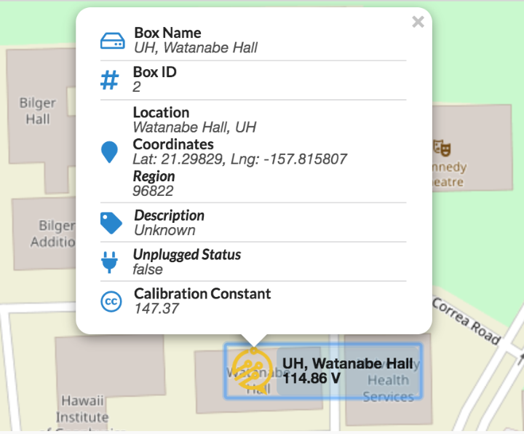
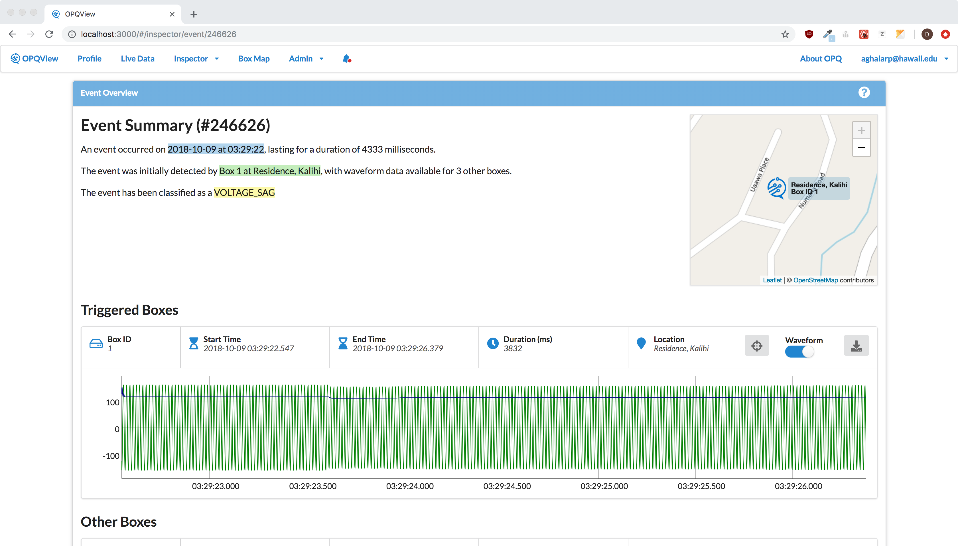
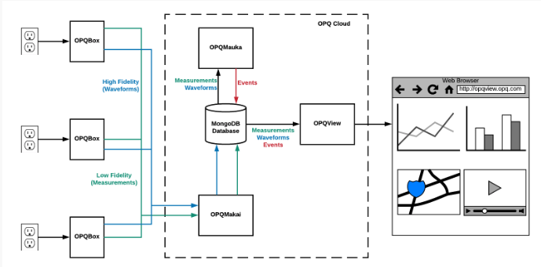
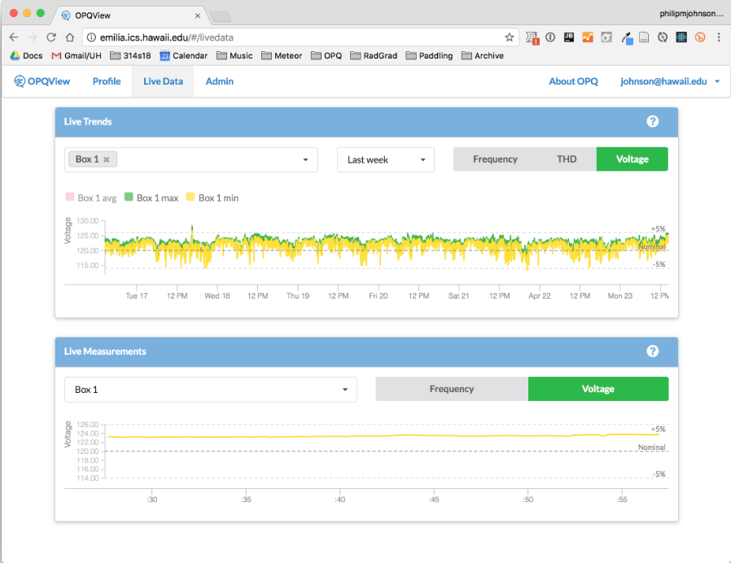
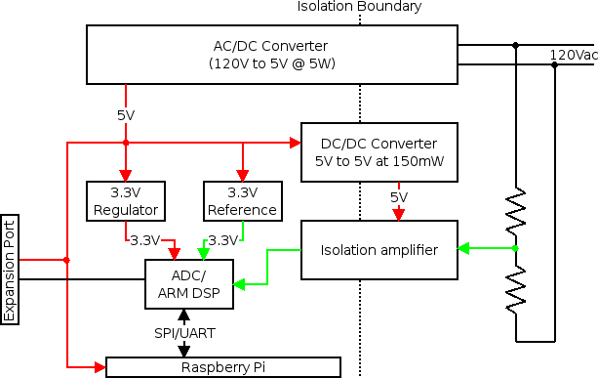
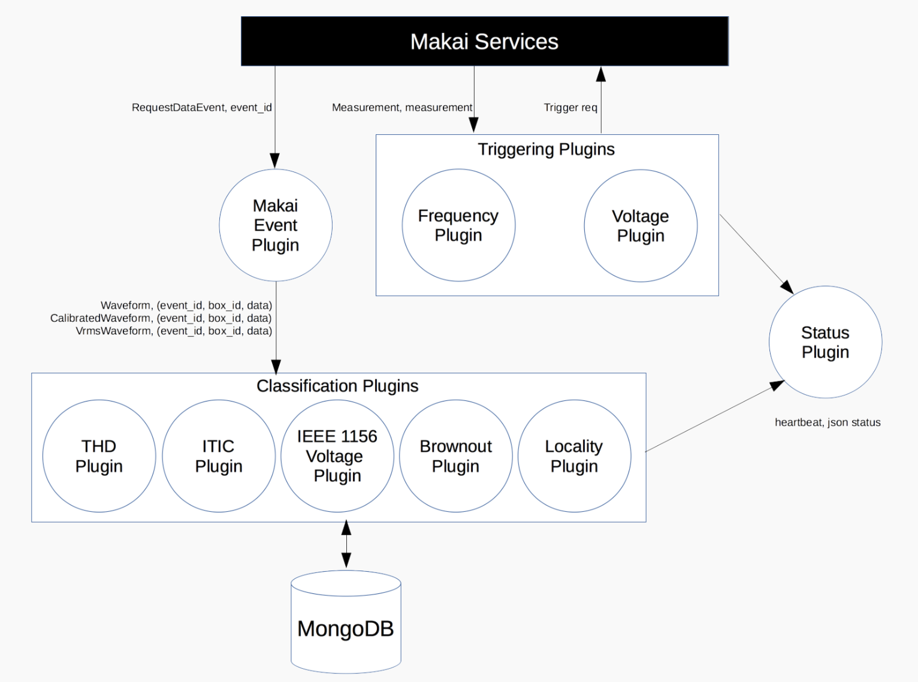
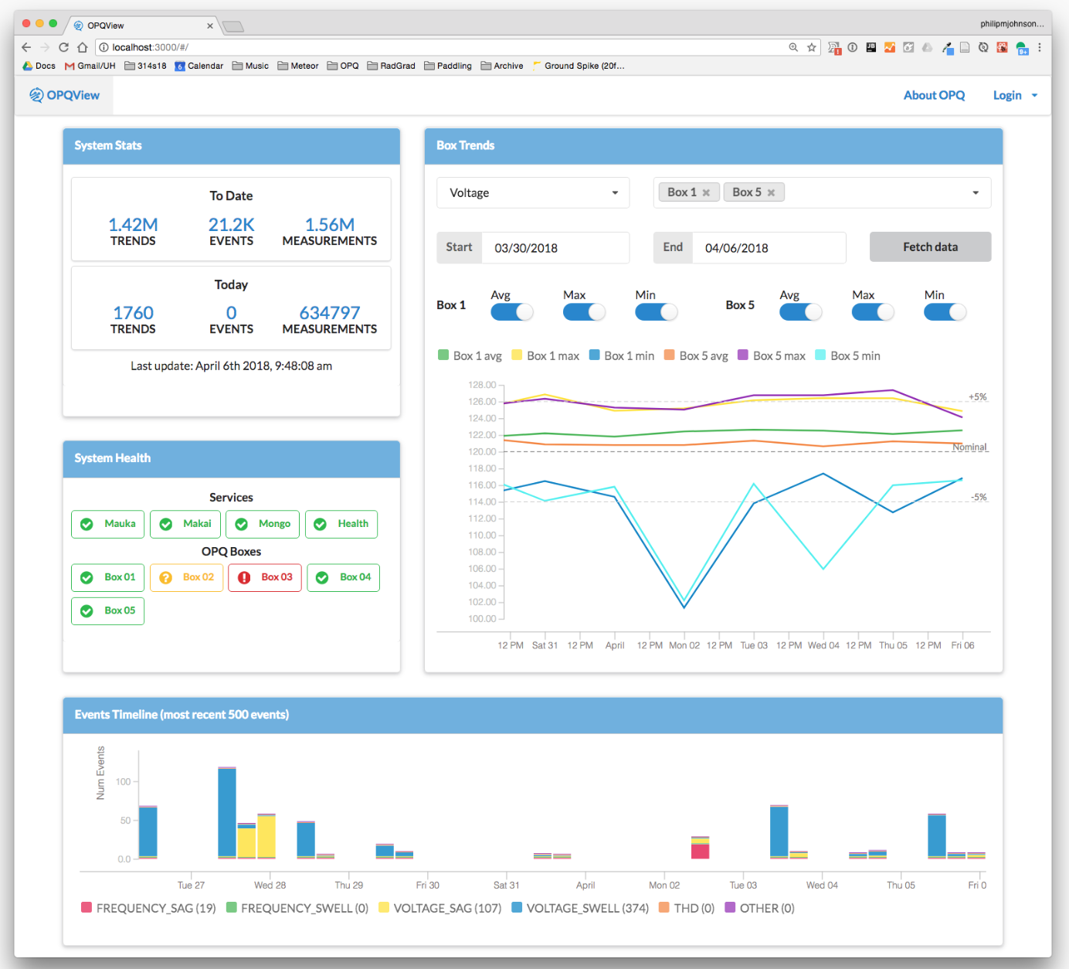
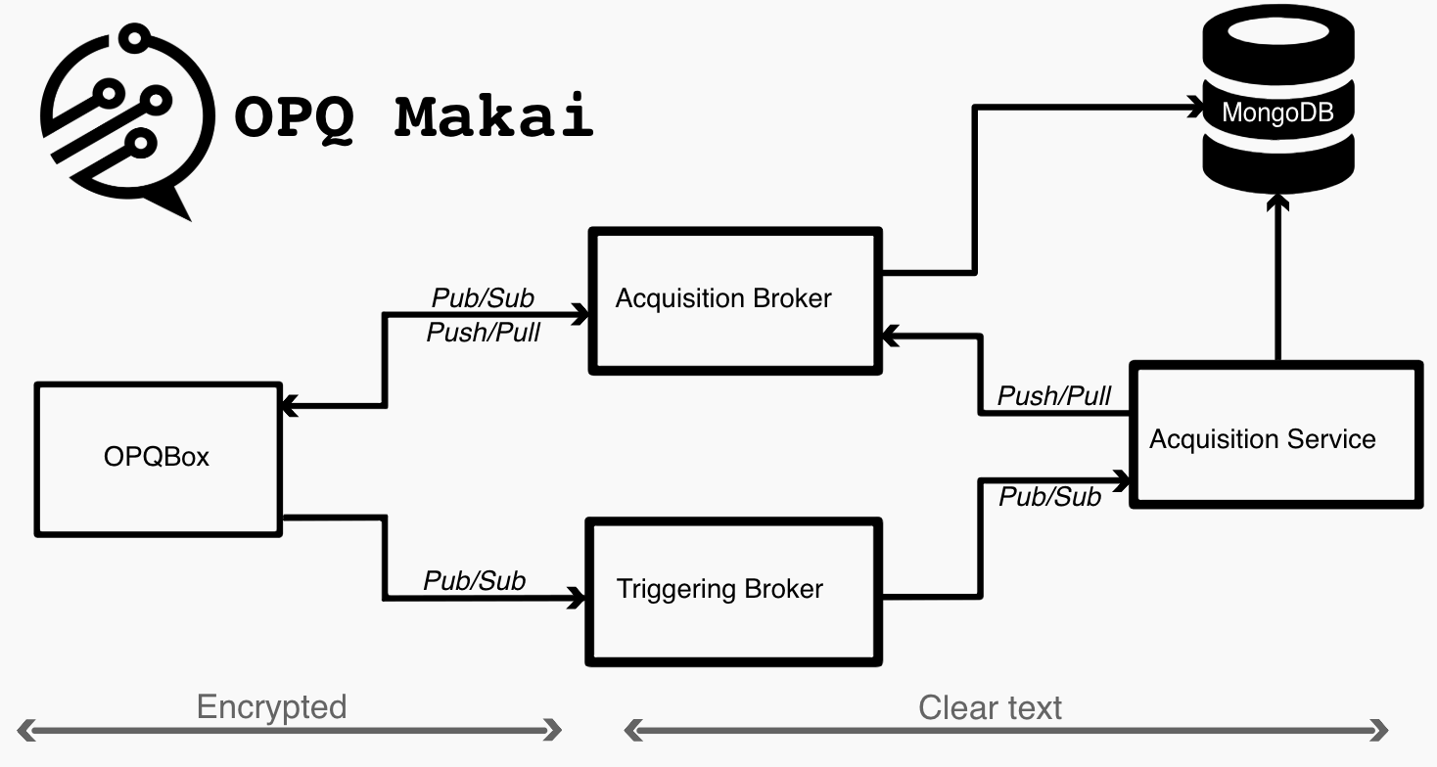
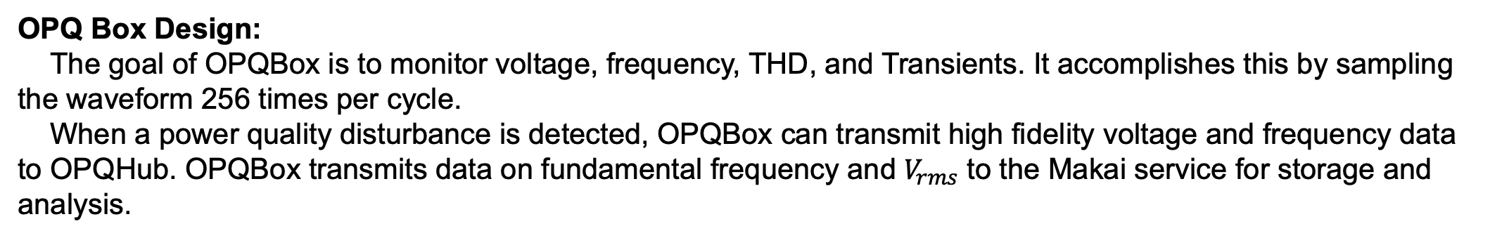
More Renewable Energy for Hawaii with Open Power Quality
Anthony Christe, Charles Dickens, Kaila Foltz, Evan Hataishi, Camelia Lai, Serge Negrashov, Il Ung Jeong Philip Johnson
Open Power Quality
Introduction & Motivation
Results
Successfully maintaining adequate power quality and providing sufficient amounts of it to meet the rising needs of consumers has been a triumph of electrical utilities for over 100 years. In recent times, however, there have been changes to the nature of electrical generation and consumption that make power quality of increasing public concern and interest.
The Open Power Quality (OPQ) project began in 2012 with the goal of developing and evaluating technology to support three important improvements to electrical infrastructure:
1: Increase the capacity of small and large electrical grids to employ distributed, intermittent forms of renewable energy.
2: Gain insight into lifespan and failure rate problems in consumer electronics due to poor power quality.
3: Provide an independent, low cost source of useful power quality data to consumers, researchers, and public policy makers.
Current state of the art power quality monitoring devices are designed for stand alone operation and follow common architectural principles that do not allow for flexibility on how data is represented and communicated and are not developed for everyday customers to understand. Furthermore, stand alone power quality monitoring devices lack global awareness, they are only able to recognize local events.
The OPQ project takes a different design approach by developing a cloud native system with two way data flow and higher frequency database updates. This allows the system to be globally aware of events happening across the grid that will potentially provide insights that would be otherwise unavailable. The OPQ system presents its data and results in an approachable way for consumers of all backgrounds.
Multiple Open Power Quality boxes have been successfully deployed and are currently monitoring the health of Oahu’s grid. The image to the left is a screenshot of the Box Map Page provided to users by OPQ view. The Box Map page provides a location-oriented perspective of the OPQ Boxes associated with an OPQ Cloud instance. Clicking on the icon associated with a box reveals additional details about its status as shown below:
Project Description
OPQ Makai has been successfully monitoring and triggering PQ events. The PQ events are analyzed by OPQ Mauka where they are potentially broken into multiple incidents and classified according to IEEE standards. The image to the left shows the Event Overview page provided by OPQ View. The particular event caught by the OPQ system in the image was classified as a VOLTAGE SAG. The waveform recorded by the OPQ Box displayed on the Event Overview page verifies this classification made by OPQ Mauka.
At the 10,000 foot level, the OPQ system architecture is extremely simple: OPQ Boxes are plugged into outlets, they monitor the quality of power, and the results are communicated via the Internet to a software system called OPQ Cloud. To see the results, users login to the system using a browser.
At a closer look, the OPQ system architecture consists of four major open source hardware and software components that provide end-to-end support for the capture, triggering, analysis, and reporting of consumer level local and global power quality events.
1: OPQ Box is a hardware device that detects the electrical waveform from a standard residential outlet.
2: OPQ Makai monitors incoming low fidelity data from OPQ Boxes, requests high fidelity data when necessary, and stores the results in a MongoDB database.
3: OPQ Mauka analyzes data and creates “incidents” when it detects power quality incidents.
4: OPQ View is a visualization platform for displaying the results for data capture and analysis.
Incidents
Incidents
The image to the right is a screenshot of the Live Data page provided by OPQ View. The Live Data page, as its name suggests, enable the user to see power quality data sent from OPQ Boxes in real time.
The image above illustrates how the four components of the OPQ system work together to collect information from wall outlets to the display and analyses in a browser.
Materials & Methods
OPQ Box Design:
The goal of OPQBox is to monitor voltage, frequency, THD, and Transients. It accomplishes this by sampling the waveform 256 times per cycle.
When a power quality disturbance is detected, OPQBox can transmit high fidelity voltage and frequency data to OPQHub. OPQBox transmits data on fundamental frequency and $V_{rms}$ to the Makai service for storage and analysis.
Conclusion
The Open Power Quality project has recently been making exciting advancements and kicking off new and interesting initiatives.
Open Power Quality is currently working on the Agile Power Monitoring project that started in Summer 2018 and will last for at least a year. The basic goal of this project is to demonstrate the ability of OPQ to provide useful analytics for UH microgrid management.
To achieve net zero energy, the University of Hawaii must install significant solar generation on the Manoa campus while maintaining grid stability. Achieving this requires data useful for creating models of the current UHM microgrid, which can then provide insight into the impact of future solar installation and other energy conservation measures (ECMs) on the UH grid. To that end, UH is installing building-level meters, which are an appropriate and crucial data collection capability. OPQ will complement this capability with an “agile” approach to power quality monitoring.
In February, 2018, the Hawaii Public Utilities Commission approved a grid modernization strategy for Oahu's electric grid. The Open Power Quality wants to aid in this effort and is currently planning for the deployment of OPQ devices across Oahu in order to provide data to support the strategy.
If Open Power Quality interests you and and you are seeking to gain experience in UI development, hardware design, and or data science then you can learn more about OPQ by attending one of our weekly project meetings, and, if you are still interested, you can sign up for an independent study and get to work!
OPQ Cloud Design:
OPQ Makai, OPQ Mauka, and OPQ View are all cloud-based software services that
collectively form a single "instance" with respect to data transmission, storage, analysis, and visualization. We refer to this collection of software-side components as OPQ Cloud. Every OPQ Box connects to a single instance of an OPQ Cloud.
Acknowledgments
Open Power Quality is sponsored by:
University of Hawaii Presidents Green Award
Collaborative Software Development Laboratory, University of Hawaii
Department of Information and Computer Sciences, University of Hawaii
Department of Electrical Engineering, University of Hawaii

