Slide 1


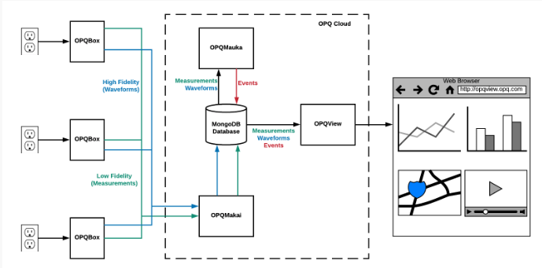
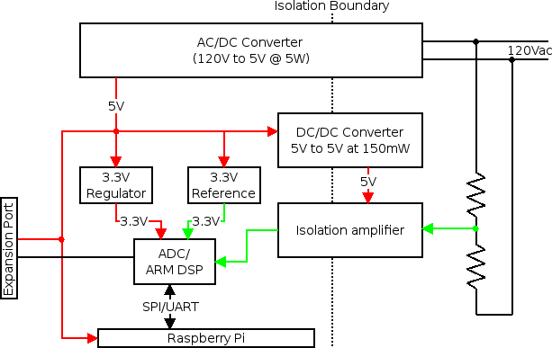
More Renewable Energy for Hawaii with Open Power Quality
Evan Hataishi, Kea Uehara, David Badke Philip Johnson
Open Power Quality
Poster No: 07
Introduction & Motivation
Results
Power quality is not currently a concern for most people in the United States. Just like most people assume that their tap water is of adequate quality to drink, most also assume that their electricity is of adequate quality to power their homes and appliances without causing harm. And, in both cases, most people assume that public utilities will monitor and correct any quality problems if they occur.
Successfully maintaining adequate power quality and providing sufficient amounts of it to meet the rising needs of consumers has been a triumph of electrical utilities for over 100 years. In recent times, however, there have been changes to the nature of electrical generation and consumption that make power quality of increasing public concern and interest.
The Open Power Quality (OPQ) project began in 2012 with the goal of developing and evaluating technology to support three important improvements to electrical infrastructure:
1: Increase the capacity of small and large electrical grids to employ distributed, intermittent forms of renewable energy.
2: Gain insight into lifespan and failure rate problems in consumer electronics due to poor power quality.
3: Provide an independent, low cost source of useful power quality data to consumers, researchers, and public policy makers.
Current state of the art power quality monitoring devices are designed for stand alone operation and follow common architectural principles that do not allow for flexibility on how data is represented and communicated and are not developed for everyday customers to understand. Furthermore, stand alone power quality monitoring devices lack global awareness, they are only able to recognize local events.
The OPQ project takes a different design approach by developing a cloud native system with two way data flow and higher frequency database updates. This allows the system to be globally aware of events happening across the grid that will potentially provide insights that would be otherwise unavailable. The OPQ system presents its data and results in an approachable way for consumers of all backgrounds.
Show the data that you have generated, and talk about what it means.
Project Description
At the 10,000 foot level, the OPQ system architecture is extremely simple: OPQ Boxes are plugged into outlets, they monitor the quality of power, and the results are communicated via the Internet to a software system called OPQ Cloud. To see the results, users login to the system using a browser.
At a closer look, the OPQ system architecture consists of four major open source hardware and software components that provide end-to-end support for the capture, triggering, analysis, and reporting of consumer level local and global power quality events.
1: OPQ Box is a hardware device that detects the electrical waveform from a standard residential outlet.
2: OPQ Makai monitors incoming low fidelity data from OPQ Boxes, requests high fidelity data when necessary, and stores the results in a MongoDB database.
3: OPQ Mauka analyzes data and creates “events” when it detects power quality incidents.
4: OPQ View is a visualization platform for displaying the results for data capture and analysis.
The image above illustrates how the four components of the OPQ system work together to collect information from wall outlets to the display and analyses in a browser.
OPQ Makai, OPQ Mauka, and OPQ View are all cloud-based software services that collectively form a single "instance" with respect to data transmission, storage, analysis, and visualization. We refer to this collection of software-side components as OPQ Cloud. Every OPQ Box connects to a single instance of an OPQ Cloud. It is possible to have multiple OPQ Cloud instances. For example, a company might install an OPQ Cloud instance behind their firewall along with OPQ Boxes to provide a private mechanism for collecting and analyzing power quality data.
Conclusion
Materials & Methods
Sum up your key results
Can also mention future work
OPQ Box Design:
OPQ Cloud Design:
Acknowledgments
Funding sources, etc.

