Slide 1


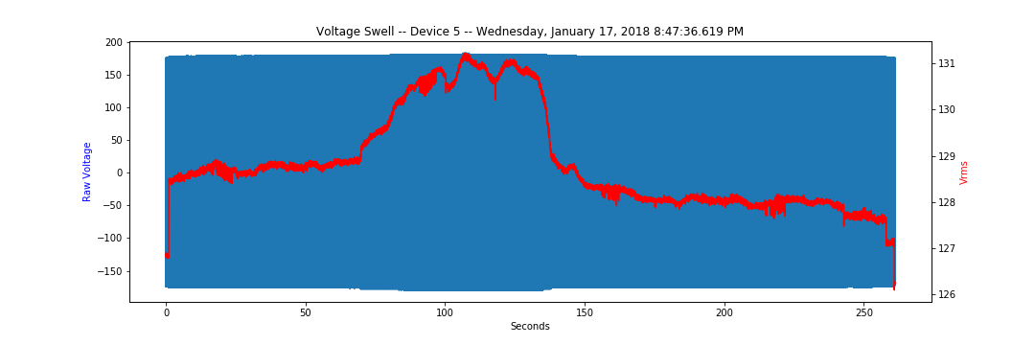
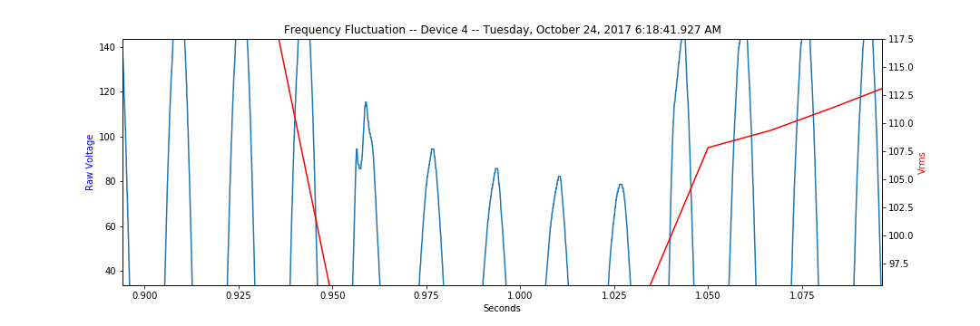
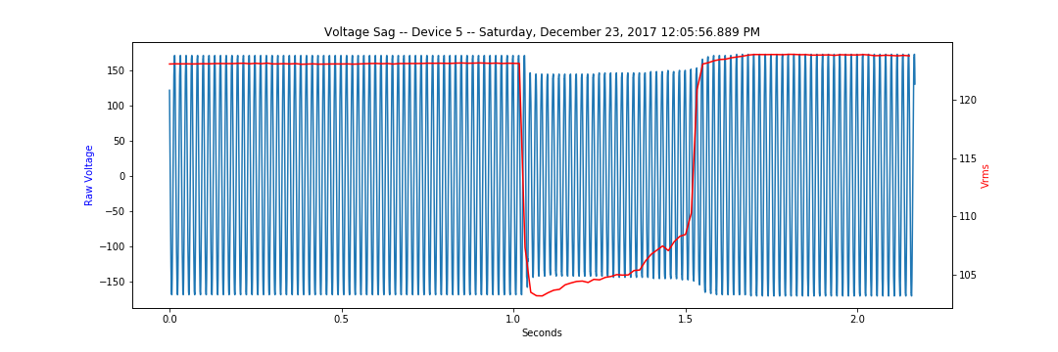
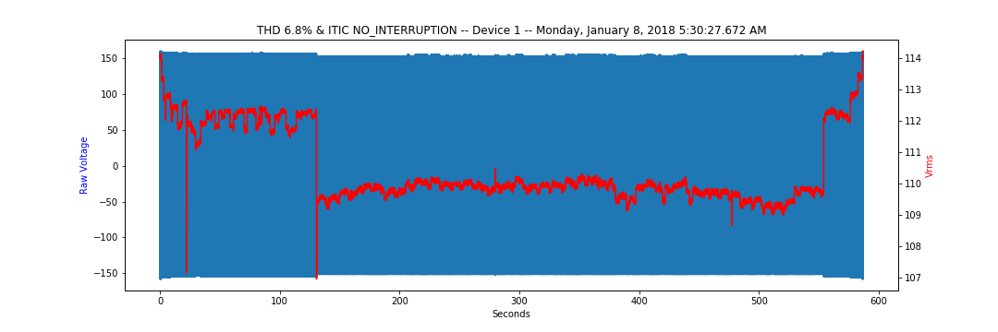
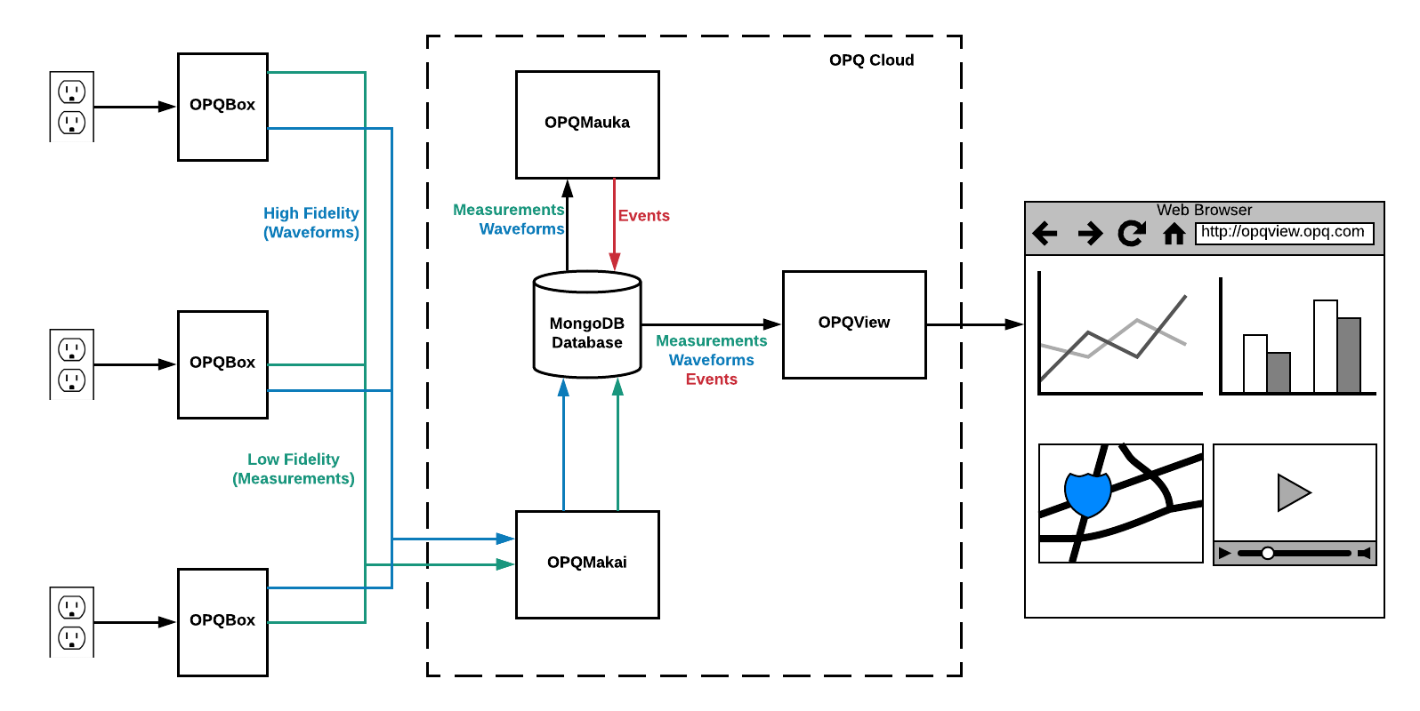
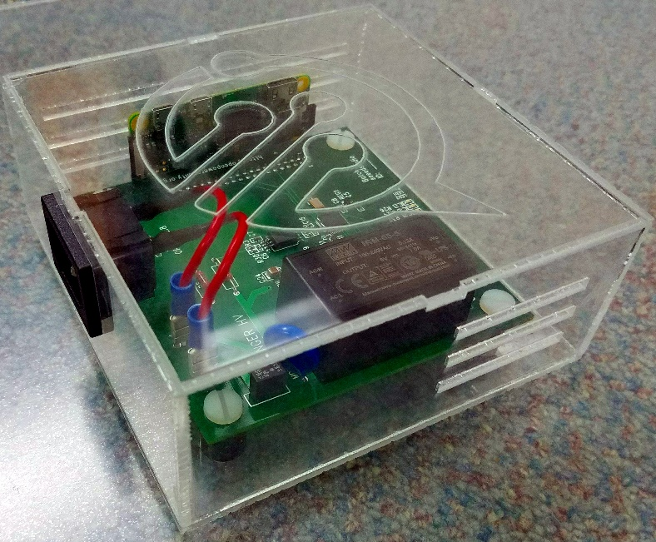
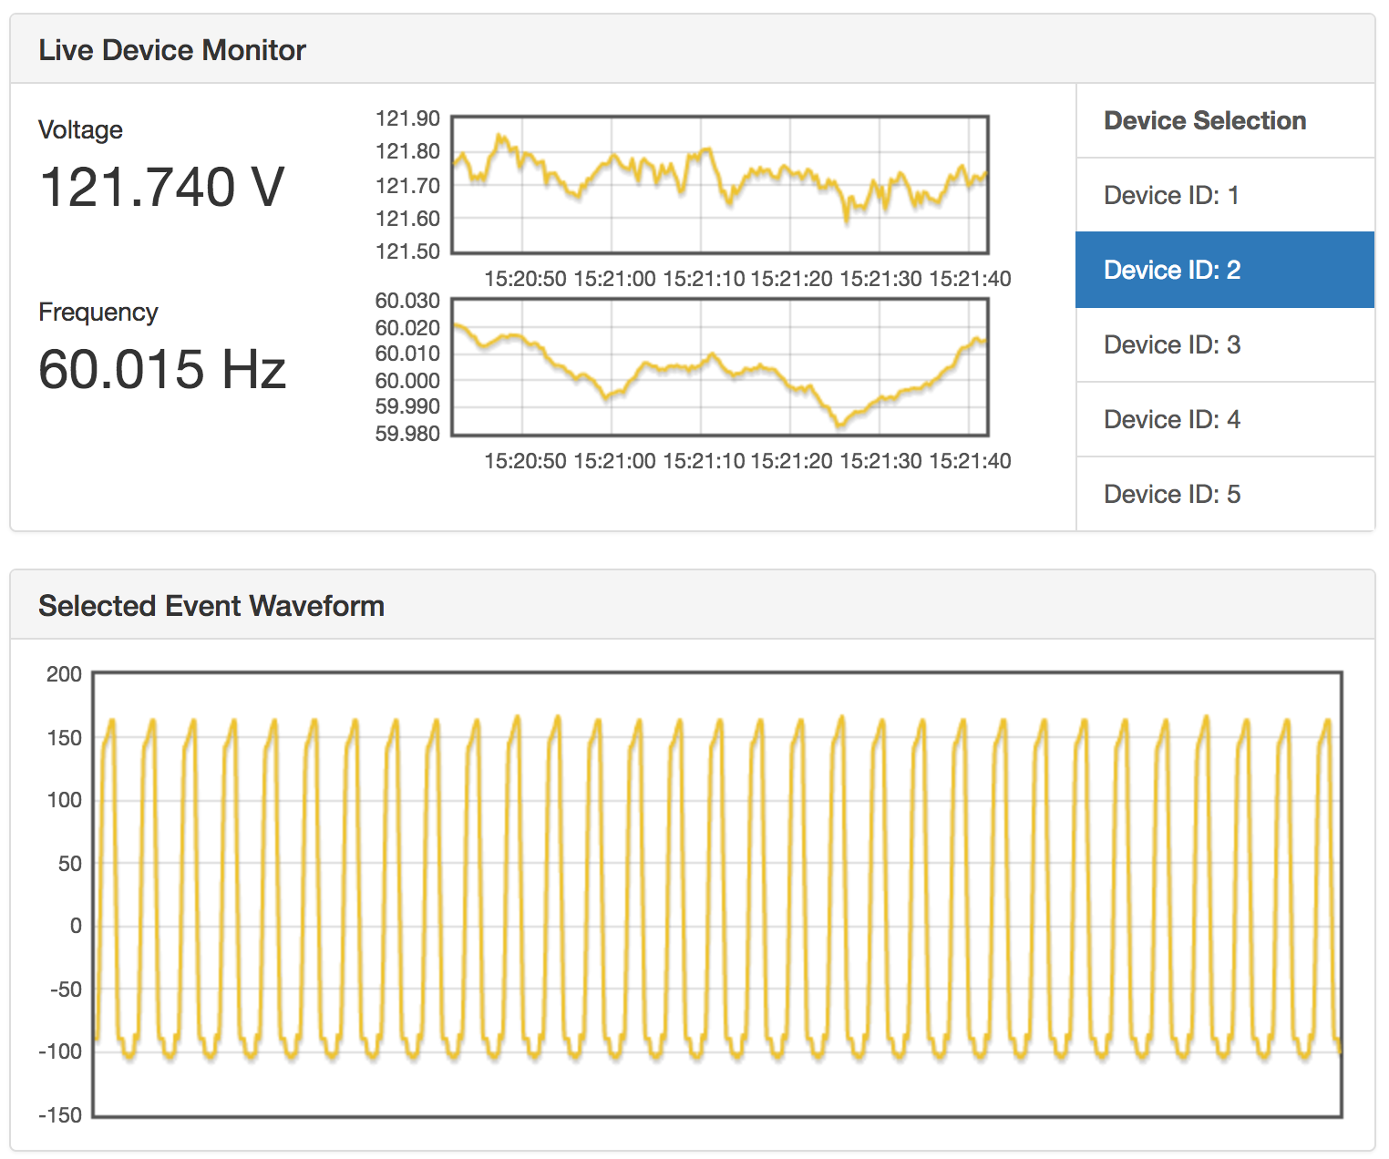
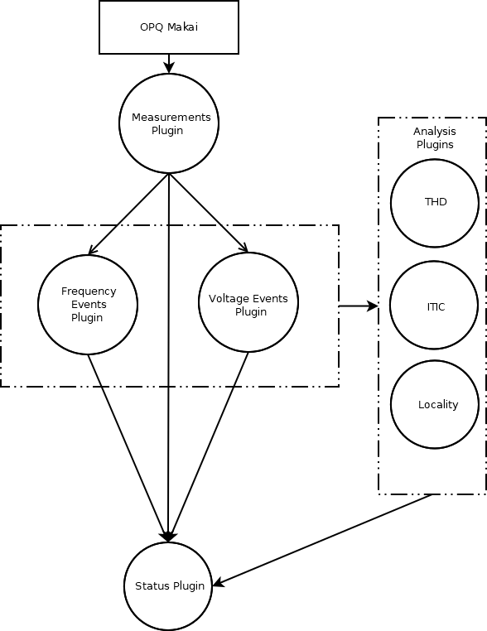
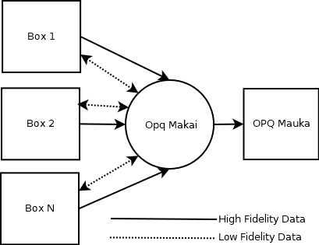
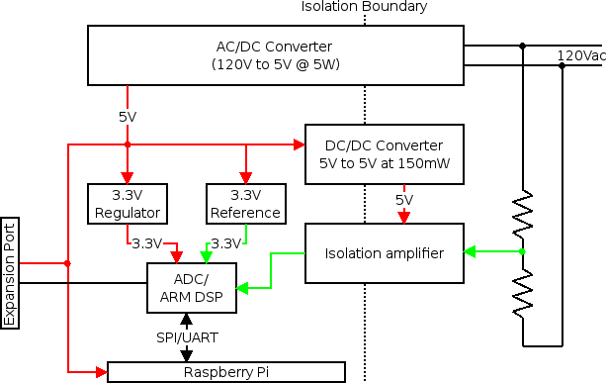
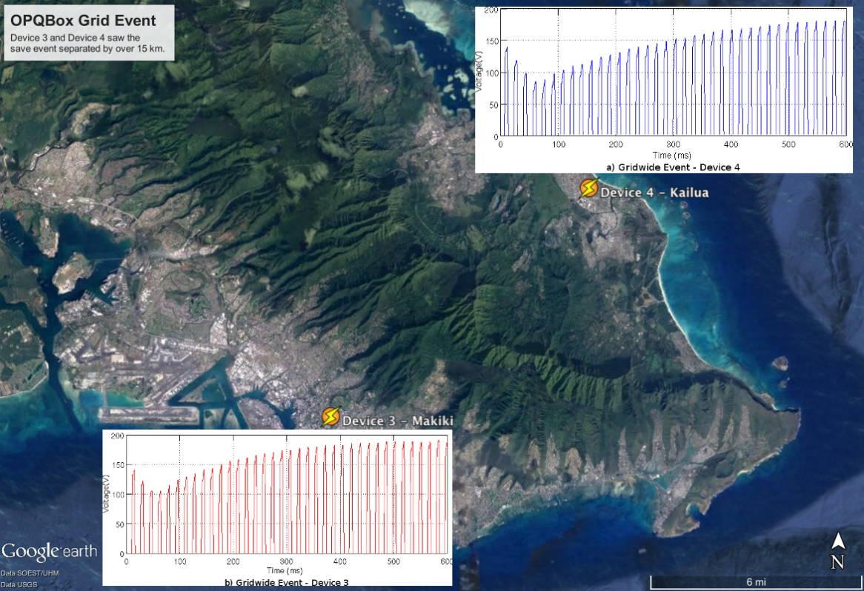
Comparing and Contrasting Power Quality Issues between Kyushu University and the University of Hawaii at Manoa.
Anthony Christe, Sergey Negrashov, Philip M. Johnson
Information and Computer Sciences Department
University of Hawaii at Manoa
achriste@hawaii.edu
Introduction
What is Power Quality?
Electrical power grids are transitioning from centralized to distributed energy generation. Photovoltaics, wind, geothermal, wave, and other sources of renewable energy generation are becoming quite common. However, the intermittent nature of these energy sources can cause imbalances between generation and consumption which in turn can cause power quality (PQ) issues in your home, your neighborhood, or across the entire electrical grid.
The Open Power Quality project provides a cost effective, scalable, open source hardware and software for collecting, analyzing, and reporting on power quality issues both locally and distributed across the electrical grid.
We propose a collaboration between the University of Hawaii and
Kyushu University that would take into consideration the differences between the University of Hawaii’s electrical grid and Kyushu University’s electrical grid to determine how those differences impact effective and efficient power quality monitoring, collection, and analysis.
A set of metrics that define the “goodness” of a power supply.
U.S.A 120V@60Hz W. Japan 100V@60Hz E. Japan 100V@50Hz
Voltage Swell
Frequency Fluctuation
Voltage Sag
THD and ITIC Levels
OPQ System Architecture and Components
OPQ System
Box
Makai
Mauka
View
Distributed Collection of Open Source Hardware and Cloud Services that allow for scalable
Acquisition
Storage
Analysis
Reporting
Analytics
Open Source Power Quality Monitor
Plugs into wall
Connects over WiFi
Measures Voltage, Frequency, THD
Can store raw waveform on board for detailed analysis
Inexpensive
Monitors low-fidelity feature stream
Encrypted communications between boxes and Makai
Triggers on interesting features
Requests raw data
Stores raw data
Forwards raw data to OPQ Mauka for further analysis
High-level Analysis
THD
ITIC
Localization
Scalable Architecture
Distributed Plugins
D.A.G. Semantics
Cloud Based Interface for Analysis and Reporting
Collaboration with Kyushu University
We propose a collaboration that would compare and contrast power quality (PQ) between the University of Hawaii and Kyushu University.
The collaboration provides opportunities for hardware design, big data management, data analytics, and front end web design.
The intended outcome of this collaboration would be several joint papers, conferences, and progress towards a degree for those involved.
University of Hawaii Provides...
And Together We Can...
A set of OPQBoxes
Full access to data and servers
Support
Develop algorithms that can characterize PQ
Detection
Classification
Transduction
Localization
Assess how differences in electrical grids impact on the design and implementation of the OPQ system architecture
Grid size
Voltage / Frequency standards
Energy generation
Assess how differences in renewable energy density contribute to PQ
Assess how differences in yearly weather patterns contribute to PQ
Update Open Power Quality to work internationally
Update Views for Japanese Users
Language Internationalization
Kyushu University Provides...
Space to install a set of OPQBoxes
Access to the Kyushu University’s WiFi for each Box
A student to maintain the OPQBoxes at Kyushu University for the duration of the collaboration

