Slide 1
OPQ Version 2: An Architecture for Distributed, Real-Time, High Performance Power Data Acquisition, Analysis, and Visualization
A. Christe, S. Negrashov, P. Johnson,
D. Aghalarpour, D. Badke, D. Nakahodo
University of Hawaii at Manoa
IEEE Cyber 2017
Waikiki, Hawaii

Slide 2
Today’s Talk
Hawaii’s unique PQ situation
Brief overview of Open Power Quality
Power quality event acquisition
System architecture
Conclusions and future work

Slide 3
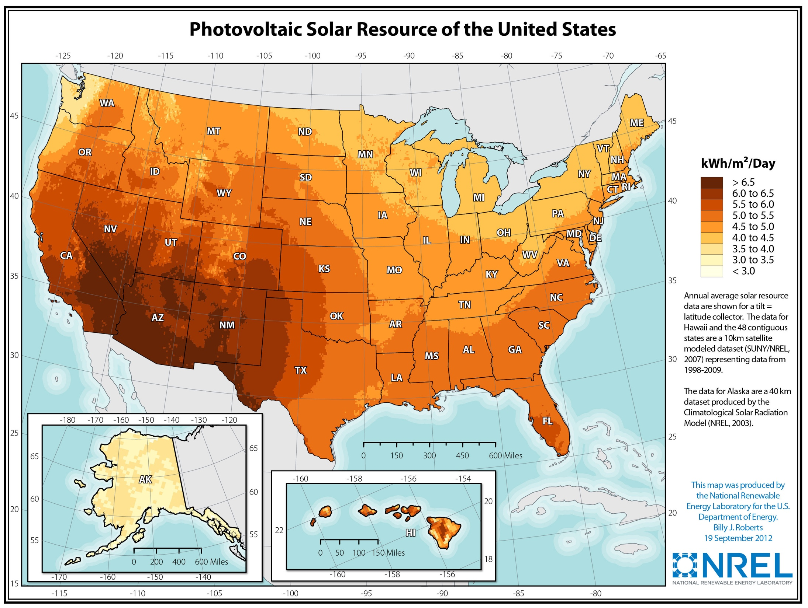
Hawaii’s Unique PQ Situation
Notes:
http://blogs.scientificamerican.com/plugged-in/3-reasons-hawaii-put-the-brakes-on-solar-and-why-the-same-won-t-happen-in-your-state/
http://www.nrel.gov/gis/solar.html
We have a lot of solar production but we’re not far off from the reste of the country
The growing pains that we’re feeling the rest of the mainland us will eventually feel as well
-- Need a slide to show all of the issues with expanding PV due to HECO’s worry about PQ, how can we help the along?

Slide 4
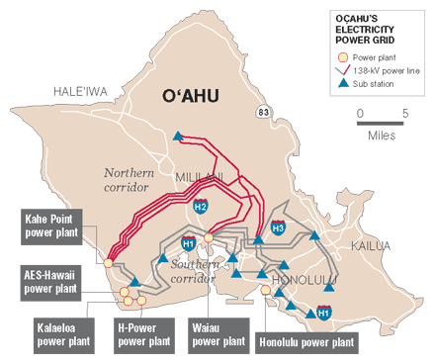
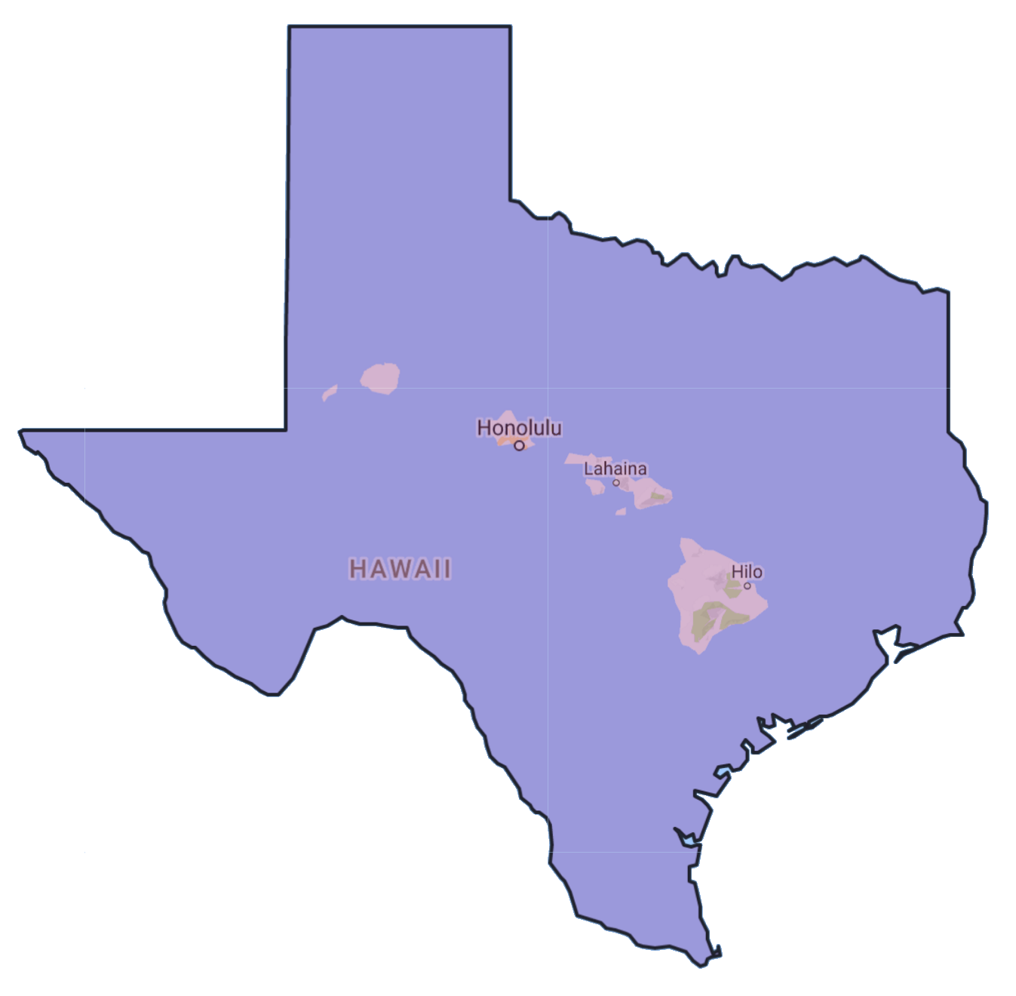
PQ Research in the Pacific?
Notes:
This is the oahu power grid on the left and on the right is our grid inside of the texas grid
Most of our grid was built in the 1950s and has not received major upgrades
Maybe the current grid design is based on a 50’s architcutre of something like that

Slide 5

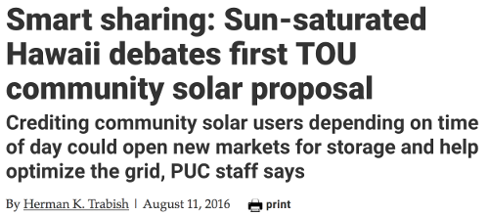





Hawaii’s Unique PQ Situation
Notes:
We talk a lot about the solar because of how visible it is to the public
Geothermal
Wave-energy
Best winds in U.S.
Fantastic place to come and study how renewable energies affect small grids
And the technological advances that are being made to integrate these sources of energy
100% renewables 2045
$3-5B/yr on imported fuel (hard to interpret, what % of state GDP is this number)
~300 days of sunshine
Highest cost of electricity in the united states
Restricted pv installations
We’re in a position where people can’t actually get their solar panels hooked up which is a real shame because
- HECO’s main concern is grid stability and power quality
- It’s the combination of renewables that makes hawaii unique

Slide 6
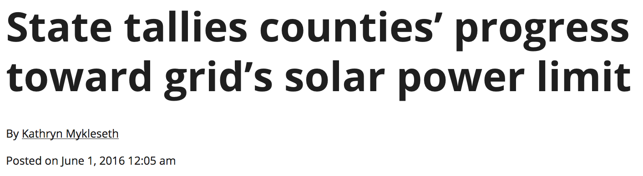
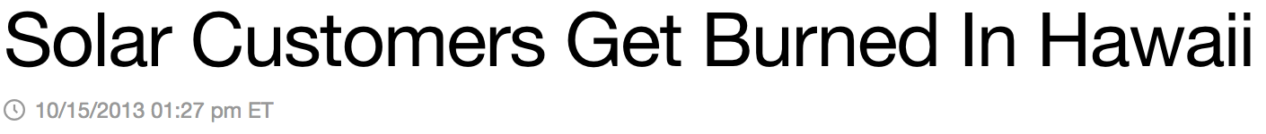
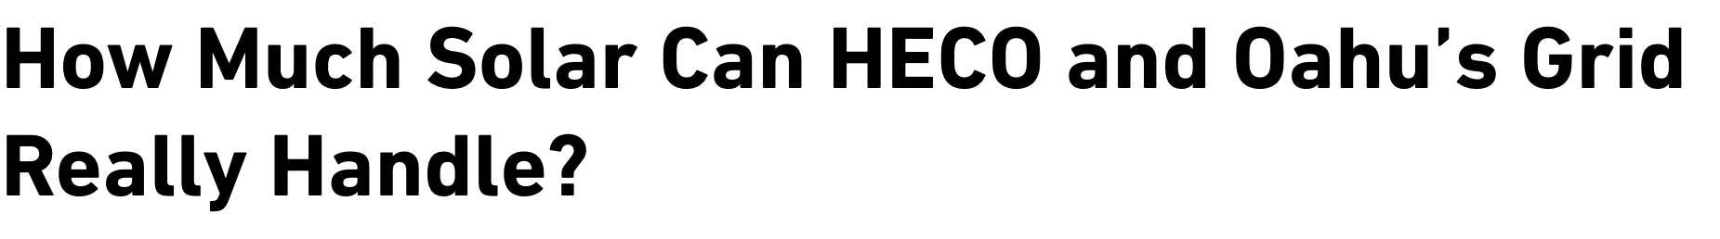
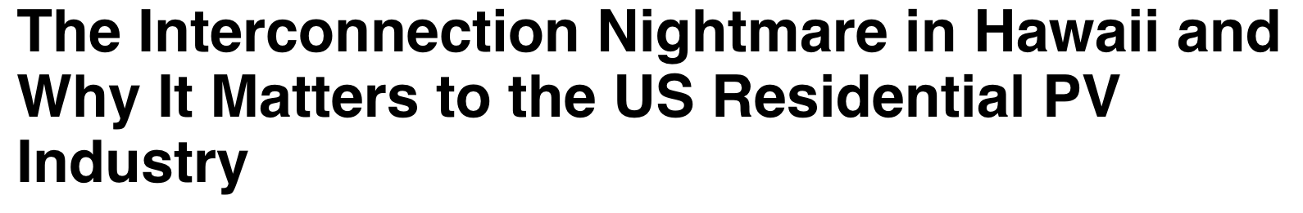
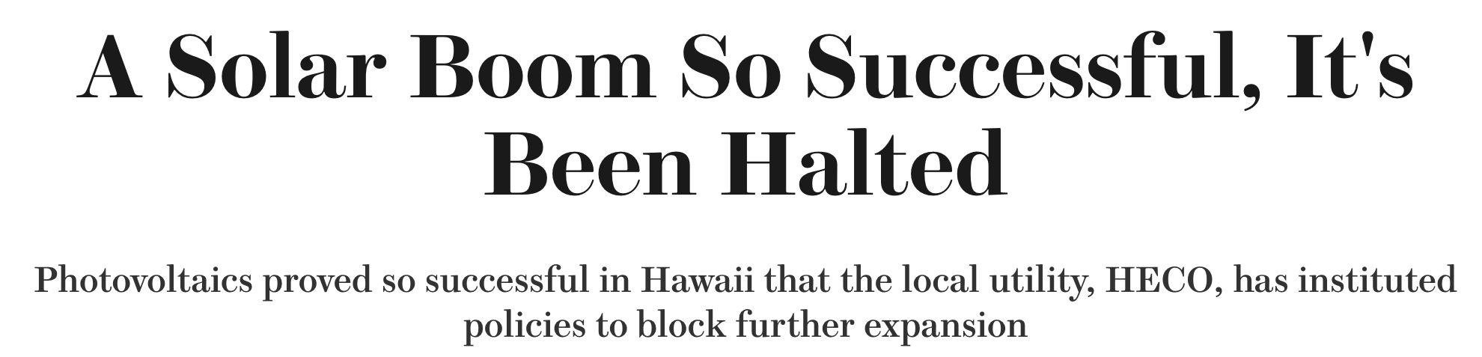

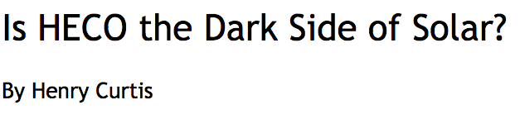
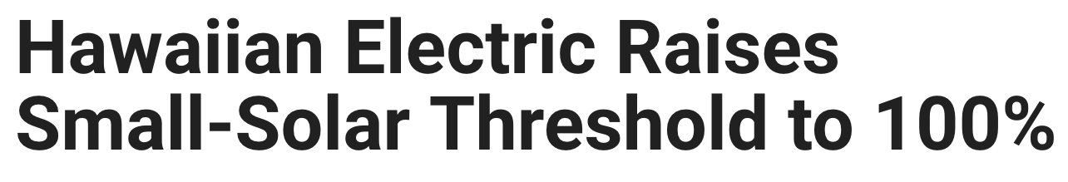
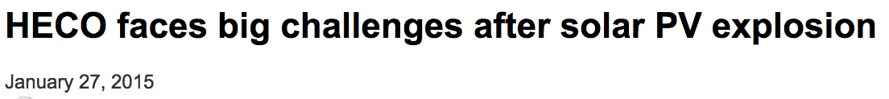
Hawaii’s Unique PQ Situation
Notes:
http://blogs.scientificamerican.com/plugged-in/3-reasons-hawaii-put-the-brakes-on-solar-and-why-the-same-won-t-happen-in-your-state/
http://www.nrel.gov/gis/solar.html
We have a lot of solar production but we’re not far off from the reste of the country
The growing pains that we’re feeling the rest of the mainland us will eventually feel as well
-- Need a slide to show all of the issues with expanding PV due to HECO’s worry about PQ, how can we help the along?

Slide 7
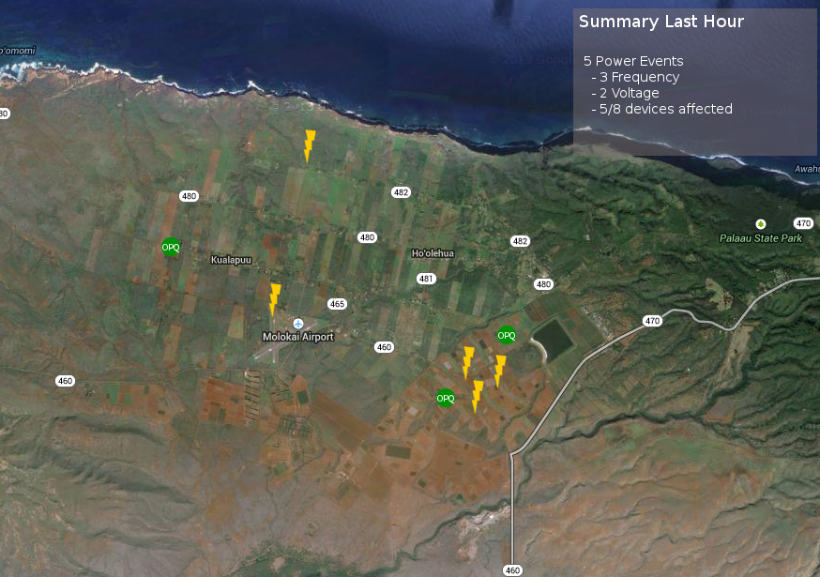
OPQ: Let’s Crowdsource PQ Data!

Slide 8
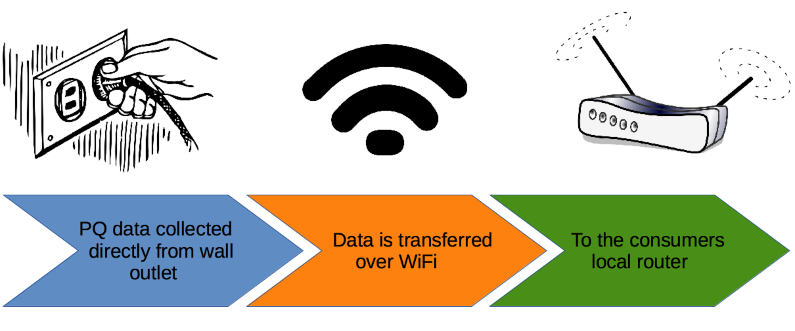
OPQ Hardware

Slide 9
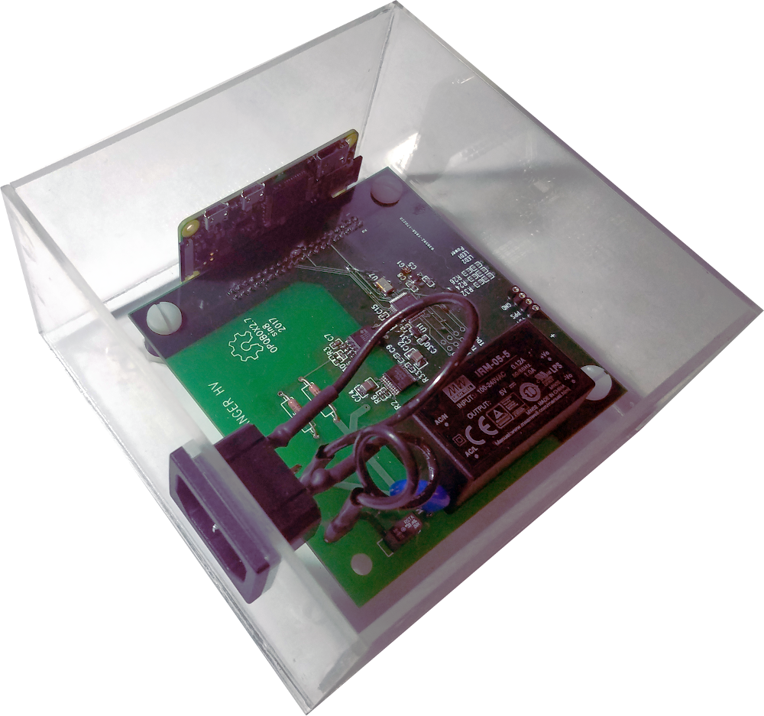
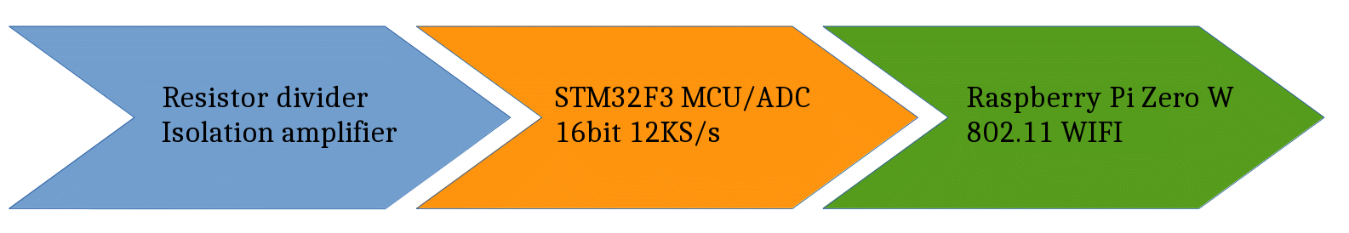
OPQBox2

Slide 10
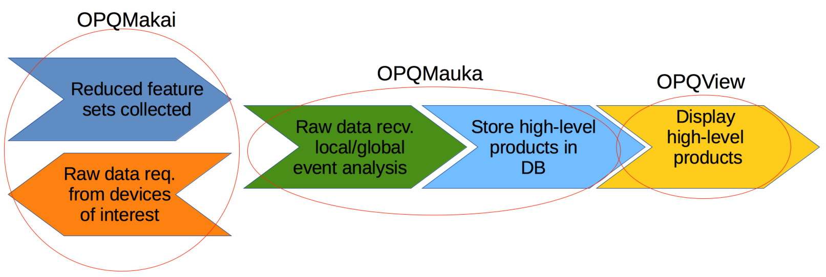

Slide 11
OPQ: A High Level Overview
Inexpensive, high performance PQ meter
  -High resolution/Sampling rate
  -$50/Box ~100 devices
Utilizes cloud/local analysis
  -Low Bandwidth requirement
Flexible acquisition and analysis architecture
  -Pluggable distributed analytics and event detection

Slide 12
What have we found?
Large collection of distributed global events
Large collection of local events

Slide 13
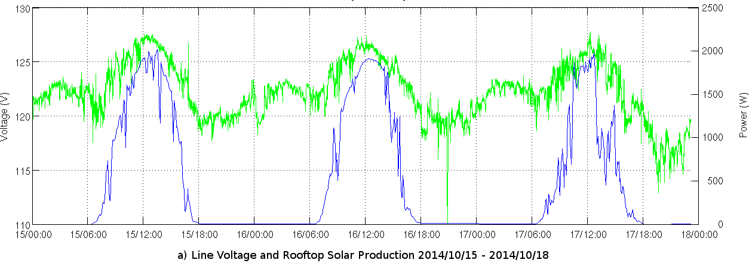
OPQ: Daily Trends
RMS LN Voltage(V)
Solar Power Produced (W)

Slide 14
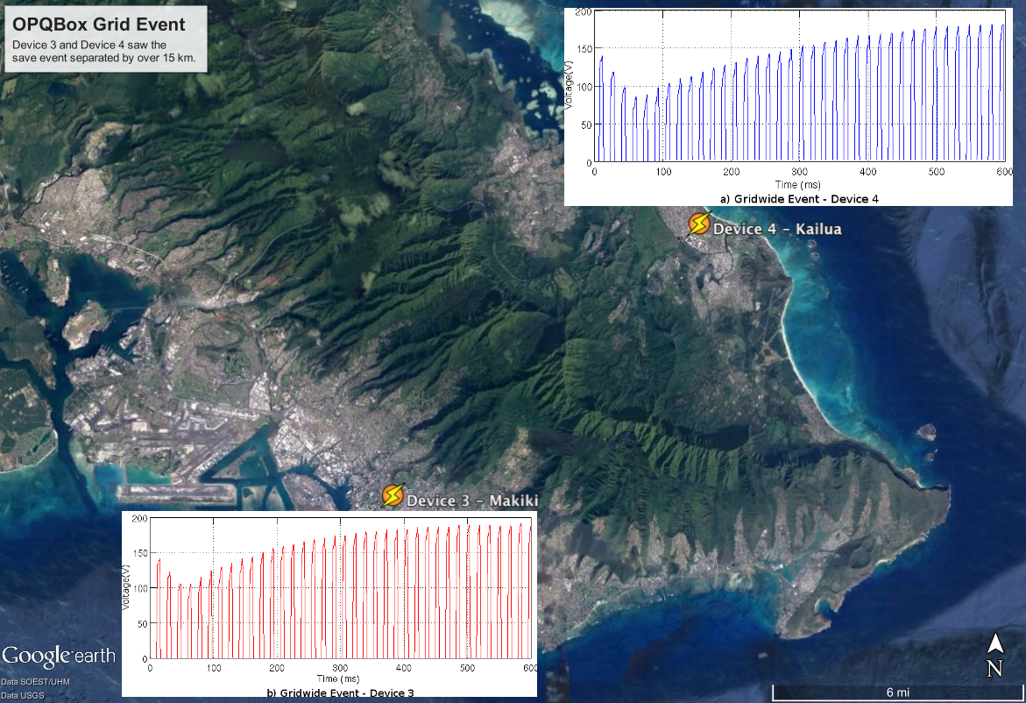

Slide 15
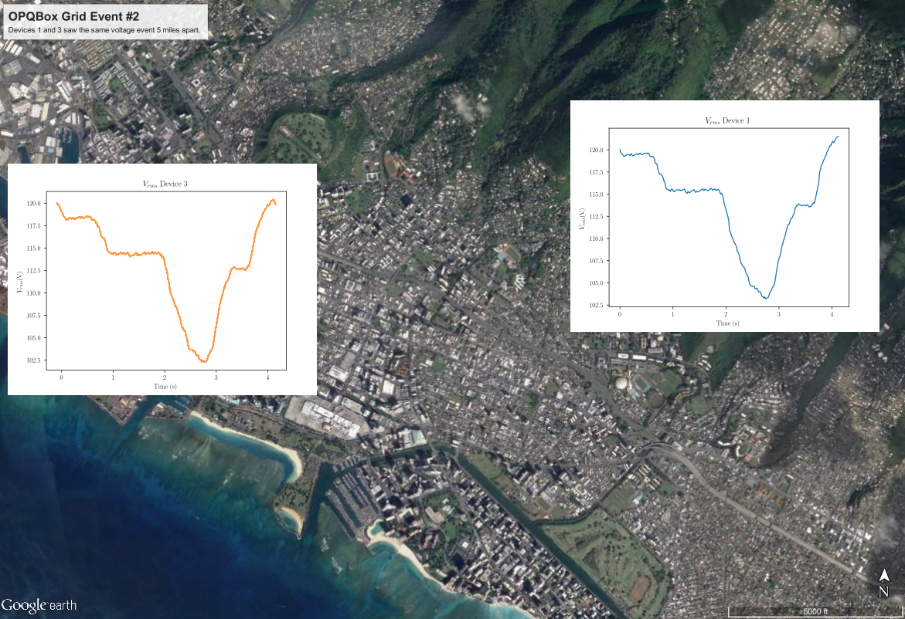

Slide 16

Second Global Event

Slide 17
PQ Disturbances occur on both sides of the power meter
Consumer Power generation:

Slide 18
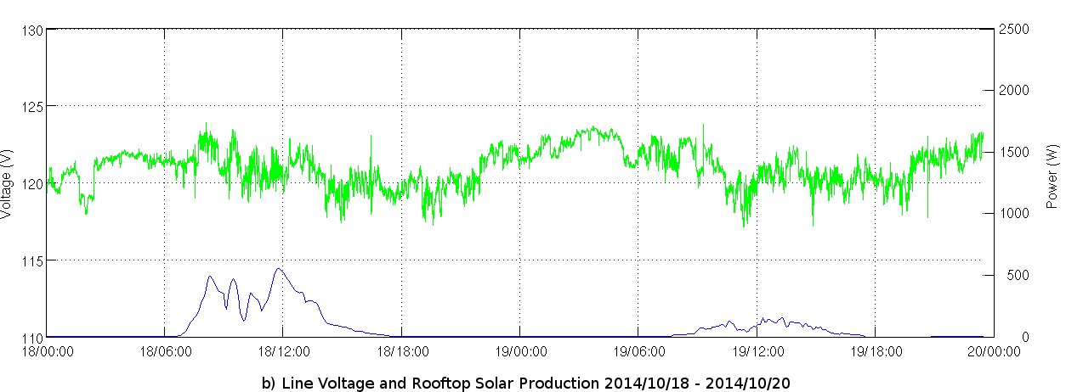
OPQ: Daily Trends
RMS LN Voltage(V)
Solar Power Produced (W)

Slide 19
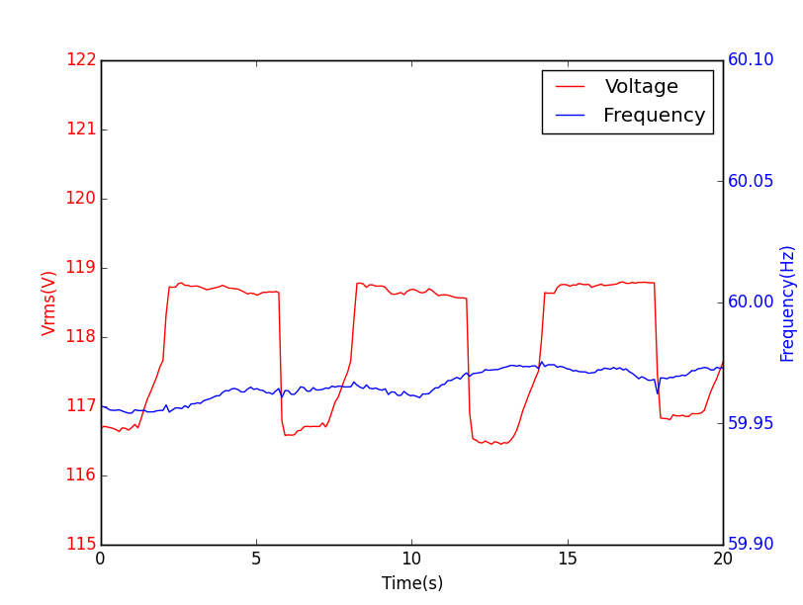
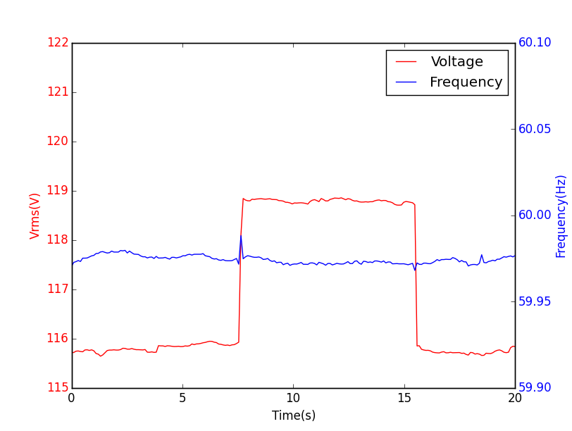
PQ Disturbances occur on both sides of the power meter
Inductive Hotplate
Toaster Oven

Slide 20
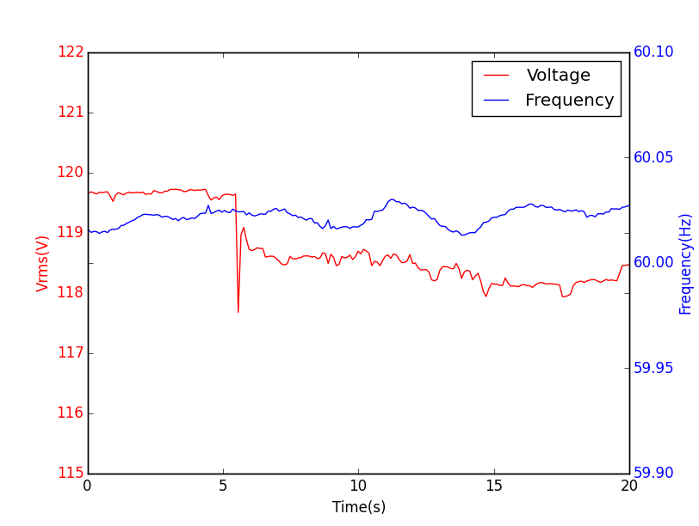
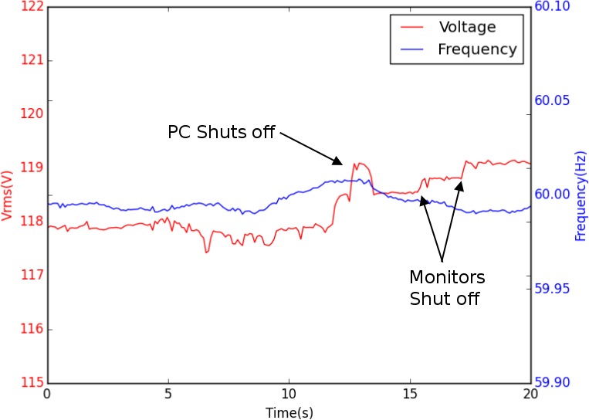
OPQ: Local event signatures
Desktop PC Power on
Desktop PC Power off

Slide 21
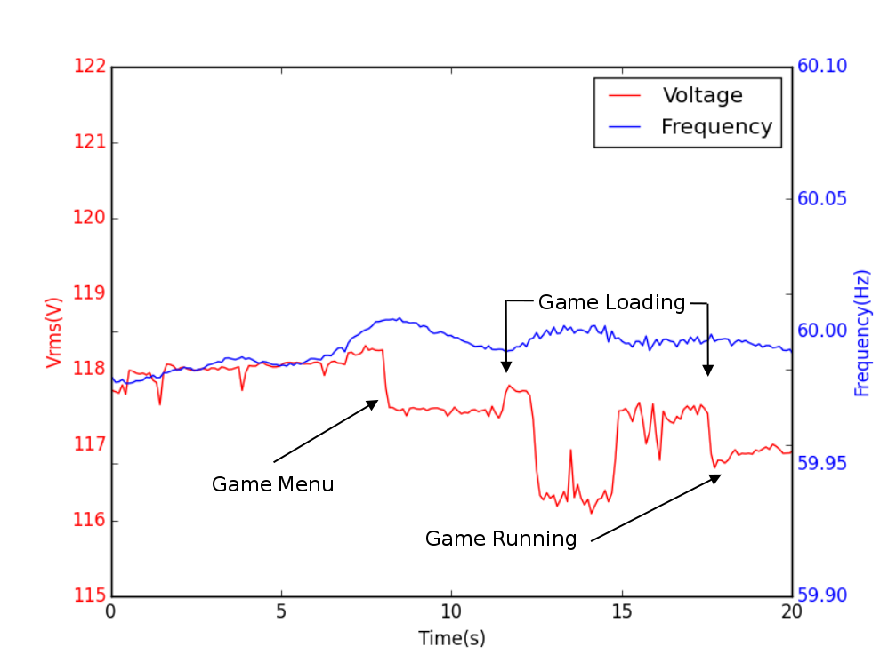
PQ Privacy concerns
Desktop PC under high load

Slide 22
PQ Sensitivity
Desktop PC under high load

Slide 23
Event Detection
Local Event Detection is impractical:
High rate of False positives
Missed sub-threshold data
Privacy concerns
Centralized Event Detection is too expensive:
High bandwidth/Computational cost
Even more privacy concerns
We need a hybrid approach

Slide 24
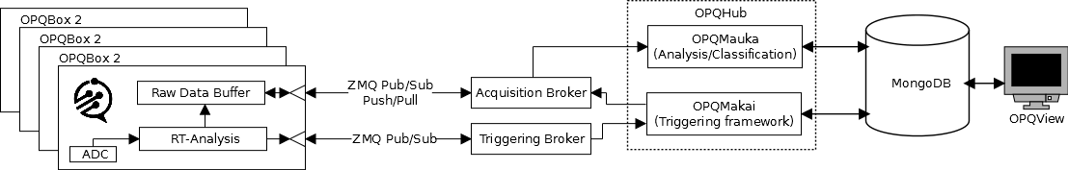
System Architecture
OPQBox2 processes and stores [how long is the buffer?] data locally
Data features are sent to the cloud
High fidelity data is requested based on data features
OPQMakai is an acquisition and triggering backend
OPQMauka is an analysis middleware component
OPQView is the event display frontend

Slide 25
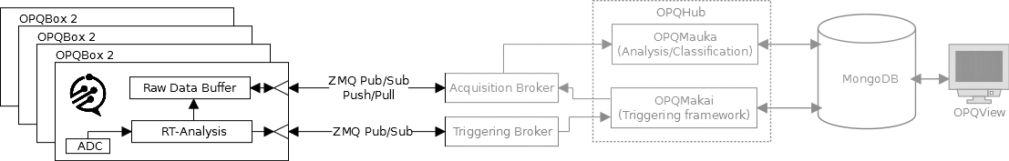
OPQBox2
16Ks/s 16Bit sampling
Electrically isolated from the mains
STM32 DSP:
  Sampling control
Raspberry Pi Zero W:
  NTP synchronization
  Local feature extraction
  30 minute buffer for raw waveforms
  802.11 WiFi
Optional features
  Battery backup
  GPS synchronization

Slide 26
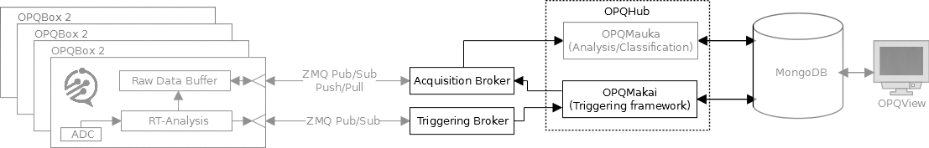
OPQMakai
Communication with OPQBox2s:
Encrypted
Brokered
Scalable [appears to be]
Asynchronous

Slide 27
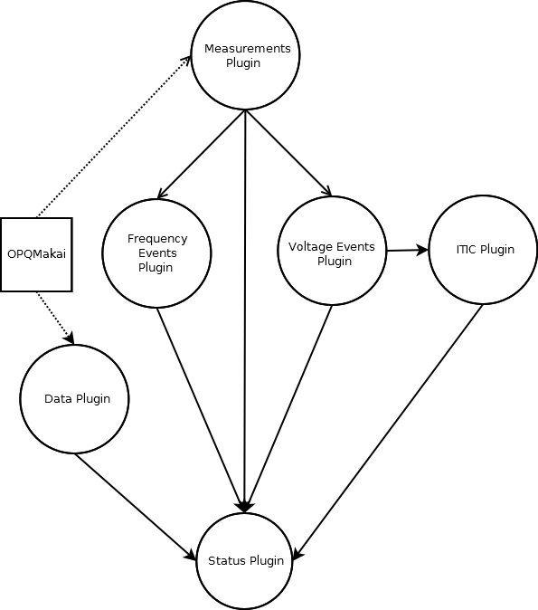
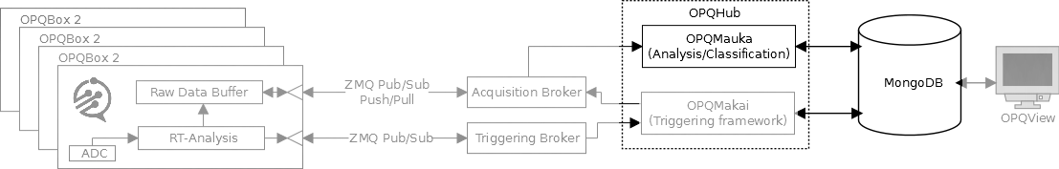
OPQMauka
Distributed plugin based analysis middleware
  Acts on data from OPQMakai
  I.P.C. via ZeroMQ
  Plugins form D.A.G.
  Publish/subscribe
  Basic classification
  Store products for OPQView

Slide 28
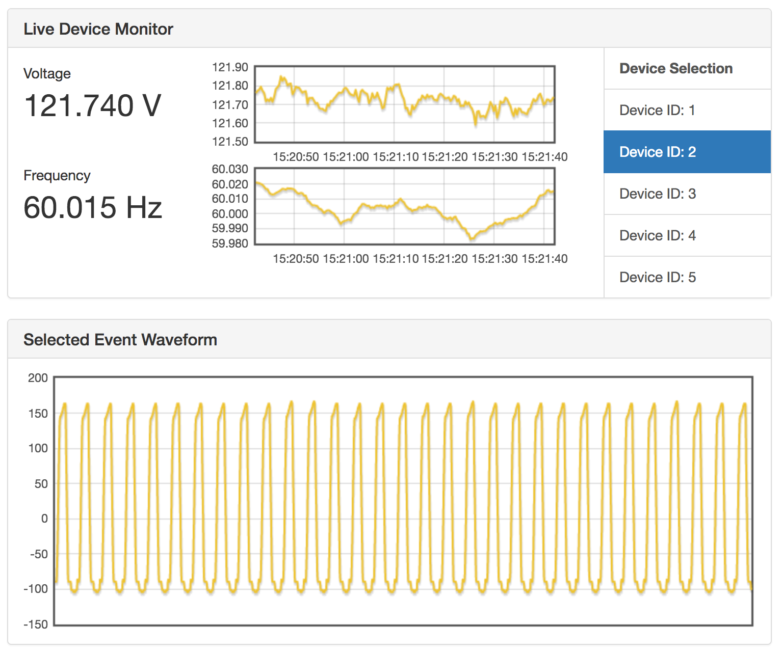
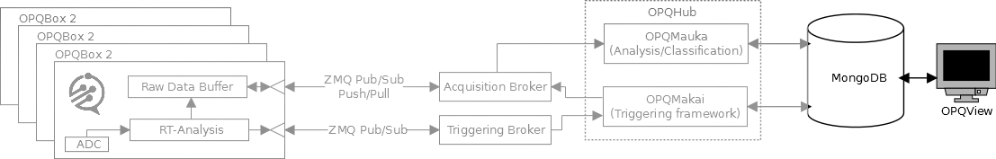
OPQView
Web based PQ
  Reporting
  Analytics
  Trends
  Status of network

Slide 29
Future Work
Privacy study
Signal classification
PQ communities
Higher level feature extraction on OPQBox2
Kickstarter campaign (Fall 2017)
Notes:
We might want a single slide for each of the future work directions
What would be the interesting outcome that we could gain from machine learning
-- replace ntp or gps for grid based synchronization

Slide 30
Future Work
Collaboration With You?
Notes:
We might want a single slide for each of the future work directions
What would be the interesting outcome that we could gain from machine learning
We’re working on ways to view the state of the grid, but we donlt really have the chops or know-how to fix. We’re appleaing to the experts to the experts in this room to
Come join us in the sun to study and rectify hawaii’s renewable generation issues and growing pains

Slide 31
We Welcome Contributions
Find us at
  http://openpowerquality.org
  http://github.com/openpowerquality
Contact us at
  achriste@hawaii.edu
  sin8@hawaii.edu
  johnson@hawaii.edu
Notes:
Alex McEachern – Power Standards Lab

Slide 32
Acknowledgements
  Electric Power Research Institute
  Hawaiian Electric Company
  Power Standards Lab
Notes:
Spell out epri

Slide 33
Mahalo!
Questions?

Slide 35
Future Work – Privacy Study
Identify sensitive PQ data
Ensure sensitive PQ data is not leaked
Do users feel that their privacy is respected?
Do privacy controls affect overall DQ?
Notes:
We might want a single slide for each of the future work directions
What would be the interesting outcome that we could gain from machine learning
-- replace ntp or gps for grid based synchronization

Slide 36
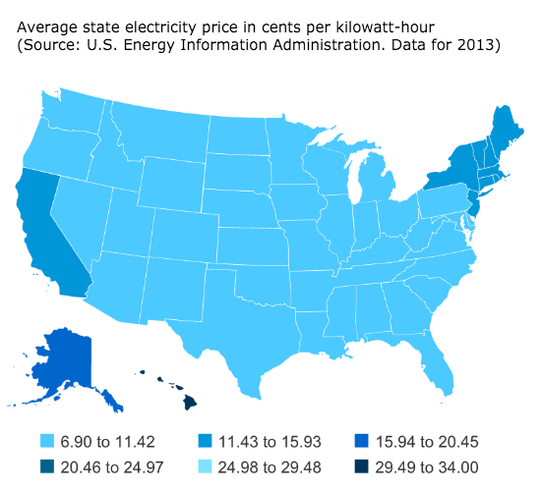
Hawaii’s Unique PQ Situation
Notes:
http://blogs.scientificamerican.com/plugged-in/3-reasons-hawaii-put-the-brakes-on-solar-and-why-the-same-won-t-happen-in-your-state/

Slide 37
Future Work – Privacy Study
Identify sensitive PQ data
Ensure sensitive PQ data is not leaked
Do users feel that their privacy is respected?
Do privacy controls affect overall DQ?
Notes:
We might want a single slide for each of the future work directions
What would be the interesting outcome that we could gain from machine learning
-- replace ntp or gps for grid based synchronization

Slide 38
Future Work – Signal Classification
Better classification of PQ events
Local Events vs. Grid Wide Events
Creation of a training set of events for supervised learning
Notes:
We might want a single slide for each of the future work directions
What would be the interesting outcome that we could gain from machine learning
-- replace ntp or gps for grid based synchronization

Slide 39
Future Work – PQ Communities
Examine the electrical distance between devices
Group devices into communities based on electrical distance
Group devices into communities based on PQ
Notes:
We might want a single slide for each of the future work directions
What would be the interesting outcome that we could gain from machine learning
-- replace ntp or gps for grid based synchronization

Slide 40
Future Work
Grid Based Time Synchronization
Replace GPS and NTP synchronization
with grid based synchronization
Notes:
We might want a single slide for each of the future work directions
What would be the interesting outcome that we could gain from machine learning
-- replace ntp or gps for grid based synchronization

Slide 41
Future Work
Limited Bandwidth Data Acquisition
Notes:
We might want a single slide for each of the future work directions
What would be the interesting outcome that we could gain from machine learning
-- replace ntp or gps for grid based synchronization

