Slide 1
OPQ
Summer 2018

Slide 2
What is the fundamental innovation in OPQ?

Slide 3
Answer:
OPQ implements a
Cloud Native
Architecture for
Power Quality

Slide 4
Electrical power technology is over 100 years old.
Today’s power quality technology is based on pre-Internet days.
This has interesting architectural implications.

Slide 5
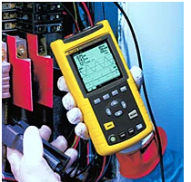
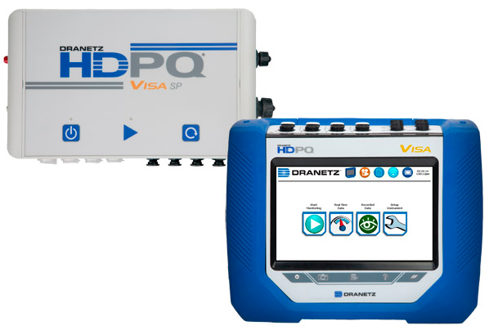
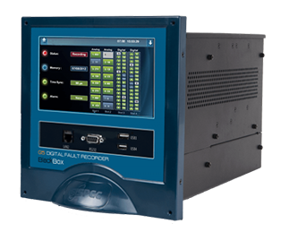
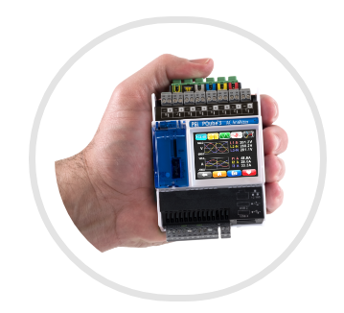

Power Quality Monitoring Devices

Slide 6
PQ Monitoring Devices
Handheld PQ monitors
Data loggers
  Local display
  No “global awareness”
  Intended for electrical engineers to diagnose PQ problems at point of use
  No local storage
  Local display
  No “global awareness”
  Intended for electrical engineers to diagnose PQ problems at point of use
  Some local storage
  History can be downloaded via USB cable or MODBUS
Key point: PQ monitoring devices are designed for standalone operation.

Slide 7
PQ Database Software
My research has uncovered two systems.
PQView
  “Industry standard”
  Has yearly user group meetings
PQScada
  A somewhat more modern looking UI

Slide 8
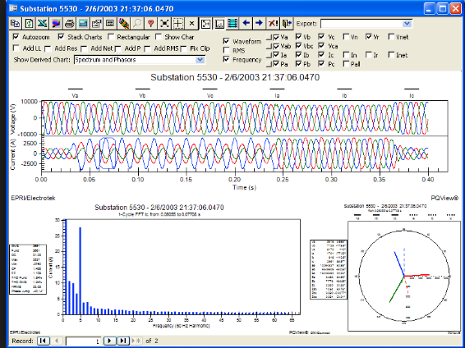
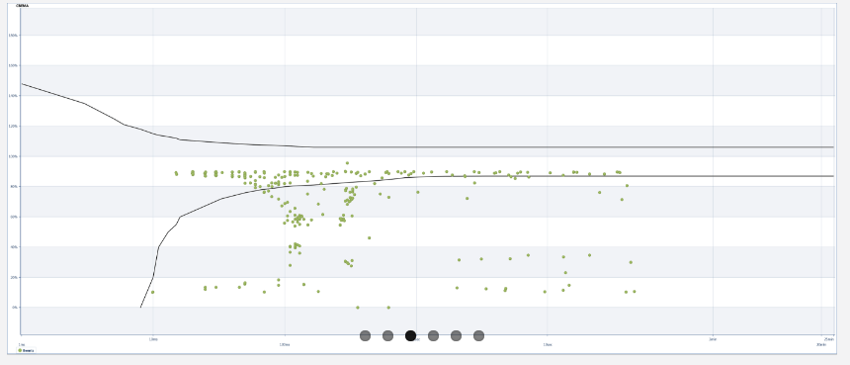

Slide 9
Common Architectural Principles
The database must be built from data collected by existing PQ Monitors (i.e. “stand-alone” devices).
There is a standard (PQDif) for how this data is represented and communicated.
Implications:
  No flexibility on how data is represented and communicated.
  One way dataflow (from monitor to DB)
  Low frequency updates (daily!)

Slide 10
Enter the OPQ project
We were unburdened by any knowledge of the traditional relationship between PQ monitors and databases.
We designed the system such that the hardware cannot function without cloud-based software
“Cloud Native”, not “Standalone”

Slide 11
Architectural differences
Feature | Stand alone | Cloud Native
Local Display | Yes | No
Global awareness | No | Yes
User Community | Engineer | Customer
Data communication | PQDif | Custom
Data flow | One way | Two way
DB Update Frequency | Day | Second

Slide 12
The fundamental research questions
How does a cloud-native architecture enable novel findings regarding power quality?
  Does a triggering system (i.e. two way communication) enable data availability not possible with a standalone architecture?
  Does global awareness enable classifications not available otherwise?
  Does the combination support new insights (i.e. into the impact of renewables on the grid)?

Slide 13
Shortest path to completed theses
  Deployed, functioning cloud-native system that gathers interesting PQ data.
  Documentation and development structures to quickly integrate new developers and organizations.
  Research publication rate accelerates
  Future team members and partner organizations focus on system maintenance and management; you become free to focus on research data and writeup.

Slide 14
Summer 2018 Project Planning
Two immediate issues for discussion:
Tasks for Serge to complete prior to his backpacking trip.
Onboarding tasks for new students.

Slide 15
Proposed Serge Tasks
Location representation in Makai
Design/document Box software
  Development environment
  Deployment to box
  Testing and verification.
Revise Box software to implement new Measurement representation
  Once-per-second updates
  Max-Min-Ave Voltage, Frequency, THD
  Presence of transients
David B. -> Box software development?

Slide 16
Onboarding tasks
View:
  Implement entity management UI
Mauka:
  ?
Makai:
  ?
Box:
  ?

Slide 17
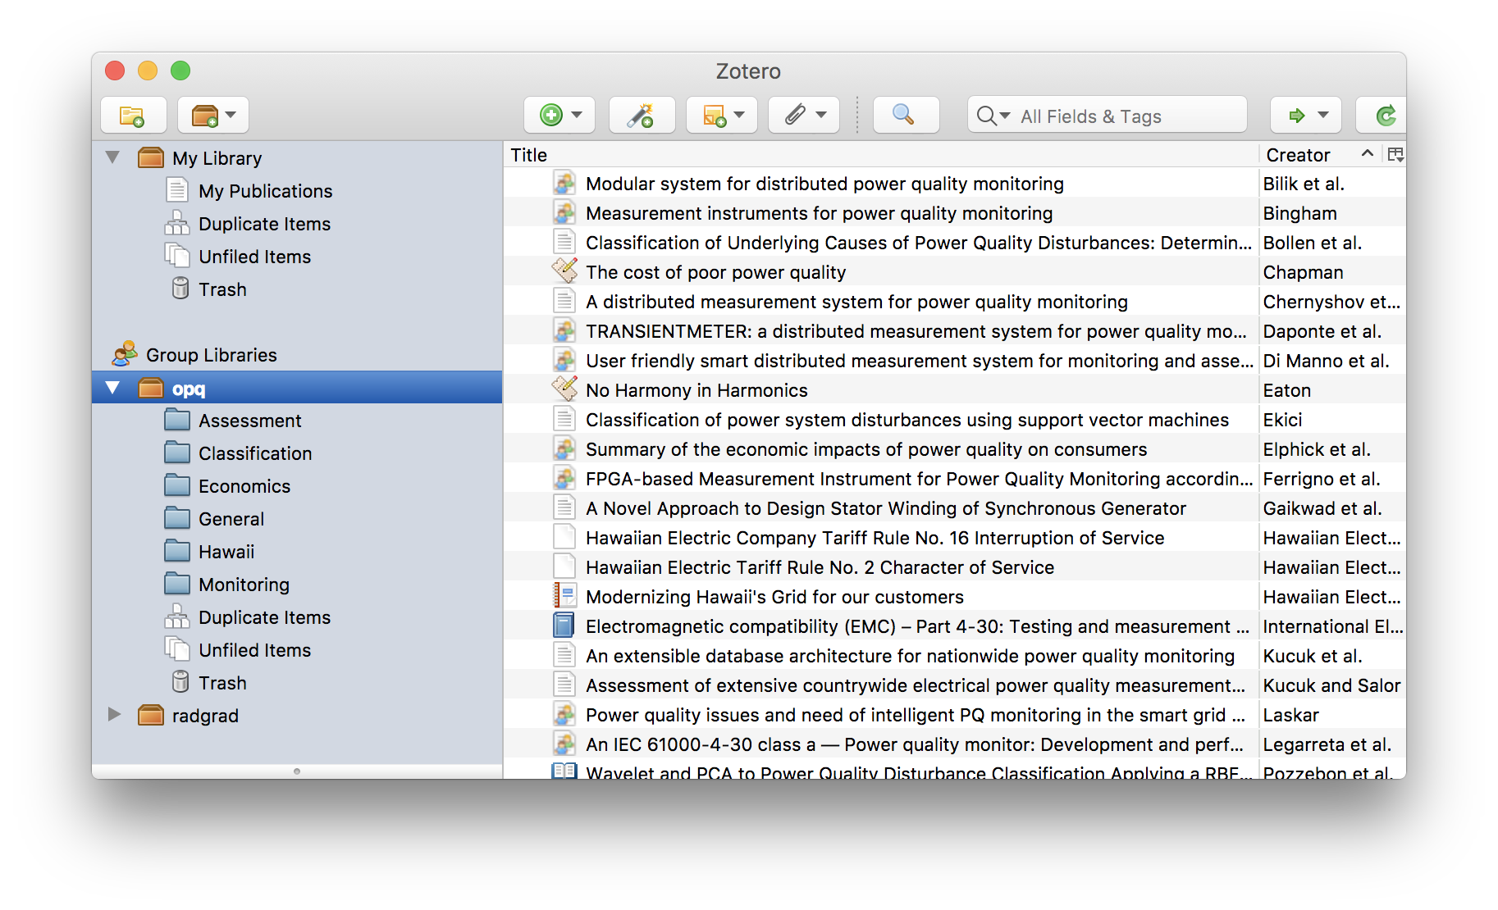
Zotero

