Slide 1



Advanced Topics in STR DNA Analysis
Y-STRs and mtDNA
AAFS 2006 Workshop #6
Seattle, WA
February 20, 2006
Dr. John M. Butler
Dr. Bruce R. McCord
john.butler@nist.gov
mccordb@fiu.edu

Slide 2
Outline for This Section
Y-STRs and mtDNA
Role of Y-STRs and mtDNA compared to autosomal STRs
Advantages and disadvantages of lineage markers
Y-STR core loci and available kits
Y-STR haplotype databases and statistics
mtDNA characteristics
Efforts to resolve common types
Hair shaft analysis with mtDNA and STRs

Slide 3
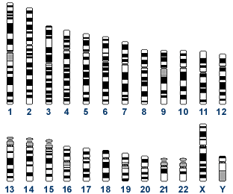
Human Genome
23 Pairs of Chromosomes + mtDNA
Located in cell nucleus
Autosomes
2 copies per cell
Located in mitochondria (multiple copies in cell cytoplasm)
http://www.ncbi.nlm.nih.gov/genome/guide/
mtDNA
16,569 bp
1 2 3 4 5 6 7 8 9 10 11 12
Mitochondrial DNA
13 14 15 16 17 18 19 20 21 22 X Y
Sex-chromosomes
Nuclear DNA
3.2 billion bp
100s of copies per cell
Butler, J.M. (2005) Forensic DNA Typing, 2nd Edition, Figure 2.3, ©Elsevier Science/Academic Press
Notes:
Figure 2.3 The human genome contained in every cell consists of 23 pairs of chromosomes and a small circular genome known as mitochondrial DNA. Chromosomes 1-22 are numbered according to their relative size and occur in single copy pairs within a cell’s nucleus with one copy being inherited from one’s mother and the other copy coming from one’s father. Sex-chromosomes are either X,Y for males or X,X for females. Mitochondrial DNA is inherited only from one’s mother and is located in the mitochondria with hundreds of copies per cell. Together the nuclear DNA material amounts to over 3 billion base pairs (bp) while mitochondrial DNA is only about 16,569 bp in length.

Slide 4
Role of Y-STRs and mtDNA
Compared to Autosomal STRs
Autosomal STRs provide a higher power of discrimination and are the preferred method whenever possible
Due to capabilities for male-specific amplification, Y-chromosome STRs (Y-STRs) can be useful in extreme female-male mixtures (e.g., when differential extraction is not possible such as fingernail scrapings)
Due to high copy number, mitochondrial DNA (mtDNA) may be the only source of surviving DNA in highly degraded specimens or low quantity samples such as hair shafts

Slide 5
Different Inheritance Patterns
Lineage Markers
CODIS STR Loci
Autosomal
(passed on in part,
from all ancestors)
Y-Chromosome
(passed on complete, but only by sons)
Mitochondrial
(passed on complete,
but only by daughters)
Butler, J.M. (2005) Forensic DNA Typing, 2nd Edition, Figure 9.1, ©Elsevier Science/Academic Press
Notes:
Figure 9.1 Illustration of inheritance patterns from recombining autosomal genetic markers and the lineage markers from the Y-chromosome and mitochondrial DNA.

Slide 6
Lineage Markers:
Y-STRs and mtDNA
Advantages
Extend possible reference samples beyond a single generation (benefits missing persons cases and genetic genealogy)
Family members have indistinguishable haplotypes unless mutations have occurred
Disadvantages
Lower power of discrimination due to no genetic shuffling with recombination
Family members have indistinguishable haplotypes unless mutations have occurred

Slide 7
Y-STRs permit extension of possible reference samples in missing persons cases
uncle
3rd cousin
(paternal)
?
Butler, J.M. (2005) Forensic DNA Typing, 2nd Edition, Figure 9.3, ©Elsevier Science/Academic Press
Notes:
Figure 9.3 An example pedigree showing patrilineal inheritance where all shaded males have the same Y-chromosome barring any mutations. To help identify the person in question, any of the other males with the same patrilineage could provide a reference sample to assist in a missing persons investigation, mass disaster victim identification, or deficient paternity test (boxed region) where the father is deceased or not available for testing.

Slide 8
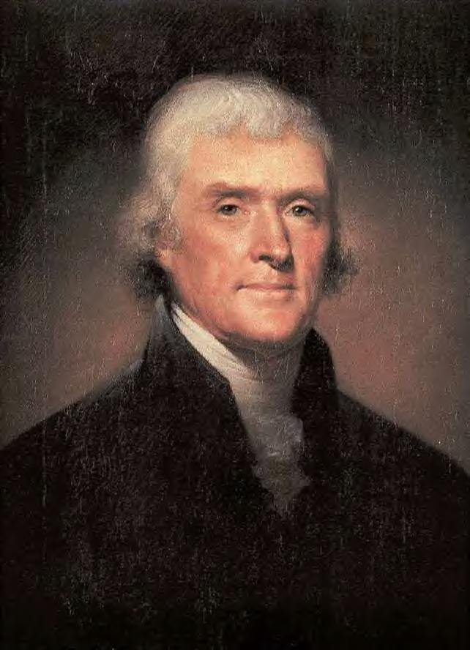




Historical Investigation of Jefferson-Hemings DNA
Thomas Jefferson II
Field Jefferson
Peter Jefferson
Genetic Genealogy Companies
President
Thomas Jefferson
?
Eston Hemings
Thomas Woodson
Same Y
Haplotype
Jefferson
Y Haplotype
Jefferson
Y Haplotype
Different Y Haplotype
SOURCE: Foster et al. (1998) Nature 396:27-28
Figure 9.10, J.M. Butler (2005) Forensic DNA Typing, 2nd Edition © 2005 Elsevier Academic Press
Notes:
Figure 9.10 Ancestry of Thomas Jefferson and Eston Hemings male lines. The shaded boxes represent the samples tested by Foster et al. (1998) in their Jefferson Y chromosome study. A male descendant of Eston Hemings, son of Thomas Jefferson’s slave Sally Hemings, was found to have a Y chromosome haplotype that matched male descendants of Field Jefferson, President Thomas Jefferson’s uncle. A male descendant of Thomas Woodson, claimed by some to be descended from Jefferson, had a different Y haplotype and therefore could not have been a Jefferson.

Slide 9
Value of Y-Chromosome Markers
J.M. Butler (2005) Forensic DNA Typing, 2nd Edition; Table 9.1
Application
Advantage
Forensic casework on sexual assault evidence
Male-specific amplification (can avoid differential extraction to separate sperm and epithelial cells)
Paternity testing
Male children can be tied to fathers in motherless paternity cases
Missing persons investigations
Patrilineal male relatives may be used for reference samples
Human migration and evolutionary studies
Lack of recombination enables comparison of male individuals separated by large periods of time
Historical and genealogical research
Surnames usually retained by males; can make links where paper trail is limited

Slide 10
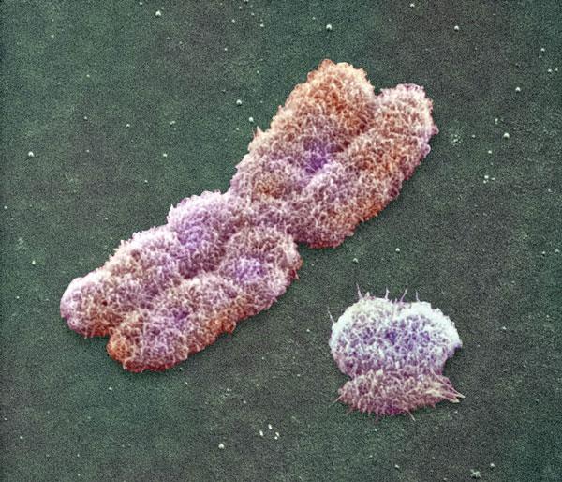
THE HUMAN Y CHROMOSOME:
AN EVOLUTIONARY MARKER COMES OF AGE
Mark A. Jobling & Chris Tyler-Smith
Nature Reviews Genetics (2003) 4, 598-612
(From Nature website)
10,000X magnification
of X and Y chromosomes
Abstract
Until recently, the Y chromosome seemed to fulfill the role of juvenile delinquent among human chromosomes — rich in junk, poor in useful attributes, reluctant to socialize with its neighbors and with an inescapable tendency to degenerate. The availability of the near-complete chromosome sequence, plus many new polymorphisms, a highly resolved phylogeny and insights into its mutation processes, now provide new avenues for investigating human evolution. Y-chromosome research is growing up.

Slide 11
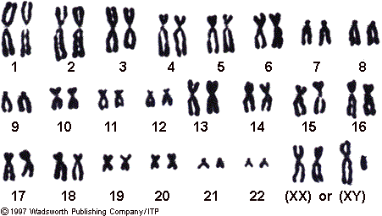
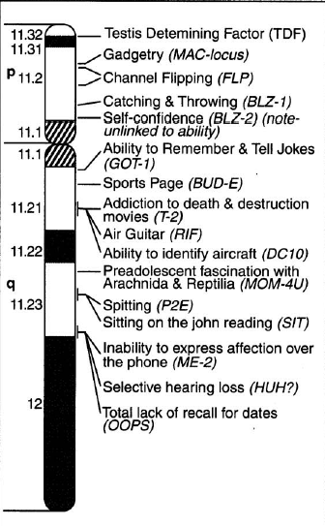
Traits found on the Y - Chromosome
An Early Y-Chromosome Map
spitting
incessant use of TV remote buttons
if lost, cannot stop and ask for directions
ability to recall facts about baseball/basketball/hockey/golf/etc.
male pattern baldness
congregates with other Y-chromosome bearers to do “guy things”
Source of “Testosterone poisoning”
Science (1993) 261:679

Slide 12
What has happened in the past few years
“Full” Y-chromosome sequence became available in June 2003; over 200 Y-STR loci identified (only ~20 in 2000)
Selection of core Y-STR loci (SWGDAM Jan 2003)
Multiple commercial Y-STR kits released
  Y-PLEX 6,5,12 (2001-03), PowerPlex Y (9/03), Yfiler (12/04)
Many population studies performed and databases generated with thousands of Y-STR haplotypes
Forensic casework demonstration of value of Y-STR testing along with court acceptance

Slide 13
Disadvantages of the Y-Chromosome
Loci are not independent of one another and therefore rare random match probabilities cannot be generated with the product rule; must use haplotypes (combination of alleles observed at all tested loci)
Paternal lineages possess the same Y-STR haplotype (barring mutation) and thus fathers, sons, brothers, uncles, and paternal cousins cannot be distinguished from one another
Not as informative as autosomal STR results
  More like addition (10 + 10 + 10 = 30) than multiplication (10 x 10 x 10 = 1,000)

Slide 14
Forensic Advantages of Y-STRs
Male-specific amplification extends range of cases accessible to obtaining probative DNA results (e.g., fingernail scrapings, sexual assault without sperm)
Technical simplicity due to single allele profile; can potentially recover results with lower levels of male perpetrator DNA because there is not a concern about heterozygote allele loss via stochastic PCR amplification; number of male contributors can be determined
Courts have already widely accepted STR typing, instrumentation, and software for analysis (Y-STR markers just have different PCR primers)
Acceptance of statistical reports using the counting method due to previous experience with mtDNA

Slide 15
Scenarios Where Y-STRs
Can Aid Forensic Casework
Sexual assaults by vasectomized or azoospermic males (no sperm left behind for differential extraction)
Extending length of time after assault for recovery of perpetrator’s DNA profile (greater than 48 hours)
Fingernail scrapings from sexual assault victims
Male-male mixtures
Other bodily fluid mixtures (blood-blood, skin-saliva)
Gang rape situation to include or exclude potential contributors

Slide 16
Y-STRs can permit simplification of male DNA identification in sexual assault cases
Female Victim DNA Profile
No signal observed
Male Perpetrator DNA Profile
DNA Profile from Crime Scene
Autosomal STR
Profile
Y-Chromosome STR Profile
Butler, J.M. (2005) Forensic DNA Typing, 2nd Edition, Figure 9.2, ©Elsevier Science/Academic Press
Notes:
Figure 9.2 Schematic illustrating the types of autosomal or Y-STR profiles that might be observed with sexual assault evidence where mixtures of high amounts of female DNA may mask the STR profile of the perpetrator. Y-STR testing permits isolation of the male component without having to perform a differential lysis.

Slide 17
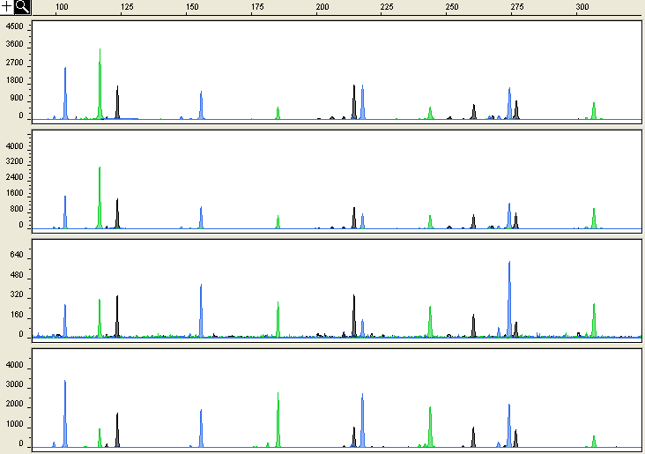
PowerPlex Y Performance in Our Hands
2 ng male
2 ng male: 15 ng female
500 pg male: 408 ng female
800X female DNA
1 ng male: 816 ng female

Slide 18
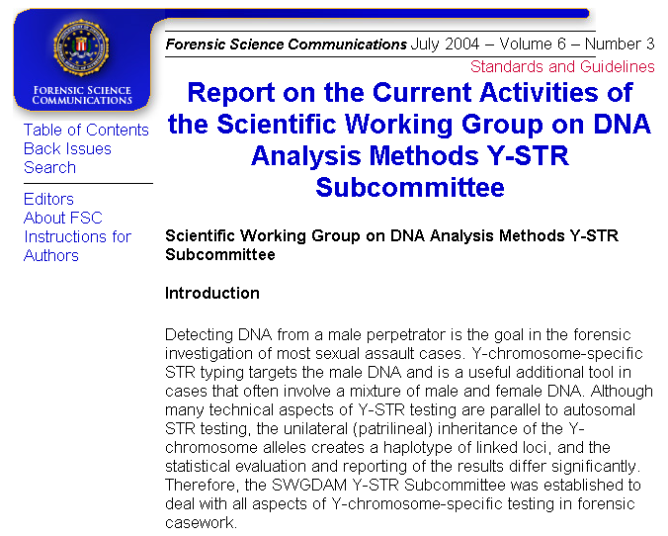
Selection of Core Y-STR Loci
Selection of
U.S. Core Loci:
DYS19,
DYS385 a/b, DYS389I/II, DYS390, DYS391, DYS392, DYS393, DYS438,
DYS439

Slide 19
Core Y-STR Characteristics
11 PCR products
9 primer sets
STR Marker | Position (Mb) | Repeat Motif | Allele Range | Mutation Rate
DYS393 | 3.17 | AGAT | 8-17 | 0.05%
DYS19 | 10.12 | TAGA | 10-19 | 0.20%
DYS391 | 12.54 | TCTA | 6-14 | 0.40%
DYS439 | 12.95 | AGAT | 8-15 | 0.38%
DYS389 I/II | 13.05 | [TCTG] [TCTA] | 9-17 / 24-34 | 0.20%, 0.31%
DYS438 | 13.38 | TTTTC | 6-14 | 0.09%
DYS390 | 15.71 | [TCTA] [TCTG] | 17-28 | 0.32%
DYS385 a/b | 19.19, 19.23 | GAAA | 7-28 | 0.23%
DYS392 | 20.97 | TAT | 6-20 | 0.05%
Positions in megabases (Mb) along the Y-chromosome were determined with NCBI build 35 (May 2004) using BLAT. Allele ranges represent the full range of alleles reported in the literature. Mutation rates summarized from YHRD (http://www.yhrd.org; accessed 6 Apr 2005).
Butler, J.M. (2006) Genetics and genomics of core STR loci used in human identity testing. J. Forensic Sci., in press.

Slide 20
(A)
DYS385 a/b
Multi-Copy (Duplicated) Marker
R primer
R primer
a
b
F primer
F primer
Duplicated regions are 40,775 bp apart and facing away from each other
a = b
a ≠ b
(B)
DYS389 I/II
Single Region but Two PCR Products (because forward primers bind twice)
I
II
DYS389I
DYS389II
F primer
F primer
R primer
Butler, J.M. (2005) Forensic DNA Typing, 2nd Edition, Figure 9.5, ©Elsevier Science/Academic Press
Notes:
Figure 9.5 Schematic illustration of how multiple PCR primer binding sites give rise to multi-copy PCR products for (A) DYS385 a/b and (B) DYS389I/II. Arrows represent either forward “F” or reverse “R” primers. In the case of DYS385 a/b, the entire region around the STR repeat is duplicated and spaced about 40,775 bp apart on the long arm of the Y-chromosome. Thus, amplification with a single set of primers gives rise to one peak if the “a” repeat region is equal in size to the “b” repeat region or separate peaks if “a” and “b” differ in length. DYS389 possess two primary repeat regions that are flanked on one side by a similar sequence. Widely used forward primers bind adjacent to both repeats generating amplicons that differ in size by ~120 bp. Note that DYS389II is inclusive of the DYS389I repeat region and therefore some analyses subtract DYS389II-DYS389I repeats.

Slide 21
Allele size range and locus dye colors
PowerPlex® Y
Released by Promega Corporation in Sept 2003
100 bp
200 bp
300 bp
400 bp
FL
DYS391
DYS389I
DYS439
DYS389II
DYS438
DYS19
DYS392
3 dye colors
12-plex PCR
JOE
DYS437
TMR
DYS393
DYS390
DYS385a/b
AmpFlSTR® Yfiler™
Released by Applied Biosystems in Dec 2004
100 bp
200 bp
300 bp
400 bp
6-FAM
DYS456
DYS389I
DYS390
DYS389II
4 dye colors
17-plex PCR
VIC
DYS458
DYS19
DYS385a/b
NED
DYS393
DYS391
DYS439
DYS635
DYS392
PET
H4
DYS437
DYS438
DYS448

Slide 22
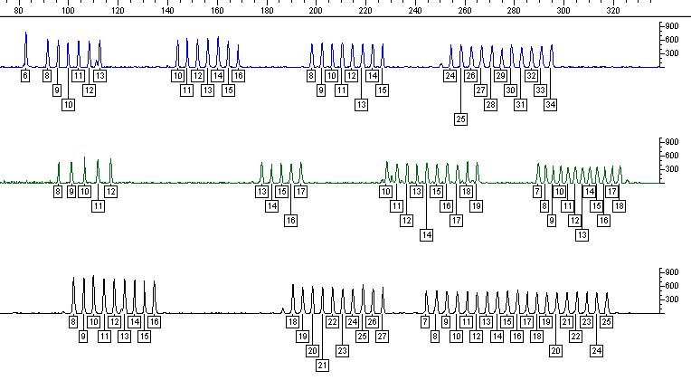
Promega PowerPlex® Y Allelic Ladders
DYS391
DYS389I
DYS439
DYS389II
DYS438
DYS437
DYS19
DYS392
DYS393
DYS390
DYS385 a/b
U.S. Core Loci + DYS437
Single amplification; ladders contain 103 alleles

Slide 23
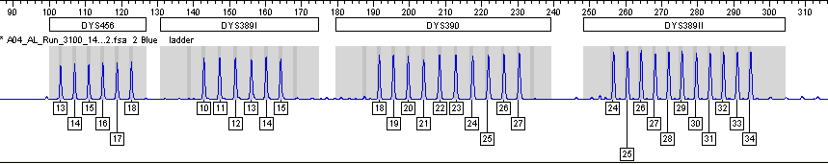
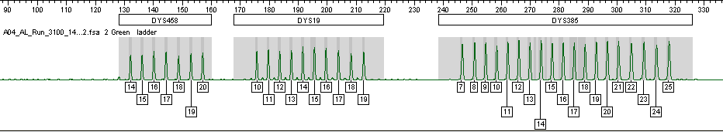
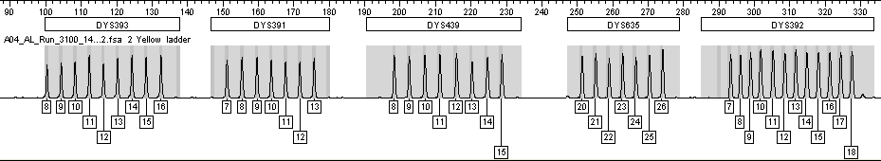
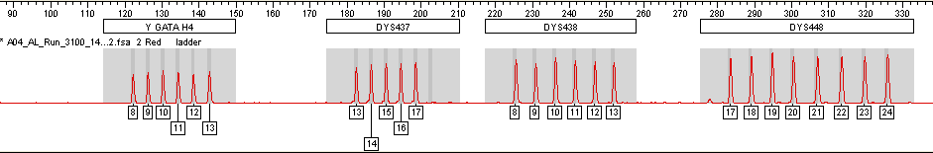
Yfiler Allelic Ladders
U.S. Core Loci + DYS437, DYS448, DYS456, DYS458, DYS635, GATA H4

Slide 24
Subdividing Common Types with More Loci
657 males from 3 U.S. populations
Most common type
DYS19 – 14
DYS389I – 13
DYS389II – 29
DYS390 – 24
DYS391 – 11
DYS392 – 13
DYS393 – 13
DYS385 a/b – 11,14
Minimal haplotype
(19, 389I/II, 390, 391, 392, 393, 385 a/b)
U.S. Haplotype
(26)
SWGDAM recommended loci (+ 438,439)
(7)
(15)
(4)
PowerPlex Y (+437)
(2)
(4)
(1)
(3)
(12)
(1)
(3)
Yfiler (+448,456,458,635,H4)
(1)
(1)
(1)
(1)
(1)
(1)
(1)
(1)
(1)
(1)
(1)
(1)
(1)
(1)
(1)
(1)
(1)
(1)
(1)
(1)
(1)
(3)
(1)
(1)
Identical: DYS…444,446,485,495,505,508,534,540,556
Subdivide into two groups (2)(1): DYS…449,463,520,532,533,557,570,594,643
Subdivide into three groups (1)(1)(1): DYS522, DYS576

Slide 25
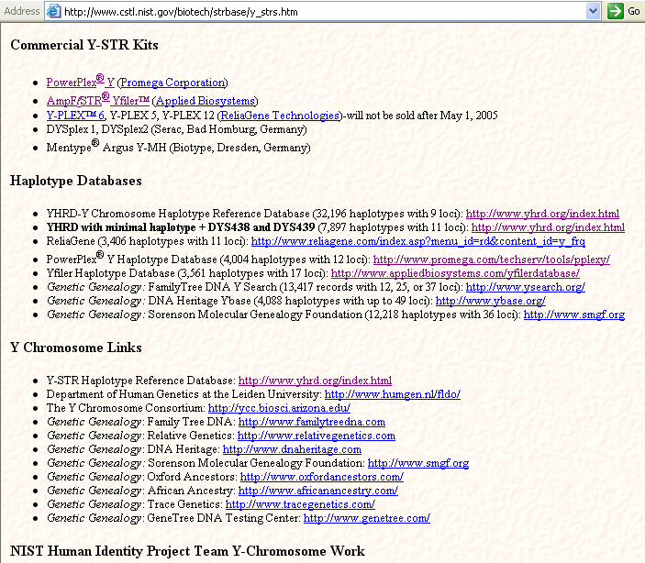
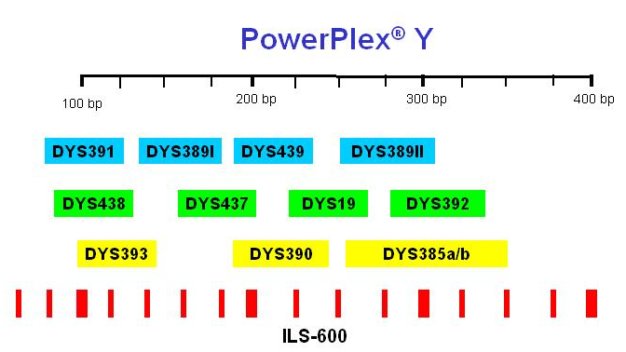
New Y-Chromosome Information Resources on STRBase
Locus boxes are hyperlinked to STR Fact Sheets
http://www.cstl.nist.gov/biotech/strbase/y_strs.htm
Largest Y-STR Database
YHRD has
9,634 haplotypes (from 61 populations) with SWGDAM recommended loci

Slide 26

Y-Chromosome Haplotype Reference Database (YHRD)
Run only with minimal haplotype
DYS19
DYS389I/II
DYS390
DYS391
DYS392
DYS393
DYS385 a/b
http://www.yhrd.org
As of 12/5/05: 34,558 haplotypes
9,634 haplotypes with all US required loci
Commercial Y-STR kits exist to amplify all of the core loci in a single reaction (plus a few additional markers)
US haplotype requires
2 additional loci:
DYS438
DYS439

Slide 27
Haplotype Databases for Y-STR Kits
http://www.promega.com/techserv/tools/pplexy/
http://www.appliedbiosystems.com/yfilerdatabase/
PowerPlex Y
  1311 Caucasians
  325 Asians
  894 Hispanics
  1108 African Americans
  366 Native Americans
  --------------
  4,004 total
  (as of March 2005)
Yfiler
  1276 Caucasians
  330 Asians
  597 Hispanics
  985 African Americans
  106 Native Americans
  105 Filipino
  59 Sub-Saharan Africans
  103 Vietnamese
  ---------------
  3,561 total
  (as of December 2004)

Slide 28
Statistics with Y-STR Haplotypes
Most labs will probably go with the counting method (number of times a haplotype is observed in a database) as is typically done with mtDNA results

Slide 29
Example Y-STR Haplotype
Core US Haplotype
DYS19 – 14
DYS389I – 13
DYS389II – 29
DYS390 – 24
DYS391 – 11
DYS392 – 14
DYS393 – 13
DYS385 a/b – 11,15
DYS438 – 12
DYS439 – 13
Matches by Databases
YHRD (9 loci)
  7 matches in 27,773
YHRD (11 loci)
  0 matches in 6,281
ReliaGene (11 loci)
  0 matches in 3,403
PowerPlex Y (12 loci)
  0 matches in 4,004
Yfiler (17 loci)
  0 matches in 3,561

Slide 30
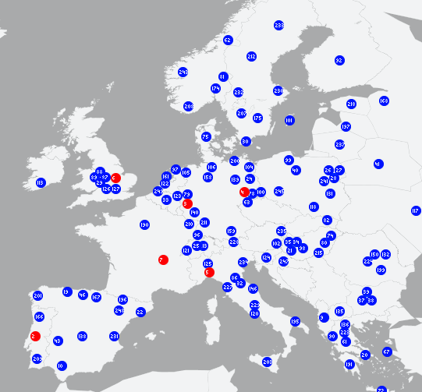
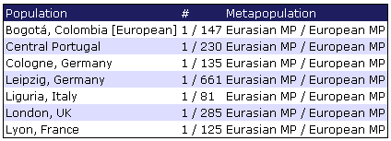
www.YHRD.org
Y-Chromosome Haplotype Reference Database
7 matches in 27,773 individuals from 236 worldwide populations
Release "15" from 2004-12-17 16:11:24
Minimal Haplotype Result
DYS19 – 14
DYS389I – 13
DYS389II – 29
DYS390 – 24
DYS391 – 11
DYS392 – 14
DYS393 – 13
DYS385 a/b – 11,15

Slide 31
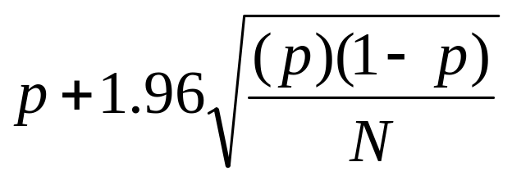
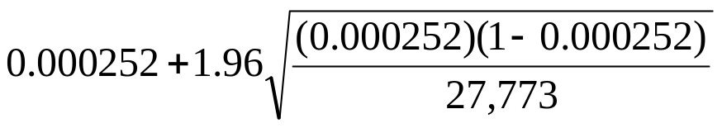
Frequency Estimate Calculations
Using the Counting Method
In cases where a Y-STR profile is observed a particular number of times (X) in a database containing N profiles, its frequency (p) can be calculated as follows:
p = X/N
An upper bound confidence interval can be placed on the profile’s frequency using:
7 matches in 27,773
p = 7/27,773 = 0.000252 = 0.025%
= 0.000252 + 0.000187 = 0.000439
= 0.044% (~1 in 2270)

Slide 32
When there is no match with the counting method…
In cases where the profile has not been observed in a database, the upper bound on the confidence interval is
1-α^{1/N}
where α is the confidence coefficient (0.05 for a 95% confidence interval) and N is the number of individuals in the database.
0 matches in 4,004
1-α^{1/N} = 1-(0.05)^{[1/4,004]} = 0.000748
= 0.075% (~1 in 1340)
If using database of 2,443, then the best you can do is 1 in 816

Slide 33
The Meaning of a Y-Chromosome Match
Conservative statement for a match report:
The Y-STR profile of the crime sample matches the Y-STR profile of the suspect (at xxx number of loci examined). Therefore, we cannot exclude the suspect as being the donor of the crime sample. In addition, we cannot exclude all patrilineal related male relatives and an unknown number of unrelated males as being the donor of the crime sample.

Slide 34
Difficult Questions…
Which database(s) should be used for Y-STR profile frequency estimate determination?
Are any of the current forensic Y-STR databases truly adequate for reliable estimations of Y-STR haplotype frequencies?
  Some individuals share identical Y-STR haplotypes due to recurrent mutations, not relatedness…
  Is the database a random collection reflecting Y-STR haplotype frequencies of the population?
  Is the Y-STR haplotype frequency relevant for the population of the suspect?
Issues raised by Peter de Knijff at his Promega meeting presentation (Oct 2004)

Slide 35
Conclusions from Peter de Knijff
From his presentation at the Promega meeting (Oct 2004)
A haplotype frequency taken from any Y-STR database should not be reported or seen as a random match probability
  Because all male relatives have the same haplotype
  Males can share haplotypes without being related
Database estimates are at most qualitative…

Slide 36
What Peter de Knijff Reports with a Y-STR Match
From his presentation at the Promega meeting (Oct 2004)
The Y-STR profile of the stain matches with the suspect.
Therefore, the suspect cannot be excluded as the donor of the stain.
On the basis of this DNA evidence, I can also not exclude all paternally related male relatives of the suspect as possible donors of this stain.
In addition, an unknown number of males from the same region cannot be excluded. A more accurate answer can only be obtained if (1) we have detailed knowledge of the population structure of the region of interest, (2) the Y-STR frequencies therein are known, and (3) we have knowledge about the family structure of the suspect.

Slide 37
Can Y-STR results be combined with autosomal STR information?
Still subject to some debate among experts (most say “yes”)
Problem of different inheritance modes
Multiply random match probability from the autosomal STR profile obtained with the upper bound confidence limit from the Y-STR haplotype frequency estimate

Slide 38
International Forensic Y-User Workshops
Next meeting (5th): Sept 26-30, 2006 (Innsbruck, Austria) – will also cover mtDNA
1st – Berlin, Germany June 1996
2nd – Berlin, Germany June 2000
3rd – Porto, Portugal Nov 2002
4th – Berlin, Germany Nov 2004
For more information, see: http://www.yhrd.org/index.html

Slide 39
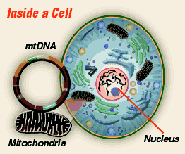
Mitochondrial DNA (mtDNA)

Slide 40
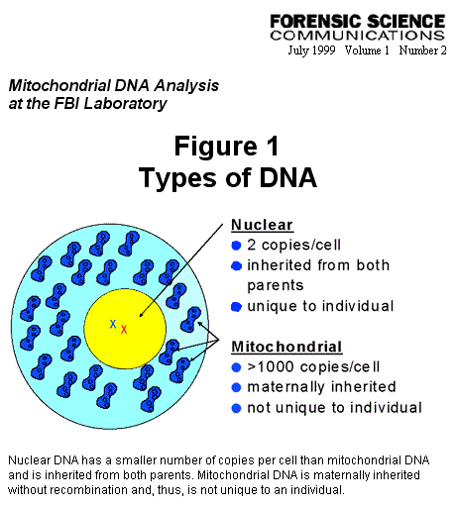
Comparison of Nuclear and Mitochondrial DNA
Advantages of mtDNA testing:
Higher copy number per cell
Results with highly degraded DNA
Results with limited sample (hair shaft)
Disadvantages of mtDNA testing:
Low power of discrimination
Labor intensive
Expensive
http://www.fbi.gov/hq/lab/fsc/backissu/july1999/dnaf1.htm

Slide 41
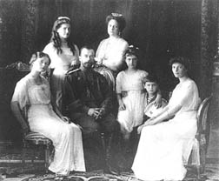
Identifying the Romanov Remains (the Last Russian Czar)
Louise of Hesse-Cassel
16169T/C
16169T/C
Georgij
Romanov
Tsar
Nicholas II
Tsarina
Alexandra
Mitotype
16111T
16357C
263G
315.1C
Prince Philip
Duke of Edinburgh
Xenia Cheremeteff-Sfiri
Mitotype
16126C
16169T
16294T
16296T
73G
263G
315.1C
SOURCES: Gill et al. (1994) Nature Genetics, 6, 130‑135.; Ivanov et al. (1996) Nature Genetics, 12, 417‑420; Stone, R. (2004) Science, 303, 753.
D.N.A. Box 10.2, J.M. Butler (2005) Forensic DNA Typing, 2nd Edition © 2005 Elsevier Academic Press

Slide 42
16024
16365
1
73
340
HV1
HV2
16024
Control region (D-loop)
576
22 tRNAs
O_{H}
2 rRNAs
12S
rRNA
T
F
Heavy (H) strand
cyt b
V
13 genes
1/16,569
16S
rRNA
P
E
L1
ND6
Coding Region
ND5
ND1
L2
“16,569” bp
I
S2
H
Q
M
ND4
Light (L) strand
O_{L}
A
N
ND2
C
Y
W
ND4L
R
S1
9-bp deletion
ND3
G
COI
COIII
ATP6
COII
D
ATP8
K
Figure 10.1, J.M. Butler (2005) Forensic DNA Typing, 2nd Edition © 2005 Elsevier Academic Press
Notes:
Figure 10.1 Schematic showing the circular mitochondrial DNA genome (mtGenome). The heavy (H) strand is represented by the outside line and contains a higher number of C-G residues than the light (L) strand. The 37 RNA and protein coding gene regions are abbreviated around the mtGenome next to the strand from which they are synthesized (see Table 10.2). Most forensic mtDNA analyses presently examine only HV1 and HV2 in the non-coding control region or displacement loop shown at the top of the figure. Due to insertions and deletions that exist around the mtGenome in different individuals, it is not 16,569 bp.

Slide 43
Control Region (16024-576)
1,122 nucleotide positions
Typically only 610 bases examined
  (HVI: 16024-16365; HVII: 73-340)
Coding Region (577-16023)
15,446 nucleotide positions
Challenges with typing widely spaced SNPs
  Multiplex PCR required
Polymorphisms may have medical significance

Slide 44
FBI A1 (L15997)
GAAAAAGTCT TTAACTCCAC CATTAGCACC CAAAGCTAAG ATTCTAATTT AAACTATTCT
CTTTTTCAGA AATTGAGGTG GTAATCGTGG GTTTCGATTC TAAGATTAAA TTTGATAAGA
15970 15980 15990 16000 16010 16020
CTGTTCTTTC ATGGGGAAGC AGATTTGGGT ACCACCCAAG TATTGACTCA CCCATCAACA
GACAAGAAAG TACCCCTTCG TCTAAACCCA TGGTGGGTTC ATAACTGAGT GGGTAGTTGT
16030 16040 16050 16060 16070 16080
ACCGCTATGT ATTTCGTACA TTACTGCCAG CCACCATGAA TATTGTACGG TACCATAAAT
TGGCGATACA TAAAGCATGT AATGACGGTC GGTGGTACTT ATAACATGCC ATGGTATTTA
16090 16100 16110 16120 16130 16140
ACTTGACCAC CTGTAGTACA TAAAAACCCA ATCCACATCA AAACCCCCTC CCCATGCTTA
TGAACTGGTG GACATCATGT ATTTTTGGGT TAGGTGTAGT TTTGGGGGAG GGGTACGAAT
16150 16160 16170 16180 16190 16200
CAAGCAAGTA CAGCAATCAA CCCTCAACTA TCACACATCA ACTGCAACTC CAAAGCCACC
GTTCGTTCAT GTCGTTAGTT GGGAGTTGAT AGTGTGTAGT TGACGTTGAG GTTTCGGTGG
16210 16220 16230 16240 16250 16260
CCTCACCCAC TAGGATACCA ACAAACCTAC CCACCCTTAA CAGTACATAG TACATAAAGC
GGAGTGGGTG ATCCTATGGT TGTTTGGATG GGTGGGAATT GTCATGTATC ATGTATTTCG
16270 16280 16290 16300 16310 16320
CATTTACCGT ACATAGCACA TTACAGTCAA ATCCCTTCTC GTCCCCATGG ATGACCCCCC
GTAAATGGCA TGTATCGTGT AATGTCAGTT TAGGGAAGAG CAGGGGTACC TACTGGGGGG
16330 16340 16350 16360 16370 16380
TCAGATAGGG GTCCCTTGAC CACCATCCTC CGTGAAATCA ATATCCCGCA CAAGAGTGCT
AGTCTATCCC CAGGGAACTG GTGGTAGGAG GCACTTTAGT TATAGGGCGT GTTCTCACGA
16390 16400 16410 16420 16430 16440
Revised Cambridge Reference Sequence (rCRS) – formerly known as the “Anderson” sequence
HV1
Hypervariable Region I
HV1
C-stretch
342 bp examined
16024-16365
HV1
Adapted from Figure 10.6, J.M. Butler (2005) Forensic DNA Typing, 2nd Edition © 2005 Elsevier Academic Press
FBI B1 (H16391)
Notes:
Figure 10.6

Slide 45
FBI C1 (L048)
GATCACAGGT CTATCACCCT ATTAACCACT CACGGGAGCT CTCCATGCAT TTGGTATTTT
CTAGTGTCCA GATAGTGGGA TAATTGGTGA GTGCCCTCGA GAGGTACGTA AACCATAAAA
10 20 30 40 50 60
CGTCTGGGGG GTATGCACGC GATAGCATTG CGAGACGCTG GAGCCGGAGC ACCCTATGTC
GCAGACCCCC CATACGTGCG CTATCGTAAC GCTCTGCGAC CTCGGCCTCG TGGGATACAG
70 80 90 100 110 120
GCAGTATCTG TCTTTGATTC CTGCCTCATC CTATTATTTA TCGCACCTAC GTTCAATATT
CGTCATAGAC AGAAACTAAG GACGGAGTAG GATAATAAAT AGCGTGGATG CAAGTTATAA
130 140 150 160 170 180
ACAGGCGAAC ATACTTACTA AAGTGTGTTA ATTAATTAAT GCTTGTAGGA CATAATAATA
TGTCCGCTTG TATGAATGAT TTCACACAAT TAATTAATTA CGAACATCCT GTATTATTAT
190 200 210 220 230 240
ACAATTGAAT GTCTGCACAG CCACTTTCCA CACAGACATC ATAACAAAAA ATTTCCACCA
TGTTAACTTA CAGACGTGTC GGTGAAAGGT GTGTCTGTAG TATTGTTTTT TAAAGGTGGT
250 260 270 280 290 300
AACCCCCCCT CCCCCGCTTC TGGCCACAGC ACTTAAACAC ATCTCTGCCA AACCCCAAAA
TTGGGGGGGA GGGGGCGAAG ACCGGTGTCG TGAATTTGTG TAGAGACGGT TTGGGGTTTT
310 320 330 340 350 360
ACAAAGAACC CTAACACCAG CCTAACCAGA TTTCAAATTT TATCTTTTGG CGGTATGCAC
TGTTTCTTGG GATTGTGGTC GGATTGGTCT AAAGTTTAAA ATAGAAAACC GCCATACGTG
370 380 390 400 410 420
TTTTAACAGT CACCCCCCAA CTAACACATT ATTTTCCCCT CCCACTCCCA TACTACTAAT
AAAATTGTCA GTGGGGGGTT GATTGTGTAA TAAAAGGGGA GGGTGAGGGT ATGATGATTA
430 440 450 460 470 480
Revised Cambridge Reference Sequence (rCRS) – formerly known as the “Anderson” sequence
HV2
Hypervariable Region II
HV2
268 bp examined
73-340
C-stretch
HV2
FBI D1 (H408)
Adapted from Figure 10.6, J.M. Butler (2005) Forensic DNA Typing, 2nd Edition © 2005 Elsevier Academic Press
Notes:
Figure 10.6

Slide 46
Process for Evaluation of mtDNA Samples
Performed separately and preferably after evidence is completed
Extract mtDNA from evidence (Q) sample
Extract mtDNA from reference (K) sample
PCR Amplify
HV1 and HV2 Regions
PCR Amplify
HV1 and HV2 Regions
Sequence HV1 and HV2 Amplicons
(both strands)
Sequence HV1 and HV2 Amplicons
(both strands)
Confirm sequence with forward and reverse strands
Confirm sequence with forward and reverse strands
Note differences from Anderson (reference) sequence
Note differences from Anderson (reference) sequence
Question Sample
Reference Sample
Compare Q and K sequences
Compare with database to determine haplotype frequency
Figure 10.4, J.M. Butler (2005) Forensic DNA Typing, 2nd Edition © 2005 Elsevier Academic Press
Notes:
Figure 10.4 Process for evaluation of mtDNA samples. The evidence or question (Q) sample may come from a crime scene or a mass disaster. The reference or known (K) sample may be a maternal relative or the suspect in a criminal investigation. In a criminal investigation, the victim may also be tested and compared to the Q and K results.

Slide 47
HV1
TCTTTC ATGGGGAAGC AGATTTGGGT ACCACCCAAG TATTGACTCA CCCATCAACA ACCGCTATGT ATTTCGTACA
AGAAAG TACCCCTTCG TCTAAACCCA TGGTGGGTTC ATAACTGAGT GGGTAGTTGT TGGCGATACA TAAAGCATGT
16030 16040 16050 16060 16070 16080 16090 16100
TTACTGCCAG CCACCATGAA TATTGTACGG TACCATAAAT ACTTGACCAC CTGTAGTACA TAAAAACCCA ATCCACATCA
AATGACGGTC GGTGGTACTT ATAACATGCC ATGGTATTTA TGAACTGGTG GACATCATGT ATTTTTGGGT TAGGTGTAGT
16110 16120 16130 16140 16150 16160 16170 16180
AAACCCCCTC CCCATGCTTA CAAGCAAGTA CAGCAATCAA CCCTCAACTA TCACACATCA ACTGCAACTC CAAAGCCACC
TTTGGGGGAG GGGTACGAAT GTTCGTTCAT GTCGTTAGTT GGGAGTTGAT AGTGTGTAGT TGACGTTGAG GTTTCGGTGG
16190 16200 16210 16220 16230 16240 16250 16260
CCTCACCCAC TAGGATACCA ACAAACCTAC CCACCCTTAA CAGTACATAG TACATAAAGC CATTTACCGT ACATAGCACA
GGAGTGGGTG ATCCTATGGT TGTTTGGATG GGTGGGAATT GTCATGTATC ATGTATTTCG GTAAATGGCA TGTATCGTGT
16270 16280 16290 16300 16310 16320 16330 16340
TTACAGTCAA ATCCCTTCTC GTCCC
AATGTCAGTT TAGGGAAGAG CAGGG
16350 16360
ATGCACGC GATAGCATTG CGAGACGCTG GAGCCGGAGC ACCCTATGTC GCAGTATCTG TCTTTGATTC
TACGTGCG CTATCGTAAC GCTCTGCGAC CTCGGCCTCG TGGGATACAG CGTCATAGAC AGAAACTAAG
80 90 100 110 120 130 140
CTGCCTCATC CTATTATTTA TCGCACCTAC GTTCAATATT ACAGGCGAAC ATACTTACTA AAGTGTGTTA ATTAATTAAT
GACGGAGTAG GATAATAAAT AGCGTGGATG CAAGTTATAA TGTCCGCTTG TATGAATGAT TTCACACAAT TAATTAATTA
150 160 170 180 190 200 210 220
GCTTGTAGGA CATAATAATA ACAATTGAAT GTCTGCACAG CCACTTTCCA CACAGACATC ATAACAAAAA ATTTCCACCA
CGAACATCCT GTATTATTAT TGTTAACTTA CAGACGTGTC GGTGAAAGGT GTGTCTGTAG TATTGTTTTT TAAAGGTGGT
230 240 250 260 270 280 290 300
AACCCCCCCT CCCCCGCTTC TGGCCACAGC ACTTAAACAC
TTGGGGGGGA GGGGGCGAAG ACCGGTGTCG TGAATTTGTG
310 320 330 340
Revised Cambridge Reference Sequence (rCRS) – formerly known as the “Anderson” sequence
HV2
HV1: 16024-16365 (342 bp examined)
HV2: 73-340 (268 bp examined)
Notes:
Figure 10.6

Slide 48
Differences from Reference Sequence
mtDNA sequences from tested samples are aligned with the reference rCRS sequence (e.g., positions 16071-16140)
16090 16100 16110 16120 16130 16140
rCRS
ACCGCTATGT ATTTCGTACA TTACTGCCAG CCACCATGAA TATTGTACGG TACCATAAAT
Q
ACCGCTATGT ATCTCGTACA TTACTGCCAG CCACCATGAA TATTGTACAG TACCATAAAT
K
ACCGCTATGT ATCTCGTACA TTACTGCCAG CCACCATGAA TATTGTACAG TACCATAAAT
16093
16129
Differences are reported by the position and the nucleotide change (compared to the rCRS)
Sample Q
16093C
16129A
Sample K
16093C
16129A
Adapted from Figure 10.8, J.M. Butler (2005) Forensic DNA Typing, 2nd Edition © 2005 Elsevier Academic Press
Notes:
Figure 10.8 (A) Comparison of sequence alignments for hypothetical Q and K samples with (B) conversion to the revised Cambridge Reference Sequence (rCRS) differences for reporting purposes.

Slide 49
Challenges with mtDNA
Data Interpretation
  Heteroplasmy
  Sample mixtures (currently not possible)
DNA Database Sizes
  Similar issues to Y-STRs but takes longer to generate mtDNA data than Y-STR haplotypes
DNA Database Quality

Slide 50
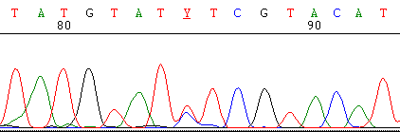

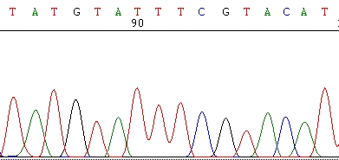
Sequence Heteroplasmy at Position 16093
16086
16093 (C/T)
16101
Figure 10.9, J.M. Butler (2005) Forensic DNA Typing, 2nd Edition © 2005 Elsevier Academic Press
Notes:
Figure 10.9 (A) Sequence heteroplasmy at position 16093 possessing both C and T nucleotides compared to (B) the same region (positions 16086-16101) on a different sample containing only a T at position 16093.

Slide 51

Disadvantages to Sequencing
Expensive
  Primarily due to intensive labor in data analysis
Error possibilities with more data to review
Most information is not used
Review forward and reverse sequences across 610 bases only to report…
263G, 315.1C
Most common type: found in ~7% of Caucasians…

Slide 52
Advantages to Screening Methods
Rapid results
Aids in exclusion of non-matching samples
Less labor intensive
Usually less expensive
Permits more labs to get involved in mtDNA
Screening assays are essentially a presumptive test prior to final confirmatory DNA sequencing.
Sequencing is necessary to certify that every position matches between a question and a known sample.

Slide 53
LINEAR ARRAY mtDNA Typing Strips:
New Screening Method
HVI
HVII
IA
ID
IIA
IIC
16093
IC
IE
IIB
IID
189
1
2
3
1
2
1
2
1
2
4
5
1
2
Ref
1
2
1
2
3
4
1
2
3
1
2
3
4
5
6
7
1
2
K
Q
“blank”
Reported Types
Weak signal
K: 1-1-1-1-1-1-1-1-1-1
If known (K) and question (Q) samples do not match, there is no need to involve the expense of mtDNA sequencing
Q: 1-2-3-2-0-1-4-2-2-w1
Figure 10.10, J.M. Butler (2005) Forensic DNA Typing, 2nd Edition © 2005 Elsevier Academic Press
Notes:
Figure 10.10 (A) Results schematically displayed of a known (K) reference and a question (Q) sample that do not match one another using the Roche LINEAR ARRAY mtDNA HVI/HVII Region-Sequence Typing Strips. (B) Types are reported as a string of numbers representing the LINEAR ARRAY probe results. Failure of the PCR product to bind to a probe region (e.g., HVIE in sample Q) is referred to as a “blank”, is reported as a zero in the string of numbers, and is due to polymorphisms in the sample near the probe site that disrupt hybridization. Weak signals such as indicated by the arrow for 189 in sample Q are also due to a closely spaced polymorphism that disrupts full hybridization of the PCR product to the sequence-specific probe present on the LINEAR ARRAY.

Slide 54
A Common Use of mtDNA is for Hair Shaft Analysis
Human hair shafts contain very little DNA but because mtDNA is in higher copy number it can often be recovered and successfully analyzed
Melanin found in hair is a PCR inhibitor
Important Publications:
Wilson, M.R., et al. (1995) Extraction, PCR amplification and sequencing of mitochondrial DNA from human hair shafts. Biotechniques 18(4): 662-669.
  Tissue grinding method described by FBI Lab
Melton et al. (2005) Forensic mitochondrial DNA analysis of 691 casework hairs. J. Forensic Sci. 50(1): 73-80.
  Obtained a full or partial mtDNA profile for >92% of hairs tested

Slide 55
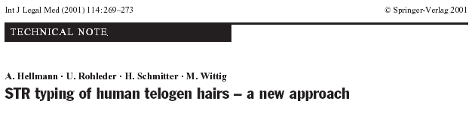
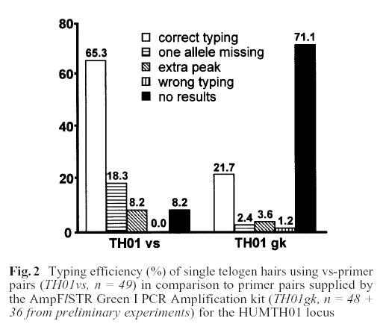
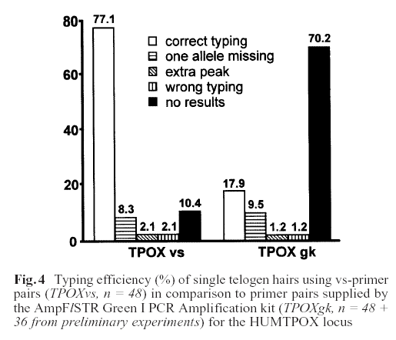
PCR Product Size Reduction Improves Recovery of STR Information from Telogen Hairs
Hellmann, et al. (2001) Int. J. Legal Med. 114(4-5): 269-273
First use of miniSTRs for typing hair shafts
108 bp size reduction
160 bp size reduction

Slide 56
mtDNA and miniSTRs
Due to the higher copy number, mtDNA will still have a role in many highly degraded DNA scenarios or where limited biological material is present, such as hair shafts.
However, miniSTRs will most likely extend the range of cases where highly informative STR data can be obtained

Slide 57
THANK YOU FOR YOUR ATTENTION…
Thank you for attending and participating in this Advanced Topics in STR DNA Analysis Workshop
Feel free to contact us if you have further questions:
      John Butler (NIST): john.butler@nist.gov
      Bruce McCord (FIU): mccordb@fiu.edu

