Slide 1
Building in
Security and Innovation
David A. Wheeler
ApacheCon North America 2011
Version 2011-11-09
Notes:
This is for ApacheCon North America 2011, Vancouver, BC, http://na11.apachecon.com/
David A. Wheeler may be contacted at dwheeler, at ida dot org.
Note: The images used here all are considered “fair use”:
1. “The purpose and character of the use, including whether such use is of a commercial nature or is for nonprofit educational purposes” – the work is for nonprofit educational purposes
2. “the nature of the copyrighted work;” – The original copyrighted works are for other purposes, such as movies or books for entertainment. In contrast, the use here is as humorous illustrative support for serious technical discussions, and thus are fundamentally transformative.
3. “the amount and substantiality of the portion used in relation to the copyrighted work as a whole” - These images as presented in the presentation are smaller, lower-quality versions of the real images. In many cases they are single images (snippets) from entire movies.
4. “the effect of the use upon the potential market for or value of the copyrighted work.” – the use of these images does not in any way reduce the potential market for, or value of, the copyrighted work. In particular, it does not supersede or substitute the use of the original work. In fact, if anything they increase their value, since they remind viewers about them.

Slide 2
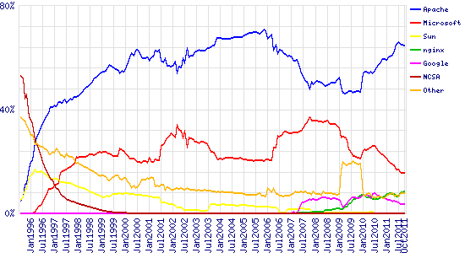
Some joke about world domination; Apache web server’s been doing it since 1996
Source: Netcraft October 2011 Web Server Survey,
http://news.netcraft.com/archives/category/web-server-survey/
November 9, 2011

Slide 3







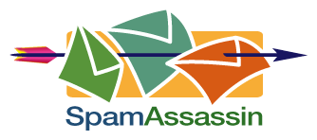

Apache Software Foundation supports many other widely-used projects, too
Apache
Pig
Apache
Tomcat
Apache
Geronimo
… and many,
many other
projects!
Apache
Maven
Apache Ant
November 9, 2011
Trademarks belong to their owner(s)

Slide 4

But those on top do not always stay that way…
November 9, 2011
Source: King Kong (1933)
Notes:
Image from “King Kong” 1933.
http://www.imdb.com/media/rm3678574592/tt0024216

Slide 5

… and if you’re given or trusted much, you should give much
“With great power there must also come -- great responsibility!”
Not a new idea:
“…everyone to whom much was given, of him much will be required, and from him to whom they entrusted much, they will demand the more.…”
Luke 12:48 (ESV)
November 9, 2011
Notes:
Amazing Fantasy #15 (August 1962) is the first Spider-man story.
For more on the quote, see:
http://en.wikiquote.org/wiki/Stan_Lee
http://www.newsfromme.com/archives/2005_10_06.html

Slide 6
Build in Security and Innovation
If you want to get or stay on top, you need to:
  Meet and exceed people’s needs, including security
  Keep innovating (for current and future users)
So build security and innovation into the projects you’re involved in!
  If you’re a developer, do it!
  If you’re a reviewer or user, demand it!
How?
  Developer: Agree to try
  Reviewer/user: Agree to demand it
  Here are some ideas that I hope will help
    (You already know you should do some of these)
November 9, 2011

Slide 7

Security
November 9, 2011
Notes:
This is an Improved Outer Tactical Vest (IOTV), which is three pounds lighter and more protective than the Outer Tactical Vest. It will soon be issued to Soldiers deploying to Iraq and Afghanistan.
Photo courtesy U.S. Army
Date Shot: April 02, 2007
http://www.army.mil/-images/2007/04/02/3754/army.mil-2007-04-04-075805.jpg
http://en.wikipedia.org/wiki/File:Army_IOTV.jpg
This image is a work of a U.S. Army soldier or employee, taken or made as part of that person's official duties. As a work of the U.S. federal government, the image is in the public domain.

Slide 8
Building in security: Requirements
What are your security requirements?
  Confidentiality, integrity, availability (vs. DoS), auditability (logging), non-repudiation
  If you’re a developer, tell people what you’re trying to do
    Not just your users, but also your co-developers ☺
  Put it in the user or admin guide
November 9, 2011

Slide 9
Building in security: Design
Minimize attack surface: Limit external access
  Limit ports, limit requests, authenticate users
  Encrypted connections (SSL, SSH)
Limit privileges (time, amount, code with privileges)
  Different users, file privileges, SELinux/AppArmor privileges, …
  Keep data in only certain components / encrypt it / throw it away
Make it modular
  Can remove/replace subcomponents
  Can give different components different privileges
November 9, 2011

Slide 10
Building in security: Implementation
Be aware of & avoid common mistakes – OWASP Top 10, CWE/SANS TOP 25 Most Dangerous Software Errors
  (SQL) injection (prepared statements)
  XSS (encode your outputs!)
  Broken authentication, buffer overflow, etc.
Filter inputs (& maybe outputs) with whitelists (not blacklists)
  At least untrusted input, but trusted admins make mistakes too
  Filter at the server, not (just) the client
Prefer implementation tools that prevent errors
  Turn on warning flags, use coding style that avoids some mistakes
“So clear it’s obviously right”: Prepared statements, safe functions,...
Lots of freely-available information – take a look at it!
  “Pocket guide” series at “Build Security In” website, e.g., “Key Practices for Mitigating the Most Egregious Exploitable Software Weaknesses”
  Free book: http://www.dwheeler.com/secure-programs/
November 9, 2011
Notes:
https://buildsecurityin.us-cert.gov/swa/downloads/ Mitigating_Weaknesses_PocketGuide_Print.pdf

Slide 11
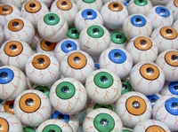
Building in security: Test/Review
Use static analysis tools to find vulnerabilities (false +, false -)
Use dynamic analysis tools to find vulnerabilities (fuzzers!)
Peer review
  Discuss security implications all the time
    “Convince me it’s secure”
  Enable Free/Libre/Open Source Software
  (FLOSS) mass peer review
    Reviewable patches (smaller, one task at a time, good summary)
    Use common CM tools/languages/licenses
    Broad usefulness
    Incentives
Develop & include automated regression test suite
Penetration testing
November 9, 2011
Notes:
Eyeballs picture from:
“Beyond Eyeballs: The Three Body Parts that Create Real Revenue”
by Sonia Simone
http://www.copyblogger.com/beyond-eyeballs/

Slide 12
Building in security: Deployment
Make it easy to deploy securely
  “Default secure” configuration
  Explain/warn how to use it securely (“Don’t enable Q unless…”)
  Simplify automated patch management by following standard packaging conventions. For POSIX: *
    Support DESTDIR
    Don’t require web interactivity for (re)building software
    Let users easily use their (updated) system/local tools/libraries
  Cryptographically sign releases (mea culpa)
  Make it easy to do backups/checkpoints/recovery
  Hook up with logging systems, Intrusion detection/prevention systems
Handle security flaw reports well
  Tell everyone how to report them
  Take them seriously
  When you announce, include CVE numbers & credit the reporter!
November 9, 2011
*See: http://www.dwheeler.com/essays/releasing-floss-software.html

Slide 13
Build security in: Miscellaneous
Consider creating an “assurance case” as you go
  Justifies “why it’s secure”
    Gives claims & arguments, points to evidence
  Lets potential users understand why it’s “okay to use”
  More important: Helps developers be aware of problems before they happen
  More common in custom software, but no reason it can’t be done for any software
Resources
  “Build Security In” site: https://buildsecurityin.us-cert.gov
  http://www.dwheeler.com/secure-programs/
November 9, 2011

Slide 14
Developer/Repository Attacks
Some developers are malicious or have their account subverted
Source code repositories should be able to (minimum practice):
  Record who made the change, when, & the specific change
    You can check what they (or their subverted account) did
  Prevent unauthorized changes to source & require 2+ party review
  Record immutable history (but: encumbrance pollution attack)
Repositories are major targets
Prevent unauthorized undetected changes even when an attacker has root privileges over the repository
  Attackers are getting root on these systems
  At the least, external backups & check-ups so you can detect & recover
  Longer-term: Improve version control systems so cryptographic signatures, chaining, and automated duplicate copies/backups can prevent a lot of these problems
    So repository subversion can roll back, but not add different material
November 9, 2011
See: http://www.dwheeler.com/essays/scm-security.html

Slide 15

Innovation
November 9, 2011

Slide 16
Software Innovation
“The Most Important Software Innovations” by yours truly
  Software = new types of applications, new development or programming approaches… not hardware
  Innovation = new idea in software technology
Examples:
  1837: Babbage’s Analytical Engine (programmability)
  1945: Hypertext
  1960: Packet-switching networks
  1964: Word processor (1972 - Screen-oriented word processor)
  1966: Generating pseudo-code (later used in Java)
  1968: GUI
  1978: Spreadsheets
  1986: Lockless version management (CVS)
  1989: Distributed Hypertext via Simple Mechanisms (WWW)
  2004: Massively-parallel MapReduce (Google’s; Hadoop)
November 9, 2011
See: http://www.dwheeler.com/innovation/innovation.html
This talk refers to the 2011-07-22 version

Slide 17
Remarkable conclusions from this
We’re greatly impacted by major software innovations
  But fewer than you might think; 58 since 1837, 88% before 1991
  Fundamental software technology not changing that rapidly (!)
Illusion of landslide of major software innovations:
  Many smaller improvements/innovations accumulate
    Better meet needs, constant interface changes
  Computer hardware’s rising performance with lowering cost & size → can apply computers in more & more situations
  Rapid social change from increasing availability & lower cost
  Competing products/companies → changes in fortune
Microsoft: None. FLOSS: Several
Radically different ≠ better
Most of the time, software innovation is an accretion of many small incremental improvements… & hard work
November 9, 2011
Notes:
As noted in Eureka! It Really Takes Years of Hard Work (by Janet Rae-Dupree, New York Times, February 3, 2008), innovation is (primarily) “a slow process of accretion, building small insight upon interesting fact upon tried-and-true process.” Jonathan Sachs (co-developer of Lotus 1-2-3) similarly stated, “The rate of innovation is rather slow. There are only a few really new ideas every decade.” See Scott Berkun’s 2007 book “The Myths of Innovation” for more.

Slide 18
Eliminate software patents
I believe software patents harm, not help innovation
  This belief is widely shared among software developers
  As U.S. software patentability went up, software innovation went down (in contrast with the rest of industry) [Bessen and Maskin]
  Software patent lawsuits cost the industry $11.26 billion annually [2008 End Software Patents report]
  Patent troll lawsuits cost ~$500B of lost wealth in 1990-2010; the majority (62%) were software patent lawsuits [Bessen, Muerer, Ford]
  “Many panelists and participants expressed the view that software and Internet patents are impeding innovation. They stated that such patents are impairing follow-on incentives, increasing entry barriers, creating uncertainty that harms incentives to invest in innovation, and producing patent thickets.” [U.S. Federal Trade Commission (FTC) report]
This paper provides no evidence that patents tend to encourage major innovations; very few of even these were patented
  Copyright & trademark appear to provide adequate protection & incentive for writing innovative software (& documents, math or not)
November 9, 2011
See: http://www.dwheeler.com/essays/software-patents.html

Slide 19

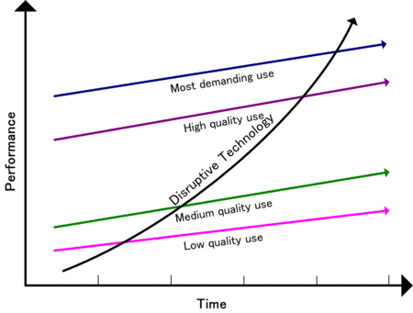
Sustaining vs. Disruptive Innovation
Sustaining innovation (technology) does not affect existing markets
  Evolutionary: improves a product in an existing market in ways that customers are expecting
  Revolutionary (discontinuous, radical): unexpected innovation that does not affect existing markets
Disruptive innovation: creates a new & unexpected market by applying a different set of values
Some major innovations are revolutionary…
and some are disruptive
See: http://en.wikipedia.org/wiki/Disruptive_technology
November 9, 2011
Notes:
Text, and performance/time chart, from
http://en.wikipedia.org/wiki/Disruptive_technology
The chart is released to the public domain, according to Wikipedia.
Examples:
Evolutionary – fuel injection
Revolutionary – the car
Disruptive – lower-priced Ford Model T

Slide 20
FLOSS & disruptive innovation
Innovation: New capabilities & new ways to use it
FLOSS projects can be hostile
  Often funded by commercial companies with existing customers
  “Too few people would want that feature” – resist adding features that will be important tomorrow
  “We’ve never done it that way”
FLOSS projects can we welcoming
  “It’s okay to add features that many current users find unimportant, if it has users; this addition may get us more users”
  Many major innovations first emerged in FLOSS world
What about software complexity?
  Look for general abstraction (make it configurable)
  Split up the work into parts…
November 9, 2011

Slide 21
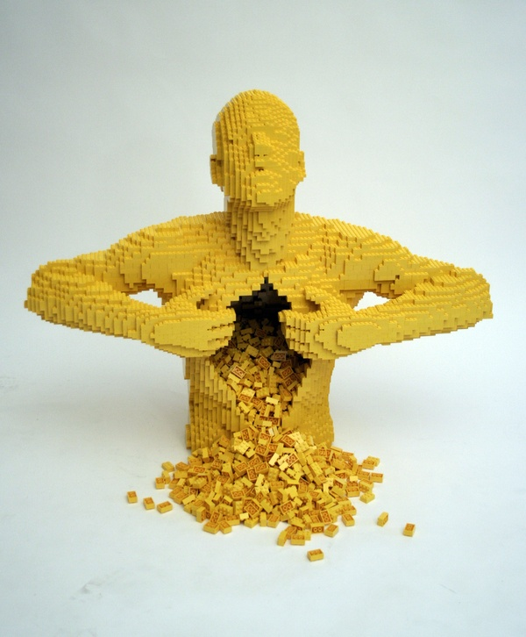
Big key for security & innovation: Modularity
Break up your software into easily reused & configured pieces
  Plug-ins, adapters, etc.
  “Do one thing well” & easily integrate
  Keep making it modular – refactor!
Make it easy to create new plug-ins & modules
  Simple things should be simple
  Include templates to get started
  Make it easy to use securely
  Hard to document → too hard to use!
Make it easy to modify/reuse system & components for new innovation or security situation
“Yellow”
Nathan Sawaya
November 9, 2011
Notes:
“Yellow” by Nathan Sawaya is at: http://www.behance.net/Gallery/Yellow/192175
Provided under Attribution-NonCommercial 3.0 Unported (CC BY-NC 3.0) license.

Slide 22

Make great products – even if they cannibalize your old project
“Steve Jobs focused on making great products
that the customers would love (even if they had
no idea they would want one), and explicitly not on profit.
With that focus, worrying about ‘cannabalizing’
your own business melted away, and with it,
many of the problems of the Innovator’s Dilemma.”
– “Steve Jobs Solved the Innovator’s Dilemma”
by James Allworth
http://blogs.hbr.org/cs/2011/10/
steve_jobs_solved_the_innovato.html
FLOSS is already very good at focus on “good products”
& not just “this quarter’s profits” – make sure
they are easy to use & not just technically good products
November 9, 2011

Slide 23
FLOSS License “Slide”
Weakly
Protective
Strongly
Protective
Permissive
Public Domain
LGPLv2.1
GPLv2
MIT/X11
LGPLv2.1+
GPLv2+
BSD-new
LGPLv3 (+)
GPLv3 (+)
Apache 2.0
MPL 1.1
Affero GPLv3
A→B means A can
be merged into B
See http://www.dwheeler.com/essays/floss-license-slide.html
Common licenses make software easy to reuse:
Aids innovation (reuse) & security (worth reviewing)
November 9, 2011

Slide 24

Documentation?
Draft OOXML specification
November 9, 2011
Notes:
This is the printout of a draft revision of OOXML, a specification rushed through the ISO process:
http://www.christopher-parsons.com/blog/technology/the-sweet-smell-of-redmond/
I’m sure every balloter read every word, carefully.

Slide 25
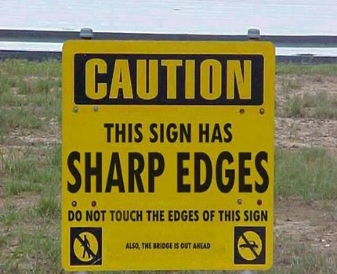
Documentation?
November 9, 2011
Notes:
http://www.reallyfunnypictures.co.uk/funnysigns/pic17.php

Slide 26
Documentation
Make sure no documentation is needed, when you can
  Good names in code, APIs, & the user interfaces
  Good mental models
  Create “it just works (securely)” defaults. Yes, this is hard
  Don’t put many comments inside methods/functions, make the code clear in the first place
  Make it obvious how you use the program & easy to use
Don’t kill people with documentation volume
  Give users just the information they need, when they need it
    Method/function headers (pre- & postconditions, what it does)
    User recipes/“how to” (how to install, enable something, etc.)
  Warn people if something will disable security!
Most programs need some documentation – provide it!
Keep it current
November 9, 2011

Slide 27
Conclusions
Build security and innovation into the projects you’re involved in!
  If you’re a developer, do it!
  If you’re a reviewer or user, demand it!
How?
  Developer: Agree to try
  Reviewer/user: Agree to demand it
November 9, 2011

