Slide 1

Solr Power FTW
Alex Pinkin
@apinkin
#solrnosql

Slide 2

What Will I Cover?
  Who I am
  What Bazaarvoice does
  SOLR and NoSQL
  Can SOLR handle 20K queries per second?
  Lessons learned: large scale multi data center deployment
  Conclusion

Slide 3

Alex Pinkin
  Software Engineering Lead,
  Data Infrastructure team,
  Bazaarvoice
  Loves to play with SQL and NoSQL
@apinkin

Slide 4

Bazaarvoice
  Bazaarvoice is a software as a service
  company powering user generated content
  such as ratings and reviews
  on thousands of web sites
  5 billion page views per month
  230 billion impressions
  75 million UGC

Slide 5
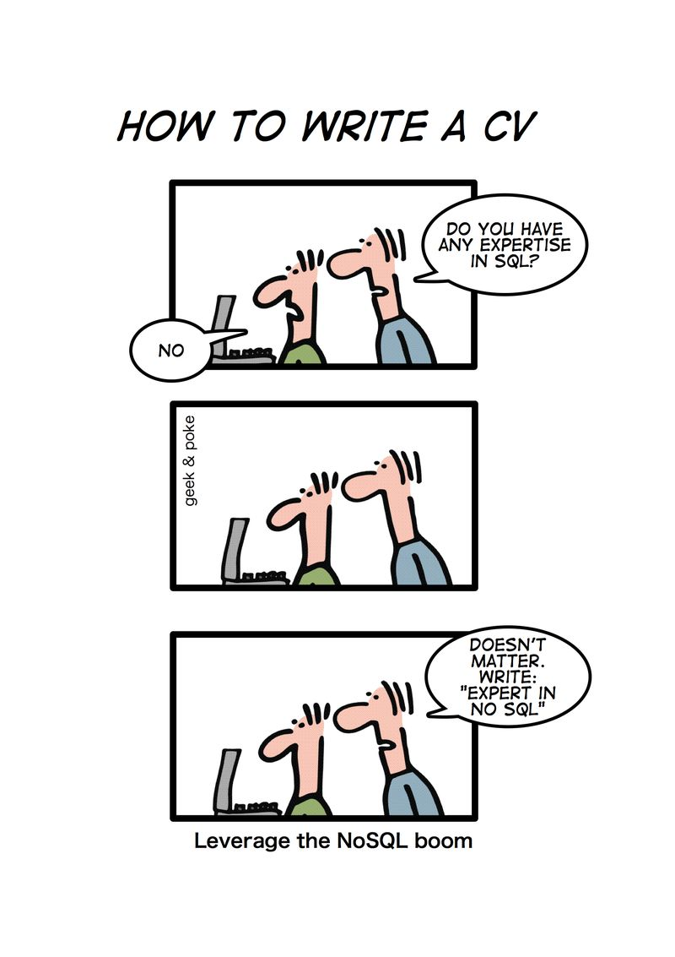
NoSQL ?

Slide 6








SQL vs NoSQL

Slide 7
NoSQL is Not Only SQL
  Departs from relational model
  No fixed schema
  No joins
  Eventual consistency is OK
  Scale horizontally

Slide 8
Types of NoSQL
  Key-value (Redis, Riak, Voldemort)
  Document (MongoDB, CouchDB)
  Graph (Neo4J, FlockDB)
  Column family (Cassandra, HBase)

Slide 9
SOLR as NoSQL
  Non-relational model - Check
  No fixed schema - Check (dynamic fields)
  No joins - Check (denormalization)
  Horizontal scaling - Check (with work)

Slide 10
SOLR stats - Bazaarvoice
Documents
250 MM
Index size
200 GB
QPS, avg
2,350
QPS, max
10,200
Response time, avg
12 ms
Servers
6+20

Slide 11
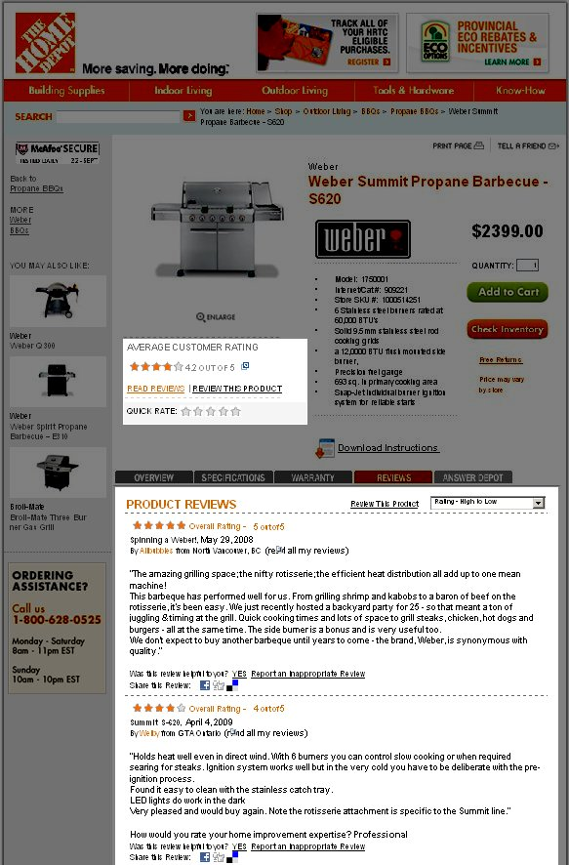
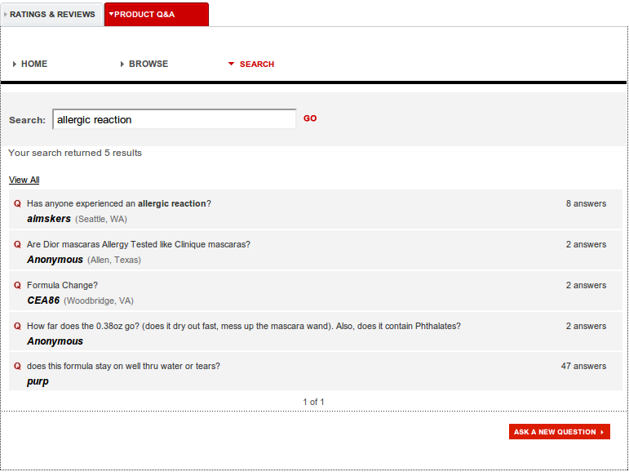
SOLR Case Study

Slide 12
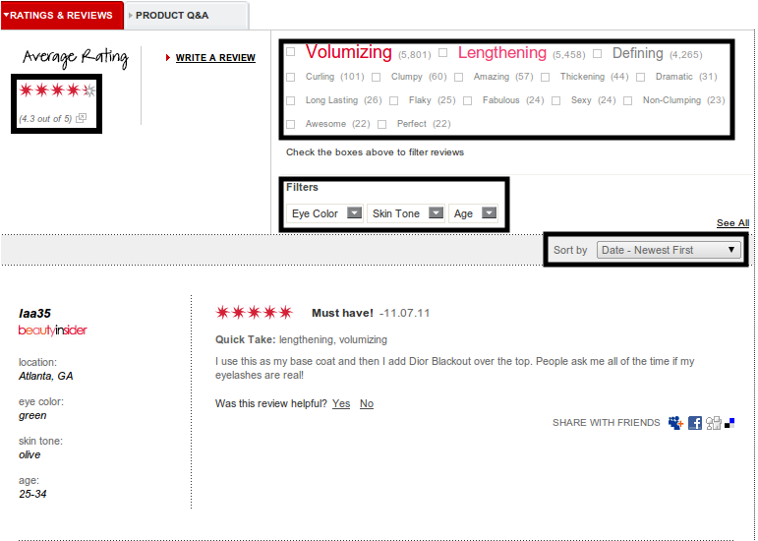
SOLR Case Study

Slide 13

Life Before SOLR
  Indexes for sorting and filtering
  Aggregate tables for stats
  Nightly jobs
  Bugs...

Slide 14
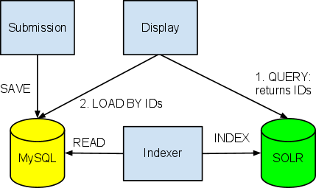
Enter SOLR
  Index content and product catalog
  De-normalization
  Filtering and sorting
  Index every 15 minutes (20 seconds NRT)

Slide 15
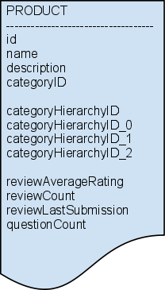
SOLR - Statistics
  COUNT, SUM, AVG, MIN, MAX
  (StatsComponent)
  Stored fields
  Whenever content changes,
  re-calc stats for all affected subjects

Slide 16
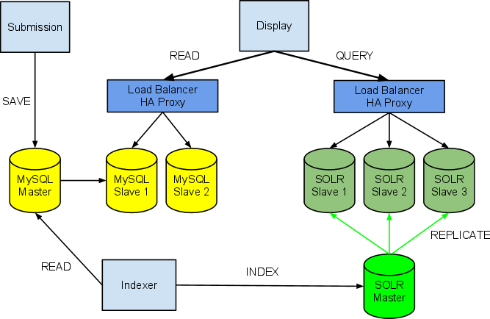
Scaling reads - Replication

Slide 17
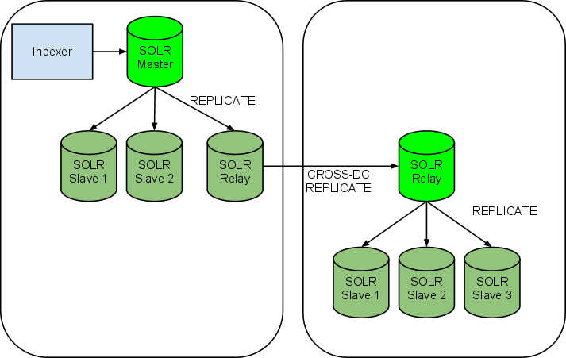
Replication - Multiple Data Centers

Slide 18
Replication - Multiple Data Centers
Chatty if using multiple cores
Relay
  Core auto-warming disabled
  Connection wait and read timeouts increased
  Replication poll interval increased (15 min)
  Compression enabled
...
<str name="httpConnTimeout">20000</str>
<str name="httpReadTimeout">65000</str>
<str name="pollInterval">00:15:00</str>
<str name="compression">internal</str>
...

Slide 19
SOLR Cloud - Bazaarvoice version
  Multiple cores (100+ per server)
  Re-balance indexes across cores and servers
    Automatic
    Manual
  Deployment map stored in MySQL
    Host - Core - Partition
    Statistics
  Partition lifecycle

Slide 20
Schema Changes
Re-indexing is time consuming for large indexes
Process
    Full re-index off-line prior to the release
    Incremental indexing after the release
Bottleneck: reading from MySQL
Goal: Transparent re-indexing

Slide 21
Performance Tuning
  Heap size
  Cache sizing
  Auto-warming
  Stored fields
  Merge factor
  Commit frequency
  Optimize frequency
Process: Simulate and measure
  Replay logs
  Analyze metrics
  Monitor GC

Slide 22
Performance Tuning - GC
# Java memory usage settings
# Force the NewSize to be larger than the JVM typically allocates.
# In practice, the JVM has been allocating an extremely small Young generation which objects to be prematurely promoted to the Tenured generation
JAVA_MEM_OPTS="-Xms27g -Xmx27g -XX:NewRatio=8"
# -verbose:gc -XX:+PrintGCDetails -XX:+PrintGCDateStamps --> Turn on GC Logging
# -XX:+UseConcMarkSweepGC --> Use the concurrent collector
# -XX:+CMSIncrementalMode --> Incremental mode for the concurrent collector
# -XX:+CMSIncrementalPacing --> Let the JVM adjust the amount of incremental collection
JAVA_GC_OPTS="-verbose:gc -XX:+PrintGCDetails -XX:+PrintGCDateStamps -XX:+UseConcMarkSweepGC -XX:+UseParNewGC -XX:CMSInitiatingOccupancyFraction=55 -XX:ParallelGCThreads=8 -XX:SurvivorRatio=4"

Slide 23

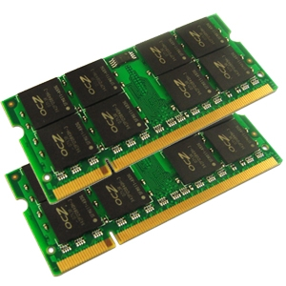
SOLR Performance - Summary
  SOLR loves RAM!
  Log replay
  Same config, same hardware
  Get the most out of one instance
SOLR

Slide 24
Conclusion - SOLR Strengths
  Lightning fast given enough RAM
  Good scale out support
  including multi-data center
  Great community

Slide 25
Conclusion - SOLR's Gaps
  Not fully elastic
  Real time takes work
  Secondary data store = sync overhead
  Schema changes

Slide 26

Questions
@apinkin

