Slide 1
The MeteoSwiss Py-ART
Daniel Wolfensberger, Jordi Figueras i Ventura

Slide 2
Contents
Introduction
Py-ART architecture
Data processing with Py-ART

Slide 3
1. Introduction

Slide 4
What is Py-ART?
The Python ARM Radar Toolkit (Py-ART) was initially created to work with the data produced by radars of the Atmospheric Radiation Measurement Climate Research facility (ARM) programme of the US Department of Energy
It was first released in 2013 as an open-source software
It relies heavily on the scientific python stack (numpy, scipy, matplotlib, pandas, cartopy, etc.)
The ARM-DOE Py-ART can be used for:
Reading radar data in a variety of file formats
Creating plots and visualization of radar data
Some corrections of radar moments (Doppler de-aliasing, attenuation correction, etc.)
Mapping data from one or more radars onto a Cartesian grid
Performing some retrievals
Writing radar and Cartesian data to NetCDF files

Slide 5
Why using the MeteoSwiss Py-ART ?
The ARM-DOE Py-ART is a library of basic building blocks for data reading and visualization. The software is high quality and well maintained but has a limited scope
The MeteoSwiss Py-ART adds many additional corrections and retrievals that were developed to serve semi-operational data processing chains
Some functionalities available on the MeteoSwiss Py-ART are transferred to the ARM-DOE Py-ART

Slide 6
2. Py-ART architecture

Slide 7
Py-ART modules
core
Data objects
Coordinate transforms
map
Mapping radar data from radar to Cartesian coordinates
io
graph
Plots of radar and grid fields
Reading and writing
aux_io
Non-standard Reading and writing
util
Auxiliary functions
filters
Filtering (removing of undesired gates)
bridge
Bridge to other software packages, e.g. wradlib
correct
Correction of radar fields
e.g. attenuation, dealiasing
testing
Utilities to facilitate the generation of unit tests
retrive
Radar retrieval
e.g. rainfall rate, melting layer, etc.
tests
Unit tests

Slide 8
Py-ART data objects
Object | Purpose | Comment
Radar | Store radar data in antenna coordinates. The data structure is based on C/F Radial V1 | Data fields are stored in a 2-D matrix (ray, range) Some Pyrad applications use the same structure to store (time, range). Assumes uniform range resolution !
RadarSpectra | Store IQ spectral and spectral data in antenna coordinates. Inherits from Radar object | Data fields are stored in a 3-D complex matrix (ray, range, Doppler bin/slow time)
Grid | Store rectilinear gridded data in Cartesian coordinates | Data fields are stored in a 3-D matrix (z, y, x) The grid is referenced as distance from the grid origin. Assumes uniform spacing of the data !
HorizontalWindProfile | Store horizontal wind profile data | Not used by Pyrad

Slide 9
Py-ART plotting objects
Object | Purpose | Functions
radardisplay | Display object to create plots from data in a radar object | plot_ray, plot_ppi, plot_rhi, plot_azimuth_to_rhi (pseudo-RHI), plot_vpt (time-height for vertically pointing radar), plot_xsection
radardisplay_airborne | Same as above but for airborne radar data. Inherits from radardisplay | Not used by Pyrad
radarmapdisplay | Display object to create plots on a geographic map from data in a radar object. Inherits from radardisplay | plot_ppi_map
gridmapdisplay | Display object to create plots from data in a grid object | plot_grid (plot grid data projected into a map), plot_grid_raw (plot grid in native Cartesian coordinates) plot_grid_contour (plot contours of grid data projected into a map) plot_latitude_slice (plot slice along a given latitude) plot_longitude_slice (plot slice along a given longitude) plot_latlon_slice (plot slice crossing 2 arbitrary coordinate points)

Slide 10
3. Data processing with Py-ART

Slide 11
Basic data processing
Level | Location | Purpose
IQ and spectral data processing | retrieve/iq.py retrieve/spectra.py | Computation of raw moments from IQ and/or spectral data
Noise and bias corrections | retrieve/simple_moment_calculations.py correct/bias_and_noise.py correct/despeckle.py | Compute noise level and correct raw moments for noise and biases
Clutter suppression | filters/gatefilter.py | Mask undesired data
PhiDP/KDP retrieval | correct/phase_proc.py retrieve/kdp_proc.py | Implementation of various PhiDP/KDP retrieval algorithms available in literature
Doppler velocity unfolding | correct/dealias.py correct/region_dealias.py correct/unwrap.py | Implementation of various unfolding techniques
Melting layer detection | retrieve/ml.py | Implementation of various melting layer detection algorithms available in literature
Attenuation correction | correct/attenuation.py | Implementation of various attenuation correction algorithms available in literature
VPR correction | correct/vpr.py | Implementation of the VPR correction algorithm operational at Météo-France

Slide 12
Retrievals
Level | Location | Purpose
Hydrometeor classification | retrieve/echo_class.py | Convective/stratiform classification and MeteoSwiss hydrometeor classification
Rainfall Rate retrieval | retrieve/qpe.py | Implementation of various rainfall rate retrieval algorithms
Wind retrievals | retrieve/vad.py retrieve/wind.py | Wind retrievals using VAD techniques and other

Slide 13
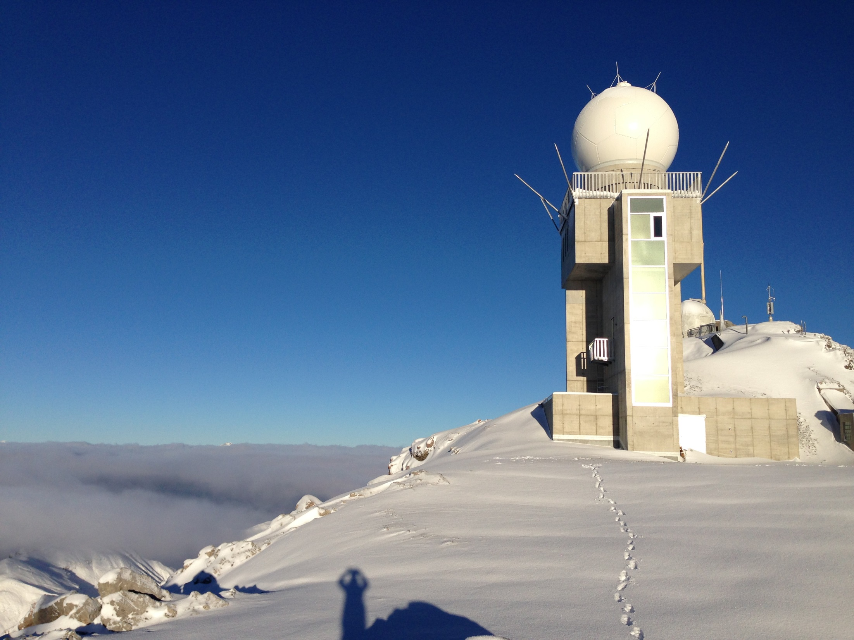
Thank you! Grazie mille! Moltes Gràcies! Merci!

Slide 15
Appendix. Data processing details

Slide 16
IQ data
retrieve/iq.py
compute_pol_variables_iq
compute_st1_iq
compute_st2_iq
compute_wbn_iq
compute_mean_phase_iq
….
Fields for
Radar obj.
RadarSpectra
Obj. with
IQ data
compute_spectra
Spectra fields
for
RadarSpectra obj.

Slide 17
Spectral data
compute_iq
IQ fields for
RadarSpectra
obj.
retrieve/spectra.py
compute_spectral_reflectivity
compute_spectral_differential_phase
compute_spectral_noise
compute_spectral_power
….
RadarSpectra
Obj. with
spectral data
Spectral Fields
for
RadarSpectra
obj.
compute_pol_variables
compute_noise_power
compute_reflectivity
compute_Doppler_velocity
….
Fields for
Radar obj.

Slide 18
Noise and bias correction
correct/bias_and_noise.py
correct_noise_rhohv
retrieve/simple_moment_calculations.py
correct/despeckle.py
Radar obj.
compute_radial_noise_hs
compute_radial_noise_ivic
calculate_snr_from_reflectivity
Radar obj.
despeckle_field
correct_bias
correct_visibility

Slide 19
Filtering undesired echoes
GateFilter | Purpose
moment_based_gate_filter | Masked based on thresholds on reflectivity and RhoHV
moment_and_texture_based_gate_filter | Masked based on thresholds on raw moments (dBZ, RhoHV, ZDR, PhiDP) and their textures
snr_based_gate_filter | Masked based on SNR threshold
class_based_gate_filter | Masked based on desired hydrometeors
visibility_based_gate_filter | Masked based on visibility threshold
temp_based_gate_filter | Masked based on temperature from and NWP model (removes non-liquid precipitation)
iso0_based_gate_filter | As above but using the height of the gate with respect to the iso-0° altitude
birds_gate_filter | Mask suspected bird echoes. Based on thresholds on moments and velocity

Slide 20
Raw PhiDP processing
det_sys_phase
det_sys_phase_ray
correct/phase_proc.py
retrieve/kdp_proc.py
correct_sys_phase
Radar obj.
kdp_leastsquare_single_window
kdp_leastsquare_double_window
PhiDP, Kdp
fields
smooth_phidp_single_window
smooth_phidp_double_window
phase_proc_lp
kdp_schneebeli
kdp_vulpiani
kdp_maesaka

Slide 21
Detect the melting layer
Function | Type
melting_layer_mf | Operational MF algorithm. Based on finding the theoretical RhoHV profile that best compares with the observed one. Only one profile per radar volume is found.
melting_layer_giangrande | Algorithm described in Giangrande et al. (2008). Captures the azimuthal variation of the melting layer
melting_layer_hydroclass | Melting layer is determined from the results of an hydrometeor classification given as input
detect_ml | Algorithm described in Wolfensberger et al. (2016). Uses RHIs or pseudo-RHIs. Needs good volumetric coverage
All provide:
ml_dict: a field of flags indicating the position of the gate with respect to the melting layer
ml_obj: a Radar-like object containing the top (range pos. 1) and bottom (range pos. 0) of the melting layer for each azimuth
iso0_dict: a field with the altitude of the gate with respect to the iso-0° altitude (assuming iso-0° altitude=ml top)

Slide 22
Compute attenuation
correct/attenuation.py
Radar obj.
Ah, Adp
PIA, PIDA,
Zh_corr, Zdr_corr
calculate_attenuation_philinear
calculate_attenuation_zphi

Slide 23
Hydrometeor classification
Function | Purpose
steiner_conv_strat | Convective/stratiform determination following Steiner et al. (1995) algorithm
hydroclass_semisupervised | Semi-supervised hydrometeor classification described in Besic et al. (2016). Provides the dominant hydrometeor, the entropy and the proportion of each hydrometeor at each range gate
retrieve/echo_class.py

Slide 24
VPR correction
Function | Purpose
correct_vpr | Operational MF VPR algorithm described in Tabary 2007. Based on finding the theoretical VPR profile that best fits observations of ratios of reflectivity at different elevation angles. Only one profile per radar volume is obtained. Provides the corrected reflectivity, the correction applied and the theoretical VPR profile used in the correction.
correct_vpr_spatialised | As above but once the profile is obtained the correction applied to each range gate is adapted to the altitude of the gate with respect to the iso-0° altitude
correct/vpr.py

Slide 25
RR retrieval
Function | Retrieval
est_rain_rate_zpoly | Retrieve rainfall rate from reflectivity by applying a polynomial Z-R relation
est_rain_rate_z | Retrieval using a power law on Z
est_rain_rate_kdp | Retrieval using a power law on KDP
est_rain_rate_a | Retrieval using a power law on Ah
est_rain_rate_zkdp | Retrieval using Z or KDP depending on the rainfall intensity
est_rain_rate_za | Retrieval using Z or Ah depending on the rainfall intensity
est_rain_rate_hydro | Retrieval using estimates adapted to the dominant hydrometeor type at each range gate
retrieve/qpe.py

Slide 26
Velocity unfolding
Function | Retrieval
dealias_fourdd (correct/dealias.py) | De-aliasing using the 4DD algorithm described in James and Houze (2001)
dealias_region_based (correct/region_dealias.py) | De-aliasing using a region-based approach. Unfolding is performed by grouping regions with similar velocities and trying to determine which regions have to be unfolded by looking at neighbouring regions
dealias_unwrap_phase (correct/unwrap.py) | De-aliasing by using multi-dimensional phase unwrapping

Slide 27
Velocity retrievals
Function | Retrieval
vad_michelson (retrieve/vad.py) | VAD retrieval following Michelson et al. (2000) algorithm
vad_browning (retrieve/vad.py) | VAD retrieval following Browning and Wexler (1968) algorithm
est_wind_profile (retrieve/wind.py) | Another VAD retrieval
est_wind_vel (retrieve/wind.py) | Estimates wind velocity from Vr. Projects Vr into a horizontal plane (azimuthal horizontal wind) or a vertical plane (vertical wind component). Assumes the velocity in the orthogonal axis is negligible.
est_vertical_windshear (retrieve/wind.py) | Estimates wind shear from azimuthal horizontal wind

Slide 28
Auxiliary processing

Slide 29
Py-ART monitoring functions
correct/bias_and_noise.py
Function | Purpose
sun_retrieval | Estimate sun parameters from sun hits
get_sun_hits | Detect sun hits. Uses Hildebrand and Sekhon (1974) noise estimate
get_sun_hits_ivic | Detect sun hits. Uses Ivic (2013) noise estimate
get_sun_hits_psr | Detect sun hits. Uses the noise estimated from the Doppler spectra
est_rhohv_rain | Keeps data that can be used to determine the RhoHV in rain
est_zdr_precip | Keeps data that can be used to estimate the ZDR bias using either moderate rain or from a vertically pointing scan
est_zdr_snow | Keeps data that can be used to estimate the ZDR bias using measurements in snow
selfconsistency_bias | Estimates reflectivity bias at each ray using the self-consistency algorithm by Gourley

Slide 30
Py-ART DEM processing
Py-ART can provide parameters useful in radar data processing from a DEM.
e.g. Expected RCS from ground clutter, Expected dBm from ground clutter, Expected dBZ from froung clutter, visibility
retrieve/gecsx.py

Slide 31
Py-ART QVP family
retrieve/qvp.py
Function | Purpose
compute_qvp | Quasi Vertical Profile
compute_rqvp | Range-defined Quasi Vertical Profile
compute_evp | Enhanced Vertical Profile (non radar centric)
compute_svp | Slanted Vertical Profile (non radar centric)
compute_vp | Compute Vertical Profile at a given location
compute_ts_along_coord | Computes Time Series along one of the radar coordinates (rng, azi or ele.)
Output is stored in a radar-like object where each ray represents a time step

Slide 32
Mapping into a grid
Function grid_from_radars in map/grid_mapper.py

