Slide 1
An overview of open source software packages for radar meteorology: focus on Pyrad
Jordi Figueras i Ventura (on behalf of the open source weather radar community)
IV Convegno Nazionale di Radar meteorologia, RadMet20201.IT, Firenze, 6-8.7.2021

Slide 2
What is Open Source Software ?
  A software package is open source if :
    Allows free (senza pagare) redistribution
    Includes the source code (or it is easily accessible) and allows distribution of both compiled and source code.
    Allows modifications and derived works, allows distributing them under the same terms as the licence of the original software
    No discrimination against persons or groups
    No discrimination against fields of use (e.g. business, genetic research)
    No need for any other licence (appart from the one of the package) to use it
    The licence is not specific to a product, software within a distribution can be used and distributed independently
    The licence does not restric the use of other software
    The licence is technology-neutral
https://opensource.org

Slide 3
Why Open Source ?
Fundamental pilar of open science (https://en.unesco.org/science-sustainable-future/open-science)
The wheel has been invented (and perfected) for you. You can concentrate on the rest of the car
You save in licences costs (but DO NOT FORGET the cost of implementation, maintenance and support!)
Everybody can spot the bugs in the code (and correct them)
If you collaborate in an open source project you get many developers for the price of one
Stand on the shoulders of giants (or dwarfs)
Your users (aka clients) know what you are doing, and how
Facilitates collaboration between entities
You can costumize the code to exactly fulfill your needs
NO BLACK BOX
______________________ (put your own reason here)

Slide 4
Open source for weather radar ?
Since the late 2000s (and even before) there has been a number of major open source projects released (see e.g. https://openradarscience.org).
Some of them are in a mature stage and are widely used in an academic (mostly) but also operational environment
Most make use of modern tools (e.g. github, conda, docker) and practices (e.g. Continuous Integration, automatic tests) that make them easy to evolve and deploy
Most are backed by major weather services or academic institutions
Projects are not competing among them but collaborating : Best practices and inter-operability are discussed regularly and joint open source courses have been organized for years at major radar conferences (AMS, ERAD)

Slide 5

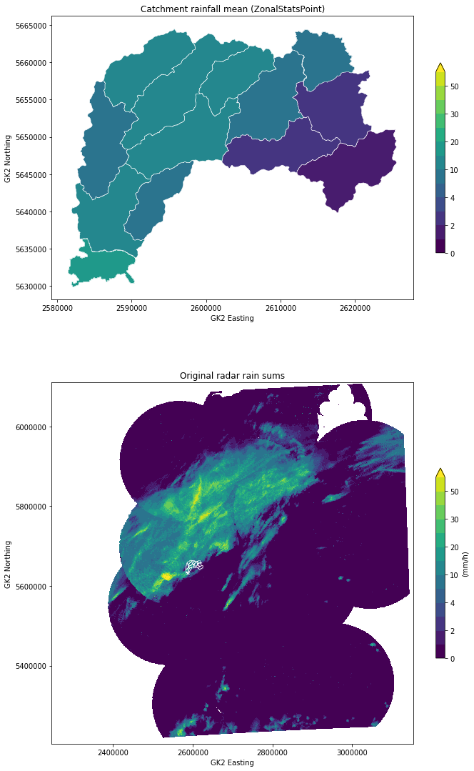
wradlib
Philosophy : Keep the magic to the minimum (and let the user decide)
One of the oldest packages (2011)
Open platform for collaborative development of algorithms
Python-based
Linux/Windows/Mac
Flat data model that allows maximum flexibility to interact with the data. xarray readers available
Comprehensively addresses the full radar processing chain
Mainly geared to interactive use in research but used in operations too
Easy to install (PyPI, conda, Docker Hub)
https://wradlib.org

Slide 6

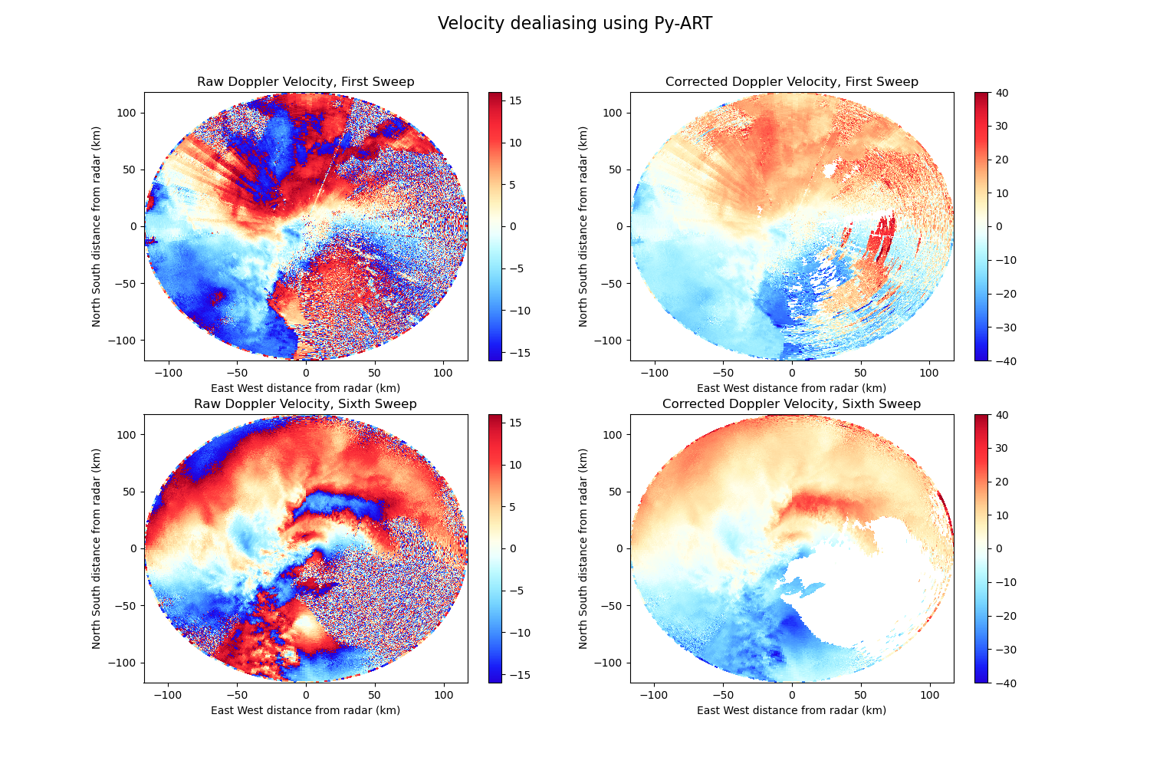
DOE-ARM Py-ART
Philosophy : It’s all about the data model
Created in the context of the ARM programme (2013)
Open platform for collaborative development of algorithms
Mostly Python-based (some modules in C, Cython and FORTRAN)
Linux/Windows/Mac
Core : Radar object that structures the radar data and metadata mirroring the C/F Radial standard
Limited scope. Base block to built upon
Rich ecosystem of packages :
  ART-VIEW, PyTDA, MultiDop, TINT, Pyrad...
Easy to install (PyPI, conda)
https://arm-doe.github.io/pyart/

Slide 7




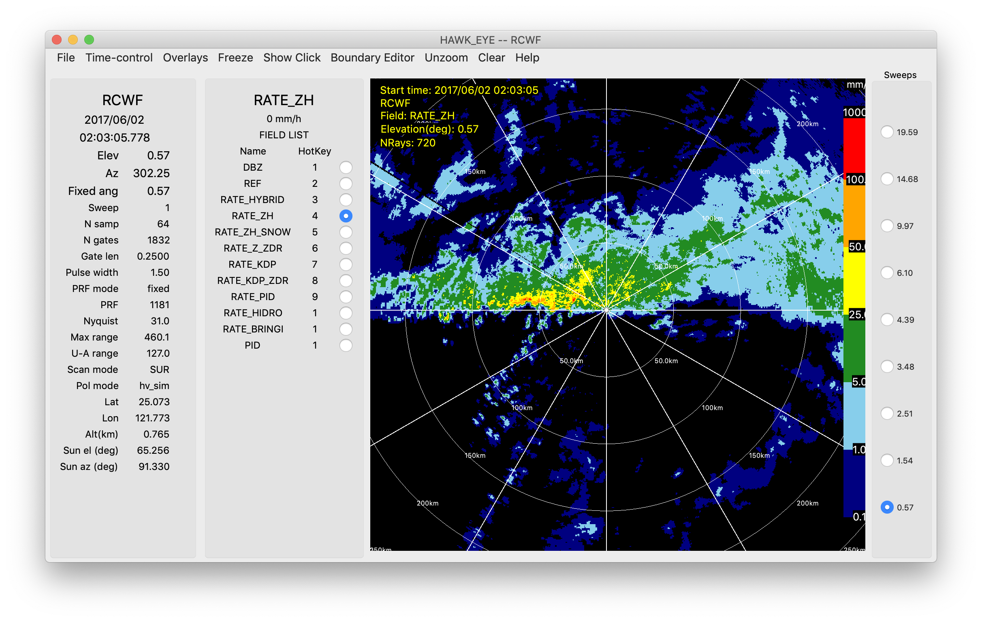
LROSE
Philosophy : High quality building blocks for complex workflows
Based on legacy of NCAR and CSU tools
Fast native cross-platform applications
Mostly C++
Linux/Mac/partially Windows
Many stand-alone tools
Stores data in CF/Radial
http://lrose.net/

Slide 8

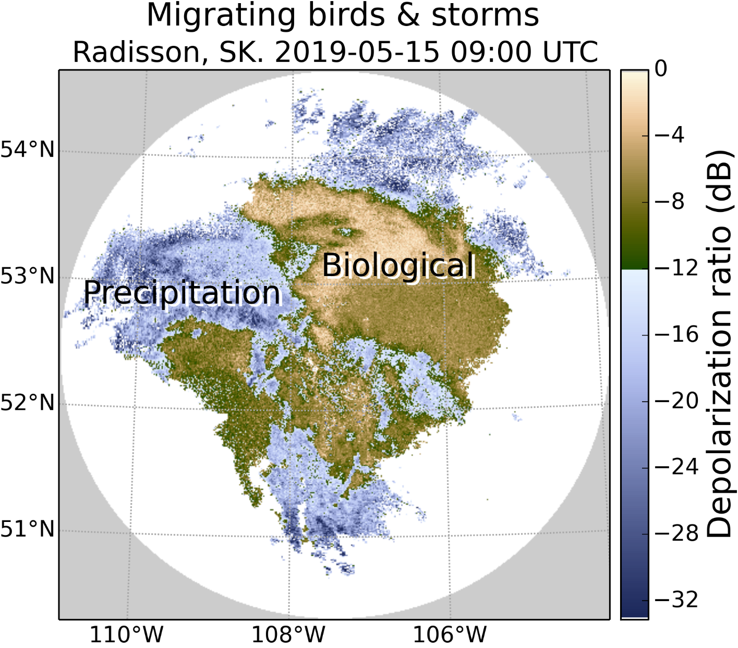
BALTRAD
Philosophy : Advanced Weather Radar Network
Heritage from the Nordic Network NORDRAD. Partly funded by the EU. BALTRAD and BALTRAD+ projects (2009-2014). 13 partners in 10 countries
Real-time data exchange and data processing
Sub-packages written in different languages
      Data exchange: JAVA
      Data processing: C and Python
Linux/Mac
Distributed networking, partners exchange polar
data and process them using a common toolbox
Uses ODIM-H5
Docu: https://baltrad.github.io/
Code: https://github.com/baltrad

Slide 9

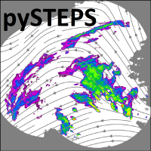



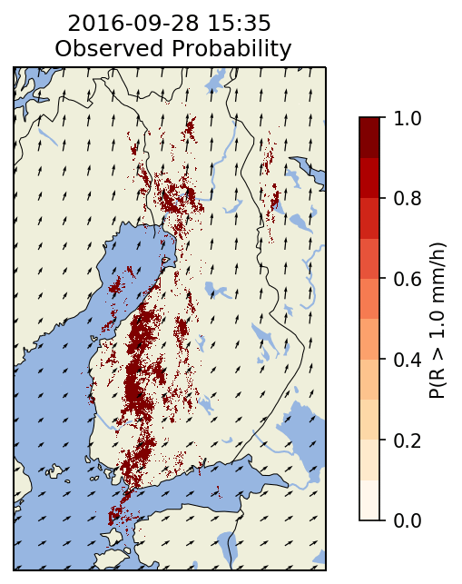
Pysteps
McGill University
Philosophy : framework for short-term ensemble prediction systems
Collaboration between Meteorological Services (MeteoSwiss, FMI, BoM) and Academic Institutions (CSU, ETH Zurich, McGill) (2018)
Written in Python
Linux/Mac/Windows
Easy to use library for short-term ensemble prediction systems.
Installation via conda, pypi
https://pysteps.readthedocs.io

Slide 10
Pyrad
Python-based weather radar data processing framework
Initially developed at MeteoSwiss. Now shared development between MeteoSwiss and Météo-France
Flexible Processing and visualizing from IQ to gridded multi-radar data
Capable of operating in real time or off-line
Open source, version controlled github: https://github.com/MeteoSwiss/pyrad
Core based on ARM-DOE Py-ART (MeteoSwiss major contributor)
Ingests:
    polarimetric and Doppler moments and secondary radar products as well as auxiliary data (NWP data, rain gauges, etc.).
    Cloud radar and LIDAR data
    MeteoSwiss and MétéoFrance operational Cartesian products
    Doppler spectra
    IQ data
    DEM
Possibility to ingest data from multiple radars
Capable of reading data in most common file formats (ODIM, C/F Radial, NEXRAD level-2, Rainbow)
Automatic documentation published online based on doc-strings
Easy to install (PyPI, conda)

Slide 11
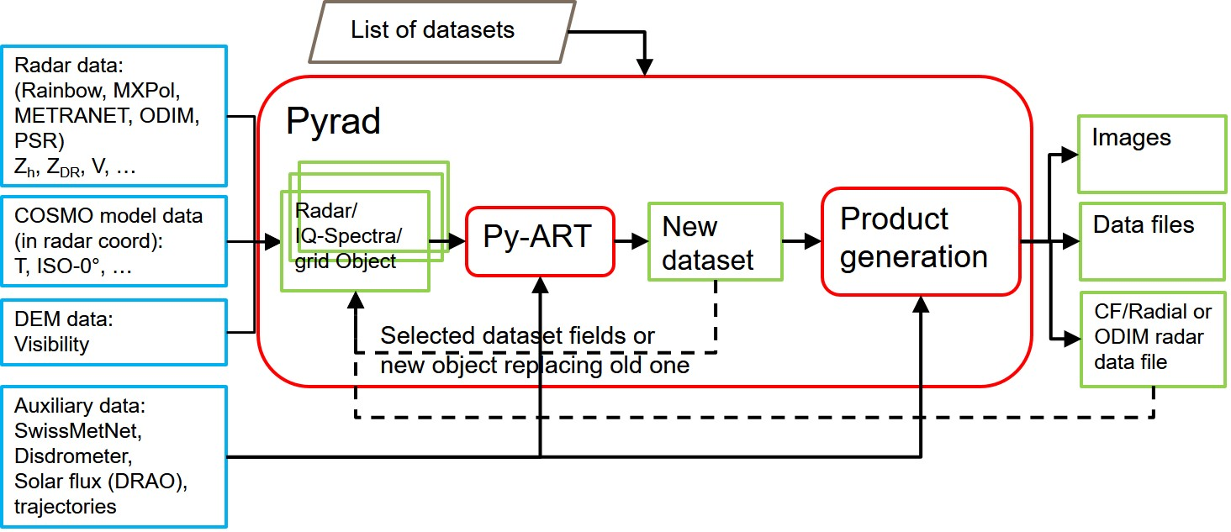
Pyrad Architecture

Slide 12
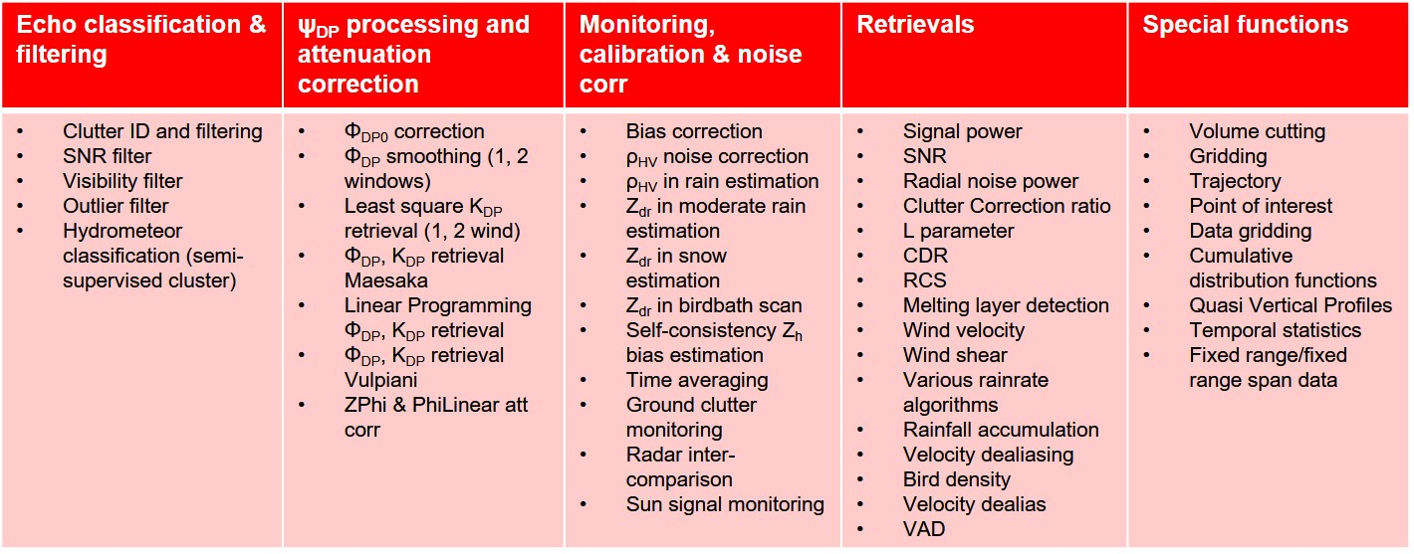
Pyrad capabilities (volume data)
18 dataset groups, 80+ different processings, 40+ different products

Slide 13
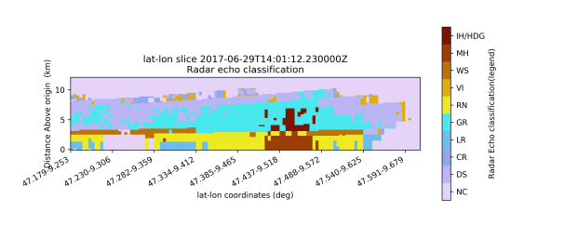
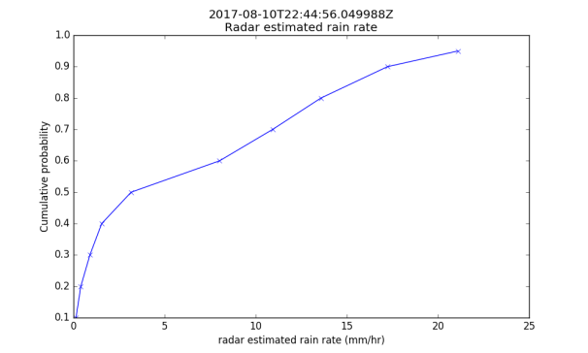
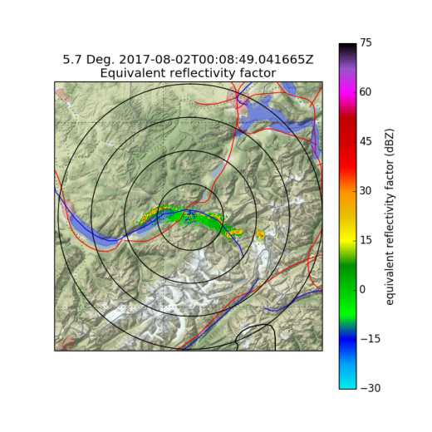
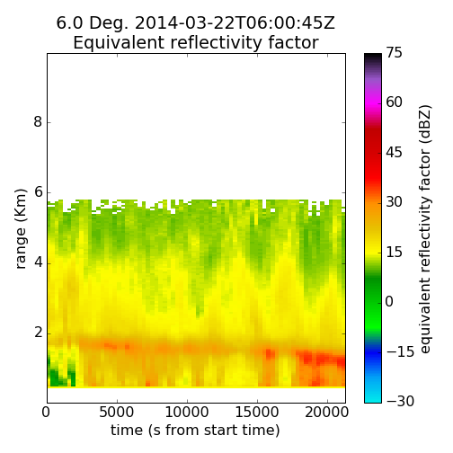
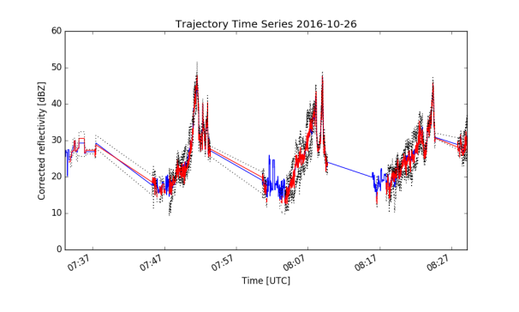
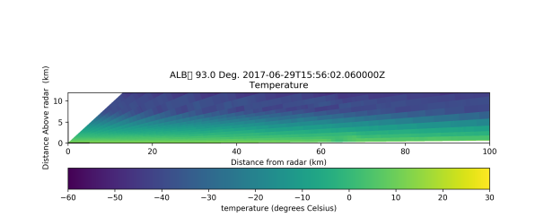
Pyrad Products (volume data)
Visualization: (Pseudo)PPI, (Pseudo)RHI, B-scope, CAPPI, cross-sections, histograms (1D, 2D), quantiles, point of interest time series (comparison with other sensors), time-range plots, scatter plots, etc. Saved in various formats (png, jpeg, eps, etc.)
Data files: Radar objects saved in CF/Radial or ODIM convention, other data in CSV files

Slide 14
Pyrad capabilities and products (other data)
 | IQ data | Spectral data | Gridded data
Capabilities | Computation of polarimetric and Doppler moments (lag-N estimators) Transformation into spectral data (FFT) | 0-Doppler filtering sRhoHV filtering Spectral noise filtering (Spectral clipping) Point of interest Region of interest Spectral power, phase, reflectivity, ZDR, RhoHV, PhiDP Noise estimation Computation of polarimetric and Doppler moments Transformation into IQ data (inverse FFT) | Point of interest Region of interest Temporal statistics
Products | Range/Angle/Time-Doppler plot Save data in netcdf |  | Mapped image/contour Cross-sections Histograms Save data in netcdf

Slide 15
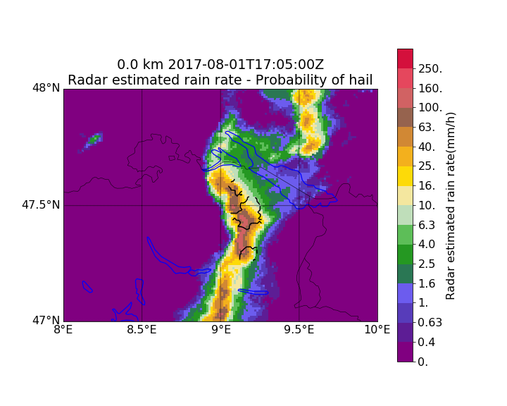
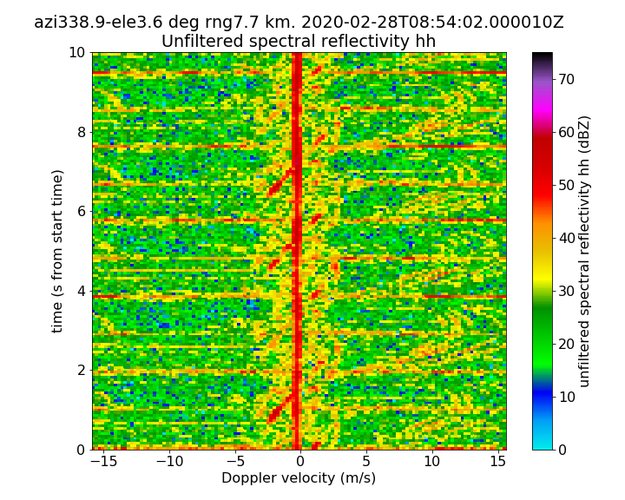
Pyrad capabilities and products (other data)

Slide 16
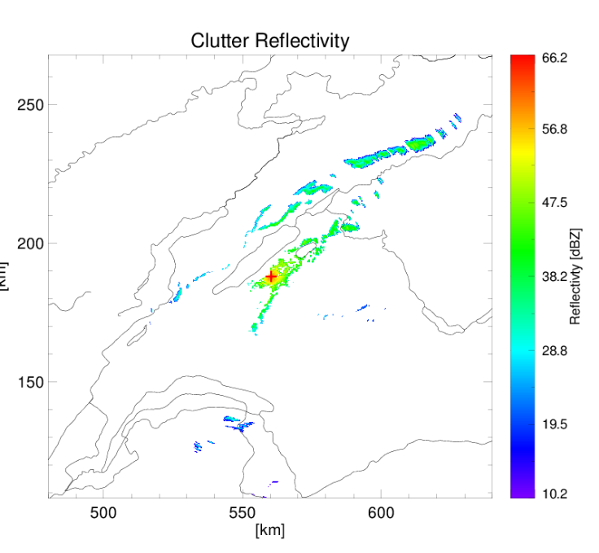
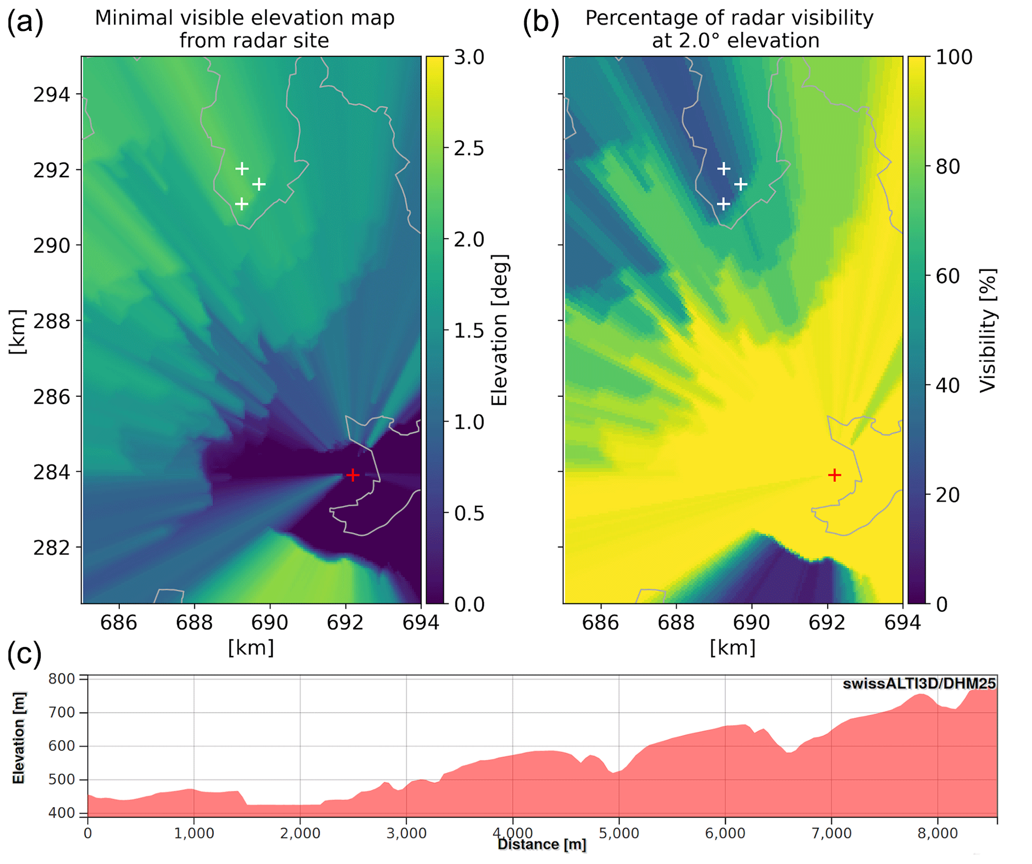
Pyrad GECSX : Ground Echo Characterization Software Extended
Input : Radar characteristics (or radar file with metadata), DEM, refractive index profile in the boundary layer
Output : Ground clutter returns, beam occultation, earth curvature-atmospheric refraction factors, etc.

Slide 17
Final thoughts
If you use open source :
  Acknowledge it : To get the backing of the institutions that finance the PIs it it is important to show that it is used
  Contribute back : reports on bugs, enhancements, even feedback on how you use it are crucial to improve the code (and boost the morale of the developers).
  Do not be afraid to contribute your code even if you are not confident about your programming skills: Your code will be reviewed before merging and you will learn a lot in the process
Open source should not just be putting your program somewhere in a server. If you create a new project you should be prepared to provide a minimum support (good documentation, code consistency, some level of engagement with the user, etc.)
PERSONAL THOUGHT : We are lucky that the weather radar open source environment is quite rich and mature. Before creating your own project from scratch think whether it can fit in an existing project

Slide 18
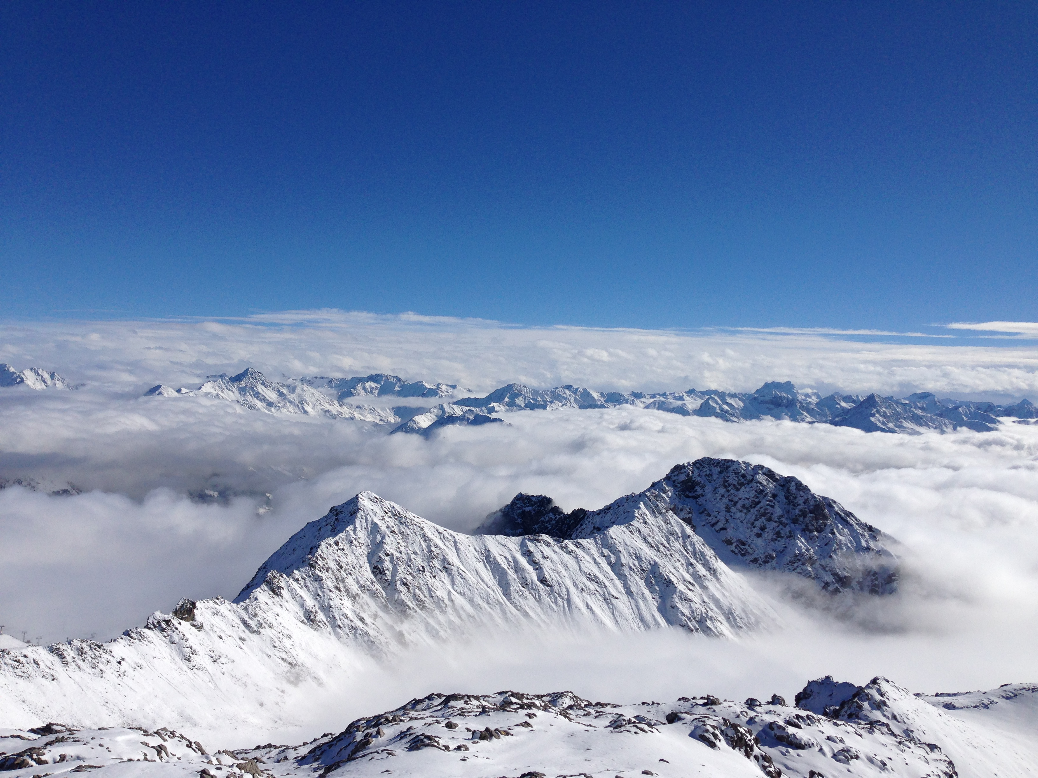
GRAZIE !
MERCI!
THANK YOU !
GRÀCIES!
jordi.figuerasiventura@meteo.fr
Subscribe to Pyrad newsletter at https://github.meteoswiss.pyrad

