Slide 1





An overview of open source software packages for radar meteorology
ERAD2022 Open Radar Short Course, Locarno, Switzerland, 28.08.2022

Slide 2
What is Open Source Software ?
  A software package is open source if :
    Allows free (senza pagare) redistribution
    Includes the source code (or it is easily accessible) and allows distribution of both compiled and source code.
    Allows modifications and derived works, allows distributing them under the same terms as the licence of the original software
    No discrimination against persons or groups
    No discrimination against fields of use (e.g. business, genetic research)
    No need for any other licence (appart from the one of the package) to use it
    The licence is not specific to a product, software within a distribution can be used and distributed independently
    The licence does not restrict the use of other software
    The licence is technology-neutral
https://opensource.org

Slide 3
Open source for weather radar ?
Since the late 2000s (and even before) there has been a number of major open source projects released (see e.g. https://openradarscience.org).
Some of them are in a mature stage and are widely used in an academic (mostly) but also operational environment
Most make use of modern tools (e.g. github, conda, docker) and practices (e.g. Continuous Integration, automatic tests) that make them easy to evolve and deploy
Most are backed by major weather services or academic institutions
Projects are not competing among them but collaborating : Best practices and inter-operability are discussed regularly and joint open source courses have been organized for years at major radar conferences (AMS, ERAD)

Slide 4
The weather radar business
Metadata generation
Beam blockage
Scattering simulations
PSDs
Calibration/monitoring
Solar monitoring
Sphere calibration
Inter-comparison
Severe weather alarms
radar/RG merging
Forest fires
Hydrological models
Bird/insect migration prediction
Radar-derived products
Precipitation Nowcasting
Assimilation in NWP models
Storm tracking
VAD
3D winds
Bird/insect migration detection
VIL
Zmax
Echo top
Ground QPE
PoH
Mesh
Radar-based products
QVP
VPR
ML detection
1D/2D/3D Compositing
RR
LWC
hydro-class
Gate-based products
Moment correction
Clutter removal
De-aliased Vr
KDP
Attenuation
IQ data processing
Raw Dual-pol/
Doppler moments
Radar control
Data visualization
Reading/Writing

Slide 5
The weather radar business
Metadata generation
Pyrad
Py-Tmatrix
PyDSD
Calibration/monitoring
Pyrad BALTRAD
LROSE
wradlib
wradlib
LROSE
PyBlock
LROSE
TINT
Radar-derived products
Pysteps
Rainymotion
wradlib
PyDDA
PyTDA
SingleDop
Rainforest
vol2bird
LROSE
BALTRAD
Pyrad
Py-ART
wradlib
Radar-based products
Pyrad
Py-ART
wradlib
LROSE
BALTRAD
1D/2D/3D Compositing
LROSE
BALTRAD
Gate-based products
Pyrad
Py-ART
wradlib
LROSE
BALTRAD
Moment correction
Pyrad
Py-ART
wradlib
IQ data processing
Pyrad
HighIQ
Radar control
Data visualization
Reading/Writing

Slide 6
Other useful meteorological software
Py-TROLL : satellite data processing
WRF: weather Research and Forecasting Model
MetPy: weather data visualization
Metview: Meteorological workstation
MetWork Framework: Useful modules to build meteorological applications

Slide 7
Radar Data Formats
Radar data takes different formats at each processing stage:
      IQ data: Time series of complex numbers
      Moments: Polar coordinates (azimuth, elevation, range)
      Composites: Cartesian/geo-referenced grids
      Radar-based products: Grids but also time-height, time-range, etc.
      Radar-derived products: ??????
There is no formally accepted standard yet for radar data at any stage
Most radar manufacturers and major Met services use their own proprietary formats
There are 3 de-facto standards for moment data file formats:
      ODIM_H5
      CfRadial
      NEXRAD-AR2

Slide 8
CfRadial
NetCDF Climate and forecast (CF) Conventions for RADAR and LIDAR data in polar coordinates
Based on Network Common Data Form (NetCDF)
Maintained by NCAR
De-facto standard for the research community
Two major versions:
      CfRadial Version 1: (Since 2010) Classic model using NetCDF3 =>
        Data stored in regular 2D (time, range) format
        Metadata: range, time, elevation, azimuth, (ray_n_gates, ray_start_index)
      CfRadial version 2: (Since 2016) uses NetCDF4 (based on HDF5) and groups
        Hierarchical grouping volume=>sweep=>dataset (time, range)
        Candidate for WMO radar data standard (FM301)
Readers: wradlib, BALTRAD, Py-ART (V1), LROSE, Pyrad (V1 and (partially) V2)
Py-ART data model
https://ncar.github.io/CfRadial/

Slide 9
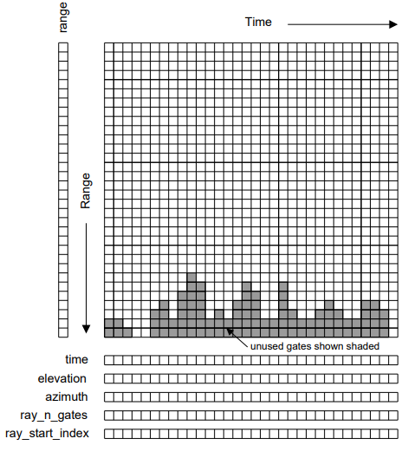
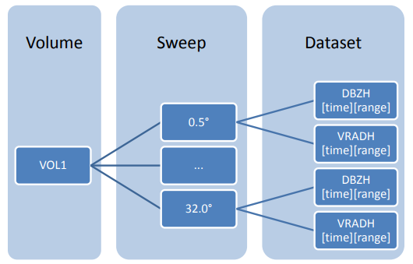
CFRadial
CFRadial 1
CFRadial 2

Slide 10
ODIM_H5
OPERA Data Information Model for HDF5
Based on HDF5
Maintained by the OPERA programme of EUMETNET
European standard for the exchange of radar data
Defined for exchange of polar AND Cartesian data
Uses groups
Readers: wradlib, Py-ART, Pyrad, BALTRAD, LROSE

Slide 11
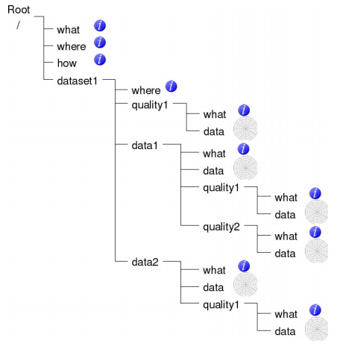
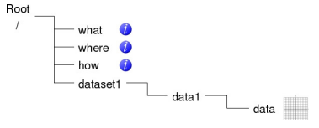
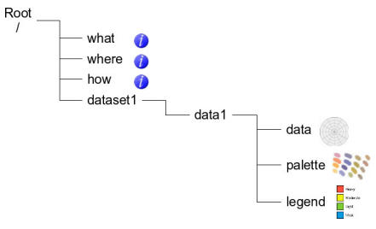
ODIM

Slide 12
NEXRAD-AR2 data
Data from the US Weather radar network
NEXRAD Level-II (Base) Data: reflectivity, mean radial velocity, spectrum width, (differential reflectivity, correlation coefficient, differential phase)
NEXRAD Level-III Products: More than 75 products
Readers: wradlib, Py-ART, Pyrad (level II), LROSE

Slide 13

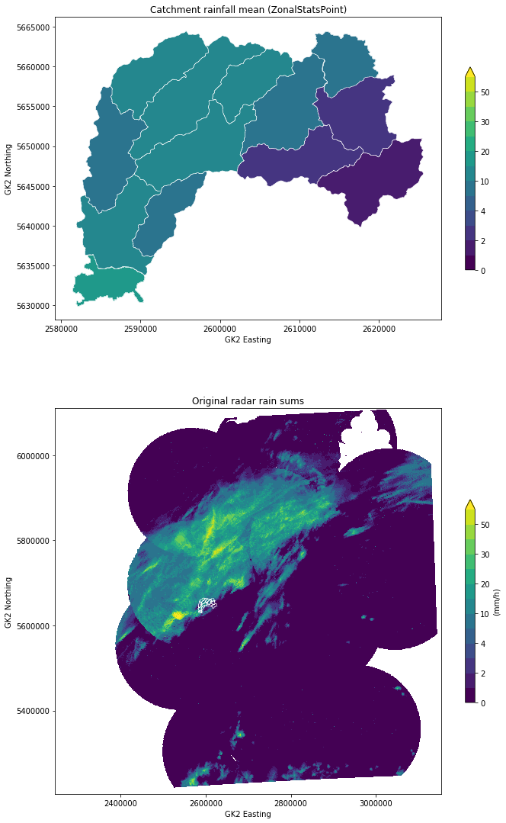
wradlib
Philosophy : Keep the magic to the minimum (and let the user decide)
One of the oldest packages (2011)
Open platform for collaborative development of algorithms
Python-based
Linux/Windows/Mac
Flat data model that allows maximum flexibility to interact with the data. xarray readers available
Comprehensively addresses the full radar processing chain
Mainly geared to interactive use in research but used in operations too
Easy to install (PyPI, conda, Docker Hub)
https://wradlib.org

Slide 14
Wradlib functionality
Module | Functionality | Comments
adjust | Gage adjustment
atten | Attenuation Correction | Hitschfeld, PIA from KDP
classify | Hydrometeor Classification | Fuzzy logic classifier
clutter | Clutter Identification
comp | Composition | Multiple Radar compositing
dp | Dual-Pol and Differential Phase | KDP retrieval, texture computation, de-polarization ratio computation
georef | Georeferencing
io | Raw data I/O | Many readers, some put data in xarrays
ipol | Interpolation | Interpolation functions
qual | Data Quality | Beam blockage calculations, Bright band contamination
trafo | Data Transformation | e.g. linear to dB
util | Utility Functions | Despeckle, derivate, etc.
verify | Verification | Comparison between radar-base precipitation and ground truth
vis | Visualization | PPI, RHI, etc.
vpr | Vertical Profile of Reflectivity | Create and work with 3D grids
zonalstats | Zonal Statistics
zr | Z-R Conversions

Slide 15

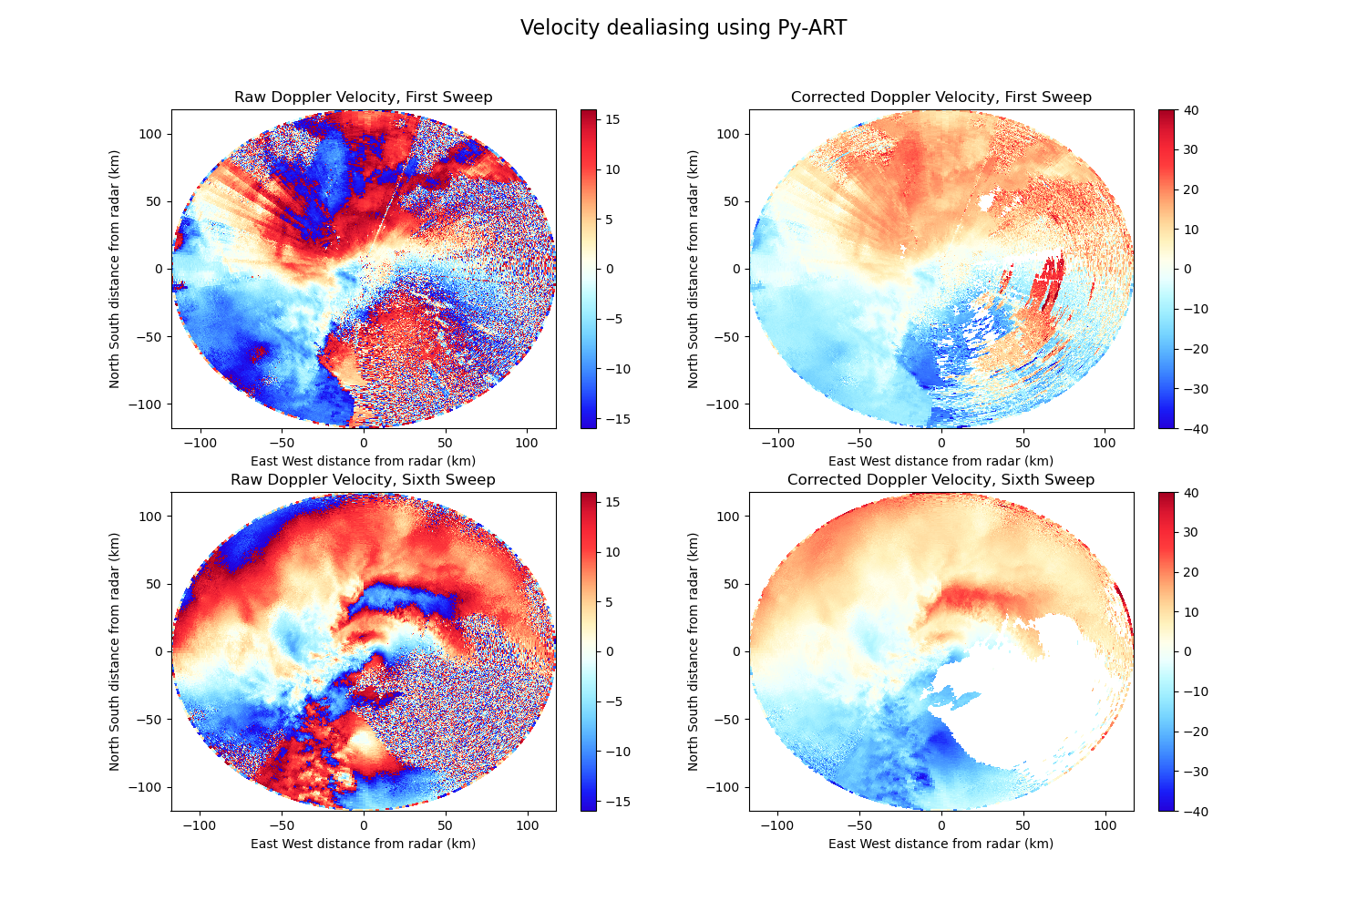
DOE-ARM Py-ART
Philosophy : It’s all about the data model
Created in the context of the ARM programme (2013)
Open platform for collaborative development of algorithms
Mostly Python-based (some modules in C, Cython and FORTRAN)
Linux/Windows/Mac
Core : Radar object that structures the radar data and metadata mirroring the C/F Radial standard
Limited scope. Base block to built upon
Rich ecosystem of packages :
  ART-VIEW, PyTDA, PyDDA, TINT, Pyrad...
Easy to install (PyPI, conda)
https://arm-doe.github.io/pyart/

Slide 16
Py-ART functionality
Category | Module | Functionality
Reading/writing | io and aux_io | Reading and writing gridded and polar data
Correcting radar fields | correct | Attenuation, bias, noise in RhoHV, Doppler velocity de-aliasing, PhiDP processing, Despeckling and clutter filtering
Retrieving | retrieve | Secondary moments (e.g. Noise, SNR, CDR, KDP) VAD, hydrometeor classification, RR
Plotting | graph | Horizontal grid plotting, 3D grid slice plotting, PPI, RHI, ray, Pseudo-PPI,
Compositing | map
Filtering | filters | According to temperature, position with respect to iso-0°, moments, moments and textures

Slide 17
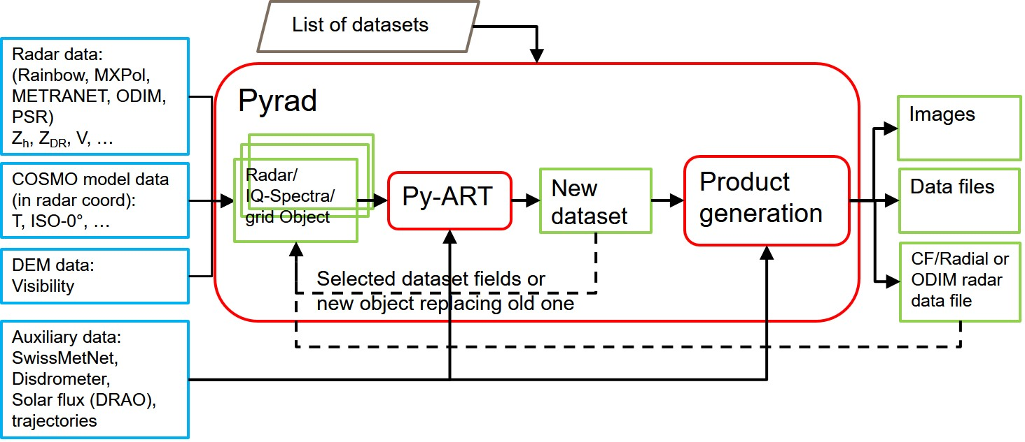
Pyrad
Philosophy : Flexible and replicable data processing chains with no programming
Initially developed at MeteoSwiss. Now shared development between MeteoSwiss and Météo-France
Python-based weather radar data processing framework capable of operating in real time or off-line
Core based on ARM-DOE Py-ART (Pyrad major contributor)
Easy to install (PyPI, conda)
https://github.com/MeteoSwiss/pyrad

Slide 18
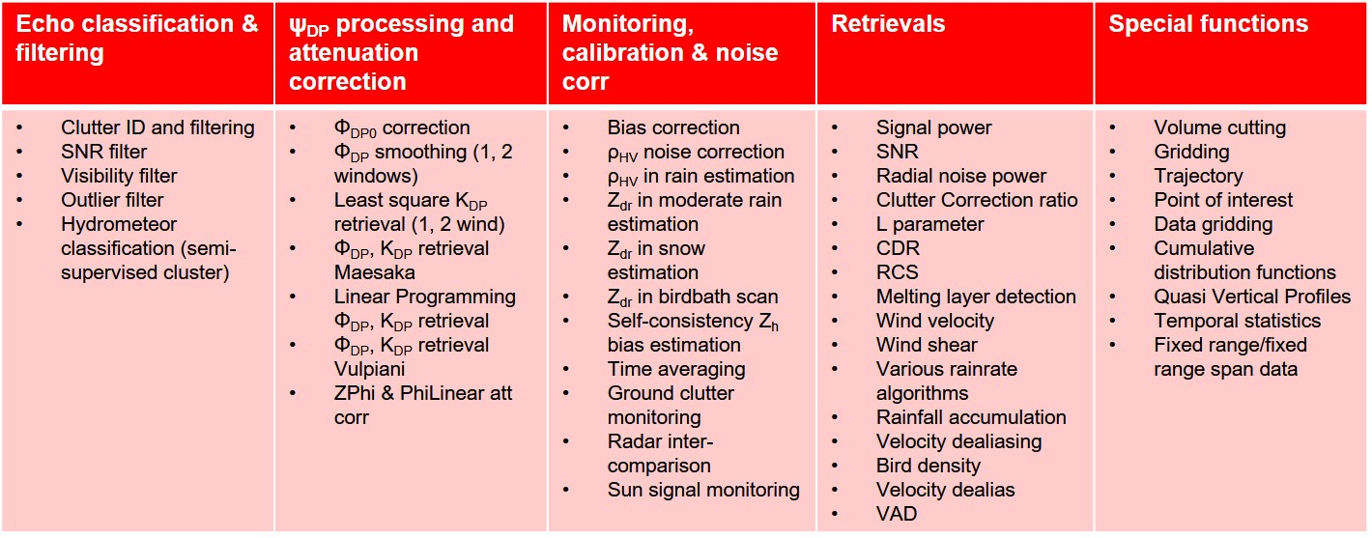
Pyrad capabilities (volume data)
18 dataset groups, 80+ different processings, 40+ different products

Slide 19
Pyrad capabilities and products (other data)
 | IQ data | Spectral data | Gridded data
Capabilities | Computation of polarimetric and Doppler moments (lag-N estimators) Transformation into spectral data (FFT) | 0-Doppler filtering sRhoHV filtering Spectral noise filtering (Spectral clipping) Point of interest Region of interest Spectral power, phase, reflectivity, ZDR, RhoHV, PhiDP Noise estimation Computation of polarimetric and Doppler moments Transformation into IQ data (inverse FFT) | Point of interest Region of interest Temporal statistics
Products | Range/Angle/Time-Doppler plot Save data in netcdf |  | Mapped image/contour Cross-sections Histograms Save data in netcdf

Slide 20



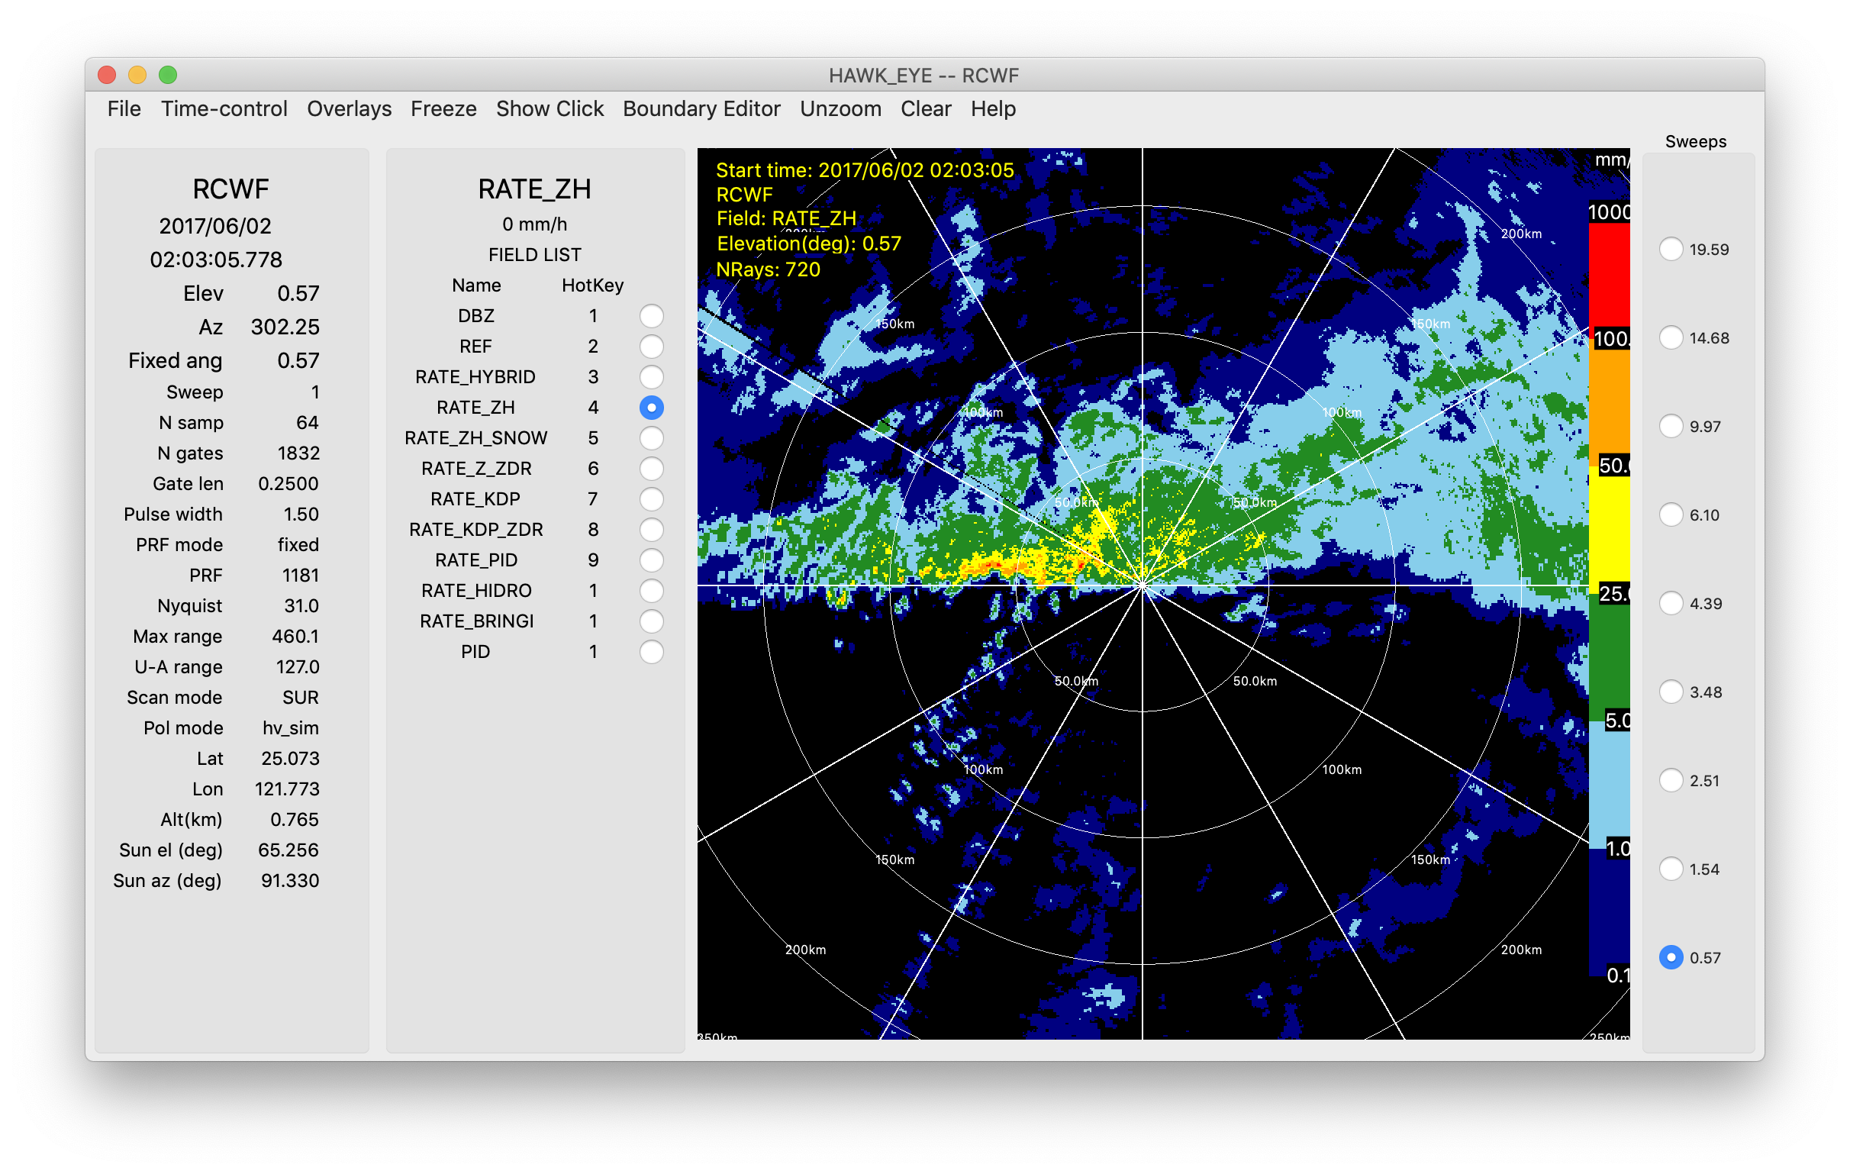
LROSE
Philosophy : High quality building blocks for complex workflows
Based on legacy of NCAR and CSU tools
Fast native cross-platform applications
Mostly C++
Linux/Mac/partially Windows
Many stand-alone tools
Stores data in CF/Radial
http://lrose.net/

Slide 21
LROSE tools
Convert | RadxPrint: Print file properties and determine if it is supported by Radx RadxConvert and RadxBufr: Conversion from 25 formats to CfRadial
Display | HawkEye
Quality Control | 14 tools: compare merge and filter fields Detect sun hits and analyse them
Grid | Radx2Grid
Echo | 23 tools: KDP and Attenuation Particle Identification, hydrometeor classification Rain rate and rainfall accumulation Beam blockage estimation Convective/stratiform Mesocyclones Refractivity and moisture Titan (Thunderstorm Identification, Tracking, Analysis and Nowcasting)
Wind | 5 tools: VAD Multi-Doppler retrieval Vortex Optical Flow

Slide 22

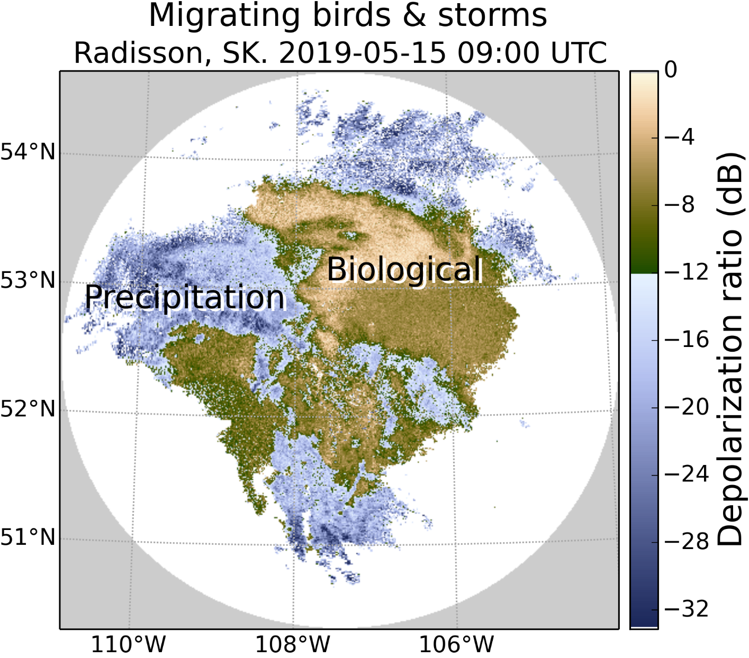
BALTRAD
Philosophy : Advanced Weather Radar Network
Heritage from the Nordic Network NORDRAD. Partly funded by the EU. BALTRAD and BALTRAD+ projects (2009-2014). 13 partners in 10 countries
Real-time data exchange and data processing
Sub-packages written in different languages
      Data exchange: JAVA
      Data processing: C and Python
Linux/Mac
Distributed networking, partners exchange polar
data and process them using a common toolbox
Uses ODIM-H5
Docu: https://baltrad.github.io/
Code: https://github.com/baltrad

Slide 23
BALTRAD packages
Package | Environment | Description
baltrad-db | Python, Java | Database manager subsystem
BaltradDex | Java | Distribution and Exchange subsystem
baltrad_wms | OGC Map Server | Web map services
bbufr | C, Python | BALTRAD interface to EUMETNET OPERA’s BUFR Software
beamb | C, Python | Beam blockage correction
beast | Java | Task manager/scheduler subsystem
bRopo | C, Python | Anomaly (non-precipitation echo) detection and removal
GoogleMapsPlugin | Python | Creation of PNG images to use in Google Maps
node-installer | Python | Installation wizard
OdimH5 | Java | Data injector using ODIM_H5 and Rainbow file formats
RAVE | C, Python | Product generation framework and toolbox
baltrad_wrwp | C, Python | Wind products
baltrad-ppc | C, Python | Polarimetric processing chain

Slide 24
Final thoughts
If you use open source :
  Acknowledge it : To get the backing of the institutions that finance the PIs it is important to show that it is used
  Contribute back : reports on bugs, enhancements, even feedback on how you use it are crucial to improve the code (and boost the morale of the developers).
  Do not be afraid to contribute your code even if you are not confident about your programming skills: Your code will be reviewed before merging and you will learn a lot in the process
Open source should not just be putting your program somewhere in a server. If you create a new project you should be prepared to provide a minimum support (good documentation, code consistency, some level of engagement with the user, etc.)
PERSONAL THOUGHT : We are lucky that the weather radar open source environment is quite rich and mature. Before creating your own project from scratch think whether it can fit in an existing project

Slide 25
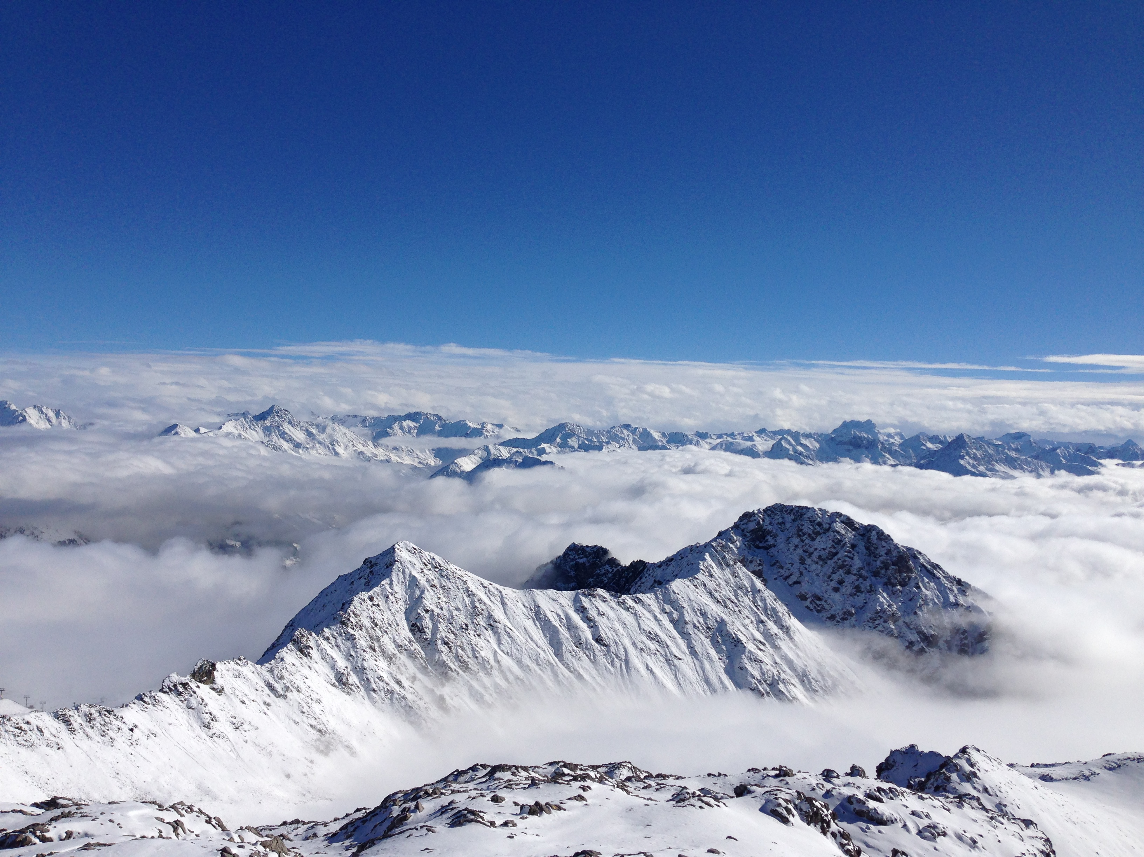
GRAZIE !
MERCI!
THANK YOU !
GRÀCIES!

