Slide 1
Pyrad architecture and principles
Jordi Figueras i Ventura Pyrad course

Slide 2
Contents
Introduction
Pyrad working philosophy
Pyrad architecture
Launching Pyrad
File management
Constructing the processing chain

Slide 3
1. Introduction

Slide 4
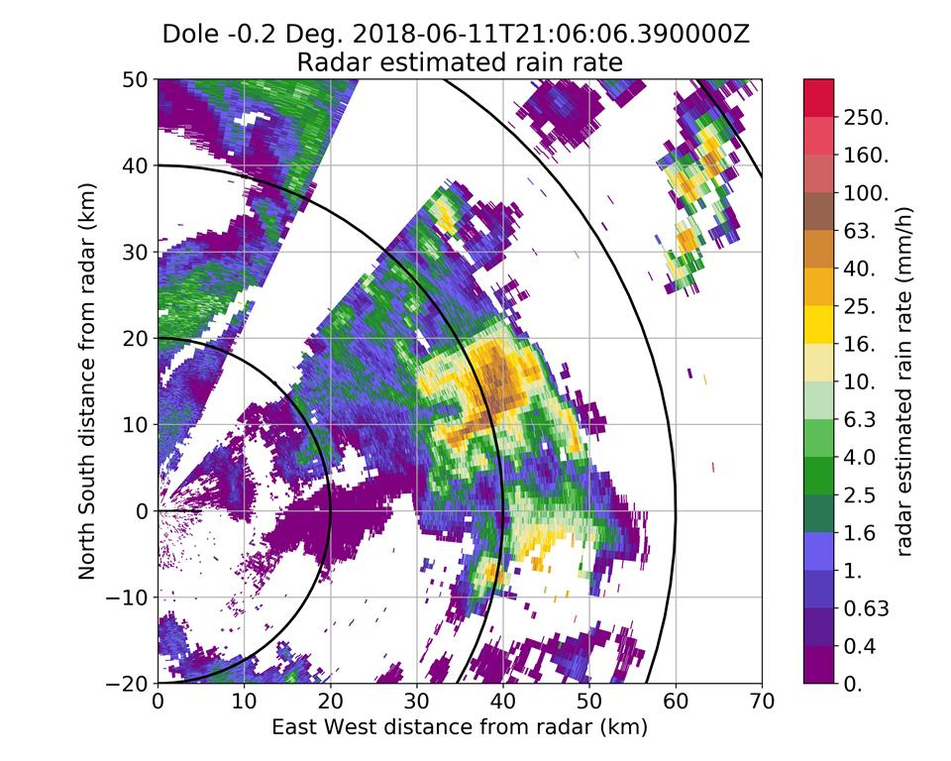
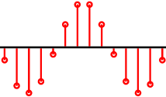
What is Pyrad ?
Pyrad is a processing framework that allows the creation of flexible and replicable data processing chains with no programming. It is capable of operating in real time or off-line. It is aimed mainly for weather radar data processing but has some limited functionality allowing to process data from other sensors.
Pyrad

Slide 5
History and use
2016 – Initially developed at MeteoSwiss as Python replacement for and IDL processing framework
2020 – First release as a python and conda package (v0.4.4)
2021 – Agreement to have a joined development between MeteoSwiss and Météo-France
2022 – Version 1.0.0
Use :
Operational real-time post-processing of X-band radar data (MeteoSwiss)
Operational polarimetric data quality monitoring (MeteoSwiss)
Platform for rapid algorithm prototyping
Platform for MeteoSwiss and Météo-France radar volume data processing and visualization by third parties
Common development platform for institutions partnering with MeteoSwiss or Météo-France

Slide 6
General characteristics
Python-based (> v. 3.7)
Linux platform
Open source, version controlled (https://github.com/MeteoSwiss/pyrad)
Core based on our own version of ARM-DOE Py-ART (The Pyrad project contributes back regularly)
Possibility to ingest data from multiple radars
Ingests multiple data types: IQ data, spectral data, polarimetric and Doppler moments, Cartesian data, etc.
Capable of reading the main file formats used for volume radar data storage
Automatic documentation published online based on doc-strings
Easy to install (PyPI, conda)

Slide 7
2. Pyrad working philosophy

Slide 8
General characteristics
KEY CONCEPT : Separation between dataset generation and product generation
Dataset : New data generated from the processing of a Pyrad data object. It can be in the form of a new field of the same object type or a completely new object. It can be re-ingested in the data processing chain. Examples :
- rainfall rate field generated from a reflectivity field contained in a radar object
- Reflectivity generated from a spectral data object
Product : Output generated out of a dataset for human or machine consumption. Examples :
- PPI of reflectivity
- File containing timeseries of values at a point of interest

Slide 9
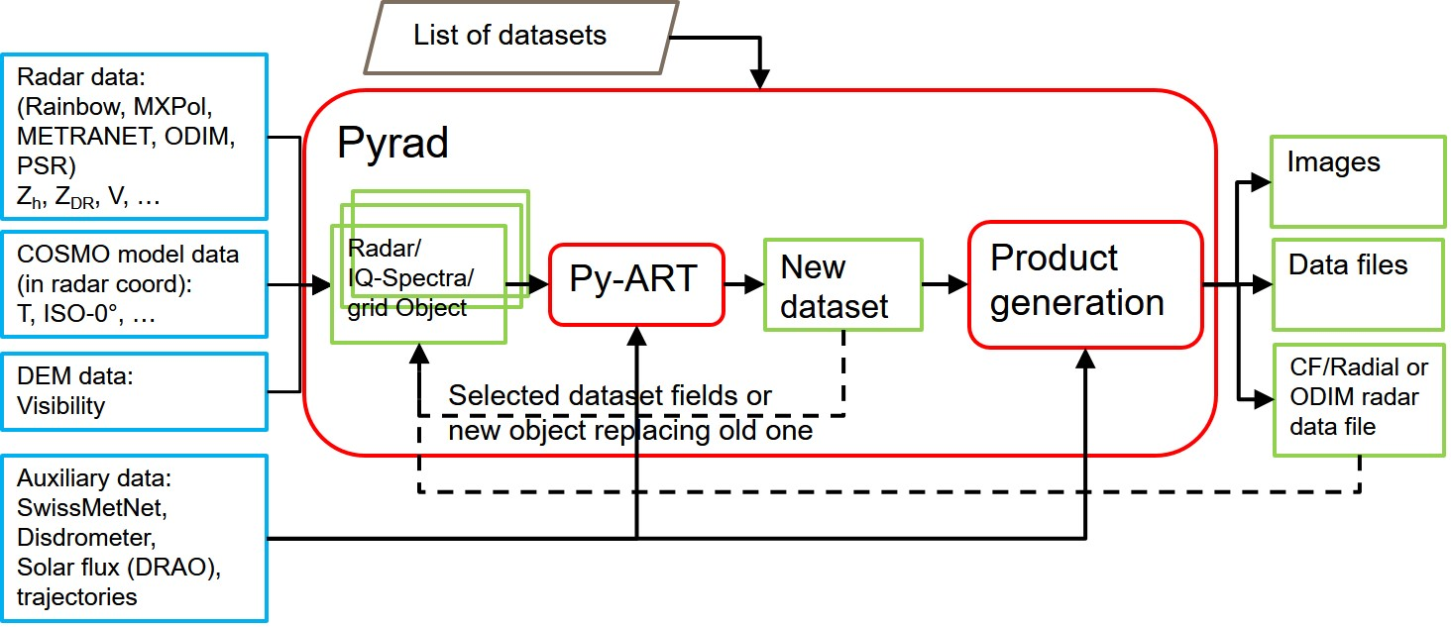
Pyrad flow diagram

Slide 10
Configuration files
Main config file | Base paths of data Location of config files Base path for output data and image format(s)
location config file | Radar(s) name and scan list General radar and scan characteristics (scan periodicity, radar constant, …) Images configuration
product config file | List of datasets to generate For each dataset List of inputs Dataset specific configuration List of products to generate MAKE_GLOBAL SUBSTITUTE_OBJECT FIELDS_TO_REMOVE
Internally all the configuration parameters are stored in a dictionary cfg
From cfg pyrad creates :
- datacfg : necessary parameters to read the input data
- dscfg : parameters to create the datasets (one per dataset)
- prdcfg : parameters to create products (one per product)

Slide 11
Config file data types
Data types in the config file are mapped to Python values
Pyrad data type Keyword | Python data type
BYTE, INT, LONG, HEX | int
EXP, FLOAT, DOUBLE | float
STRING | str
BYTARR, INTARR, LONARR, HEXARR | Numpy array of byte, int32, int64, H
EXPARR, FLTARR, DBLARR | Numpy array of float64, float64, double
STRARR | List of strings
STRUCT | dict

Slide 12
3. Pyrad architecture

Slide 13
Github architecture
Pyrad superproject
master
dev
User manual
Specific guides
additional_doc
ci
PyTDA
Turbulence
detection
Continuous integration
config
libDX50
Reading of DX50
Spectral data
Configuration
doc
pyart
Online documentation
src
pyrad_proc
Source code
tools
scripts
Pyrad launching
scripts
MCH specific tools

Slide 14
pyrad_proc modules
flow
Control of data flow
graph
Image and graphics creation
io
Reading and writing of data
proc
Dataset generation
prod
Product generation
util
Auxiliary functions

Slide 15
Proc files
process_aux.py | Selection of process according to config file. Radar data resampling. Conversion from radar to grid data
process_calib.py | Bias correction. Monitoring with the sun and ground clutter
process_cosmo.py | Interpolation of NWP data into radar grid
process_dem.py | Managing of Digital Elevation Models (e.g. visibility)
process_Doppler.py | De-aliasing, turbulence detection, wind retrievals
process_echoclass.py | Echo classification and data filtering
process_grid.py | Grid data processing
process_intercomp.py | Radar-radar intercomparison
process_iq.py | IQ data processing. Computation of moments from IQ data
process_monitoring.py | Polarimetric data quality monitoring
process_phase.py | PhiDP and KDP retrievals. Attenuation correction
process_retrieve.py | Miscellaneous retrievals. (e.g. VPR, rain rate, noise, etc.)
process_spectra.py | Spectral processing. Computation of moments from spectral data
process_timeseries.py | Time series (POI, QVP, columns at a prescribed location, etc.)
process_traj.py | Trajectory processing (retrieval of data at given locations)

Slide 16
Prod files
process_grid_products.py | Products from grid datasets
process_intercomp_products.py | Products from intercomp datasets
process_monitoring_products.py | Products from monitoring datasets
process_product.py | Products from miscellaneous datasets (e.g. QVP, ML, VPR, NWP models, etc.)
process_spectra_products.py | Products from spectra datasets
process_timeseries_products.py | Products from timeseries (includes trajectory on a CAPPI)
process_traj_products.py | Products from trajectory
process_vol_products.py | Products from radar volume datasets
product_aux.py | Selection of product family according to config file

Slide 17
4. Launching Pyrad

Slide 18
Pyrad processing status
Status 0 : Initialization of datasets
Status 1 : Sequential processing of input data. Persistent data and parameters are stored internally
Status 2 : All input data consumed. Final dataset production if necessary

Slide 19
Pyrad Launching scripts
main_process_data.py | Process data sequentially according to starttime and endtime defined in command line or by input file
main_process_data_period.py | Process available data within time intervals specified by user between dates specified by user. Useful to obtain daily statistics
main_process_data_rt.py | Real time data processing

Slide 20
Trajectory processing with main_process_data.py
If a trajfile is provided pyrad enters in a special processing mode
-t, --trajfile | Trajectory file or file containing disjoint processing periods
--trajtype | plane : File contains a trajectory defined by lat, lon, altitude and time. Pyrad will look for data inputs within the time range defined by the file and a time series of radar data at the location of the « plane » can be obtained lightning : As above but with multiple simultaneous trajectories proc_periods : File contains a series of disjoint processing periods. Useful to process only data at periods of interest
--flashnr | If trajtype is lightning you can select the trajectory that you want to process. If 0 all trajectories will be processed

Slide 21
5. File management

Slide 22
Reading input data files
Off-line: Pyrad looks for all files present in the expected file directories within a time period defined by the user or the --trajfile
Real time: Pyrad looks for new files that have appeared between the last time it processed a file and the current time, then it processes all new files sequentially
If more than one type of file must be read per time step, a master file is defined and all other files depend on this master
Metadata required for data processing is read from the file. If metadata is absent or wrong the user can specify it in the loc config file
Internally, all data and metadata is stored in a single data object. Therefore the data read in the files must be compatible with the same object type
If the input data does not have the same grid, Pyrad will internally interpolate the data to the grid of the master file(s)
If the user is interested only in a particular region it can specify the limits of the region in the loc file

Slide 23
Reading input data files. Searching for data
Pyrad looks for data in the following base repositories :
datapath : primary base path where to look for data
loadbasepath : base path where to look for datasets generated by pyrad
cosmopath : base path where to look for model data
dempath : base path where to look for DEM data (e.g. visibility)
satpath : base path where to look for satellite data in gridded netcdf format
psrpath : base path where to look for spectral data (needs datapath)
iqpath : base path where to look for IQ data (needs datapath)

Slide 24
Reading input data files. The ScanList keyword
A radar volume may be distributed in separate files by sweep (fixed angle), datatype or both
The ScanList variable consists on a list of identifiers of each file in order to be able to group them in a single radar volume
The first identifier in the list will be used as master and all the others will be referred to it
ScanList STRARR 9
dBuZ_PAMA40LFPW
dBuZ_PAMB40LFPW
dBuZ_PAMC40LFPW
RhoHV_PAMA40LFPW
RhoHV_PAMB40LFPW
RhoHV_PAMC40LFPW
ZDR_PAMA40LFPW
ZDR_PAMB40LFPW
ZDR_PAMC40LFPW
ScanList STRARR 9
MALS_LOC_274_up_nopsr.ele/
MALS_LOC_278_dw_nopsr.ele/
MALS_LOC_282_up_nopsr.ele/
MALS_LOC_286_dw_nopsr.ele/
MALS_LOC_284_up_nopsr.ele/
MALS_LOC_280_dw_nopsr.ele/
MALS_LOC_276_up_nopsr.ele/
MALS_LOC_272_dw_nopsr.ele/
MALS_LOC_268_up_nopsr.ele/
ScanList STRARR 5
001
002
003
004
005

Slide 25
Folder hierarchy : path_convention keyword
Pyrad can work with multiple folder hierarchies depending on the input data and the user-specified data format. The data of the files has to be compatible (e.g. do not mix grid data with radar volume data).
Most common file formats folder hierarchy:
ODIM, ODIMBIRDS, CFRADIAL, CFRADIAL2, CF1, NEXRADII, GAMIC, ODIMGRID :
MCH : datapath/[YYJJJ]/[(M/P)(L/H)(X)YYJJJ]/
ODIM :datapath/[day_dir]/
RT : datapath/[(M/P)(L/H)(X)]/
Pyrad output (CFRADIALPYRAD, ODIMPYRAD, PYRADGRID, ODIMPYRADGRID, NETCDFSPECTRA, CSV):
loadbasepath/loadname/[YYYY-MM-DD]/dataset/product/

Slide 26
Folder hierarchy : path_convention keyword
Other formats convention hierarchy:
RAINBOW : datapath/[scan][YYYY-MM-DD]
RAD4ALP :
LTE : datapath/[(M/P)(L/H)(X)YYhdfJJJ]/
MCH : datapath/[YYJJJ]/[(M/P)(L/H)(X)YYJJJ]/
RT : datapath/[(M/P)(L/H)(X)]/
RAD4ALPGRID, RAD4ALPGIF, RAD4ALPBIN
SATGRID : satpath/[YYYY]/[MM]/[DD]/
MFCFRADIAL, MFBIN, MFPNG, MFGRIB, MFDAT, MFCF : datapath/[day_dir]/
MXPol : Default and LTE
COSMORAW (needs datatype as reference):
cosmopath/raw[1]/
MCH : cosmopath/raw[1]/[YYYY-MM-DD]/

Slide 27
Reading data files: the datatype keyword
The datatype string allows to define which field must be read and from which file type and into which structure has to be stored. Internally all data types in the product config file are grouped so that reading is done only once.
Datatype definition has the following structure:
datatype STRING [radarnr]:[datagroup],[fieldname],[dataset/file_naming],[product]
Example:
datatype STRARR 2
RADAR001:ODIM,dBZ,D{%Y/%m/%d}-F{%Y%m%d%H%M%S}
RADAR001:ODIMPyrad,hydro,hydrometeor_classification,SAVED_VOLUME

Slide 28
Reading data files : the datatype keyword
radarnr | RADARXXX : The number of the data object where the input data will be stored. Starting by 001. If more than one data object will be input this keyword is used to identify to which data object the metadata belongs to (e.g. in the ScanList) | RADAR001 is the default. There is no need to specify it if only one radar will be used
datagroup | Type of input file | RAINBOW is the default.
fieldname | Fieldname according to Pyrad convention | e.g. dBZ
dataset/file_naming | Dataset=> For pyrad output files: Name of the dataset subdirectory where data has been stored. file_naming=> For files following the ODIM path convention: The directory structure linked to the date and the file time stamp format | Dataset=> e.g. Zh file_naming=> D{format for directory}-F{format for file} e.g. D{%Y/%m/%d}-F{%Y%m%d%H%M}
product | For pyrad output files: Name of the product subdirectory where data has been stored | e.g. PPI_EL001

Slide 29
Datagroups for radar volume object. Widely used formats
ODIM | HDF5 European standard
ODIMPYRAD | As above but with the Pyrad folder hierarchy
CFRADIAL | CF Radial V1 format
CFRADIALPYRAD | As above but with the Pyrad folder hierarchy
CFRADIAL2 | CF Radial V2 format. Only partially compatible
NEXRADII | Nexrad file format
PROC | Data generated on the fly by Pyrad

Slide 30
Datagroups for radar volume object. Proprietary formats
ODIMBIRDS | HDF5 for profile data used by the aeroecology community. Similar to ODIM but with additional metadata
CFRADIALCOSMO | NWP data in radar coordinates in a CF Radial V1 format
MFCFRADIAL | CF Radial V1 format with MF fieldnames mapping
RAINBOW | Leonardo proprietary Rainbow file format
COSMO | NWP data in radar coordinates in Rainbow format
DEM | Visibility data in Rainbow format
GAMIC | GAMIC proprietary file format
MXPOL | MXPOL proprietary file format
RAD4ALP | METRANET format (ELDES proprietary format used at MeteoSwiss)
RAD4ALPCOSMO | NWP data in radar coordinates in METRANET format
RAD4ALPHYDRO | Hydrometeor classification data in METRANET format. Needs a RAD4ALP file to get the metadata
RAD4ALPDOPPLER | De-aliased Doppler velocity in METRANET format. Needs a RAD4ALP file to get the metadata
CF1 | Data in the NETCDF/CF format. Data format of a cloud radar
All formats read by Py-ART can be easily added to Pyrad

Slide 31
Datagroups for grid object
ODIMGRID | Cartesian grid products in ODIM file format
ODIMPYRADGRID | Pyrad generated Cartesian data in ODIM format
PYRADGRID | Pyrad generated Cartesian data in NETCDF format
RAD4ALPGRID | METRANET format for Cartesian grid products
RAD4ALPGIF | MeteoSwiss data in GIF format
RAD4ALPBIN | MeteoSwiss data in binary format
MFBIN | Météo-France data in binary format
MFDAT | Météo-France data in text format
MFPNG | Météo-France data in PNG format
MFGRIB | Météo-France data in GRIB format
MFCF | Météo-France data using NETCDF/CF format
SATGRID | Satellite data in NETCDF format

Slide 32
Datagroups for IQ/Spectra object
RAD4ALPIQ | Internal MeteoSwiss data format for IQ data (binary file). Requires reading a radar object to get the metadata
PSRSPECTRA | Rainbow file format for spectral data. Requires reading a radar object to get the metadata
NETCDFSPECTRA | Pyrad output of the IQ/Spectra object. Written in NETCDF in a format analogous to CFRadial1

Slide 33
Other pathes where pyrad searches for data and metadata
configpath: basepath for configuration files required for specific dataset or product generation routines
General pathes to Auxiliary data used for specific dataset or product generation functions:
colocgatespath: basepath to files containing the position of co-located gates used to inter-compare radar output
solarfluxpath: basepath to location of a solar flux file produced by DRAO
excessgatespath: basepath to location of file containing the position of gates used for clutter monitoring
disdropath: basepath to disdrometer data. Used to compare time series of radar data and disdrometer data at the disdrometer location
smnpath: basepath to weather station data. Used to compare time series of radar-derived vs rain gauge measured rainfall rate at the location of the rain gauge
Other dataset/product generation functions may require auxiliary data defined at the dataset

Slide 34
Pyrad output folder structure
By default Pyrad will store the data using the following folder structure:
saveimgbasepath/[proc_space]/[time_info]/[dataset_name]/[product_name]/
e.g. home/jfigui/TOUL/2023-04-25/dBZ/PPI_EL001/
saveimgbasepath | Base path where Pyrad output data is stored | e.g. /home/jfigui/
proc_space | Where to store all data output generated from the same main config file. Defined by the name keyword in the main config file | e.g. TOUL
time_info | Usually YYYY-MM-DD. Can be absent depending on the product. e.g. Long term time series | Dataset=> e.g. Zh file_naming=> D{directory format}-F{fileformat} D{%Y%m%d}-F{%Y%m%d%H%M}
dataset_name | Name of the dataset as defined by the product config file | Can be modified using keyword dssavename when defining the dataset
product_name | Name of the output product as defined by the product config file | Can be modified using keyword prdsavedir when defining the product

Slide 35
Pyrad output file name convention
Usually the Pyrad output file names have the following structure:
[time_stamp]_[run_info]_[product_id]_[dataset_id]_[fieldname]_[prod_info].[termination]
time_stamp | time stamp info. Usually the nominal time stamp as read from the input file. Usually of the form YYYYmmddHHMMSS | e.g. 20230425120500
run_info | Additional information provided at run time by the keyword -i, --infostr in the launching script | e.g. run23
product_id | String identifying the product | e.g. ppi
dataset_id | String identifying the dataset type | e.g. RAW (output of raw data reading)
fieldname | Pyrad convention field name | e.g. dBZ
prod_info | Additional string identifying the product. | e.g. el0.4
termination | For images it can be that of any file format accepted by Matplotlib and it is defined by keyword imgformat in the main config file. Outputs that are not grid or radar objects usually are .csv

Slide 36
6. Constructing the processing chain

Slide 37
Constructing the processing chain
Each dataset type is identified by a keyword that internally is associated to a processing function
Internally the datasets are grouped in families. Those families can generate similar products
The user can define up to 99 levels of processing for each input data object
Datasets that are not inter-dependent can be generated at the same processing level. There is an option to generate those in parallel
Levels will be processed sequentially. At the end of each processing level the keywords MAKE_GLOBAL, SUBSTITUTE_OBJECT and FIELDS_TO_REMOVE will control the behaviour of the new dataset created
For each new dataset as many products as specified by the user will be generated. There is an option to generate those in parallel. If desired no product needs to be generated

Slide 38
Constructing the processing chain
MAKE_GLOBAL | 1 - The newly generated dataset fields will be added to the data object and will be available for the next processing level. Assumes that the generated dataset is compatible with the current data object. If a field with the same name exists it will be overwritten 0 – The dataset will not be added to the data object
FIELDS_TO_REMOVE | List of fields to remove. The fields removed will not be available for the next processing level. Useful to remove intermediate fields to reduce the memory footprint
SUBSTITUTE_OBJECT | 1 - The data object used at the current level will be erased and substituted by the newly generated dataset. Useful for e.g. transition from a volume radar object to a grid

Slide 39
Dataset families. Most common
VOL | generate_vol_products | Radar volume output
TIMEAVG | generate_time_avg_products | Radar volume time averaging products. Same products as above but with different time stamp
SPECTRA | generate_spectra_products | Spectra or IQ volume output
GRID | generate_grid_products | Cartesian grid data ouput
GRID_TIMEAVG | generate_grid_time_avg_products | Time-averaging or accumulation of grid data. Same products as above but with different time stamp
QVP | generate_qvp_products | Time-column data (e.g. QVP, columns, etc.)
TIMESERIES | generate_timeseries_products | Time series of POIs products
List of pyrad datasets
List of pyrad products

Slide 40
Dataset families. Specialized functions
MONITORING | generate_monitoring_products | Polar data monitoring
SUN_HITS | generate_sun_hits_products | Monitoring using the sun
OCCURRENCE | generate_occurrence_products | Monitoring using ground clutter
COLOCATED_GATES | generate_colocated_gates_products | Data used to find co-located gates for radar inter-comparison
INTERCOMP | generate_intercomp_products | Inter-comparison between radars
COSMO2RADAR | generate_cosmo_to_radar_products | Output of the interpolation of NWP data into radar coordinates
COSMO_COORD | generate_cosmo_coord_products | Data used to select the grid coordinates of the NWP data that will be interpolated into radar coordinates
ML | generate_ml_products | Melting layer detection data
VPR | generate_vpr_products | Vertical profile of reflectivity correction data
CENTROIDS | generate_centroids_products | Data used to obtain centroids for the semi-supervised hydrometeor classification
TRAJ_ONLY | generate_traj_product | Trajectory products

Slide 41
Identification of data fields
Internally pyrad uses the naming convention of Py-ART which follows closely the CF/Radial convention for radar data fields.
There are some fields that are non-standard and therefore defined by Pyrad
The Py-ART names used internally are defined in the Py-ART config file
Since the Py-ART naming is very long, Pyrad uses short keywords in the Pyrad config files. The short keywords are mapped internally using the function get_fieldname_pyart in io_aux.py
The special keyword « all_fields » allows to load all data saved in a Pyrad generated volume
Mapping of Pyrad into Py-ART

Slide 42
Generation of images
Standard radar images (PPI, CAPPI, RHI, etc.) are generated using the plotting functions from Py-ART
Standard Cartesian images (Surface, cross-sections, etc.) are generated using the plotting functions from Py-ART
Other images (e.g. B-scope) and graphics (e.g. time series) are generated by Pyrad itself
Colormap and value limits, field name to show, units, etc. are generally defined at the Py-ART config file. Pyrad allows using a discrete colormap
The image size, resolution and area plotted are defined by ImageConfig structs in the pyrad loc config file
Images can be overplot on a map generated by cartopy

Slide 43
Generation of images
ppiImageConfig | PPI-like image configuration
rhiImageConfig | RHI-like image configuration
ppiMapImageConfig | PPI-like image overplotted on a map configuration
gridMapImageConfig | Cartesian grid image overplot on a map configuration
xsecImageConfig | Vertical cross-section of 3D gridded data
sunhitsImageConfig | Sun hits image (delta_az, delta_ele)

Slide 44
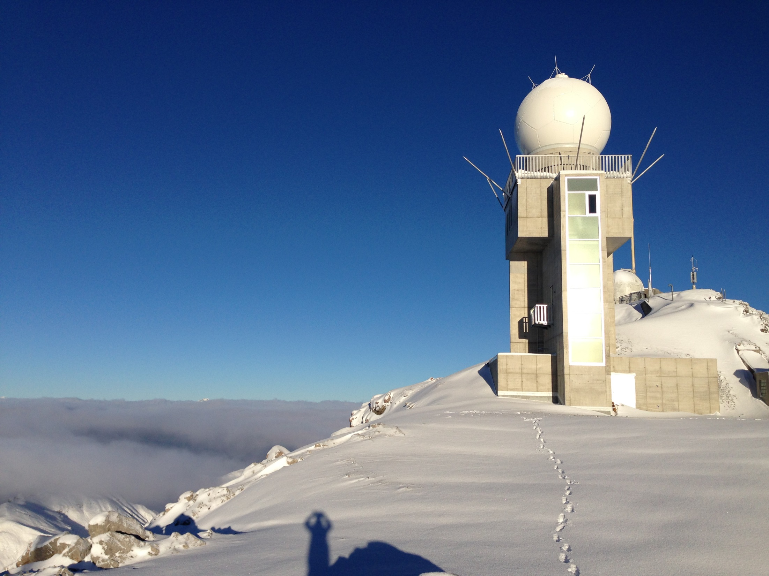
Thank you! Grazie mille! Moltes Gràcies! Merci!

