Slide 1




Modeling Alternative Inspection Protocols with FaultTree on R
12th IMA International Conference on
Modelling in Industrial Maintenance and Reliability
July 4-6, 2023
David J Silkworth
Vero Beach, Florida, USA djsilk@openrealiability.org

Slide 2

A word about OpenReliability.org
Currently developing in the R Statistical Programming environment.
WeibullR – Life Data Analysis in the Graphical Tradition of Waloddi Weibull
WeibullR.ALT – Accelerated Life Testing
wrg – Gamma distribution support for WeibullR
FaultTree
FaultTree.SCRAM – integration of analytics available with SCRAM
FaultTree.widget – Generation of HTML widgets (for dislplay in RStudio)
Stosim – Stochastic Simulator for Reliability Analysis
dem – Discrete Event Modeler
David J Silkworth
Vero Beach, Florida, USA djsilk@openrealiability.org

Slide 3
Latency
The identification of latency is perhaps one of the most valuable contributions to safety and reliability engineering.
Latent component events are characterized by hidden failures (or faults).
Hidden failures represent conditions under which additional failures may combine to propagate system failure, or undesired events.
Only an inspection protocol can permit the correction of hidden failures.

Slide 4
Reliability Theory Inspection and Remediation
https://raw.githubusercontent.com/openrelia/ModelingAlternativeInspections/Inspection.r
Notes:
It is well known that the application of an inspection and repair protocol must be established to reveal such failures that would otherwise remain unknown. According to established reliability theory such hidden failures may occur at any time over the interval between inspections according to our best understanding of the failure probability distribution. Very often the exponential distribution is used assuming random failure at constant rate.
A typical model of the probability of failure over time reveals a triangular, or “sawtooth”, distribution.
For reliability considerations it is common to take an averaged probability into evaluations. Sometimes the maximum probability of failure might be specified for consideration of particularly hazardous outcomes,. For purposes of this evaluation an averaged probability calculation will be utilized, which is a default with FaultTree.

Slide 5
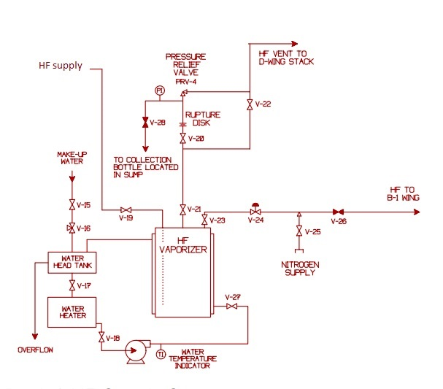
Example System
DOE Handbook [for] Chemical Process Hazards Analysis” (DOE-HDBK-1100-2004).
Notes:
It is often the case that evaluation is made on a system or device that must be decommissioned for inspection. So prevalent is this type of inspection that system evaluation may not consider varied types of inspection that can be performed, at varying degrees of completeness and varying degrees of cost. A simple system is exampled here that can be evaluated using varied intervals on varied inspections.

Slide 6
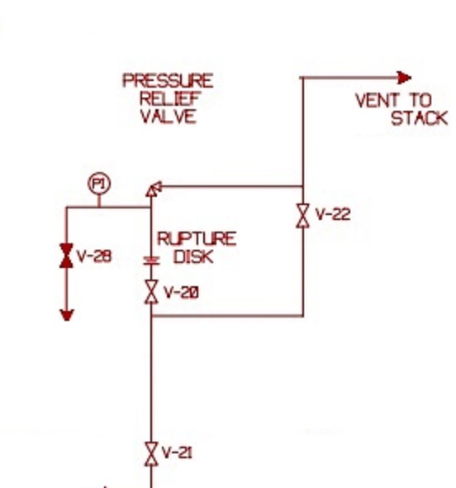
Focus of Attention
In this case latency is observed in the following places:
The primary function of the relief valve
Minute leakage in the rupture disk
Failure of the pressure gauge to accurately indicate pressure
- The manual position of the isolation valves V-20 and V-21
Notes:
The combination of rupture disk and relief valve is required in such corrosive service as HF gas. If the relief valve were not isolated in this way it would be subject to corrosion due to minute leakage through the safety valve seat permitting HF vapor to contact moist ambient air. However this required rupture disk will add risk to the performance of the entire pressure relief function. In particular it is somewhat likely that the rupture disk may form a pin-hole leak that will pressurize the piping inside V28, PRV4 and the rupture disk. Such a condition would render the rupture disk incapable of performing its required function upon process pressure increase. The relief valve would therefore not function as well.
These points of latency suggest a series of inspection steps that could be administered at varied intervals according to cost or ease of carrying out the inspection.

Slide 7
rv_test-The relief valve will be sent out for bench test and any required reconditioning. pi_test- verification is made of the pressure gage integrity walk-by- Log the pressure indicated on the pressure gauge and make note of the position of the isolation valves V20 and V21.
Modeled Inspections
Notes:
rv_test
This is a rather expensive test that must be done while the system has been decommissioned, likely for other extensive maintenance. Relief valve PRV4 will be replaced with a new or reconditioned valve. The old valve will be sent out for bench test and any required reconditioning. Upon restoration of the system a pi_test and walkby will also be completed.
pi_test
This test involves applying a modest pressure of nitrogen through a connection at V28. During this test verification is made of the pressure gage integrity. It is also likely that some disposable testing device might be used to verify that no leakage of HF gas is occurring through the rupture disk. Upon completion of a pi_test a walkby will also be completed.
walk-by
This easiest test requires no intervention on the system other than possible call for remediation. The operator/inspector will log the pressure indicated on the pressure gauge and make note of the position of the isolation valves V20 and V21.

Slide 8
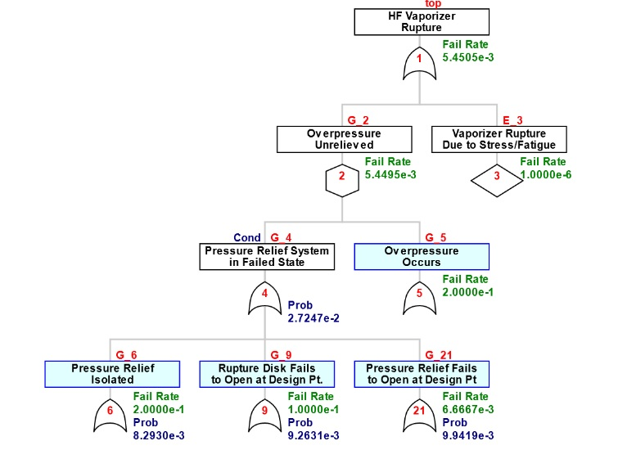
Fault Tree Construction
https://github.com/openrelia/ModelingAlternativeInspections/blob/main/hf.r
Notes:
Construction of a fault tree for undesired vaporizer loss of containment will incorporate t the effect of the latent elements.

Slide 9
FaultTree Scripting
hf<-ftree.make(type="or", name="HF Vaporizer", name2="Rupture")
hf<-addLogic(hf, at=1, type="inhibit", name="Overpressure", name2="Unrelieved")
hf<-addDemand(hf, at=1, mttf=1e6, name= "Vaporizer Rupture", name2="Due to Stress/Fatigue")
hf<-addLogic(hf, at=2, type="or", name="Pressure Relief System", name2="in Failed State")
hf<-addLogic(hf, at=2, type="or", name="Overpressure", name2="Occurs")

Slide 10
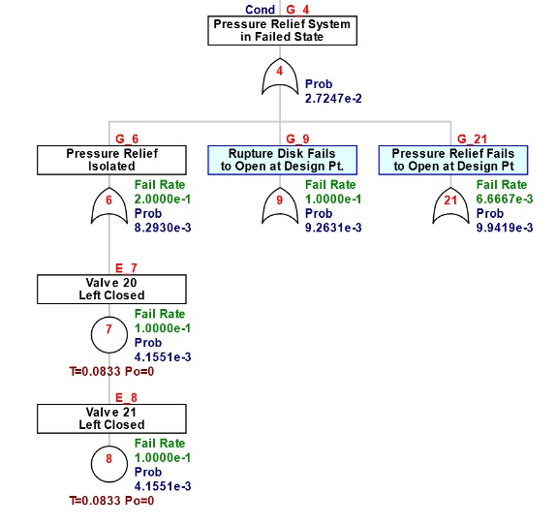
Latency Scripting - walkby
walkby=1/12
hf<-addLatent(hf, at=6, mttf=10, inspect=walkby, name="Valve 20", name2="Left Closed")
hf<-addLatent(hf, at=6, mttf=10, inspect=walkby, display_under=7, name="Valve 21", name2="Left Closed")

Slide 11
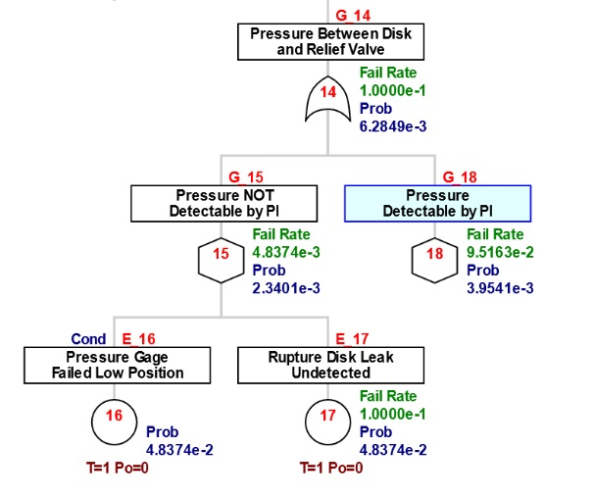
Latency Scripting – pi_test
pi_test=1
hf<-addLatent(hf, at=15, mttf=10, inspect=pi_test, name="Pressure Gage", name2="Failed Low Position")
hf<-addLatent(hf, at=15, mttf=10, inspect=pi_test, name="Rupture Disk Leak", name2="Undetected")

Slide 12
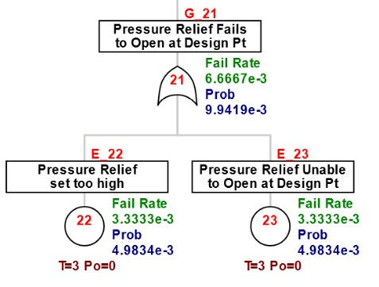
Latency Scripting – rv_test
rv_test=3
hf<-addLatent(hf, at=21, mttf=300, inspect=rv_test, name="Pressure Relief", name2="set too high")
hf<-addLatent(hf, at=21, mttf=300, inspect=rv_test, name="Pressure Relief Unable", name2="to Open at Design Pt")

Slide 13
Scripting Multiple Inspection Protocols
rv_test<-c(3,3,3,2,1,2,1)
pi_test<-c(3,1,1/12,1/12,1/12,1/52,1/52)
walkby<-c(3,1/12,1/52,1/52,1/52,1/52,1/52)
cases<-cbind(rv_test,pi_test,walkby)
mttf<-NULL
CFRat14<-NULL
for(case in 1:nrow(cases)) {
rv_test<-cases[case,1]
pi_test<-cases[case,2]
walkby<-cases[case,3]
https://raw.githubusercontent.com/openrelia/FaultTree.gallery/master/scripts/tutorial_scripts/hf_cases.r
Notes:
Because FaultTree is a package running in the R environment it is relatively easy to generate multiple fault tree calculations in a programmed loop. In this case multiple inspection durations are listed in vectors, then bound into a matrix that can be accessed within the loop.

Slide 14
Scripting Multiple Inspection Protocols
hf<-ftree.calc(hf)
mttf<-c(mttf,1/ hf$CFR[1])
CFRat14<-c(CFRat14, hf$CFR[14])
} # closure of for loop
cases<-cbind(cases, mttf, CFRat14)
> cases
rv_test pi_test walkby mttf CFRat14
[1,] 3 3.000 3.000 13.8 0.1
[2,] 3 1.000 0.083 183.4 0.1
[3,] 3 0.083 0.019 317.0 0.1
[4,] 2 0.083 0.019 400.3 0.1
[5,] 1 0.083 0.019 543.8 0.1
[6,] 2 0.019 0.019 400.7 0.1
[7,] 1 0.019 0.019 544.6 0.1
https://raw.githubusercontent.com/openrelia//ModelingAlternativeInspections/hf_cases.r
Notes:
The final result is a table of results providing insight as to the effectiveness of each inspection.

Slide 15
Closing Thoughts – Design for Reliability
Inspection opportunities need to be sought out early in a system design.
Often particular assets must be added to the system that enable certain tests without system interruption.
Costs of inspections can vary depending on staffing resources.
At times we have considered instrumenting systems to provide data on protective system performance so as to consider a response to demand to be an inspection.

Slide 16
Closing Thoughts – Using FaultTree on R
Using a fault tree application that resides within the R statistical computing environment facilitates unique techniques for automating alternative tree inputs and summarizing results.

