Slide 1
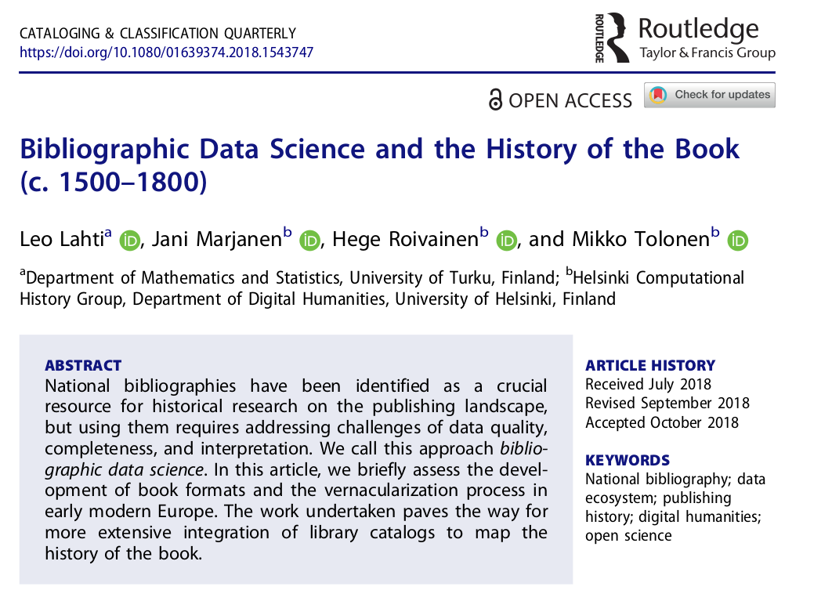

Slide 2
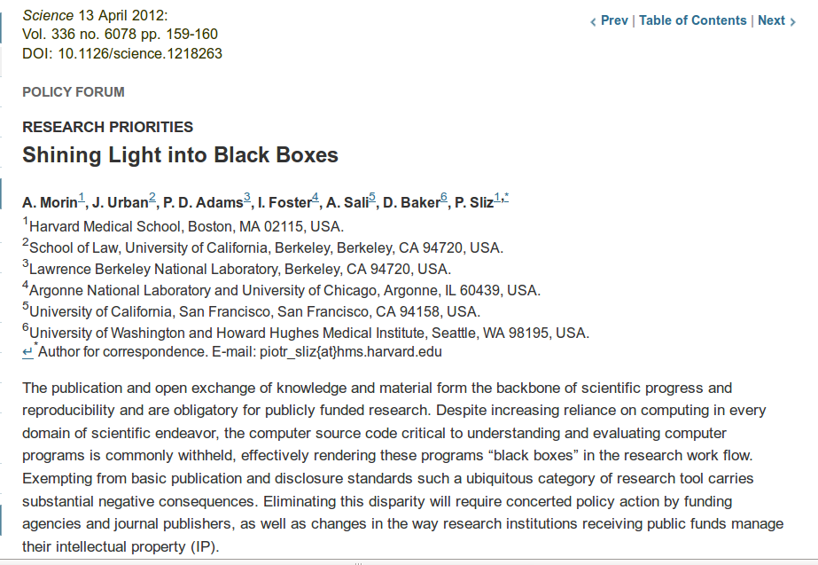


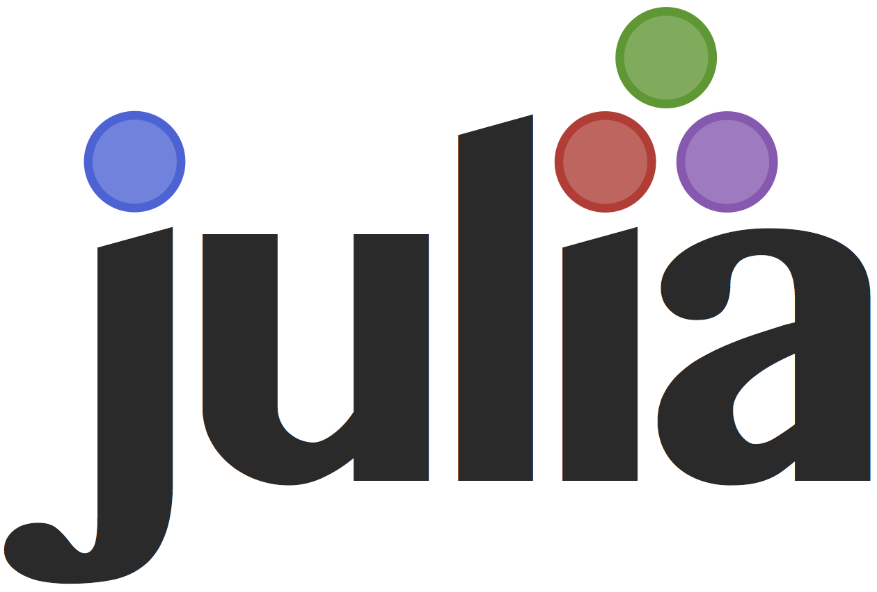
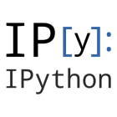
Computational workflows have now increasingly central role in research: challenge & opportunity
1) data gathering and storage
2) access, documentation
3) harmonization & enrichment
4) quality control
5) custom analysis tools and workflows
6) reporting & dissemination
R for Data Science / H. Wickham

Slide 3
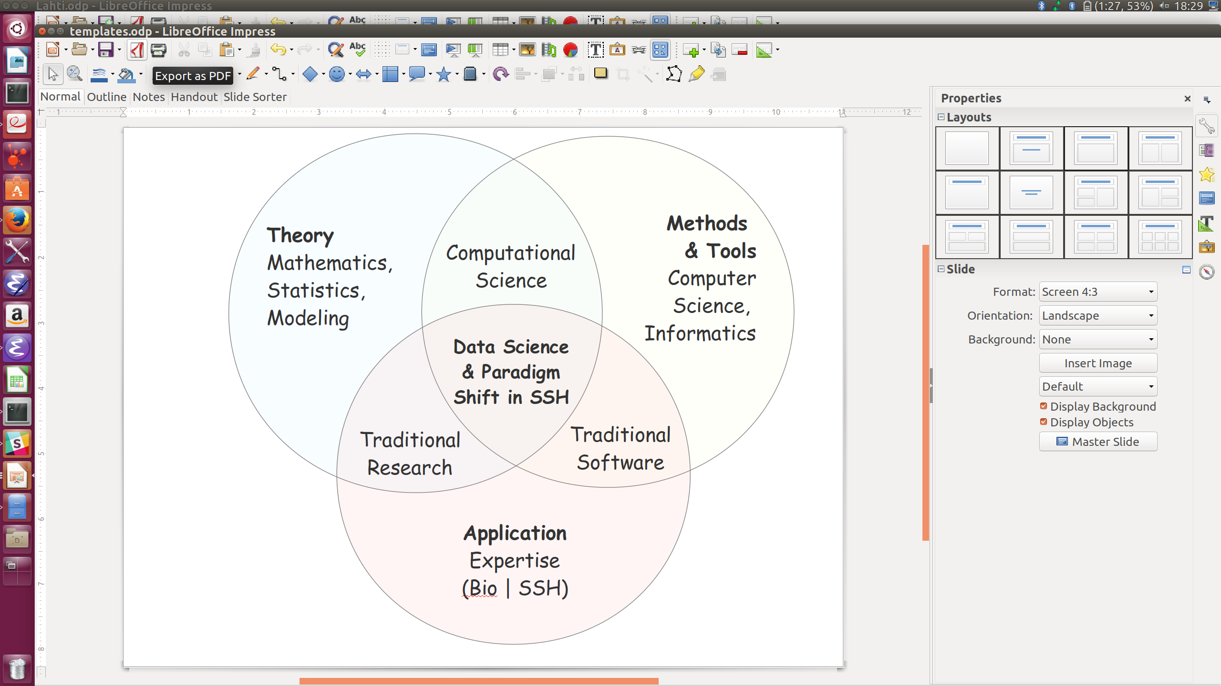
Data science as a melting point of many fields
<number>/36

Slide 4

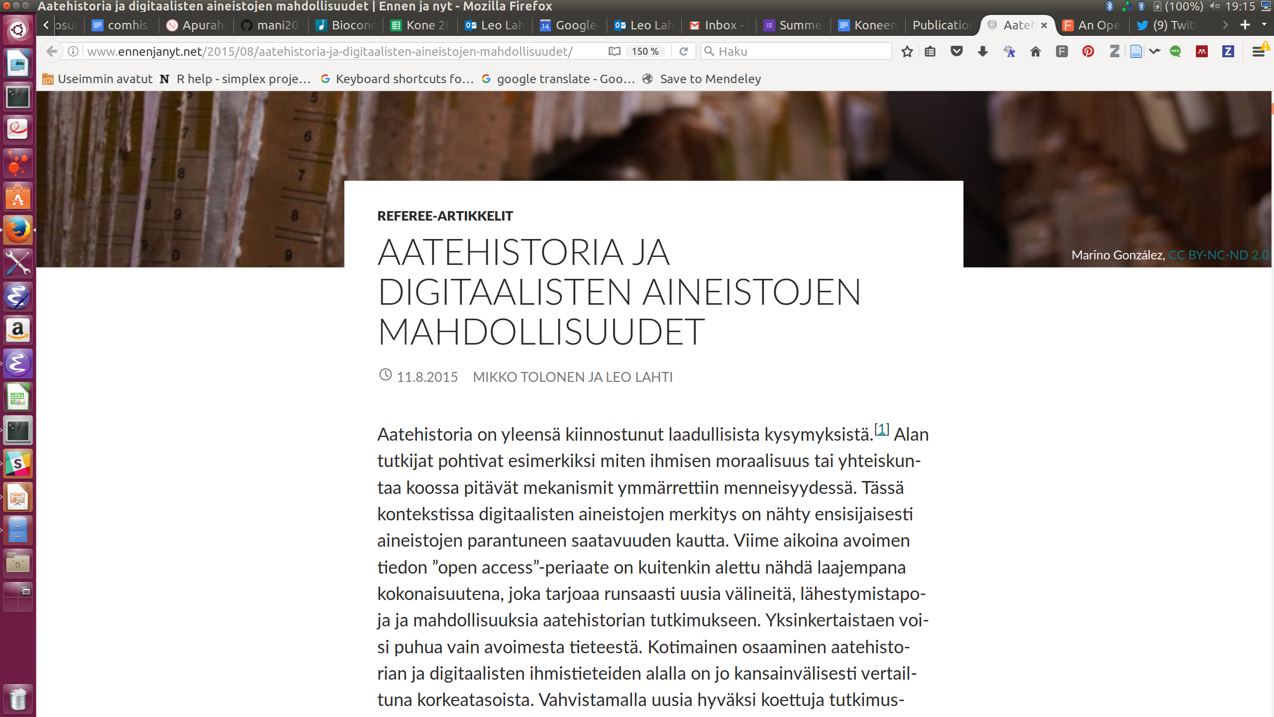
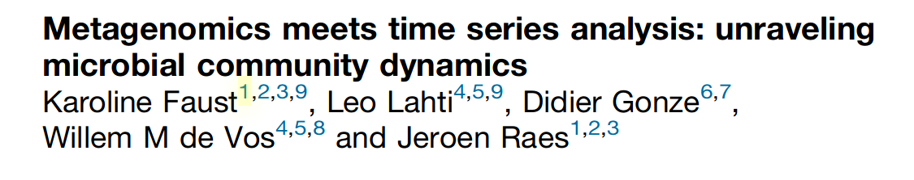
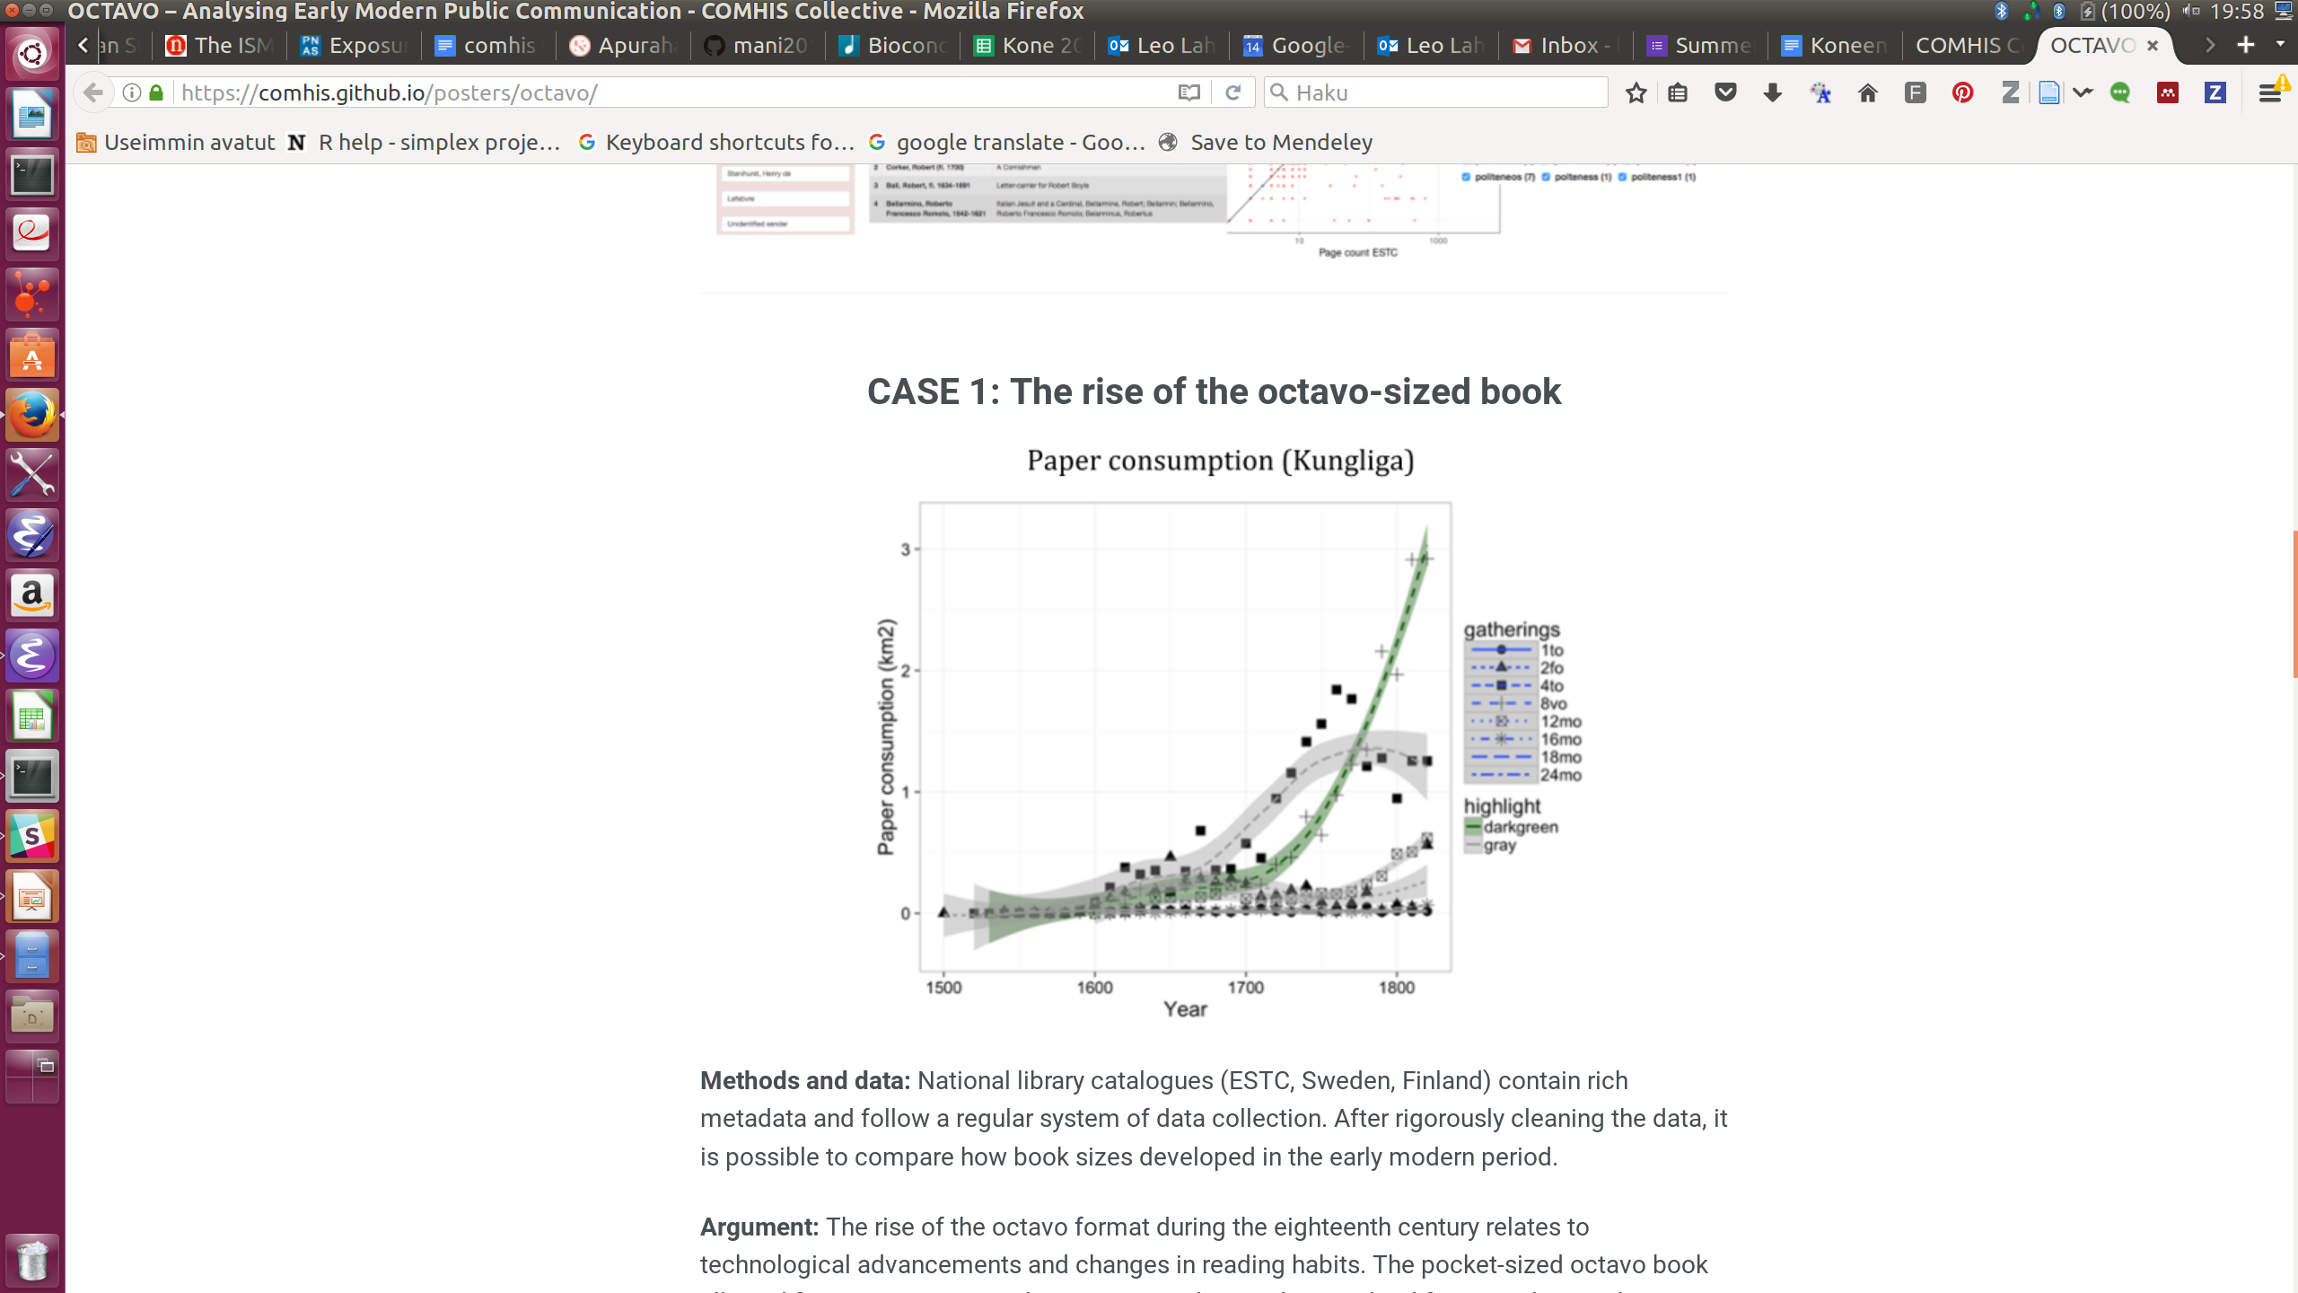
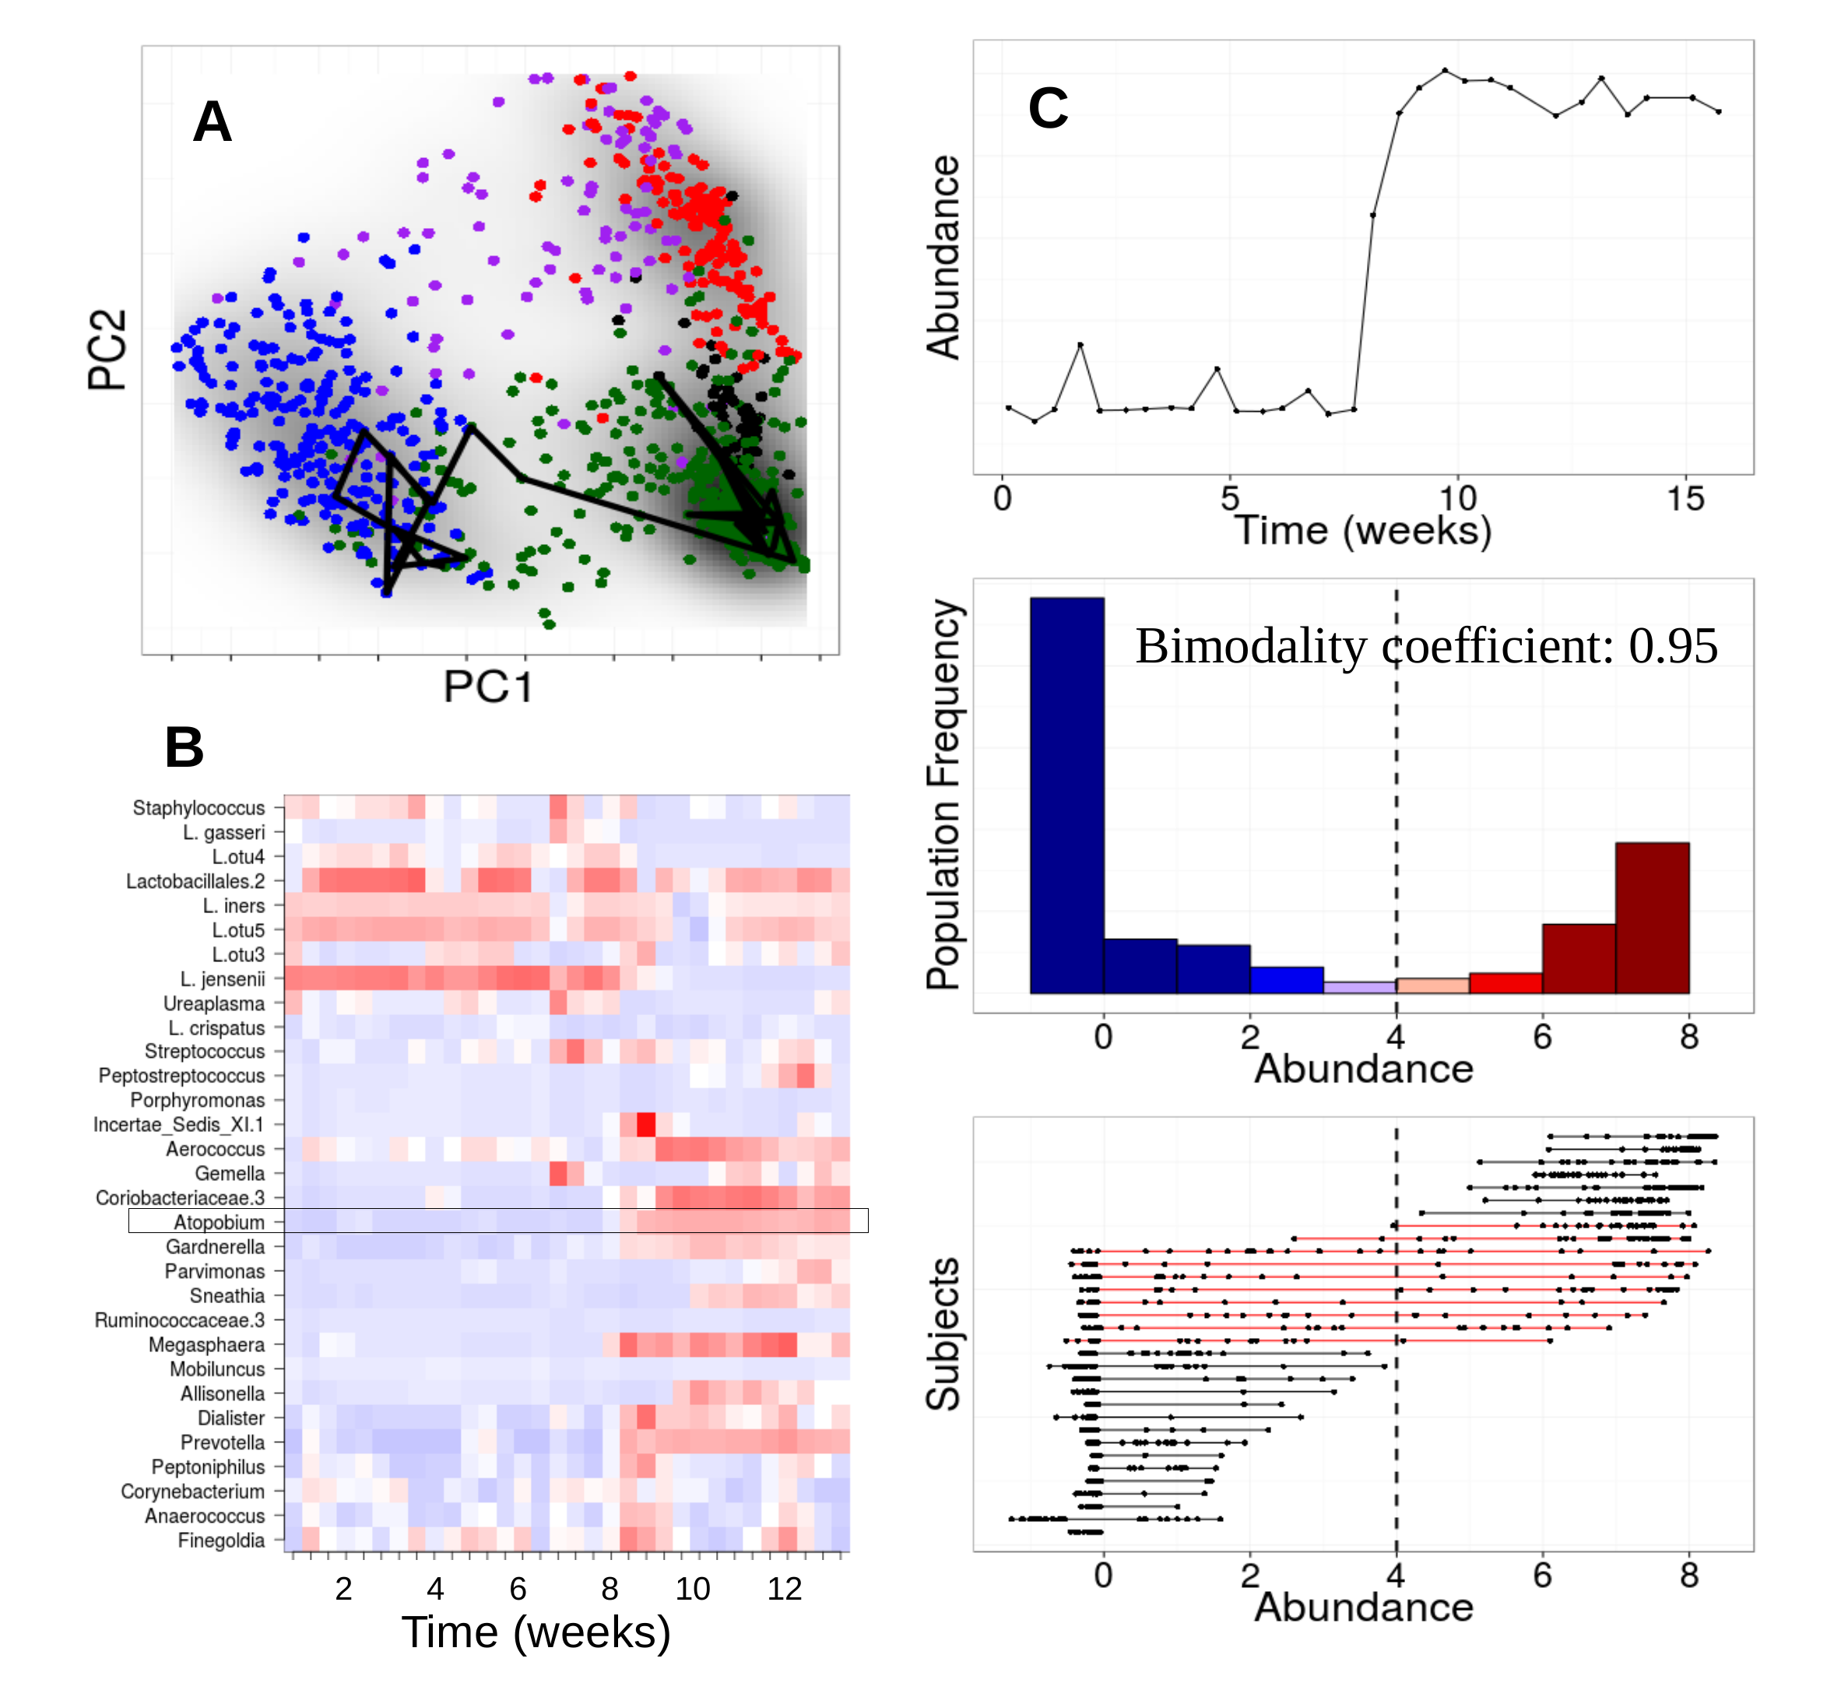
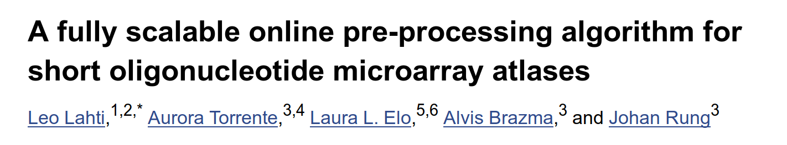
Bioinformatics
Digital Humanities
Ecosystems, Genomics,
Microbiomics,
Large population studies
<number>/36

Slide 5
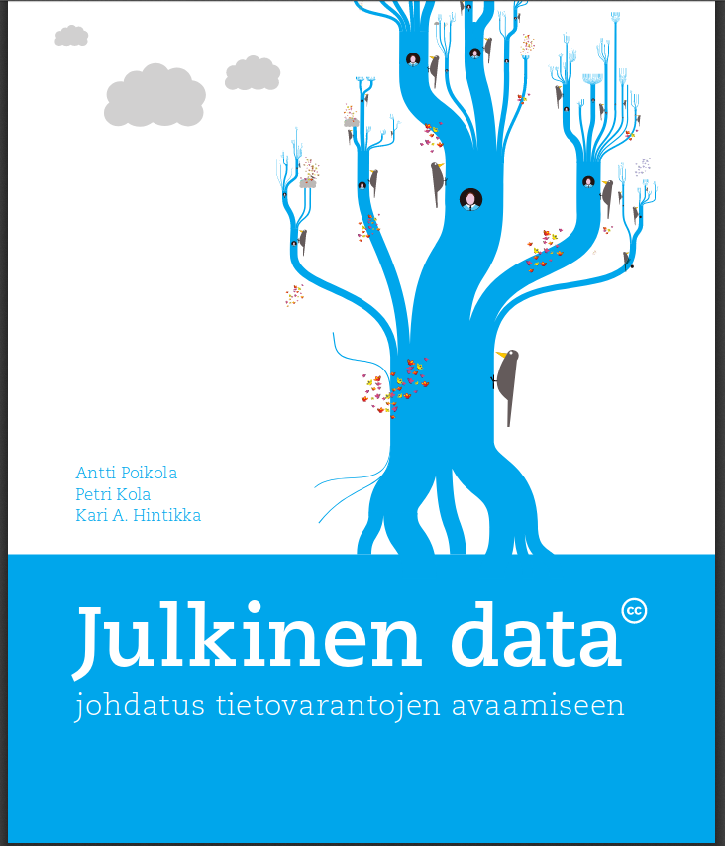

Slide 6
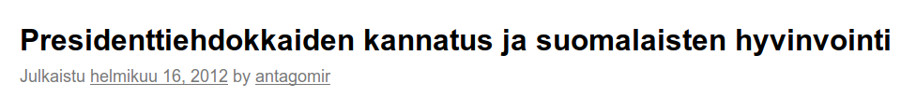
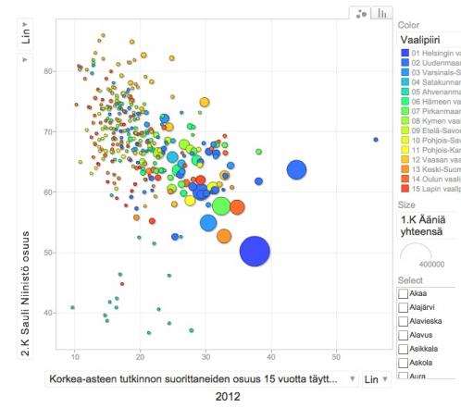
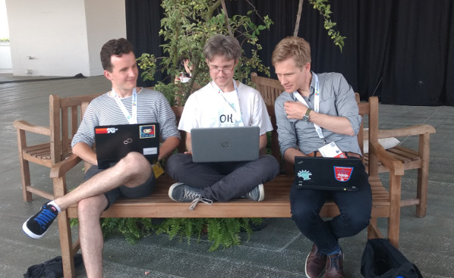
louhos.wordpress.com
Data:
- Land Survey Finland
- Statistics Finland
- YLE / HS
<number>/36

Slide 7
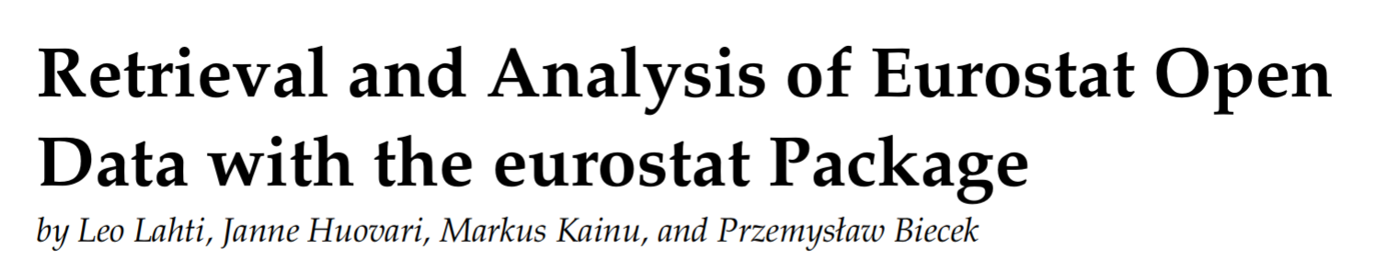

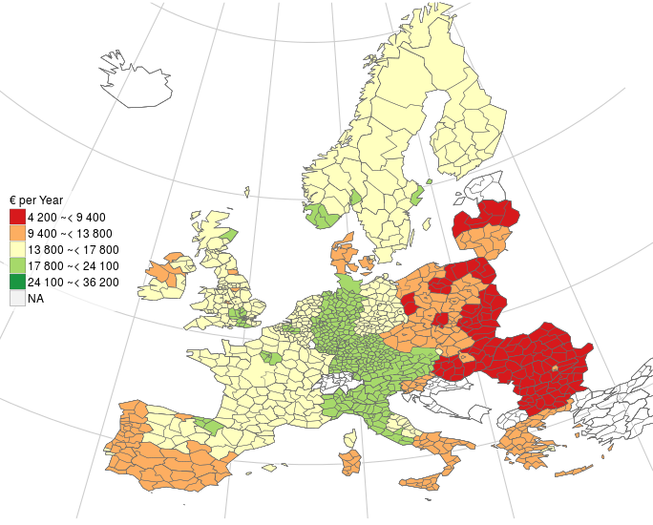
Eurostat open data: average household expenditure in 2011
International network for open government data analytics
- 20+ R packages
- 100k+ downloads
- open collaboration
(C) EuroGeographics for the administrative boundaries
<number>/36

Slide 8
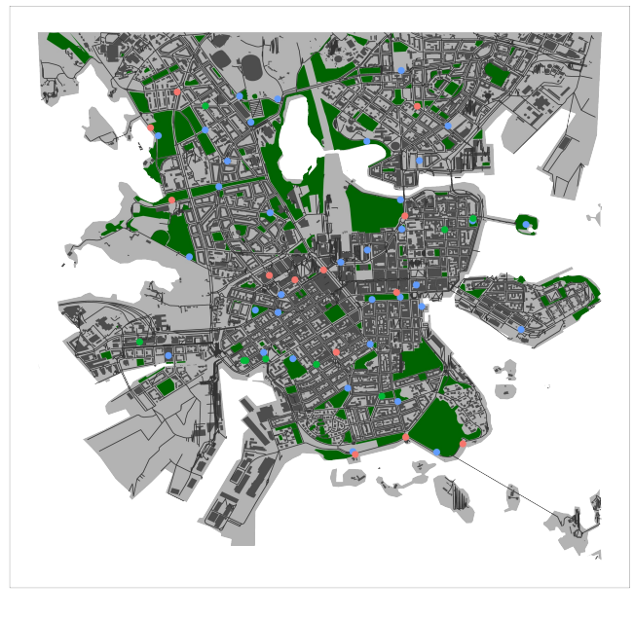
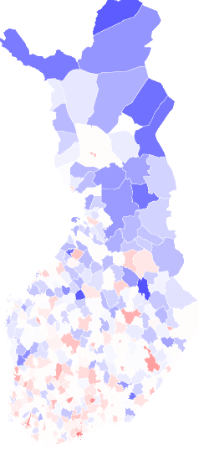





From specific packages to package ecosystems
Open Street Map
Helsinki (osmar)
Algorithms for open data
in Finland
KELA Open
Data & Methods?
Weather
(fmi)
Geospatial
(gisfin, osmar)
Health
(sotkanet)
Registers etc.
(finland)
Statistics
(pxweb)
pxweb for PX-Web/PC-Axis data
from stats authorities in: Denmark,
Finland, Greenland, Iceland, Latvia,
Norway, Sweden.. world bank, FAO
Cities
(helsinki)
<number>/36

Slide 9
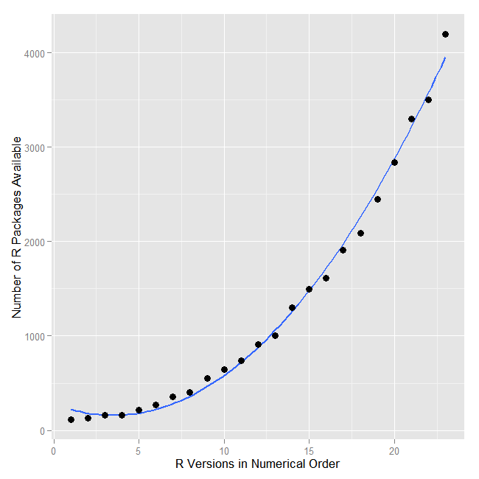





Number of open analysis tools has grown exponentially
Value of data can increase through sharing & use
<number>/36

Slide 10
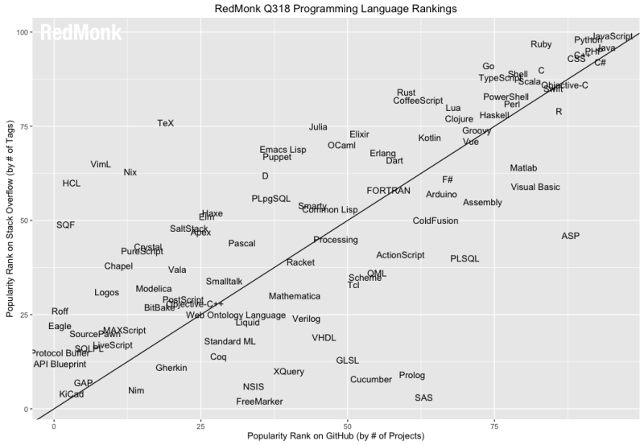
Varying cultures of open collaboration

Slide 11
Elements of bibliographic data science
Quantitative frame for qualitative research
Beyond counting titles (volume, time, geography…)
Bibliographic
metadata
Open data science ecosystem
Full texts: books,
newspapers...
Supporting data
R for Data Science / H. Wickham
<number>/36

Slide 12
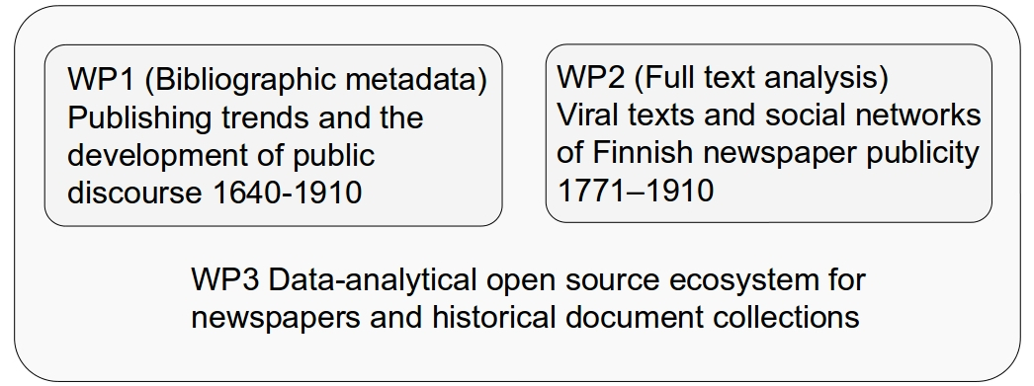
Academy of Finland COMHIS consortium 2016-2019
University of Helsinki, University of Turku, National Library of Finland
Quantify early-modern knowledge production with massive bibliographic collections, full texts, and open data analytical infrastructure
<number>/36

Slide 13
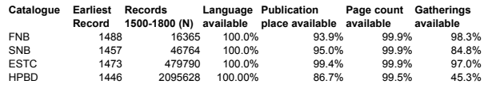
Data: library catalogues
FNB (Fennica)
Finnish National bibliography
>900,000 books and monographies (printed and electronic) since 1488
>70,000 continuous publications (journals or series) since 1771
Series, maps, audiovisual, and electronic material
Open data
SNB (Kungliga)
Swedish National bibliography
>18 million entries
ESTC
British Library
> 500,000 entries
Heritage of the printed book database (CERL/HPBD)
Göttingen.
>2M entries 1470-1800
>6M entries total
<number>/36

Slide 14
<number>/36

Slide 15
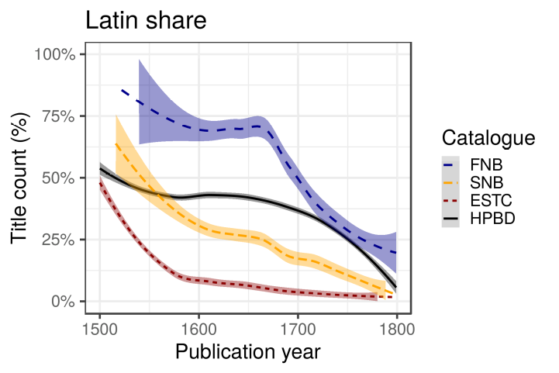
Title count share for books in Latin (primary language)
<number>/36

Slide 16
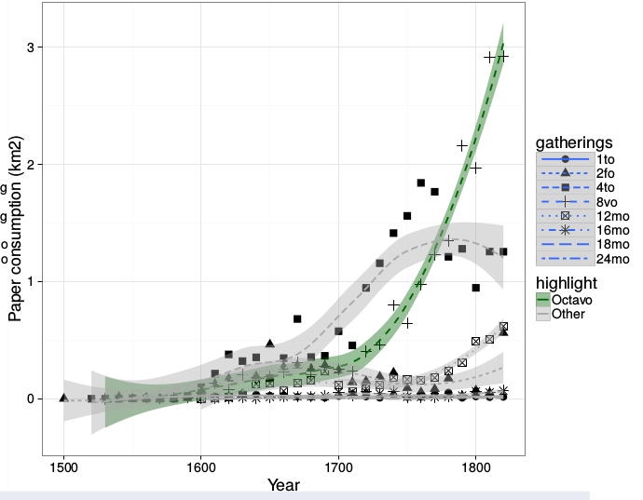
The rise of Octavo: paper consumption
SNB
<number>/36

Slide 17
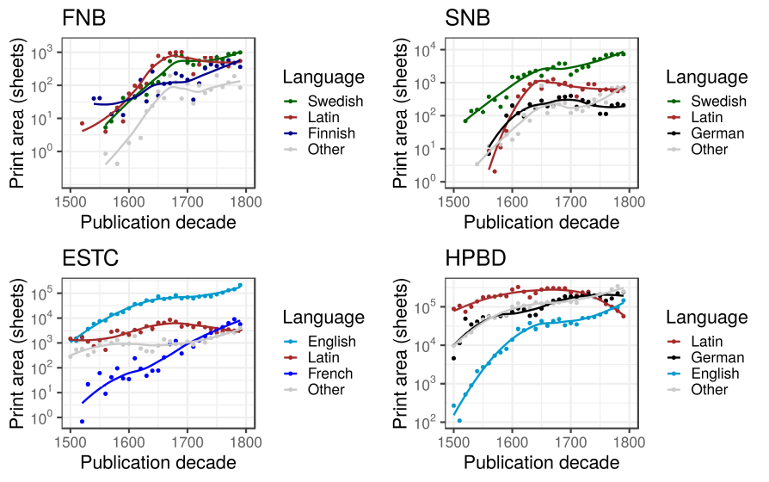
Print area for top languages
Fig 4. Changes in print area over time. The most common language from each catalogue are included.
<number>/36

Slide 18
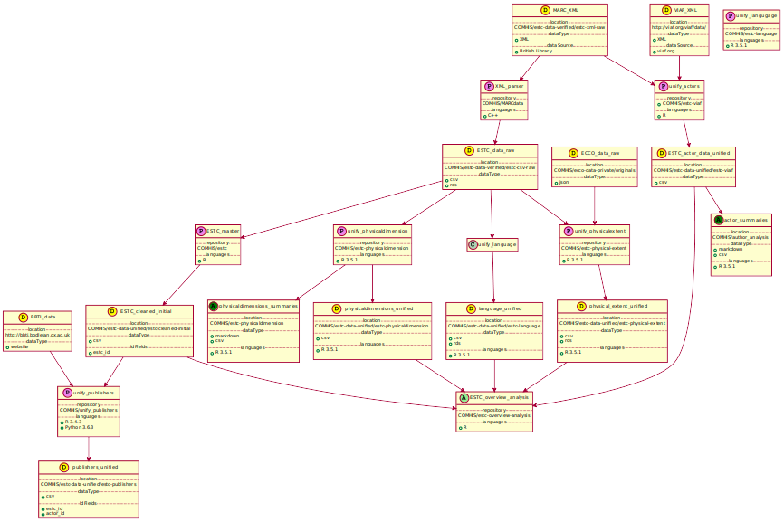
Linked data science
Authors (Mark Hill)
Publishers (Ville Vaara)
Editions (Ali Ijaz)
Publication place (Iiro Tiihonen)
Gatherings
Page count
Language
Genre...
Data → Standardization → Validation → Integration → Analysis
<number>/36

Slide 19
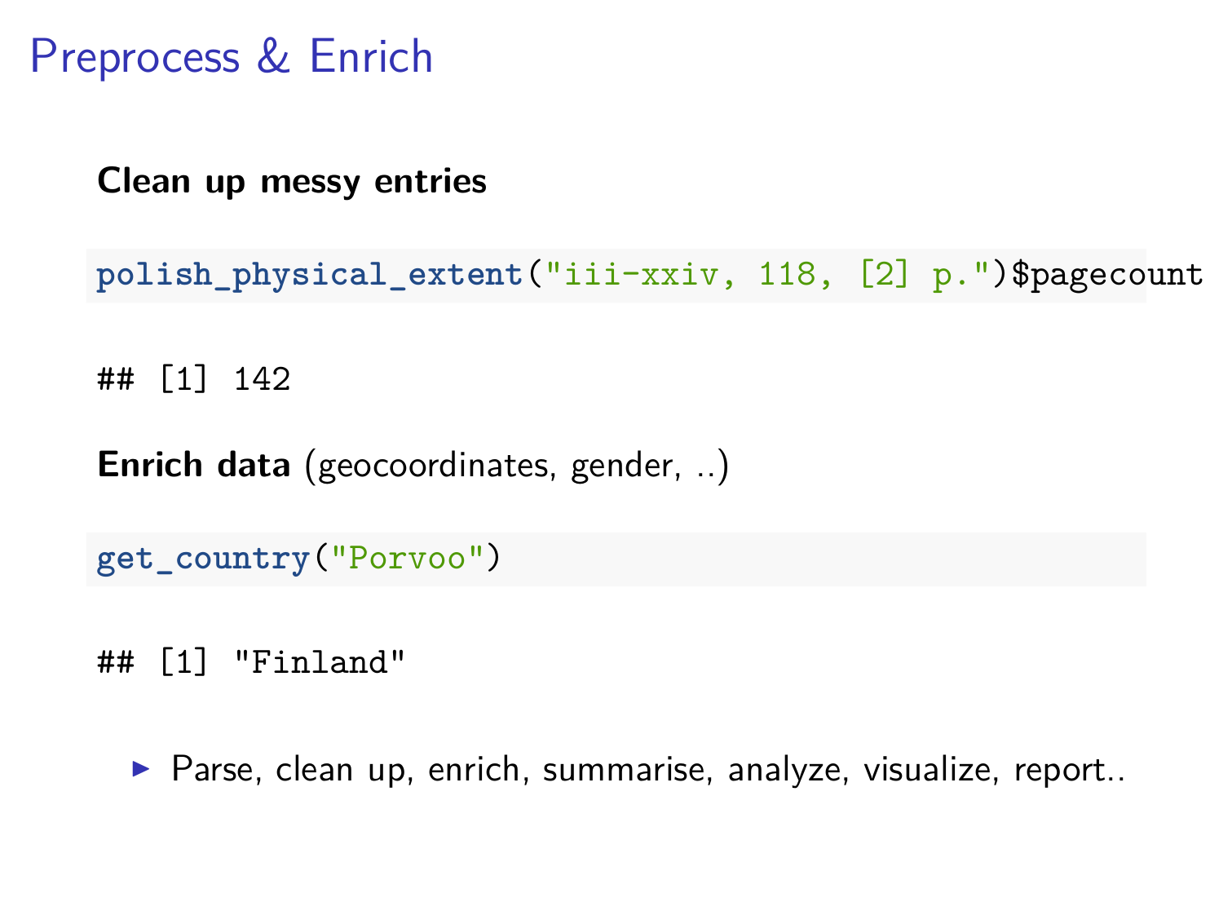

Slide 20
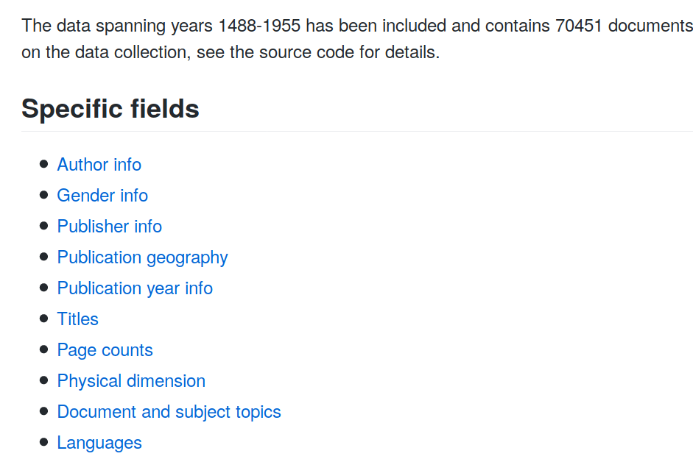
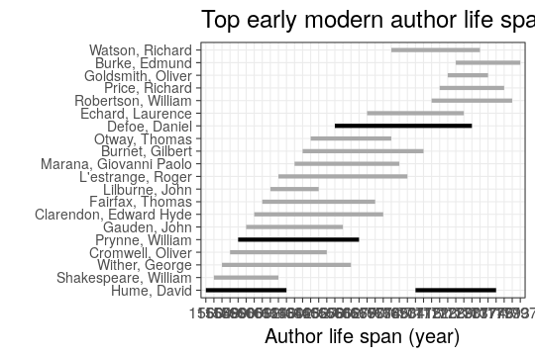
Automated summaries for the unified data

Slide 21
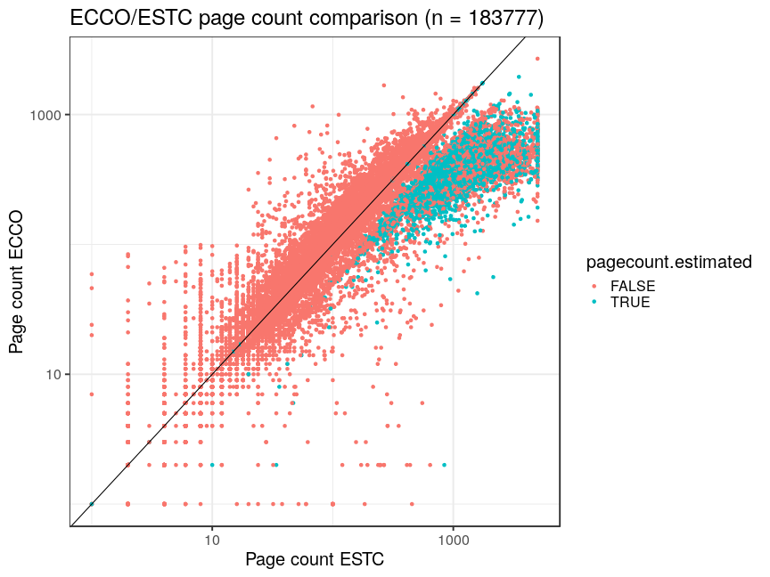
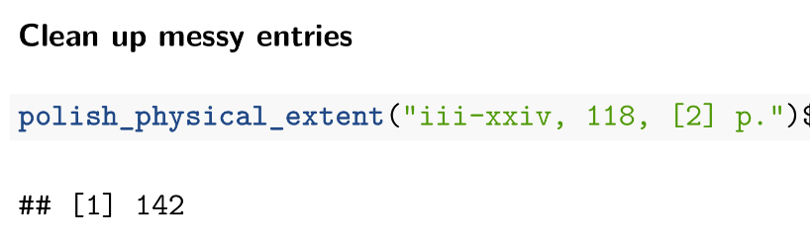
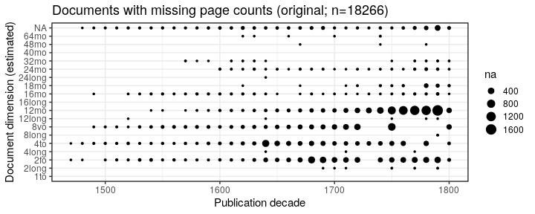
Validation: page count (ECCO vs. ESTC)

Slide 22
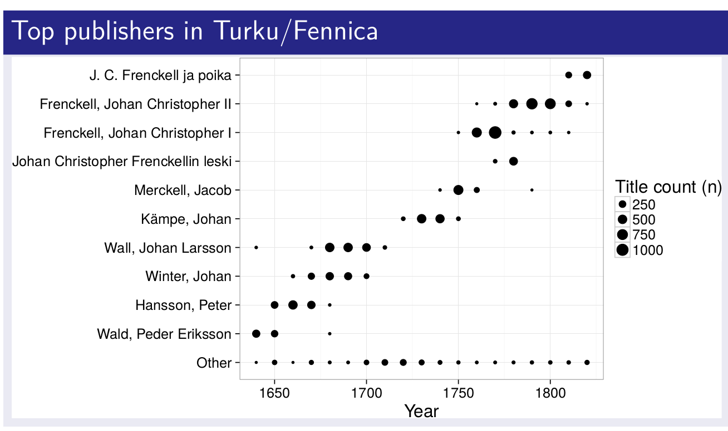
Library metadata as research object
Author & publisher networks
Spatio-temporal dynamics
History, philosophy, religion, science..
<number>/36

Slide 23

Data Analysis
Data Preprocessing

Slide 24
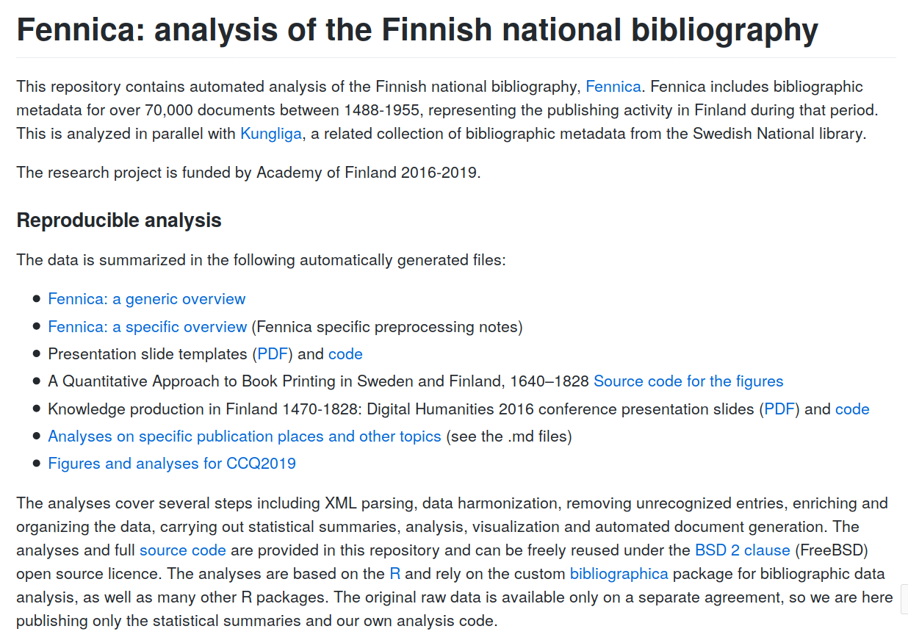
github.com/COMHIS/fennica

Slide 25
Open methods development
can complement FAIR data sharing
Data
Methods
Access
Tidy
Analyze
Model
Open research software
Enrich
Harmonize
Validate
Integrate
Wrangle
Explore
Visualize
Report
Hypotheses
<number>/36

Slide 26
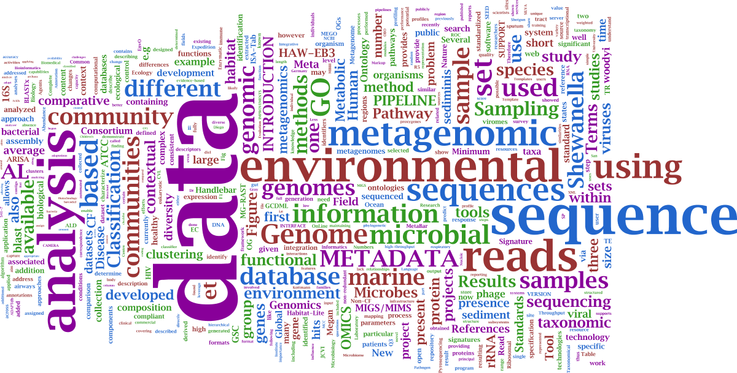

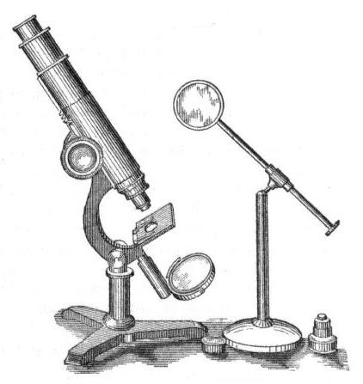
Hypothesis testing vs. hypothesis discovery?
?
Hypothesis
Method
Data
Tools

Slide 27
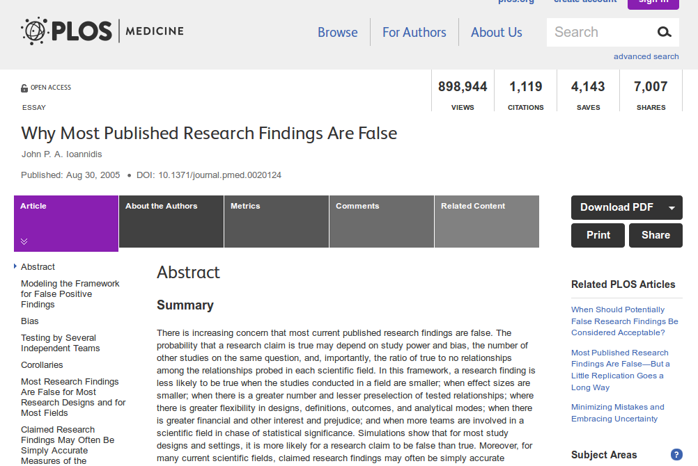

<number>/36

Slide 28
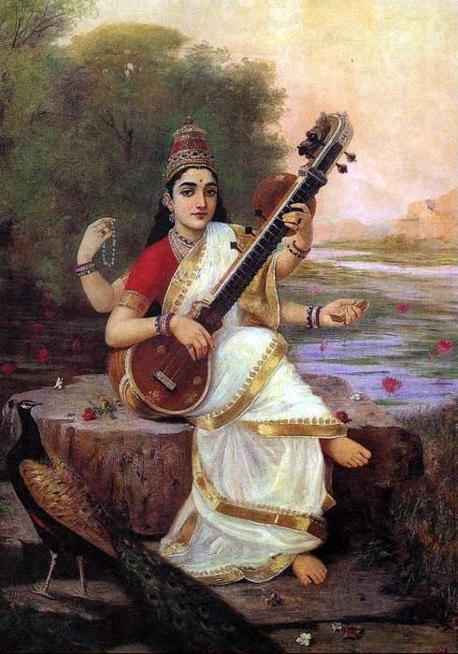

From Data to Knowledge
Wisdom
Knowledge, understanding
Information, facts
Observations, Data
<number>/36

Slide 29
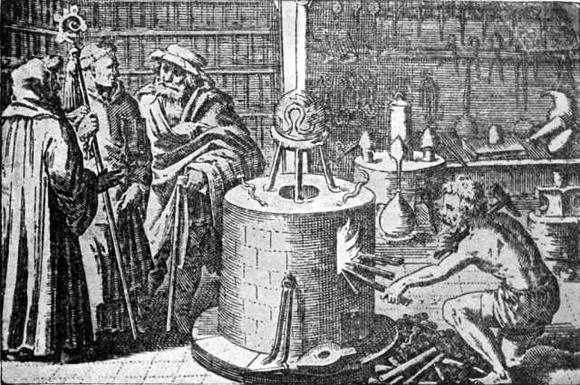
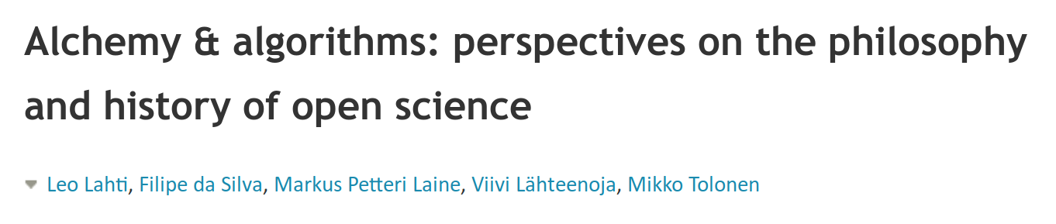
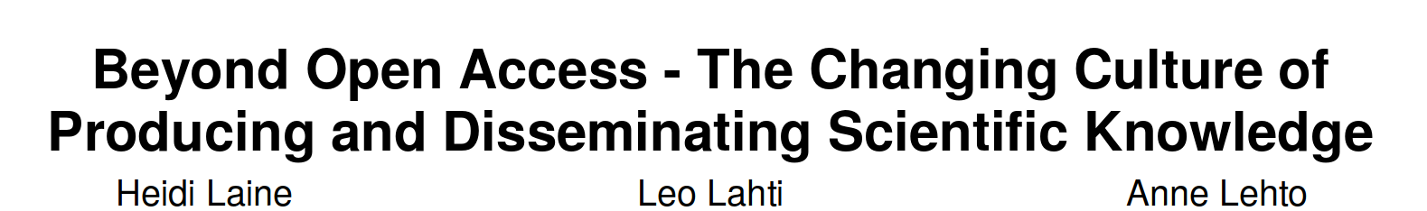
Transparent reporting and communication were part of academic culture since the early days
Source: Wikimedia Commons / Public domain
<number>/36

Slide 30
Key modes of academic publishing
 | Subscription | Open access
Novelty | Traditional | Rapidly growing
Access | Behind paywall | Open for ‘all’
Licensing | Proprietary licenses | Open access licenses
Who pays ? | Library (or reader) pays | Researcher pays
Pricing information | Confidential pricing | Open pricing
Publishing costs for a researcher | ‘Free’ to publish | ‘Expensive’ APCs (0-5000e/pub)
<number>/36

Slide 31
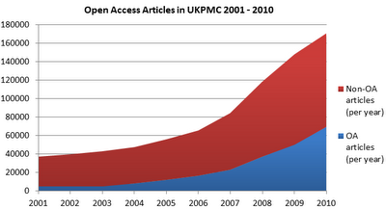
Dramatic growth in open access publishing 2001-2010
Out of ~35 000 peer-reviewed academic journals (Ware & Mabe, 2015) less than a third (11 000) are open access (DOAJ, 2016).
<number>/36

Slide 32
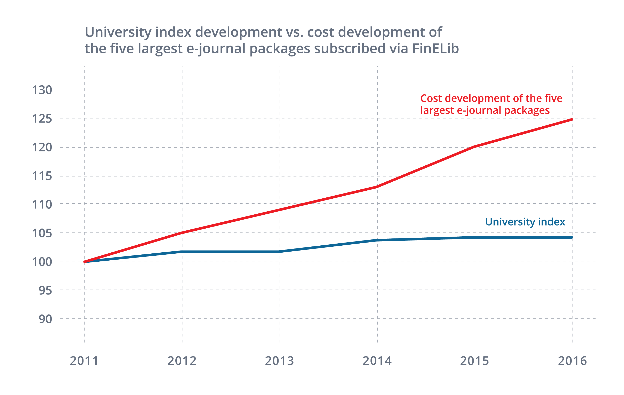
Costs for the top-5 journal packages increased 25% while university funding nearly unaltered
(Finland 2011-2016)
Rapidly increasing prices form a bottleneck for research
Source: https://www.kiwi.fi/pages/viewpage.action?pageId=64487647#What%27sgoingonwithscholarlyjournalnegotiations?-Accesstoscholarlyjournals%E2%80%93atwhatcost?(19.9.2016)
<number>/36

Slide 33
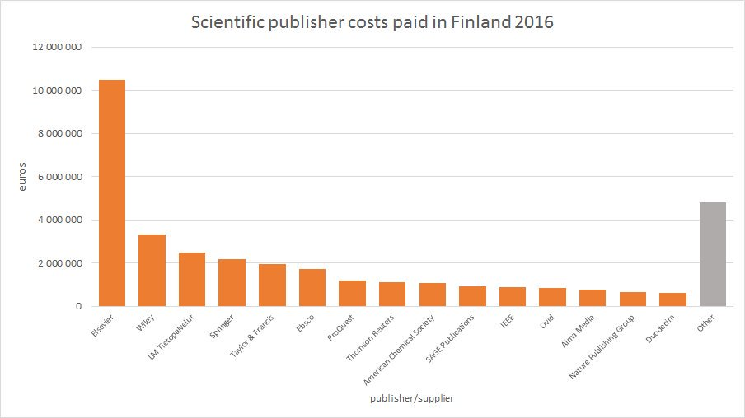
In 2016, Finland paid ~30 million euros to access academic journals. Third of this went to Elsevier, which has reported 30-40% profit margins.

Slide 34
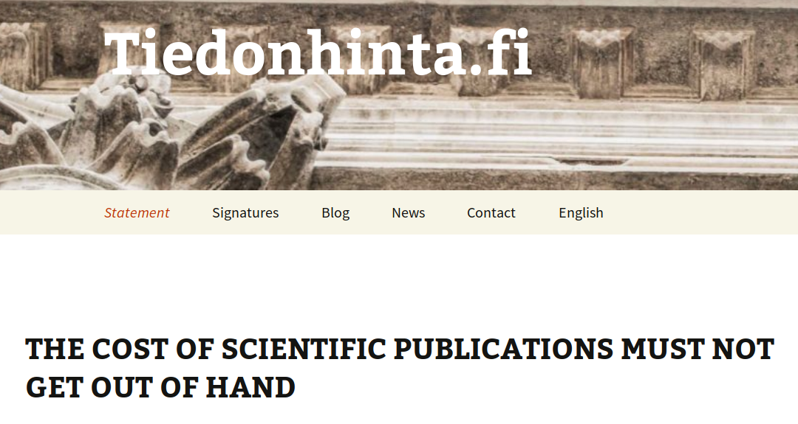
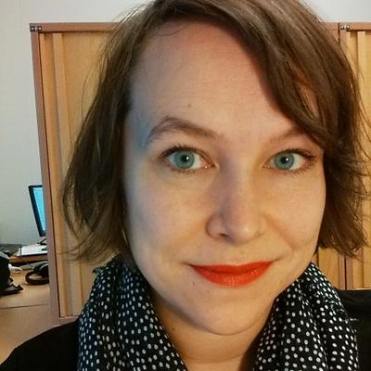
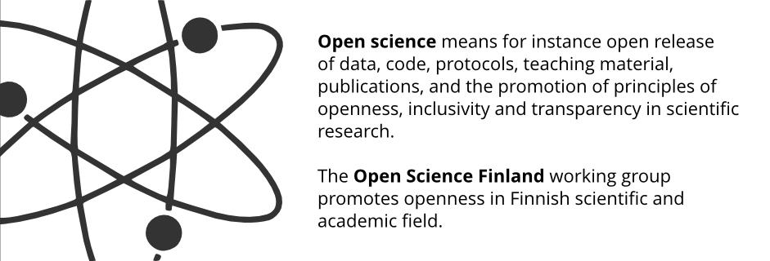
Heidi Laine
<number> / 36

Slide 35
Elements of open data science
Open
Collaboration
Open
Data
Open
Methods
L Lahti. Advances in Intelligent Data Analysis XVII. Springer, 2018.
<number>/36

Slide 36
Potential of data science in SSH research?
- New methods, classical questions
- Entirely new scales of quantitative analysis
- Transparent conclusions
- Quality through collaboration
Pitfalls of data science in SSH research?
- Data quality overlooked
- Expertise lacking
- Tools drive research
- Unrealistic expectations

