Slide 1
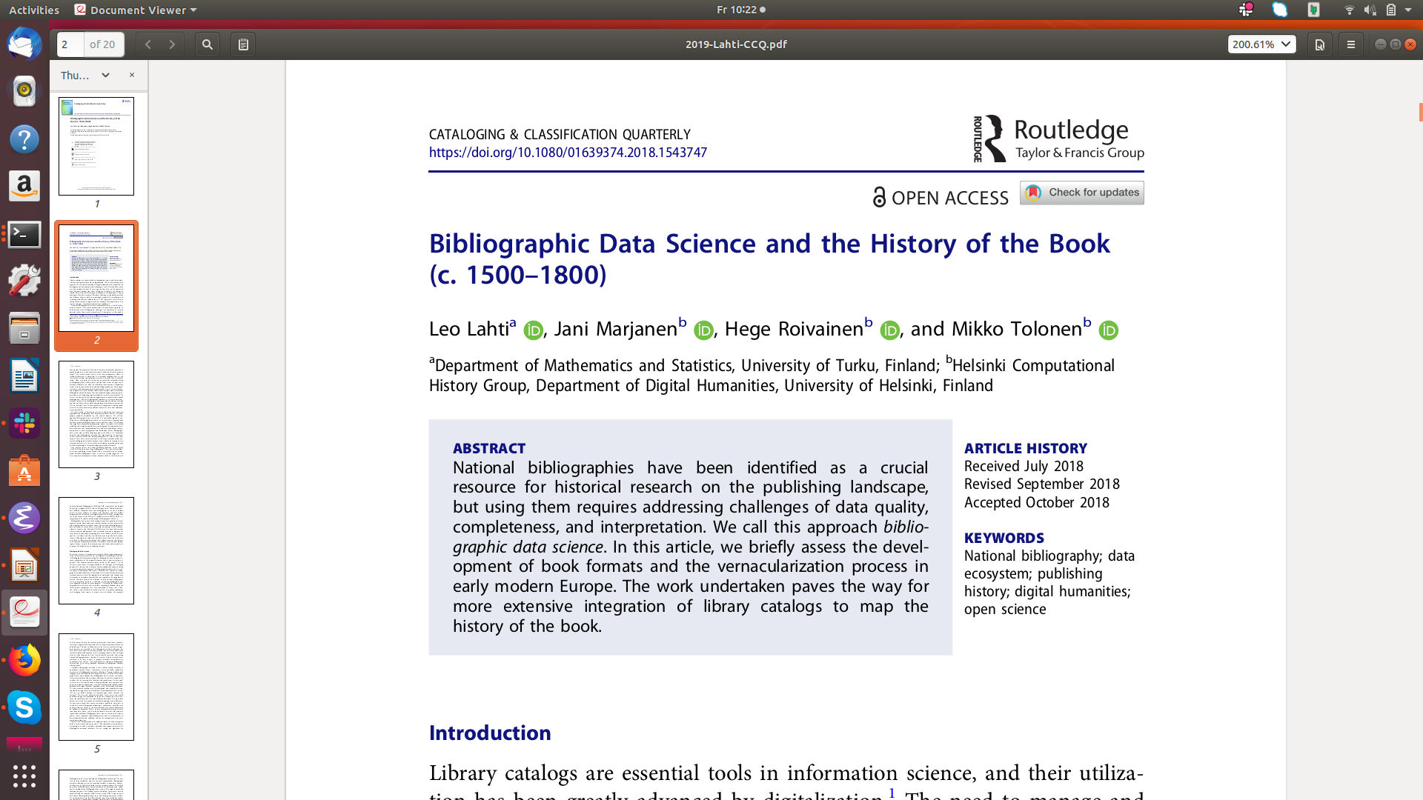

Slide 2
Helsinki
Computational
History
Group https://comhis.github.io/
Computer scientists researching open workflows, algorithms and interfaces for humanities text and metadata
Linguists exploring the relationship between words and concepts
Historians interested in conceptual and actual historical processes

Slide 3
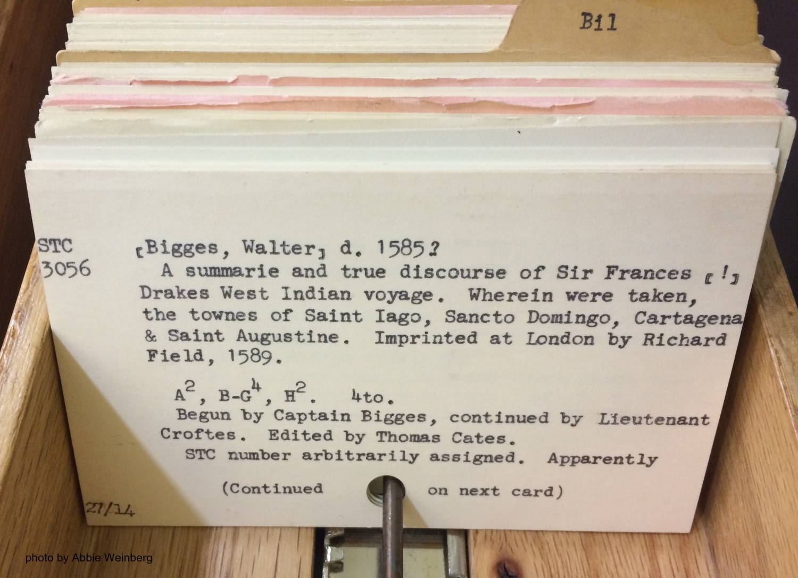
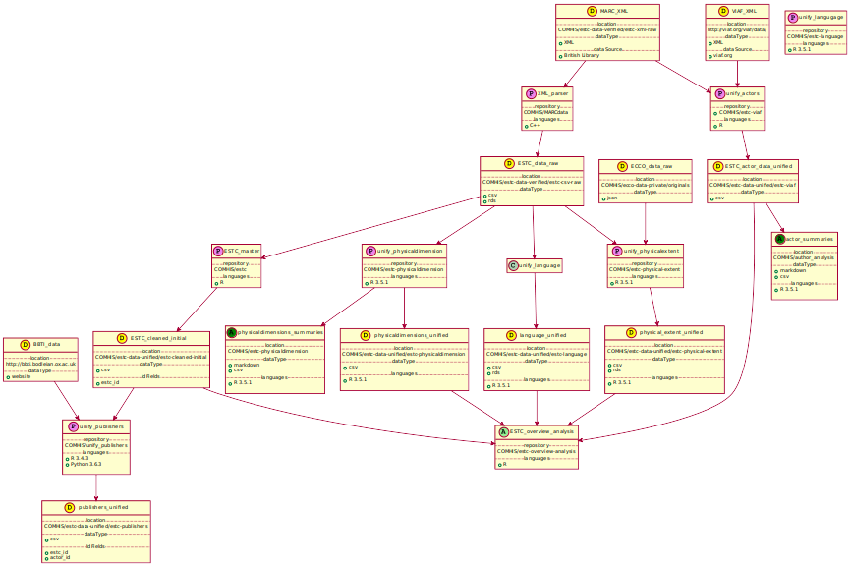
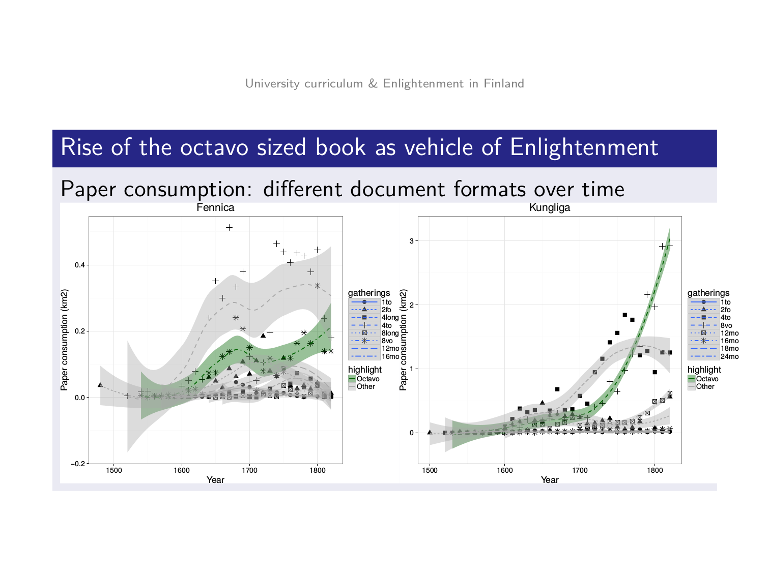
From library catalogues to research reports
Research potential
Open data science
ecosystem
Research cases

Slide 4
The rise of Octavo: paper consumption
SNB
<number>/37

Slide 5
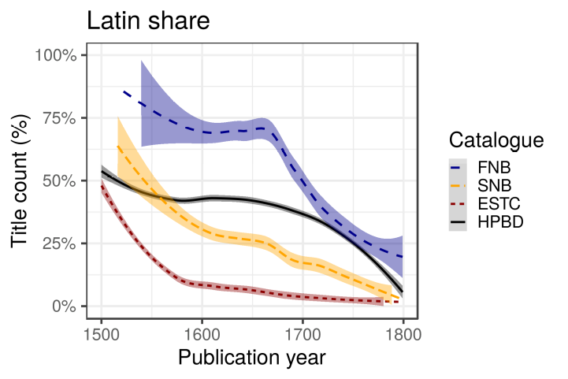
Title count share for books in Latin (primary language)
<number>/37

Slide 6
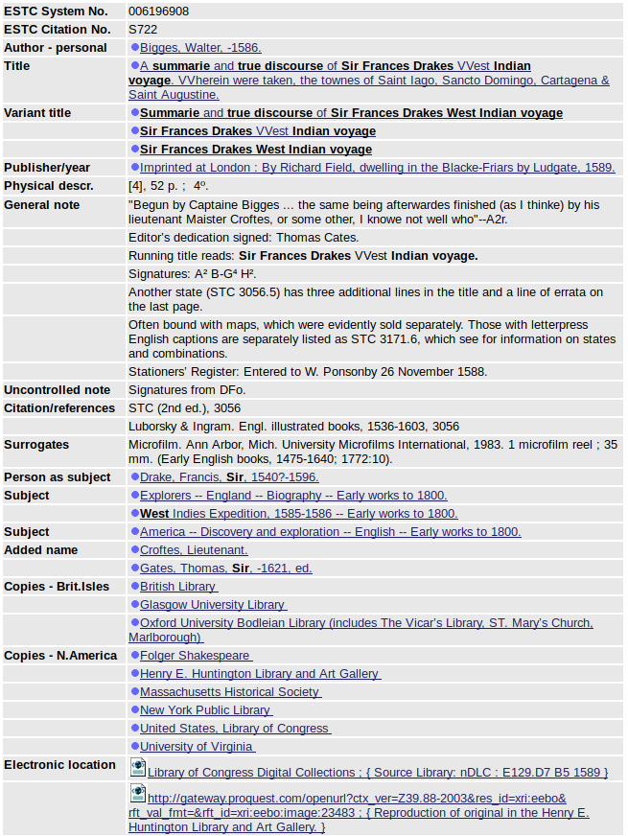
The (meta)data
Notes:
The first contribution comes from the transformation of bibliographic record into historical relic; specifically, the process of taking a discrete set of catalogue records and turning them into a harmonized relational dataset rich in historical data. This is a complex process. Each document’s record can contain as many as 420 discrete data points, covering details from the document’s location, to its former owner, all of which is recorded using the MARC 21 standard.

Slide 7
FMT | BK
LDR | cam a2200469 4500
001 | 006196908
003 | Uk-ES
005 | 20130916220616.0
008 | 900830s1589 enk|||| 00| ||eng c
009 | S722
035 | |a (CU-RivES)S722
040 | |a CU-RivES |c CU-RivES |d CStRLIN |d Uk-ES |e dcrb
1001 | |a Bigges, Walter, |d -1586.
24512 | |a A summarie and true discourse of Sir Frances Drakes VVest Indian voyage. |b VVherein were taken, the townes of Saint Iago, Sancto Domingo, Cartagena & Saint Augustine.
2463 | |a Summarie and true discourse of Sir Frances Drakes West Indian voyage
2463 | |a Sir Frances Drakes VVest Indian voyage
2463 | |a Sir Frances Drakes West Indian voyage
260 | |a Imprinted at London : |b By Richard Field, dwelling in the Blacke-Friars by Ludgate, |c 1589.
300 | |a [4], 52 p. ; |c 4⁰.
500 | |a "Begun by Captaine Bigges ... the same being afterwardes finished (as I thinke) by his lieutenant Maister Croftes, or some other, I knowe not well who"--A2r.
500 | |a Editor's dedication signed: Thomas Cates.
500 | |a Running title reads: Sir Frances Drakes VVest Indian voyage.
500 | |a Signatures: A² B-G⁴ H².
500 | |a Another state (STC 3056.5) has three additional lines in the title and a line of errata on the last page.
500 | |a Often bound with maps, which were evidently sold separately. Those with letterpress English captions are separately listed as STC 3171.6, which see for information on states and combinations.
500 | |a Stationers' Register: Entered to W. Ponsonby 26 November 1588.
509 | |a Signatures from DFo.
5104 | |a STC (2nd ed.), |c 3056
5104 | |a Luborsky & Ingram. Engl. illustrated books, 1536-1603, |c 3056
533 | |a Microfilm. |b Ann Arbor, Mich. |c University Microfilms International, |d 1983. 1 microfilm reel ; 35 mm. |f (Early English books, 1475-1640; 1772:10).
60010 | |a Drake, Francis, |c Sir, |d 1540?-1596.
648 7 | |a 1473-1640 |2 local
650 0 | |a Explorers |z England |v Biography |v Early works to 1800.
650 0 | |a West Indies Expedition, 1585-1586 |v Early works to 1800.
651 0 | |a America |x Discovery and exploration |x English |v Early works to 1800.
7001 | |a Croftes, |c Lieutenant.
7001 | |a Gates, Thomas, |c Sir, |d -1621, |e ed.
752 | |a Great Britain |b England |d London.
852 | |a bL |b British Library |e London, England, U.K. |j [Shelfmark not available] |x C> |q imp., e [CM] |r 1116038
852 | |a nDFo |b Folger Shakespeare |e Washington, District of Columbia |j STC 3056 |x V> |q HH27/14. Stained, t.p. torn and mended, affecting imprint. Bernard Quaritch pencilled note. |p bookplate of Gloddaeth library; small label: Edwd. Parry ...; signature of Persivall Golding; Baron Mostyn - Harmsworth copy |r 1116040
852 | |a bGu |b Glasgow University Library |e Glasgow, Scotland |j [Shelfmark not available] |x C> |q [CM] |r 1116037
852 | |a nCSmH |b Henry E. Huntington Library and Art Gallery |e San Marino, California |j 18731 |x P> |q Binding signed by F. Bedford. +Port. and 4 plates with Latin and French engraved captions |p bookplates of Marshall Clifford Lefferts and E.D. Church |r 1116036
852 | |a nMHi |b Massachusetts Historical Society |e Boston, Massachusetts |j [Shelfmark not available] |x C> |q [CM] |r 1116041
852 | |a nNN |b New York Public Library |e New York, New York |j [Shelfmark not available] |x C> |q b [CM] |r 1116042
852 | |a bO |b Oxford University Bodleian Library (includes The Vicar's Library, ST. Mary's Church, Marlborough) |e Oxford, England |j Antiq.e.E.1589.5 |x V> |r 1116039
852 | |a nDLC |b United States, Library of Congress |e Washington, District of Columbia, United States. |j E129.D7 B5 1589 |x W> |q L.C. copy cropped; lacks headers and page numbers. Hans and Hanni Kraus Sir Francis Drake Collection (Library of Congress) |r 3869575
852 | |a nViU |b University of Virginia |e Charlottesville, Virginia |j McGreg A 1589 .B53 |x V> |q Lacks all 4 folding maps described in Church 307. |p Bound in full burgundy crushed levant morocco by Sangorski & Sutcliffe. |r 1116043
SYS | 006196908
Notes:
While this means that the data is nominally machine readable, the process of creating a linked dataset should not be trivialized. MARC records were not designed with linked data, and the quantitative analysis of this data, in mind. This, therefore, is the first contribution: the transformation of bibiographic record into a structured data model useful for systematic research – a task which his part of a larger project being conducted by the Helsinki Computational History Research Group.

Slide 8
English Short Title Catalogue
(ESTC)
English literature
~0.5M entries 1470-1800
Online version:
Entire catalogue browsable at http://estc.bl.ac.uk
Offline version:
Not open or publicly available
One (non-standard) XML file
1,450,034 lines
Data entries discrete & non-harmonized

Slide 9

A quantitative study of history in the English short-title catalogue (ESTC)
Leo Lahti, Niko Ilomäki, Mikko Tolonen
LIBER Quarterly 25(2), 2015
Scaling
Combining catalogues, harmonizing formats; language differences..
Automation
Optimizing analysis algorithms (speed, accuracy, generalizability.)
Extensions
Support full-text analyses
<number>/37

Slide 10
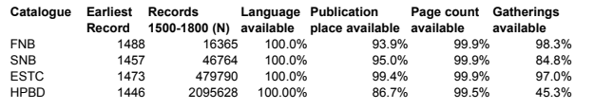
Library catalogues
FNB (Fennica)
Finnish National bibliography
>900,000 books and monographies (printed and electronic) since 1488
>70,000 continuous publications (journals or series) since 1771
Series, maps, audiovisual, and electronic material
Open data
ESTC British Library: N > 500,000
SNB (Kungliga): Swedish National bibliography N >18 M entries
HPBD Heritage of the printed book, Göttingen: N > 6M entries
<number>/37

Slide 11
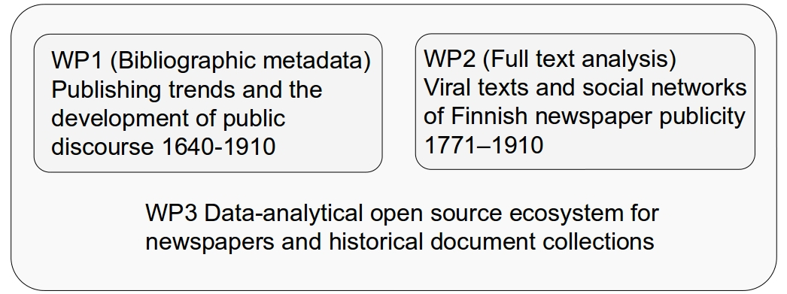

COMHIS consortium (Academy of Finland 2016-2019)
University of Helsinki, University of Turku, National Library of Finland
Quantify early-modern knowledge production with large bibliographic collections, full texts, and open data analytical infrastructure
<number>/37

Slide 12
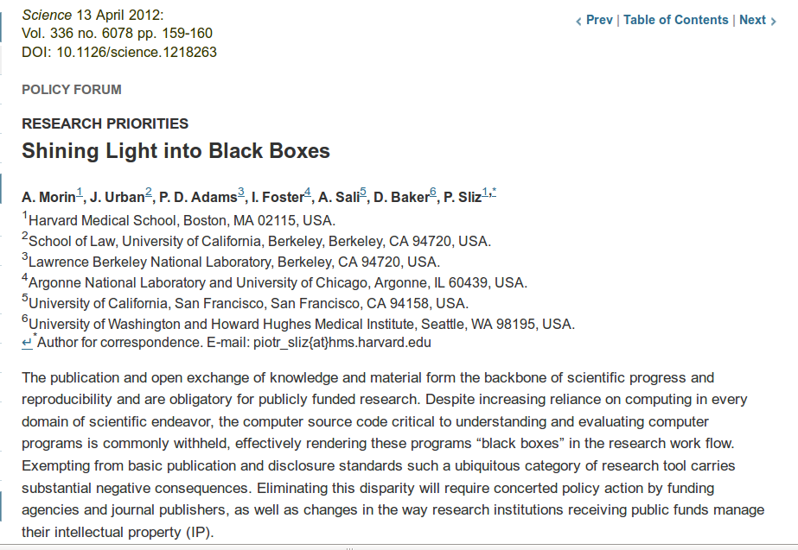




The role of computational / data science workflows
1) data gathering and storage
2) access, documentation
3) harmonization & enrichment
4) quality control
5) custom analysis algorithms & tools
6) reporting & dissemination
R for Data Science / H. Wickham

Slide 13
Elements of bibliographic data science
Quantitative frame for qualitative research
Beyond counting titles (volume, time, geography…)
Bibliographic
metadata
Open data science ecosystem
Full texts: books,
newspapers...
Supporting data
R for Data Science / H. Wickham
<number>/37

Slide 14
Measuring printing activity: quantitative indicators
Print run: 1000
Page
count
Title count
Print area
Paper consumption
Area
Height
Width
Title count
<number>/37

Slide 15
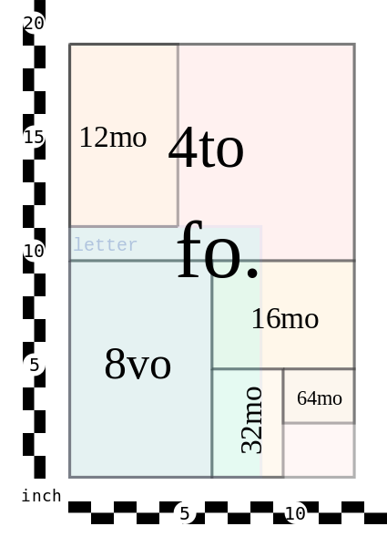
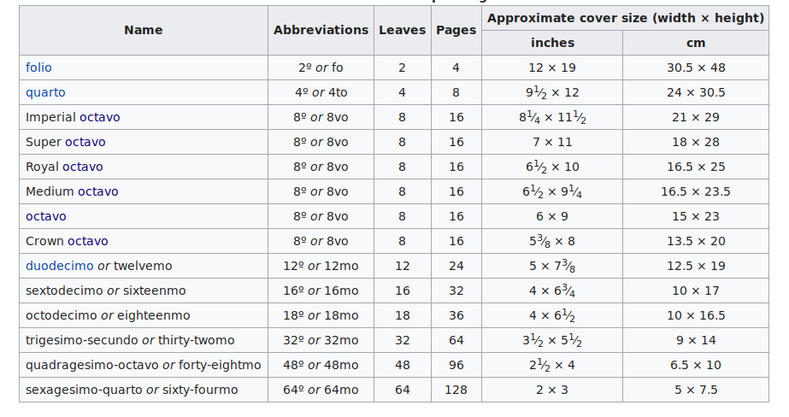
Document size matters
<number>/37

Slide 16
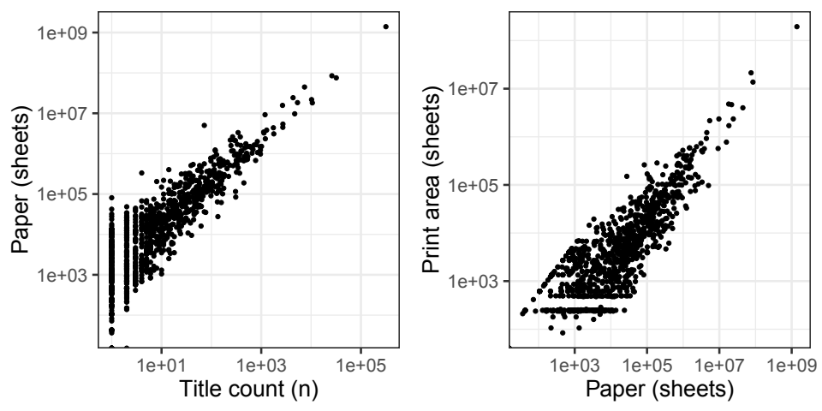
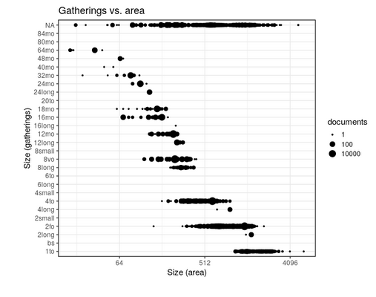
Printing activity: quantitative indicators
- Title count (number of unique titles)
- Print area (width x height x title count)
- Paper (width x height x page count x title count x print run)
<number>/37

Slide 17
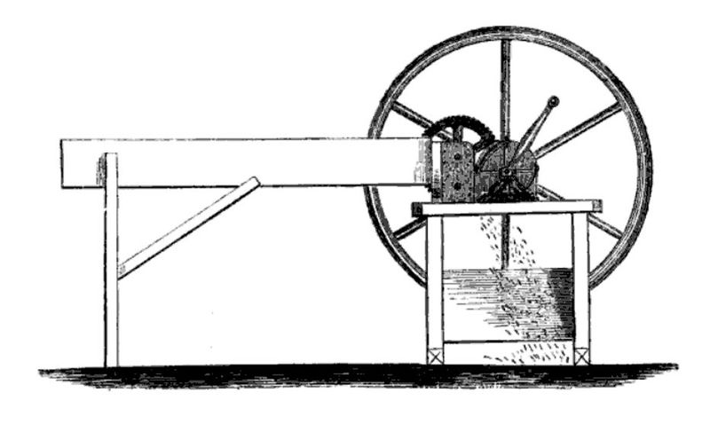
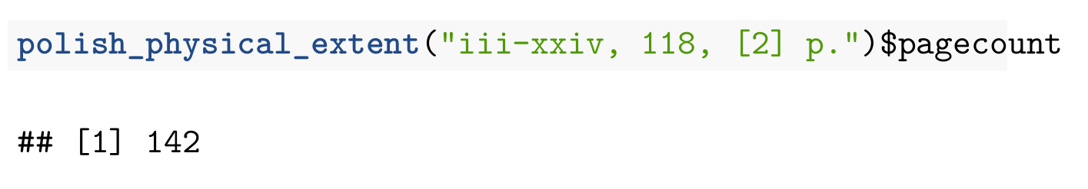
Data harmonization: estimating page counts from MARC cataloguing standards
→ 240 pages
“[4],vii-xii,[4],222p.,plate”
<number>/37

Slide 18
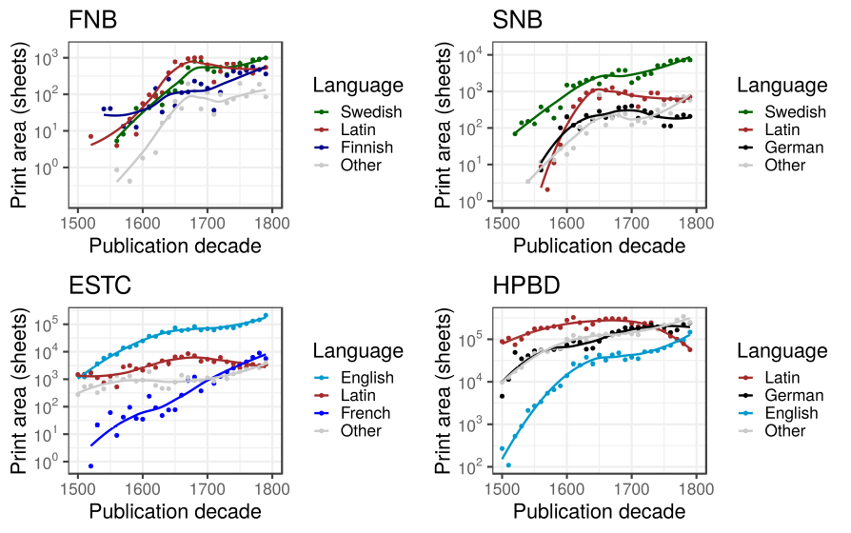
Print area for top languages
<number>/37

Slide 19
ESTC Actor Fields (100, 110, 700, 710)
Extracted 557,847 actors from 397,061 documents (for which there were named actors)
Cleaned up and standardized unicode.
Created individual actor records per document.
Assigned roles when known.
Harmonized by string matching (when appropriate) and with Virtual International Authority File (VIAF)
  Problems: VIAF often has duplicate records; single records are clearly for multiple individuals, IDs change.
558,243 actor records harmonized into 92.044 unique actors.
<number>/37
Data harmonization: Mark Hill, Ville Vaara, Ali Ijaz
Notes:
MARC tags 100, 110, 700, and 710 contain details of actors involved with a specific document. While there may be as many as 20 discrete pieces of data included, the key points of interest include names; initials, abbreviations, phrases, or numbers used in place of a name; titles or other words associated with a name; birth and death years, or active years; and the role of the person with regard to the work.
From these fields we have been able to extract around 550,000 discrete references to actors from 400,000 documents.
Because there are no recorded relationships between actors recorded in the ESTC, there is no way of knowing whether one entry for William Shakespeare is a reference to the same Shakespeare found elsewhere. Or, more problematically, whether any of the 137 records for the initials “A. B.” are to the same person. Thus, before analysis was possible, extensive processing, harmonization, and validation were necessary.
This process has, so far, allowed to the harmonization of 90,000 unique actors from 560,000 references to actors.
In many cases records within the ESTC themselves were robust enough for this - for example, when an actor’s name included specific years of activity. In these cases, different string matching methods were used to unify actors.
In many cases, however, names are too ambiguous to trust string matches. In these situations we turned to the Virtual International Authority File, a harmonized record of multiple international library catalogues which has collected and unified individual records for actors. We made use of the VIAF API to conduct more fuzzy matches on both actor names and the titles of the document they were linked to.
There are problems with the Viaf, however. First, it has multiple records for the same actor. Conversley, there are single records in VIAF which actually represent multiple individuals. Therefore, a number of verification steps were necessary to validate and further harmonize actors. Specifically, there is an extensive semi-automated verification process which made use of historical knowledge to make judgements in specific cases. Importantly, actors which shared a name, but for which there was no further evidence for being the same person, are treated as distinct.

Slide 20
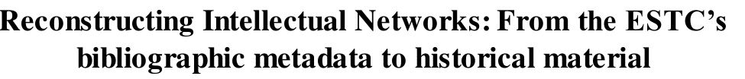
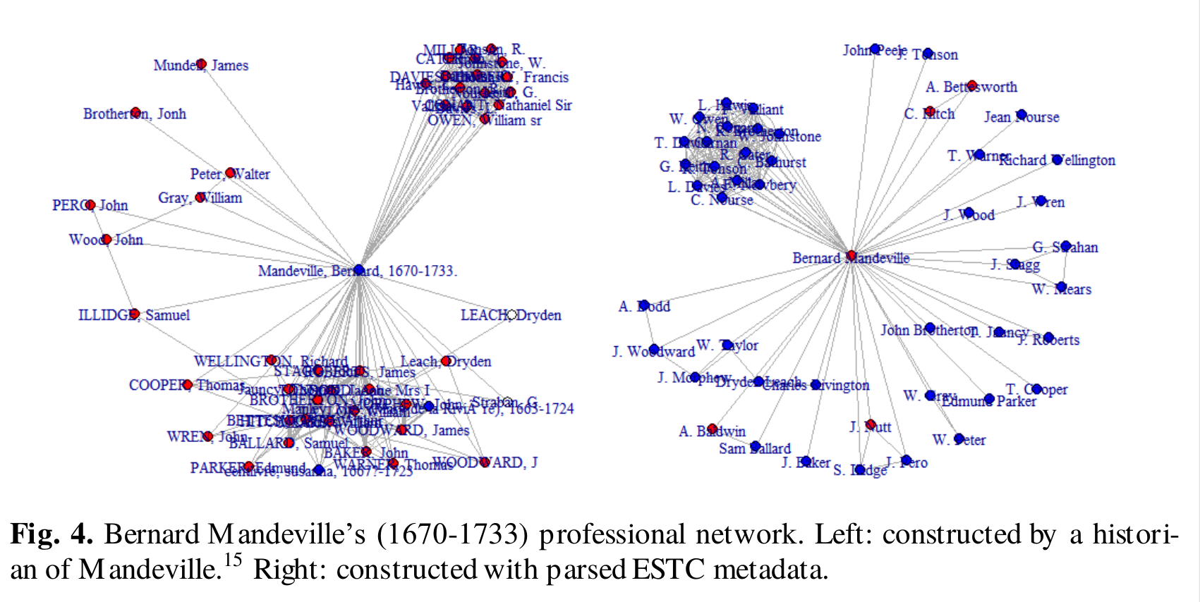
Expert curated
Automatically constructed
<number>/37
Mark Hill et al. DHN 2019.

Slide 21
Imprint Field (260)
Named entities from ESTC field 260 (imprint/publisher statement)
  printed for Bernard Lintott at the Cross-Keys, between the two Temple-Gates, in Fleet-Street. The Double Gallant: Or, the Sick Lady's Cure. A Comedy. Written by Mr. Cibber
  printed by E: Coates. 1655. Sould by Thomas Heath in Covent garden, and Henry Herringman at the Ancker on the lowest side of the New-Exchange.
Assigned roles (publisher, printer, bookseller) and addresses
Corrected and enriched names
Using town, address, matching initials and name, name combinations, years of activity, etc, harmonized and expand on existing named entities.
Verified against BBTI (British Book Trade Index)
Similar issues to VIAF - in particular duplicated entries
332,410 named actors in tag 260 unified as 35,252 unique actors..
<number>/37
Notes:
A similar process was followed with MARC field 260, which covers the imprint – that is, notes relating to the publication, printing, distribution, and production of a work. While the field itself contains fewer data points than the actor fields, it is recorded in a much more problematic manner: entities representing booktrade actors are contained within text chunks replicating full publisher statements which can be very ambiguous.
To parse these statements, therefore, first relevant data was identified, differentiated, and separated from the rest of the imprint using natural language processing. This data is then identified as entities representing persons, roles, names of organisations, and locations.
Once extracted, a similar unification process to that used.
At this point, however, we have harmonized 35,000 unique actors from 330,000 discrete entries.
First, postprocessing of names is necessary. This includes correcting spelling errors and normalizing spelling variations when sensical – for example, location information and years of activity are used to match initials with full names. Entities are then unified as far as possible by cross-referencing names with existing records extracted from the ESTC, the VIAF, and the British Book Trade Index. As with the VIAF, there are issues with the BBTI – in particular duplicate entries which require further processing.

Slide 22
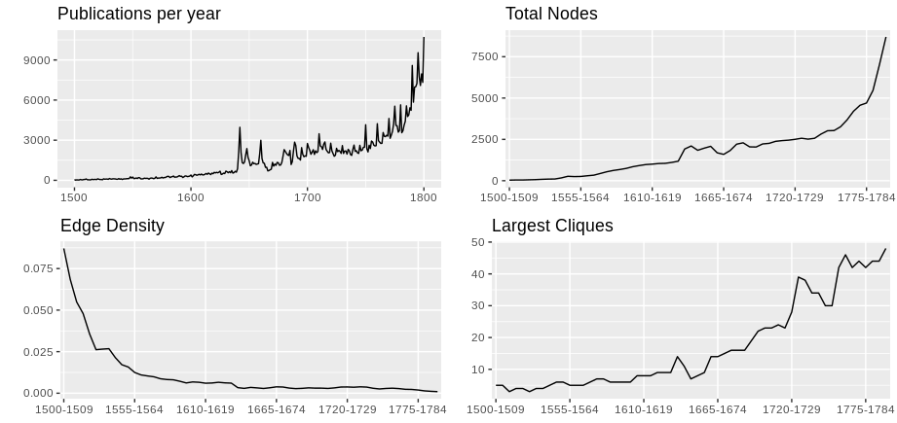
ESTC network changes: 1500-1799
As publications increase, so too do actors (nodes).
Density drop, clique growth: emerging network order representing specialization in trade.
Great Frie
Civil War
<number>/37
Mark Hill et al. DHN 2019.
Notes:
Sparse to start
Growth of the booktrade was tied to increases in labour - and this relationship is visible immediately: as the number of documents printed increases, so too does the size the network.
However, the transformation is more complex than this, as visible in the increase of cliques and drop in edge density. These are both signs that the network was becoming more diverse, indicating an structure in which particular nodes played central roles.
That is, as new individuals were brought into the booktrade to increase production, aspects of the trade become increasingly specialized and connections were vertical with with specific actors emerging as key in managing and developing the industry.

Slide 23
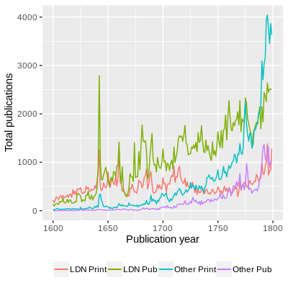
Increase in printers
Growth of non-London based booktrade actors
1710 Copyright Act ending perpetual copyright, and booms in reprints in 1740s and 1770s (red arrows)
Piracy? (still working out how to measure)
<number>/37
Mark Hill et al. 2019.
Notes:
Three historical reasons for this.
First, the growth of the colonial booktrade in the 18th century, where publishing had yet to take the form it had in London, meant printers were more frequently identified on imprints than publishers
LEFT: THE JUMP IN “OTHER PRINT” and “OTHER PUB”
RIGHT: the, much, flatter ratio of publishers to printers outside of London (RED LINE).
As the sources of publications increased outside of London towards the end of the 18th century, this impact was amplified.
Second 1710 Copyright Act.
While the legality of the statute is complicated, in theory it ended perpetual copyright after 28 years. This resulted in an increase in reprints of works, first in the 1740s by printers outside London, and then in the 1770s by those in London (both identified with the red arrows, and the latter noticeable in the drop in the London printer-publisher ratio).
The third reason was piracy; while a work legitimately tied to an established publisher would make this clear on the imprint, pirated works were, unsurprisingly, more vague in this regard.
On the whole, these network overviews offer clear evidence for the potential of the datasets use for longue durée historical insights - which is an important contribution in itself. These insights must, however, be tempered by detailed analyses of the finer points - and one way of doing just that is by turning to individual authors.

Slide 24
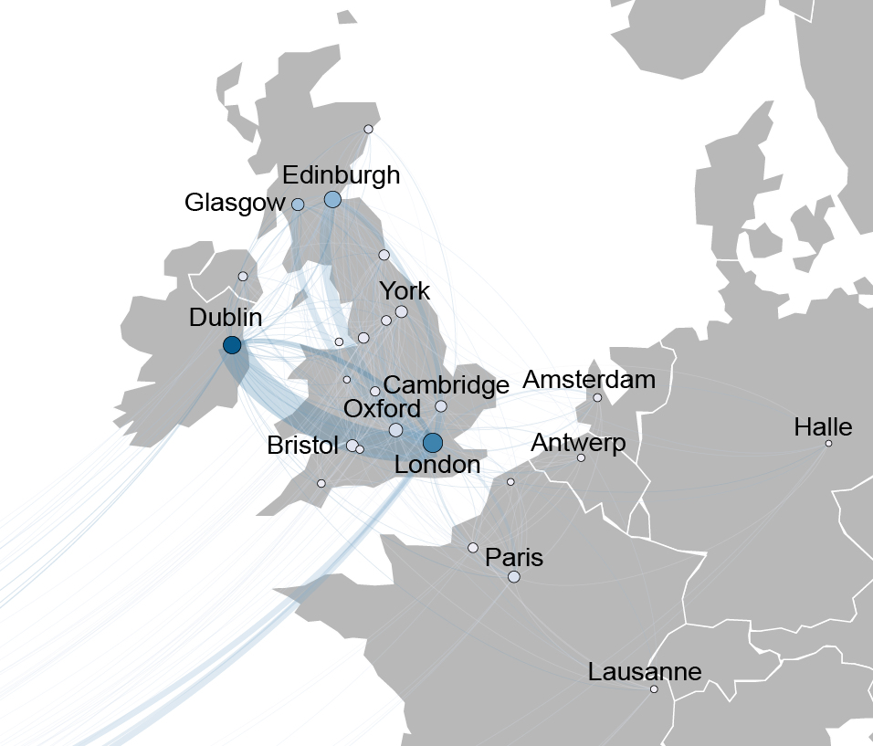
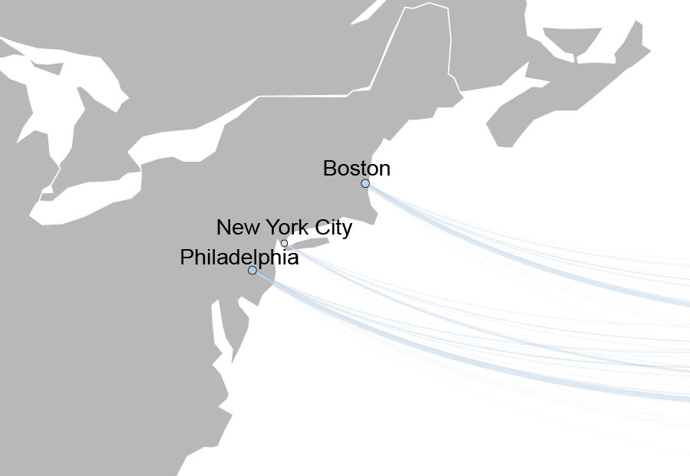
The Movement of Editions
<number>/37
Mark Hill et al. 2019.
Notes:
Darkness of node = overall number of editions not originally printed in that city, but which subsequently are. Weight of edge = weight of movement in that direction of editions from city x to city z
London is the intellectual centre.
To note: Dublin is a huge receiver of works - copyright law
Harder to see, but altough Edinburgh is also a received, it’s also, proportionally, quite a strong outputer. This is perhaps the Scottish Enlightenment.
The colonies are not, at this time, exporting works - or if they are they are being printed in London first.

Slide 25
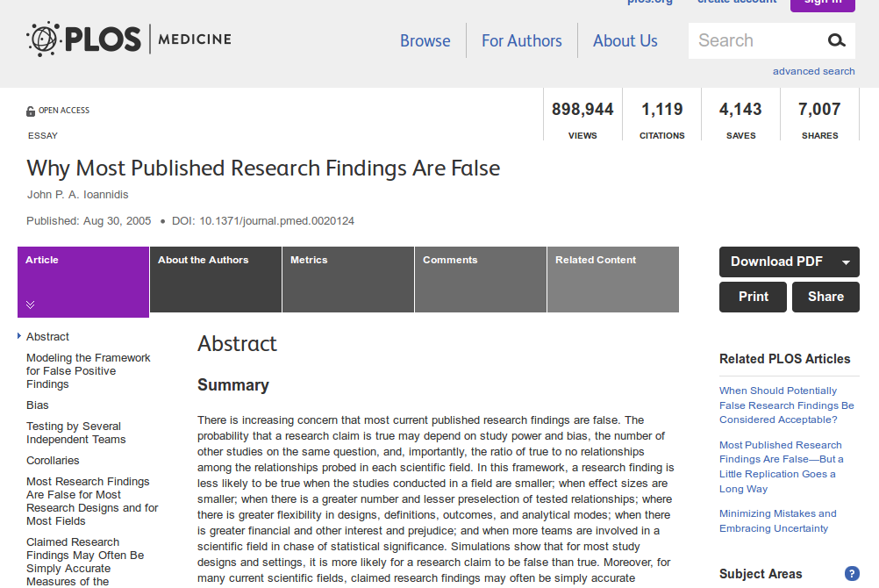
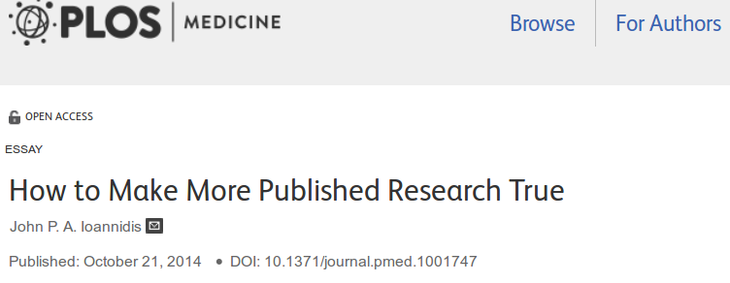
<number>/37
<number>/37

Slide 26
Linked data science?
Authors (Mark Hill)
Publishers (Ville Vaara)
Editions (Ali Ijaz)
Publication place (Iiro Tiihonen)
Gatherings
Page count
Language
Genre...
Data → Standardization → Validation → Integration → Analysis
<number>/37

Slide 27
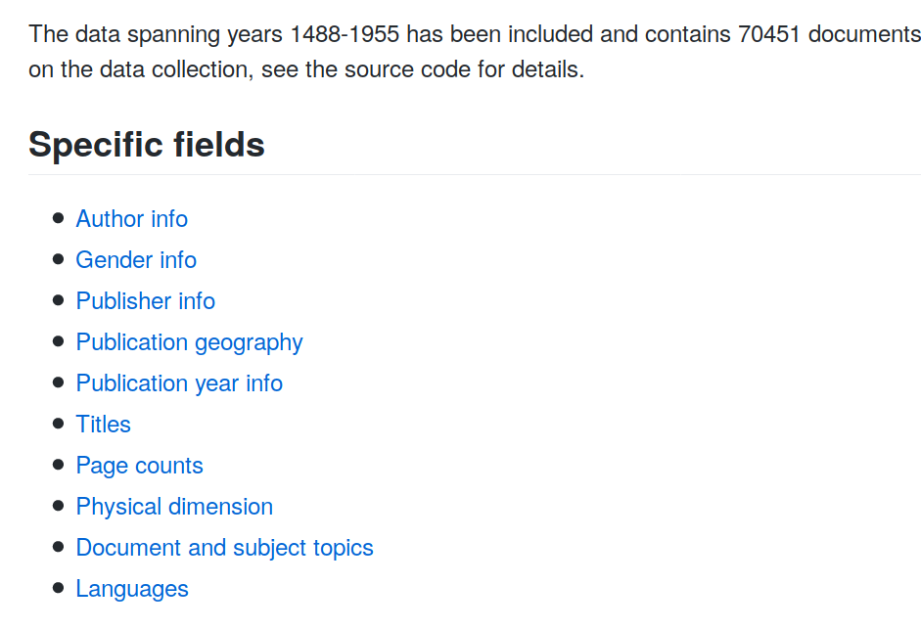
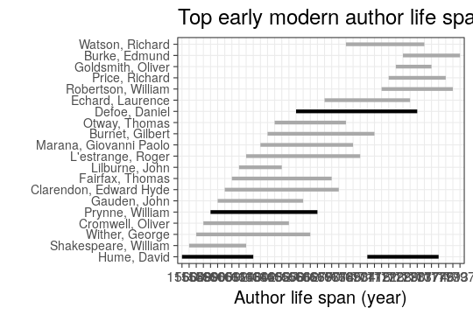
Automated summaries for the unified data
<number>/37

Slide 28
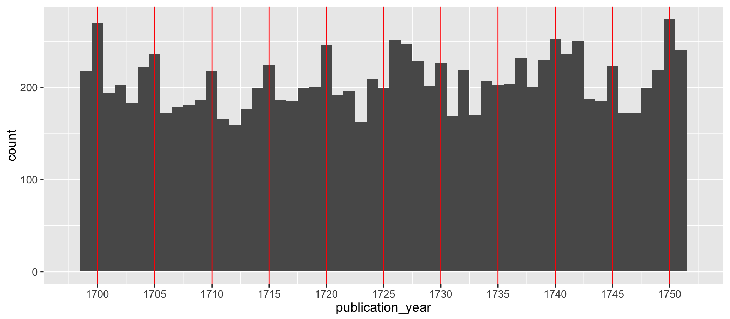
Example of questions particular to data in DH collaboration:
The 5-year theory with respect to ESTC catalogue
<number>/37

Slide 29
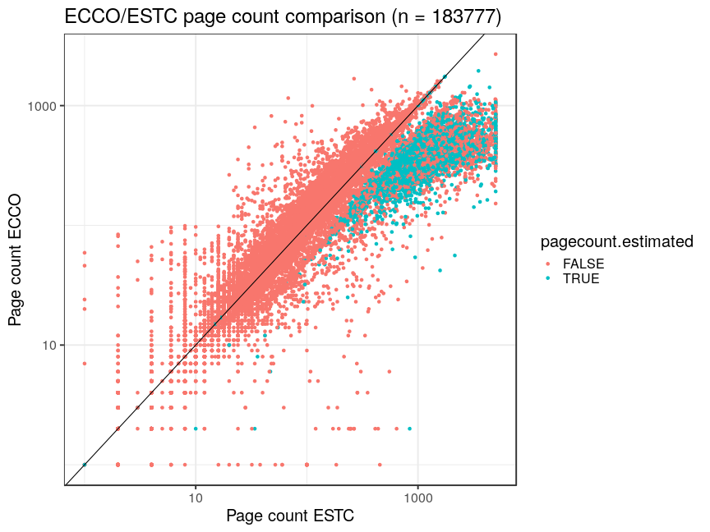
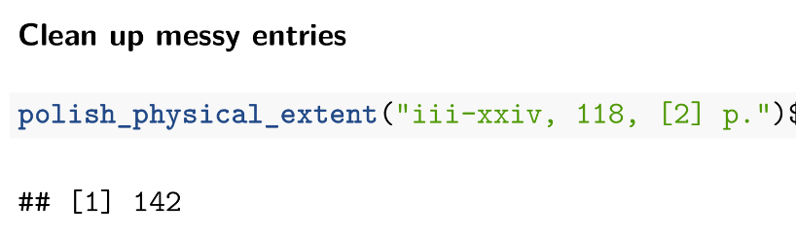
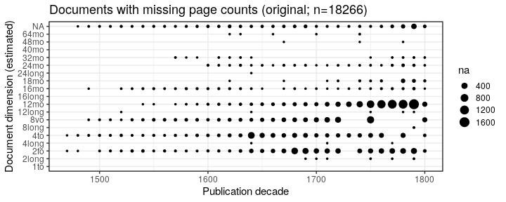
Validation: page count (ECCO vs. ESTC)
<number>/37

Slide 30
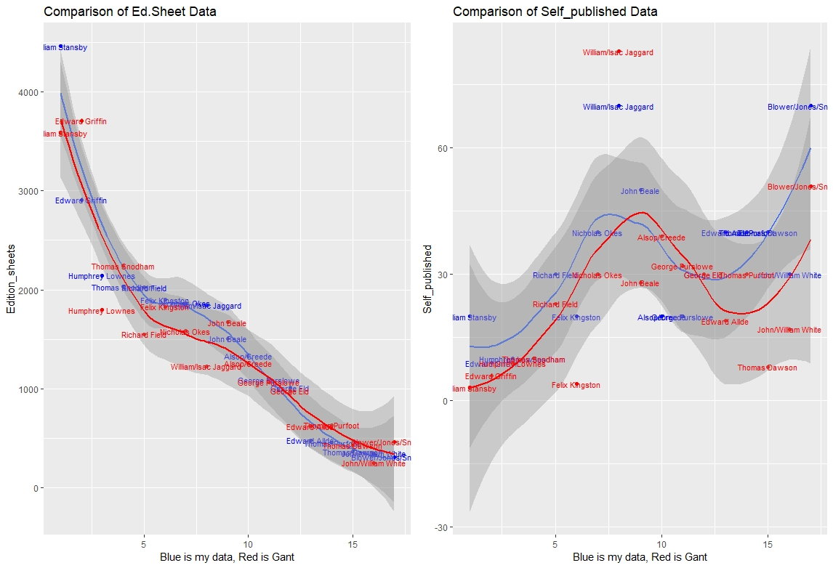
Scaling up by automated data harmonization:
edition sheets: automated vs. curated?
Fig: Iiro Tiihonen. Printers and Publishers in London From 1637 to 1662: a Quantitative Approach
<number>/37

Slide 31
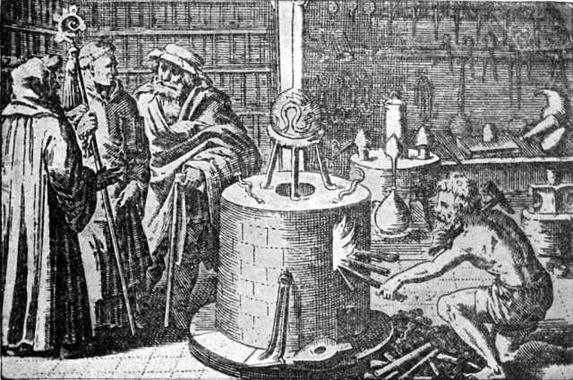
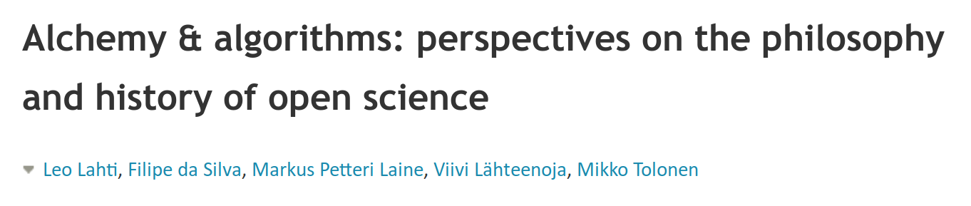
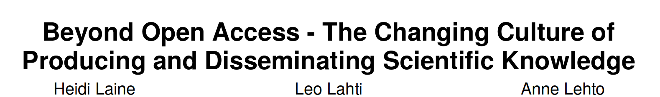
Transparent reporting and communication were part of academic culture since the early days
Source: Wikimedia Commons / Public domain
<number>/37
<number>/37

Slide 32
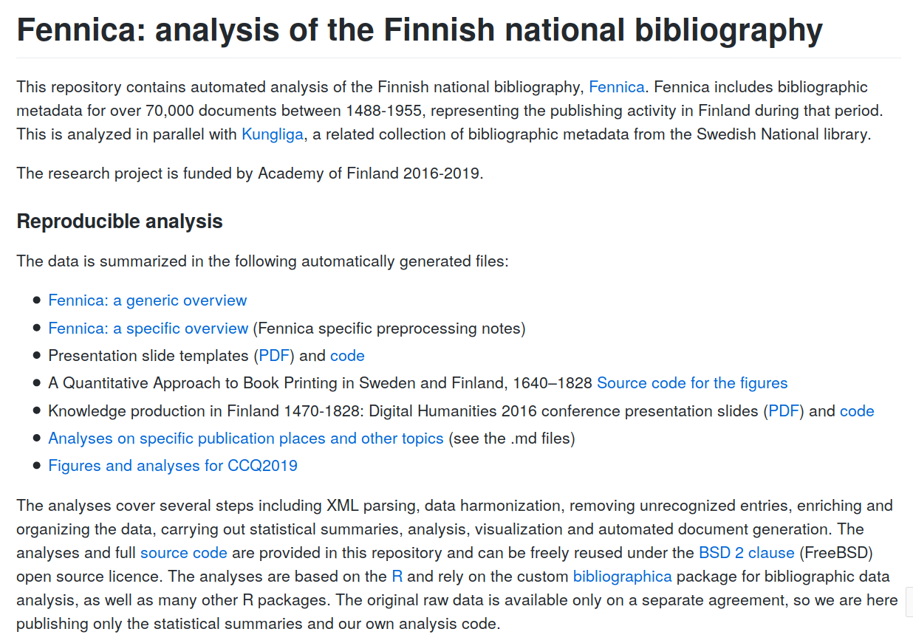
<number>/37
github.com/COMHIS/fennica

Slide 33
Elements of open data science
Open
Collaboration
Open
Data
Open
Methods
<number>/37

Slide 34
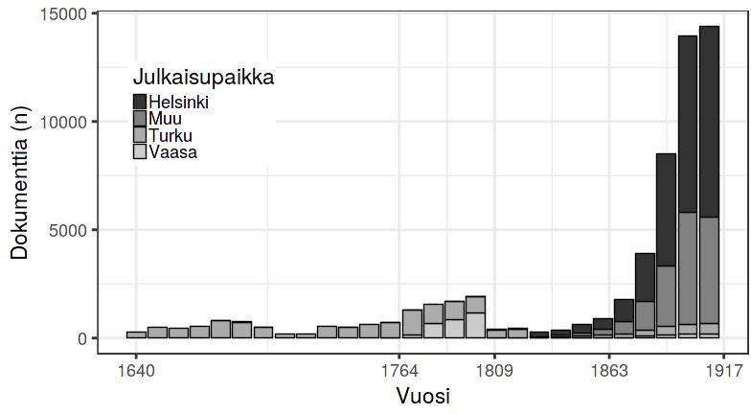
Publishing in Finland 1640-1917 (title count)
<number>/37

Slide 35
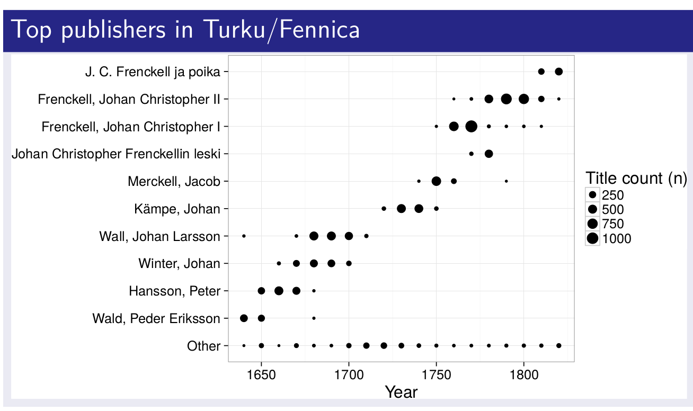
Publisher landscape in Turku 1640-1820
Author & publisher networks
Spatio-temporal dynamics
History, philosophy, religion, science..
<number>/37

Slide 36
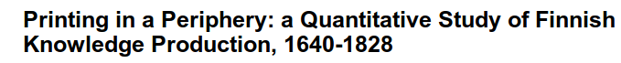
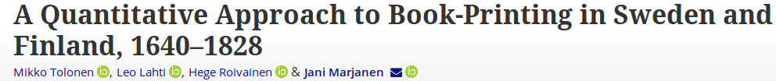
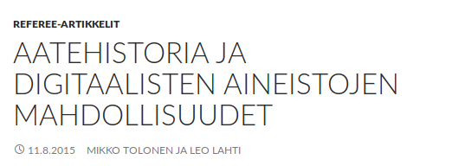
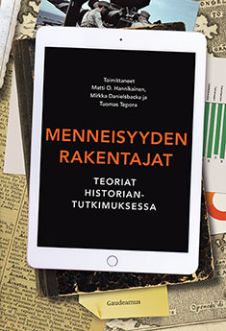
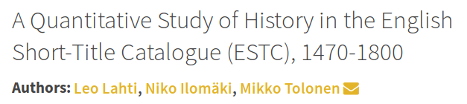
<number>/37

Slide 37
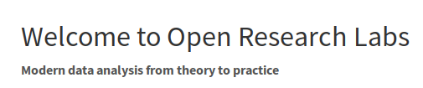



https://www.helsinki.fi/en/researchgroups/computational-history
Mikko Tolonen
Jani Marjanen
Mark Hill
Ali Ijaz
Ville Vaara
Hege Roivainen
Eetu Mäkelä
Tanja Säily
Antti Kanner
Simon Hengchen
Iiro Tiihonen
Metadata as research object
- Underestimated
- Objective
- Scalable

