Slide 1




OpenSAFELY and risk of COVID-19 related mortality and hospital admissions: age risk profiles
Dr Elizabeth Williamson and Professor Stephen Evans
On behalf of the OpenSAFELY collaborative

Slide 2
OpenSAFELY
Sample
~ 17 million adult patients in England
The timeframe
1 February - 24 June 2020 for COVID-19 death (144 days)
1 February - 24 May 2020 for admissions (113 days)
11,174 COVID-19 related deaths
21,929 COVID-19 related admissions
Absolute risks by age by comorbidities
Notes:
- Data do not include occupation; household conditions also not incorporated.
- Not causal.

Slide 3
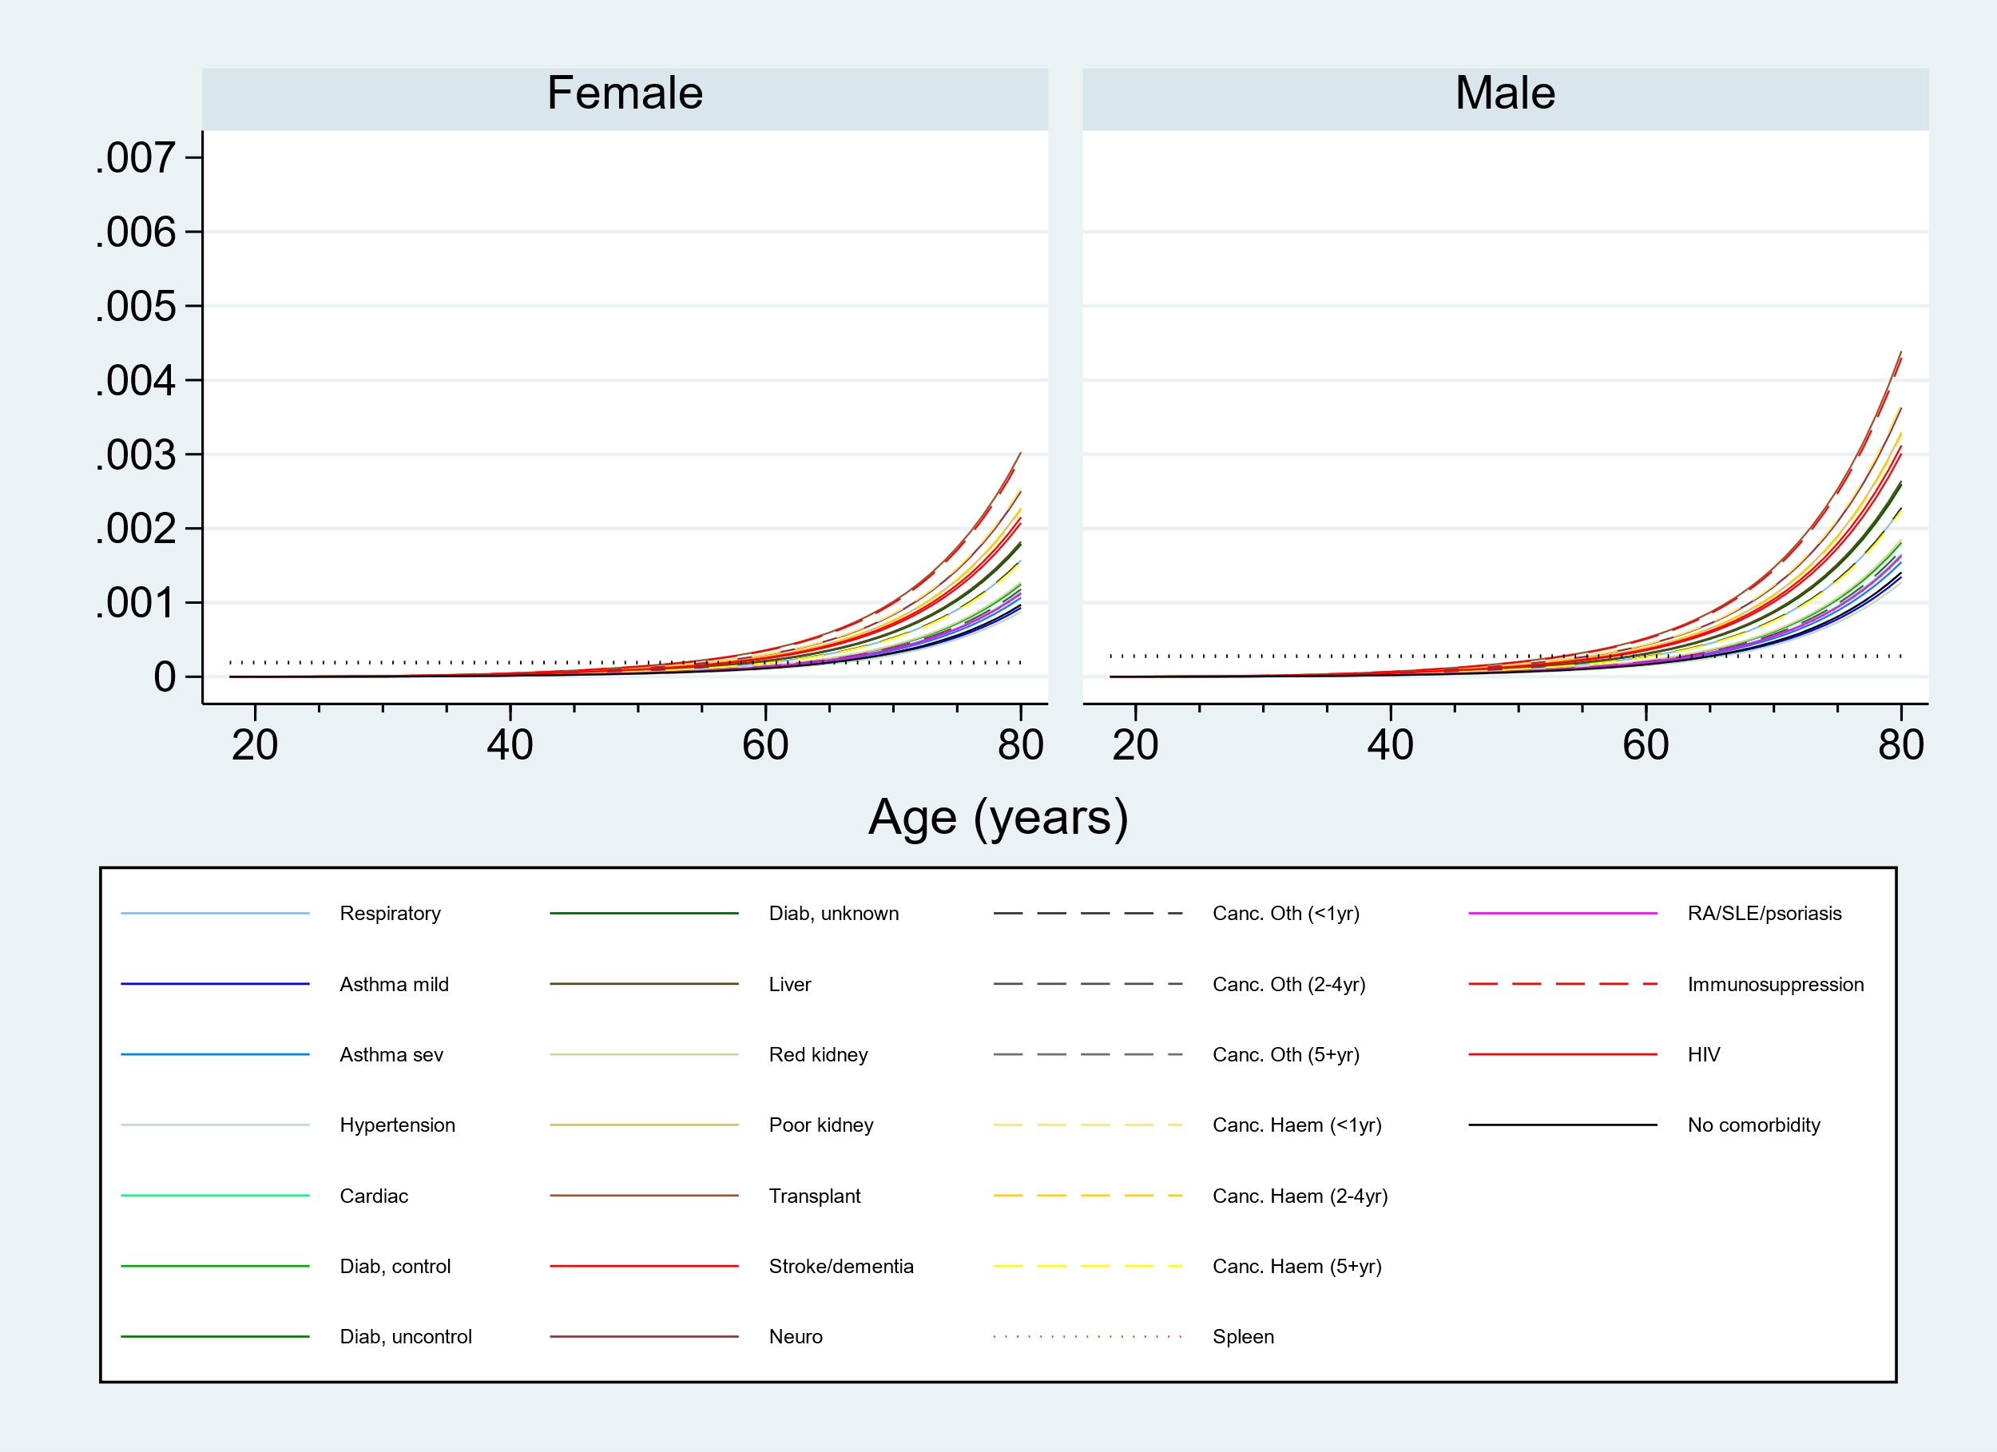
COVID-19 related mortality

Slide 4
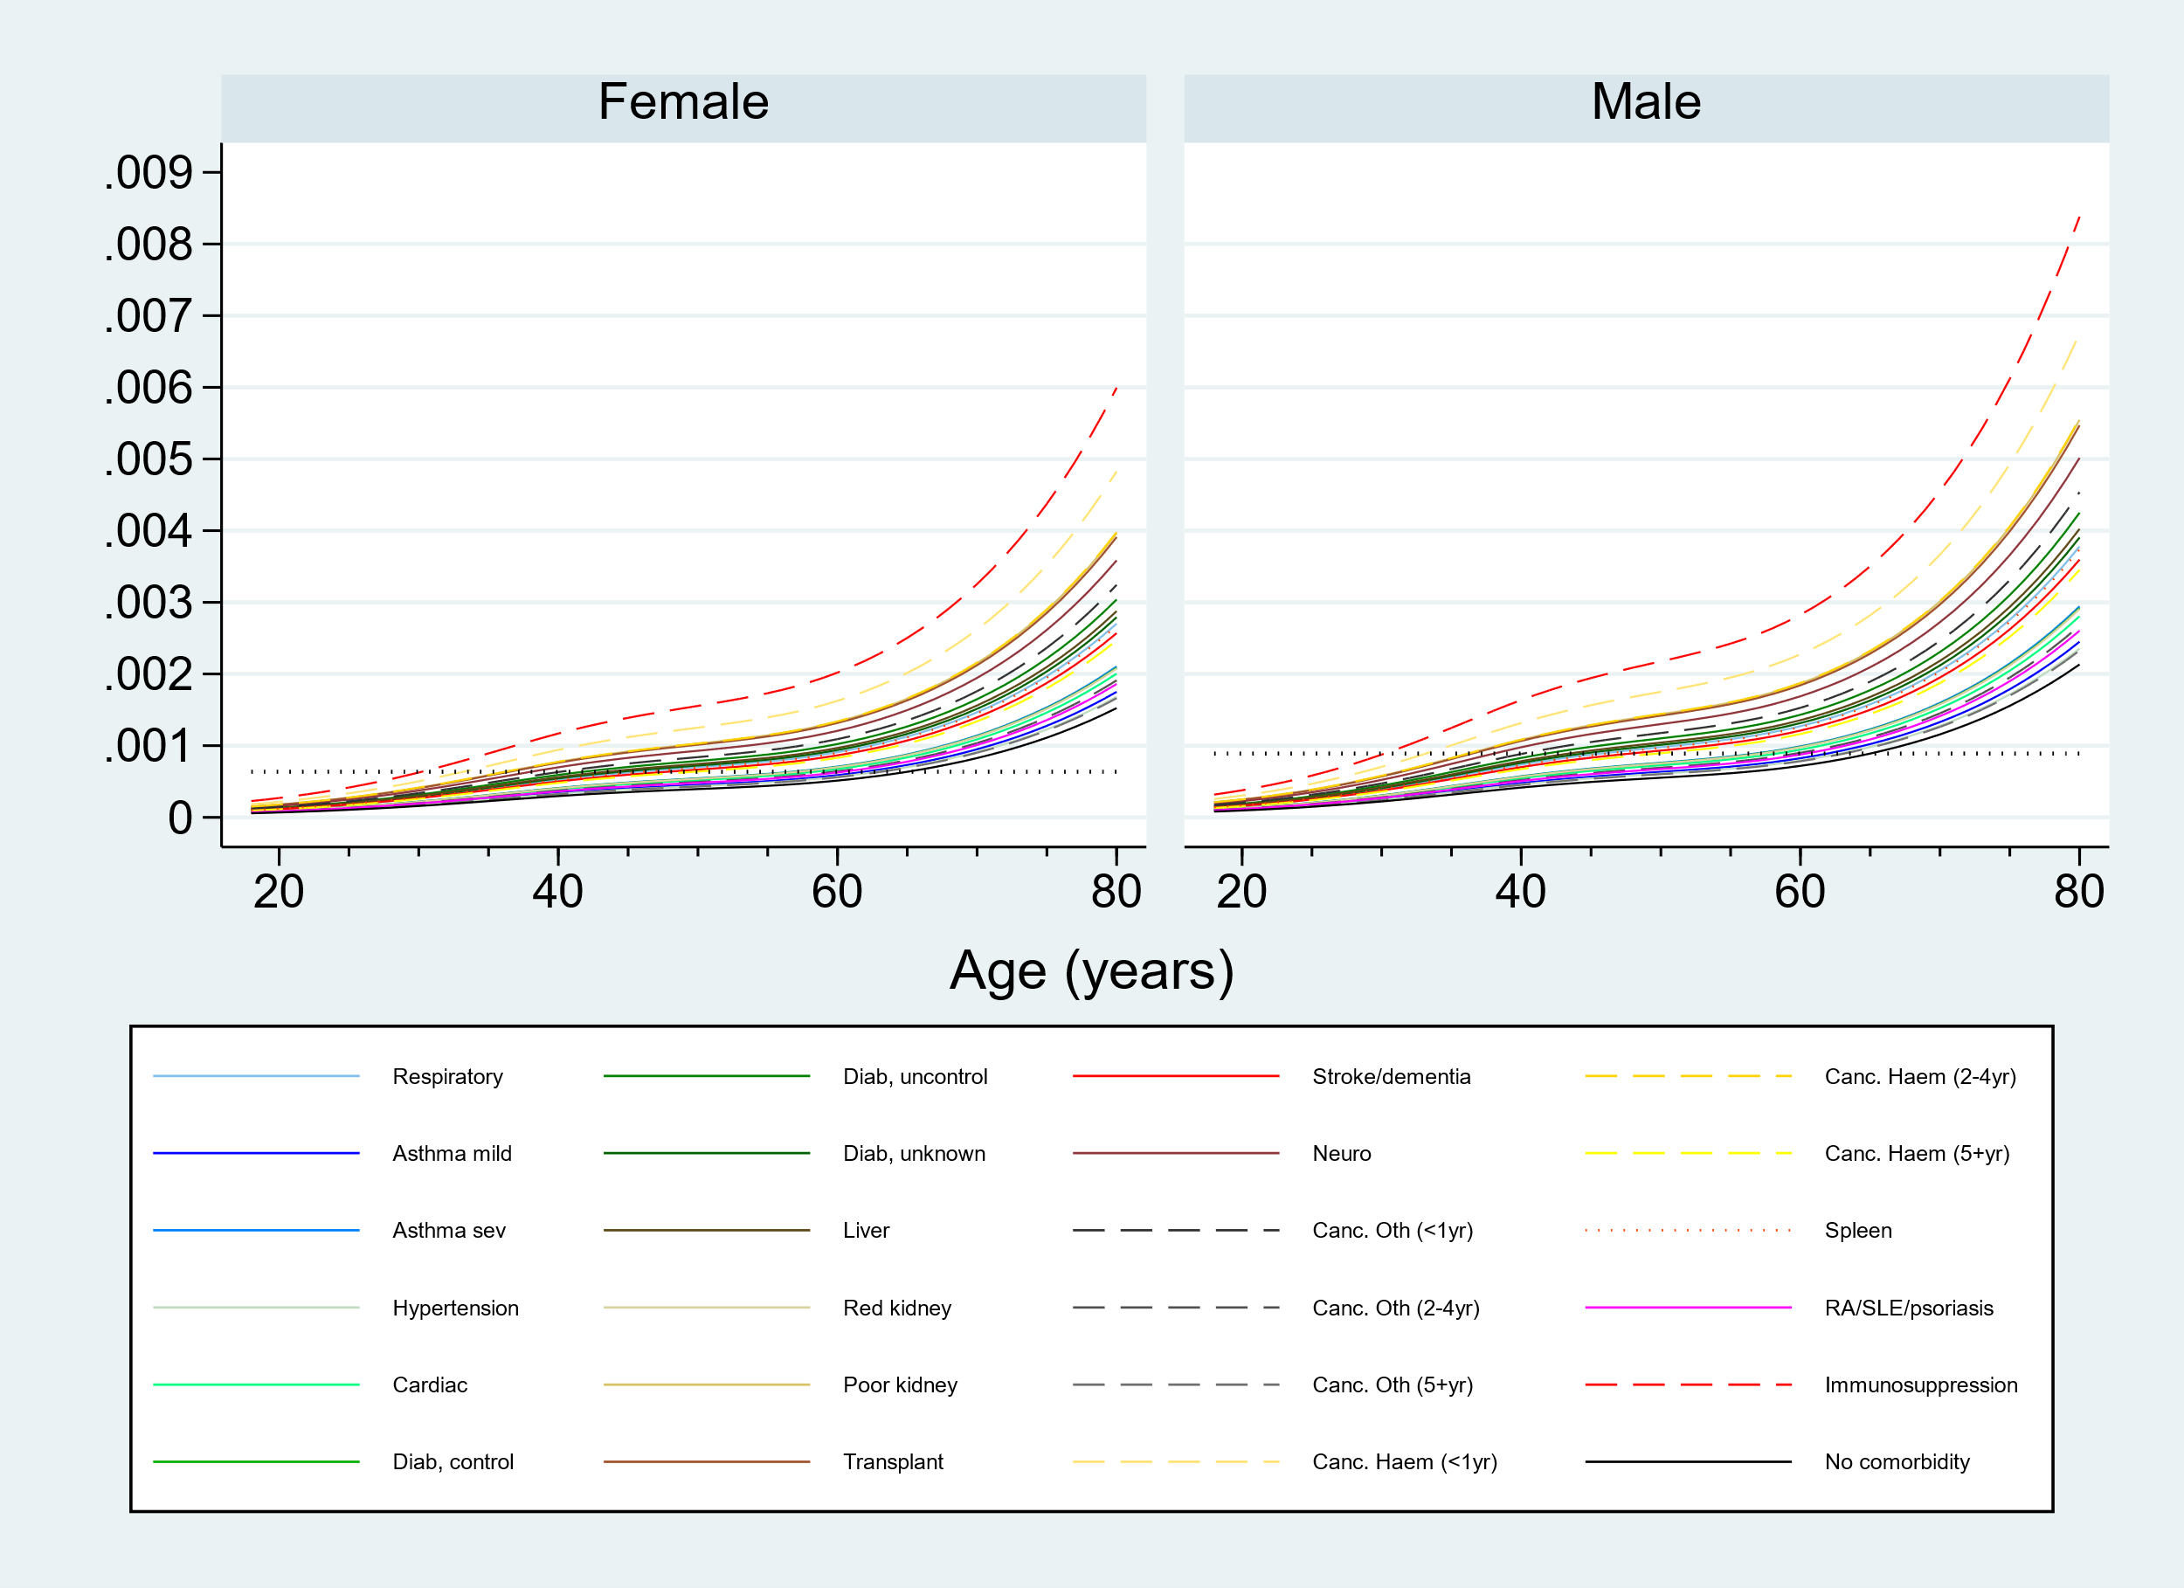
COVID-19 related hospital admissions

Slide 5
65-year old risk
Comorbidity | Approximate age at which “65-year old risk”* is attained (OpenSAFELY data)
 | Death | Hospital admissions
Respiratory disease | 60 | 45
Asthma, mild | 65 | 50
Asthma, severe | 65 | 60
Hypertension/High BP | 65 | 63
Diabetes, controlled | 62 | 56
Diabetes, uncontrolled | 56 | 43
Diabetes, unknown | 56 | 43
Cardiac disease | 64 | 55
Organ transplant | 52 | 35
Kidney function, reduced | 61 | 55
Kidney function, poor | 55 | 36
Liver disease | 58 | 44
Stroke/dementia | 57 | 50
Other neurological condition | 55 | 37
Cancer Haematological, <1yr | 55 | 34
Cancer Haematological, 2-4yr | 55 | 35
Cancer Haematological, >5yr | 60 | 48
Cancer Other, <1yr | 60 | 40
Cancer Other, 2-4yr | 61 | 50
Cancer Other, >5yr | 65 | 62
Spleen | 62 | 43
RA/SLE/Psoriasis | 63 | 63
Immunosuppression | 57 | 30

Slide 6
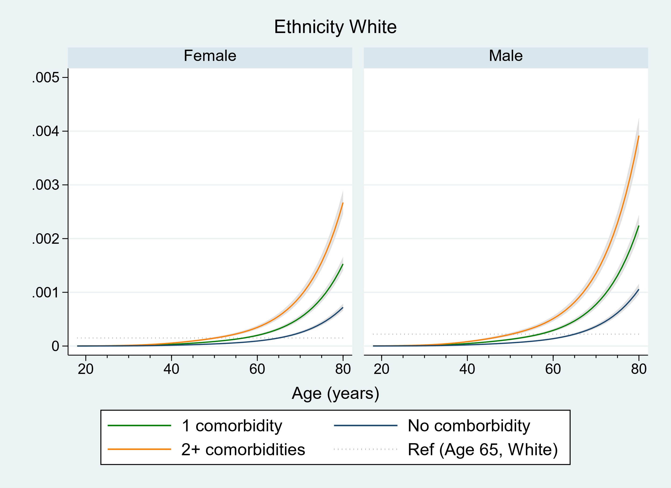
Mortality

Slide 7
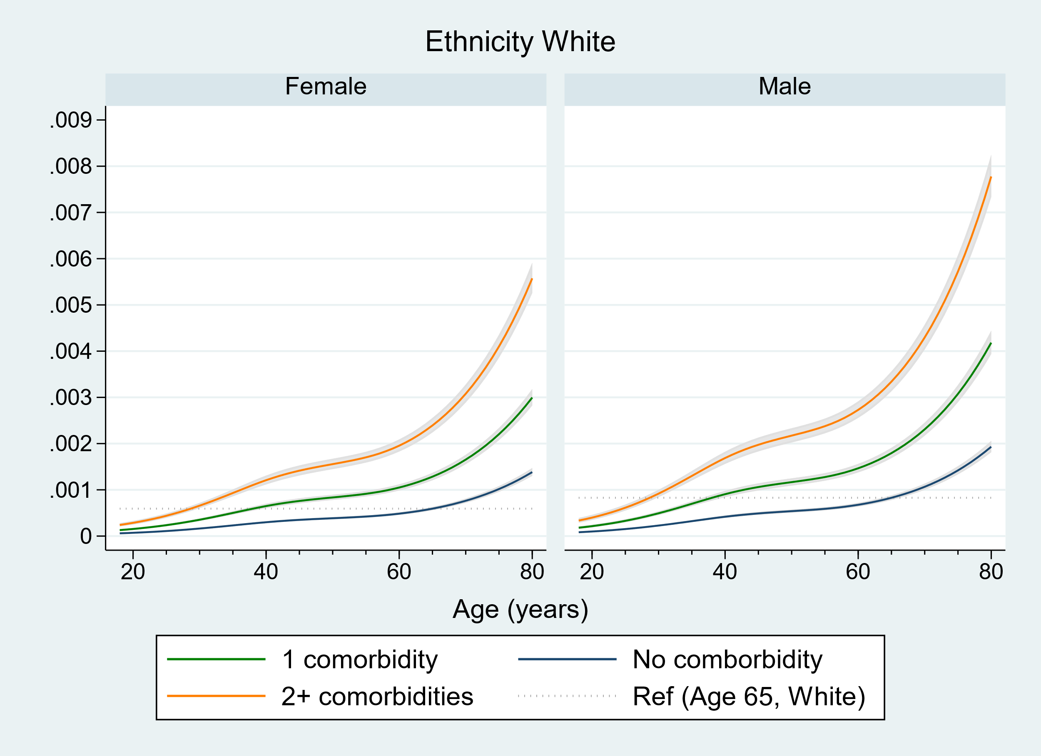
Hospital admissions

Slide 8
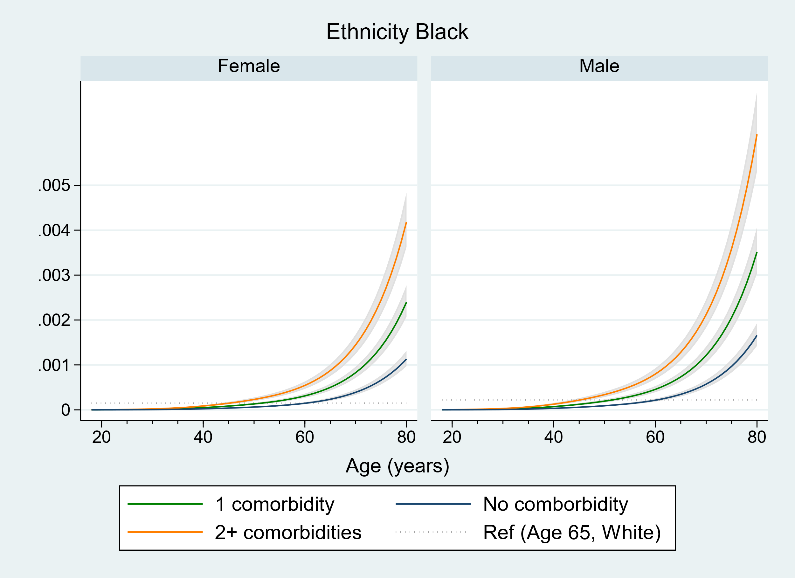
Black ethnicity - mortality

Slide 9
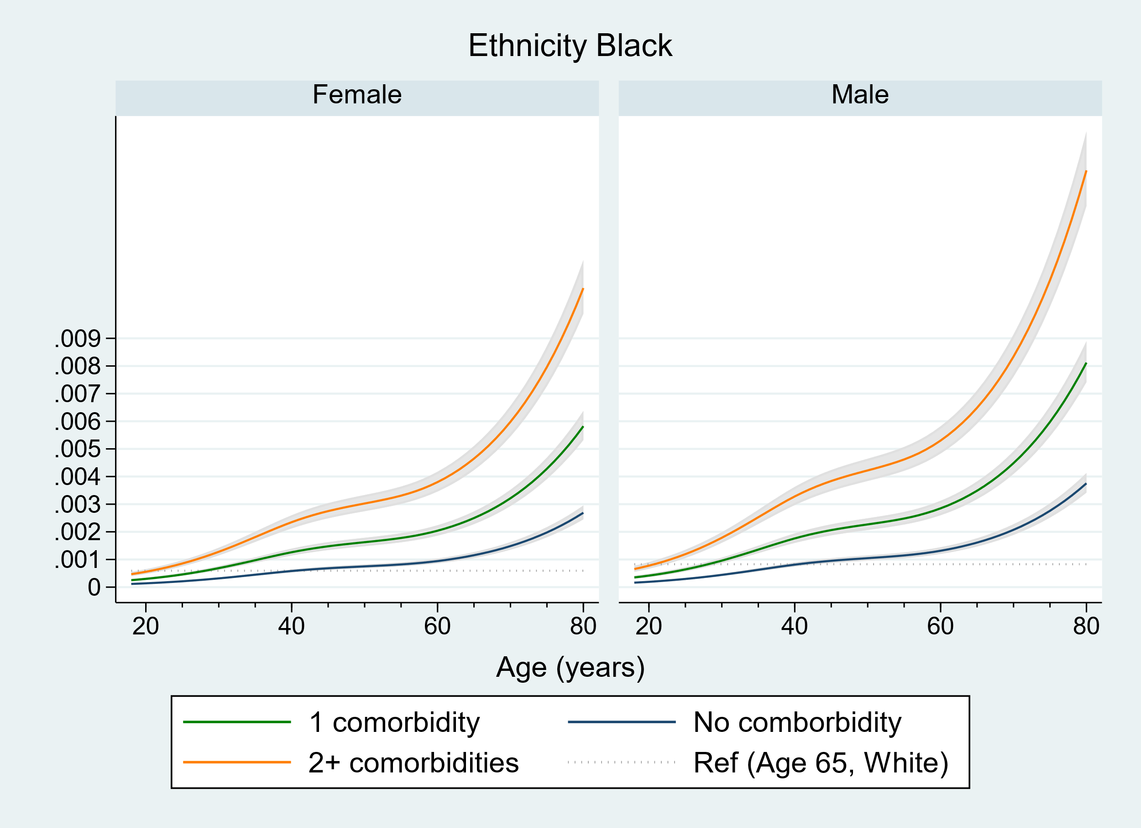
Black ethnicity – hospital admissions

Slide 10
Ethnicity and grouped comorbidity
Ethnicity | Number of comorbidities | Approximate age at which “age 65 risk” is attained
 |  | Death | Hospital admissions
White | 0 | 65 | 65
 | 1 | 57 | 39
 | 2+ | 50 | 28
Asian | 0 | 60 | 50
 | 1 | 53 | 30
 | 2+ | 45 | 28
Black | 0 | 60 | 42
 | 1 | 52 | 28
 | 2+ | 43 | 22
Mixed | 0 | 62 | 48
 | 1 | 52 | 30
 | 2+ | 44 | 27
Other | 0 | 62 | 50
 | 1 | 54 | 32
 | 2+ | 46 | 28
Respiratory disease, severe asthma, chronic cardiac disease, diabetes, non-haematological cancer (diagnosed in last year), haematological cancer (diagnosed within 5 years), liver disease, stroke, dementia, poor kidney function, organ transplant, asplenia, other immunosuppression.

