Slide 1
Open Science Evaluation Overview
Ginger Fitzhugh

Slide 2
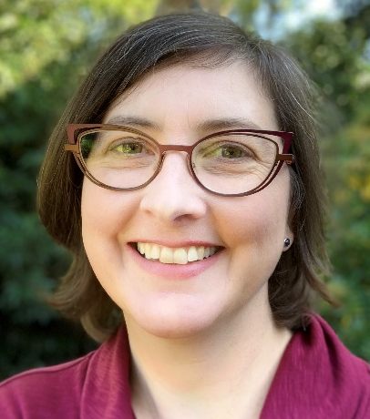
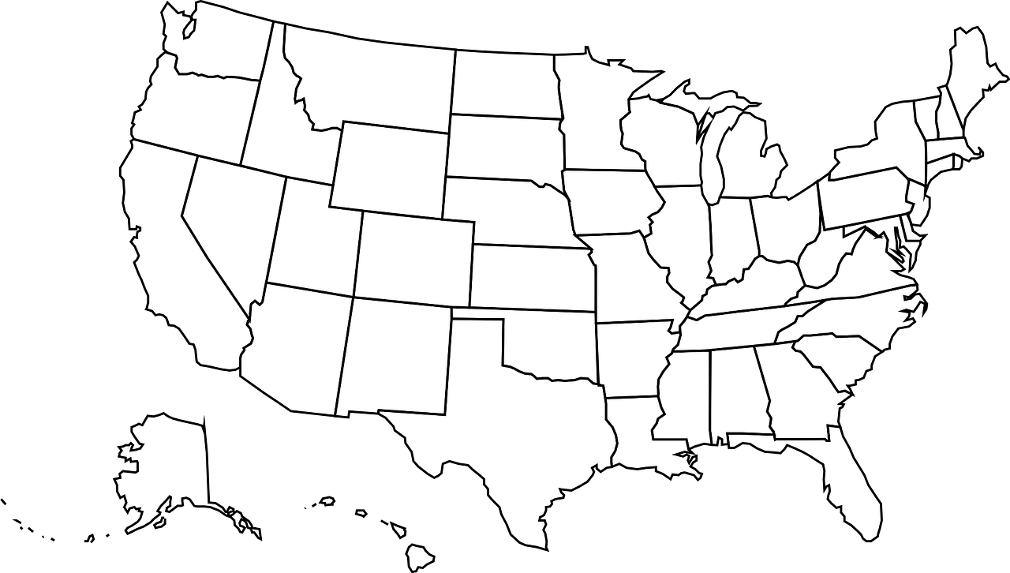

Open science evaluator
Ginger
Fitzhugh
gfitzhugh@edc.org

Slide 3




What we’ll be asking you to do for evaluation
 | What | When
 | Complete brief surveys following specific Open Science workshops/activities | As scheduled
 | Evaluator will attend & observe some meetings | When scheduled
 | Participate in an online focus group or interview | Winter or Spring 2023
 | Complete final survey at the end of your time as a Fellow | Spring 2023

