Slide 1

Software Process Plan-Driven Driven Methodologies
CSC 326

Slide 2
Software Development Process
Process by which user needs are translated into a software product. The process involves translating user needs into software requirements, transforming the software requirements into design, implementing the design in code, testing the code, and sometimes installing and checking out the software for operational use. Note: these activities may overlap or be performed iteratively.

Slide 3
Software Process Model
A simplified, abstracted, description of a software development process
Software methodologists create specific software development processes that
Adhere to the spirit of the models
Have specific software practices
Like the ones we’ve learned this semester…
Engineering: selecting the right model/process/practice for the job

Slide 4
Plan-Driven Process Models
Up front requirements
Stable requirements
Cost of development minimized by up front planning
Architecture and design documented and inspected
“Do it right the first time”
Safety- and mission-critical systems

Slide 5
Agile Process Models
Anticipation of change
Planning done in small iterations
Gather requirements and plan for small chunks of functionality
We’ll discuss Agile Models next class

Slide 6
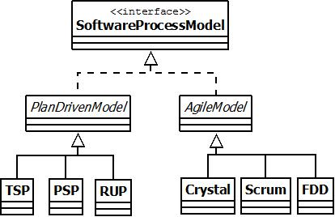
Models and Processes

Slide 7
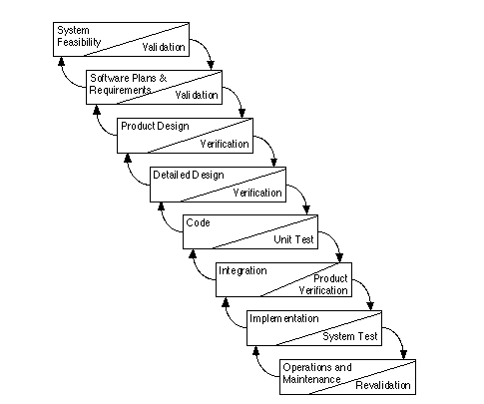
Waterfall Model
Predictable but risky
Notice back/
feedback arrows.
Notes:
Series of products and processes
Completion of one phase before moving on to next phase.
Verification – building software right
Validation – building the right software
V&V activities occur throughout the development process
The feedback arrows show iteration where products are refined during development.
Pros: Works best when requirements are well understood upfront and for contractual requirements – good for defense and aerospace, workforce specialization, documentation and reports
Cons: With feedback loops, changing requirements and specifications are handled, but changing requirements are still difficult to handle. Difficult to use with interactive end-user applications or when the requirements are not understood upfront. No risk assessment. Working system late in process, therefore problems found late in process
http://courses.cs.vt.edu/~csonline/SE/Lessons/Waterfall/index.html
http://www.stsc.hill.af.mil/crosstalk/1995/01/Comparis.asp

Slide 8
Spiral Model
A prototype is released each “circuit.” Some prototypes are specifications.
Part of circuit n is evaluating circuit n-1.
Considers risk
Notes:
Barry Boehm – 1988
The spiral model is waterfall-ish starting in the middle with requirements and each cycle moves through the next phase of development. Prototyping is done until the requirements are understood and then, follows waterfall for design, test and delivery. Maintenance becomes another spiral.
Spiral size = system size
Distance between coils = resources
Size of total spirals = cost of development
Pros: risk-driven approach, use of prototypes, customer evaluation at teach loop and risk assessment, early functionality, incomplete requirements
Cons: customers may not believe evolutionary approach is controllable. Considerable risk assessment, and if a risk is missed, then problems will occur, difficulty with formal review, problems pushed to future
http://courses.cs.vt.edu/~csonline/SE/Lessons/Spiral/index.html
http://www.stsc.hill.af.mil/crosstalk/1995/01/Comparis.asp

Slide 9
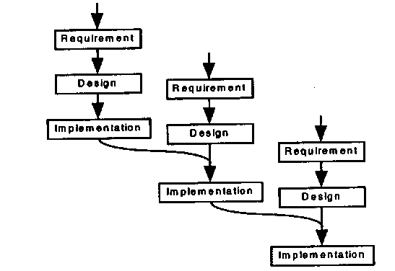
Incremental Model
Incorporate customer feedback
Each iteration delivers to customer
Incremental fundamentally means “add onto.”
Output from an increment is released to customers.
Notes:
Projects divided into small parts, and each iteration is a mini-waterfall
Pros: feedback after each implementation, early working project
Cons: user involved throughout project, scope creep – increased demands
http://www.ctg.albany.edu/publications/reports/survey_of_sysdev/survey_of_sysdev.pdf

Slide 10
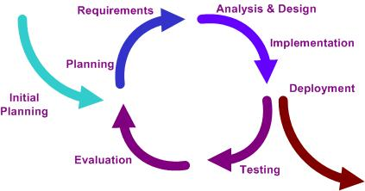
Iterative Model
Iterative fundamentally means “redo.”
Output from an iteration is examined for modification.
Protoyping to incorporate changes
Each iteration deliver sth but not necessarily to a customer
http://en.wikipedia.org/wiki/Iterative_and_incremental_development

Slide 11
Iterative Model II
Prototyping
Rapid application development (RAD)

Slide 12
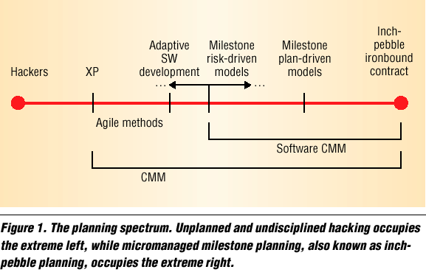
The Planning Spectrum
I
Source: Barry Boehm “Get Ready For Agile Methods, With Care,” IEEE Computer, Jan 2002.

Slide 13
Plan-Driven Software Development Processes
Focus on repeatability and predictability
Defined, standardized, and incrementally improving processes
Thorough documentation
A defined software system architecture defined up-front
Detailed plans, workflow, roles, responsibilities, and work product descriptions
Process group containing resources for specialists: process monitoring, controlling, and educating
On-going risk management
Focus on verification and validation

Slide 14

Personal Software Process
Developed by Watts Humphrey (SEI)
Followed by a single developer
Guides developer in using a defined, measured, planned, and quality controlled process
Also helps developers/engineers understand their own skills to improve personal performance
Scripts, checklists, and templates to guide developer through each level of the PSP

Slide 15
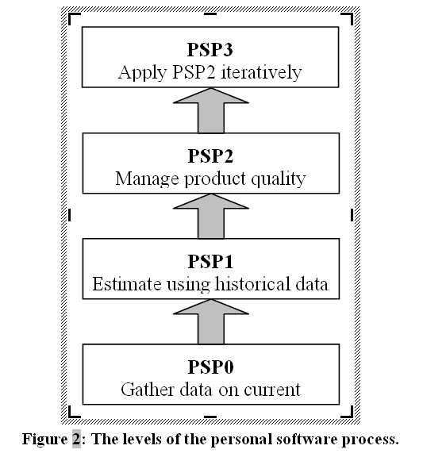
Personal Software Process Levels
Philosophies
Faults that are in the code for a long time are more costly to fix
How do we find faults?
Defect prevention more effective than defect removal
How can we prevent faults?

Slide 16
Process Scripts
Process script – inputs and steps to complete a process
Exit criteria – process completion
Planning script – planning development activities
Size and time estimates
High-level design script – creating high-level design
PSP3 only
High-level design review script – reviewing PSP3 high-level design
Development script – steps for design, code, compile, and test
Postmortem script – analyzing and summarizing the data collected

Slide 17
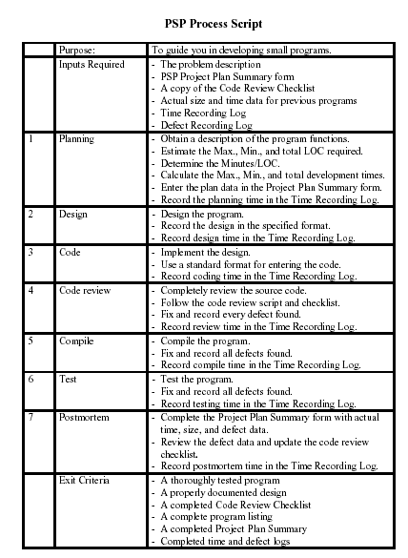
Example Process Script

Slide 18
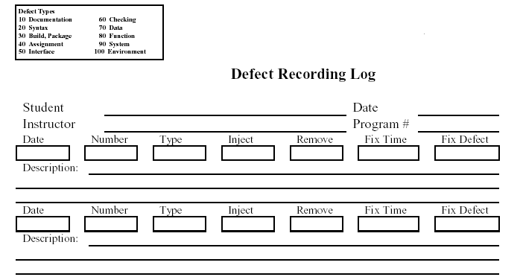
Defect Forms

Slide 19
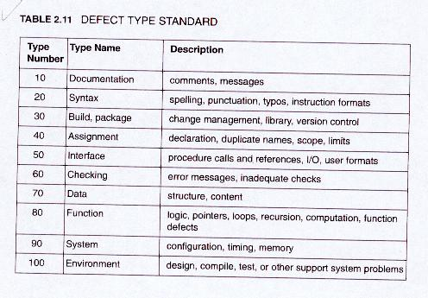
Defect Type (ODC)

Slide 20
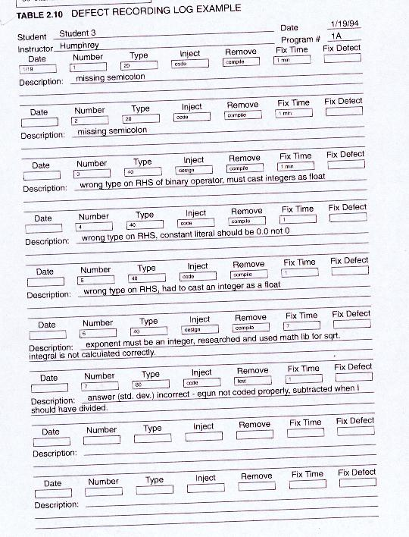

Defect Form Example

Slide 21
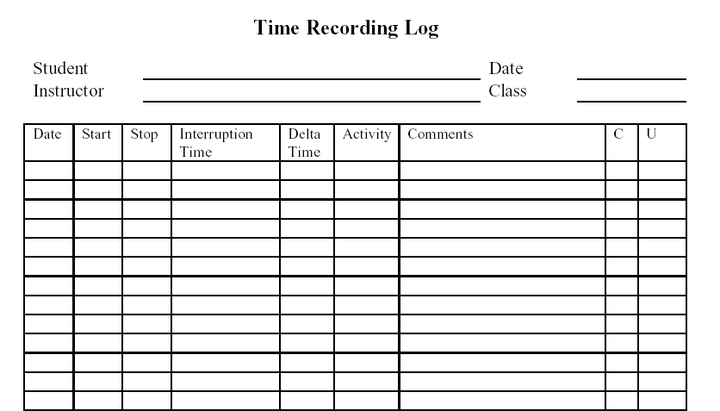
Time Recording Log

Slide 22
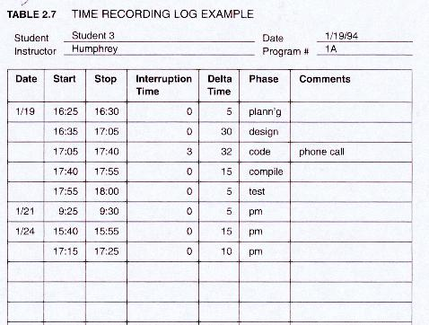
Time Recording Log Example

Slide 23
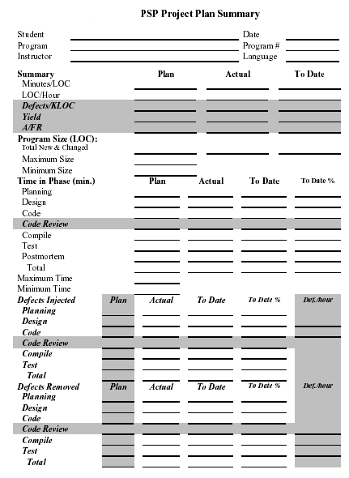
Project Plan Summary

Slide 24
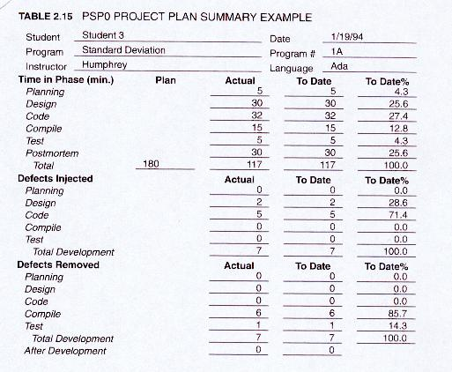
Project Plan Summary Example

Slide 25
PSP Discussion
Advantages
Improved estimation (size & time)
Improved productivity
Reduced testing time
Improved quality
Drawbacks
Some people struggle with detailed reporting
Longevity requires discipline – many people stop using PSP after a while
Notes:
Exercise 26.01

Slide 26
Team Software Process (TSP)
Created by Watts Humphrey
Structure for self-directed teams to
plan and track their work
Establish goals
Create their own processes and plans
Guidance to the individual software engineer about how to perform on a tem
Teams of up to 150 engineers
Large, possibly multi-year projects

Slide 27
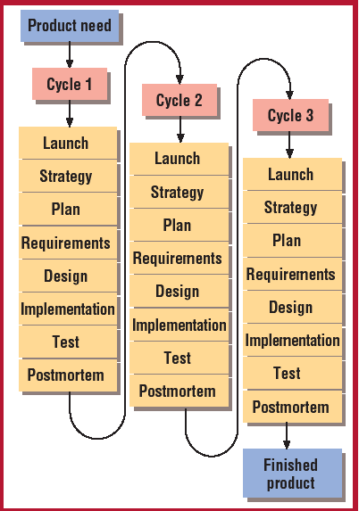
TSP
21 process scripts
10 role scripts
21 forms
3 standards

Slide 28
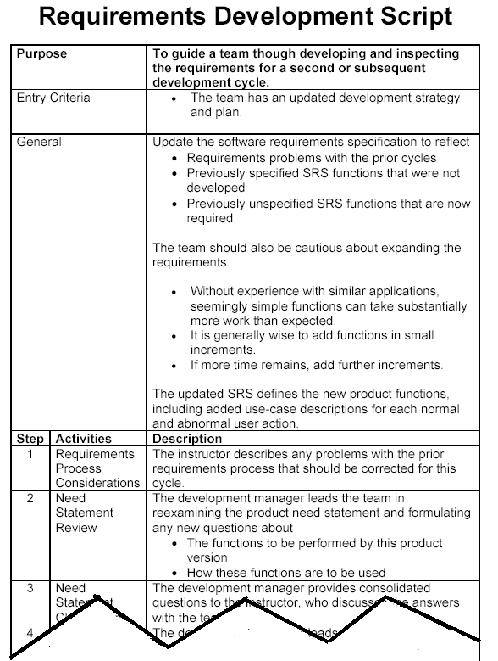
Example Script

Slide 29
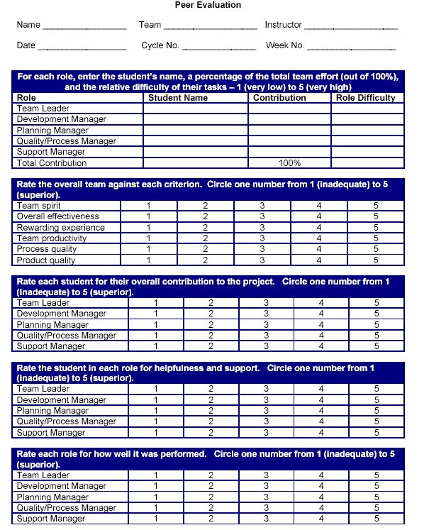
Example Form

Slide 30
Roles
Team Leader
Development Manager
Planning Manager
Quality/Process Manager
Support Manager
Goals of each role outlined in team project roles deck

Slide 31
Discussion
Advantage and drawbacks similar to PSP
Principal Benefit
Shows teams of students or engineers how to produce quality products for planned costs and on aggressive schedules by managing work and making team members owners of their plans and processes.

Slide 32
Rational Unified Process (RUP)
Embeds OO techniques and uses UML as principle notation
Customizable process framework
Tailored or extended to match the needs of an adopting organization (team size, project size, etc.)

Slide 33
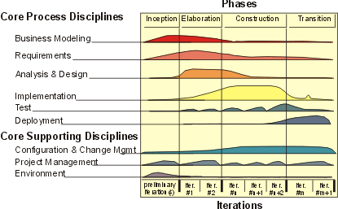
Process Structure
Inception. Defining the objectives of the project, including the business case. This involves risk analysis, initial project plans, and resource requirements.
Elaboration. Creating and validating the architecture of the software system, capturing the most important and critical requirements, and planning and estimating the rest of the project. The use cases developed in the inception phase are done in detail.
Construction. Implementing the system based on the executable architecture created in the elaboration phase.
Transition. Beta testing the system with some customers and preparing release candidates.
“tailor down”

Slide 34
Discussion
Advantages
Specialized for a large class of software systems, different application areas, different types of organizations, different competence levels, and different project sizes
Drawbacks
Seen as impractical for small, fast-paced projects
More Agile versions of RUP

