Slide 1
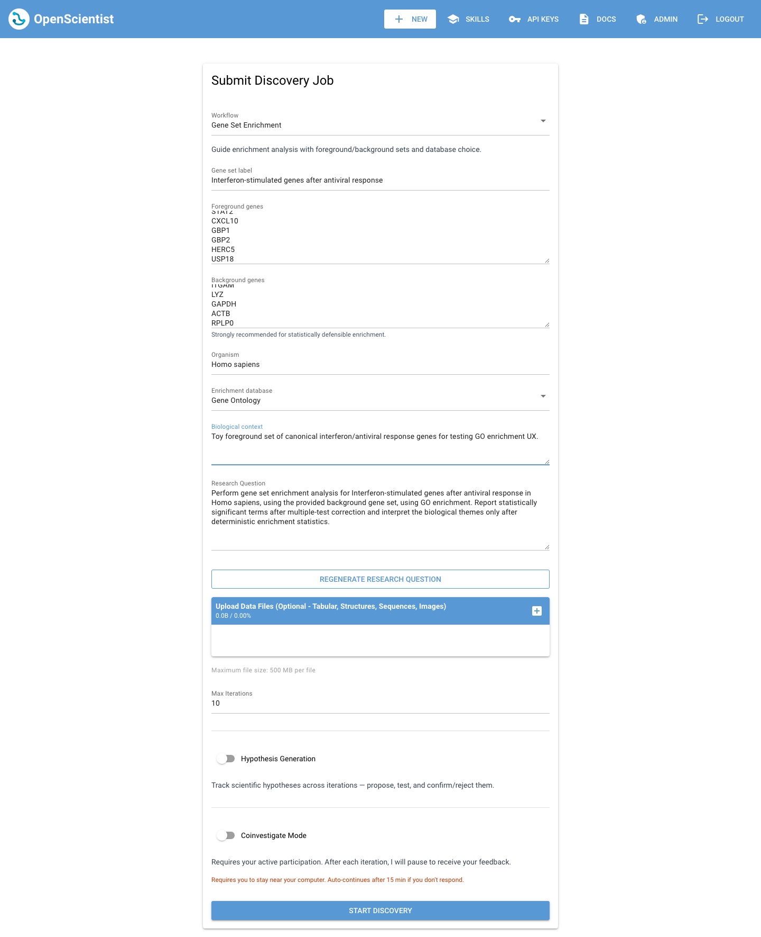
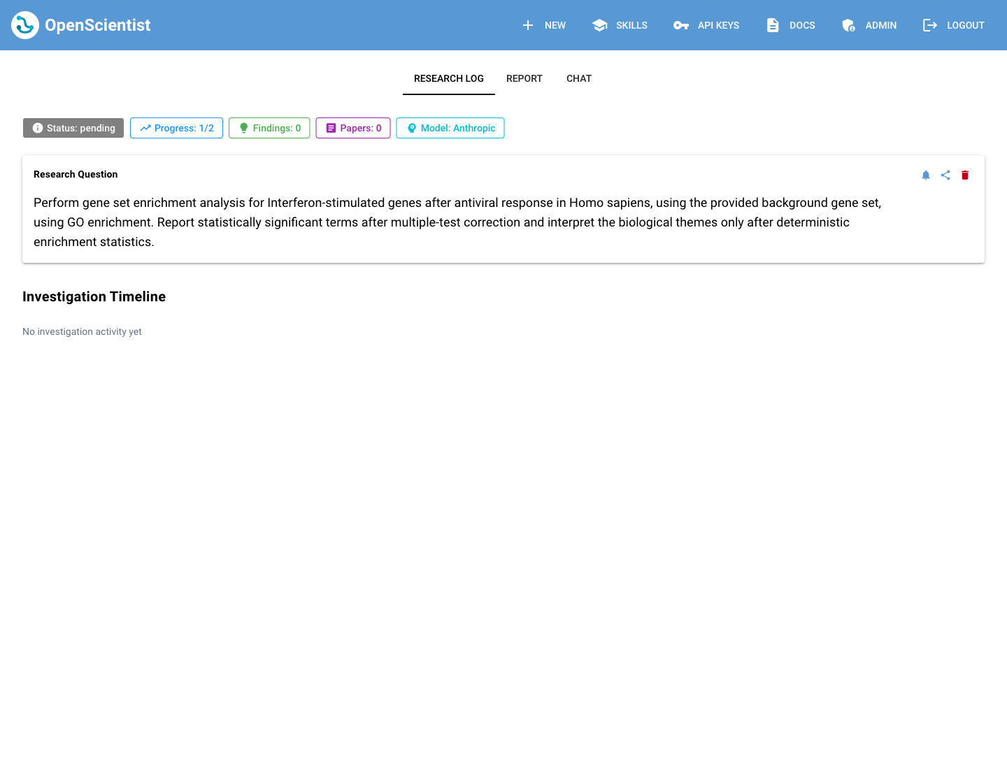
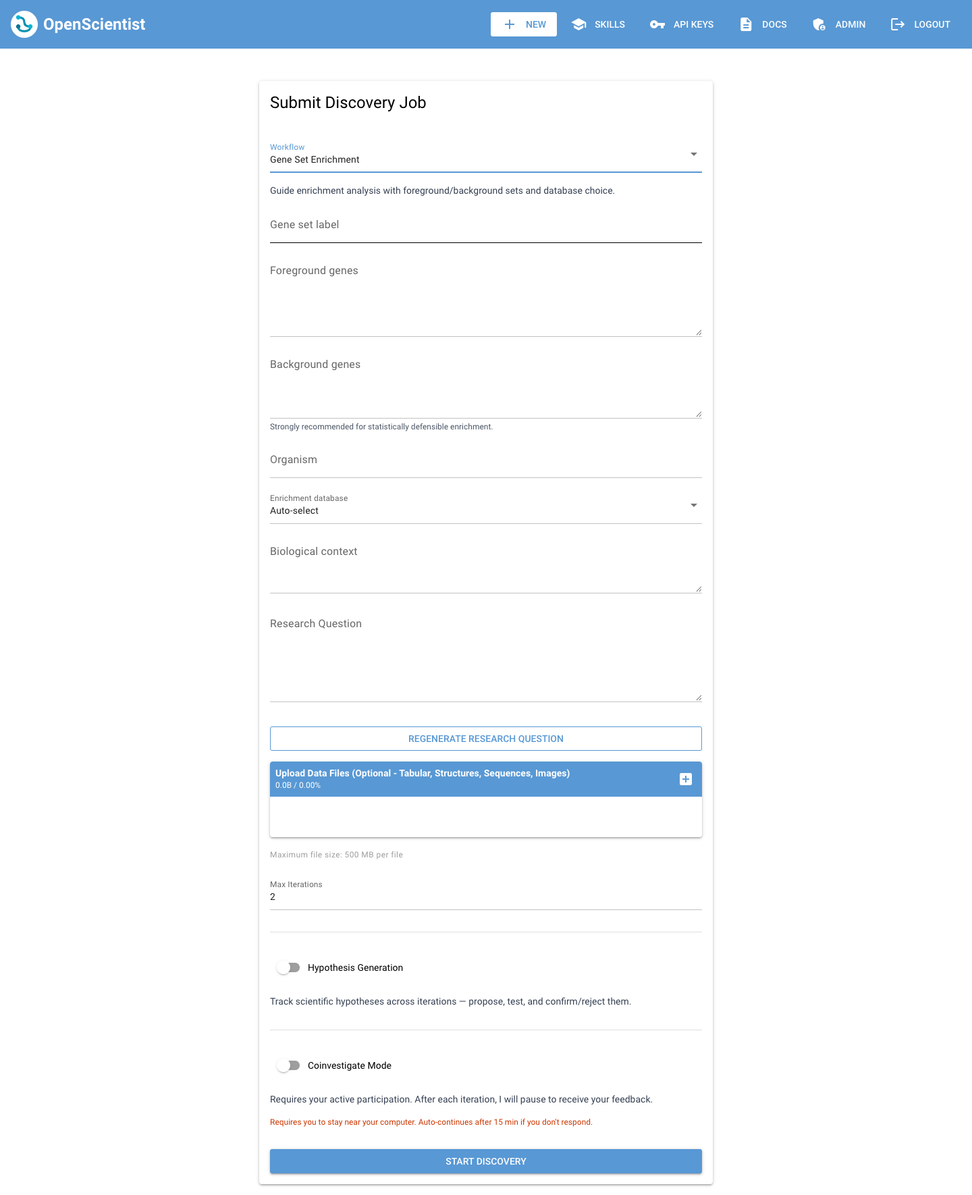
LOCAL PRODUCT WALKTHROUGH
Guided templates make OpenScientist jobs easier to start
The new /new flow preserves freeform discovery while adding structured scientific workflows. This walkthrough uses Gene Set Enrichment with a 2-iteration test run.
6
2
5
screenshots captured from localhost:8080/new
iterations used for enrichment workflow testing
guided workflow families in the template registry
Evidence-led deck: screenshots are the primary artifact, with notes explaining the product and runtime path.
OpenScientist template walkthrough
01

Slide 2
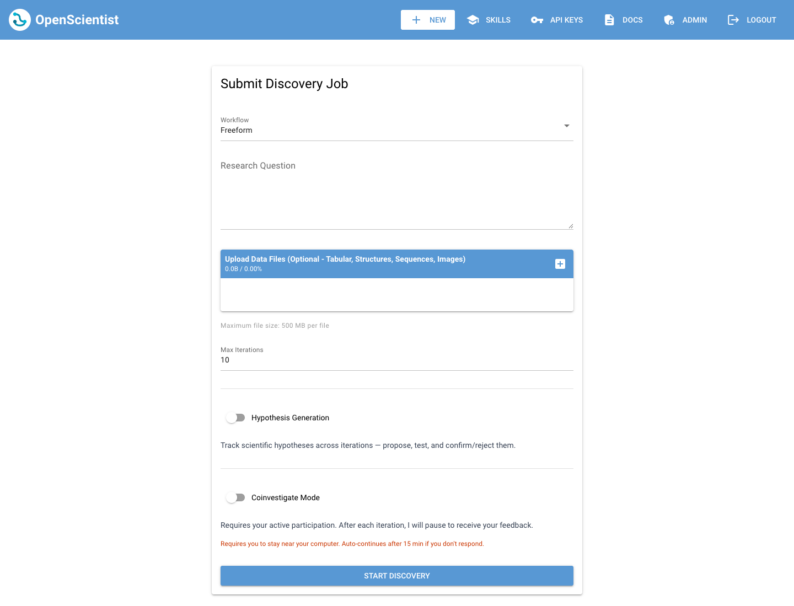
STAGE 1 - ENTRY POINT
The form still starts as a familiar freeform job
Templates are optional. The existing research-question experience stays intact, which lowers adoption risk for users who already know what they want to ask.
Workflow selector is the new entry point
Freeform remains the default, while guided workflows are one dropdown away.
Existing controls remain visible
Uploads, max iterations, hypothesis generation, and coinvestigation stay in the same job creation surface.
User experience goal
Add scientific scaffolding without making the fast path feel heavier.
Freeform default state
Freeform
Workflow
Inputs
Question
Iterations
Job
OpenScientist template walkthrough
02

Slide 3

STAGE 2 - TEMPLATE SELECTED
A workflow selection expands into method-specific inputs
Gene Set Enrichment asks for the inputs that determine statistical validity before the agent starts interpreting biology.
Foreground and background sets are explicit
The workflow captures the test set and the universe needed for defensible enrichment statistics.
Database choice becomes part of the job
GO, KEGG, Reactome, or auto-select are normalized into structured template inputs.
Agent guardrails start here
The template later instructs the runtime to run deterministic enrichment before interpretation.
Gene Set Enrichment template fields
Freeform
Workflow
Inputs
Question
Iterations
Job
OpenScientist template walkthrough
03

Slide 4
STAGE 3 - EXAMPLE DATA
The example gene set turns the template into a concrete question
The form was filled with an interferon-stimulated gene set, a toy background, Homo sapiens, and Gene Ontology as the enrichment database.
Generated research question
Perform gene set enrichment analysis for interferon-stimulated response genes in Homo sapiens using the provided background gene set and GO enrichment. Report significant terms after multiple-test correction.
Why this matters
The user can edit the generated question, but the default now carries the structured inputs and the scientific guardrails forward into the job.
Foreground sample: IFIT1, IFIT2, IFIT3, ISG15, MX1, OAS1, IRF7, STAT1, CXCL10, GBP1, USP18...
Filled enrichment inputs
Freeform
Workflow
Inputs
Question
Iterations
Job
OpenScientist template walkthrough
04

Slide 5
STAGE 4 - ITERATION DEFAULT
Workflow defaults reduce setup friction
After the walkthrough, Gene Set Enrichment was given a default of 2 iterations. Users can still override the number before starting discovery.
Gene Set Enrichment defaults to 2
Enough for a quick deterministic analysis plus interpretation pass during local testing.
Longer workflows get higher defaults
Evidence synthesis and simulation default to 4; microbiome and variant interpretation default to 3.
Manual edits are respected
Once the user edits Max Iterations, workflow switching no longer overwrites their choice.
Template selection preloads Max Iterations = 2
Freeform
Workflow
Inputs
Question
Iterations
Job
OpenScientist template walkthrough
05

Slide 6
STAGE 5 - JOB HANDOFF
Starting discovery persists template metadata and opens the job detail page
The creation path generated a normal job record with template fields attached, then navigated to the existing job detail view.
Persisted state
job_id 23564342-33fd-4b27-8a4f-fc5f45356649
status pending
current_iteration 1 / max_iterations 2
template_id gene-set-enrichment
template_version 1
Observed runtime caveat
The UI and database handoff worked. The background execution did not advance locally because the app process could not reach the Docker socket used by the job container runner.
Job detail after Start Discovery
Freeform
Workflow
Inputs
Question
Iterations
Job
OpenScientist template walkthrough
06

Slide 7
IMPLEMENTATION SUMMARY
Behind the screenshots, templates now travel through the full job stack
The product flow is backed by server-side validation, persisted metadata, prompt guidance, and template-aware skill selection.
Template registry
fields, defaults, guardrails
New Job UI
dynamic fields and generated prompt
API + validation
structured inputs normalized
Database
id, version, inputs
Orchestrator
prompt and skill guidance
What this improves
What the local run surfaced
Users get a scientifically scoped starting point; agents receive method guardrails; the system still stores a plain research question for compatibility.
The page-level flow works. Next polish areas are Docker socket setup for local execution and the fixed-header overlap visible in full-page captures.
OpenScientist template walkthrough
07

