Slide 1
Background
This document provides the high level architecture of SODA Core Projects overall and overall SODA Framework. This will be an running document.
Date | Description | Author
07-Apr-2020 | Initial Document with consolidated architecture so far discussed and proposed in the TSC | Sanil

Slide 2



SODA High Level Architecture
Sanil Kumar (skdsanil@gmail.com)
github: @skdwriting
TSC Member, Architecture WG lead
Updated & Detailed Documentations : https://docs.sodafoundation.io

Slide 3
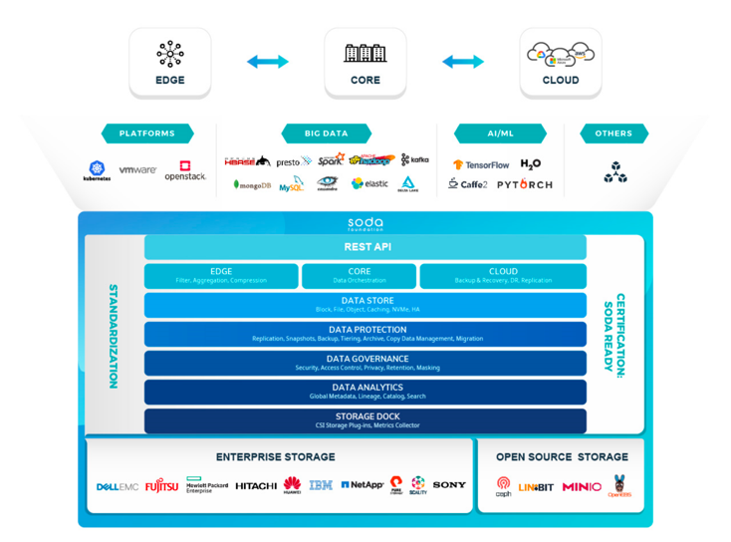
THE SODA FRAMEWORK
SODA is an open source unified autonomous data management framework for data mobility from edge to core to cloud.

Slide 4
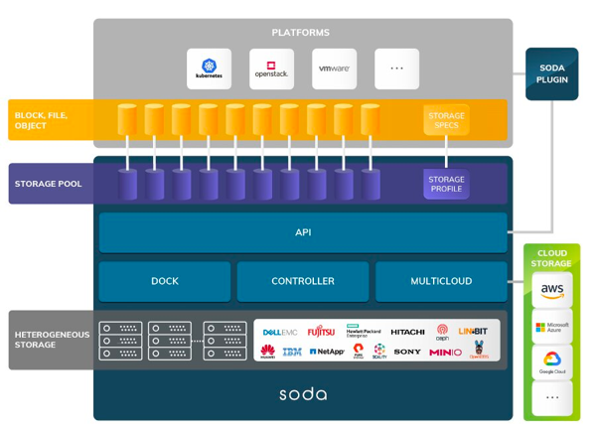
SODA Architecture
SODA comprises the following core projects:
API
Plugins
Controller
Dock
Multicloud

Slide 5
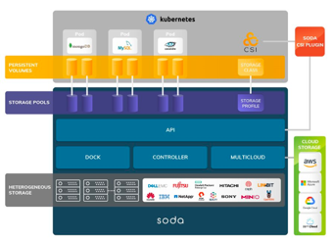
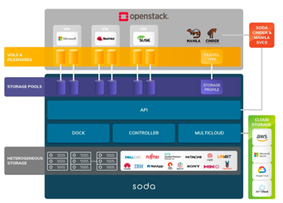
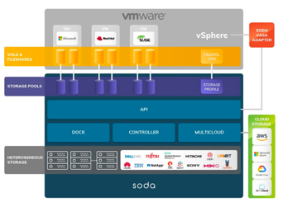
SODA PLUGINS
SODA Plugins enable awareness and seamless integration between SODA and compute platforms or application frameworks.
SODA provides plugins for Kubernetes, OpenStack and VMWare.

Slide 6
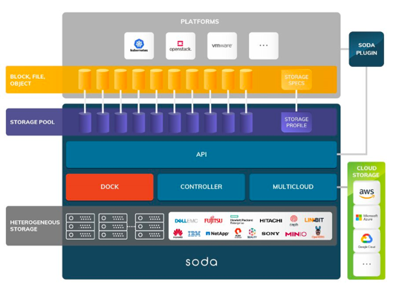
SODA DOCK
SODA Dock allows different storage backends to be connected to SODA with extensible storage drivers. SODA supports OpenStack Cinder and Manila storage drivers, as well as Ceph. We are working looking to extending support for CSI drivers on the backend, which will simplify management and enable orchestration across heterogeneous storage for Kubernetes.

Slide 7
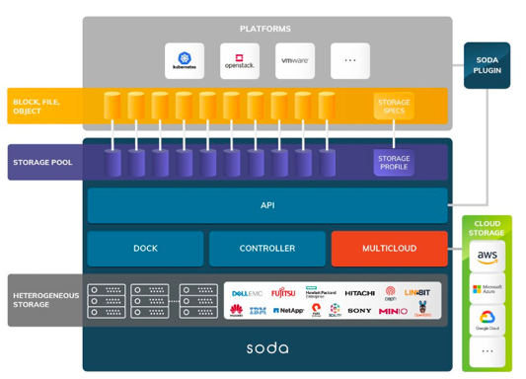
SODA MULTICLOUD
SODA Multicloud provides a cloud vendor agnostic data management for hybrid cloud and multicloud with a common S3 interface.

Slide 8
SODA Platform Architecture (On-prem) along with SODA Telemetry (Elba Release)
nbp, api, controller,dock are separate projects currently
Telemetry feature is implemented in Dock, Controller and API across for specific metrics data. No seperate repo.
Application Platforms
North Bound Plugins
API
Controller
Telemetry
Exporter Plugins
DOCK
IRM
Storage Backends

Slide 9
SODA Platform Architecture (On-prem)
Platform or Application Solution 1
(Ex: Kubernetes, OpenStack, VMWare etc..)
Platform or Application Solution n
(Ex: Kubernetes, OpenStack, VMWare etc..)
SODA Client (Compliant to SODA API)
SODA
North Bound Plugin(NBP) 1
SODA
North Bound Plugin(NBP) n
….
SODA API
Exporter Plugins
SODA Controller
Telemetry
SODA Dock 1
SODA Dock n
SODA Driver 1
….
SODA Driver n
….
SODA Driver 1
….
SODA Driver n
Storage Backend(s)
….
Storage Backend(s)
Storage Backend(s)
….
Storage Backend(s)
**In future, controller could be optional…?

Slide 10
SODA Projects Brief (Elba Release)

Slide 11
SODA API https://github.com/sodafoundation/api
SODA API is an open source implementation of SODA API Standards for Data and Storage Management. The effort is to provide a common unified data and storage interface to store, run any data anywhere.
This project implements the API Server, Different API services, utilities and more. The implementation will be based on the API standards from The SODA Foundation.
It connects the application or client to the storage backends to do data/storage management seamlessly providing a platform and storage agnostic framework.
Any application or client platform can implement the interface using the API specification to connect to API or implement northbound plugins to bridge their specifications to SODA API.
Currently we support block and file APIs for key features of data management (provisioning, migration, fileshare, etc). for on-prem implementation
This is one of the SODA Core Projects and is maintained by SODA Foundation directly.
Earlier part of github.com/sodafoundation/opensds Or github.com/opensds/opensds

Slide 12
SODA Controller https://github.com/sodafoundation/controller
SODA Controller is an open source implementation for all the control services (like metadata management, scheduler, other bookkeeping, utils etc) . This is currently added a separate repository considering many core services could be developed under this for the overall data store framework.
In the API flow from SODA API to SODA DOCK, controller plays a critical role for all the API flow management and tracking to handle all the state machine and metadata management requirements. This will be a layer to keep addons to new services or facilities or utilities for the soda data platform
This layer can be optional going forward or pick and use needed services from the controller during the deployment. However, the users need to do certain integration with api and dock for their controller modules in such cases
Controller interfaces with SODA api and dock.
This is one of the SODA Core Projects and is maintained by SODA Foundation directly.
Earlier part of github.com/sodafoundation/opensds Or github.com/opensds/opensds

Slide 13
SODA DOCK https://github.com/sodafoundation/dock
SODA Dock is an open source implementation for the unified interface to connect heterogeneous storage backends. So dock is a docking station for heterogeneous storage backends! This is where all the different storage vendors drivers for various storage backend models get attached.
We strive to make most of the protocols and backends supported as close as ‘plug n play’. Currently, each storage backend needs a thin, easy to develop SODA Driver Plugin to connect the storage backend to the DOCK. The SODA Driver Plugin and Storage vendor driver together can be called SODA Driver for xxx vendor yy model storage. SODA Driver can support one or more or multiple classes of storage backends.
SODA DOCK can interface directly to SODA API or via Controller. We recommend through the controller for a complete end to end solution, as it can provide the metadata management, handling multiple dock etc. For the api to dock direct interfacing, currently the user needs to do the necessary changes.
Plan to have multiple instance, multi driver docks to support multi-cluster, multi-platform or multi-cloud scenarios in future.
This is one of the SODA Core Projects and is maintained by SODA Foundation directly. We recommend adding all the storage vendor drivers under this project to build a huge repository for the storage vendor support. However the soda driver plugins can be maintained anywhere, and if it is compliant with SODA API, it can be part of SODA Project Landscape.
Earlier part of github.com/sodafoundation/opensds Or github.com/opensds/opensds

Slide 14
SODA NBP https://github.com/sodafoundation/nbp
SODA nbp(North-Bound Plugin) Project focuses to extend all the industry platforms and application solutions to interface with SODA API or make the platform compliant with SODA API developing a plugin. So, with thin, easy to develop north-bound plugins, any platforms can be connected to SODA Platform.
We support multiple top industry platforms like Kubernetes, OpenStack and VMWare. More getting added over the releases based on the users/community demands.
If the application or platform is already compliant with SODA API, the plugin is not needed, as the platform can directly connect to SODA API layer.
This is one of the SODA Core Projects and is maintained by SODA Foundation directly. We recommend building more northbound plugins under this project for each new platform. However there can be cases, one can develop a specific platform plugin and maintain separately. As long as it follows the SODA API standards, it can be submitted to add as a soda landscape project.

Slide 15
SODA Multicloud - https://github.com/sodafoundation/multi-cloud
SODA Multi-cloud project provides a cloud vendor agnostic data management for hybrid cloud, intercloud or intracloud. It provides an s3-compatible interface. It can be hosted on prem or cloud native.
It provides a backend manager which is S3 compatible to connect with any cloud vendors. It supports various cloud backends like MS Azure, GCP, AWS, Huawei, IBM and more. It also supports Ceph backed to enable on-prem. We have also integrated some optimizations and also YIG-Ceph backend from China Unicom YIG project.
Currently it provides Object Storage and we are working to support file and block services from the cloud vendors.
This is one of the SODA Core Projects and is maintained by SODA Foundation directly.

Slide 16
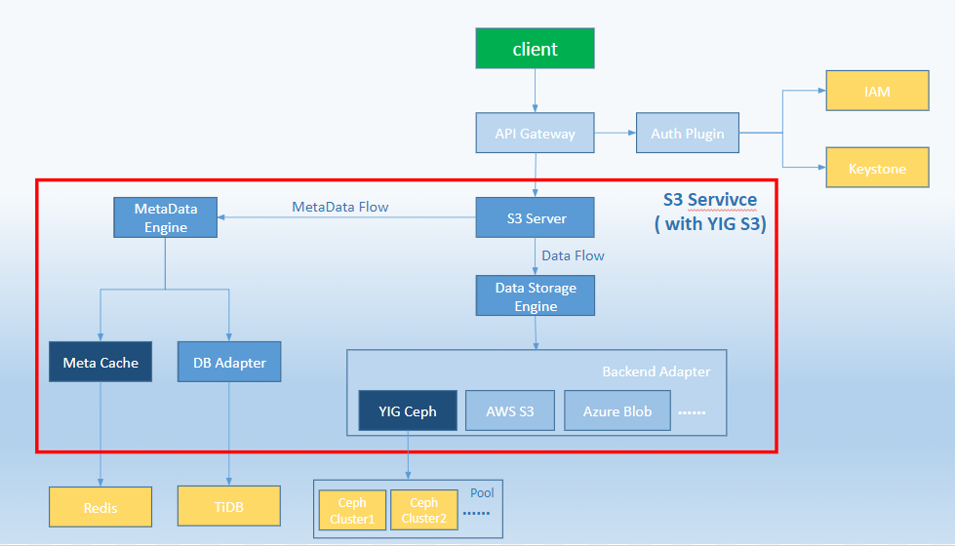

Slide 17
SODA Telemetry (In Elba release the implementation is same as Daito release)
Note: This architecture would be updated in future releases
This provides the monitoring and alert management. Provides standard interfaces to pull the statistical and health data from the infrastructure (including storage, host, ports etc) to export to the clients for further processing. It also provide a highly configurable alert management system.
Extendable design with thin easy to develop exporters to interface telemetry clients to pull the monitoring data for further processing. It can also be exported to machine learning workflows to do AI and build intelligent telemetry. SODA has a reference implementation through SODA Anomaly Detection Project.
Currently we support exporters for Prometheus, Kafka and sample for a third party client.
This will be a separate project and will be managed by SODA Foundation. Mostly this will be changing to SODA Resource & Infrastructure Management

Slide 18
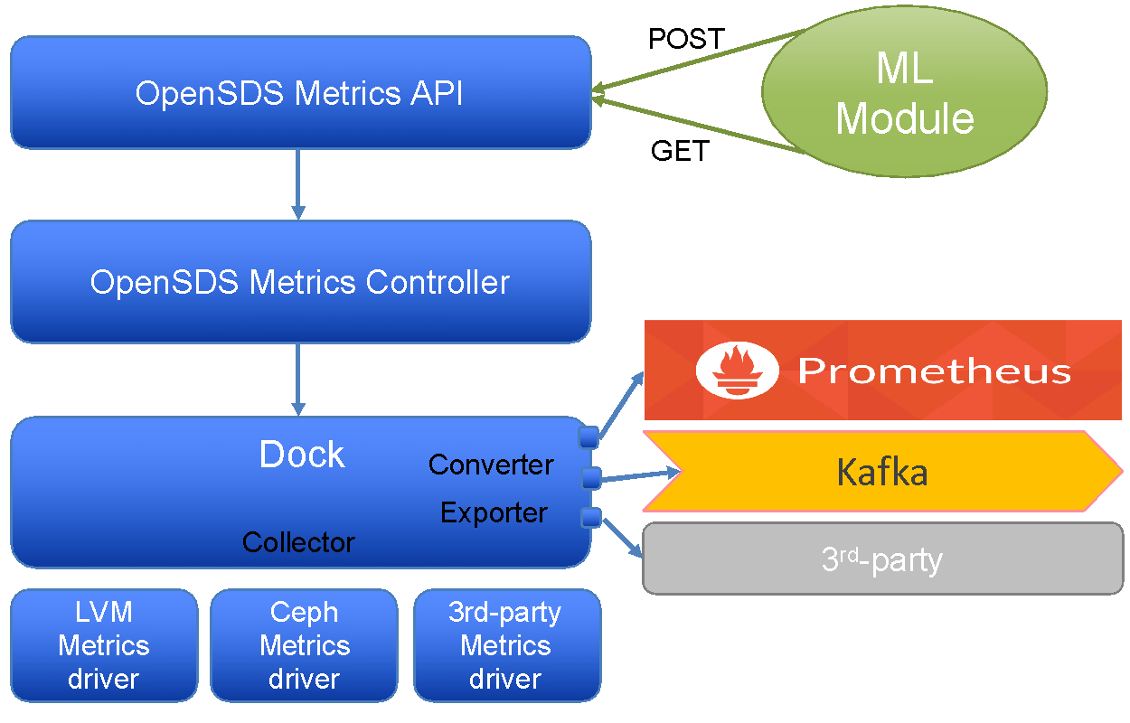
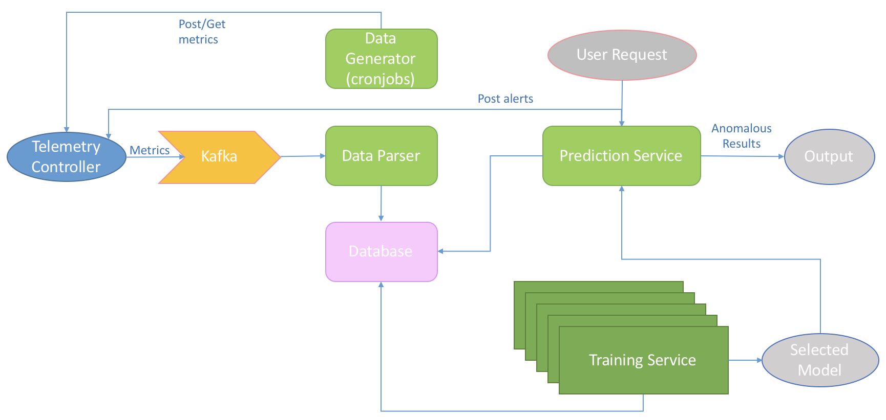
SODA Telemetry - Current View, as in OpenSDS Daito
Note: We are migrating the telemetry feature to SODA from OpenSDS. The above architecture is based on current OpenSDS based.

Slide 19
SODA Orchestration https://github.com/sodafoundation/orchestration
SODA Orchestration project is an open source workflow orchestration & automation framework. In a distributed environment, the business processes consist of several interconnected steps which may require streamline the process. SODA Orchestration provides orchestrating these processes to ensure accurate and faster execution with minimal manual intervention. The Orchestration framework provides flexibility to use existing workflows or define customized workflows to get the simplified execution of tasks.
It has a pluggable workflow engine. Currently we use the open source stackstorm. You can integrate any such workflow engines to SODA Orchestration.
This is one of the SODA Core Projects and is maintained by SODA Foundation directly. . However there can be other SODA Compliant Orchestration projects from partners in future which can be part of SODA Foundation Project Landscape

Slide 20
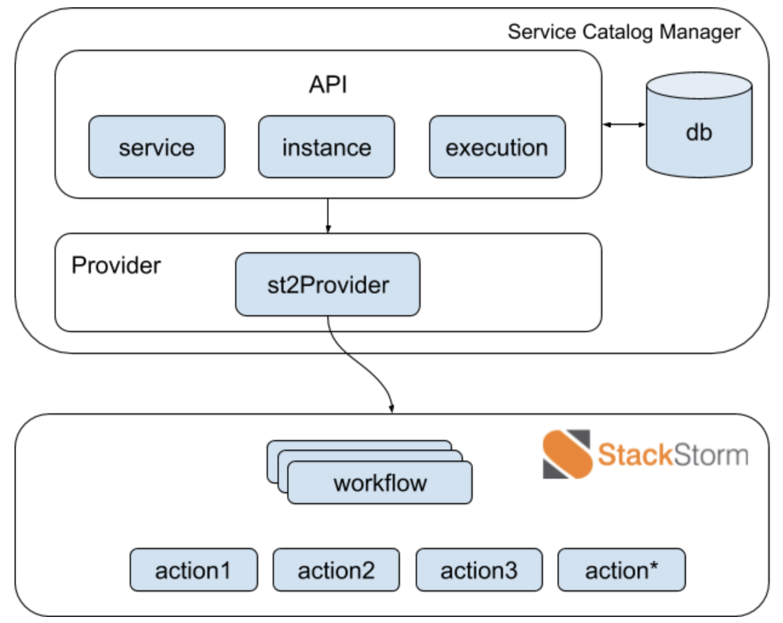
SODA Orchestration
SODA API
SODA MultiCloud
Any other API Service

Slide 21
SODA Anomaly Detection https://github.com/sodafoundation/anomaly-detection
It is a reference implementation of intelligent monitoring which can utilize SODA Telemetry data, through exporters with Kafka (or similar) and a standard ML algorithm.
Any machine learning algorithm based on the use case can be integrated to this framework for specific data analysis and prediction.
This is one of the SODA Core Projects and is maintained by SODA Foundation directly. However there can be other SODA Compliant Anomaly Detection or intelligent telemetry projects from partners in future which can be part of SODA Foundation Project Landscape.

Slide 22
Current View, as in OpenSDS Daito
Note: We are migrating the telemetry feature to SODA from OpenSDS. The above architecture is based on current OpenSDS based.

Slide 23
Join Us!
https://www.sodafoundation.io
https://github.com/sodafoundation
info@sodafoundation.io
@sodafoundation
Thank You
https://www.sodafoundation.io/slack/

