Slide 1
UCCS for OpenSHMEM
Presenters: Aaron Welch, Pavel Shamis, Steve Poole
Material: Aaron Welch, Pengfei Hao, Deepak Eachempati, Swaroop Pophale, Tony Curtis
University of Houston, Texas
http://www.uh.edu/

Slide 2
UCCS – Universal Common Communication Substrate

Slide 3

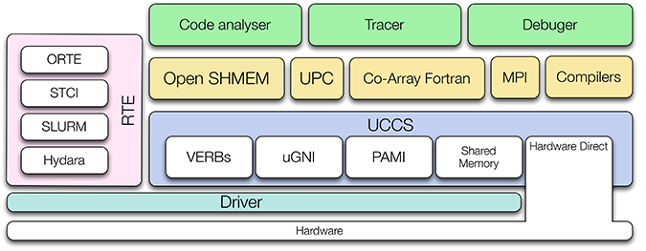
UCCS Overview
Abstract communication and networking implementation details
Support multiple transport layers/programming models
Provide single consistent interface
Communication decoupled from run-time environment
3
Notes:
3

Slide 4
Motivation
Efficient communication expected to become increasingly important
What underlying technologies will prevail is unclear
Provide general but low-level interface capable of supporting current or future models
Notes:
4

Slide 5
Usability Goals
Increase code reuse, decrease complexity of network backend
Support for multiple communication libraries
Tight integration to foster support for languages and tools
Notes:
5

Slide 6
UCCS Design
Designed for low overhead, scalability, and resiliency
Maintain minimal footprint with emphasis on reducing the critical path by operating very close to the hardware
Three different sizes for puts and gets (short, medium, and large) using different methods for handling network requests
Emphasis on non-blocking calls using request handles
Support for atomic operations and low-level collectives
Notes:
6

Slide 7
UCCS Design
Capabilities interface allows for querying of hardware support details
Connectivity maps allow for heterogeneous network systems
Dynamic memory registration for multiple remotely accessible regions
Support for active messages
Notes:
7

Slide 8
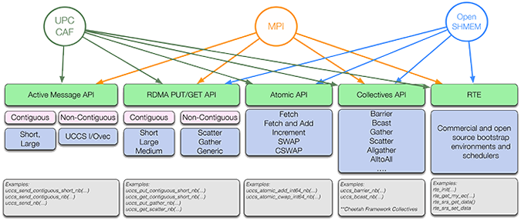
UCCS Design
Notes:
8

Slide 9
UCCS Concepts
Contexts provide communication scope and isolation
Resources represent available communication channels for a network
Endpoints are the destinations reachable over a particular resource
Notes:
9

Slide 10
RTE Design
Handles bootstrapping and other dynamic aspects of the run-time environment
Provides out-of-band support
Abstracted under a single interface to support multiple RTE backends including ORTE, STCI, SLURM, and ALPS
Notes:
10

Slide 11
Modular Component Architecture
Allows for multiple components to be plugged in or swapped out
Interface allows for easy creation of custom components
Licensing support extends to development of proprietary components
Notes:
11

Slide 12
Transport Layers
Multiple options including InfiniBand, uGNI, and support for intra-node communication
Can be dynamically selected, mixed, and matched
Allows support for hybrid network systems, multi-rail
Integrates with capabilities for transport priority when multiple routes available
12
Notes:
12

Slide 13
What UCCS allows
Library implementers can easily support a wide array of network technologies and configurations
Consistent interface across multiple interconnects and communication libraries
Hybrid development
Heterogeneous systems
Notes:
13

Slide 14
User Environment
Communication Library
UCCS
libRTE
RTE backend (ORTE, STCI, etc)
Notes:
14

Slide 15
Example: shmem_int_add()
shmem_int_add(void *target, void *value, size_t nbytes, int pe) {
uccs_request_handle_t desc;
uccs_status_t status;
resource = select_highest_priority_resource(pe);
dest = translate_target_to_remote_address(target);
find_memory_registration_for_dest_on_pe(dest, pe, &rem_reg);
uccs_atomic_add_int64_nb(resource, endpoint, dest, &rem_reg,
value, 255, &desc);
uccs_wait(desc, &uccs_status);
}
Notes:
15

Slide 16

Example: shmem_int_p()
void shmem_int_p(int *target, int value, int pe) {
uccs_request_handle_t desc;
dest = translate_target_to_remote_address(target);
uccs_put_contiguous_short_nb(resource, endpoint, dest,
&value, &remote_reg, sizeof(int), 0, &desc);
uccs_wait(desc, &status);
}
16
Notes:
16

Slide 17
Example: shmem_int_put()
void shmem_int_put(int *target, const int *source, size_t len, int pe) {
uccs_request_handle_t desc;
dest = translate_target_to_remote_address(target);
if (len <= comms[pe].short_put_size)
uccs_put_contiguous_short_nb(resource, endpoint, dest,
source, remote_reg, len, 0, desc);
else if (len <= comms[pe].medium_put_size)
uccs_put_contiguous_medium_nb(resource, endpoint, dest, source,
remote_reg, NULL, len, 0, desc);
else
uccs_put_contiguous_large_nb(resource, endpoint, dest, source,
remote_reg, NULL, len, 0, desc);
uccs_wait(desc, &status);
}
Notes:
17

Slide 18
Testing Environment
OpenSHMEM reference implementation 1.0e
GASNet v1.20.2
Pre-production version of UCCS based on v0.2 of UCCS specification
SGI Altix XE1300 system with 12 nodes with two Intel Xeon X5660 CPUs
InfiniBand interconnect using Mellanox ConnectX-2 QDR HCA
SGI MPT v2.03
Notes:
18

Slide 19
Testing Environment
Results obtained from “Designing a High Performance OpenSHMEM Implementation Using Universal Common Communication Substrate as a Communication Middleware”, First OpenSHMEM Workshop
19
Notes:
19

Slide 20
Put Latency
Notes:
20

Slide 21
Get Latency
Notes:
21

Slide 22
Long Long Fetch-and-Add Latency
Notes:
22

Slide 23
Development Status
Supported interconnects: IB, uGNI/Cray
http://uccs.github.io/uccs/
mailto:uccs-info@ornl.gov
Notes:
23

Slide 24


Acknowledgements
This work was supported by the United States Department of Defense & used resources of the Extreme Scale Systems Center at Oak Ridge National Laboratory.

