Slide 1
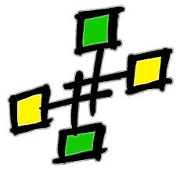
Openshmem analyzer (OSA)
Presented by:
Dounia Khaldi

Slide 2



Acknowledgments
The OpenSHMEM Analyzer is an on-going research project developed collaboratively by Oak Ridge National Laboratories and the University of Houston, with funding from DOD.

Slide 3
Outline
Motivation
Features
OpenUH Compiler
Current Analyses
How to install
How to use (Demo)
Conclusion
Current Work

Slide 4
Motivation
Library vs. Language
Common errors
Porting existing codes to OpenSHMEM
OpenSHMEM specification allows unaligned barriers
Necessity of compile-time approach for large scale executions
Implementation of OpenSHMEM-aware compiler within OpenUH
Notes:
Library based models such as OpenSHMEM is treated as a blackbox for the compiler and do not benefit from the same semantic checking capabilities offered to a language

Slide 5
Features
Supported input languages: C and C++
Source code analysis and correctness checking capabilities
Verification at compile time that all OpenSHMEM library calls are using the appropriate classes of data as required by Specification 1.0
Graphical and textual display of analyses for the source program
Intra-and Inter-procedural analysis using IPA phase of the OpenUH compiler.
Notes:
- The OpenSHMEM Analyzer has an interactive component that provides a graphical user interface using HTML to display its output and to navigate the source code and error messages within them.
-The current input languages for the OpenSHMEM Analyzer are C/C++, OpenSHMEM API 1.0.

Slide 6
OpenUH compiler
Open64-based compiler
Sophisticated intra- and inter-procedural analyses and optimizations
Existing support for parallel models: OpenMP, OpenACC and CAF

Slide 7
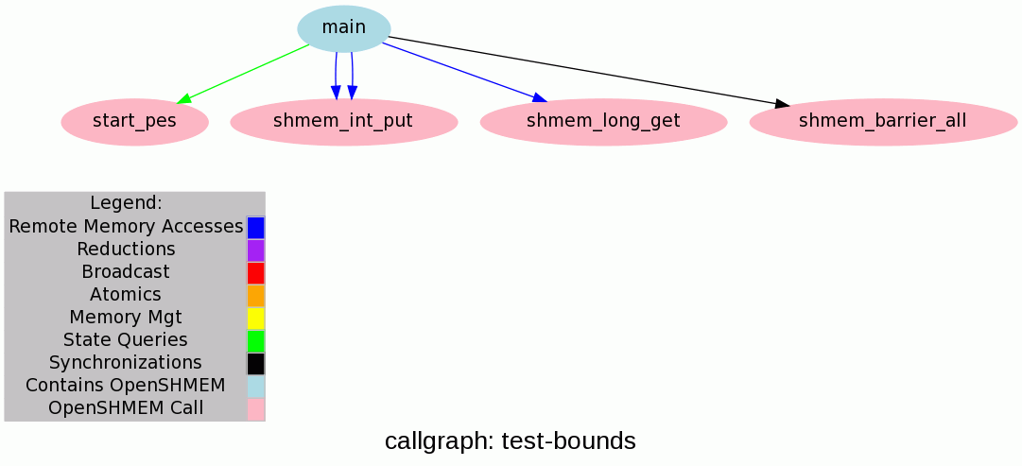
OpenShmem Analyzer in Openuh
Compilation using OpenUH
uhcc -shmem-analyzer -c
Linker (interprocedural)
uhcc –shmem-analyzer *.-o
Symmetric Variable Checking
Bounds Checking
Type Checking
Pointer Initialization Checking
Barrier Matching
Enabling parallel optimizations:
message vectorization, communication/computation overlap...

Slide 8
Current Analyses
 | Collective Operations | RMA Operations | Synchronization Operations
Symmetric variable checking | X | X | X
Bounds checking | X | X | X
Type checking | X | X | X
Pointer initialization | X | X | X
Barrier matching |  |  | X

Slide 9
How to install
The project website for the OpenSHMEM Analyzer
http://www.openshmem.org/OSA
Install OpenUH (>= 3.0.38)
http://web.cs.uh.edu/~openuh/download/
Packages to Install:
Code2html
Graphviz
Notes:
Installation instructions:
Install code2html 0.9.1
http://www.palfrader.org/code2html/
Use current .tar.gz file)
Note: Make sure to add the path to 'code2html' to your $PATH
Install graphviz 2.28.0
http://www.graphviz.org/
Use current .tar.gz file
Recommended Configuration: ./configure --prefix=<install directory> --enable-python=no
Note: Make sure to add the path to 'dot' to your $PATH

Slide 10
How to use OpenSHMEM Analyzer (Demo)
Hints on preparing programs for OSA
Visualization of results and manipulating graphs
Demo videos are here
http://web.cs.uh.edu/~hpctools/openshmem

Slide 11
Conclusion
Work in progress
Starting point for
Complete semantic awareness of OpenSHMEM in the compiler
A comprehensive analysis and optimization framework for OpenSHMEM
Notes:
The tool is currently in its infancy and there are many enhancements to be made, both with
analysis capabilities and with its use and invocation.

Slide 12
Current work
Improving interprocedural analyses
Extending OpenSHMEM Analyzer to PGAS using the Parallel IR of OpenUH
More analyses such as data race detection
Developing optimizations based on OSA
Notes:
TO DO
Fix Figure 1 in shmem analyzer guide (shmemcc → uhcc)
Remove the generation of .msg files
Remove dot files after generation of gif images
Restructure OpenSHMEM code in OpenUH
Record test-bounds

