Slide 1




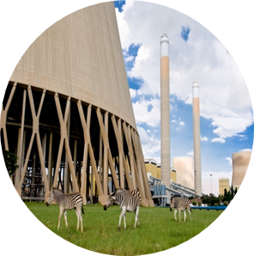

Block with Hole Tutorial
Stefan van der Walt
vdwalts@eskom.co.za
01/12/2016

Slide 2
Background
In this tutorial a basic block with a hole will be created using the part design workbench.
A steady state thermo-mechanical finite element analysis will then be set up and solved.
The results will be displayed with the built-in results view.
A transient thermo-mechanical finite element analysis will then be set up and solved.
The results will be viewed by using a macro to plot different result types.

Slide 3
Project Startup

Slide 4
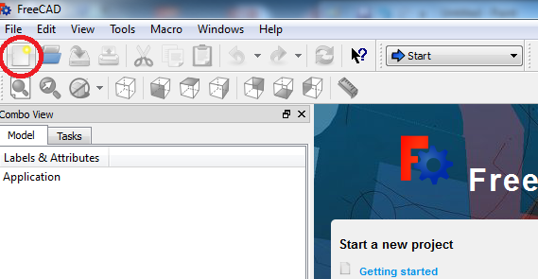
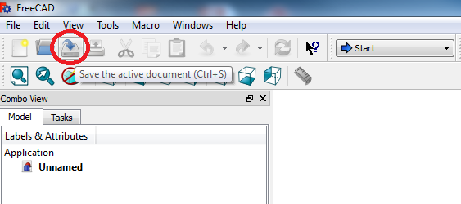
Project Startup
Create the Project:
When you open Freecad, the home screen appears.
Create a new document by clicking on the ‘Create a new empty document' icon.
It is a good idea to save the document before starting. Click on the ‘Save’ icon on the taskbar. Name the file “Block”.
Remember to save regularly.

Slide 5
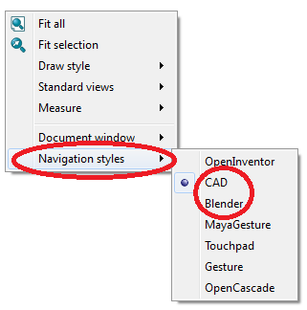
Project Startup – Mouse Navigation
Basic navigation
There are different navigation modes available within Freecad. If you right-click anywhere on an open part of the display window, you can select the navigation mode you prefer.
The ‘CAD’ and ‘Blender’ navigation styles are two of the most commonly used styles.

Slide 6
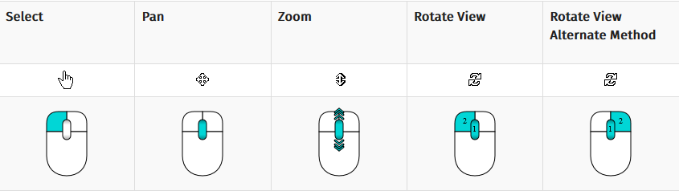
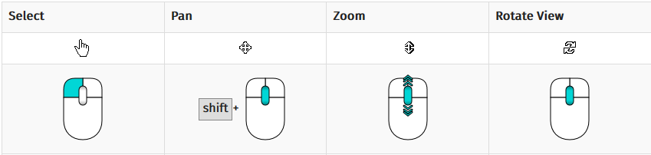
Project Startup – Mouse Navigation
Rotate parts with navigation styles
It is important to know how to rotate parts with these navigation styles.
If the Blender style is selected, a part can be rotated by clicking and holding the middle mouse button.
If the CAD style is selected, you can rotate a part by clicking and holding both the middle mouse button and the left mouse button.
The images on the right summarises the main mouse functions.
CAD Navigation
Blender Navigation

Slide 7
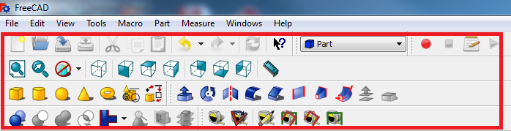
Project Startup - Layout
Screen layout and terminology
Certain terms will be used throughout the training material, which will be shown here.
The taskbar refers to the area at the top of the screen where all the relevant icons are located. The icons will change whenever the workbenches are changed. The example shown here is of the taskbar with the general icons as well as the Part workbench icons.
The entire area enclosed within the red box is referred to as the taskbar.

Slide 8
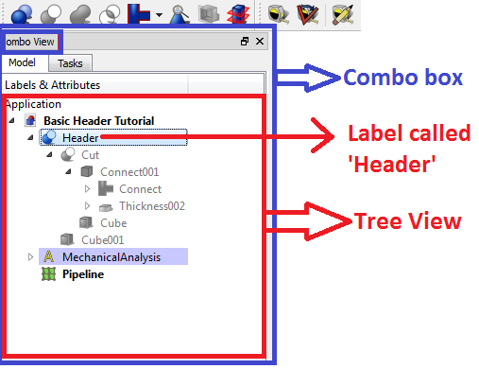
Basics – Layout
Other terms often used are the tree view, combo box and label.
The tree view, which is contained within the combo box, refers to the window in which all the parts and features that was created and applied to the model are displayed.
In the example shown, the tree view contains features added with the parts workbench as well as features added with the FEM workbench. Each item in the list is called a ‘Label’ and has a name. If you click on a label you can edit its properties which appear underneath the tree view.
You can hide a label by clicking on it and pressing spacebar.

Slide 9
Creating the geometry

Slide 10
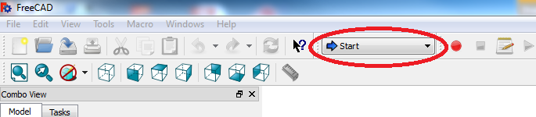
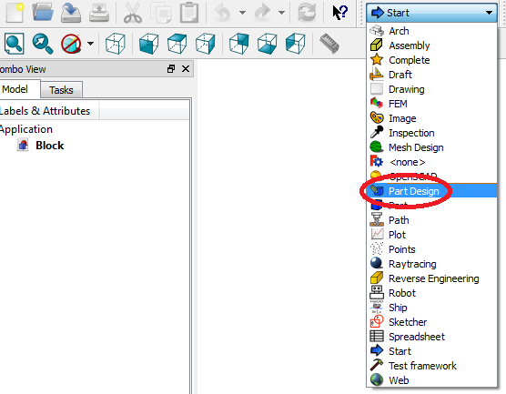
Creating the Sketch
Create the Project:
The workbench dropdown menu is located at the top of the screen on the taskbar. If Freecad has just been opened, it will display ‘Start’, otherwise it will display the most recent workbench that was used.
Click on the workbench dropdown menu. The menu will expand and display all the available workbenches within Freecad.
Click on the ‘Part Design’ workbench.

Slide 11
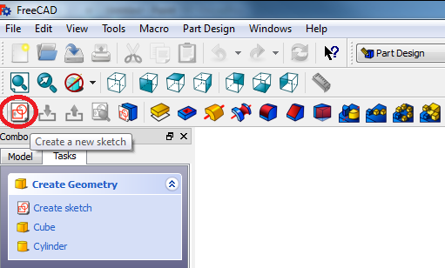
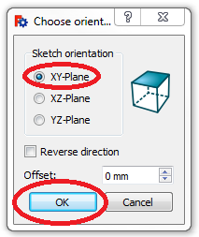
Creating the Sketch
Once the workbench has been changed to the Part Design workbench, locate the ‘Create a new sketch’ icon on the taskbar, and click on it.
A prompt will appear, asking on which plane to create the sketch. Select the ‘XY-Plane’, and click on ‘OK’ to close the prompt.

Slide 12
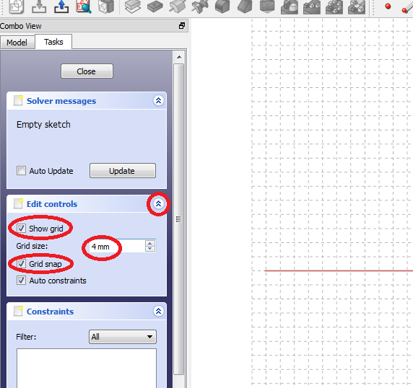
Creating the Sketch
A sketch grid will appear, and its fineness and other options can be adjusted in the combo view to the left of the screen.
Expand the ‘Edit controls’ box by clicking on the arrow next to it.
Ensure that ‘Show grid’ is enabled in order to view the sketch grid, enable ‘Grid snap’ (this will ensure that your sketch snaps to the grid) and change the fineness to 4mm.
These settings can be changed for other projects according to your preferences, but for the purpose of this tutorial we will change it to its current values and settings.

Slide 13

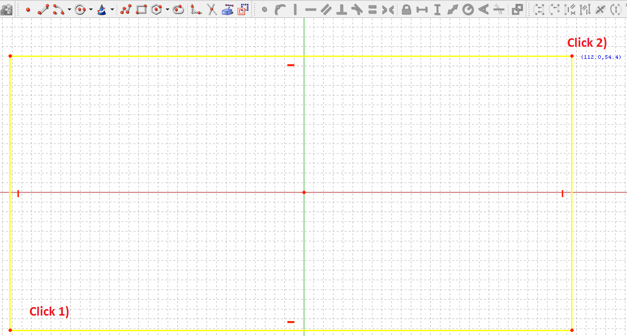
Creating the Sketch
Select the ‘Rectangle’ icon on the taskbar.
To draw a rectangle, go to the sketch area in the display window and click and release on the bottom left part of the sketch grid to set the bottom left corner of the rectangle.
The sketch function is now active, and the rectangle will be seen as the cursor is dragged over the screen. Move the cursor to the top right-hand part of the screen and click and release again to create the top right-hand corner of the rectangle.
Right-click to exit the ‘Rectangle’ sketching function.

Slide 14

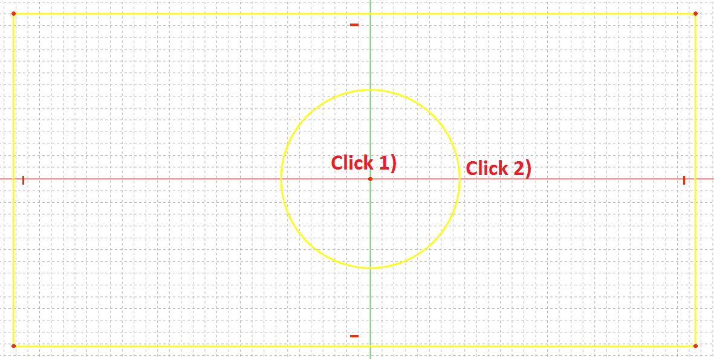
Creating the Sketch
Next, click on the ‘Insert Circle’ icon in the taskbar.
Hover over the origin until it turns yellow, then click and release to start drawing your circle. Click and release again to finalise drawing your circle. Ensure that the circle fits well within the rectangle.
Right click to exit drawing mode.

Slide 15
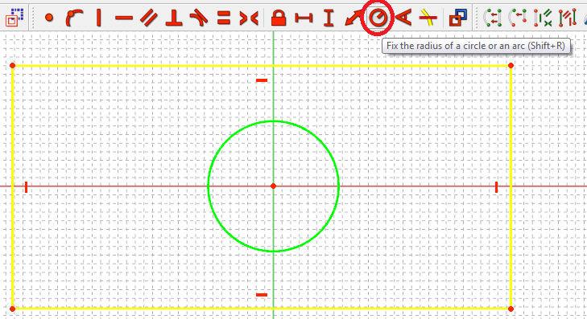
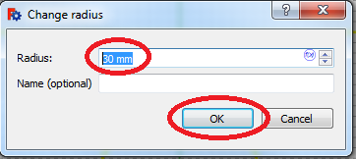
Creating the Sketch
After right-clicking to exit drawing mode, hover with the mouse pointer over the circle until it changes colour, and click on it to select it.
Go to the constraints icons (icons with red colours) on the taskbar, and select the ‘Radius’ constraint.
Depending on the size of your block, type in a value which ensures that the circle still fit comfortably inside the block, a rounded value as close as possible to the circle’s original value.
Click on ‘OK’ to close the dialogue.

Slide 16
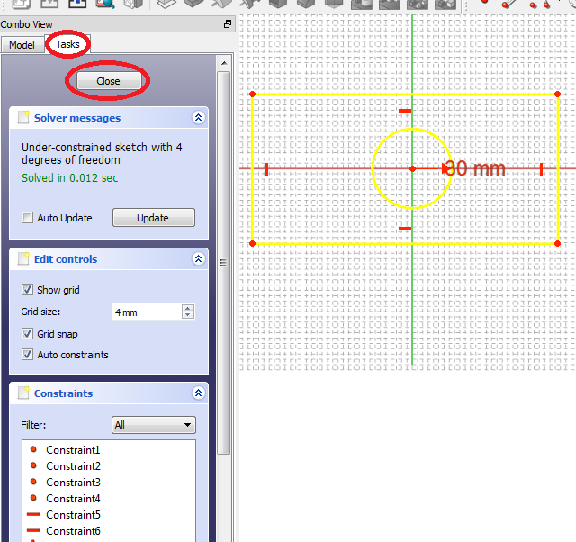
Creating the Sketch
After changing the radius of the circle, the sketch can be closed. This can be done by clicking on the ‘Close’ button in the combo view, under the ‘Task’ tab.

Slide 17
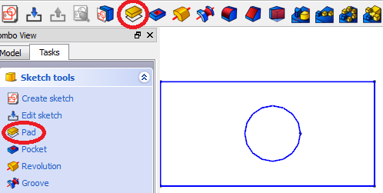
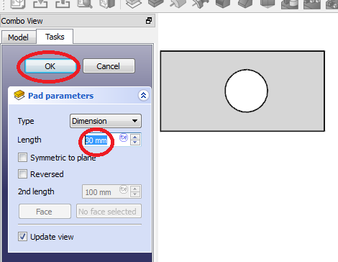
Extruding the sketch
After clicking the ‘Close’ button, a selection of features automatically appear under the ‘Task’ tab. Either click on the ‘Pad’ icon in this list or click on the ‘Pad’ icon on the taskbar. It will automatically open the pad properties and automatically apply the ‘pad’ feature by extruding the sketch to the default thickness.
Change the length of the ‘pad’ (extrusion) to 30 mm.
Click on ‘Close’ to close the dialogue.

Slide 18
Setting up the FEM model

Slide 19
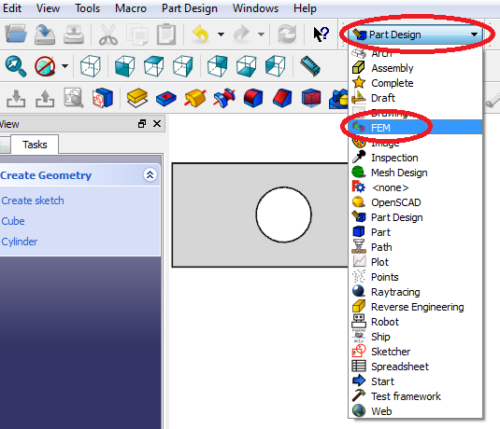
Selecting the FEM Workbench
In order to create a new Finite Element Analysis (FEA), click on the workbench dropdown menu and change to the FEM Workbench.

Slide 20
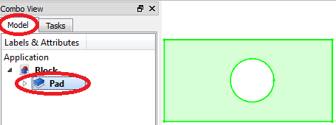
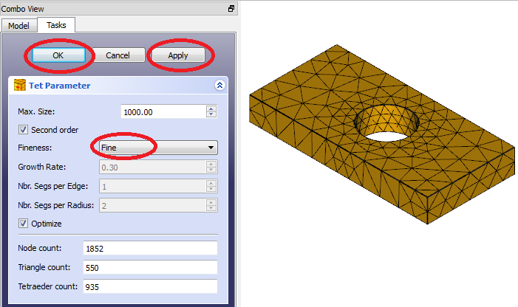
Creating New Analysis and Mesh
Click on the ‘Model’ tab to view the tree view, and click on the ‘Pad’ label in the tree view in order to select the geometry for the analysis. The block in the display window will turn green.
Click on the ‘New Mechanical Analysis’ icon in the taskbar.
The mesh dialogue will automatically appear. Select a ‘Fine’ mesh (next to ‘Fineness’) and click ‘Apply’, and then click ‘OK’.

Slide 21

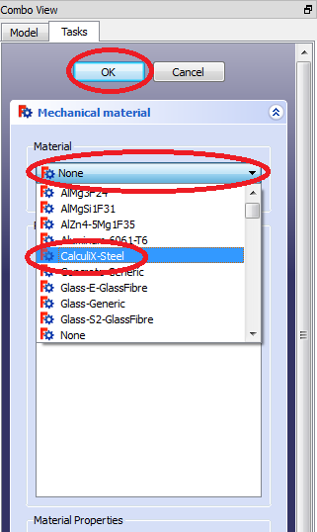
Selecting the Material
Click on the ‘Add Material’ icon on the taskbar. The ‘Mechanical material’ dialogue will automatically appear.
Under material, click the dropdown menu and select ‘Calculix Steel’.
Click ‘OK’ to close the dialogue.

Slide 22

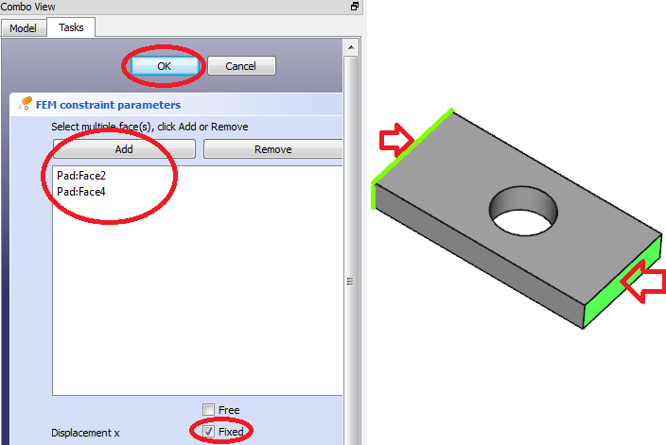
Adding the Displacement Constraint
Two of the block’s sides are going to be constrained from moving or expanding in the x-direction. In order to achieve this, the displacement constraint need to be added.
Select the displacement constraint from the taskbar. Its dialogue automatically open.
Select the two sides normal to the x-axis by ctrl+clicking it, and then click ‘Add’.
Select the ‘Fixed’ box next to ‘Displacement x’ in order to fix the two faces’ displacement in the x-direction. Click ‘OK’ to close the dialogue.

Slide 23

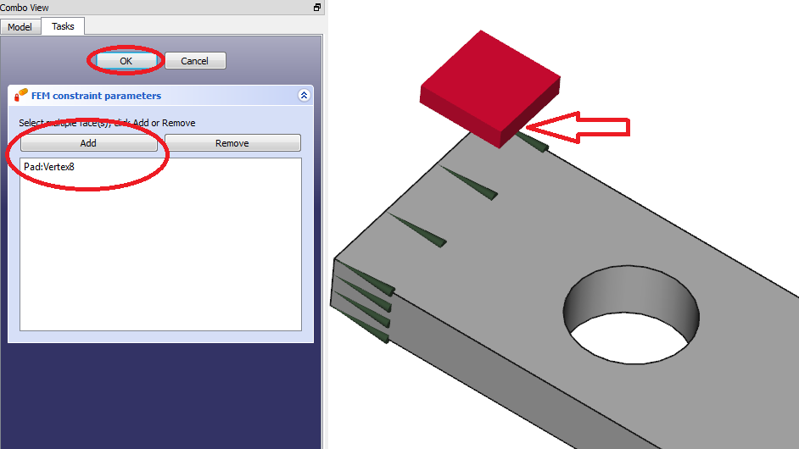
Adding the fixed constraint
In order to prevent rigid body motion of the part during analysis, the part must contain constraints constraining movement in all three major directions (x-, y- and z-axis).
Since only the movement in the x-direction have been constrained, a fixed constraint will be added to a point which will constrain the movement of that point in all three major directions and serve as a reference point for the displacement of the block.
Click on the ‘Fixed Constraint’ icon in the taskbar.
Click on the top left corner to select it, click add and click close.

Slide 24
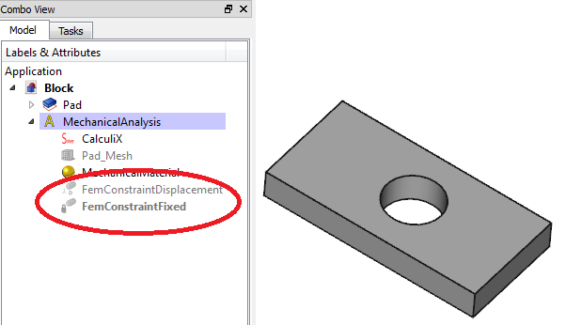
Hiding Objects
After adding the displacement and fixed constraints, certain graphics were added to the relevant faces to indicate the different constraints added to the faces. Since these graphics can obscure the faces, it is sometimes a good idea to hide these graphics to improve visibility.
A handy shortcut to remember to hide features or bodies, is the spacebar key on the keyboard.
Select the displacement constraint and the fixed constraint on the tree view by using ctrl+click, and press spacebar to hide its graphics. The labels will turn grey to show its visibility is hidden. Press spacebar again to unhide it.

Slide 25
Adding Heat flux Constraints
The effect of having two fluids at different temperatures on opposite sides of a part are going to be illustrated.
It must always be remembered that the temperature constraint can’t be added since it is fundamentally wrong. The inclusion of the fixed temperature constraint was just for the purposes of validation of the software. A heat flux must rather be applied. The reason for this will be made apparent when solving the analysis.

Slide 26

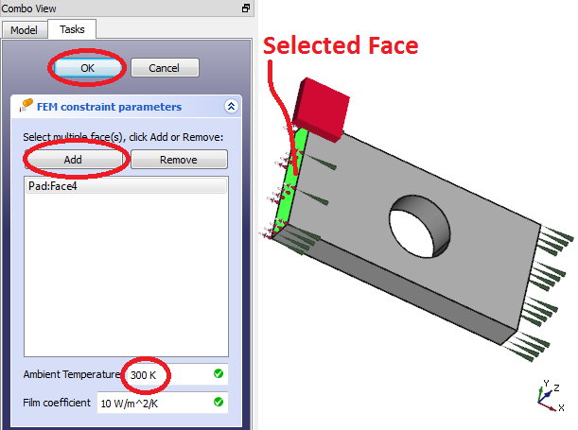
Adding Heatflux Constraints
Click on the ‘Add Heatflux’ constraint on the taskbar. Its dialogue automatically appears.
Select the face normal to the negative x-axis, and click ‘Add’. That specific face will be added to the list.
Leave the temperature next to ‘Ambient Temperature’ on 300 K. This is the temperature of the gas/fluid which is applying the heat flux to the surface.
Click ‘OK’ to close the dialogue.

Slide 27
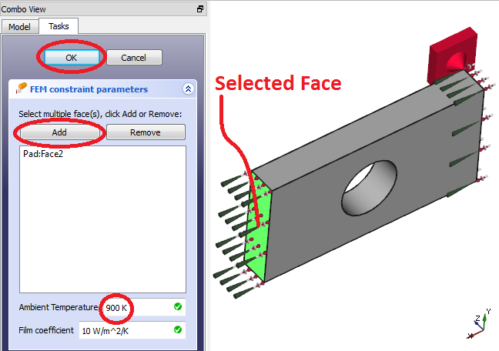
Adding Heatflux Constraints
Another heat flux constraint need to be added to the opposite face. Click on the ‘Add Heatflux’ constraint on the taskbar to open its dialogue.
Select the opposite face to the one selected in the previous step, and click add.
Change the temperature to 900 K.
Click ‘OK’ to exit the dialogue.
We now have a block that can’t expand either way in the x-direction, and with a hot fluid at 900K on the one side and a cold fluid on the other.

Slide 28

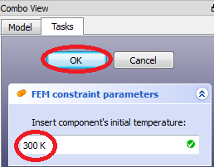
Adding the Initial Temperature
One more constraint need to be added before this model can be solved. Click on the ‘Initial Temperature’ constraint on the taskbar to open its dialogue.
This constraint need to be added whenever a thermo-mechanical analysis is run, whether it be steady state or transient. It is not needed for a static analysis. This constraint is the initial guess value for the system temperature for the transient analysis.
Leave the temperature at 300 K.
Click ‘OK’ to close the dialogue.

Slide 29
Solving the steady-state analysis

Slide 30
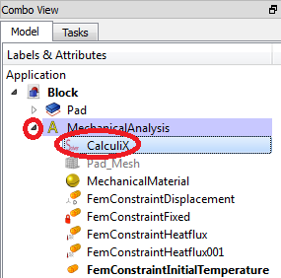
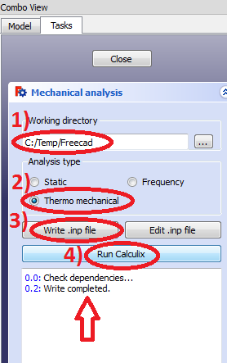
Running the Analysis
The thermo-mechanical analysis can now be run. In the tree view, double-click on the calculix solver under ‘MechanicalAnalysis’. If its not visible under ‘MechanicalAnalysis’, expand the label first by clicking on the arrow to its left.
After double-clicking on the calculix solver label, its dialogue will open. Select ‘Thermo mechanical’, ensure that your temporary path is set to a satisfactory location, and then click on ‘Write .inp file’. Wait for the writing to finish.
When the message ‘Write completed’ appears in the message window, click on ‘Run Calculix’.

Slide 31

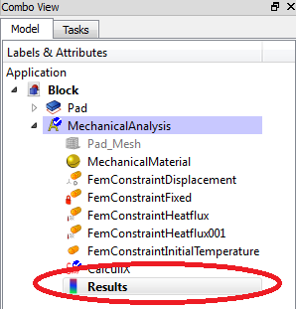
Viewing the results
When calculix has finished, a ‘CalculiX done!’ message will appear at the bottom of the message box. If this message displays, click ‘Close’ to close the dialogue box.
Click on the ‘open results’ icon on the taskbar or double-click on the ‘Results’ label in the tree view to open your results.

Slide 32
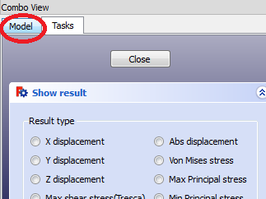
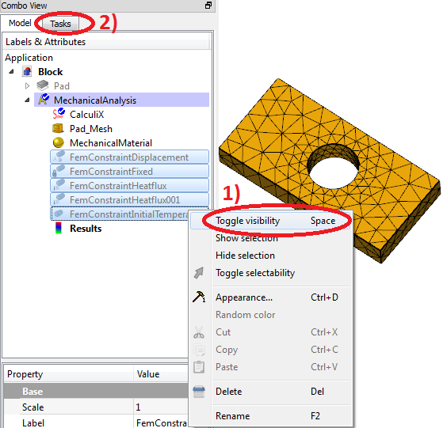
Hiding Constraints from Display Window
After opening the results, a dialogue box will appear. It might be a good idea to hide the constraints since it can obscure the view of the model. In order to do this, click on the ‘Model’ tab in the combo view to access the tree view, select the constraints by ctrl+clicking on them and press ‘spacebar’ on your keyboard.
Alternatively, you can right click on the constraints and select ‘Toggle visibility’.
To return to the results dialogue box, click on the ‘Tasks’ tab again.

Slide 33
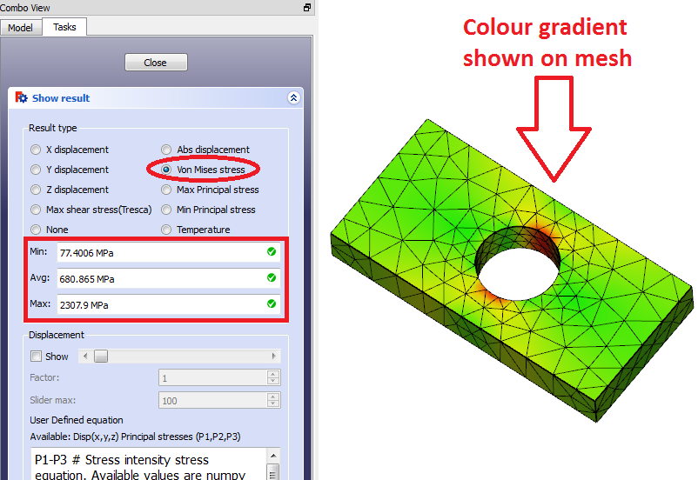
Viewing Results
The different results can be viewed by selecting the radio button next to the result. When selecting a result, its minimum, average and maximum value will be displayed in the dialogue box and a colour gradient will be visible in the display window on the model.
In this case, the Von Mises stress was selected, and its results are shown in the figure on the right.

Slide 34
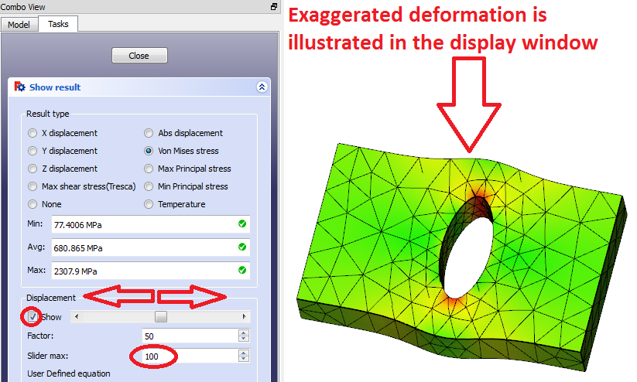
Viewing Results
Another interesting feature to show is the displacement. This feature exaggerates the deformation of the part in order for the user to visualise the displacement. To view the visualisation of the deformation, select the tick box next to ‘Show’ which is located under the ‘Displacement’ heading.
Next select the maximum exaggeration factor that can be viewed using the slider. If the part’s deformation is small, a larger value can be entered, if the deformation of the part is large, a smaller value can be entered.
View the deformation by sliding the slider around. Reset view by sliding the slider to its left-most position.

Slide 35
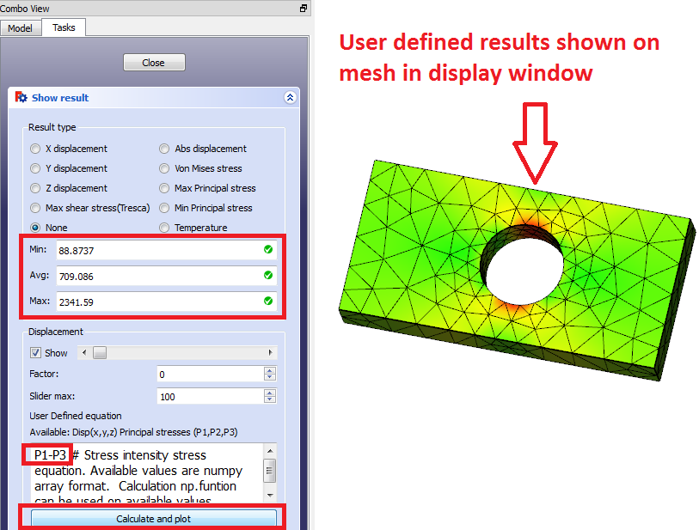
Viewing Results
User defined results can also be viewed. A minimum, average and maximum value will be displayed as well as the colour gradient of the results.
The default user defined results is the equation P1 – P3, which is the first principal stress minus the third principal stress. After the equation has been typed, the ‘Calculate and plot’ button underneath the input box can be clicked. This will calculate the results, display its minimum, average and maximum values as well as plot the colour gradient on the mesh in the display window.
Click on ‘Close’ to close the results dialogue.

Slide 36
Setting up and solving a transient analysis

Slide 37
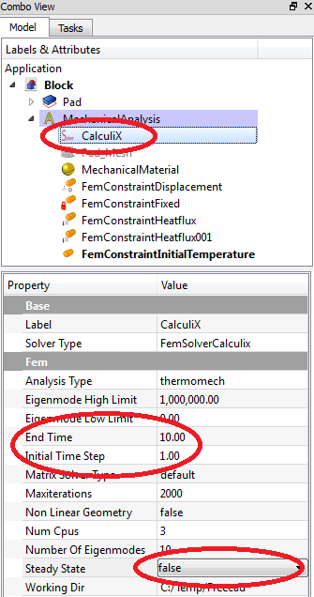
Setting Up a Transient Analysis
In order to run a transient analysis, the solver properties must first be edited.
In the tree view, click once on the ‘Calculix’ label in the tree view. Its properties should appear below.
In the properties box below, scroll down to ‘Steady State’ and change the cell next to it to ‘False’.
Change the ‘Initial Time Step’ to 1.00 and change the ‘End Time’ to 10.00. The transient simulation will start at the initial temperature and will initially proceed with a one second step, but as it converges it will automatically take bigger time steps.

Slide 38
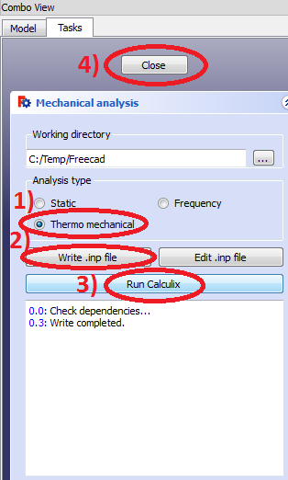
Solving the Transient Analysis
After setting the properties, the ‘Calculix’ label can now be double-clicked to open the Calculix dialogue box.
Ensure that a ‘Thermo mechanical’ analysis is selected.
Click on ‘Write .inp file’ to start start writing the input file. After the writing procedure has finished, click on ‘Run Calculix’ to run the analysis. You will notice the solution takes longer to solve than a steady state analysis due to the fact that it runs multiple iterations of the model.
After the simulation has finished, click on ‘Close’.

Slide 39
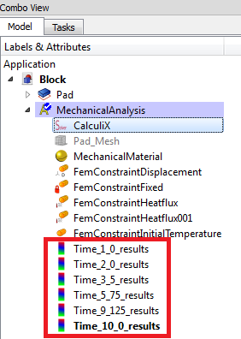
Viewing Results of individual Timesteps
It will be noticed that there are now multiple results labels are present in the tree view. Each results label is named with the time step associated with the result. If the results want to be viewed for a specific time step, double click on the appropriate time step and its results will be visible.

Slide 40
Viewing results of transient analysis using macro

Slide 41
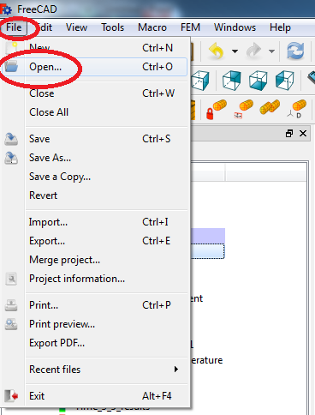
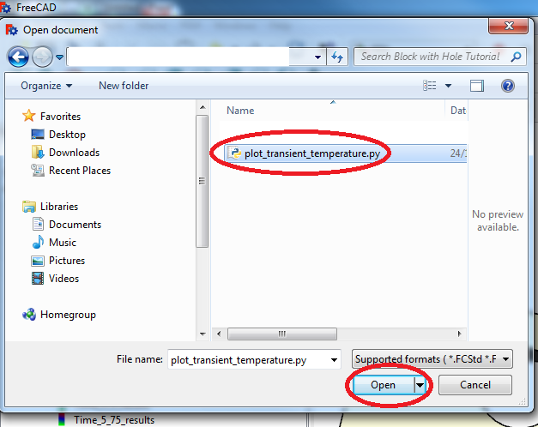
Opening the Macro
Since it can be tedious to view individual results from a transient analysis, a macro has been scripted which can easily plot the minimum and maximum values of each result type. With some programming skill additional features and results can also be manipulated and plot.
In order to access the macro, go to the top of the screen and click on ‘File→Open’. Navigate to the tutorials location where the ‘plot_transient.py’ file is located and open the file.

Slide 42
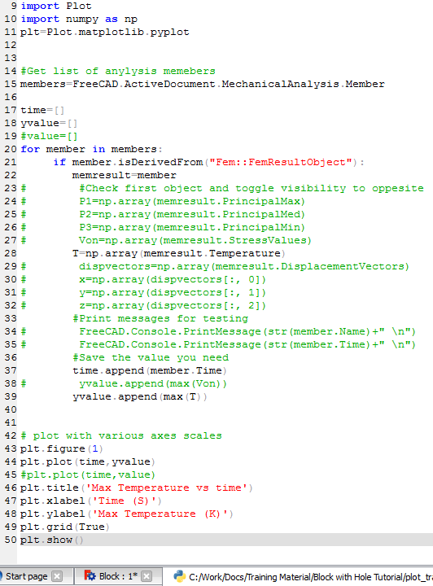
Editing the macro
The macro script (which was scripted using the python language), is automatically opened within a new window in Freecad. By commenting out certain lines (the # key comments out an entire line), different results can be viewed.
In the illustration shown to the right, the maximum temperature in the model is plotted against time.
If you want to display other results than temperature, just comment line 28 out using a # at the beginning of the line, and uncomment another result type by deleting the comment. Just remember to change the names of the plot labels at the bottom of the macro as well.

Slide 43

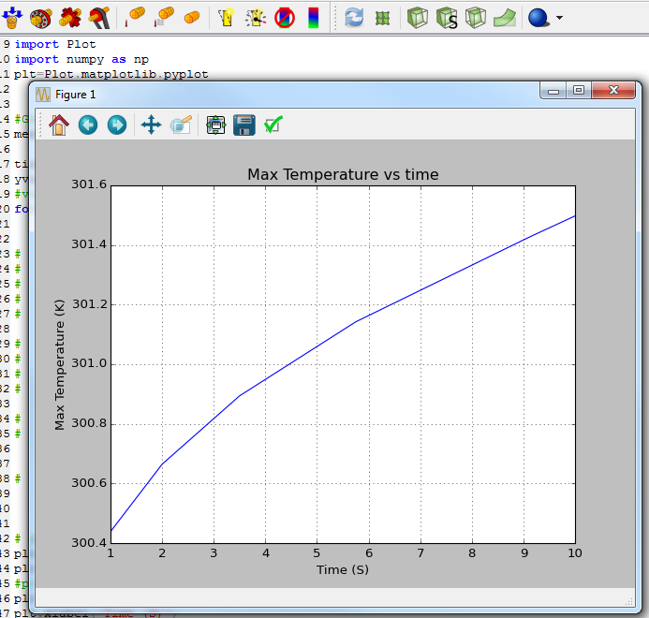
Plotting the Results
To execute the macro, click on the ‘Play’ icon in the taskbar.
An extra window will open which shows the plot. This plot is the maximum temperature of the part during each time step.

Slide 44

Thank you

