Slide 1




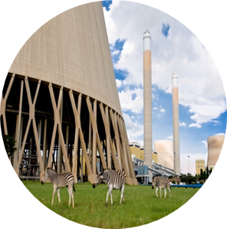

Tutorial A T-pipe junction CAD geometry
By Ofentse Kgoa
kgoaot@eskom.co.za

Slide 2
Introduction
Background:
This workshop assumes no prior experience of the FreeCAD modeling environment.
Objectives:
Create a FreeCAD project
Create T-pipe junction from sketches and basic 3D shapes in FreeCAD
Use a design code to determine amount of reinforcement
Add reinforcement to the T-pipe section

Slide 3

Project start Up
Create the Project:
Start FreeCAD
Go to “Start a new project”
Click on <Part Design>

Slide 4
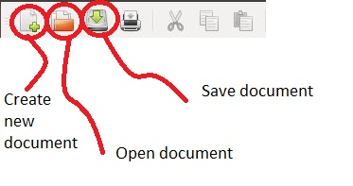
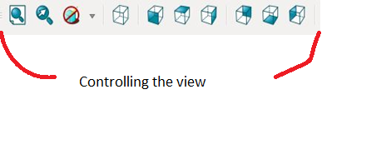
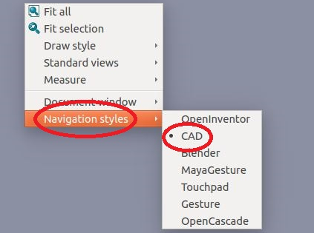
Project start Up
FreeCAD basic operations:
This slide provides a basic introduction to the FreeCAD interface.
The user can create, open and save projects.
The user also has the ability to change and control the view displayed.
The user has different navigation styles available, it is important to note that each navigation style has its own functionality and the user should familiarize themselves with the navigation style that best suits them. The tutorial is based on the navigation style “CAD”.

Slide 5
Project start Up
The CAD navigation style:
In order to Zoom roll the Mouse Wheel
In order to Pan hold the Mouse Wheel
In order to Rotate hold the Mouse Wheel and the Left Mouse Button at the same time

Slide 6
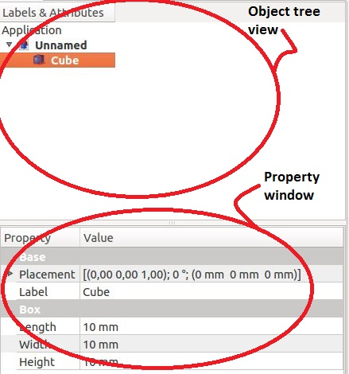
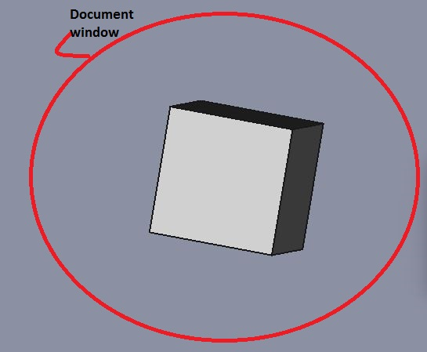
Project start Up
FreeCAD basic operations:
The FreeCAD naming convention is introduced here as depicted in the pictures on the right.
The document window is the entire area in the interface that displays the geometry.

Slide 7
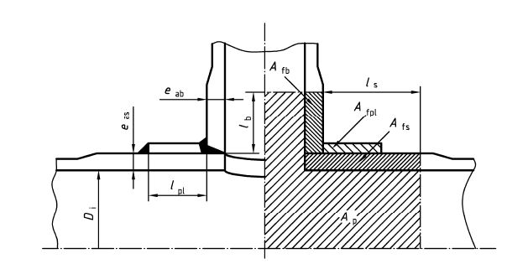
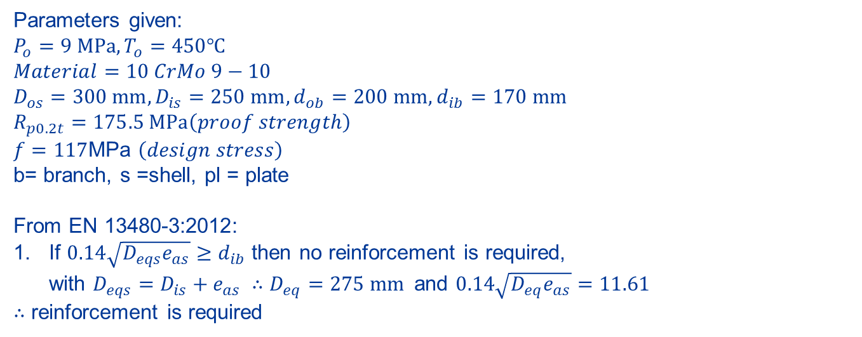
Using a design code to determine reinforcement
Determining the amount reinforcement:
Parameters given:
$$P_{o}=9 MPa, T_{o}=450℃$$
$$Material=10 CrMo 9−10$$
$D_{os}=300 mm, D_{is}=250 mm,d_{ob}=200 mm, d_{ib}=170 mm$ $R_{p0.2t}=175.5 MPa\left(proof strength\right)$
$f=117$MPa $\left(design stress\right)$
b= branch, s =shell, pl = plate
From EN 13480-3:2012:
If $0.14\sqrt{D_{eqs}e_{as}}≥d_{ib}$ then no reinforcement is required,
with $D_{eqs}=D_{is}+e_{as} ∴D_{eq}=275 mm$and $0.14\sqrt{D_{eq}e_{as}}=11.61$
$∴$ reinforcement is required

Slide 8
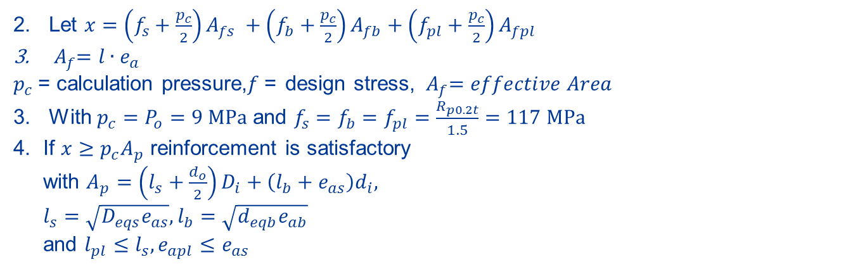
Using a design code to determine reinforcement
Determining the amount reinforcement:
Let $x=\left(f_{s}+\frac{p_{c}}{2}\right)A_{fs} +\left(f_{b}+\frac{p_{c}}{2}\right)A_{fb}+\left(f_{pl}+\frac{p_{c}}{2}\right)A_{fpl }$
${ A}_{f}=l{∙e}_{a}$
$p_{c}$= calculation pressure,$f$= design stress, ${ A}_{f}=effective Area$
With $p_{c}=P_{o}=9 MPa$ and $f_{s}=f_{b}=f_{pl}=\frac{R_{p0.2t}}{1.5}=117 MPa$
4. If $x≥p_{c}A_{p}$ reinforcement is satisfactory
with $A_{p}=\left(l_{s}+\frac{d_{o}}{2}\right)D_{i}+\left(l_{b}+e_{as}\right)d_{i},$
$l_{s}=\sqrt{D_{eqs}e_{as}},l_{b}=\sqrt{d_{eqb}e_{ab}}$
and $l_{pl}≤l_{s},e_{apl}≤e_{as}$

Slide 9
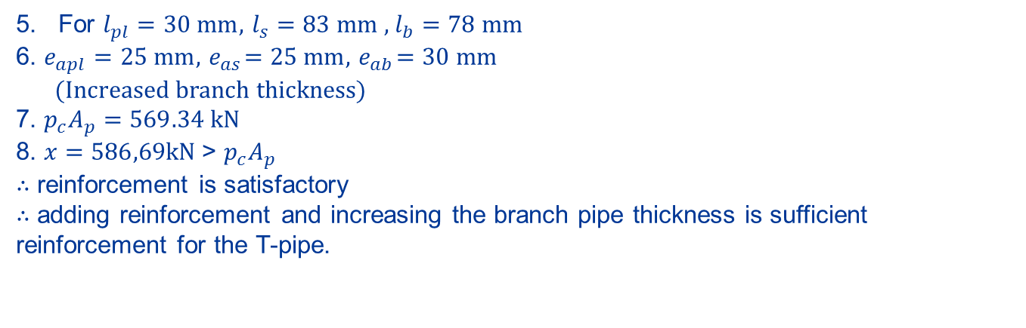
Using a design code to determine reinforcement
Determining the amount reinforcement:
For $l_{pl}=30 mm,$ $l_{s}=83 mm ,$ $l_{b}=78 mm$
6. $e_{apl}=25 mm,{ e}_{as}=25 mm,{ e}_{ab}=30 mm$
(Increased branch thickness)
7. $p_{c}A_{p}=569.34 kN$
8. $x=586,69kN$> $p_{c}A_{p}$
$∴$ reinforcement is satisfactory
$∴$ adding reinforcement and increasing the branch pipe thickness is sufficient reinforcement for the T-pipe.

Slide 10


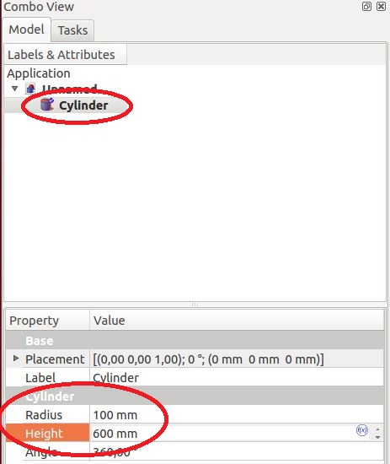
Create T-pipe junction CAD model
Create the branch pipe:
Go to the Part workbench. Create a cylinder. To do so select the icon indicated in the picture. The user can also create other primitive shapes or combine this primitives shapes to create a new part.
To change the cylinder dimensions, under “Combo view” select the Model tab. In this Model tab an object tree view is displayed with all the created objects. Click on <Cylinder> in the object tree view.
In the property window, enter a cylinder radius of 100 mm and a cylinder height of 600 mm

Slide 11
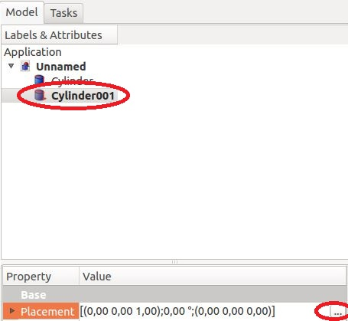
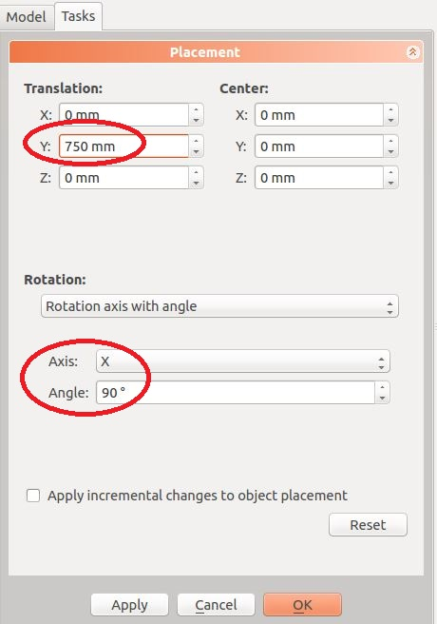
Create T-pipe junction CAD model
Create the shell pipe:
Follow same steps used to create the first cylinder
Enter a cylinder radius of 150 mm and a cylinder height of 1500 mm
In the combo view under the Model tab, click on <Cylinder001> and then click on the ellipsis (more options) icon on “Placement”.
A “Placement” task dialogue will appear and under “Translation” enter 750 in the Y direction. Enter rotation of 90°about the X axis and then click <Apply>

Slide 12
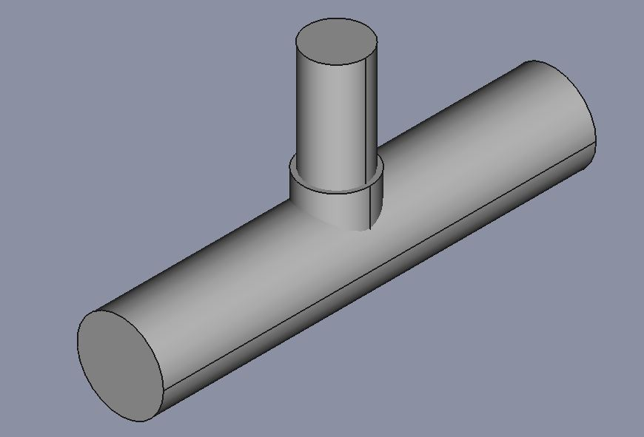
Create T-pipe junction CAD model
Increase the branch pipe thickness:
The thickness of the branch pipe will be increased with a length of 78 mm from the shell pipe outer diameter
Create a cylinder with a length 228 mm and a radius 115 mm
The geometry in the document window should be similar to that indicated in the picture.

Slide 13
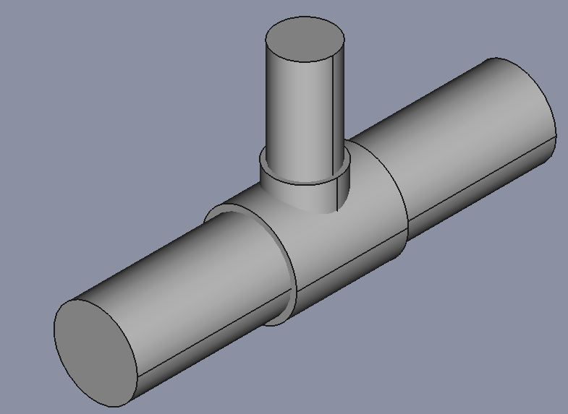
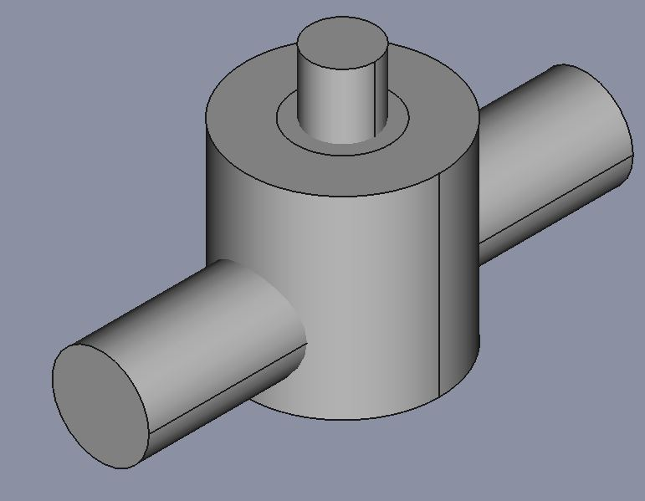
Create T-pipe junction CAD model
Add the reinforcement plate:
The reinforcement plate is to have a thickness of 20 mm and an outer radius of 145 mm
First create a cylinder with a length 400 mm and a radius 175 mm. Rotate this cylinder 90° about the X-axis and then translate it 200 mm in the Y-direction.
Create two other cylinders with length 600 mm and radii 145 mm and 300 mm respectively. Translate both these cylinders 200 mm in the negative Z-direction.

Slide 14

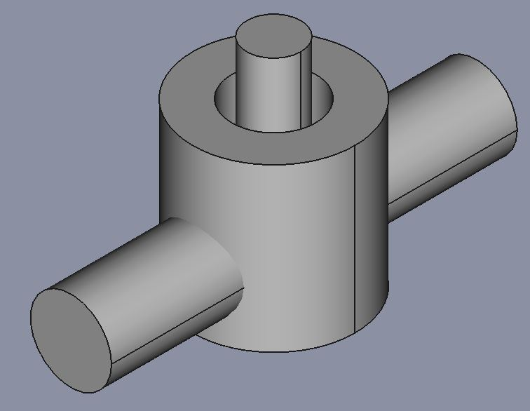
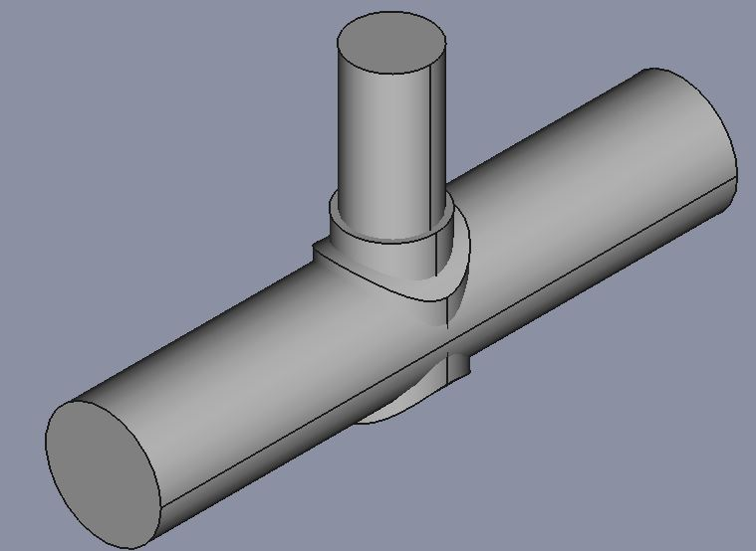
Create T-pipe junction CAD model
Add the reinforcement plate:
Use the 145 mm radius cylinder to cut the 300 mm radius cylinder. To cut, first select the 300 mm radius cylinder and then the 145 mm radius cylinder.
Now use this pipe to cut the 175 mm radius and 400 mm length cylinder by first selecting the 400 mm length cylinder and then the created pipe.

Slide 15
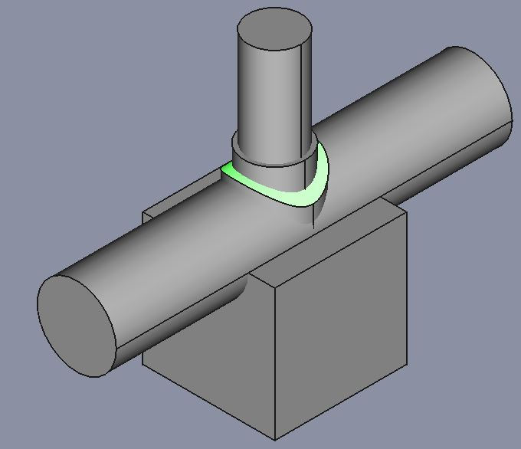
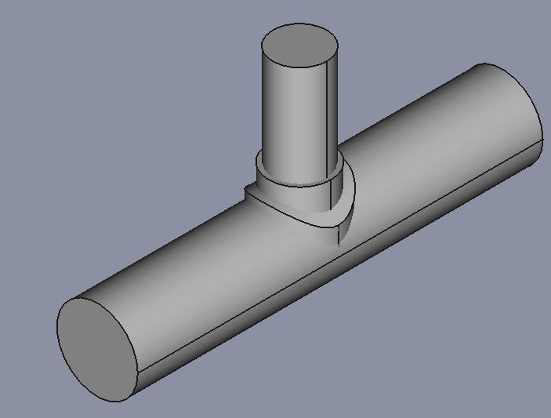
Create T-pipe junction CAD model
Add the reinforcement plate:
Now to cut off the remaining piece of the plate at the bottom of the pipe.
Create a cube with sides of 500 mm. Translate the cube 250 mm, 250 mm and 500 mm in the negative X, negative Y and negative Z directions respectively.
In order to cut, first select the plate and then the created cube.

Slide 16
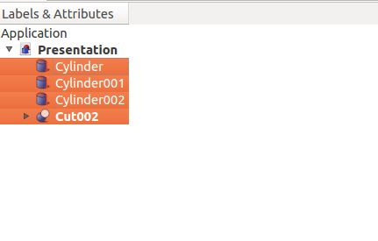
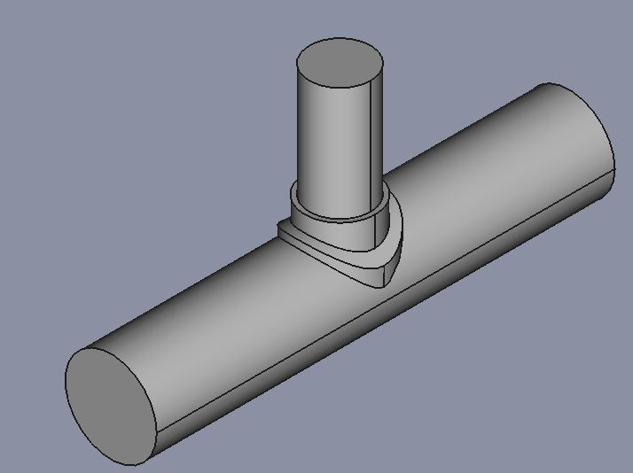
Create T-pipe junction CAD model
Add the reinforcement plate:
Select all the parts in the object tree view and then click on <Make union of several shapes>
The geometry should now be similar to that depicted in the picture.

Slide 17
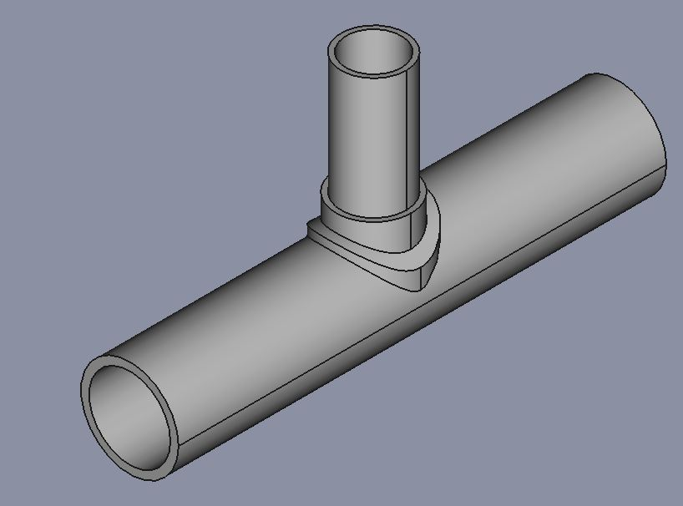
Create T-pipe junction CAD model
Finishing off the T-pipe junction:
Holes need to be made into the branch pipe and shell pipe.
Create a cylinder with length 600 mm and radius 85 mm.
Cut through the T-pipe with this created 85 mm radius cylinder.
Create another cylinder with length 1500 mm and radius 125 mm. Rotate this cylinder 90° about the X-axis and then translate it 750 mm in the Y-direction.
Cut through the T-pipe with this 125 mm radius cylinder

Slide 18

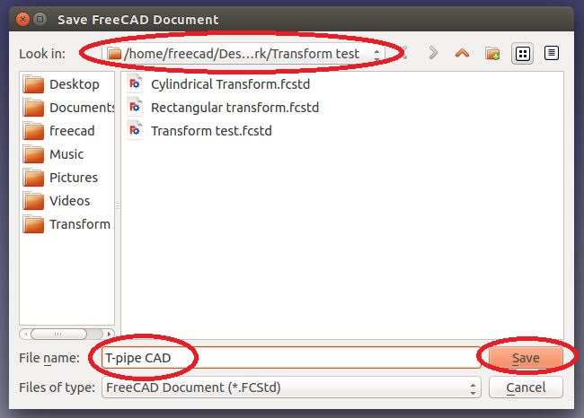
Create T-pipe junction CAD model
Saving the FreeCAD project:
To save the project click on <Save the active document> as indicated in the picture.
A task dialogue appears, choose the file directory, enter the file name and click <Save>.
It is important to regularly save the project to avoid loss of work should any power interruptions occur.

Slide 19

END

